Slide 1

ODATA
Developed by Microsoft in 2007
Building and consuming RESTful APIs.

Slide 2
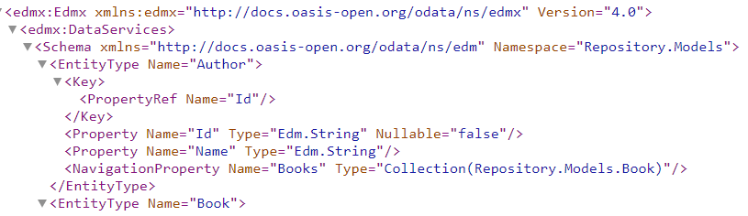
EDM odata
OData service uses an abstract data model called Entity Data Model (EDM) to describe the exposed data in the service.
Model explicit
Convention model builder
Non convention model builder

Slide 3
URL components
http://host:port/path/SampleService.svc/Categories(1)/Products?$top=2&$orderby=Name
\______________________________________/\____________________/ \__________________/
| | |
service root URL resource path query options

Slide 4

GRAPHQL
Developed by Facebook in 2012,
Query language
Alternative to REST
Single endpoint
POST requests

Slide 5
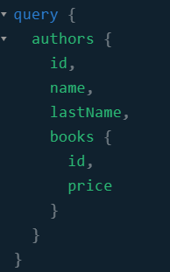
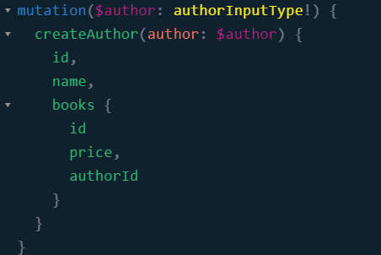
Graphql
Query
Mutation
Subscription

Slide 6
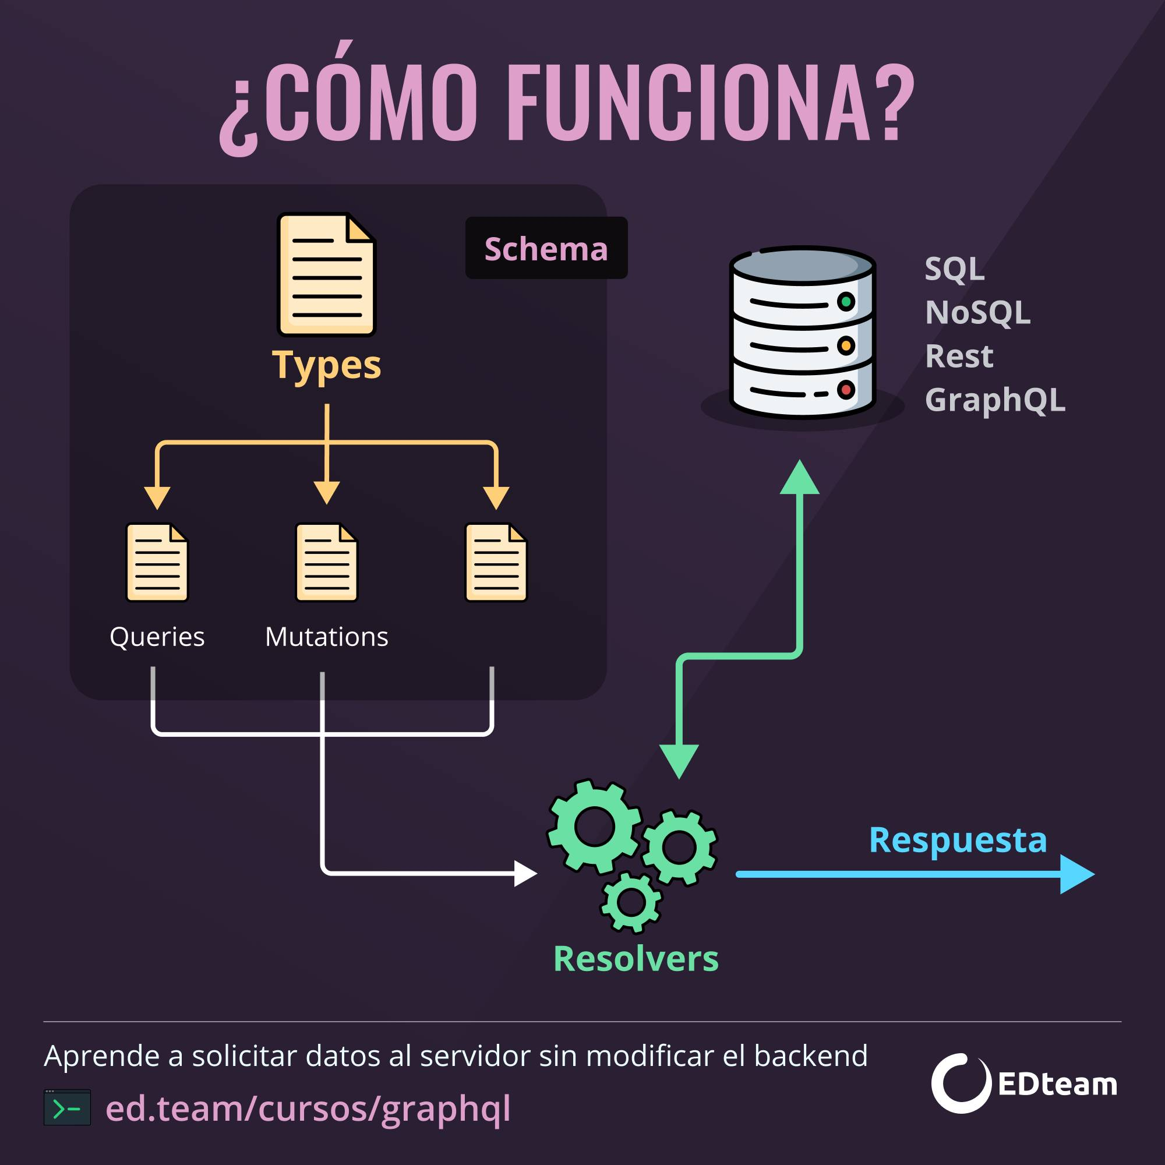
Type system
ScalarType
ObjectType
InterfaceType
UnionType
EnumType
InputObjectType

Slide 7
Contrasting the standard apis
 | GraphQL | Odata
Standars query capabilities | Yes | Yes
Surfacing metadata | Yes | Yes
Maturity of specification | No | Yes
Api versioning maintenance | No | Yes

Slide 8
Standard query capabilities
Operations | GraphQL | OData
Filtering | No | Yes
Ordering | No | Yes
Selection | Yes | Yes
Joining | Yes | Yes
Paging | Yes | Yes

Slide 9
Another considerations
 | GraphQL | OData
Over fetching | Yes | Yes
Under fetching | Yes | No
Relational/No relational Database | Yes | Yes
Self documented | Yes | No
Batching | Yes (data loader library) | Yes
Catching | Yes | Yes
Introspection | Yes | No
Subscriptions | Yes | Yes

Slide 10
Support
 | GraphQL | OData
Language support | C#, Javascript, C++, PHP, Phyton, Ruby, Go, java/kotlin, Rust, Elixir, Scala, Fluter, Clojure, Haskell, Elm, OCaml/Reason, Erlang, Groovi, R, Julia, Perl, D | C#, Java, Javascript, C++, PHP, Phyton, Ruby

Slide 11
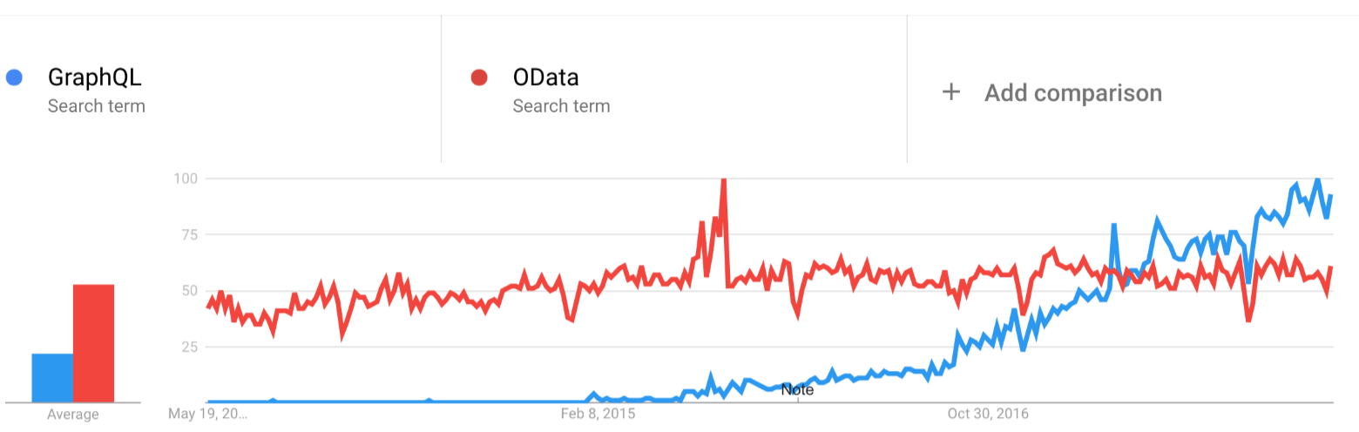
Popularity

