Slide 1
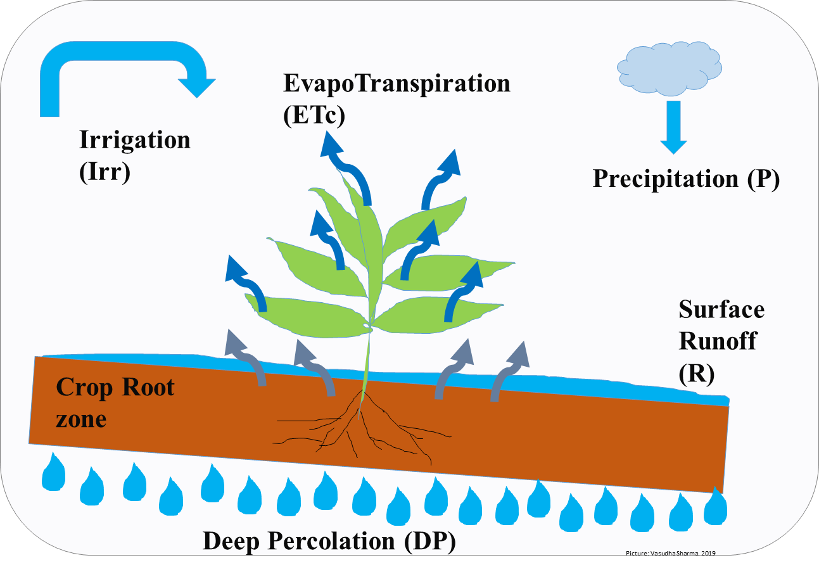
Water balance approach
Assumptions:
No runoff (R=0).
No groundwater losses: no deep percolation (DP=0).
No groundwater gains: deep water table.
No root growth restricting layers in the profile: absence of a hard pan.
This means that the soil moisture is decreasing only due to evapotranspiration (Δθ=ET).
Method description:
Method A: water balance over the entire soil depth at once.
Method B: water balance applied to every soil layer individually.
Method C: water balance applied to every soil layer individually accounting for root depth. Root depth is assumed to be a constant 2m for the alfalfa in Vernal.

Slide 2
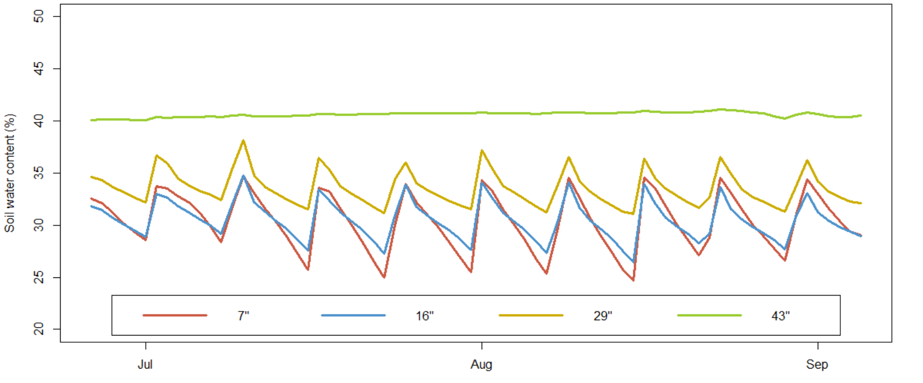
“Slope” method
Assumptions:
After an irrigation event the soil moisture will decrease rapidly at first as its draining until it reached field capacity.
Once FC is reached soil moisture will decrease only due to ET.
ET rate can be estimated as the slope of this second, less steep, curve.
Method description:
Method D: slope method applied to the entire soil profile.
Method E: slope method applied to each soil layer individually.
Method F: slope method applied to each soil layer individually accounting for root growth (FAO 56).

Slide 3
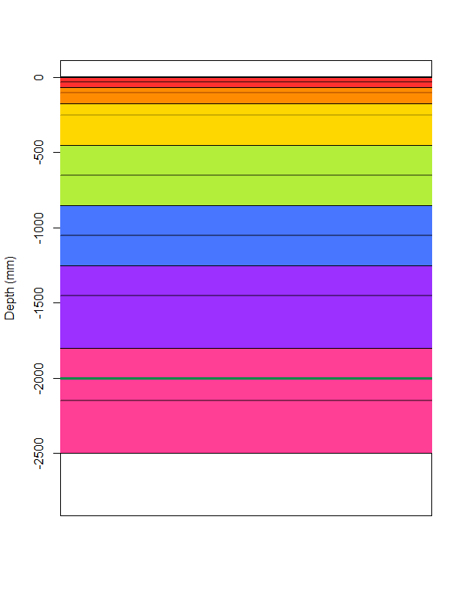
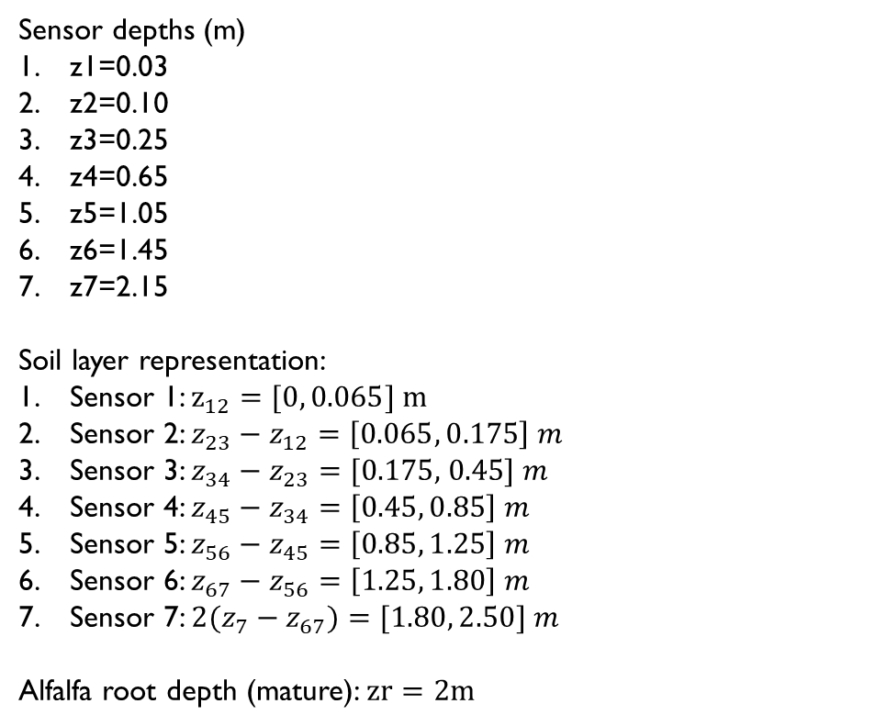
Sensor distribution and soil layer definition
Sensor depths (m)
z1=0.03
z2=0.10
z3=0.25
z4=0.65
z5=1.05
z6=1.45
z7=2.15
Soil layer representation:
Sensor 1: $z_{12}=[0, 0.065] m$
Sensor 2: $z_{23}−z_{12}=\left[0.065, 0.175\right] m$
Sensor 3: $z_{34}−z_{23}=[\text{0.175, 0.45]} m$
Sensor 4: $z_{45}−z_{34}=\left[0.45, 0.85\right] m$
Sensor 5: $z_{56}−z_{45}=\left[0.85, 1.25\right] m$
Sensor 6: $z_{67}−z_{56}=\left[1.25, 1.80\right] m$
Sensor 7: ${2(z}_{7}−z_{67})=[1.80, 2.50] m$
Alfalfa root depth (mature): $zr=2m$

Slide 4
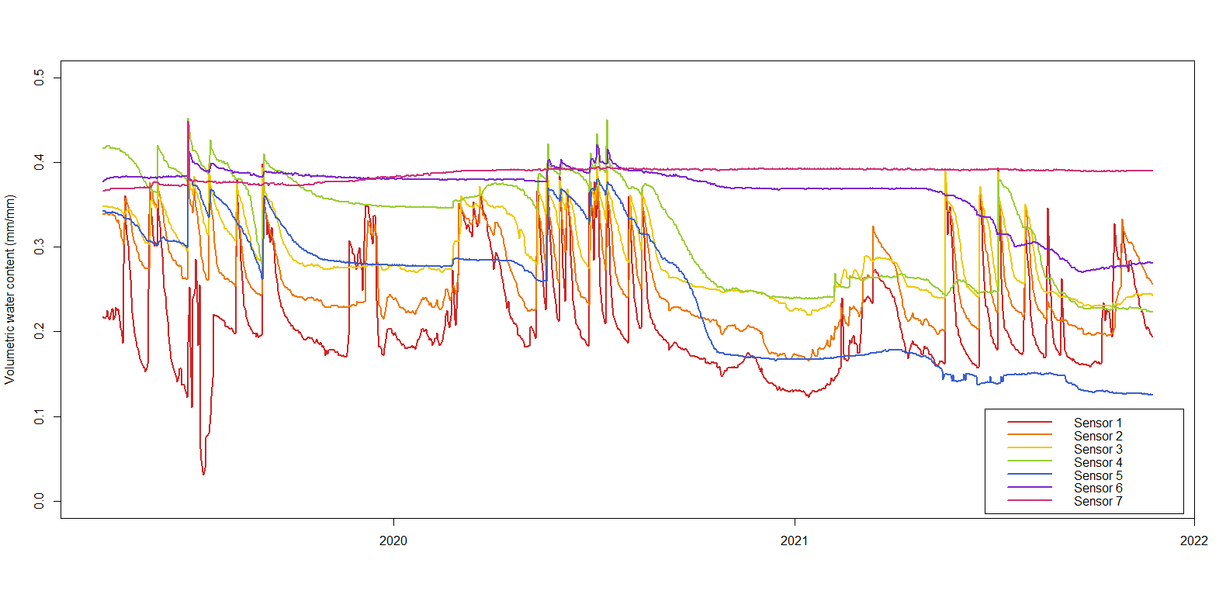
Raw soil moisture data of each sensor
* 18 values for sensor 1 were interpolated because they had unrealistic values (>50%).
All instances occurred from 28-jun-2019 to 30-jul-2019.

Slide 5
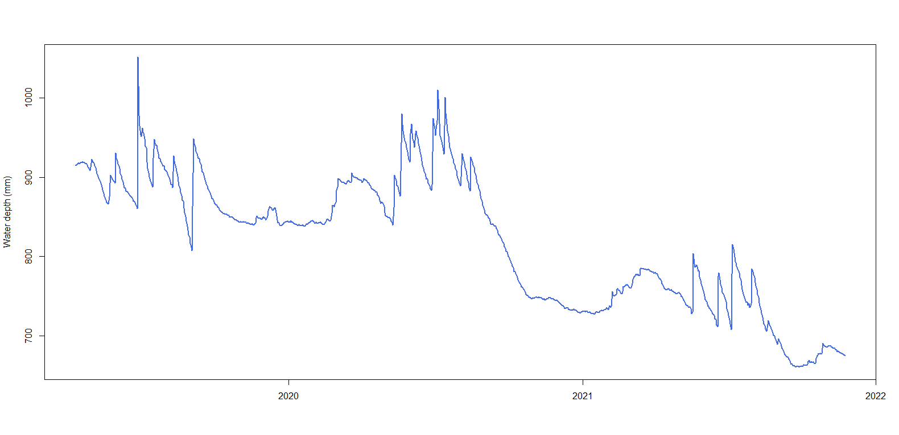
Total water depth of the soil profile
Total water depth calculated as the sum of each sensor multiplied by the soil depth represented by each sensor:
$$D=Θ_{1}∙z_{12}+Θ_{2}∙\left(z_{23}−z_{12}\right)+Θ_{3}∙\left(z_{34}−z_{23}\right)+Θ_{4}∙\left(z_{45}−z_{34}\right)+Θ_{5}∙\left(z_{56}−z_{45}\right)+Θ_{6}∙\left(z_{67}−z_{56}\right)+Θ_{7}∙2\left(z_{7}−z_{67}\right)$$
Notes:
Plot EC data to see if there is higher salt concentration at end of winter.

Slide 6
The following 10 slides contain the plots of the results of applying the methods A-F previously described to the soil moisture data from the Vernal project site from 2019 to 2021.
The bar charts represent the total daily ET (from the entire soil profile) and heatmaps represent the single soil layer (as previously defined) contribution to the total daily ET.
The daily total ET results for methods A, B, and C were modified in order to exclude any values greater than 20mm/day because such high values are attributed to deep percolation. This will be verified if irrigation dates are provided.

Slide 7
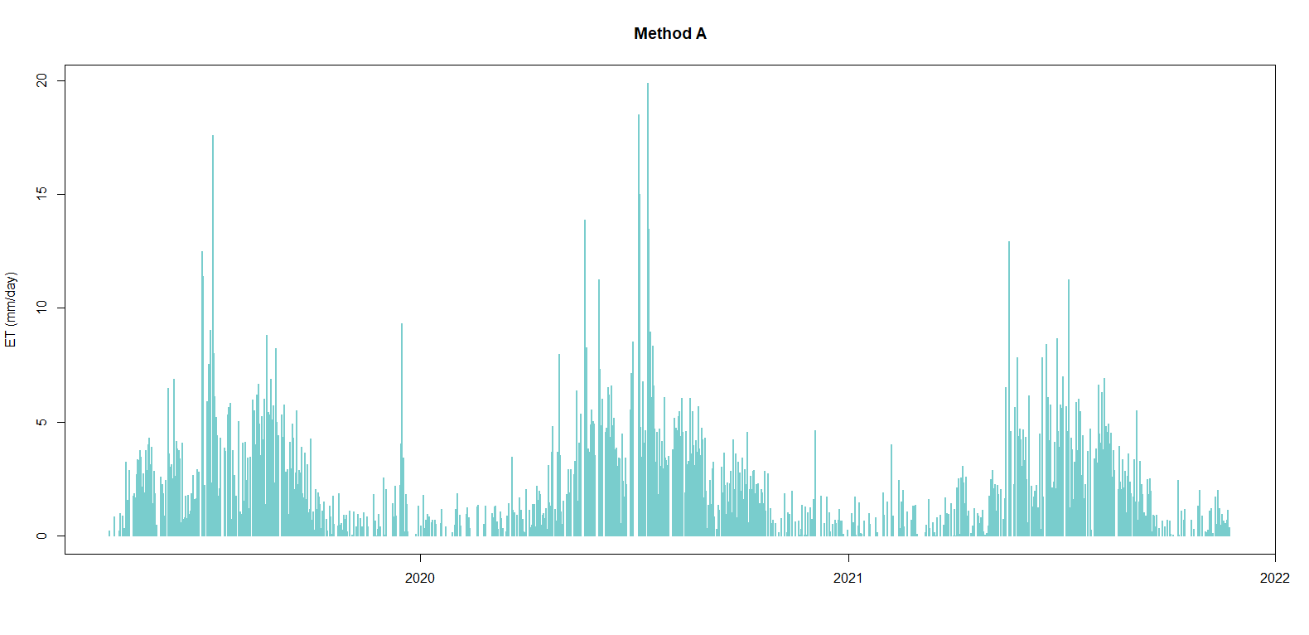
*Eliminated days with ET>20mm/day

Slide 8
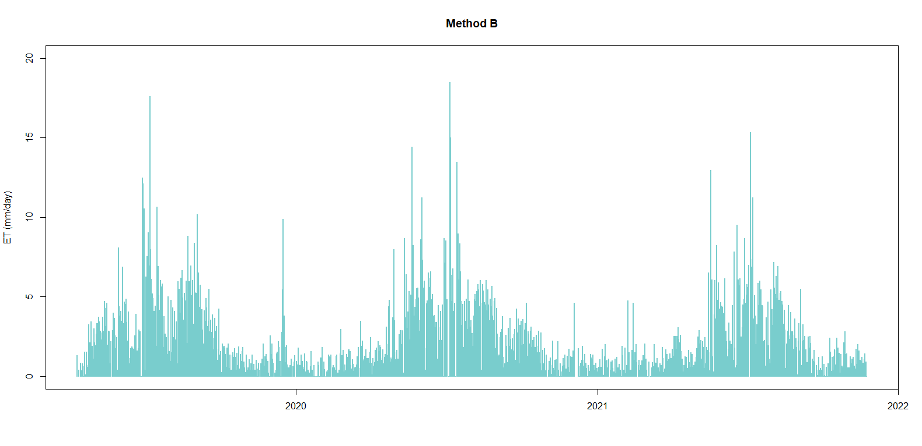
*Eliminated days with ET>20mm/day

Slide 9
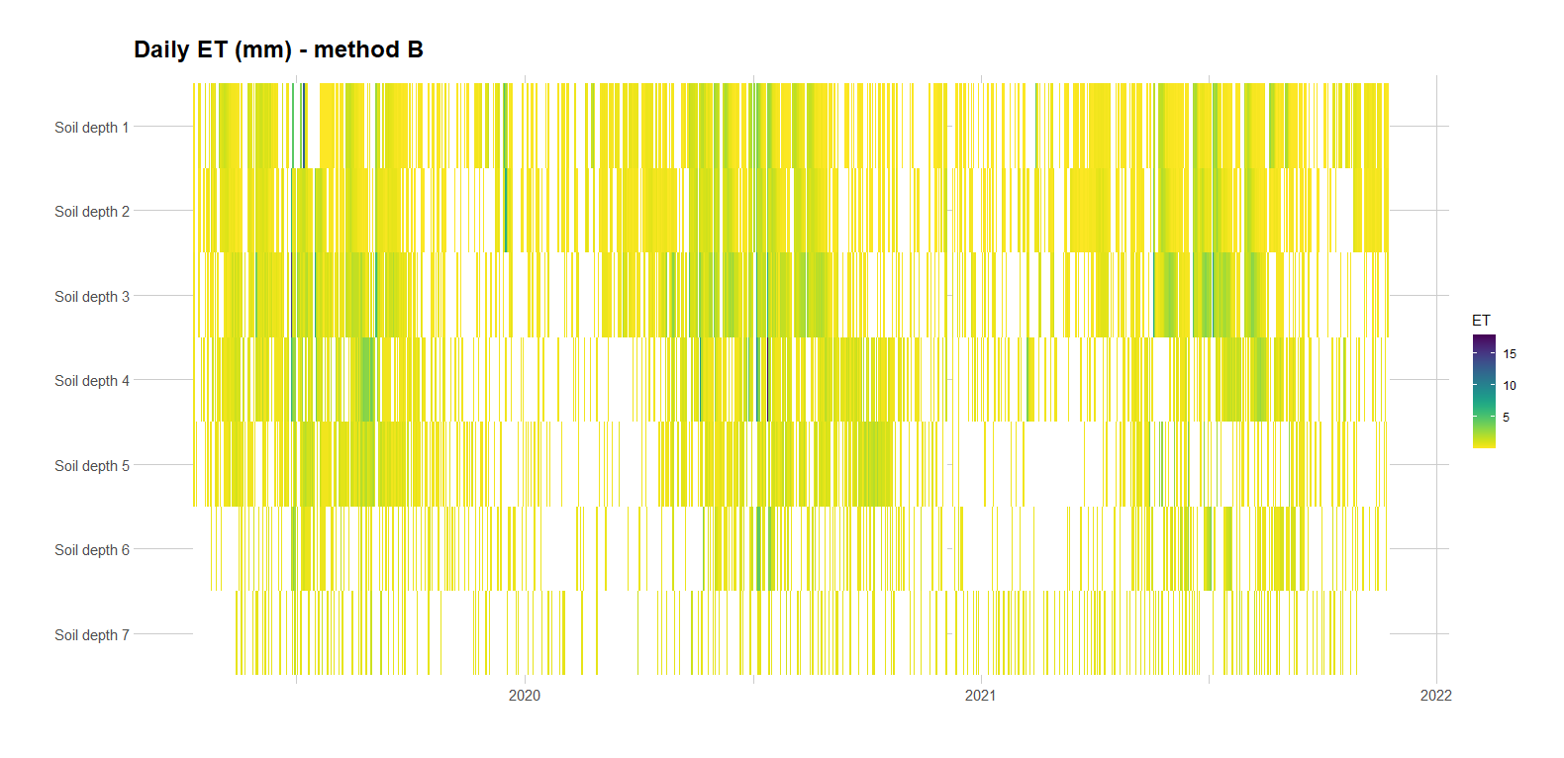

Slide 10
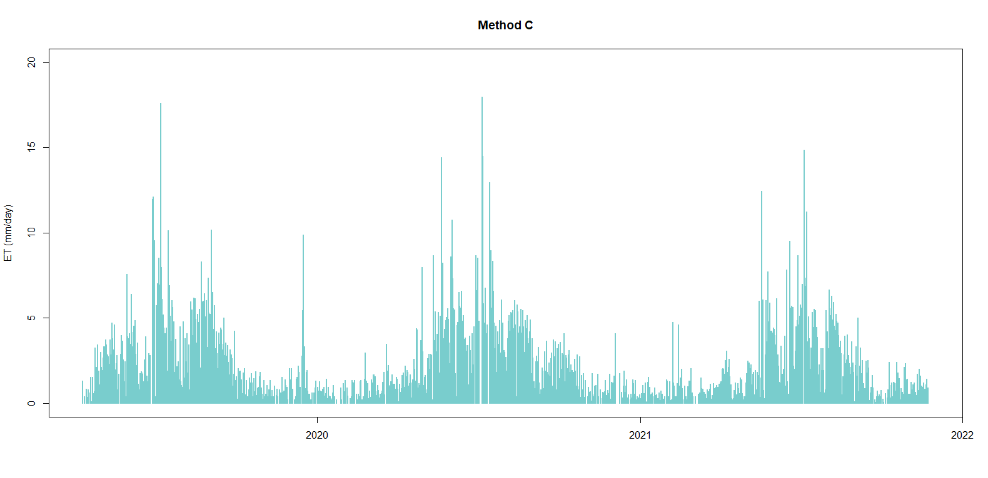
*Eliminated days with ET>20mm/day
Notes:
Method C

Slide 11
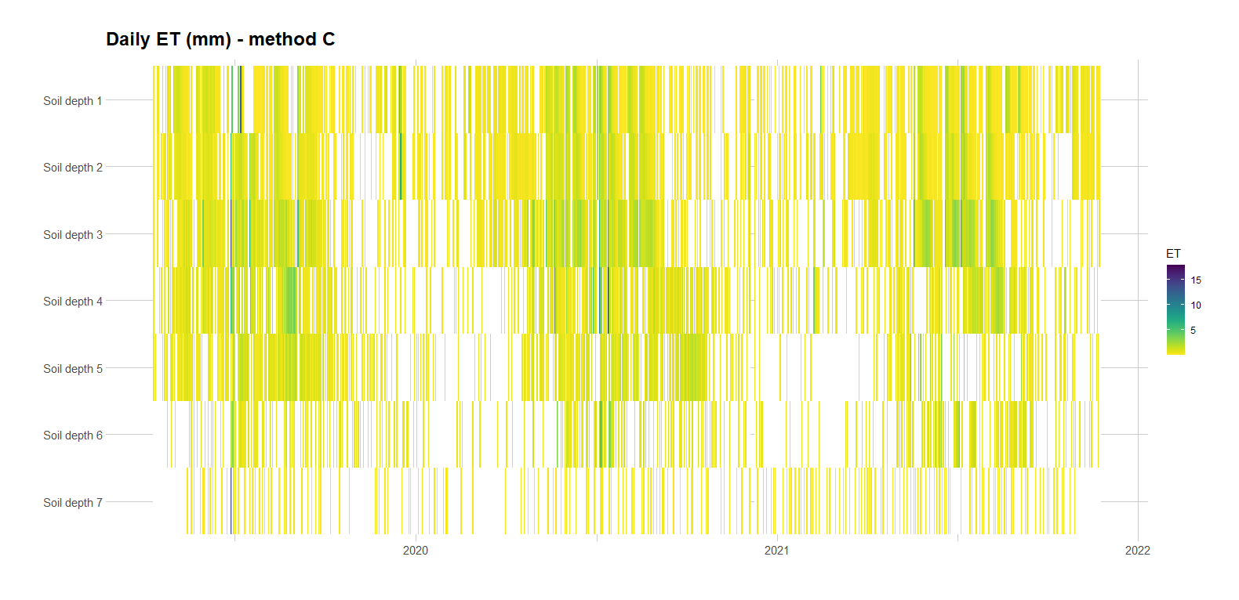

Slide 12
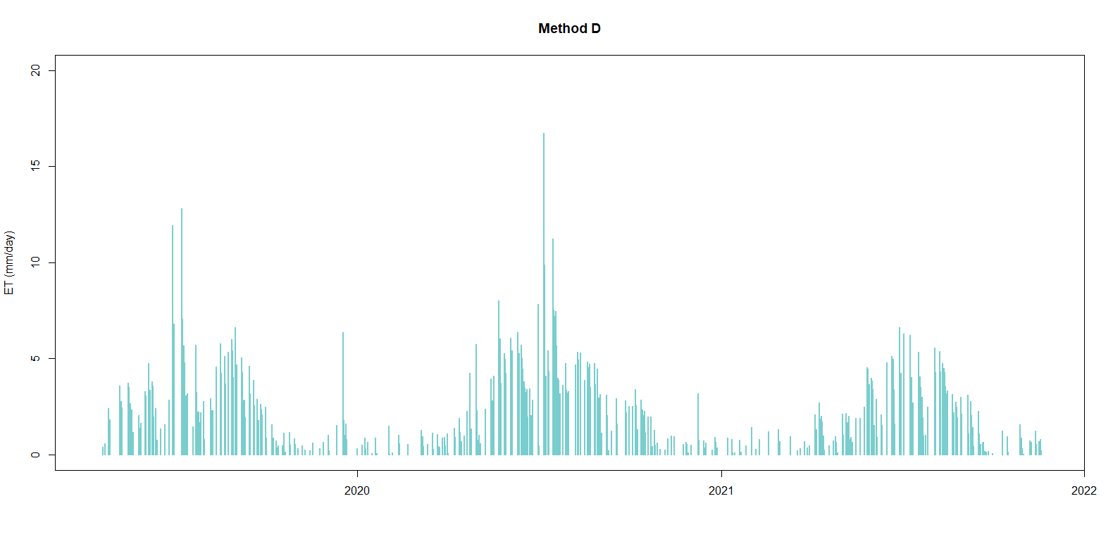

Slide 13
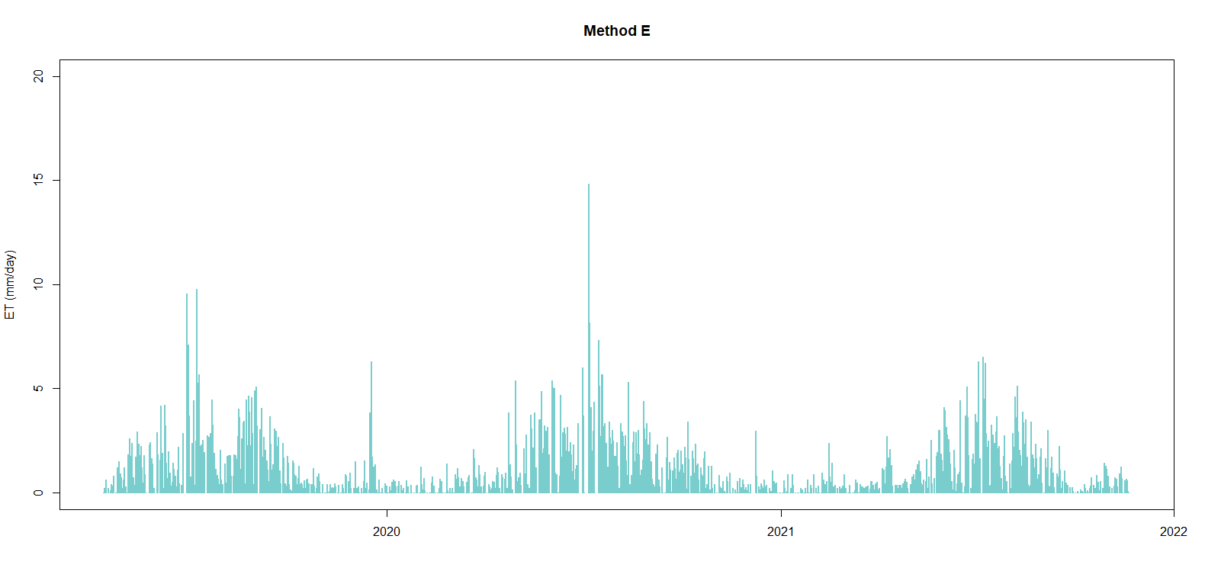

Slide 14


Slide 15
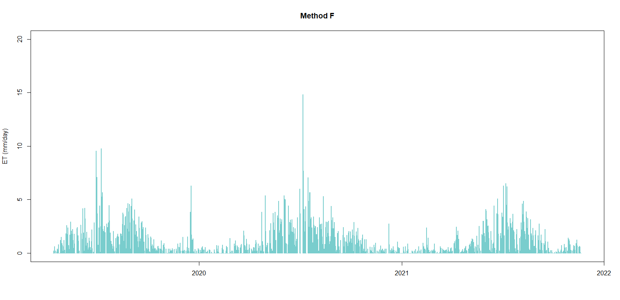

Slide 16
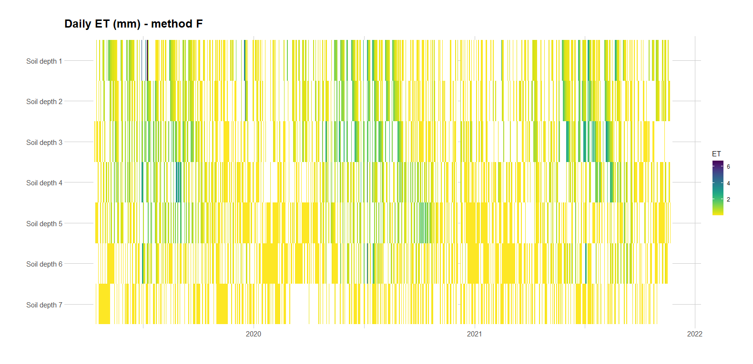

Slide 17
Data needed to continue the analysis:
ET values from the flux tower: determine whether any method has similar results
ETr: needed for gap-filling process
Irrigation dates: needed for gap-filling process
Additional information for the report:
Coordinates
Irrigation type
Pictures
Field capacity, PWP, EC
Did something change from 2nd to 3rd year? There appears to be a significant drop in soil moisture from 2020 to 2021.

