Slide 1
Stock Market Sentiment Analysis with Daily News
Team `Name Undecided`:
Shiyuan Jin | Dingyun Hu

Slide 2


Slide 3
Contents
1
2
3
4
5
6
Introduction
EDA
Problem Statement and Research Procedure
Exploration Data Analysis
Sentiment Analysis
Classification
NLP and sentiment analysis
Utilize Machine learning to classify binary labels
Time Series Analysis
Conclusion
Time Series Analysis on DJIA Value
Research result Conclusion

Slide 4
1
Introduction

Slide 5
Problem Objectives
Research Filed: Stock Market Dow Jones Index
Target: Based on Top 25 Daily news, analyze the impact of news on Stock Market, using Dow Jones Index as an indicator
Approaches: EDA, Machine Learning (Classification), TF-IDF Vectorizer, Sentiment Analysis, Autoregressive Integrated Moving Average

Slide 6
Research Procedure
Time Series Analysis
Conclusion
Data Preprocess and EDA
Sentiment Analysis
Classification（ML）

Slide 7
2
EDA Analysis
Dataset Preview

Slide 8
Data Overview
Daily News Data
Stock Data
Shape (1989,27)
Column #1: Date
Column #2: Stock increase and decrease Label (1, 0)
Column #3-25: Top 25 Reddit News titles
Shape (1989, 6)
Columns: Date, High, Low, Open, Close, Adj Close

Slide 9
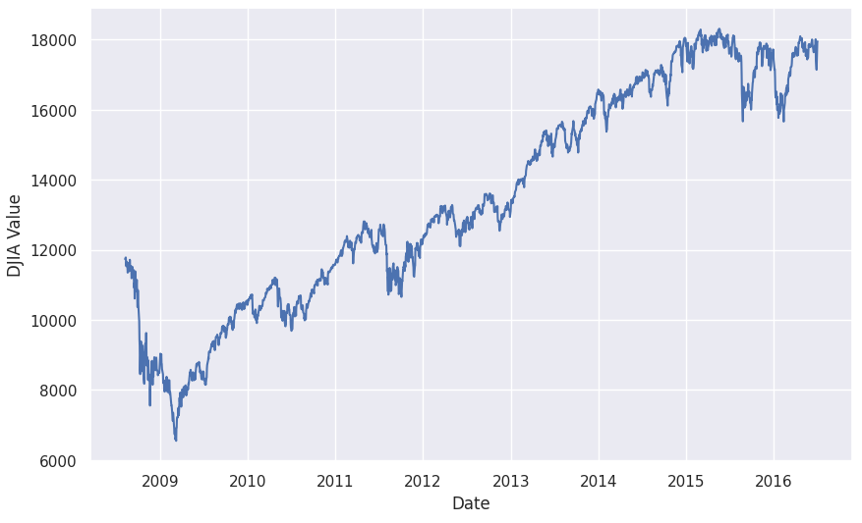
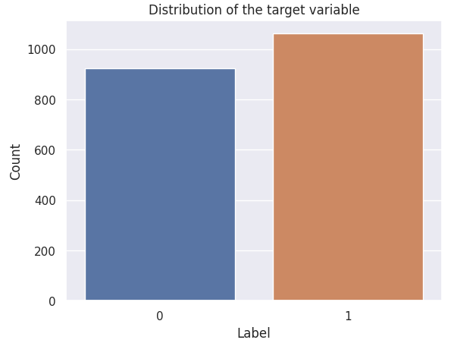
Stock chart

Slide 10
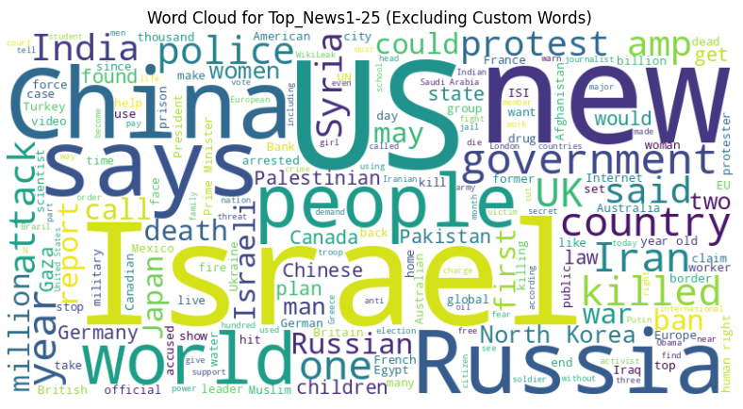
EDA on Top25 news

Slide 11
3
Sentiment Analysis
Extract sentiment from words

Slide 12
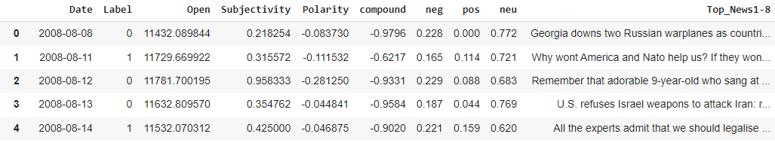
Sentiment Analysis
①: Sentiment Analysis with TextBlob:
Subjectivity
Polarity
②: Applying VaderSentimentAnalyzer to DataFrame:
Compound
Positive
Negative
Neutral

Slide 13
4
Classification
Utilize Machine Learning Techniques to classify binary labels

Slide 14
Classification based on text
Machine Learning
Linear Regression
Logistic Regression
Random Forest
Gradient Boosting
Support Vector
K-Nearest
Decision Tree
TF-IDF Vectorizer
Model Evaluation

Slide 15
Models Summary
 | Accuracy(%) | Precision(%) | Recall(%) | F-score(%)
Linear Regression | 54.77 | 57.20 | 58.29 | 57.74
Logistic Regression | 53.27 | 53.20 | 98.58 | 69.10
Support Vector | 53.02 | 53.02 | 100.00 | 69.29
Random Forest | 53.52 | 53.42 | 96.21 | 68.60
Gradient Boosting | 53.27 | 54.15 | 77.25 | 63.67
K-Nearest | 51.76 | 54.15 | 58.77 | 56.36
Decision Tree | 47.74 | 50.63 | 57.35 | 53.78

Slide 16



Machine Learning Based on Sentiment Analysis
Top 1-8
Fitting and Analysis
Divided to 3 groups
News Data
Top 9-17
Fitting and Analysis
Top 18-25
Fitting and Analysis

Slide 17
Models Summary
 | Accuracy(%) | Precision(%) | Recall(%) | F-score(%)
Top 1-8 | 47 | 54 | 55 | 54
Top 9-17 | 53 | 59 | 54 | 57
Top 18-25 | 56 | 62 | 61 | 61
Top 1-25 | 53 | 58 | 60 | 59

Slide 18
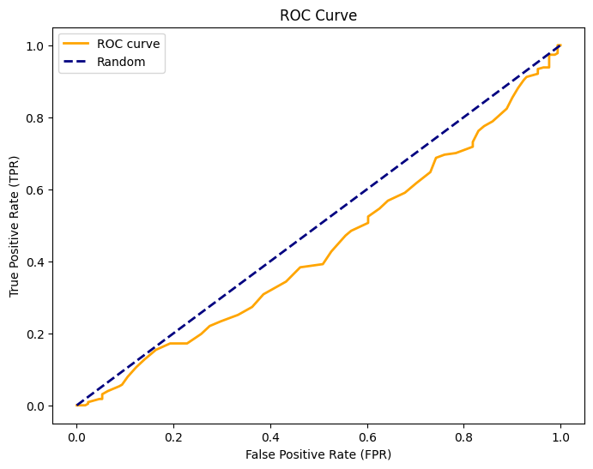
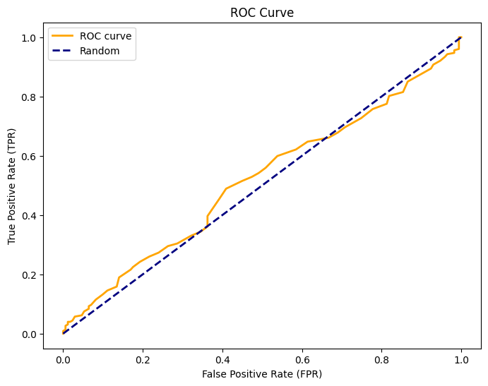
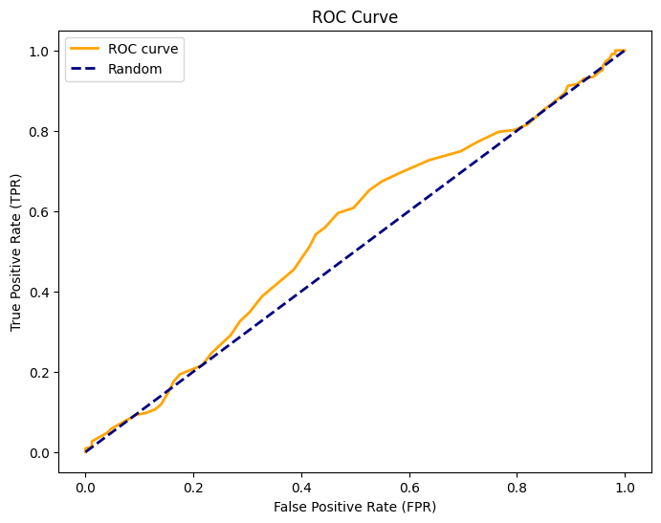
ROC Curve for 3 Groups
Group 1(#1-8)
Group 2(#9-17)
Group 3(#18-25)

Slide 19
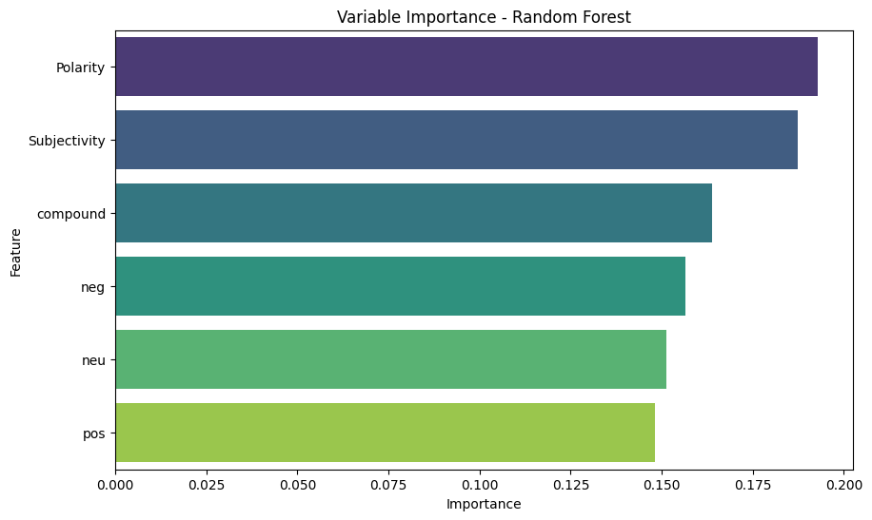
Variable Importance for Top 1-25

Slide 20
5
Time Series Analysis
MonteCarlo &
Linear programming Analysis

Slide 21
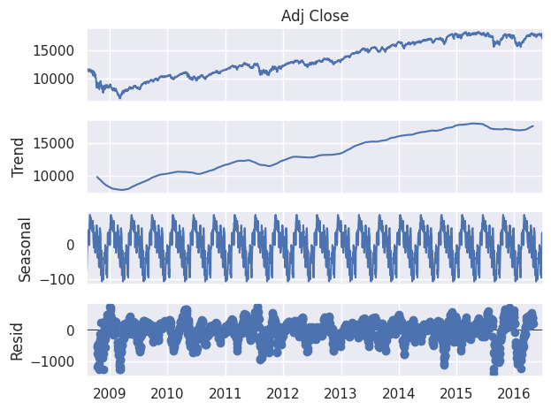
Decomposition Analysis

Slide 22
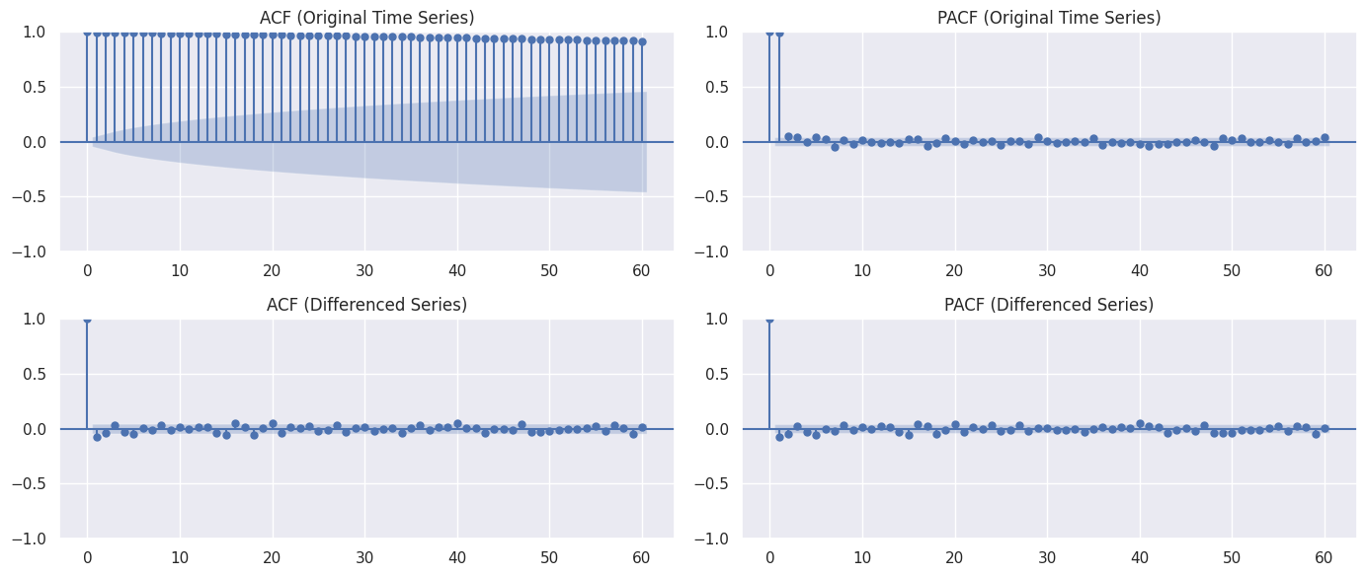
ACF and PACF Plots

Slide 23
SARIMAX Model
(Seasonal AutoRegressive Integrated Moving Average)
SARIMAX, which stands for Seasonal AutoRegressive Integrated Moving Average with eXogenous factors, is a statistical model used for time series analysis and forecasting.
Parameters:
(p, d, q): Non-seasonal order
(P, D, Q, s): Seasonal order
X: Exogenous Variable

Slide 24
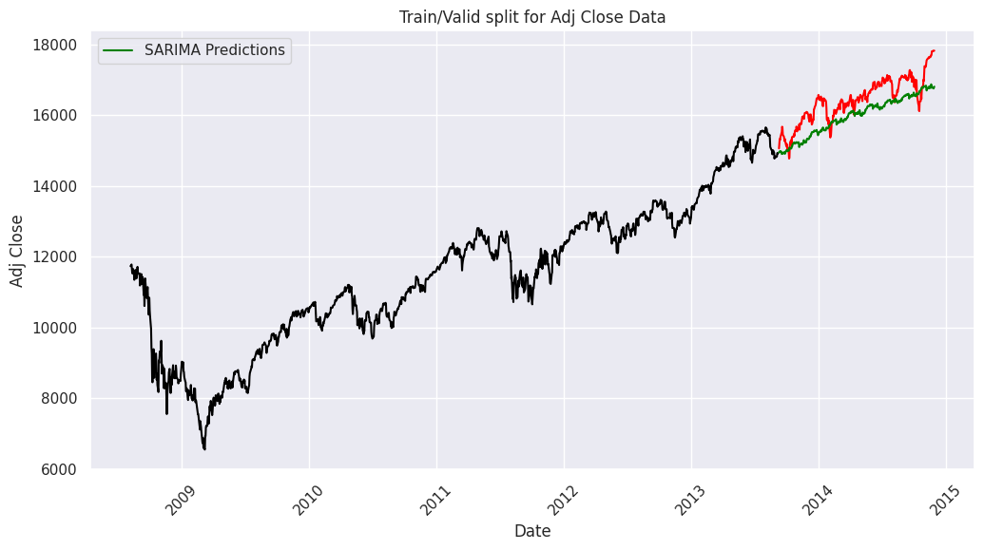
SARIMA (3,1,0)(6,1,0,36)
Evaluation Metrics
MAPE = 0.028
RMSE = 23.19
R square = 0.30

Slide 25
SARIMAX (3,1,0)(6,1,0,36)
X = ‘polarity’, ‘subjectivity’ ‘compound’, ‘neg’, ‘neu’, and ‘pos’
Evaluation Metrics
MAPE = 0.030
RMSE = 23.58
R square = 0.25

Slide 26
6
Summary

Slide 27

Research Insights
Practical Meaning
Further Improvement

Slide 28
Thank You

