Slide 1
Chapter 13
Inference About Comparing
Two Populations

Slide 2
Inference About Two Populations
We will still consider these parameters when we are looking at two populations, however our interest will now be:
➔ The difference between two means
➔ The ratio of two variances.
➔ The difference between two proportions.

Slide 3



Difference between Two Means
In order to test and estimate the difference between two population means, we draw random samples from each of two populations.
We first consider independent samples, that is, samples that are completely unrelated to one another.
(Likewise, we consider for Population 2)
Population 1
Sample, size: n₁
Parameters:
Statistics:

Slide 4

Difference between Two Means
Because we are comparing two population means, we use the statistic,
which is an unbiased and consistent estimator of µ₁- µ_{2.}

Slide 5
Making Inferences About μ₁-μ₂
We use t-statistic to generate test-statistics to make inferences about μ₁-μ₂.
We consider two cases for the unknown population variances: when we believe they are equal variance or when we believe they are unequal variance.

Slide 6

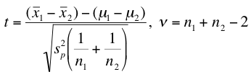
Test Statistic for μ₁-μ₂ (equal variances)
Calculate – the pooled variance estimator as…
…and use it here:
degrees of freedom
Notes:
Pooled variance estimator – conceptually like weighed variance estimator
df: considering both populations, so sum up two ns and minus 2

Slide 7

CI Estimator for μ₁-μ₂ (equal variances)
The confidence interval estimator for μ₁-μ₂ when the
population variances are equal is given by:
pooled variance estimator
degrees of freedom
Notes:
Two-tail

Slide 8


Test Statistic for μ₁-μ₂ (unequal variances)
0
The test statistic for μ₁-μ₂ when the population variances are
unequal is given by:
Likewise, the confidence interval estimator is:
degrees of freedom

Slide 9
Testing the Population Variances
Testing the Population Variances
H₀: σ₁² / σ₂² = 1 (equal variance)
H₁: σ₁² / σ₂² ≠ 1
Test statistic: s₁² / s₂², which is F-distributed with degrees of freedom ν₁ = n₁– 1 and ν₂ = n₂ −1.
The required condition is the same as that for the t-test of
µ₁ - µ₂ , which is both populations are normally distributed.

Slide 10
Testing the Population Variances
This is a two-tail test so that the rejection region is
or

Slide 11
Example 13.2
What happens to the family-run business when the boss’s son or daughter takes over?
Does the business do better after the change if the new boss is the offspring of the owner or does the business do better when an outsider is made chief executive officer (CEO)?
In pursuit of an answer researchers randomly selected 140 firms between 1994 and 2002, 30% of which passed ownership to an offspring and 70% appointed an outsider as CEO.

Slide 12
Example 13.2
For each company the researchers calculated the operating income as a proportion of assets in the year before and the year after the new CEO took over.
The change (operating income after – operating income before) in this variable was recorded. Xm13-02
Do these data allow us to infer that the effect of making an offspring CEO is different from the effect of hiring an outsider as CEO?

Slide 13
Example 13.2
The problem objective is to compare two populations.
Population 1: Operating income of companies whose CEO is an offspring of the previous CEO
Population 2: Operating income of companies whose CEO is an outsider
The data type is interval (operating incomes).
Thus, the parameter to be tested is µ₁- µ₂, where µ₁ = mean operating income for population 1 and µ₂ = mean operating income for population 2.

Slide 14
Example 13.2
We want to determine whether there is enough statistical evidence to infer that µ₁ is different from µ₂. That is, that
µ₁- µ₂ is not equal to 0. Thus,
H₁: µ₁- µ₂ ≠ 0
and
H₀: µ₁- µ₂ = 0
We need to determine whether to use the equal-variances or unequal-variances t –test of µ₁- µ_{2.}

Slide 15
Example 13.2
IDENTIFY
To decide which t-test to apply we conduct the F-test of σ₁²/ σ₂² .
From the data we calculated the following statistics.
s₁² = 3.79 and s₂² = 8.03
Test statistic: F = 3.79/8.03 = 0.47
Rejection region:
or

Slide 16
Example 13.2
IDENTIFY
The value of the test statistic is F = .47. The p-value of the test we're conducting is 2 .0040 = .0080.
Thus, the correct technique is the unequal-variances t-test of µ₁- µ_{2.}

Slide 17
Example 13.2
COMPUTE
Click Data, Data Analysis, t-Test: Two-Sample Assuming Unequal Variances

Slide 18
Example 13.2…
COMPUTE
The t-statistic is – 3.22 and its p-value is .0017. Accordingly, we conclude that there is sufficient evidence to infer that the mean times differ.

Slide 19
Confidence Interval Estimator
We can also draw inferences about the difference between the two population means by calculating the confidence interval estimator. We use the unequal-variances confidence interval estimator of and a 95% confidence level.
We estimate that the mean change in operating incomes for
outsiders exceeds the mean change in the operating income
for offspring lies between .51 and 2.16 percentage points.

Slide 20
Example 13-A
Do golfers spend less than skiers on vacations?
To help answer the question, a travel agency surveyed 10 customers who regularly take their spouses on either a skiing or golfing vacation.
The amounts spent on vacations last year are shown here.
Can we infer that the golfers do spend less than the skiers?

Slide 21
Example 13-A
The 10 surveyed customers spending are listed below.
We want to determine whether there is enough statistical evidence to infer that µ₁ (Golfer) is less than µ₂ (Skier). That is,
H₁: µ₁- µ₂ < 0
and
H₀: µ₁- µ₂ = 0
Golfer | 2450 | 2800 | 2000 | 1950 | 2050 | 2800
Skier | 3800 | 3500 | 2500 | 3000

Slide 22
Example 13-A
To decide which t-test to apply we conduct the F-test of σ₁²/ σ₂² .
From the data we calculated the following statistics.
s₁² = 157416.7 and s₂² = 326666.7
And therefore the test statistic F is 157416.7 / 326666.7 = 0.48.

Slide 23
Testing the Population Variances
This is a two-tail test so that the rejection region is
or

Slide 24
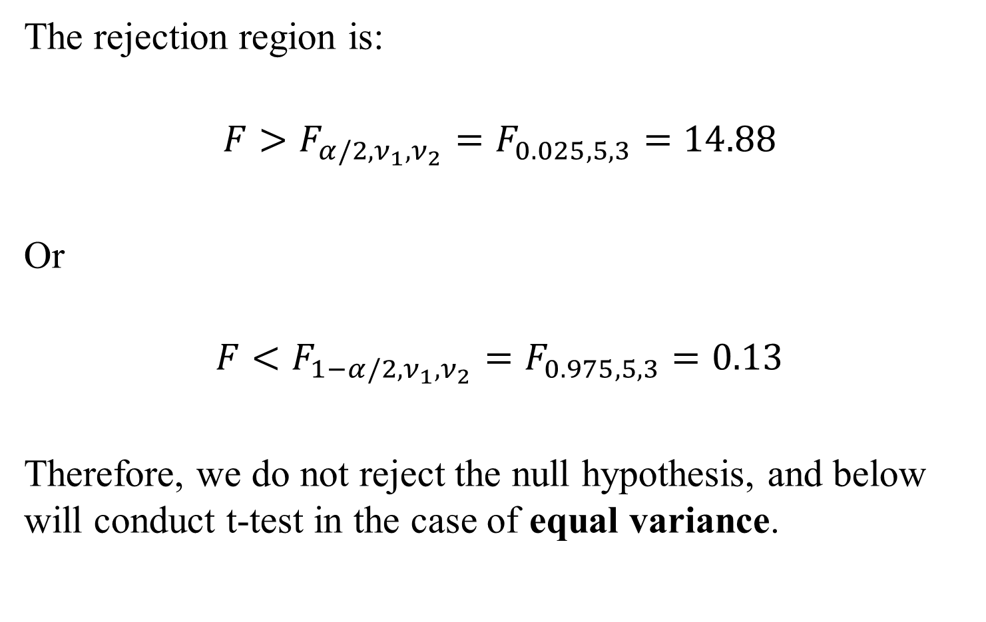
Example 13-A
The rejection region is:
$$F>F_{α/2, ν_{1},ν_{2}}=F_{0.025,5,3}=14.88$$
Or
$$F<F_{1−α/2, ν_{1},ν_{2}}=F_{0.975,5,3}=0.13$$
Therefore, we do not reject the null hypothesis, and below will conduct t-test in the case of equal variance.

Slide 25
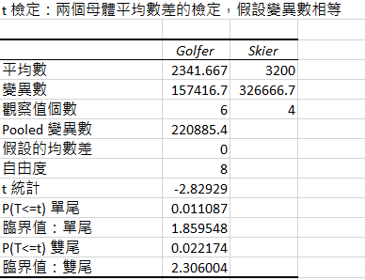
Example 13-A

Slide 26
Example 13-A
The t-statistic is – 2.83 and the one-tailed p-value is 0.011.
Accordingly, under the 5% significance level, we may conclude that there is sufficient evidence to infer that the golfers do spend less the skiers.

Slide 27
Checking the Required Condition
Both the equal-variances and unequal-variances techniques require that the populations be normally distributed. As before, we can check to see whether the requirement is satisfied by drawing the histograms of the data.

Slide 28
Checking the Required Condition: Example 13.1
.

Slide 29
Checking the Required Condition: Example 13.2
.

Slide 30
Violation of the Required Condition
When the normality requirement is unsatisfied, we can use a nonparametric technique-the Wilcoxon rank sum test for independent samples (Chapter 19)--to replace the equal-variances test of µ₁-µ₂ .
We have no alternative to the unequal-variances test of µ₁-µ₂ when the populations are very nonnormal.

Slide 31
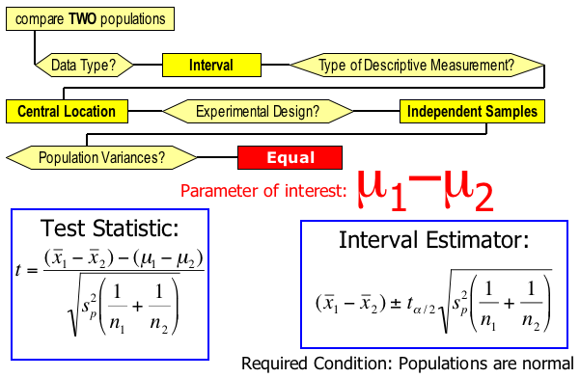
Identifying Factors I…
Factors that identify the equal-variances t-test and estimator of :

Slide 32
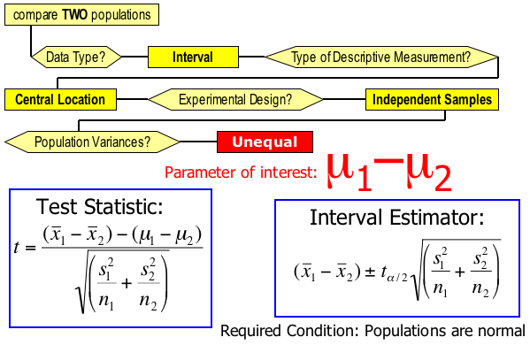
Identifying Factors II…
Factors that identify the unequal-variances t-test and estimator of :

Slide 33
Matched Pairs Experiment
Previously when comparing two populations, we examined independent samples.
If, however, an observation in one sample is matched with an observation in a second sample (meaning that the two samples are not independent), this is called a matched pairs experiment.
To help understand this concept, let’s consider Example 13.4

Slide 34
Example 13.4
In the last few years a number of web-based companies that offer job placement services have been created.
The manager of one such company wanted to investigate the job offers recent MBAs were obtaining.
In particular, she wanted to know whether finance majors were being offered higher salaries than marketing majors.

Slide 35
Example 13.4
In a preliminary study she randomly sampled 50 recently graduated MBAs half of whom majored in finance and half in marketing.
From each she obtained the highest salary (including benefits) offer (Xm13-04).
Can we infer that finance majors obtain higher salary offers than do marketing majors among MBAs?

Slide 36
Example 13.4
IDENTIFY
The parameter is the difference between two means (where µ₁ = mean highest salary offer to finance majors and µ₂ = mean highest salary offer to marketing majors).
Because we want to determine whether finance majors are offered higher salaries, the alternative hypothesis will specify that is µ₁ greater than µ₂.
Calculation of the F-test of two variances indicates the use the equal-variances test statistic.

Slide 37
Example 13.4
IDENTIFY
The hypotheses are
The Excel output is:

Slide 38
Example 13.4
COMPUTE

Slide 39
Example 13.4
INTERPRET
The value of the test statistic (t =1.04) and its p-value (.1513) indicate that there is very little evidence to support the hypothesis that finance majors attract higher salary offers than marketing majors.
BUT…..
We have some evidence to support the alternative hypothesis, but not enough.
Note that the difference in sample means is
= (65,624 -60,423) = 5,201

Slide 40
Example 13.5
Suppose now that we redo the experiment in the following way.
We examine the transcripts of finance and marketing MBA majors.
We randomly sample a finance and a marketing major whose grade point average (GPA) falls between 3.92 and 4 (based on a maximum of 4).
We then randomly sample a finance and a marketing major whose GPA is between 3.84 and 3.92.

Slide 41
Example 13.5
We continue this process until the 25th pair of finance and marketing majors are selected whose GPA fell between 2.0 and 2.08.
(The minimum GPA required for graduation is 2.0.)
As we did in Example 13.4, we recorded the highest salary offer . Xm13-05
Can we conclude from these data that finance majors draw larger salary offers than do marketing majors?

Slide 42
Example 13.5
IDENTIFY
The experiment described in Example 13.4 is one in which the samples are independent. That is, there is no relationship between the observations in one sample and the observations in the second sample. However, in this example the experiment was designed in such a way that each observation in one sample is matched with an observation in the other sample. The matching is conducted by selecting finance and marketing majors with similar GPAs. Thus, it is logical to compare the salary offers for finance and marketing majors in each group. This type of experiment is called matched pairs.
For each GPA group, we calculate the matched pair difference between the salary offers for finance and marketing majors.

Slide 43
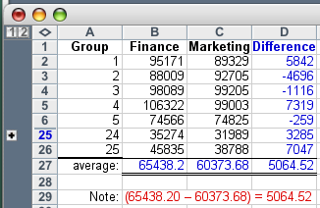

Example 13.5
IDENTIFY
The numbers in black are the original starting salary data (Xm13-05) ; the numbers in blue were calculated.
although a student is either in Finance OR in Marketing (i.e. independent), that the data is grouped in this fashion makes it a matched pairs experiment (i.e. the two students in group #1 are ‘matched’ by their GPA range
the difference of the means is equal to the mean of the differences, hence we will consider the “mean of the paired differences” as our parameter of interest:

Slide 44


Example 13.5
IDENTIFY
Do Finance majors have higher salary offers than Marketing majors?
Since:
We want to research this hypothesis: H₁:
(and our null hypothesis becomes H₀: )

Slide 45


Test Statistic for
IDENTIFY
The test statistic for the mean of the population of differences ( ) is:
which is Student t distributed with n_{D}–1 degrees of freedom, provided that the differences are normally distributed.

Slide 46
Example 13.5
COMPUTE
The p-value is .0004. There is overwhelming evidence that Finance majors do obtain higher starting salary offers than their peers in Marketing.

Slide 47
Example 13-B
In a preliminary study to determine whether the installation of a camera designed to catch the cars that go through red lights affects the violators, the number of red-light runner was recorded for each day during weekdays before and after the camera was installed.
The data are listed below.
Day | Monday | Tuesday | Wednesday | Thursday | Friday
Before | 15 | 12 | 25 | 15 | 20
After | 9 | 15 | 10 | 12 | 8

Slide 48
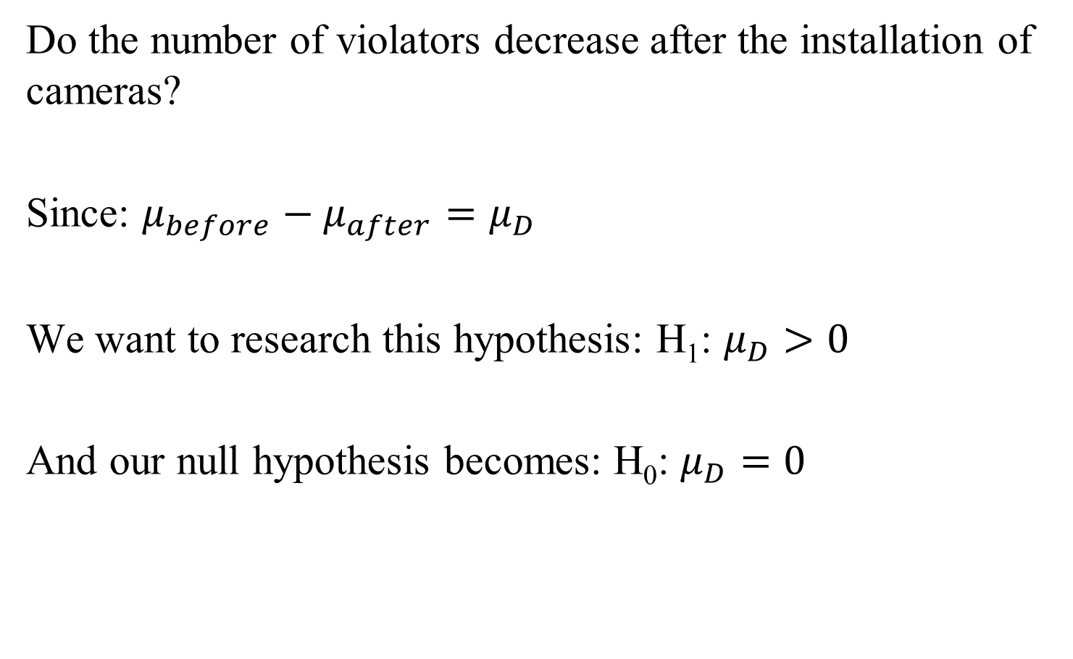
Example 13-B
IDENTIFY
Do the number of violators decrease after the installation of cameras?
Since: $μ_{before}−μ_{after}=μ_{D}$
We want to research this hypothesis: H₁: $μ_{D}>0$
And our null hypothesis becomes: H₀: $μ_{D}=0$

Slide 49
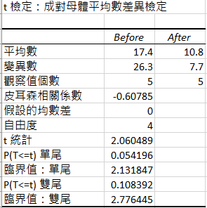
Example 13-B
COMPUTE

Slide 50
Example 13-B
INTERPRET
The one-tailed p-value is 0.054.
Therefore, if the decision maker uses a significance level of 5%, she might conclude that the installed camera is not effective in terms of reducing the number of the red-light runners.
However, if a 10% significance level is used, she might conclude that the installed camera is effective.

Slide 51

Example 13.6 Confidence Interval Estimator for µ_{D}
We can derive the confidence interval estimator for
algebraically as:

Slide 52
Checking the Required Condition
The population of differences are required to be normally distributed. As before, we can check to see whether the requirement is satisfied by drawing the histogram of the differences.

Slide 53
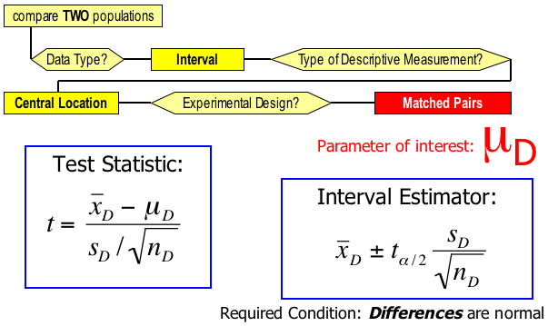
Identifying Factors…
Factors that identify the t-test and estimator of :

Slide 54



Inference about the ratio of two variances
So far we’ve looked at comparing measures of central location, namely the mean of two populations.
When looking at two population variances, we consider the ratio of the variances, i.e. the parameter of interest to us is:
The sampling statistic: is F distributed with
degrees of freedom.

Slide 55


Inference about the ratio of two variances
Our null hypothesis is always:
H₀:
(i.e. the variances of the two populations will be equal, hence their ratio will be one)
Therefore, our statistic simplifies to:

Slide 56
Example 13.7
IDENTIFY
In Example 12.3, we applied the chi-squared test of a
variance to determine whether there was sufficient evidence
to conclude that the population variance was less than 1.0.
Suppose that the statistics practitioner also collected data
from another container-filling machine and recorded the fills
of a randomly selected sample.
Can we infer at the 5% significance level that the second
machine is superior in its consistency?

Slide 57
Example 13.7
IDENTIFY
The problem objective is to compare two populations where
the data are interval.
Because we want information about the consistency of the
two machines, the parameter we wish to test is σ₁² / σ₂²,
where σ₁² is the variance of machine 1 and σ₂², is the
variance for machine 2.

Slide 58
Example 13.7
IDENTIFY
We need to conduct the F-test of to determine whether the
variance of population 2 is less than that of population 1.
Expressed differently, we wish to determine whether there is
enough evidence to infer that is σ₁² is larger than σ₂². Hence
the hypotheses we test are
H₀: σ₁² / σ₂² = 1
H₁: σ₁² / σ₂² > 1

Slide 59
Example 13.7
COMPUTE
There is not enough evidence to infer that the variance of
machine 2 is less than the variance of machine 1.

Slide 60
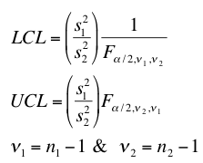
Example 13.8
Determine the 95% confidence interval estimate of the ratio
of the two population variances in Example 13.7.
The confidence interval estimator for σ₁² / σ₂² is:
That is, we estimate that σ₁² / σ₂² lies between .6164 and 3.1741
Note that one (1.00) is in this interval.

Slide 61
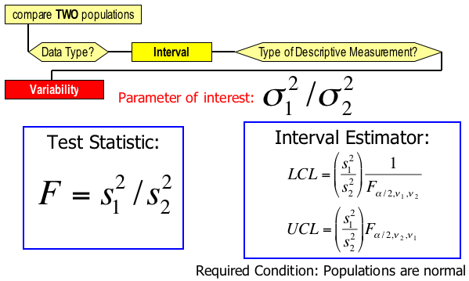
Identifying Factors
Factors that identify the F-test and estimator of :

Slide 62
Difference Between Two Population Proportions
We will now look at procedures for drawing inferences about the difference between populations whose data are nominal (i.e. categorical).
As mentioned previously, with nominal data, calculate proportions of occurrences of each type of outcome. Thus, the parameter to be tested and estimated in this section is the difference between two population proportions: p₁–p₂.

Slide 63


Statistic and Sampling Distribution…
To draw inferences about the the parameter p₁–p₂, we take samples of population, calculate the sample proportions and look at their difference.
is an unbiased estimator for p₁–p₂.
x₁ successes in a sample of size n₁ from population 1

Slide 64
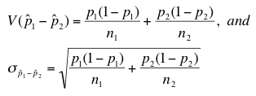


Sampling Distribution
The statistic is approximately normally distributed if the sample sizes are large enough so that:
Since its “approximately normal” we can describe the normal distribution in terms of mean and variance…
…hence this z-variable will also be approximately standard normally distributed:

Slide 65
Testing and Estimating p₁–p₂
Because the population proportions (p₁ & p₂) are unknown, the standard error:
is unknown. Thus, we have two different estimators for the standard error of , which depend upon the null hypothesis. We’ll look at these cases on the next slide…

Slide 66
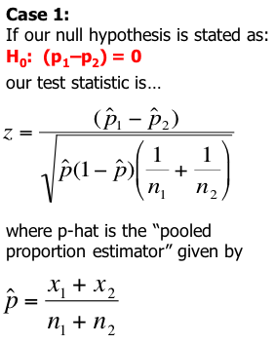
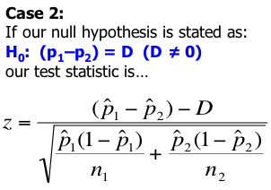
Test Statistic for p₁–p₂
There are two cases to consider…

Slide 67
Example 13.9
The General Products Company produces and sells a bath soap, which is not selling well.
Hoping to improve sales General products decided to introduce more attractive packaging.
The company’s advertising agency developed two new designs.

Slide 68
Example 13.9
The first design features several bright colors to distinguish it from other brands.
The second design is light green in color with just the company’s logo on it.
As a test to determine which design is better the marketing manager selected two supermarkets.
In one supermarket the soap was packaged in a box using the first design and in the second supermarket the second design was used.

Slide 69
Example 13.9
The product scanner at each supermarket tracked every buyer of soap over a one week period.
The supermarkets recorded the last four digits of the scanner code for each of the five brands of soap the supermarket sold. Xm13-09
The code for the General Products brand of soap is 9077(the other codes are 4255, 3745, 7118, and 8855).

Slide 70
Example 13.9
After the trial period the scanner data were transferred to a computer file.
Because the first design is more expensive management has decided to use this design only if there is sufficient evidence to allow them to conclude that it is better.
Should management switch to the brightly-colored design or the simple green one?

Slide 71
Example 13.9
IDENTIFY
The problem objective is to compare two populations. The first is the population of soap sales in supermarket 1 and the second is the population of soap sales in supermarket 2.
The data are nominal because the values are “buy General Products soap” and “buy other companies’ soap.”
These two factors tell us that the parameter to be tested is the difference between two population proportions p₁-p₂ (where p₁ and p₂ are the proportions of soap sales that are a General Products brand in supermarkets 1 and 2, respectively.

Slide 72
Example 13.9
IDENTIFY
Because we want to know whether there is enough evidence to adopt the brightly-colored design, the alternative hypothesis is
H₁: (p₁ – p₂) > 0
The null hypothesis must be
H₀: (p₁ – p₂) = 0
which tells us that this is an application of Case 1. Thus, the test statistic is

Slide 73
Example 13.9
INTERPRET
The value of the test statistic is z = 2.90; its p-value is .0019. There is enough evidence to infer that the brightly-colored design is more popular than the simple design. As a result, it is recommended that management switch to the first design.

Slide 74
Example 13.10
Suppose in our test marketing of soap packages scenario that instead of just a difference between the two package versions, the brightly colored design had to outsell the simple design by at least 3%

Slide 75
Example 13.10
IDENTIFY
Our research hypothesis now becomes:
H₁: (p₁–p₂) > .03
And so our null hypothesis is: H₀: (p₁–p₂) = .03
Since the r.h.s. of H₀ is
not zero, it’s a “case 2” type problem
There is not enough evidence to infer that the brightly colored design outsells the other design by 3% or more.

Slide 76

Example 13.11
To help estimate the difference in profitability, the
Marketing manager in Examples 13.9 and 13.10 would
like to estimate the difference between the two
proportions. A confidence level of 95% is suggested.
The confidence interval estimator for p₁–p₂ is given by:

Slide 77
Example 13-C
A firm has classified its customers in two ways:
According to whether the account is overdue and
Whether the account is new (less than 12 months) or old.
To acquire information about which customers are paying on time and which are overdue, a random sample of 292 customer accounts was drawn.

Slide 78
Example 13-C
Each was categorized as a new account (less than 12 months) and old, and whether the customer has paid or is overdue.
The results are summarized below.
 | New account | Old account
Sample size | 83 | 209
Overdue account | 12 | 49

Slide 79
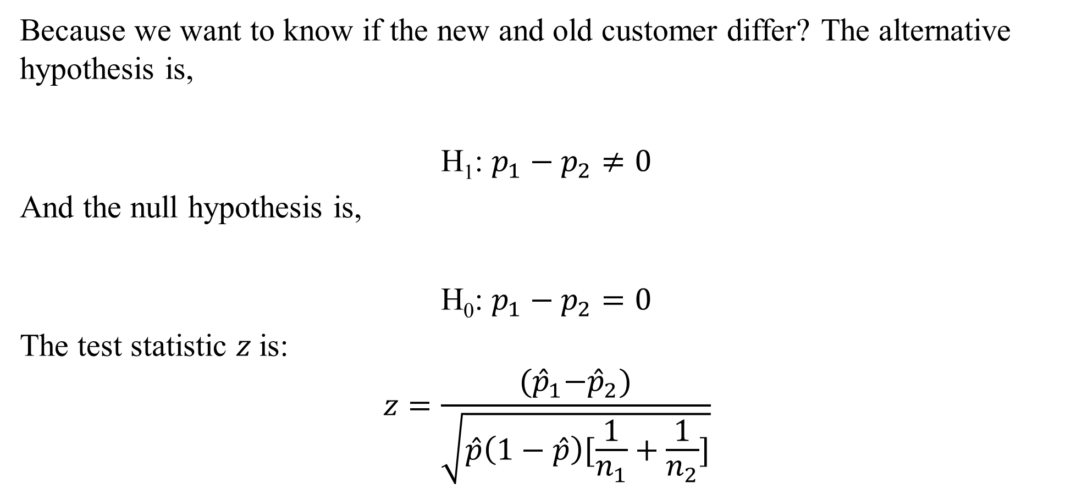
Example 13-C
IDENTIFY
Because we want to know if the new and old customer differ? The alternative hypothesis is,
H₁: $p_{1}−p_{2}≠0$
And the null hypothesis is,
H₀: $p_{1}−p_{2}=0$
The test statistic $z$is:
$$z=\frac{{(\hat{p}}_{1}−{\hat{p}}_{2})}{\sqrt{\hat{p}\left(1−\hat{p}\right)[\frac{1}{n_{1}}+\frac{1}{n_{2}}]}}$$

Slide 80
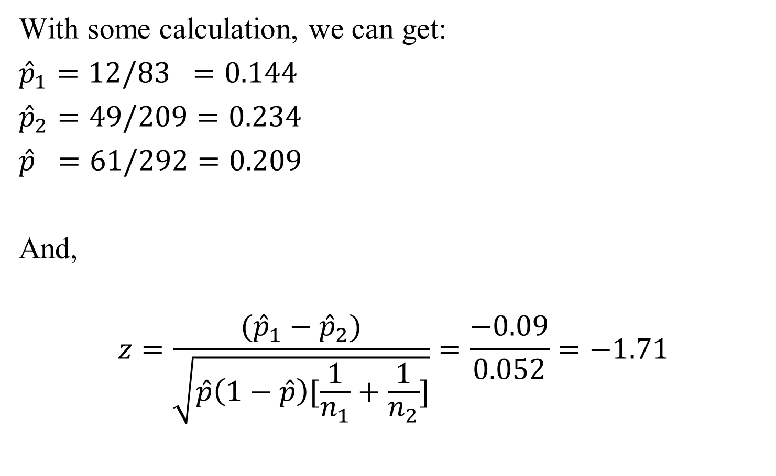
Example 13-C
COMPUTE
With some calculation, we can get:
${\hat{p}}_{1}=12/83 =0.144$
${\hat{p}}_{2}=49/209=0.234$
$\hat{p} =61/292=0.209$
And,
$$z=\frac{({\hat{p}}_{1}−{\hat{p}}_{2})}{\sqrt{\hat{p}\left(1−\hat{p}\right)[\frac{1}{n_{1}}+\frac{1}{n_{2}}]}}=\frac{−0.09}{0.052}=−1.71$$

Slide 81
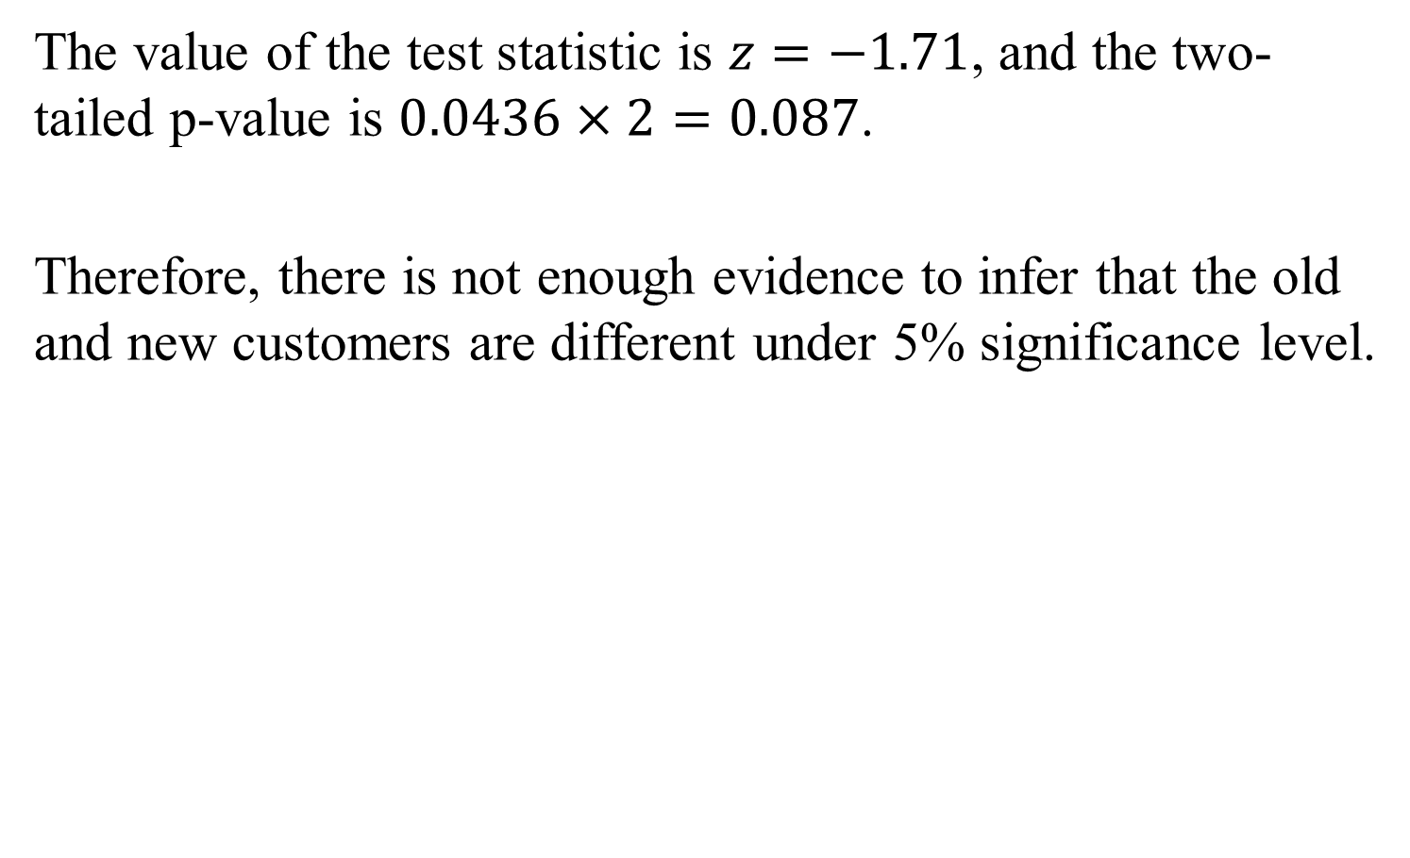
Example 13-C
The value of the test statistic is $z=−1.71$, and the two-tailed p-value is $0.0436×2=0.087$.
Therefore, there is not enough evidence to infer that the old and new customers are different under 5% significance level.

Slide 82
Confidence Interval Estimator
The confidence interval estimator for p₁–p₂ is given by:
and as you may suspect, its valid when…

Slide 83
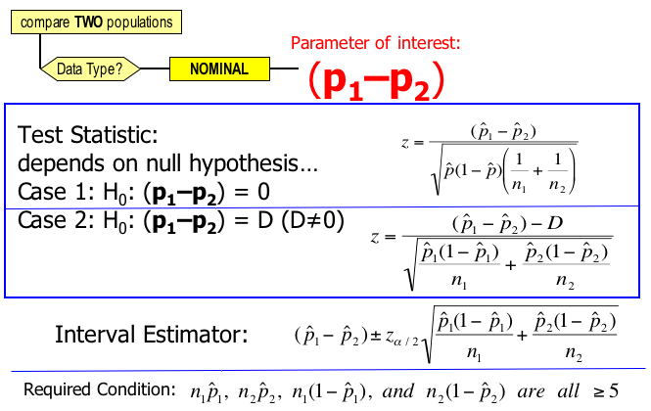
Identifying Factors…
Factors that identify the z-test and estimator for p₁–p₂

