Slide 1
Chapter 14
ANalysis Of VAriance (ANOVA)

Slide 2
Reminder
Find a team of 3-4 people for final project by next class. Those who cannot find a team by next class will be assigned one by me.
Practice session starts tomorrow (Mar 7th), 12:20 – 2:00 pm, links will be shared by Welly
Mostly focused on R programming/analyzing & class lecture clarification
Feel free to ask questions (even in Chinese)

Slide 3
Recap
When we are looking at two populations our interest will be:
➔ The difference between two means
➔ The ratio of two variances.
➔ The difference between two proportions.

Slide 4

Mean Inferences
Estimator: for µ₁- µ_{2.}
Test statistics: t-statistic
Two t-statistic cases:
Equal variance
Unequal variance
First need to test the population variance (using F-test)
H₀: σ₁² / σ₂² = 1 (equal variance)
H₁: σ₁² / σ₂² ≠ 1

Slide 5

Matched Samples
If an observation in one sample is matched with an observation in a second sample (meaning that the two samples are not independent), this is called a matched pairs experiment.
Estimator:

Slide 6

Variance Inferences
Estimator: for σ₁² / σ₂² .
Test statistics: F-statistic

Slide 7

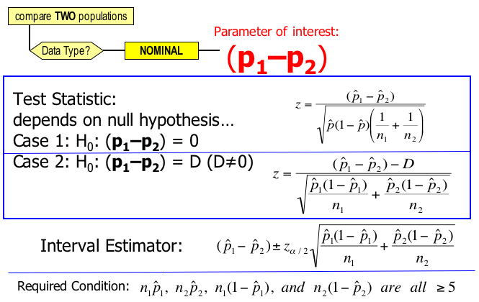
Proportion Inferences
Estimator: for p₁–p₂

Slide 8
Analysis of Variance
Analysis of variance is a technique that allows us to compare two or more populations of interval data.
-an extension of two population inference in ch.13, where the population # can be more than 2
Analysis of variance is:
➔ an extremely powerful and widely used procedure.
➔ a procedure determining whether differences exist between population means.
➔ a procedure which works by analyzing sample variance.

Slide 9
Why ANOVA instead of multiple t-tests?
To test if population means differ, we need to determine a significance level (i.e., type I error rate, usually set at .05) and then test if the test statistics yield significant result
If multiple such tests are conducted to test multiple populations, the type I error should theoretically exceed .05 much (e.g., 1-(1-.05)¹⁰ if testing 10 times).
Save time, for example the software can save time when testing hundreds or thousands or more populations
E.g., PCR tests for Covid – can tests thousands of people at once to save time (especially when the result is insignificant, you don’t have to compare the populations one by one)

Slide 10
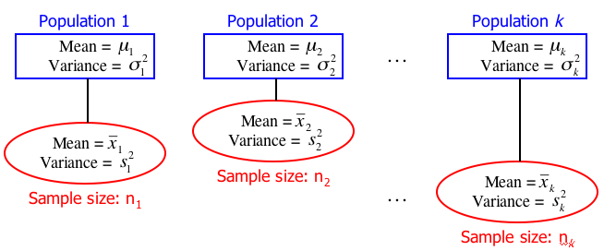
One-Way Analysis of Variance
Independent samples are drawn from k populations:
Note: These populations are referred to as treatments.
It is not a requirement that n₁ = n₂ = … = n_{k}.

Slide 11
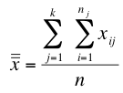
One Way Analysis of Variance
New Terminology:
x (called “capital x”) is the response variable, and its values are responses.
x_{ij} refers to the i^{th} observation in the j^{th} sample.
E.g. x₃₅ is the third observation of the fifth sample.
The grand mean, , is the mean of all the observations, i.e.:
(n = n₁ + n₂ + … + n_{k})
Population classification criterion is called a factor.
Each population is a factor level.

Slide 12
Example 14.1
In the last decade stockbrokers have drastically changed the way they do business. It is now easier and cheaper to invest in the stock market than ever before.
What are the effects of these changes?
To help answer this question a financial analyst randomly sampled 366 American households and asked each to report the age of the head of the household and the proportion of their financial assets that are invested in the stock market.

Slide 13
Example 14.1
The age categories are
Young (Under 35)
Early middle-age (35 to 49)
Late middle-age (50 to 65)
Senior (Over 65)
The analyst was particularly interested in determining whether the ownership of stocks varied by age. Xm14-01
Do these data allow the analyst to determine that there are differences in stock ownership between the four age groups?

Slide 14
Example 14.1
Terminology
Percentage of total assets invested in the stock market is the response variable; the actual percentages are the responses in this example.
Population classification criterion is called a factor.
The age category is the factor we’re interested in. This is the only factor under consideration (hence the term “one way” analysis of variance).
Each population is a factor level.
In this example, there are four factor levels: Young, Early middle age, Late middle age, and Senior.

Slide 15
Example 14.1
IDENTIFY
The null hypothesis in this case is:
H₀:µ₁ = µ₂ = µ₃ = µ₄
i.e. there are no differences between (any pairs of) population means.
Our alternative hypothesis becomes:
H₁: at least two means differ
OK. Now we need some test statistics…

Slide 16

Test Statistic
Since µ₁ = µ₂ = µ₃ = µ₄ is of interest to us, a statistic that measures the proximity of the sample means to each other would also be of interest.
Such a statistic exists, and is called the between-treatments variation. It is denoted SST, short for “sum of squares for treatments”. Its is calculated as:
grand mean
sum across k treatments
A large SST indicates large variation between sample means which supports H₁.

Slide 17
Test Statistic
When we performed the equal-variances test to determine whether two means differed (Chapter 13) we used
where
The numerator measures the difference between sample means and the denominator measures the variation in the samples.

Slide 18


Test Statistic
SST gave us the between-treatments variation. A second statistic, SSE (Sum of Squares for Error) measures the within-treatments variation.
SSE is given by: or:
In the second formulation, it is easier to see that it provides a measure of the amount of variation we can expect from the random variable we’ve observed.
Test statistics conceptually test the amount of between-treatments variation in relation to within-treatments variation -> large – reject H₀ ; small – cannot reject H₀

Slide 19
Example 14.1
COMPUTE
Since:
If it were the case that:
then SST = 0 and our null hypothesis, H₀:µ₁ = µ₂ = µ₃ = µ₄
would be supported.
More generally, a small value of SST supports the null hypothesis. A large value of SST supports the alternative hypothesis. The question is, how large is “large enough”?

Slide 20
Example 14.1
COMPUTE
The following sample statistics and grand mean were computed

Slide 21
Example 14.1
COMPUTE
Hence, the between-treatments variation, sum of squares for treatments, is
Is SST = 3,738.8 “large enough”?
3741.4
3741.4

Slide 22
Example 14.1
COMPUTE
We calculate the sample variances as:
and from these, calculate the within-treatments variation (sum of squares for error) as:
= 161,871.3
We still need a couple more quantities in order to relate SST and SSE together in a meaningful way…

Slide 23



Mean Squares
The mean square for treatments (MST) is given by:
The mean square for errors (MSE) is given by:
And the test statistic:
is F-distributed with k–1 and n–k degrees of freedom.
Aha! We must be close…

Slide 24
Example 14.1
COMPUTE
We can calculate the mean squares treatment and mean squares error quantities as:
Giving us our F-statistic of:
Does F = 2.79 fall into a rejection region or not? What is the p-value?
161871.3

Slide 25
Example 14.1
INTERPRET
Since the purpose of calculating the F-statistic is to determine whether the value of SST is large enough to reject the null hypothesis, if SST is large, F will be large.
P-value = P(F > F_{stat})

Slide 26
Example 14.1
COMPUTE

Slide 27
Example 14.1
INTERPRET
Since the p-value is .0405, which is small we reject the null hypothesis (H₀:µ₁ = µ₂ = µ₃ = µ₄) in favor of the alternative hypothesis (H₁: at least two population means differ).
That is: there is enough evidence to infer that the mean percentages of assets invested in the stock market differ between the four age categories.
- Remember that we don’t know exactly which two populations differ from the one-way ANOVA

Slide 28
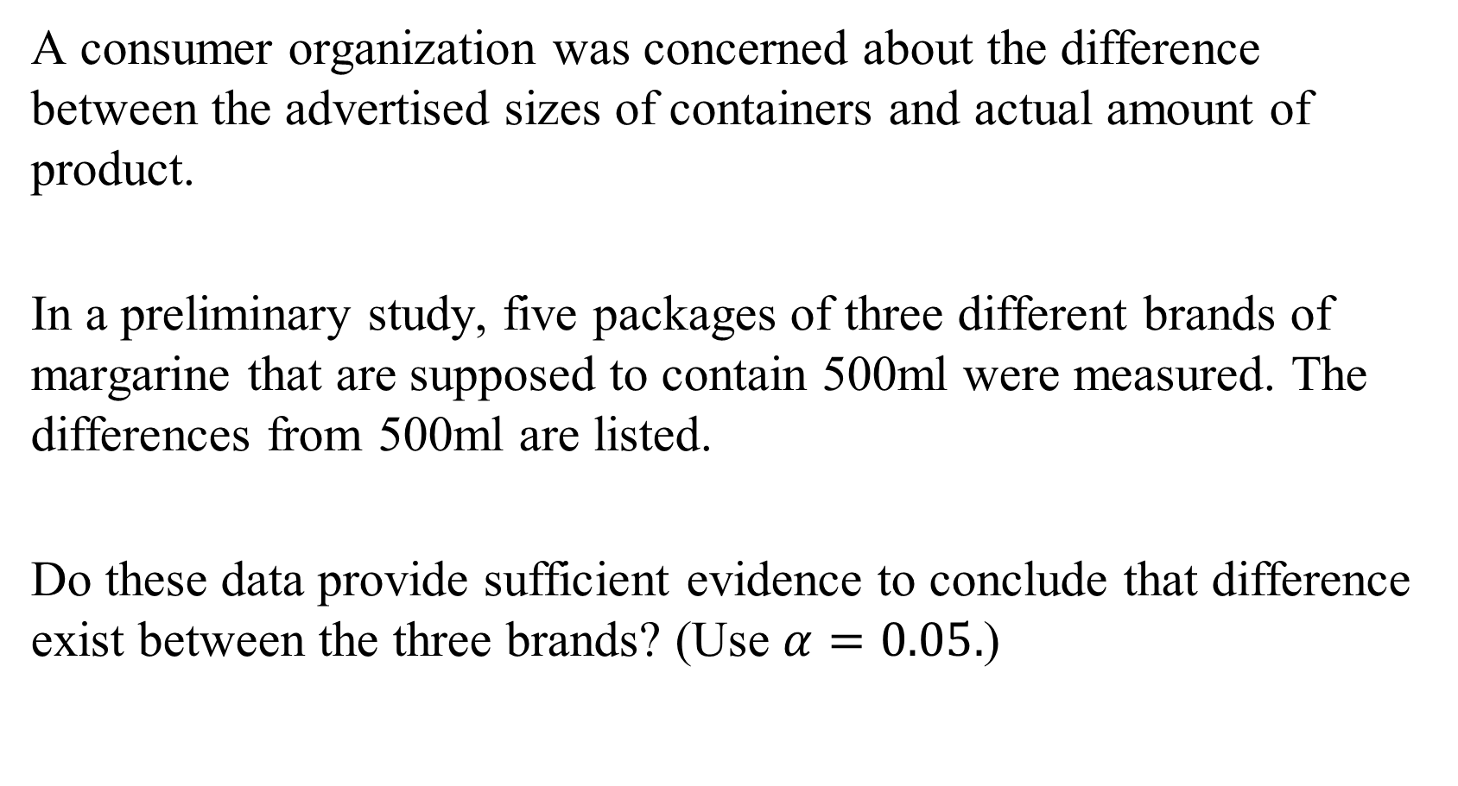
Exercise 14-A
A consumer organization was concerned about the difference between the advertised sizes of containers and actual amount of product.
In a preliminary study, five packages of three different brands of margarine that are supposed to contain 500ml were measured. The differences from 500ml are listed.
Do these data provide sufficient evidence to conclude that difference exist between the three brands? (Use $α=0.05.$)

Slide 29
Exercise 14-A
The data for the three brands are listed below.
Brand 1 | Brand 2 | Brand 3
1 | 2 | 4
3 | 4 | 2
3 | 4 | 4
0 | 5 | 2
3 | 0 | 2

Slide 30
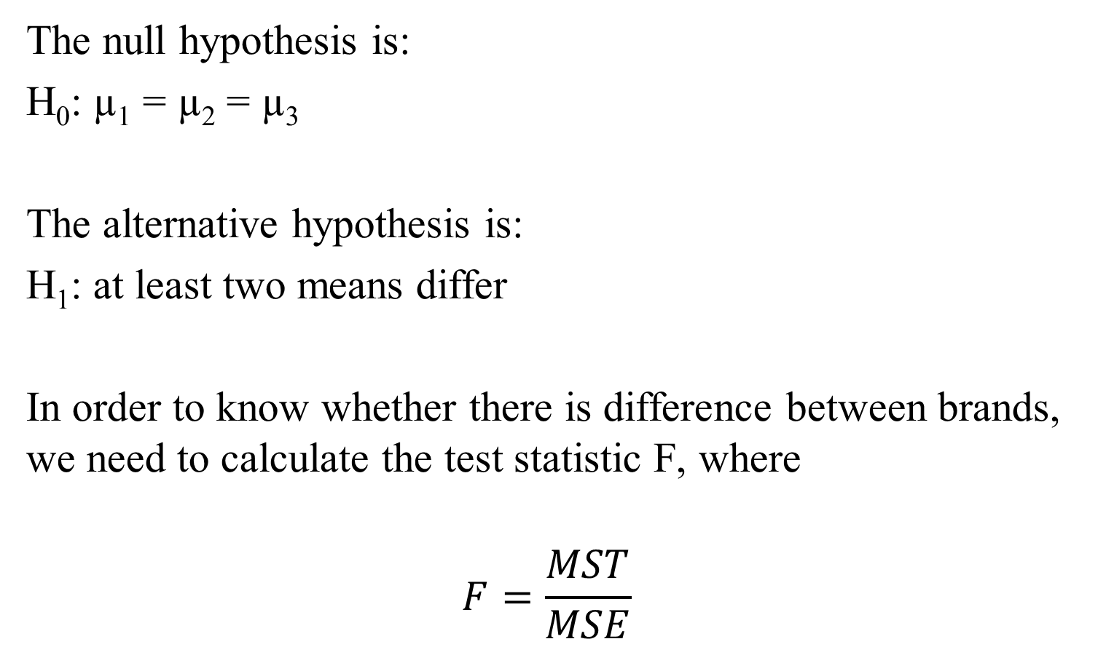
Exercise 14-A
The null hypothesis is:
H₀: µ₁ = µ₂ = µ₃
The alternative hypothesis is:
H₁: at least two means differ
In order to know whether there is difference between brands, we need to calculate the test statistic F, where
$$F=\frac{MST}{MSE}$$

Slide 31
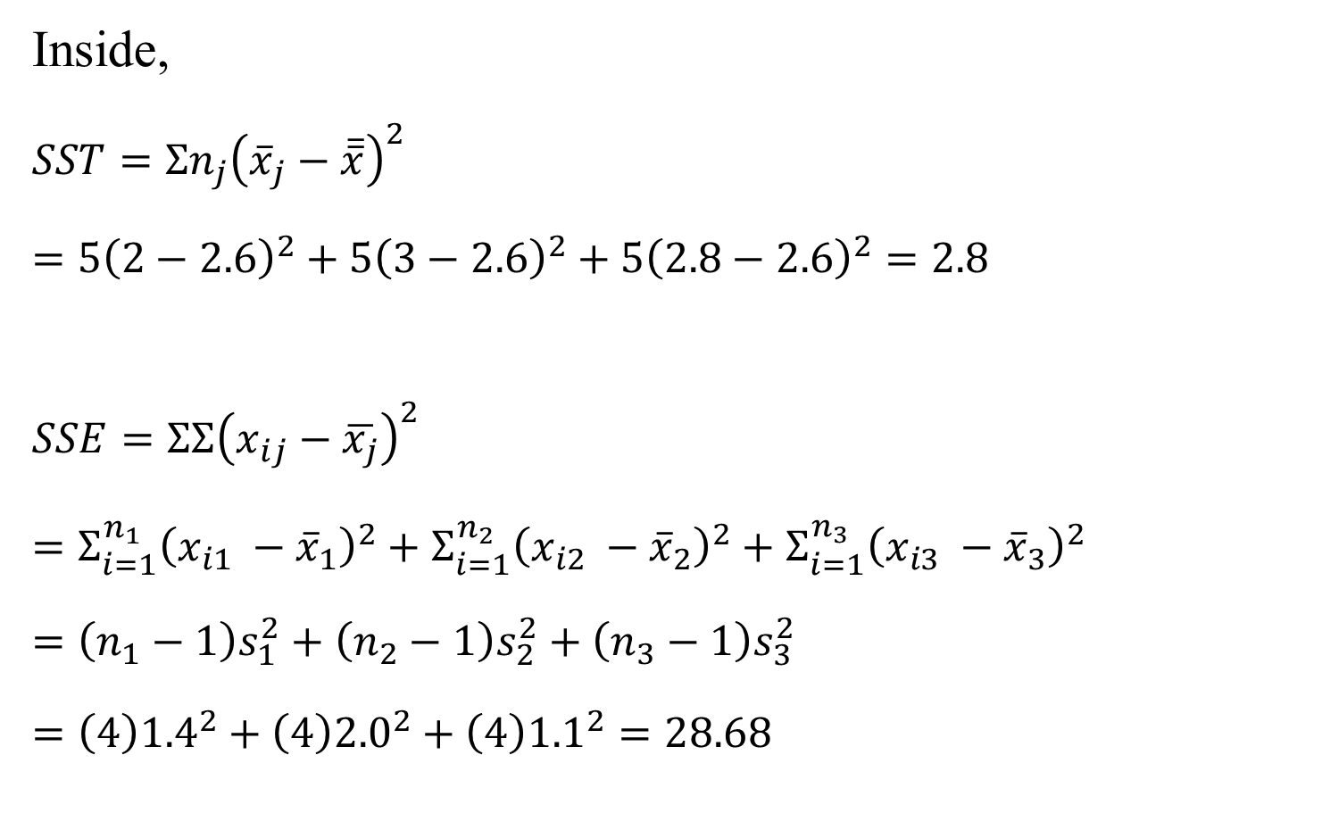
Exercise 14-A
Inside,
$SST=Σn_{j}{\left({\overline{x}}_{j}−\overline{\overline{x}}\right)}^{2}$
$=5{\left(2−2.6\right)}^{2}+5{\left(3−2.6\right)}^{2}+5{\left(2.8−2.6\right)}^{2}=2.8$
$SSE=ΣΣ{\left(x_{ij}−\overline{x_{j}}\right)}^{2}$
$=Σ_{i=1}^{n_{1}}{\left(x_{i1} −{\overline{x}}_{1}\right)}^{2}+Σ_{i=1}^{n_{2}}{\left(x_{i2} −{\overline{x}}_{2}\right)}^{2}+Σ_{i=1}^{n_{3}}{\left(x_{i3} −{\overline{x}}_{3}\right)}^{2}$
$=\left(n_{1}−1\right)s_{1}^{2}+\left(n_{2}−1\right)s_{2}^{2}+\left(n_{3}−1\right)s_{3}^{2}$
$=\left(4\right){1.4}^{2}+\left(4\right){2.0}^{2}+\left(4\right){1.1}^{2}=28.68$

Slide 32

Exercise 14-A
MST and MSE are calculated as followed.
$$MST=\frac{SST}{k−1}=\frac{2.8}{3−1}=1.4$$
And
$$MSE=\frac{SSE}{n−k}=\frac{28.68}{15−3}=2.4$$
Therefore, $F=\frac{MST}{MSE}=\frac{1.4}{2.4}=0.58$.

Slide 33
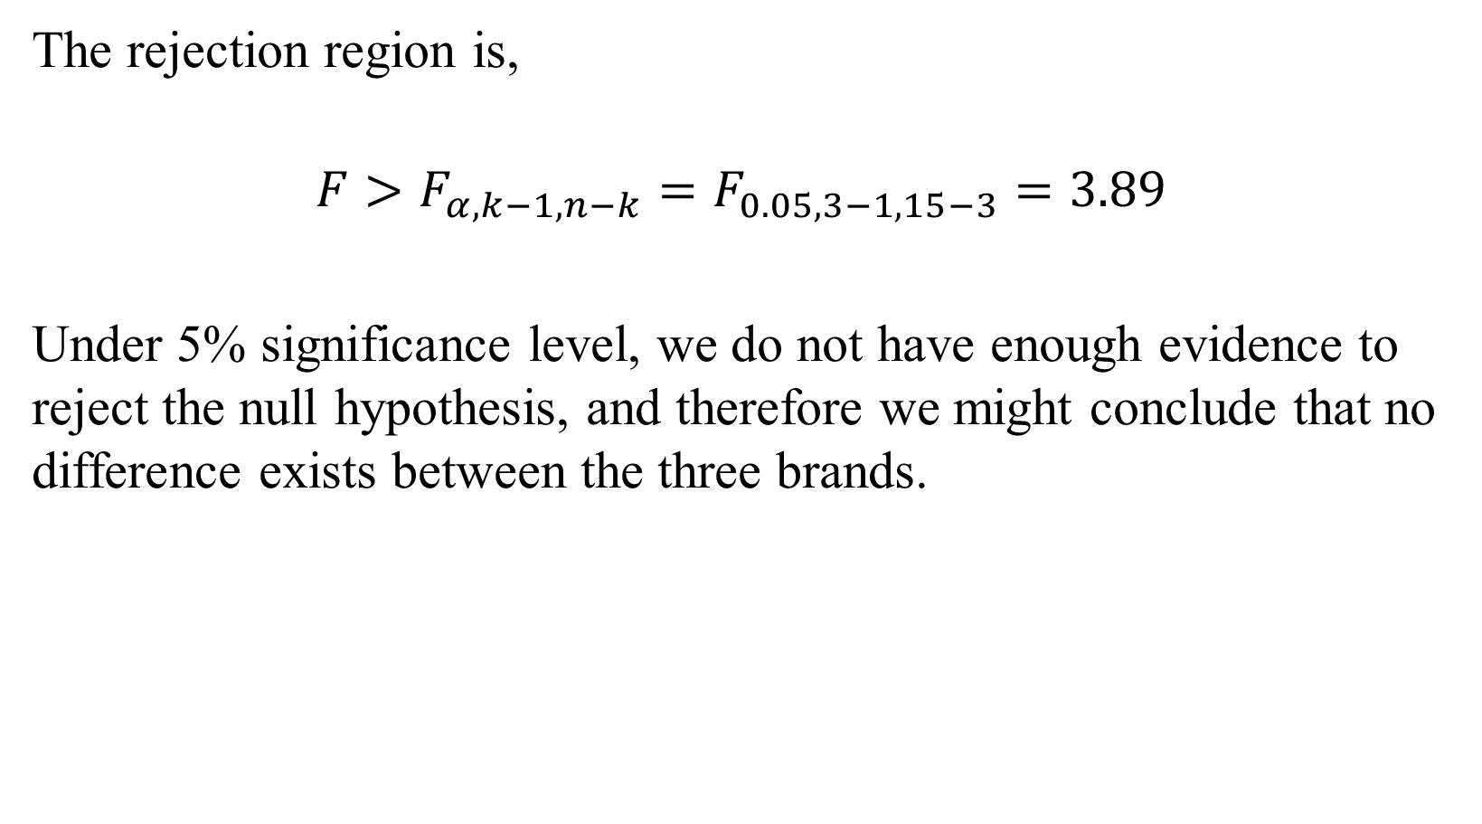
Exercise 14-A
The rejection region is,
$$F>F_{α,k−1,n−k}=F_{0.05,3−1,15−3}=3.89$$
Under 5% significance level, we do not have enough evidence to reject the null hypothesis, and therefore we might conclude that no difference exists between the three brands.

Slide 34
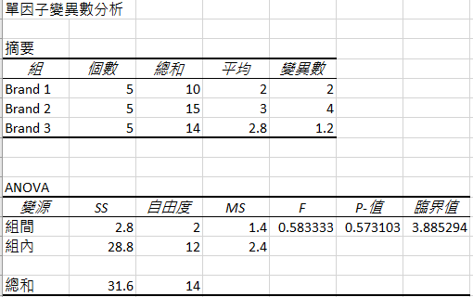
Exercise 14-A

Slide 35
ANOVA Table
The results of analysis of variance are usually reported in an ANOVA table…
Source of Variation | degrees of freedom | Sum of Squares | Mean Square
Treatments | k–1 | SST | MST=SST/(k–1)
Error | n–k | SSE | MSE=SSE/(n–k)
Total | n–1 | SS(Total)
F-stat=MST/MSE

Slide 36
ANOVA and t-tests of 2 means
Why do we need the analysis of variance? Why not test every pair of means? For example say k = 6. There are C₂⁶ = 6(5)/2= 15 different pairs of means.
1&2 1&3 1&4 1&5 1&6
2&3 2&4 2&5 2&6
3&4 3&5 3&6
4&5 4&6
5&6
If we test each pair with α = .05 we increase the probability of making a Type I error. If there are no differences then the probability of making at least one Type I error is 1-(.95)¹⁵ = 1 - .463 = .537

Slide 37
Checking the Required Conditions
The F-test of the analysis of variance requires that the random variable be normally distributed with equal variances. The normality requirement is easily checked graphically by producing the histograms for each sample.
(To see histograms click Example 14.1 Histograms)
The equality of variances is examined by printing the sample standard deviations or variances. The similarity of sample variances allows us to assume that the population variances are equal.

Slide 38
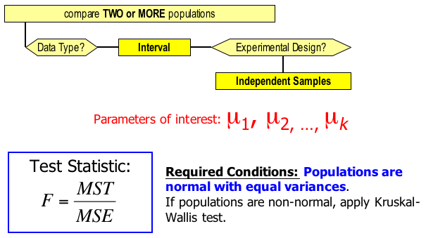
Identifying Factors
Factors that Identify the One-Way Analysis of Variance:

Slide 39

Multiple Comparisons
When we conclude from the one-way analysis of variance that at least two treatment means differ (i.e. we reject the null hypothesis that H₀: ), we often need to know which treatment means are responsible for these differences.
We will examine three statistical inference procedures that allow us to determine which population means differ:
• Fisher’s least significant difference (LSD) method
• Bonferroni adjustment, and
• Tukey’s multiple comparison method.

Slide 40

Multiple Comparisons
Two means are considered different if the difference between the corresponding sample means is larger than a critical number. The general case for this is,
IF
THEN we conclude and differ.
The larger sample mean is then believed to be associated with a larger population mean.

Slide 41
Fisher’s Least Significant Difference
What is this critical number, N_{Critical} ? Recall that in Chapter 13 we had the confidence interval estimator of µ₁-µ₂
If the interval excludes 0 we can conclude that the population means differ. So another way to conduct a two-tail test is to determine whether
is greater than

Slide 42
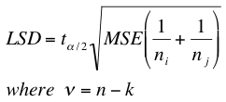
Fisher’s Least Significant Difference
However, we have a better estimator of the pooled variances. It is MSE. We substitute MSE in place of s_{p}². Thus we compare the difference between means to the Least Significant Difference LSD, given by:
LSD will be the same for all pairs of means if all k sample sizes are equal. If some sample sizes differ, LSD must be calculated for each combination.

Slide 43
Example 14.2
North American automobile manufacturers have become more concerned with quality because of foreign competition.
One aspect of quality is the cost of repairing damage caused by accidents. A manufacturer is considering several new types of bumpers.
To test how well they react to low-speed collisions, 10 bumpers of each of four different types were installed on mid-size cars, which were then driven into a wall at 5 miles per hour.

Slide 44
Example 14.2
The cost of repairing the damage in each case was assessed. Xm14-02
a Is there sufficient evidence to infer that the bumpers differ in their reactions to low-speed collisions?
b If differences exist, which bumpers differ?

Slide 45
Example 14.2
The problem objective is to compare four populations, the data are interval, and the samples are independent. The correct statistical method is the one-way analysis of variance.
F = 4.06, p-value = .0139. There is enough evidence to infer that a difference exists between the four bumpers. The question is now, which bumpers differ?

Slide 46
Example 14.2
The sample means are
and MSE = 12,399. Thus

Slide 47
Example 14.2
We calculate the absolute value of the differences between means and compare them to LSD = 101.09.
Hence, µ₁ and µ₂, µ₁ and µ₃, µ₂ and µ₄, and µ₃ and µ₄ differ.
The other two pairs µ₁ and µ₄, and µ₂ and µ₃ do not differ.

Slide 48
Bonferroni Adjustment to LSD Method…
Fisher’s method may result in an increased probability of type I error if many LSDs are produced (i.e., many groups).
We can adjust Fisher’s LSD calculation by using the “Bonferroni adjustment”.
Where we used alpha ( ), say .05, previously, we now use an adjusted value for alpha (to make the final alpha not too large):
where

Slide 49
Example 14.2
If we perform the LSD procedure with the Bonferroni adjustment the number of pairwise comparisons is 6 (calculated as C = k(k − 1)/2 = 4(3)/2).
We set α = .05/6 = .0083. Thus, t_{α/2,36} = 2.794 (available from Excel and difficult to approximate manually) and
Bonferroni adjustment typically yields larger LSDs than Fisher’s
.

Slide 50
Example 14.2 Excel (Data Analysis Plus)
Now, none of the six pairs of means differ.

Slide 51


Tukey’s Multiple Comparison Method
As before, we are looking for a critical number to compare the differences of the sample means against. In this case:
Note: is a lower case Omega, not a “w”
Critical value of the Studentized range
with n–k degrees of freedom
Table 7 - Appendix B
harmonic mean of the sample sizes

Slide 52
Example 14.2 Excel
k = number of treatments
n = Number of observations ( n = n₁+ n₂ + . . . + n_{k} )
ν = Number of degrees of freedom associated with MSE
(ν = n-k)
n_{g} = Number of observations in each of k samples
α = Significance level
= Critical value of the Studentized range

Slide 53
Example 14.2
k = 4
n₁ = n₂ = n₃ = n₄ = n_{g} = 10
v = 40 – 4 = 36
MSE = 12,399
Thus,

Slide 54
Example 14.1 • Tukey’s Method
Using Tukey’s method µ₂ and µ₄, and µ₃ and µ₄ differ.

Slide 55
Which method to use?
If you have identified two or three pairwise comparisons that you wish to make before conducting the analysis of variance, use the Bonferroni method.
If you plan to compare all possible combinations, use Tukey’s comparison method.

Slide 56
Analysis of Variance Experimental Designs
Experimental design determines which analysis of variance technique we use.
In the previous example we compared four populations on the basis of one factor – age.
One-way analysis of variance is only one of many different experimental designs of the analysis of variance.

Slide 57
Analysis of Variance Experimental Designs
A multifactor experiment is one where there are two or more factors that define the treatments.
For example, if instead of just varying the age of the household head we also look at the gender of the household head, then we have a two-factor analysis of variance in which the first factor, age, has four levels and the second factor, gender, has two levels.

Slide 58
Independent Samples and Blocks
Similar to the ‘matched pairs experiment’, a randomized block design experiment reduces the variation within the samples, making it easier to detect differences between populations.
The term block refers to a matched group of observations from each population.
We can also perform a blocked experiment by using the same subject for each treatment in a “repeated measures” experiment.

Slide 59
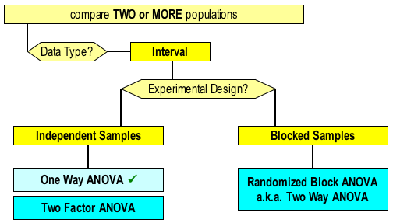
Independent Samples and Blocks
The randomized block experiment is also called the two-way analysis of variance, not to be confused with the two-factor analysis of variance. To illustrate where we’re headed…

Slide 60
Randomized Block Analysis of Variance
The purpose of designing a randomized block experiment is to reduce the within-treatments variation to more easily detect differences between the treatment means.
In this design, we partition the total variation into three sources of variation:
SS(Total) = SST + SSB + SSE
where SSB, the sum of squares for blocks, measures the variation between the blocks.

Slide 61
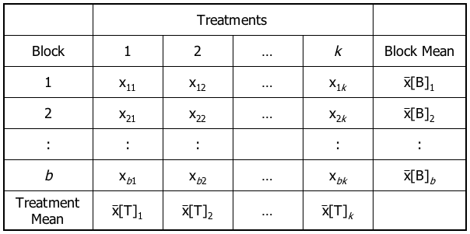
Randomized Blocks…
In addition to k treatments, we introduce notation for b blocks in our experimental design…
mean of the observations of the 1st treatment
mean of the observations of the 2nd treatment

Slide 62
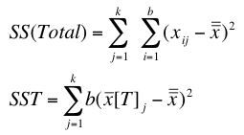
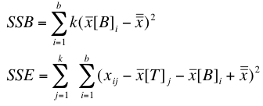
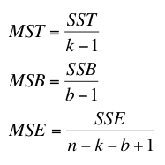
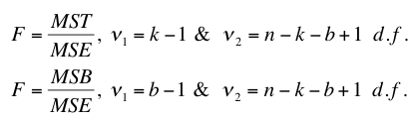
Sum of Squares : Randomized Block…
Squaring the ‘distance’ from the grand mean, leads to the following set of formulae…
test statistic for treatments
test statistic for blocks

Slide 63
ANOVA Table…
We can summarize this new information in an analysis of variance (ANOVA) table for the randomized block analysis of variance as follows…
Source of Variation | d.f.: | Sum of Squares | Mean Square | F Statistic
Treatments | k–1 | SST | MST=SST/(k–1) | F=MST/MSE
Blocks | b–1 | SSB | MSB=SSB/(b-1) | F=MSB/MSE
Error | n–k–b+1 | SSE | MSE=SSE/(n–k–b+1)
Total | n–1 | SS(Total)

Slide 64
Example 14.3
Many North Americans suffer from high levels of cholesterol, which can lead to heart attacks. For those with very high levels (over 280), doctors prescribe drugs to reduce cholesterol levels. A pharmaceutical company has recently developed four such drugs. To determine whether any differences exist in their benefits, an experiment was organized. The company selected 25 groups of four men, each of whom had cholesterol levels in excess of 280. In each group, the men were matched according to age and weight. The drugs were administered over a 2-month period, and the reduction in cholesterol was recorded (Xm14-03). Do these results allow the company to conclude that differences exist between the four new drugs?

Slide 65
Example 14.3
IDENTIFY
The hypotheses to test in this case are:
H₀:µ₁ = µ₂ = µ₃ = µ₄
H₁: At least two means differ

Slide 66
Example 14.3
IDENTIFY
Each of the four drugs can be considered a treatment.
Each group can be blocked, because they are matched by age and weight.
By setting up the experiment this way, we eliminates the variability in cholesterol reduction related to different combinations of age and weight. This helps detect differences in the mean cholesterol reduction attributed to the different drugs.

Slide 67
Example 14.3
The Data
Treatment
Block
There are b = 25 blocks, and
k = 4 treatments in this example.

Slide 68
Example 14.3
COMPUTE

Slide 69
Example 14-B
An experiment to understand measurement error, a statistics professor asks three students to measure the height of the professor, a male student, and a female student.
The differences (in centimeters) between the correct dimension and the ones produced by the students are listed below.
 | Errors in Measuring Heights of
Student | Professor | Male Student | Female Student
1 | 1.4 | 1.5 | 1.3
2 | 3.0 | 2.6 | 2.4
3 | 2.8 | 2.2 | 1.7

Slide 70
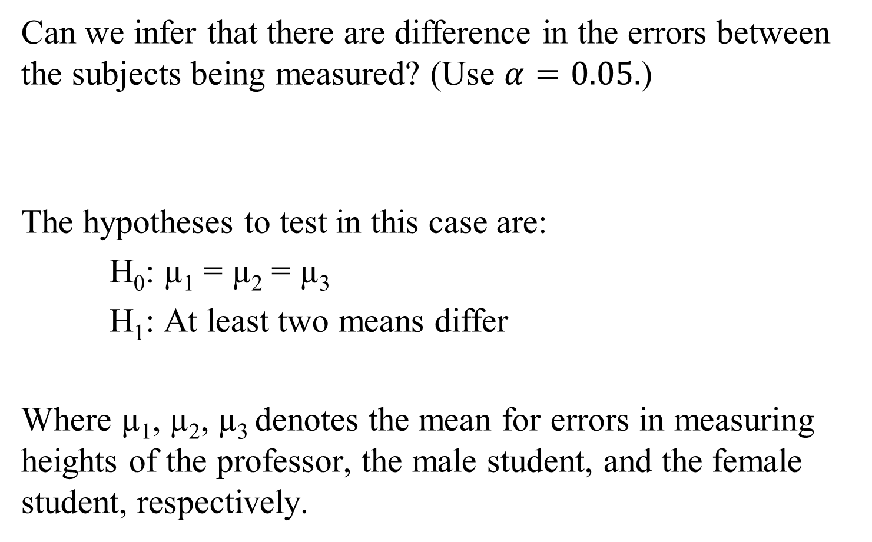
Example 14-B
Can we infer that there are difference in the errors between the subjects being measured? (Use $α=0.05.$)
The hypotheses to test in this case are:
H₀: µ₁ = µ₂ = µ₃
H₁: At least two means differ
Where µ₁, µ₂, µ₃ denotes the mean for errors in measuring heights of the professor, the male student, and the female student, respectively.

Slide 71
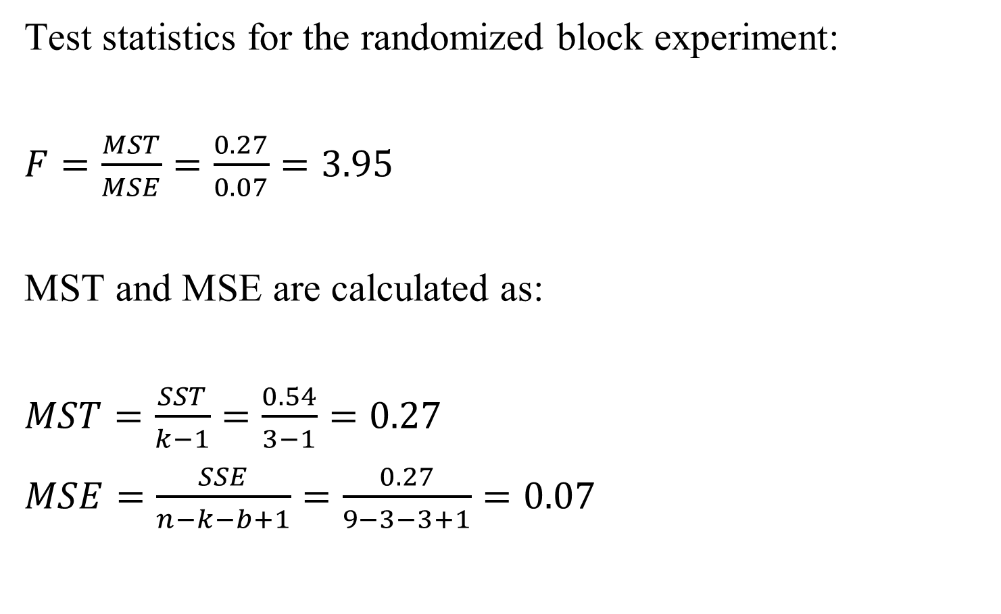
Example 14-B
Test statistics for the randomized block experiment:
$F=\frac{MST}{MSE}=\frac{0.27}{0.07}=3.95$
MST and MSE are calculated as:
$MST=\frac{SST}{k−1}=\frac{0.54}{3−1}=0.27$
$MSE=\frac{SSE}{n−k−b+1}=\frac{0.27}{9−3−3+1}=0.07$

Slide 72
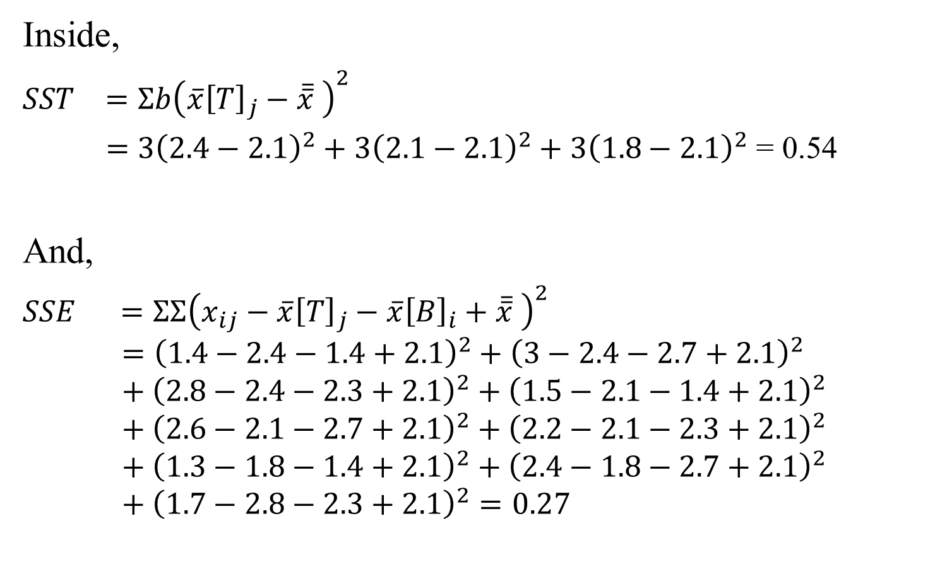
Example 14-B
Inside,
$SST =Σb{\left(\overline{x}{\left[T\right]}_{j}−\overline{\overline{x}} \right)}^{2}$
$=3{\left(2.4−2.1\right)}^{2}+$ $3{\left(2.1−2.1\right)}^{2}+3{\left(1.8−2.1\right)}^{2}$ = 0.54
And,
$SSE =ΣΣ{\left(x_{ij}−\overline{x}{\left[T\right]}_{j}−\overline{x}{\left[B\right]}_{i}+\overline{\overline{x}} \right)}^{2}$
$$={\left(1.4−2.4−1.4+2.1\right)}^{2}+{\left(3−2.4−2.7+2.1\right)}^{2}+{\left(2.8−2.4−2.3+2.1\right)}^{2}+{\left(1.5−2.1−1.4+2.1\right)}^{2}+{\left(2.6−2.1−2.7+2.1\right)}^{2}+{\left(2.2−2.1−2.3+2.1\right)}^{2}+{\left(1.3−1.8−1.4+2.1\right)}^{2}+{\left(2.4−1.8−2.7+2.1\right)}^{2}+{\left(1.7−2.8−2.3+2.1\right)}^{2}=0.27$$

Slide 73
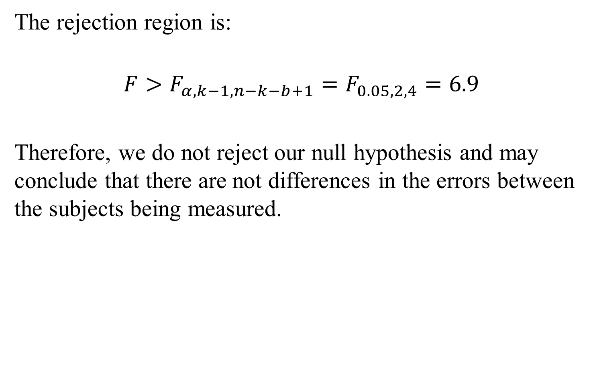
Example 14-B
The rejection region is:
$$F>F_{α,k−1,n−k−b+1}=F_{0.05,2,4}=6.9$$
Therefore, we do not reject our null hypothesis and may conclude that there are not differences in the errors between the subjects being measured.

Slide 74
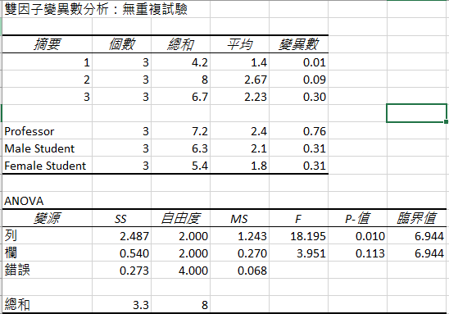
Example 14-B

Slide 75
Checking the Required Conditions
The F-test of the randomized block design of the analysis of variance has the same requirements as the independent samples design.
That is, the random variable must be normally distributed and the population variances must be equal.
The histograms (not shown) appear to support the validity of our results; the reductions appear to be normal.
The equality of variances requirement also appears to be met.

Slide 76
Developing an Understanding of Statistical Concepts
As we explained previously, the randomized block experiment is an extension of the matched pairs experiment discussed in Section 13.3.
In the matched pairs experiment, we simply remove the effect of the variation caused by differences between the experimental units.
The effect of this removal is seen in the decrease in the value of the standard error (compared to the standard error in the test statistic produced from independent samples) and the increase in the value of the t-statistic.

Slide 77
Developing an Understanding of Statistical Concepts
In the randomized block experiment of the analysis of variance, we actually measure the variation between the blocks by computing SSB.
The sum of squares for error is reduced by SSB, making it easier to detect differences between the treatments.
Additionally, we can test to determine whether the blocks differ--a procedure we were unable to perform in the matched pairs experiment.

Slide 78
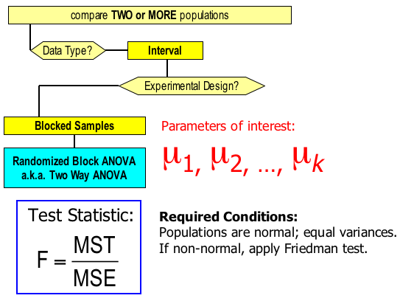
Identifying Factors
Factors that Identify the Randomized Block of the Analysis of Variance:

Slide 79
Two-Factor Analysis of Variance…
In Section 14.1, we addressed problems where the data were
generated from single-factor experiments.
In Example 14.1, the treatments were the four age categories.
Thus, there were four levels of a single factor. In this
section, we address the problem where the experiment
features two factors.
The general term for such data-gathering procedures is
factorial experiment.

Slide 80
Two-Factor Analysis of Variance…
In factorial experiments, we can examine the effect on the
response variable of two or more factors, although in this
book we address the problem of only two factors.
We can use the analysis of variance to determine whether the
Levels of each factor are different from one another.

Slide 81
Example 14.4
One measure of the health of a nation’s economy is how
quickly it creates jobs.
One aspect of this issue is the number of jobs individuals
hold.
As part of a study on job tenure, a survey was conducted
wherein Americans aged between 37 and 45 were asked how
many jobs they have held in their lifetimes. Also recorded
were gender and educational attainment.

Slide 82
Example 14.4
The categories are
Less than high school (E1)
High school (E2)
Some college/university but no degree (E3)
At least one university degree (E4)
The data were recorded for each of the eight categories of
Gender and education. Xm14-04
Can we infer that differences exist between genders and
educational levels?

Slide 83
Example 14.4

Slide 84
Example 14.4
IDENTIFY
We begin by treating this example as a one-way analysis of
Variance with eight treatments.
However, the treatments are defined by two different factors.
One factor is gender, which has two levels.
The second factor is educational attainment, which has four
levels.

Slide 85
Example 14.4
IDENTIFY
We can proceed to solve this problem in the same way we
did in Section 14.1: that is, we test the following hypotheses:
H₁: At least two means differ.

Slide 86
Example 14.4
COMPUTE

Slide 87
Example 14.4
INTERPRET
The value of the test statistic is F = 2.17 with a p-value of
.0467.
We conclude that there are differences in the number
of jobs between the eight treatments.

Slide 88
Example 14.4
This statistical result raises more questions.
Namely, can we conclude that the differences in the mean
number of jobs are caused by differences between males and
females?
Or are they caused by differences between educational
levels?
Or, perhaps, are there combinations, called interactions of
gender and education that result in especially high or low
numbers?

Slide 89
Terminology
A complete factorial experiment is an experiment in which the data for all possible combinations of the levels of the factors are gathered. This is also known as a two-way classification.
The two factors are usually labeled A & B, with the number of levels of each factor denoted by a & b respectively.
The number of observations for each combination is called a replicate, and is denoted by r. For our purposes, the number of replicates will be the same for each treatment, that is they are balanced.

Slide 90
Terminology Xm14-04a

Slide 91
Terminology
Thus, we use a complete factorial experiment where the
number of treatments is ab with r replicates per treatment.
In Example 14.4, a = 2, b = 4, and r = 10.
As a result, we have 10 observations for each of the eight
treatments.

Slide 92
Example 14.4
If you examine the ANOVA table, you can see that the total
variation is SS(Total) = 879.55, the sum of squares for
treatments is SST = 153.35, and the sum of squares for error
is SSE = 726.20.
The variation caused by the treatments is measured by SST.
In order to determine whether the differences are due to
factor A, factor B, or some interaction between the two
factors, we need to partition SST into three sources.
These are SS(A), SS(B), and SS(AB).

Slide 93
ANOVA Table…
Table 14.8
Source of Variation | d.f.: | Sum of Squares | Mean Square | F Statistic
Factor A | a-1 | SS(A) | MS(A)=SS(A)/(a-1) | F=MS(A)/MSE
Factor B | b–1 | SS(B) | MS(B)=SS(B)/(b-1) | F=MS(B)/MSE
Interaction | (a-1)(b-1) | SS(AB) | MS(AB) = SS(AB) [(a-1)(b-1)] | F=MS(AB)/MSE
Error | n–ab | SSE | MSE=SSE/(n–ab)
Total | n–1 | SS(Total)

Slide 94
Example 14.4
Test for the differences between the Levels of Factor A…
H₀: The means of the a levels of Factor A are equal
H₁: At least two means differ
Test statistic: F = MS(A) / MSE
Example 14.4: Are there differences in the mean number of jobs between men and women?
H₀: µ_{men} = µ_{women}
H₁: At least two means differ

Slide 95
Example 14.4
Test for the differences between the Levels of Factor B…
H₀: The means of the a levels of Factor B are equal
H₁: At least two means differ
Test statistic: F = MS(B) / MSE
Example 14.4: Are there differences in the mean number of
jobs between the four educational levels?
H₁: At least two means differ

Slide 96
Example 14.4
Test for interaction between Factors A and B…
H₀: Factors A and B do not interact to affect the mean responses.
H₁: Factors A and B do interact to affect the mean responses.
Test statistic: F = MS(AB) / MSE
Example 14.4: Are there differences in the mean number of jobs caused by interaction between gender and educational level?

Slide 97
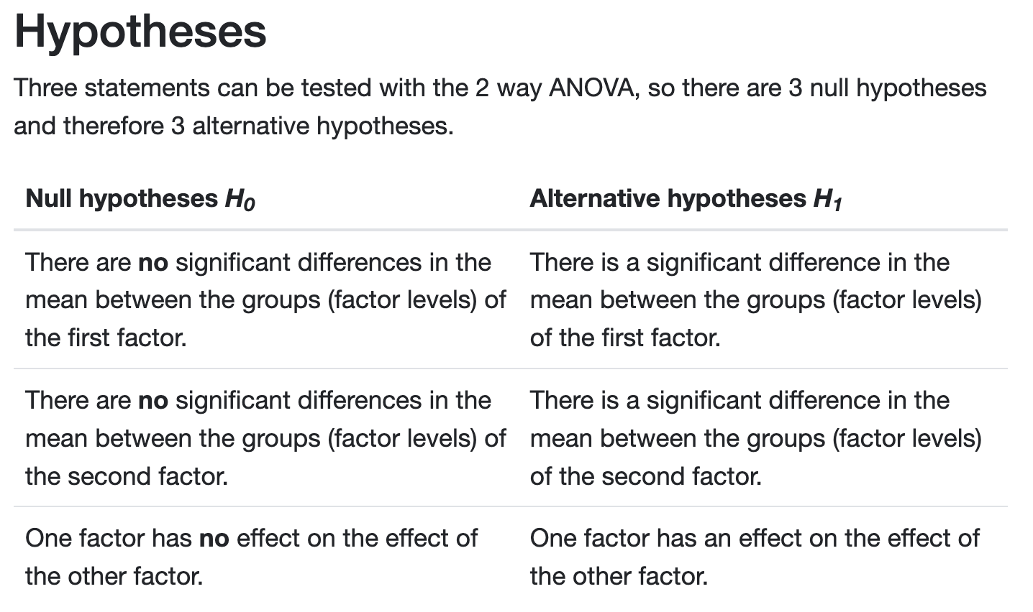
Example 14.4

Slide 98
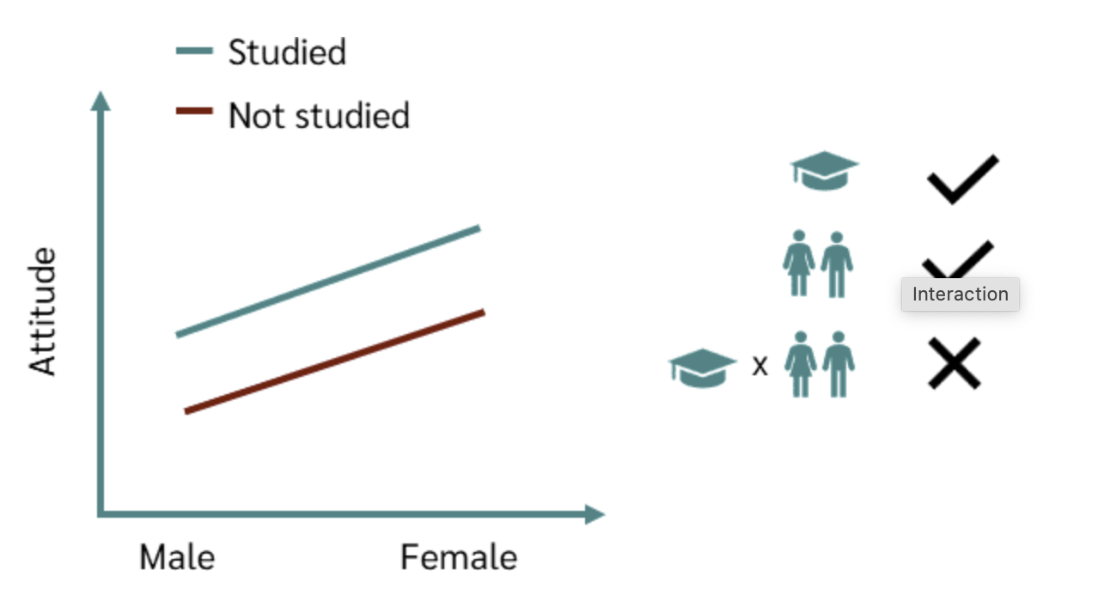
Example 14.4

Slide 99
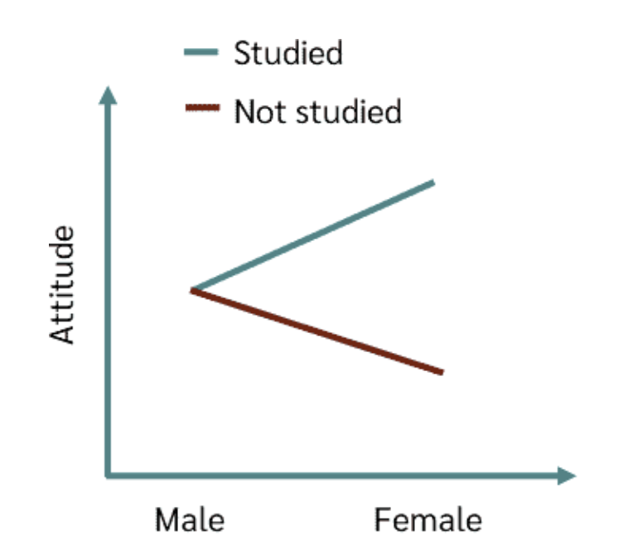
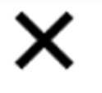

Example 14.4

Slide 100
Example 14.4
COMPUTE
ANOVA table part of the printout. Click here to see the
complete Excel printout.
In the ANOVA table Sample refers to factor B (educational level) and
Columns refers to factor A (gender). Thus, MS(B) = 45.28, MS(A) =
11.25, MS(AB) = 2.08 and MSE = 10.09. The F-statistics are 4.49
(educational level), 1.12 (gender), and .21 (interaction).

Slide 101
Example 14.4
INTERPRET
There are significant differences between the mean number
of jobs held by people with different educational
backgrounds.
There is no difference between the mean number of jobs
held by men and women.
Finally, there is no interaction.

Slide 102
Order of Testing in the Two-Factor Analysis of Variance
In the two versions of Example 14.4, we conducted the tests
of each factor and then the test for interaction.
However, if there is evidence of interaction, the tests of the
factors are irrelevant.
There may or not be differences between the levels of factor
A and of the levels of factor B.
Accordingly, we change the order of conducting the F-Tests.

Slide 103
Order of Testing in the Two-Factor Analysis of Variance
Test for interaction first.
If there is enough evidence to infer that there is interaction,
do not conduct the other tests.
If there is not enough evidence to conclude that there is
interaction proceed to conduct the F-tests for factors A and
B.

Slide 104
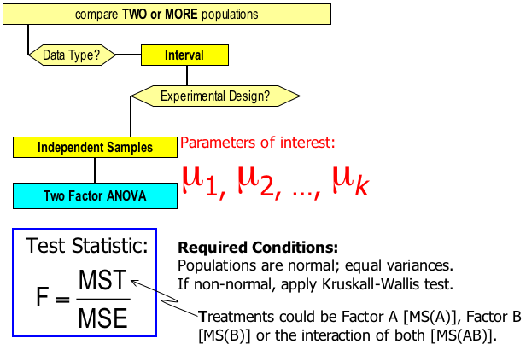
Identifying Factors…
Independent Samples Two-Factor Analysis of Variance…

Slide 105
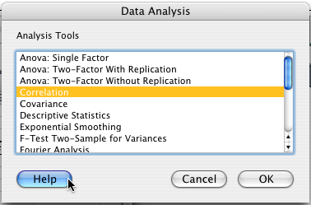
Summary of ANOVA…
two-factor analysis of variance
one-way analysis of variance
two-way analysis of variance
a.k.a. randomized blocks

