Slide 1
Chapter 15
Chi-Squared Tests
15.<number>
Notes:
Keller: Stats for Mgmt & Econ, 7th Ed
二〇二六年十一月八日
Copyright © 2006 Brooks/Cole, a division of Thomson Learning, Inc.

Slide 2

A Common Theme…
What to do? | Data Type? | Number of Categories? | Statistical Technique:
Describe a population | Nominal | Two or more | X2 goodness of fit test
Compare two populations (whether one population is independent from another population) | Nominal | Two or more | X2 test of a contingency table
Compare two or more populations | Nominal | -- | X2 test of a contingency table
Analyze relationship between two variables | Nominal | -- | X2 test of a contingency table
…Two techniques
One data type…
15.<number>

Slide 3
Two Techniques…
The first is a goodness-of-fit test applied to data produced by a multinomial experiment, a generalization of a binomial experiment and is used to describe one population of data.
The second uses data arranged in a contingency table to determine whether two classifications of a population of nominal data are statistically independent; this test can also be interpreted as a comparison of two or more populations.
In both cases, we use the chi-squared ( ) distribution.
15.<number>

Slide 4




Example 15.1
Two companies, A and B, have recently conducted aggressive advertising campaigns to maintain and possibly increase their respective shares of the market for cars. These two companies enjoy a dominant position in the market. Before the advertising campaigns began, the market share of company A was 45%, whereas company B had 40% of the market. Other competitors accounted for the remaining 15%.
15.<number>

Slide 5
Example 15.1
To determine whether these market shares changed after the advertising campaigns, a marketing analyst solicited the preferences of a random sample of 200 customers of cars. Of the 200 customers, 102 indicated a preference for company A's product, 82 preferred company B's car, and the remaining 16 preferred the products of one of the competitors. Can the analyst infer at the 5% significance level that customer preferences have changed from their levels before the advertising campaigns were launched?
16.<number>

Slide 6
Example 15.1
To determine whether these market shares changed after the advertising campaigns, a marketing analyst solicited the preferences of a random sample of 200 customers of cars.
If the market shares remain the same, each person in the sample will be
– A person who prefer A with a probability 45%
– A person who prefer B with a probability 40%
– A person who prefer other with a probability 15%
16.<number>

Slide 7
The Multinomial Experiment…
Unlike a binomial experiment which only has two possible outcomes (e.g. heads or tails), a multinomial experiment:
• Consists of a fixed number, n, of trials.
• Each trial can have one of k outcomes, called cells.
• Each probability p_{i} remains constant.
• Our usual notion of probabilities holds, namely:
p₁ + p₂ + … + p_{k} = 1, and
• Each trial is independent of the other trials.
15.<number>

Slide 8
Chi-squared Goodness-of-Fit Test…
We test whether there is sufficient evidence to reject a specified set of values for p_{i}.
To illustrate, our null hypothesis is:
H₀: p₁ = a₁, p₂ = a₂, …, p_{k} = a_{k}
where a₁, a₂, …, a_{k} are the values we want to test.
Our research hypothesis is:
H₁: At least one p_{i} is not equal to its specified value
15.<number>

Slide 9
Example 15.1
Two companies, A and B, have recently conducted aggressive advertising campaigns to maintain and possibly increase their respective shares of the market for cars. These two companies enjoy a dominant position in the market. Before the advertising campaigns began, the market share of company A was 45%, whereas company B had 40% of the market. Other competitors accounted for the remaining 15%.
15.<number>

Slide 10
Example 15.1
To determine whether these market shares changed after the advertising campaigns, a marketing analyst solicited the preferences of a random sample of 200 customers of cars. Of the 200 customers, 102 indicated a preference for company A's product, 82 preferred company B's car, and the remaining 16 preferred the products of one of the competitors. Can the analyst infer at the 5% significance level that customer preferences have changed from their levels before the advertising campaigns were launched?
16.<number>

Slide 11
Example 15.1…
We compare market share before and after an advertising campaign to see if there is a difference (i.e. if the advertising was effective in improving market share). We hypothesize values for the parameters equal to the before-market share. That is,
H₀: p₁ = .45, p₂ = .40, p₃ = .15
The alternative hypothesis is a denial of the null. That is,
H₁: At least one p_{i} is not equal to its specified value
15.<number>

Slide 12
Example 15.1…
Test Statistic
If the null hypothesis is true, we would expect the number of customers selecting brand A, brand B, and other to be 200 times the proportions specified under the null hypothesis. That is,
e₁ = 200(.45) = 90
e₂ = 200(.40) = 80
e₃ = 200(.15) = 30
In general, the expected frequency for each cell is given by
e_{i} = np_{i}
This expression is derived from the formula for the expected value of a binomial random variable, introduced in Section 7.4.
15.<number>

Slide 13
Example 15.1…
If the expected frequencies and the observed frequencies are quite different, we would conclude that the null hypothesis is false, and we would reject it.
However, if the expected and observed frequencies are similar, we would not reject the null hypothesis.
The test statistic measures the similarity of the expected and observed frequencies.
15.<number>

Slide 14


Chi-squared Goodness-of-Fit Test…
Our Chi-squared goodness of fit test statistic is given by:
Note: this statistic is approximately Chi-squared with k–1 degrees of freedom provided the sample size is large. The rejection region is:
observed frequency
expected frequency
15.<number>

Slide 15
Example 15.1…
COMPUTE
In order to calculate our test statistic, we lay-out the data in a tabular fashion for easier calculation by hand:
Company | Observed Frequency | Expected Frequency | Delta | Summation Component
 | f_{i} | e_{i} | (f_{i} – ei) | (f_{i} – e_{i})²/e_{i}
A | 102 | 90 | 12 | 1.60
B | 82 | 80 | 2 | 0.05
Others | 16 | 30 | -14 | 6.53
Total | 200 | 200 |  | 8.18
Check that these are equal
15.<number>

Slide 16

Example 15.1…
INTERPRET
Our rejection region is:
Since our test statistic is 8.18 which is greater than our critical value for Chi-squared, we reject H₀ in favor of H₁, that is,
“There is sufficient evidence to infer that the proportions have changed since the advertising campaigns were implemented”
15.<number>

Slide 17
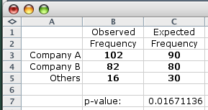
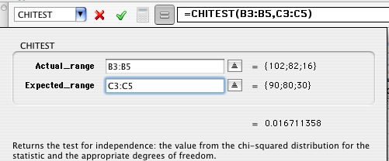

Example 15.1…
p-value
15.<number>

Slide 18
Required Conditions…
In order to use this technique, the sample size must be large enough so that the expected value for each cell is 5 or more. (i.e. n x p_{i} ≥ 5)
If the expected frequency is less than five, combine it with other cells to satisfy the condition.
Company | Observed Frequency | Expected Frequency | Delta | Summation Component
 | f_{i} | e_{i} | (f_{i} – ei) | (f_{i} – e_{i})²/e_{i}
A | 102 | 90 | 12 | 1.60
B | 82 | 80 | 2 | 0.05
Others | 16 | 3.5 | 12.5 | 6.53
Total | 200 | 200 |  | 8.18
15.<number>

Slide 19
Example
Acme Toy Company prints baseball cards. The company claims that 30% of the cards are rookies, 60% veterans but not All-Stars, and 10% are veteran All-Stars.
Suppose a random sample of 100 cards has 50 rookies, 45 veterans, and 5 All-Stars. Is this consistent with Acme's claim? Use a 0.05 level of significance.
16.<number>

Slide 20
Example
Χ²=19.58
P-value=0.000056
16.<number>

Slide 21
Example
256 visual artists were surveyed to find out their zodiac sign.
The results were: Aries (29), Taurus (24), Gemini (22),
Cancer (19), Leo (21), Virgo (18), Libra (19), Scorpio (20),
Sagittarius (23), Capricorn (18), Aquarius (20), Pisces (23).
Test the null hypothesis that zodiac signs are evenly distributed across visual artists.
16.<number>

Slide 22
Example
Χ²=5.094
P-value=0.9265
16.<number>

Slide 23
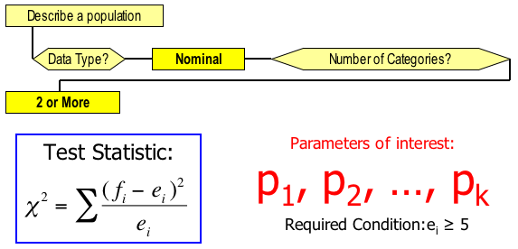
Identifying Factors…
Factors that Identify the Chi-Squared Goodness-of-Fit Test:
e_{i}=(n)(p_{i})
15.<number>

Slide 24
A Common Theme…
What to do? | Data Type? | Number of Categories? | Statistical Technique:
Describe a population | Nominal | Two or more | X2 goodness of fit test
Compare two populations | Nominal | Two or more | X2 test of a contingency table
Compare two or more populations | Nominal | -- | X2 test of a contingency table
Analyze relationship between two variables | Nominal | -- | X2 test of a contingency table
One data type…
…Two techniques
15.<number>

Slide 25
Example 15.2
The MBA program was experiencing problems scheduling their courses. The demand for the program's optional courses and majors was quite variable from one year to the next.
In desperation the dean of the business school turned to a statistics professor for assistance.
The statistics professor believed that the problem may be the variability in the academic background of the students and that the undergraduate degree affects the choice of major.
15.<number>

Slide 26
Example 15.2
As a start he took a random sample of last year's MBA students and recorded the undergraduate degree and the major selected in the graduate program.
The undergraduate degrees were BA, BEng, BBA, and several others.
There are three possible majors for the MBA students, accounting, finance, and marketing. Can the statistician conclude that the undergraduate degree affects the choice of major?
15.<number>

Slide 27
Two Techniques…
The first is a goodness-of-fit test applied to data produced by a multinomial experiment, a generalization of a binomial experiment and is used to describe one population of data.
The second uses data arranged in a contingency table to determine whether two classifications of a population of nominal data are statistically independent; this test can also be interpreted as a comparison of two or more populations.
In both cases, we use the chi-squared ( ) distribution.
15.<number>

Slide 28
Chi-squared Test of a Contingency Table
The Chi-squared test of a contingency table is used to:
• determine whether there is enough evidence to infer that two nominal variables are related, and
• to infer that differences exist among two or more populations of nominal variables.
In order to use use these techniques, we need to classify the data according to two different criteria.
15.<number>

Slide 29
Example 15.2
The MBA program was experiencing problems scheduling their courses. The demand for the program's optional courses and majors was quite variable from one year to the next.
In desperation the dean of the business school turned to a statistics professor for assistance.
The statistics professor believed that the problem may be the variability in the academic background of the students and that the undergraduate degree affects the choice of major.
15.<number>

Slide 30
Example 15.2
As a start he took a random sample of last year's MBA students and recorded the undergraduate degree and the major selected in the graduate program.
The undergraduate degrees were BA, BEng, BBA, and several others.
There are three possible majors for the MBA students, accounting, finance, and marketing. Can the statistician conclude that the undergraduate degree affects the choice of major?
15.<number>

Slide 31
Example 15.2
Xm15-02
The data are stored in two columns. The first column consist of integers 1, 2, 3, and 4 representing the undergraduate degree where
1 = BA
2 = BEng
3 = BBA
4 = other
The second column lists the MBA major where
1= Accounting
2 = Finance
3 = Marketing
15.<number>

Slide 32
Example 15.2
IDENTIFY
The problem objective is to determine whether two variables (undergraduate degree and MBA major) are related. Both variables are nominal. Thus, the technique to use is the chi-squared test of a contingency table. The alternative hypotheses specifies what we test. That is,
H₁: The two variables are dependent
The null hypothesis is a denial of the alternative hypothesis.
H₀: The two variables are independent.
15.<number>

Slide 33
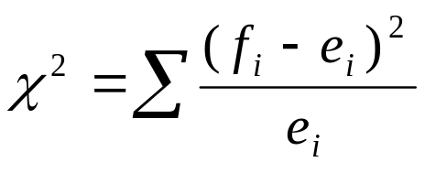
Test Statistic
The test statistic is the same as the one used to test proportions in the goodness-of-fit-test. That is, the test statistic is
Note however, that there is a major difference between the two applications. In this one the null does not specify the proportions p_{i}, from which we compute the expected values e_{i}, which we need to calculate the χ² test statistic. That is, we cannot use
e = np_{i}
because we don’t know the p_{i} (they are not specified by the null hypothesis). It is necessary to estimate the p_{i} from the data.
15.<number>

Slide 34
Example 15.2
The first step is to count the number of students in each of the 12 combinations. The result is called a cross-classification table.
15.<number>

Slide 35
Example 15.2
 | MBA Major
Undergrad Degree | Accounting | Finance | Marketing | Total
BA | 31 | 13 | 16 | 60
BEng | 8 | 16 | 7 | 31
BBA | 12 | 10 | 17 | 39
Other | 10 | 5 | 7 | 22
Total | 61 | 44 | 47 | 152
15.<number>

Slide 36
Example 15.2
If the null hypothesis is true (Remember we always start with this assumption.) and the two nominal variables are independent, then, for example
P(BA and Accounting) = [P(BA)] [P(Accounting)]
Since we don’t know the values of P(BA) or P(Accounting)
We need to use the data to estimate the probabilities.
15.<number>

Slide 37
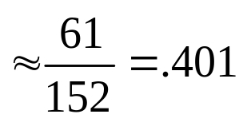
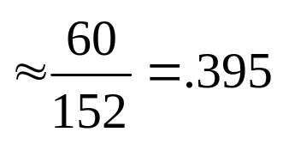
Test Statistic
There are 152 students of which 61 who have chosen accounting as their MBA major. Thus, we estimate the probability of accounting as
P(Accounting)
Similarly
P(BA)
15.<number>

Slide 38
Example 15.2…
If the null hypothesis is true
P(BA and Accounting) = (60/152)(61/152)
Now that we have the probability we can calculate the expected value. That is,
E(BA and Accounting) = 152(60/152)(61/152)
= (60)(61)/152 = 24.08
We can do the same for the other 11 cells.
15.<number>

Slide 39

Example 15.2
COMPUTE
We can now compare observed with expected frequencies…
and calculate our test statistic:
 | MBA Major
Undergrad Degree | Accounting |  | Finance |  | Marketing
BA | 31 | 24.08 | 13 | 17.37 | 16 | 18.55
BEng | 8 | 12.44 | 16 | 8.97 | 7 | 9.59
BBA | 12 | 15.65 | 10 | 11.29 | 17 | 12.06
Other | 10 | 8.83 | 5 | 6.37 | 7 | 6.80
d.f = (r-1)*(c-1)
15.<number>

Slide 40
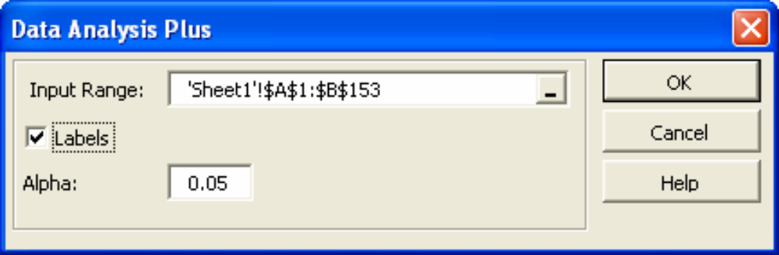
Example 15.2…
COMPUTE
Using Excel : Click Add-Ins, Data Analysis Plus, Contingency Table [if the table has already been prepared] or Contingency Table (Raw Data) [if the table has not been completed]
15.<number>

Slide 41
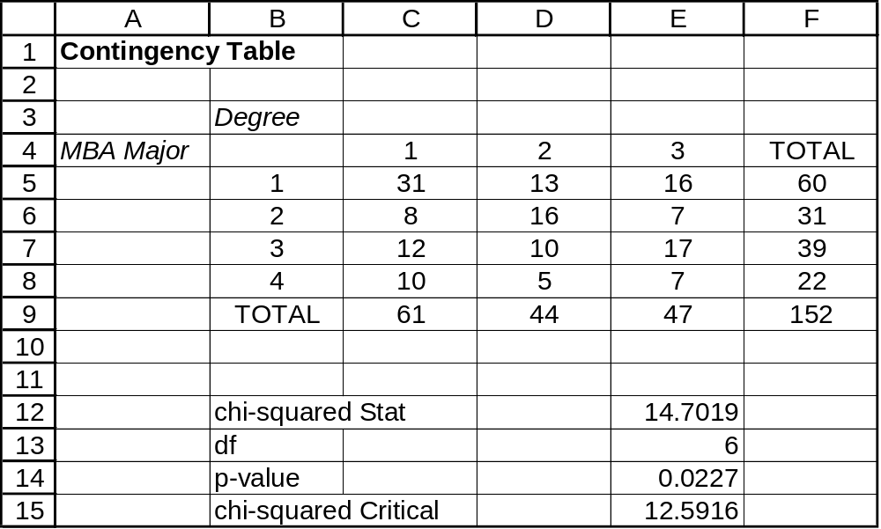
Example 15.2…
COMPUTE
The printout below was produced from file Xm15-02
using the Contingency Table (Raw Data) command
15.<number>

Slide 42
Example 15.2…
INTERPRET
The p-value is .0227. There is enough evidence to infer that
the MBA major and the undergraduate degree are related.
We can also interpret the results of this test in two other ways.
1.There is enough evidence to infer that there are differences
in MBA major between the four undergraduate categories.
2. There is enough evidence to infer that there are differences
in undergraduate degree between the majors.
15.<number>

Slide 43
Required Condition – Rule of Five…
In a contingency table where one or more cells have expected values of less than 5, we need to combine rows or columns to satisfy the rule of five.
Note: by doing this, the degrees of freedom must be changed as well.
15.<number>

Slide 44
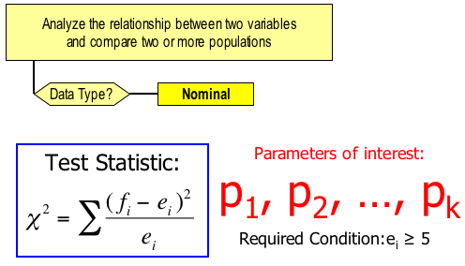

Identifying Factors…
Factors that identify the Chi-squared test of a contingency table:
15.<number>

Slide 45
Table 15.1 Statistical Techniques for Nominal Data
Problem Objective Categories Statistical Technique
Describe a population 2 z-test of p or the chi-squared
goodness-of-fit test
Describe a population More than 2 Chi-squared goodness-of-fit test
Compare two populations 2 z-test p₁–p₂ or chi-squared test
of a contingency table
Compare two populations More than 2 Chi-squared test of a contingency table
Compare more than
two populations 2 or more Chi-squared test of a contingency table
Analyze the relationship
between two variables 2 or more Chi-squared test of a contingency table
15.<number>

Slide 46
Chi-Squared test for Normality
The goodness of fit Chi-squared test can be used to determine if data were drawn from any distribution.
15.<number>

Slide 47
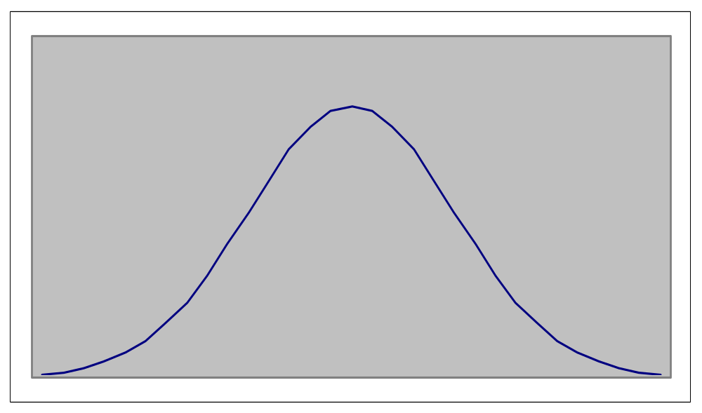
Chi-Squared test for Normality
16.<number>

Slide 48
Chi-Squared test for Normality
The goodness of fit Chi-squared test can be used to determined if data were drawn from any distribution.
The general procedure:
  Hypothesize on the parameter values of the distribution we test (i.e. μ = μ₀, σ = σ₀ for the normal distribution).
  For the variable tested X specify disjoint ranges that cover all its possible values.
  Build a Chi squared statistic that (aggregately) compares the expected frequency under H₀ and the actual frequency of observations that fall in each range.
  Run a goodness of fit test based on the multinomial experiment.
15.<number>

Slide 49
Chi-Squared test for Normality
Testing for normality in Example 12.1
For a sample size of n=50 (see Xm12-01) ,the sample mean was 460.38 with standard error of 38.83.
Can we infer from the data provided that this sample was drawn from a normal distribution with μ = 460.38 and σ = 38.83? Use 5% significance level.
15.<number>

Slide 50
χ² test for normality
Solution
First let us select z values that define each cell (expected frequency > 5 for each cell.)
z₁ = -1; P(z < -1) = p₁ = .1587; e₁ = np₁ = 50(.1587) = 7.94
z₂ = 0; P(-1 < z< 0) = p₂ = .3413; e₂ = np₂ = 50(.3413) = 17.07
z₃ = 1; P(0 < z < 1) = p₃ = .3413; e₃ = 17.07
P(z > 1) = p₄ = .1587; e₄ = 7.94
The cell boundaries are calculated from the corresponding z values under H₀.
The expected frequencies
can now be
determined for
each cell.
e₂ = 17.07
e₃ = 17.07
z₁ =(x₁ - 460.38)/38.83 = -1;
x₁ = 421.55
.3413
.3413
e₁ = 7.94
e₄ = 7.94
.1587
.1587
421.55
460.38
499.21
16.<number>

Slide 51
χ² test for normality
The test statistic
χ²=
(10 - 7.94)²
7.94
+
(13 - 17.07)²
17.07
+
(19 - 17.07)²
17.07
+
(8 - 7.94)²
7.94
= 1.72
f₃ = 19
e₂ = 17.07
e₃ = 17.07
f₂ = 13
f₁ = 10
f₄ = 8
e₁ = 7.94
e₄ = 7.94
16.<number>

Slide 52
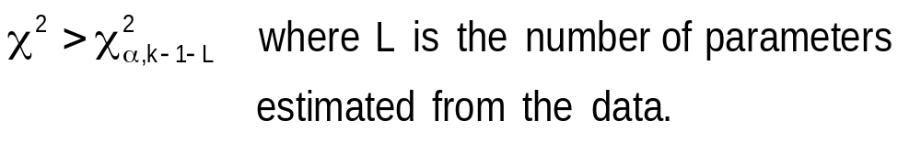
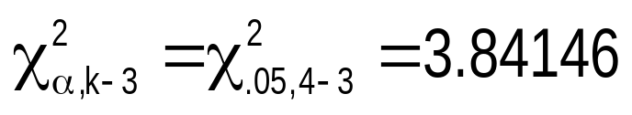
χ² test for normality
The test statistic
χ²=
(10 - 7.94)²
7.94
+
(13 - 17.07)²
17.07
+
(19 - 17.07)²
17.07
+
(8 - 7.94)²
7.94
= 1.72
The rejection region
Conclusion: There is insufficient evidence to conclude at 5% significance level that the data are not normally distributed.
16.<number>

Slide 53
Chi-Squared test for Normality
Sample size > 220
  Z < -2 0.0228
  -2 < Z ≦ -1 0.1359
  -1 < Z ≦ 0 0.3413
  0 < Z ≦ 1 0.1359
  1 < Z ≦ 2 0.0228
Sample size between 80 and 220
  Z ≦ -1.5 0.0668
  -1.5 < Z ≦ -0.5 0.2417
  -0.5 < Z ≦ 0.5 0.3829
  0.5 < Z ≦ 1.5 0.2417
  Z > 1.5 0.0668
16.<number>

Slide 54
Chi-Squared test for Normality
Sample size < 80
  Z ≦ -1 0.1587
  -1 < Z ≦ 0 0.3413
  0 < Z ≦ 1 0.3413
  Z > 1 0.1587
16.<number>

Slide 55
Example
The Anger and Heart Disease study
– A study followed a random sample of 8474 people with normal
blood pressure for about four years. All the individuals were free of
heart disease at the beginning of the study.
– Each person took the Spielberger Trait Anger Scale Test, which
measures how prone a person is to sudden anger.
– Researchers also recorded whether each individual developed
coronary heart disease (CHD). This includes people who had heart
attacks and those who needed medical treatment for heart disease.
16.<number>

Slide 56
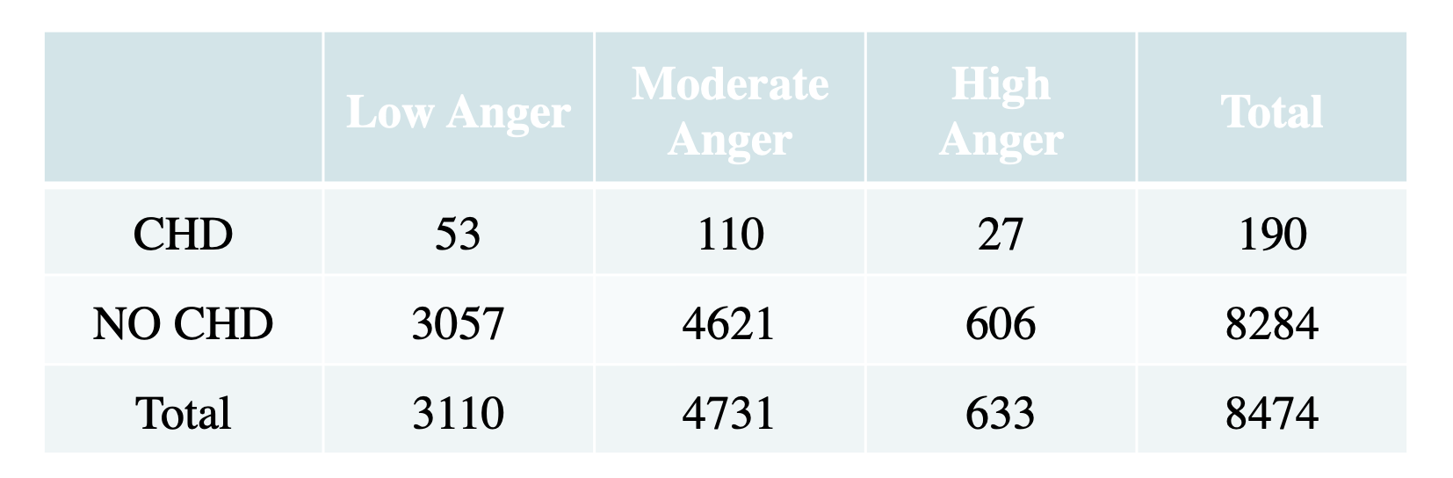
Example
The data
– CHD: coronary heart diseaseLow Anger Moderate
Anger
High
Anger Total
– What is the relationship between anger and CHD status?
16.<number>

Slide 57
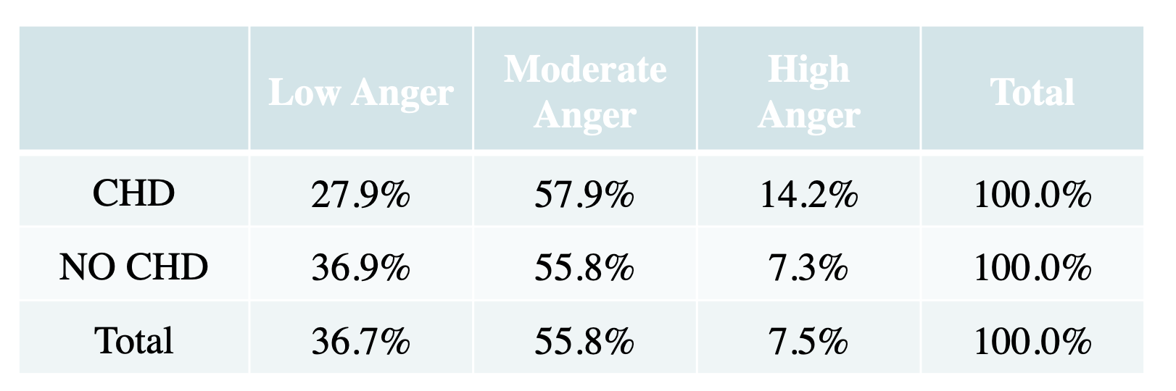
Example
The data
– First, we can eyeball the frequency distribution of the data:
Anger Moderate
Anger
High
– Does the relationship between anger and CHD status exist?
16.<number>

Slide 58
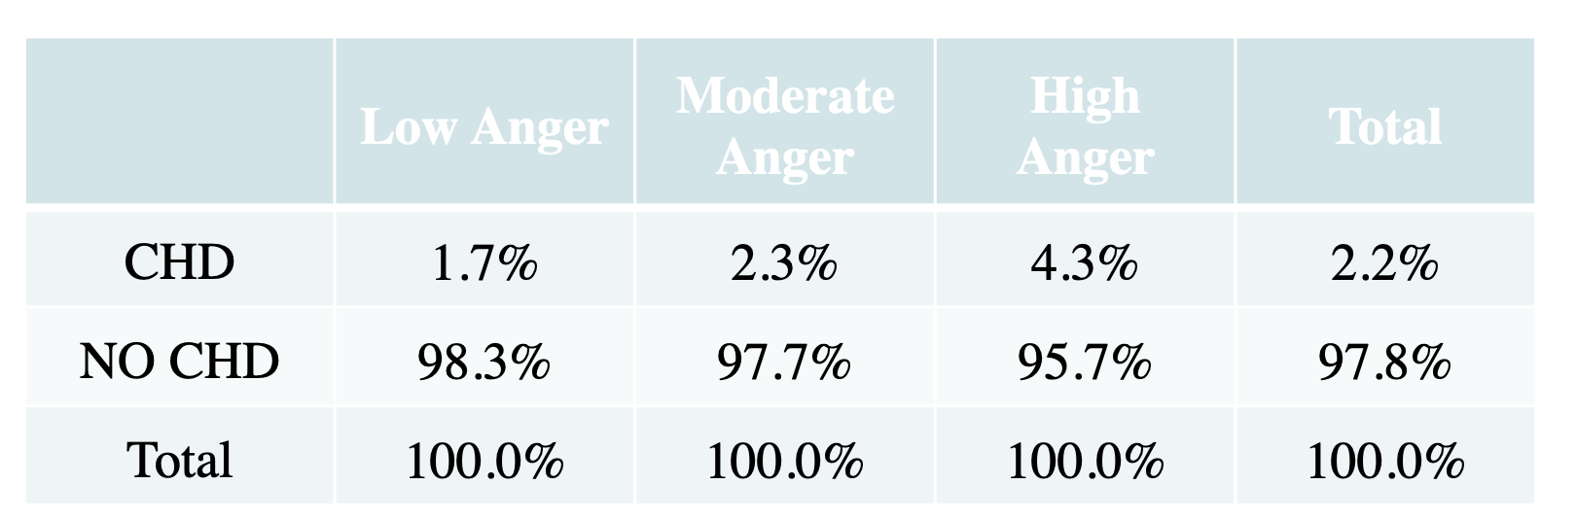
Example
The data
– Or, we can eyeball the frequency distribution of the data in another way:
Anger Moderate
Anger
High
– Does the relationship between anger and CHD status exist?
16.<number>

Slide 59
Example
Hypothesis
– H0: there is no association between anger level and heart disease in the population of people with normal blood pressure
– H1: there is an association between anger level and heart disease in the population of people with normal blood pressure
or
– H0: anger and heart disease are independent in the population of people with normal blood pressure
– H1: anger and heart disease are not independent in the population of people with normal blood pressure.
16.<number>

Slide 60
Example
• Analysis
– Chi-square statistic: χ2 = 16.077
– P-value is less than 0.0005
Conclusion
– Because the P-value is clearly less than α = 0.05, we reject H0 and
conclude that anger level and heart disease are associated in the
population of people with normal blood pressure.
16.<number>

Slide 61
Logistic Regression
Why logistic regression?
There are many important research topics for which the dependent variable is "limited" (i.e., nominal).
For example: voting, morbidity or mortality, and participation data is not continuous or distributed normally.
Binary logistic regression is a type of regression analysis where the dependent variable is a dummy variable: coded 0 (did not vote) or 1(did vote)
  A special case of multinomial experiment
16.<number>

Slide 62
Logistic Regression
If using a linear regression…
Y = γ + ϕX + e ; where Y = (0, 1)
e is not normally distributed because Y takes on only two values
The predicted probabilities can be greater than 1 or less than 0
16.<number>

Slide 63
Example
Hurricane evacuations
Did you evacuate your home to go someplace safer before Hurricane Dennis (Floyd) hit?
1 YES
2 NO
3 DON'T KNOW
4 REFUSED
16.<number>

Slide 64
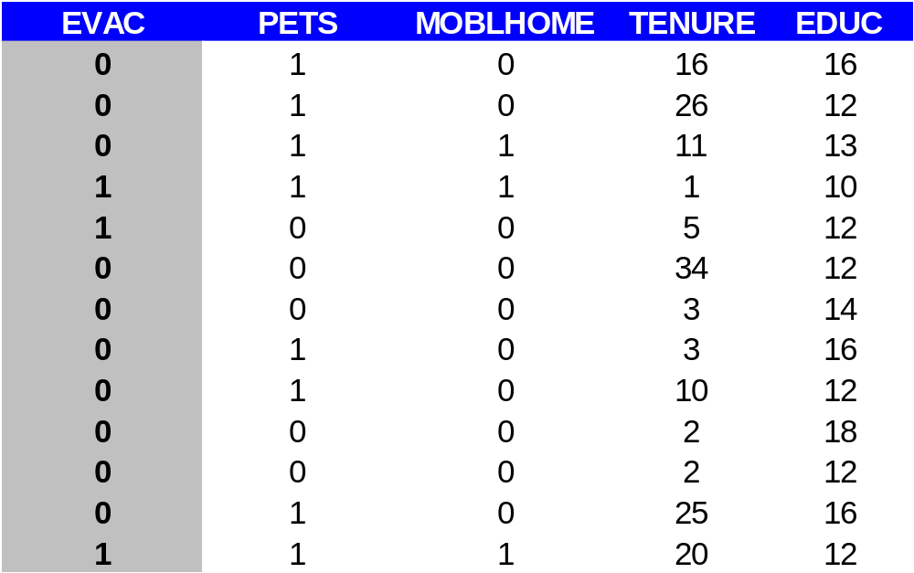
Example: Data
16.<number>

Slide 65
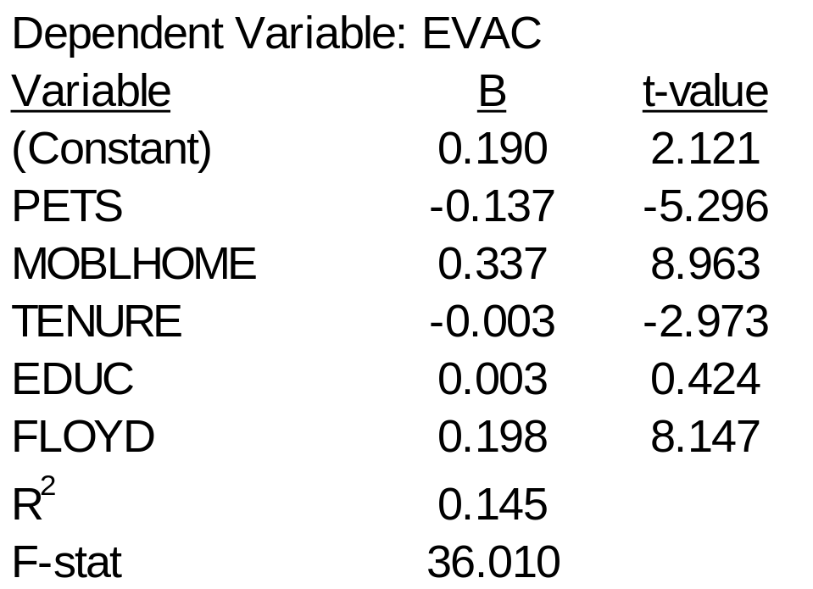
Regression results

Slide 66
Regression results
Predicted value outside of the supposed [0,1]
Descriptive Statistics
Std.
N
Minimum
Maximum
Mean
Deviation
Unstandardized
1070
-.08498
.76027
.2429907
.1632534
Predicted Value
Valid N (listwise)
1070
16.<number>

Slide 67
Logistic Regression Model
The "logit" model solves these problems:
ln[p/(1-p)] = α + βX + e
p is the probability that the event Y occurs, p(Y=1)
p/(1-p) is the "odds ratio"
ln[p/(1-p)] is the log odds ratio, or "logit"
16.<number>

Slide 68
Logistic Regression Model
The logistic distribution constrains the estimated probabilities to lie between 0 and 1.
The estimated probability is:
p = 1/[1 + exp(-α - β X)]
if you let α + β X =0, then p = .50
as α + β X gets really big, p approaches 1
as α + β X gets really small, p approaches 0
16.<number>

Slide 69
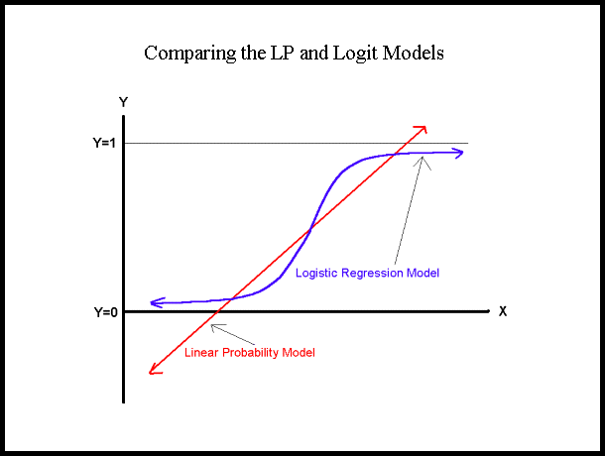

Slide 70
Maximum Likelihood Estimation (MLE)
MLE is a statistical method for estimating the coefficients of a model.
The likelihood function (L) measures the probability of observing the particular set of dependent variable values (p₁, p₂, ..., p_{n}) that occur in the sample:
L = Prob (p₁* p₂* * * p_{n})
The higher the L, the higher the probability of observing the ps in the sample.
16.<number>

Slide 71
Maximum Likelihood Estimation (MLE)
MLE involves finding the coefficients (α, β) that makes the log of the likelihood function (LL < 0) as large as possible
Or, finds the coefficients that make -2 times the log of the likelihood function (-2LL) as small as possible
The maximum likelihood estimates solve the following condition:
{Y - p(Y=1)}X_{i} = 0
summed over all observations, i = 1,…,n
16.<number>

Slide 72
Interpreting Coefficients
ln[p/(1-p)] = α + βX + e
The slope coefficient (β) is interpreted as the rate of change in the "log odds" as X changes … not very useful.
An interpretation of the logit coefficient which is usually more intuitive is the "odds ratio"

Slide 73
Odds ratio
Since:
[p/(1-p)] = exp(α + βX)
exp(β) is the effect of the independent variable on the "odds ratio"
16.<number>

Slide 74
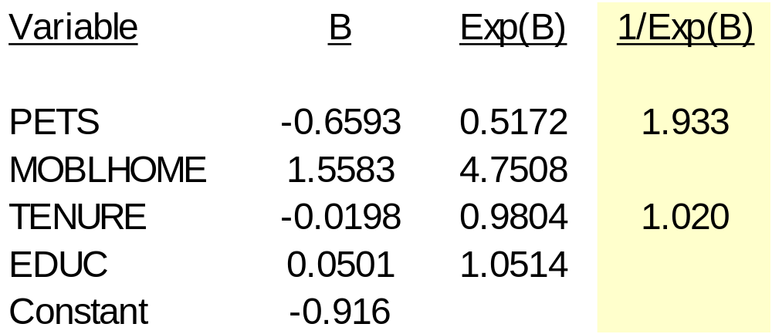
Odds ratio (from R output)
  “Households with pets are 1.933 times more likely to evacuate than those without pets.”
16.<number>

Slide 75
test statistics
The Wald statistic for the β coefficient is:
Wald = [β /se_{β}]²
which is distributed chi-square with 1 degree of freedom.
16.<number>

Slide 76
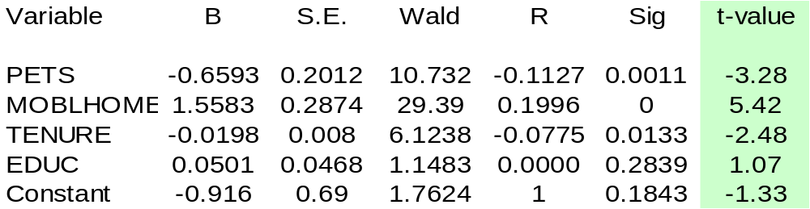
Model output
16.<number>

