Slide 1
Chapter 16
Simple Linear Regression
and Correlation

Slide 2
What we have learned so far
Business Statistics
Probability
Tools for expressing uncertainty
Statistical Inference
Inferring population characteristics from a sample
Statistical Modeling
Tools for identifying statistical relationships
Big Data
Uncertainty
Small data
Notes:
So far we finished two modules
Module I covers the probability modeling
Module II covers the Confidence Interval and Hypothesis Test.
In module 3, we will build a statistical model and use the tools we learn to
Identify relationship among variables and
Draw useful managerial insights.

Slide 3
Regression Analysis - why
In large populations in complicated real life, individuals are not homogenous
Many heterogeneities among the population exist, which can be described by interval variables
GPA, height, weight, income, age, MBTI, etc.
Can we extract more information by considering these heterogeneities?

Slide 4
Regression Analysis
Information on the relationship among variables is useful.
Regression: estimates the value of one variable with other variables.
Useful in understanding and insight gathering.
What are the drivers behind a business problem?
How does the key variable change given changes of other variables?
Will an increase in the prime rate increase GDP?
What variables are useful to explain the sales of a product?
Useful in predicting a future outcome
Estimating the unknown on bases of measurable variables
What is an estimate of the 2nd quarter revenue of Amazon.com?
What is the estimated price of a 10-yr old, 2 bedroom
apartment in Chung-Cheng district of Taipei?
Notes:
Q: Why are we interested in identifying relationship in business decision making?
A: We want to estimate (or predict) the quantity of interest using variables we can measure.
Quarterly earning: a function of variables like sales, inventory turns, number of retail outlets,
Models allow us to identify and quantify the relationship.
so that we can answer to questions like by how much the revenue increases if we increase R&D budget by 10M?
As in the quarterly earning model, the models allows us to predict the value of quantity on the basis of what we can measure today.
Statistical Modeling -> Synonym for Regression
Reg. anal. is a formal way to build relationship among variables to use in prediction and understanding.

Slide 5
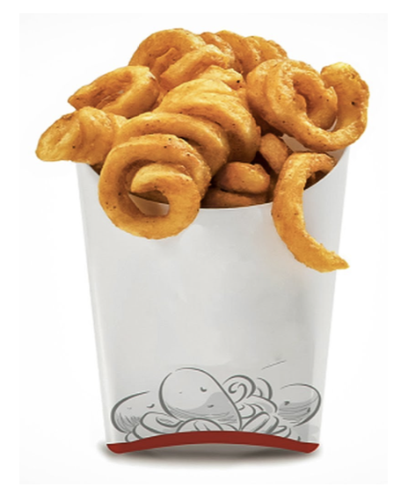
Regression Analysis
Regression analysis is concerned with the nature and degree of association between variables but does not imply or assume any causality.
E.g., Liking curly fries on Facebook reveals your high IQ?

Slide 6
Regression Analysis…
Our problem objective is to analyze the relationship between interval variables; regression analysis is the first tool we will study.
Regression analysis is used to predict the value of one variable (the dependent variable) on the basis of other variables (the independent variables).
Dependent variable: denoted Y
Independent variables: denoted X₁, X₂, …, X_{k}

Slide 7
Correlation Analysis…
If we are interested only in determining whether a relationship exists, we employ correlation analysis, a technique introduced earlier here.

Slide 8
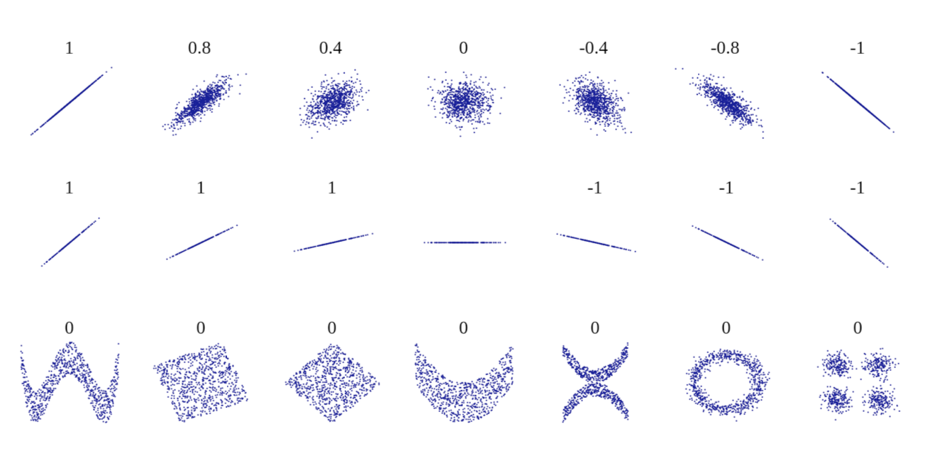
Correlation
The scatterplots can show how different patterns of data produce different degrees of correlation.

Slide 9
Regression Analysis
We use it to:
– Determine whether the independent variables explain a significant variation in the dependent variable: whether a relationship exists.
– Determine how much of the variation in the dependent variable can be explained by the independent variables: strength of the relationship.
– Determine the structure or form of the relationship: the mathematical equation relating the independent and dependent variables.
– Predict the values of the dependent variable.

Slide 10
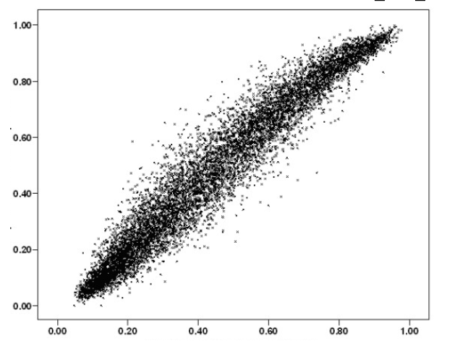
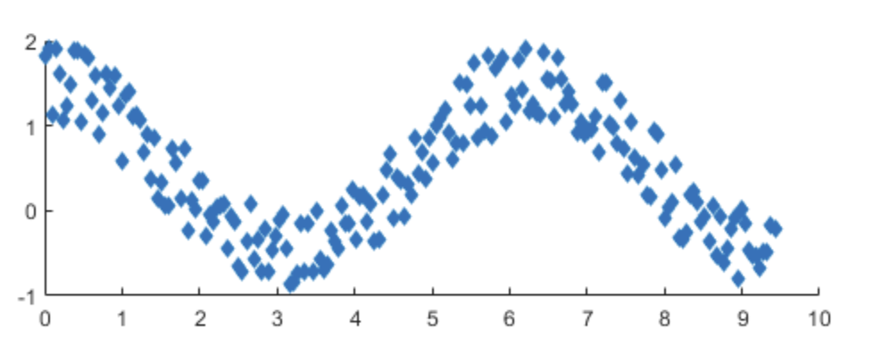
If we have the data of the whole population…
We can directly examine the distribution of the dependent variable associated with a specific range of values of the independent variable.

Slide 11
But we often cannot have the full population data…
Cost
If we’re interested in the dependent variable values in the future

Slide 12
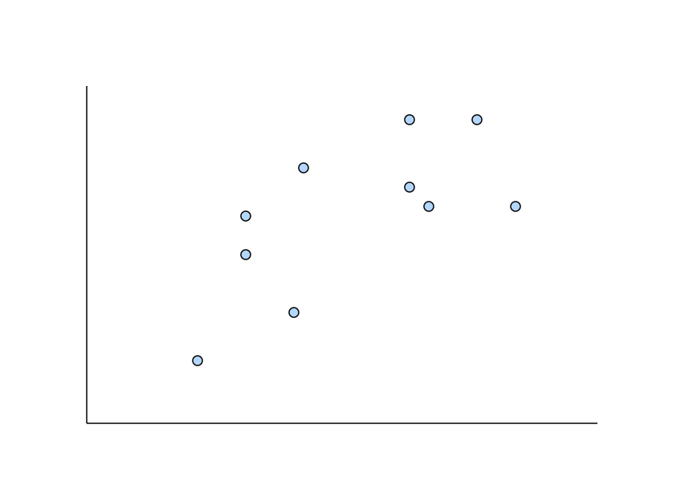
Simple linear regression
If we only have a finite sample size…

Slide 13
Regression analysis steps
1. Propose a model
2. Examine the performance of the model
3. If the model fits the data, interpret the model and its parameters.

Slide 14
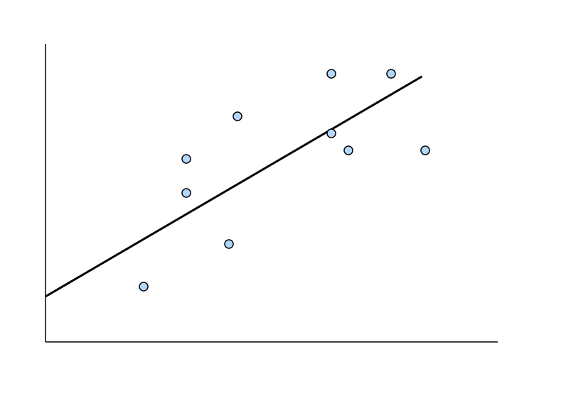
Simple linear regression
If we only have a finite sample size…

Slide 15
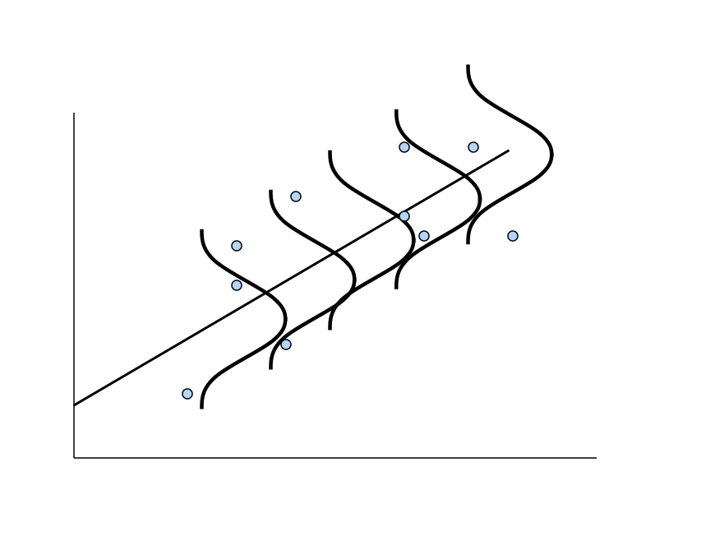
Simple linear regression
If we only have a finite sample size…
* The line here is a proposed model, for which the data are assumed normally distributed on both sides of the model

Slide 16
Model Types…
Deterministic Model: an equation or set of equations that allow us to fully determine the value of the dependent variable from the values of the independent variables.
Contrast this with…
Probabilistic Model: a method used to capture the randomness that is part of a real-life process.
E.g. do all houses of the same size (measured in square feet) sell for exactly the same price?

Slide 17
A Model…
To create a probabilistic model, we start with a deterministic model that approximates the relationship we want to model and add a random term that measures the error of the deterministic component.
Deterministic Model:
The cost of building a new house is about $100 per square foot and most lots sell for about $100,000. Hence the approximate selling price (y) would be:
y = $100,000 + (100$/ft²)(x)
(where x is the size of the house in square feet)

Slide 18
A Model…
A model of the relationship between house size (independent variable) and house price (dependent variable) would be:
House
Price
Building a house costs about
$100 per square foot.
House Price = 100,000 + 100(Size)
Most lots sell
for $100,000
House size
In this model, the price of the house is completely determined by the size.

Slide 19
A Model…
In real life however, the house cost will vary even among the same size of house:
Lower vs. Higher
Variability
House
Price
100K$
House Price = 100,000 + 100(Size) +
x
“epsilon”
House size
Same square footage, but different price points
(e.g. décor options, cabinet upgrades, lot location…)

Slide 20
Random Term…
We now represent the price of a house as a function of its size in this Probabilistic Model:
y = 100,000 + 100x +
Where (Greek letter epsilon) is the random term (a.k.a. error variable). It is the difference between the actual selling price and the estimated price based on the size of the house. Its value will vary from house sale to house sale, even if the square footage (i.e. x) remains the same.

Slide 21
Random Term…
The random term might originate from randomness.
However, it is also possible that the random term originates from other independent variables we ignored. (e.g. décor options, cabinet upgrades, lot location, time… in the previous example.) In this case, we can use multiple regression.

Slide 22
Correlation Analysis
This chapter we will study a tool/case which assumes a linear relationship between two variables, sometimes called simple linear regression.
Implicit assumption:
The distribution of y at any specific x is normal.
The mean of the distribution of y is linear in x.
The standard deviation of the distribution of y is a constant regardless of the value of x.

Slide 23
Simple linear regression

Slide 24
Simple linear regression

Slide 25

Simple Linear Regression Model…
A straight line model with one independent variable is called a first order linear model or a simple linear regression model. Its is written as:
dependent
variable
independent
variable
y-intercept
slope of the line
error variable

Slide 26


Simple Linear Regression Model…
Note that both and are population parameters which are usually unknown and hence estimated from the data.
y
rise
run
=slope (=rise/run)
=y-intercept
x

Slide 27

Estimating the Coefficients…
In much the same way we base estimates of µ on x , we estimate β₀ using b₀ and β₁ using b₁ (both are unbiased estimators), the y-intercept and slope (respectively) of the least squares or regression line given by:
(Recall: this is an application of the least squares method and it produces a straight line that minimizes the sum of the squared differences between the points and the line)

Slide 28
The Least Squares (Regression) Line
A good line is one that minimizes the sum of squared differences between the
points and the line.

Slide 29
The Least Squares (Regression) Line
Sum of squared differences =
(2 - 1)² +
(4 - 2)² +
(1.5 - 3)² +
(3.2 - 4)² = 6.89
Sum of squared differences =
(2 -2.5)² +
(4 - 2.5)² +
(1.5 - 2.5)² +
(3.2 - 2.5)² = 3.99
Let us compare two lines
4
(2,4)
w
The second line is horizontal
3
w
(4,3.2)
2.5
2
w
(1,2)
(3,1.5)
w
The smaller the sum of
squared differences
the better the fit of the
line to the data.
1
1
2
3
4

Slide 30
The Estimated Coefficients
To calculate the estimates of the line coefficients, that minimize the differences between the data points and the line, use the formulas:
The regression equation that estimates
the equation of the first order linear
model is:

Slide 31
Example 16.1
The annual bonuses ($1,000s) of six employees with different years of
experience were recorded as follows. We wish to determine the straight
line relationship between annual bonus and years of experience.
Years of experience x 1 2 3 4 5 6
Annual bonus y 6 1 9 5 17 12
Xm16-01

Slide 32
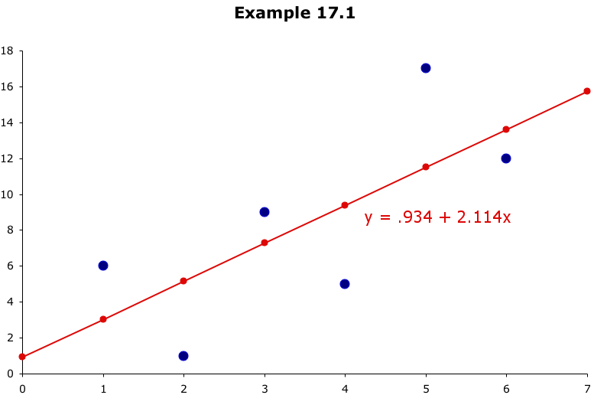
Least Squares Line…
Example 16.1
these differences are called residuals
This line minimizes the sum of the squared differences
between the points and the line…

Slide 33


Example 16.2…
Car dealers across North America use the "Red Book" to help them determine the value of used cars that their customers trade in when purchasing new cars.
The book, which is published monthly, lists the trade-in values for all basic models of cars.
It provides alternative values for each car model according to its condition and optional features.
The values are determined on the basis of the average paid at recent used-car auctions, the source of supply for many used-car dealers.
www.kbb.com

Slide 34
Example 16.2…
However, the Red Book does not indicate the value determined by the odometer reading, despite the fact that a critical factor for used-car buyers is how far the car has been driven.
To examine this issue, a used-car dealer randomly selected 100 three-year old Toyota Camrys that were sold at auction during the past month.
The dealer recorded the price ($1,000) and the number of miles (thousands) on the odometer. (Xm16-02).
The dealer wants to find the regression line.

Slide 35
Example 16.2…
Click Data, Data Analysis, Regression

Slide 36

Example 16.2…

Slide 37

Example 16.2…
INTERPRET
As you might expect with used cars…
The slope coefficient, b₁, is –0.0669, that is, each additional mile on the odometer decreases the price by $.0669 or 6.69¢
The intercept, b₀, is 17,250. One interpretation would be that when x = 0 (no miles on the car) the selling price is $17,250. However, we have no data for cars with less than 19,100 miles on them so this isn’t a correct assessment.

Slide 38
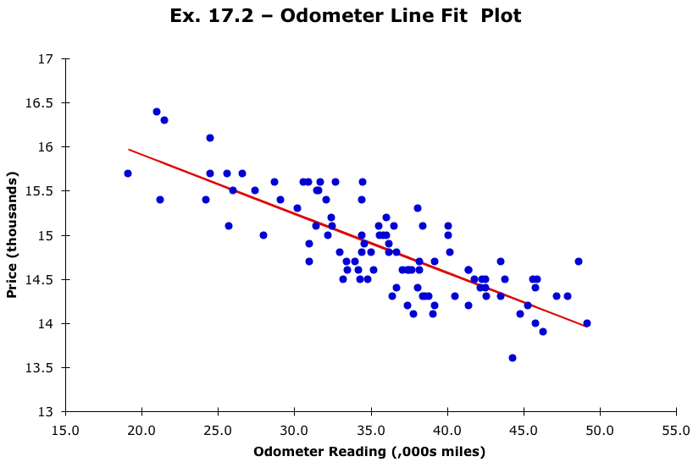
Example 16.2…
INTERPRET
Selecting “line fit plots” on the Regression dialog box, will produce a scatter plot of the data and the regression line…

Slide 39

Required Conditions…
For these regression methods to be valid the following four conditions for the error variable ( ) must be met:
• The probability distribution of is normal.
• The mean of the distribution is 0; that is, E( ) = 0.
• The standard deviation of is , which is a constant regardless of the value of x.
• The value of associated with any particular value of y is independent of associated with any other value of y.

Slide 40
The Normality of ε
The standard deviation remains constant,
E(y|x₃)
β₀ + β₁x₃
μ₃
E(y|x₂)
β₀ + β₁x₂
μ₂
but the mean value changes with x
E(y|x₁)
β₀ + β₁x₁
μ₁
From the first three assumptions we have:
y is normally distributed with mean
E(y) = β₀ + β₁x, and a constant standard deviation σ_{ε}
x₁
x₂
x₃

Slide 41
Assessing the Model…
The least squares method will always produce a straight line, even if there is no relationship between the variables, or if the relationship is something other than linear.
Hence, in addition to determining the coefficients of the least squares line, we need to assess it to see how well it “fits” the data. We’ll see these evaluation methods now. They’re based on the sum of squares for errors (SSE).

Slide 42

Sum of Squares for Error (SSE)…
The sum of squares for error is calculated as:
and is used in the calculation of the standard error of estimate:
If is zero, all the points fall on the regression line.

Slide 43
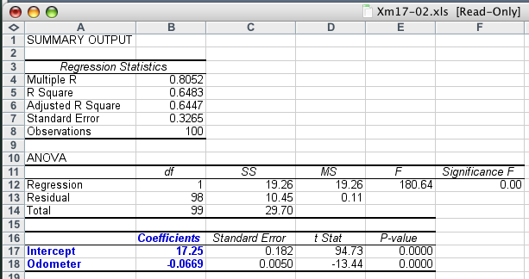
Standard Error of Estimate…
If s_{ε} is small, the fit is excellent and the linear model should be used for forecasting. If s_{ε} is large, the model is poor…
But what is small and what is large?

Slide 44
Standard Error of Estimate…
Judge the value of by comparing it to the sample mean of the dependent variable ( ).
In this example,
s_{ε} = .3265 and
= 14.841
so (relatively speaking) it appears to be “small”, hence our linear regression model of car price as a function of odometer reading is “good”.

Slide 45
Testing the slope
When no linear relationship exists between two variables, the regression line should be horizontal.
q
q
q
q
q
q
q
q
q
q
q
q
q
q
q
q
q
q
q
q
q
q
q
q
q
q
q
q
q
q
q
q
q
q
q
q
q
q
q
q
q
q
q
q
q
q
q
q
q
q
q
q
q
q
q
q
q
q
q
q
q
q
q
q
q
q
q
q
q
q
q
q
q
q
q
q
q
q
q
q
q
q
q
q
q
q
q
q
q
q
q
q
q
q
q
q
q
q
q
q
q
q
q
q
q
q
q
q
q
q
q
q
Linear relationship.
Linear relationship.
Linear relationship.
Linear relationship.
No linear relationship.
Different inputs (x) yield
the same output (y).
Different inputs (x) yield
different outputs (y).
The slope is not equal to zero
The slope is equal to zero

Slide 46
Testing the Slope…
If no linear relationship exists between the two variables, we would expect the regression line to be horizontal, that is, to have a slope of zero.
We want to see if there is a linear relationship, i.e. we want to see if the slope (β₁) is something other than zero. Our research hypothesis becomes:
H₁: β₁ ≠ 0
Thus the null hypothesis becomes:
H₀: β₁ = 0
Even if our conclusion at the end is that: we do not reject H₀,
it does not mean that there is no correlation between X and Y

Slide 47



Testing the Slope…
We can implement this test statistic to try our hypotheses:
where is the standard deviation of b₁, defined as:
If the error variable ( ) is normally distributed, the test statistic has a Student t-distribution with n–2 degrees of freedom. The rejection region depends on whether or not we’re doing a one- or two- tail test (two-tail test is most typical).

Slide 48
Example 16.4…
Test to determine if there is a linear relationship between the price & odometer readings… (at 5% significance level)
We want to test:
H₁: β₁ ≠ 0
H₀: β₁ = 0
(if the null hypothesis is true, no linear relationship exists)
The rejection region is:

Slide 49

Example 16.4…
COMPUTE
We can compute t manually or refer to our Excel output…
We see that the t statistic for
“odometer” (i.e. the slope, b₁) is –13.49
which is greater than t_{Critical} = –1.984. We also note that the p-value is 0.000.
There is overwhelming evidence to infer that a linear relationship between odometer reading and price exists.
p-value
Compare

Slide 50
Testing the Slope…
If we wish to test for positive or negative linear relationships we conduct one-tail tests, i.e. our research hypothesis become:
H₁: β₁ < 0 (testing for a negative slope)
or
H₁: β₁ >0 (testing for a positive slope)
Of course, the null hypothesis remains: H₀: β₁ = 0.

Slide 51

Coefficient of Determination…
Tests thus far have shown if a linear relationship exists; it is also useful to measure the strength of the relationship. This is done by calculating the coefficient of determination – R².
The coefficient of determination is the square of the coefficient of correlation (r), hence R² = (r)²

Slide 52
Coefficient of Determination…
As we did with analysis of variance, we can partition the variation in y into two parts:
Variation in y = SSE + SSR
SSE – Sum of Squares Error – measures the amount of variation in y that remains unexplained (i.e. due to error)
SSR – Sum of Squares Regression – measures the amount of variation in y explained by variation in the independent variable x.

Slide 53
Coefficient of determination
To understand the significance of this coefficient note:
The regression model
Explained in part by
Overall variability in y
Remains, in part, unexplained
The error

Slide 54
Coefficient of determination
y₂
Two data points (x₁,y₁) and (x₂,y₂)
of a certain sample are shown.
y
Variation in y = SSR + SSE
y₁
x₁
x₂
Total variation in y =
Variation explained by the regression line
+ Unexplained variation (error)

Slide 55
Coefficient of determination
R² measures the proportion of the variation in y that is explained by the variation in x.
R² takes on any value between zero and one.
R² = 1: Perfect match between the line and the data points.
R² = 0: There are no linear relationship between x and y.

Slide 56
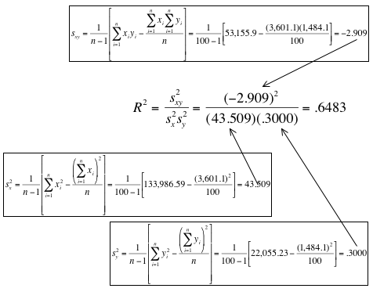
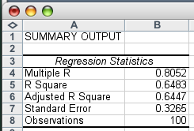
Coefficient of Determination
COMPUTE
We can compute this manually or with Excel…

Slide 57
Coefficient of Determination
INTERPRET
R² has a value of .6483. This means 64.83% of the variation in the auction selling prices (y) is explained by the variation in the odometer readings (x). The remaining 35.17% is unexplained, i.e. due to error.
Unlike the value of a test statistic, the coefficient of determination does not have a critical value that enables us to draw conclusions.
In general the higher the value of R², the better the model fits the data.
R² = 1: Perfect match between the line and the data points.
R² = 0: There are no linear relationship between x and y.

Slide 58

More on Excel’s Output…
An analysis of variance (ANOVA) table for the simple linear regression model can be give by:
Source | degrees of freedom | Sums of Squares | Mean Squares | F-Statistic
Regression | 1 | SSR | MSR = SSR/1 | F=MSR/MSE
Error | n–2 | SSE | MSE = SSE/(n–2)
Total | n–1 | Variation in y

Slide 59
Coefficient of Correlation
We can use the coefficient of correlation (introduced earlier) to test for a linear relationship between two variables.
Recall:
The coefficient of correlation’s range is between –1 and +1.
• If r = –1 (negative association) or r = +1 (positive association) every point falls on the regression line.
• If r = 0 there is no linear pattern

Slide 60



Coefficient of Correlation
The population coefficient of correlation is denoted (rho)
We estimate its value from sample data with the sample coefficient of correlation:
The test statistic for testing if = 0 is:
Which is Student t-distributed with n–2 degrees of freedom.

Slide 61
Example 16.6…
We can conduct the t-test of the coefficient of correlation as an alternate means to determine whether odometer reading and auction selling price are linearly related.
Our research hypothesis is:
H₁: ρ≠ 0
(i.e. there is a linear relationship) and our null hypothesis is:
H₀: ρ = 0
(i.e. there is no linear relationship when ρ = 0)

Slide 62



Example 16.6…
COMPUTE
We’ve already shown that:
Hence we calculate the coefficient of correlation as:
and the value of our test statistic becomes:

Slide 63
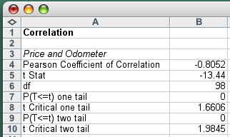
Example 16.6…
COMPUTE
We can also use Excel > Add-Ins > Data Analysis Plus
and the Correlation (Pearson) tool to get this output:
Again, we reject the null hypothesis (that there is no linear correlation) in favor of the alternative hypothesis (that our two variables are in fact related in a linear fashion).
We can also do a one-tail test for positive or negative linear relationships
p-value
compare

Slide 64
Using the Regression Equation…
We could use our regression equation:
y = 17.250 – .0669x
to predict the selling price of a car with 40 (,000) miles on it:
y = 17.250 – .0669x = 17.250 – .0669(40) = 14,574
We call this value ($14,574) a point prediction. Chances are though the actual selling price will be different, hence we can estimate the selling price in terms of an interval.

Slide 65


Prediction Interval(Single value)
The prediction interval is used when we want to predict one particular value of the dependent variable, given a specific value of the independent variable:
(x_{g} is the given value of x we’re interested in)

Slide 66
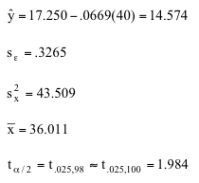

Prediction Interval…
Predict the selling price of a 3-year old Camry with 40,000 miles on the odometer… (x_{g} = 40)
We predict a selling price between $13,925 and $15,226.

Slide 67

Confidence Interval Estimator…(Mean)
…of the expected value of y. In this case, we are estimating the mean of y given a value of x:
(Technically this formula is used for infinitely large populations. However, we can interpret our problem as attempting to determine the average selling price of all Toyota Camrys, all with 40,000 miles on the odometer)

Slide 68

Confidence Interval Estimator…
Estimate the mean price of a large number of cars (x_{g} = 40):
The lower and upper limits of the confidence interval estimate of the expected value are $14,498 and $14,650

Slide 69
What’s the Difference?
Prediction Interval
Confidence Interval
1
no 1
Used to estimate the value of one value of y (at given x)
Used to estimate the mean value of y (at given x)
The confidence interval estimate of the expected value of y will be narrower than the prediction interval for the same given value of x and confidence level. This is because there is less error in estimating a mean value as opposed to predicting an individual value.

Slide 70
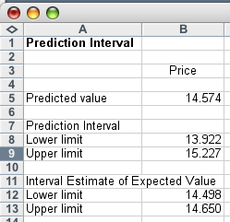
Intervals with Excel…
COMPUTE
Add-Ins > Data Analysis Plus > Prediction Interval
Point Prediction
Prediction Interval
Confidence Interval Estimator of the mean price

Slide 71
Regression Diagnostics…
There are three conditions that are required in order to perform a regression analysis. These are:
• The error variable must be normally distributed,
• The error variable must have a constant variance, &
• The errors must be independent of each other.
How can we diagnose violations of these conditions?
➔ Residual Analysis, that is, examine the differences between the actual data points and those predicted by the linear equation…

Slide 72
Residual Analysis
Standardized residuals for point
Standard Deviation of the ith Residual
where

Slide 73
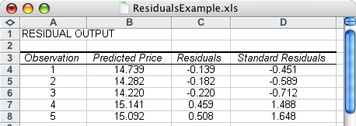
Residual Analysis…
Recall the deviations between the actual data points and the
regression line were called residuals. Excel calculates
residuals as part of its regression analysis:
We can use these residuals to determine whether the error
variable is nonnormal, whether the error variance is constant,
and whether the errors are independent…

Slide 74
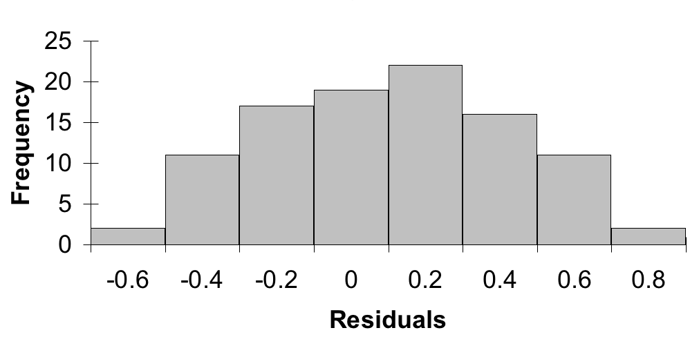
Nonnormality…
We can take the residuals and put them into a histogram to
visually check for normality…
…we’re looking for a bell shaped histogram with the mean close to zero. ✓

Slide 75
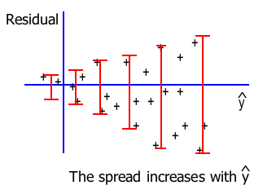
Heteroscedasticity…
When the requirement of a constant variance is violated, we
have a condition of heteroscedasticity.
We can diagnose heteroscedasticity by plotting the residual
against the predicted y.

Slide 76

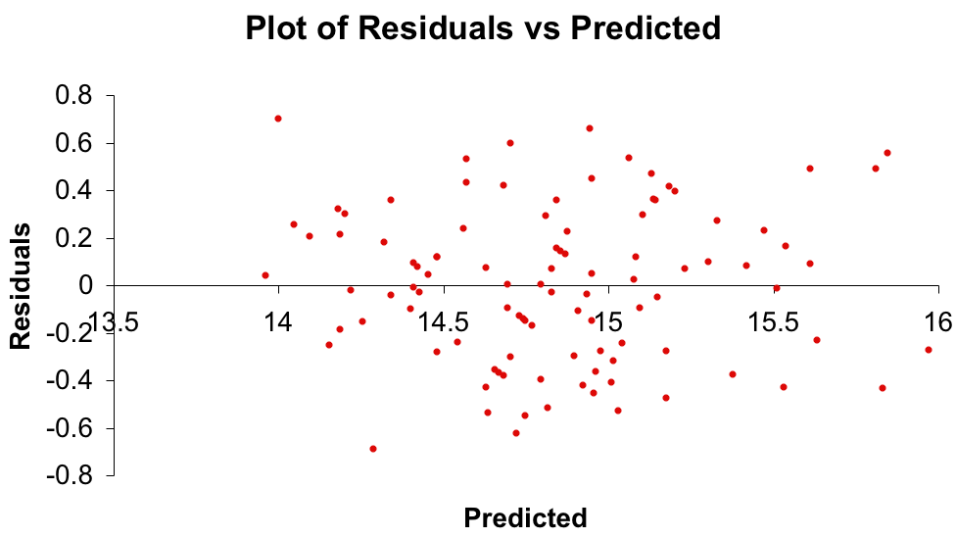
Heteroscedasticity…
If the variance of the error variable ( ) is not constant, then
we have “heteroscedasticity”. Here’s the plot of the residual
against the predicted value of y:
there doesn’t appear to be a change in the spread of the plotted points, therefore no heteroscedasticity
✓

Slide 77
Nonindependence of the Error Variable
If we were to observe the auction price of cars every week
for, say, a year, that would constitute a time series.
When the data are time series, the errors often are correlated.
Error terms that are correlated over time are said to be
autocorrelated or serially correlated.
We can often detect autocorrelation by graphing the
residuals against the time periods. If a pattern emerges, it is
likely that the independence requirement is violated.

Slide 78
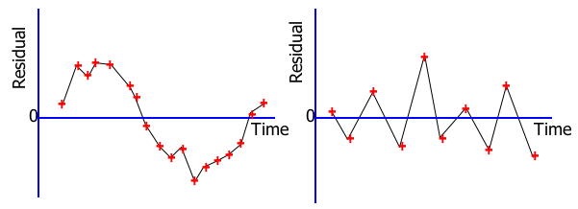
Nonindependence of the Error Variable
Patterns in the appearance of the residuals over time
indicates that autocorrelation exists:
Note the runs of positive residuals,
replaced by runs of negative residuals
Note the oscillating behavior of the
residuals around zero.

Slide 79
Outliers…
An outlier is an observation that is unusually small or
unusually large.
E.g. our used car example had odometer readings from 19.1
to 49.2 thousand miles. Suppose we have a value of only
5,000 miles (i.e. a car driven by an old person only on
Sundays ☺ ) — this point is an outlier.

Slide 80
Outliers…
Possible reasons for the existence of outliers include:
There was an error in recording the value
The point should not have been included in the sample
Perhaps the observation is indeed valid.
Outliers can be easily identified from a scatter plot.
If the absolute value of the standard residual is > 2, we suspect the point may be an outlier and investigate further.
They need to be dealt with since they can easily influence the least squares line…

Slide 81
An outlier
An influential observation
+
+
+
+
+
+
+
+
+
+
+
+
+
+
… but, some outliers
may be very influential
+
+
+
+
+
+
+
+
+
+
+
+
+
The outlier causes a shift
in the regression line

Slide 82
Graph of Non-independent Error Terms
0
X
0
X

Slide 83
Healthy Residual Plot
0
X

Slide 84
Nonlinear Residual Plot
0
X

Slide 85
Procedure for Regression Diagnostics…
Develop a model that has a theoretical basis.
Gather data for the two variables in the model.
Draw the scatter diagram to determine whether a linear model appears to be appropriate. Identify possible outliers.
Determine the regression equation.
Calculate the residuals and check the required conditions
Assess the model’s fit.
If the model fits the data, use the regression equation to predict a particular value of the dependent variable and/or estimate its mean.

