Slide 1
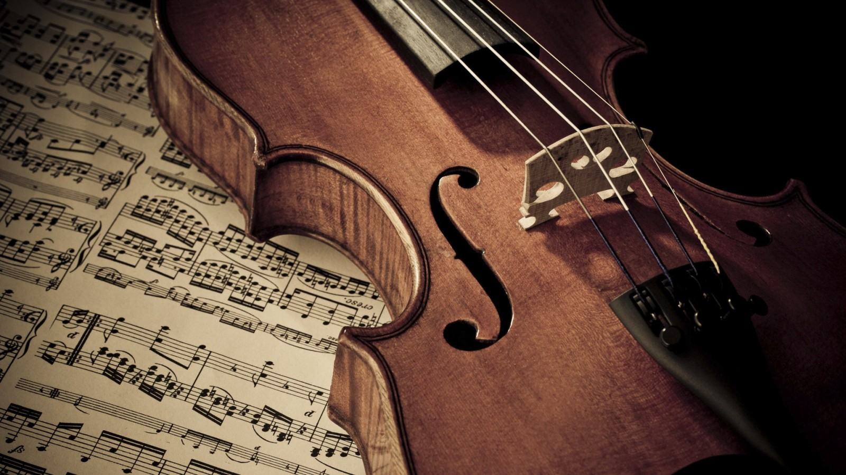
Automatic Music Transcription Research Project
Oliver Ignetik

Slide 2
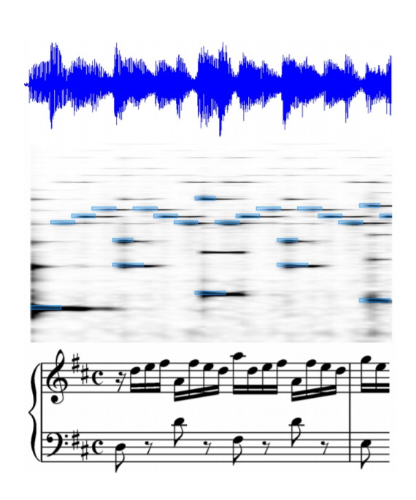
Overview
Goal: Convert the audio waveform from a musical recording into a mid level representation which encodes what notes were played and when.
Musical scores are not considered ground truth annotations.

Slide 3

Challenges
Harmonic overlap
Source separation
Timbre/ Instrument tracking
Beat/ tempo estimation
Data annotation
Large variety of music
Incorporating musical knowledge

Slide 4
Datasets
MusicNet (10GB) : collection of songs with ground truth annotations - https://homes.cs.washington.edu/~thickstn/start.html
MAPS (40GB) : isolated chords/ notes and musical excerpts with fully annotated ground truth - http://www.tsi.telecom-paristech.fr/aao/
MAESTRO (100GB) : collection of songs with ground truth annotations - https://magenta.tensorflow.org/datasets/maestro

Slide 5
Approaches
Nonnegative Matrix Factorization (NMF)
Factorization of the input spectrogram into an activation (temporal) and dictionary matrix (frequency)
Neural Networks (NN)
Multi-label approach which takes a cqt (constant-q transform) as input and outputs a vector indicating the probability of each note being active in that frame

Slide 6
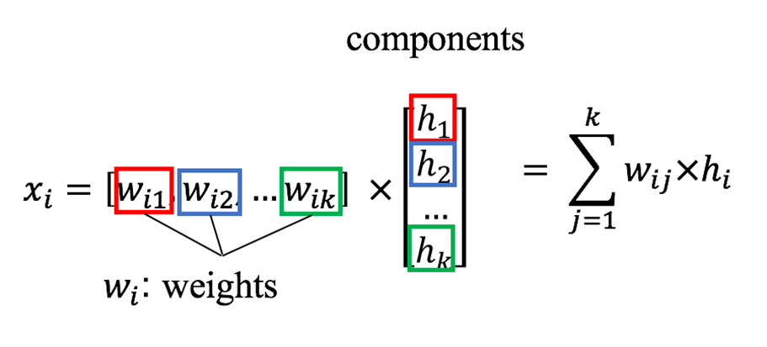
Non-negative Matrix Factorization (NMF)
NMF is a group of algorithms in multivariate analysis and linear algebra
A matrix V is factorized into two matrices W and H, with the property that all three matrices have no negative elements

Slide 7
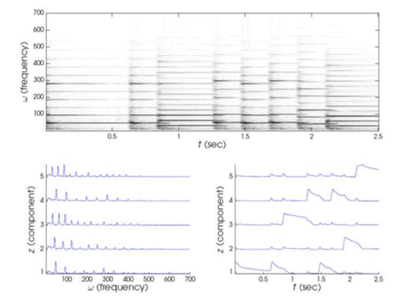
NMF Application to AMT
Spectrograms are computed by taking sliding a window of a certain sample length along the signal and taking the DFT within each frame.
Spectrograms can be decomposed into a dictionary of pitches and an activation matrix encoding the onsets of the different dictionary
NMF performs very well in the case of monophonic music

Slide 8
NMF Challenges
Limitations
When the dictionary is not pre-computed NMF (unsupervised NMF) you must indicate the number of components for decomposition.
Supervised NMF is where the dictionary is precomputed by compiling a matrix that encodes frequency templates of isolated notes.
Future work
Hidden Markov Models (HMMs) to model temporal dependencies between note transitions
Improve upon Autocorrelation Function (ACF) method for picking f0 in spectral components

Slide 9
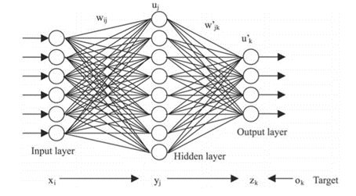
Neural Networks (NN)
Neural Networks are a form of powerful machine learning algorithms for learning patterns in datasets
Feed forward networks are appropriate for classification tasks.

Slide 10
Multi-label NN Classification problem
Goal : to learn the weights by fitting the model to the training data and optimizing the loss function
Input : cqt (STFT with constant Q-ratio on frequency bins)
Output : framewise vector indicating likelihood of note being played

Slide 11
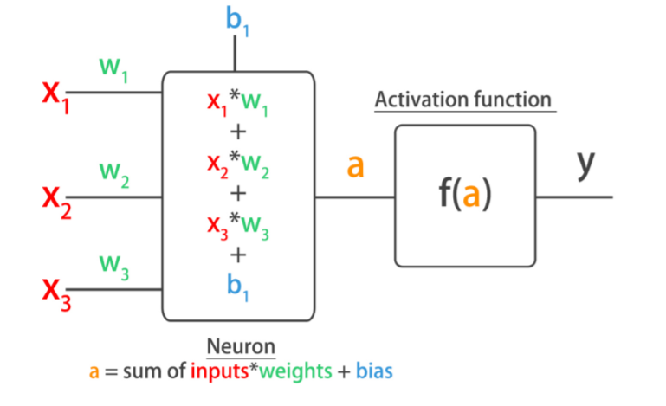
Hyper-parameter tuning for model
The input and output layer dimensions are set quite rigid and not open to much variation
Choice of activation functions, number of layers and neurons, loss function for back propagation and optimizers …

Slide 12
NN Challenges
Limitations
Needs a large dataset for training
Performs poorly with music with completely different spectral characteristics such as environment and instrumentation
Future work
Solve the class imbalance / sparsity problem by using different accuracy metrics
Long Short-Term Models for NN to learn temporal dependencies in the model
Investigate using multiple spectrograms as input to the network

Slide 13
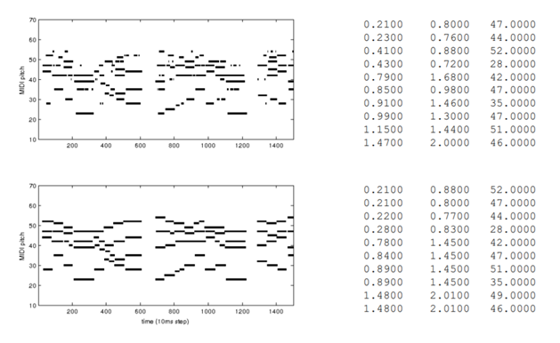
Evaluation metrics
Desired output – MIDI piano roll
Mir_eval – python library used to evaluate AMT model performance

