Slide 1


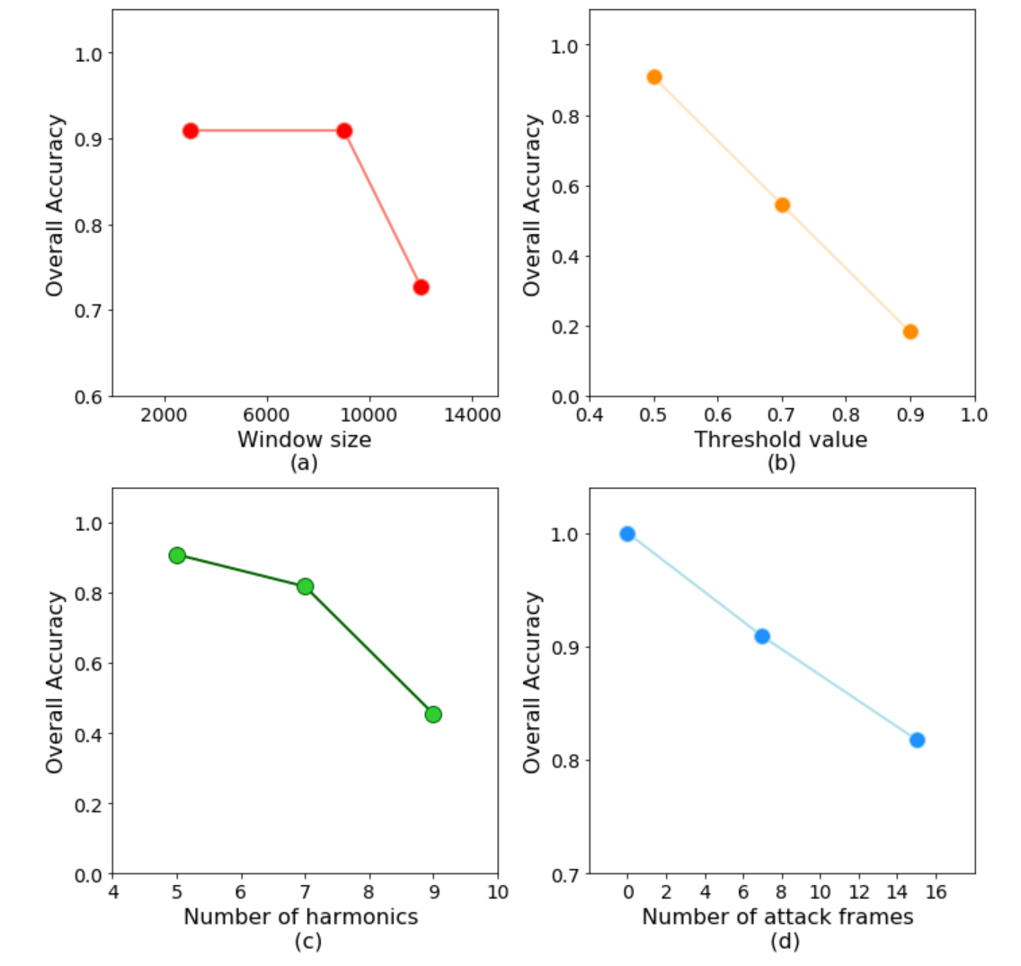
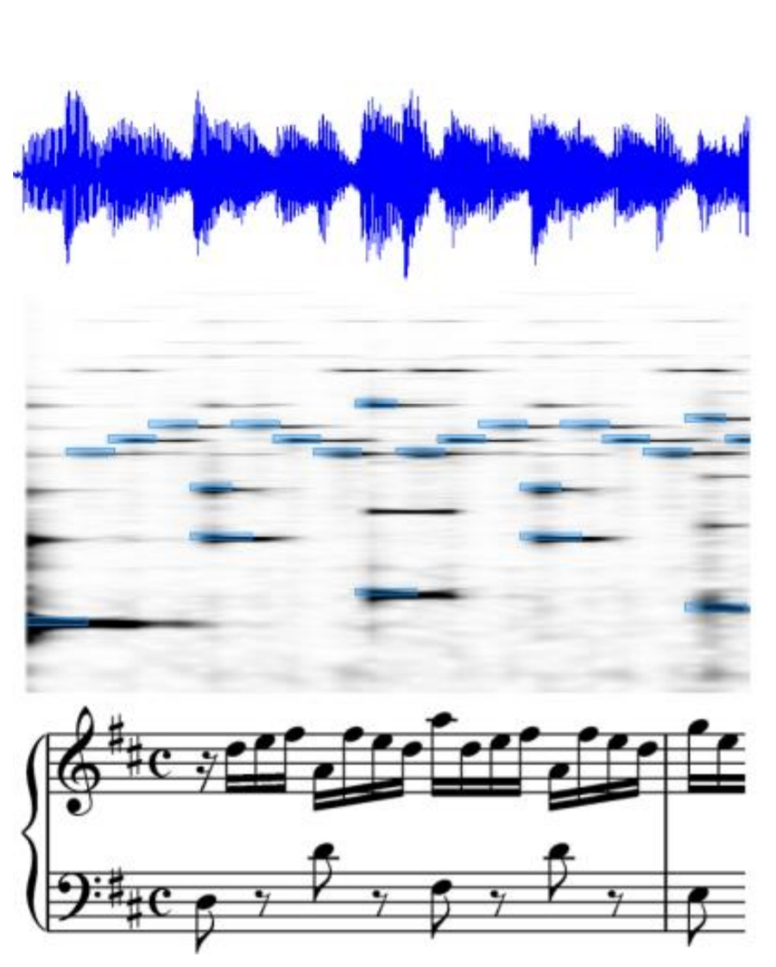
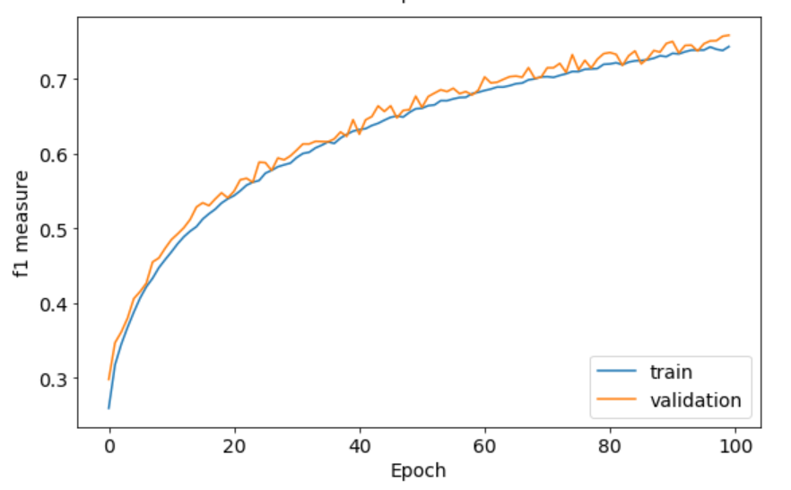
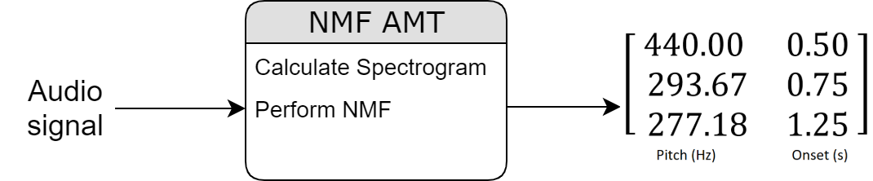
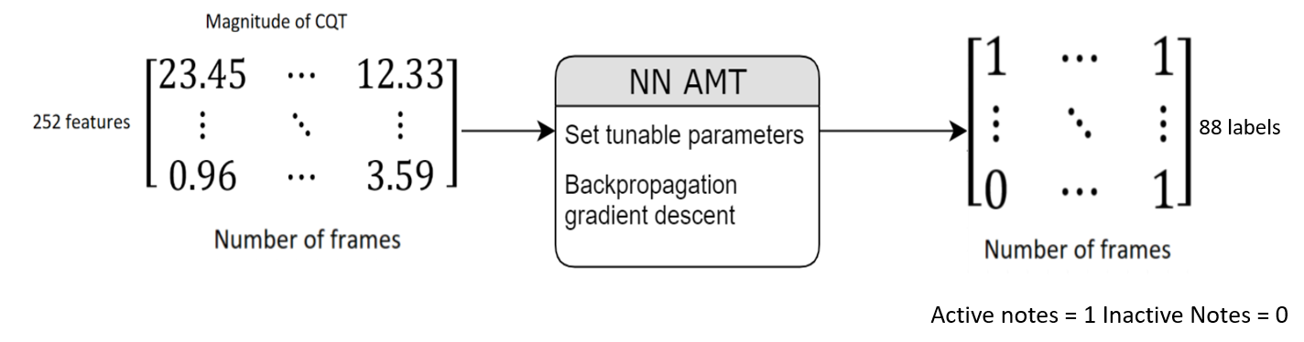
Automatic Music Transcription
Github repository : github.com/OliverIgnetik
Student: Oliver Ignetik
E-mail: u5012063@anu.edu.au
Supervisor: Dr Parastoo Sadeghi
Examiner: Dr Rodney Kennedy
Abstract
Results/Findings
This project explores the application of Non-negative Matrix Factorization (NMF) on monophonic music samples and Neural Network (NN) models on polyphonic music database. The models performed well but need more work to incorporate context into the algorithms.
NMF AMT model – monophonic
Overall accuracy achieved of 1.0 (100%)
Peak picking algorithm threshold value and the number of harmonics were the most influential parameters
NN AMT model – polyphonic
F-measure achieved of 0.75 (75%)
Initial approach used a binary entropy loss function with an automatically inferred accuracy which did not take into account the class imbalance
Background
The capability of transcribing music audio into music notation is a fascinating example of human intelligence. It involves analyzing complex auditory scenes, recognizing musical objects, forming musical structures and checking alternative hypotheses. Automatic Music Transcription (AMT) refers to the design of computational algorithms to convert acoustic music signals into some form of music notation. It is a challenging task and considered an unsolved problem in signal processing and artificial intelligence. This problem is particularly challenging in polyphonic music where even the most advanced systems are far behind meeting the accuracy of trained musicians [1].
Fig 4 : NMF model performance
Fig 1: AMT process piano roll representation [2]
Key challenges
Polyphonic mixtures – disentangling harmonics of consonant notes and diatonic harmonies
Lack of ground truth transcriptions – annotation is extremely time consuming and there are a limited number of datasets
Methodology
Fig 5 : NN model performance
NMF AMT model – monophonic
Data – MAPS database piano recordings with ground truths
Approach – NMF decomposition with peak picking algorithms
Discussion
NMF model had an accuracy of 1.0 in a simple monophonic transcription task but needs extension to polyphonic cases
NN model used a weighted loss function and appropriate scoring metric which led to a stable model performance curve
The NN model outperformed a similar model in a paper by Li et al [3] in which a regular binary entropy loss function is used
Fig 2: NMF model with input and output format
Conclusions
NN AMT model – polyphonic
Data – Musicnet HDF5 file with audio and ground truths
Approach – Multilabel classification with Constant Q-Transform input
NMF model has fast implementation but needs appropriate parameter tuning dependent on contextual factors
NN model takes a lot of time to train but performed well in polyphonic case. In the future, temporal dependencies may be included through the use of different architectures
Future work may include incorporation of prior musical knowledge such as instrument, recording environment and lead sheet information
References
[1] M. Müller, D. P. Ellis, A. Klapuri, and G. Richard, “Signal processing for
music analysis”, IEEE J. Sel. Topics Signal Process, vol. 5, no. 6, pp. 1088–110,
2011.
[2] E. Benetos, “Automatic music transcription”, Tutorial presented at National
University of Singapore, University of London, January 2019
[3] L. Li, I. Ni, and L. Yang, “Music transcription using deep learning”, 2019.
Fig 3: NN model with input and output format
ENGN4200 Individual Project Thesis Presentation
25 May 2020
ANU CECS

