Slide 1









MEDI-CONNECT
Oliver John Bollam - 002302974
Venkat Prithvi Gade - 002050824
Mansi Gondil - 002304645

Slide 2



PURPOSE
"Medi-Connect" aims to enhance healthcare experiences for patients, doctors, and hospitals through a unified platform. It streamlines appointment scheduling, treatment tracking, and payment processing for patients while offering doctors and healthcare facilities an effective solution for managing appointments and delivering patient care. By integrating these functions, "Medi-Connect" seeks to simplify administrative tasks and ensure a seamless experience for all stakeholders, fostering better communication and efficiency within the healthcare system.

Slide 3


The Problem Statement
The healthcare industry, while essential, faces challenges like complex appointment scheduling, fragmented treatment coordination, and cumbersome payment processes. These issues create inefficiencies and hinder seamless healthcare delivery, affecting both patients and healthcare providers.
"Medi-Connect" addresses these challenges by offering a unified platform that integrates appointment scheduling, treatment management, and payment solutions. It aims to enhance the overall healthcare experience for patients by simplifying their journey while equipping doctors and hospitals with an effective tool for managing appointments and delivering efficient patient care.

Slide 4

Features Added
Patients can register effortlessly on "Medi-Connect," simplifying the process of applying for insurance and ensuring they have access to comprehensive healthcare support.
Hospitals can efficiently manage their medical staff by adding and organizing doctors within the platform, enabling them to maintain accurate and up-to-date records of their professionals.
Patients can conveniently access prescription medications directly through "Medi-Connect," streamlining the process of obtaining essential medicines.
Pharmacies can efficiently manage and replenish their inventory, ensuring an adequate supply of medications and minimizing delays in fulfilling patient orders.

Slide 5
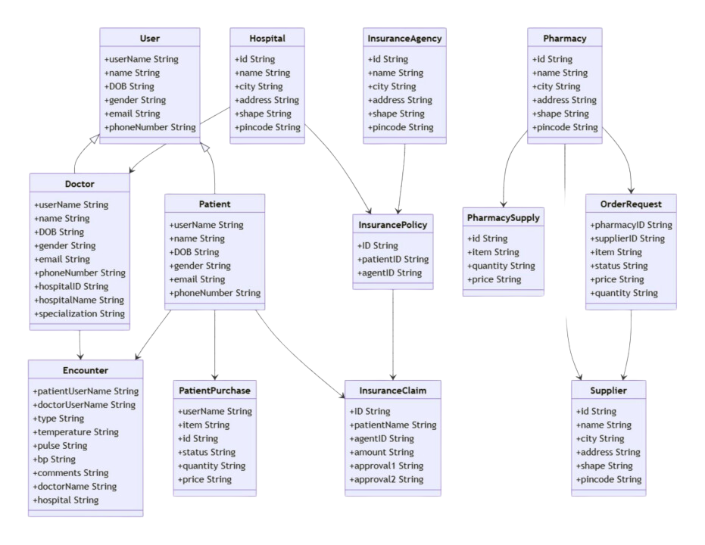
Class Diagram

Slide 6
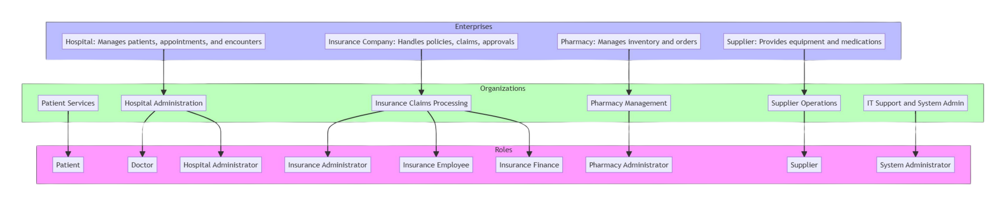
High Level
Component Diagram

Slide 7
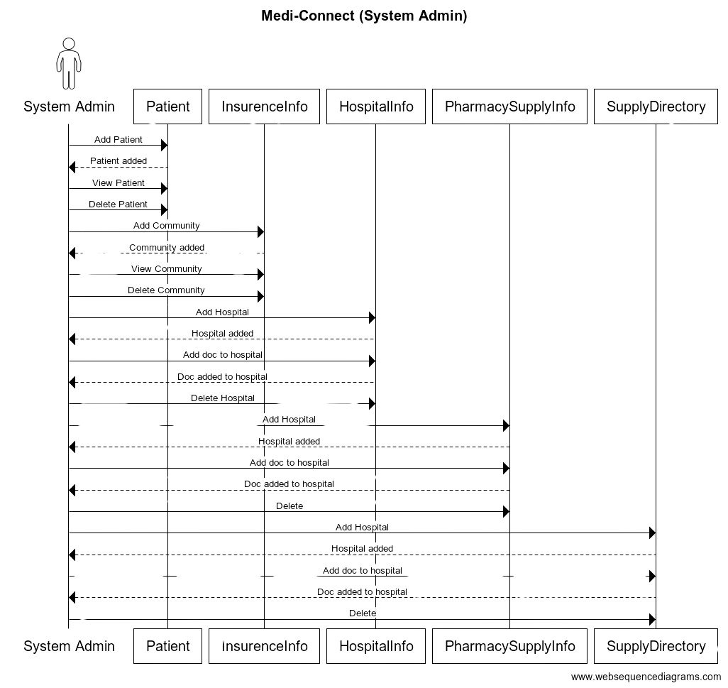
Sequence Diagram
(System Admin)

Slide 8
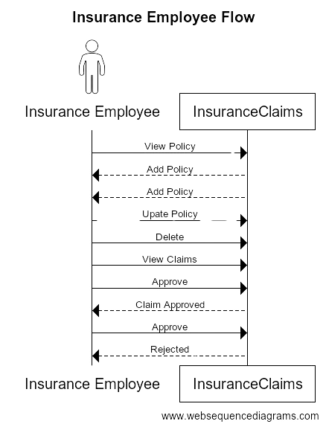
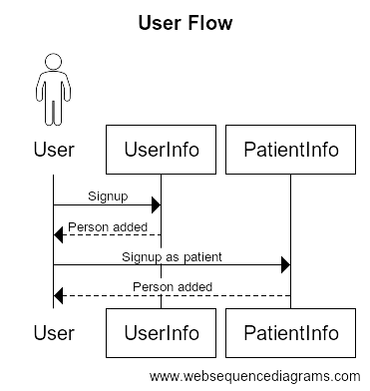

Slide 9
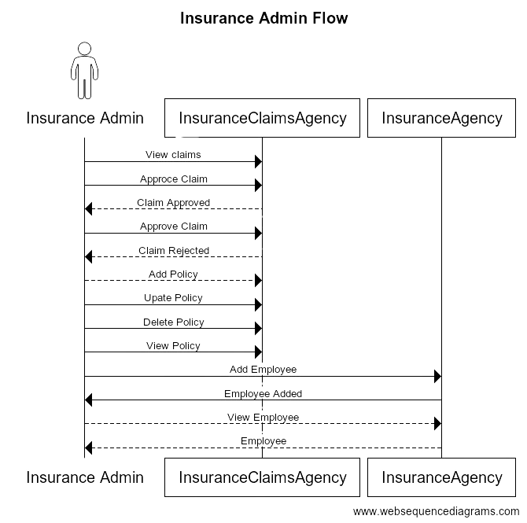

Slide 10
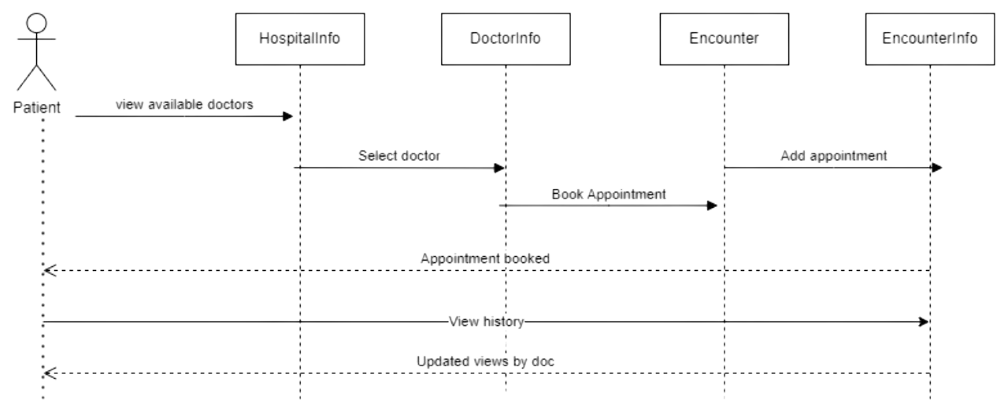
Patient Flow

Slide 11
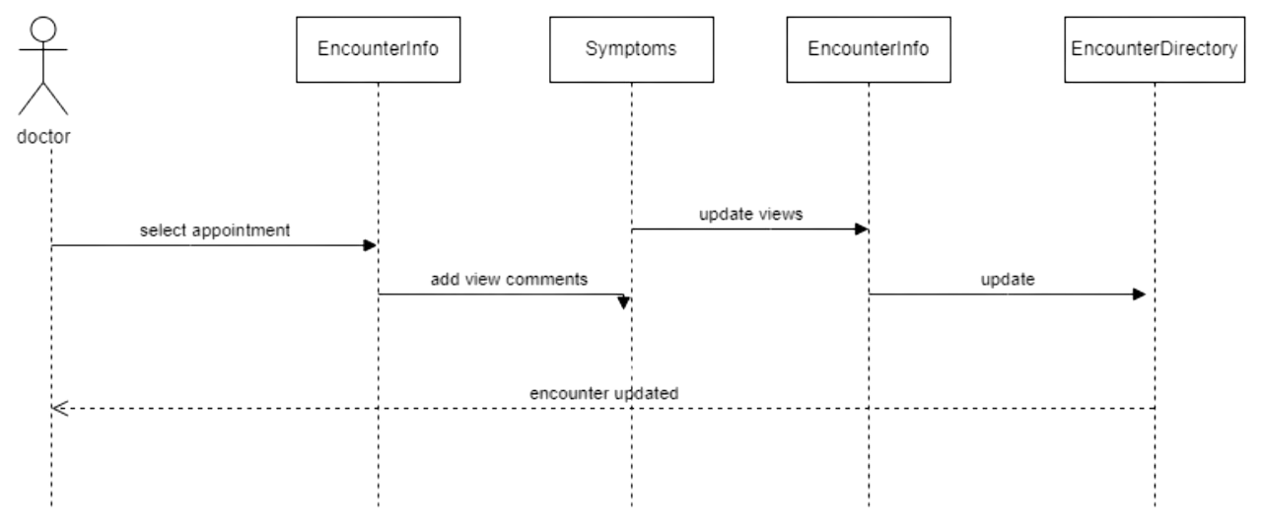
Doctor Flow

Slide 12
Thank You!

