Slide 1

Schema Compilation with Query-Set Aware Optimisation for Embedded Database Generation
Author: Oliver Killane
Supervisor: Holger Pirk

Slide 2
What is an embedded database?
Databases that can be embedded in applications. Running in the same process & address space as the application.
In-Memory
(usually)
Application Dependent
Complex Queries
In-Process?
Integrated?
Notes:
Embedded is a bad name
Term is (I believe) misused for key value stores, btree

Slide 3
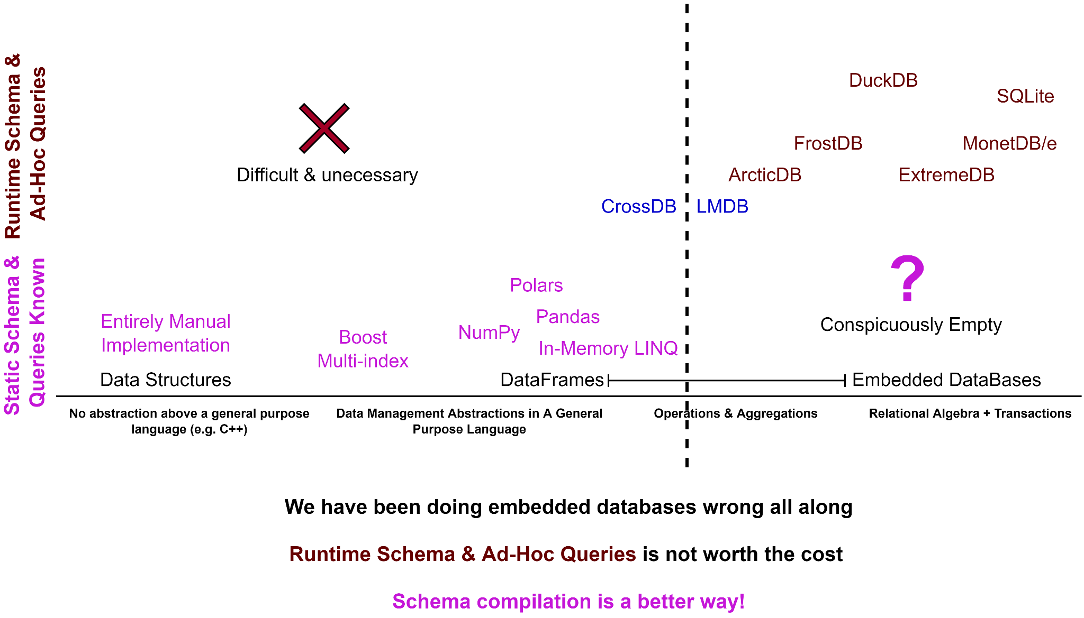
Notes:
Runtime schema is not necessary, so no market for top left
Why is bottom right empty?
There is a cost to flexibility, there is a cost to language agnosticism
Is the cost worth it?

Slide 4
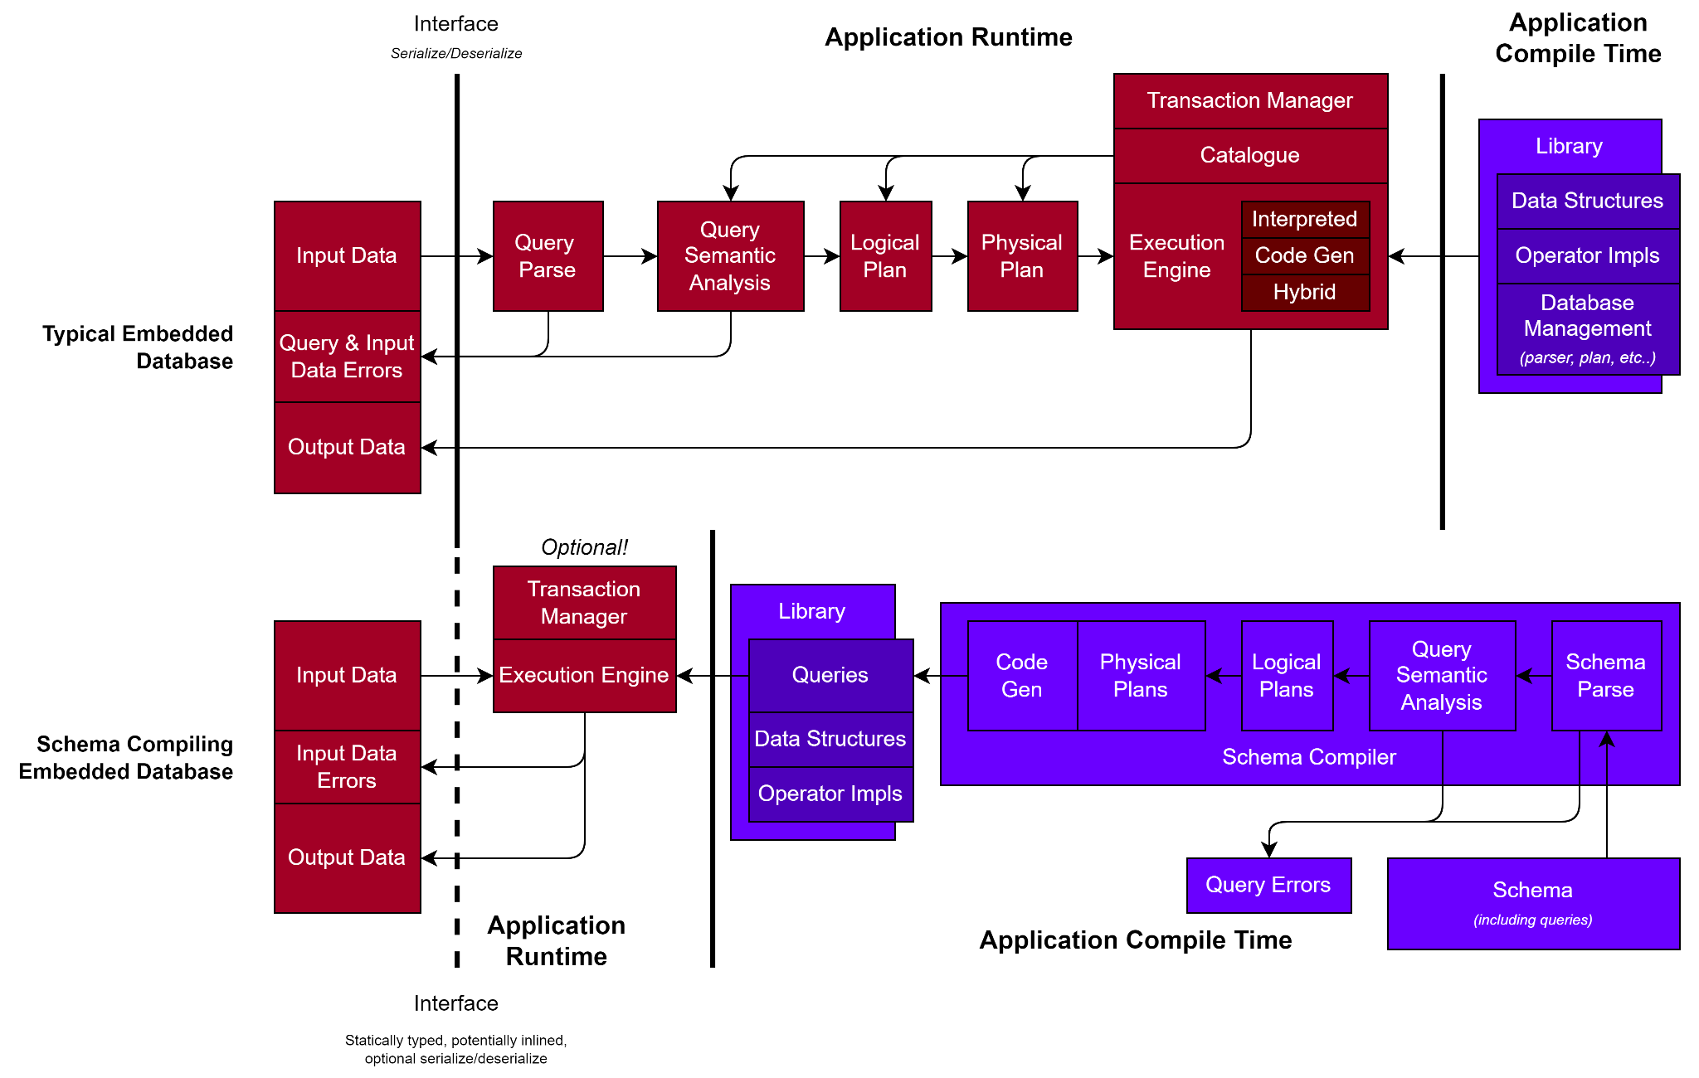

Slide 5
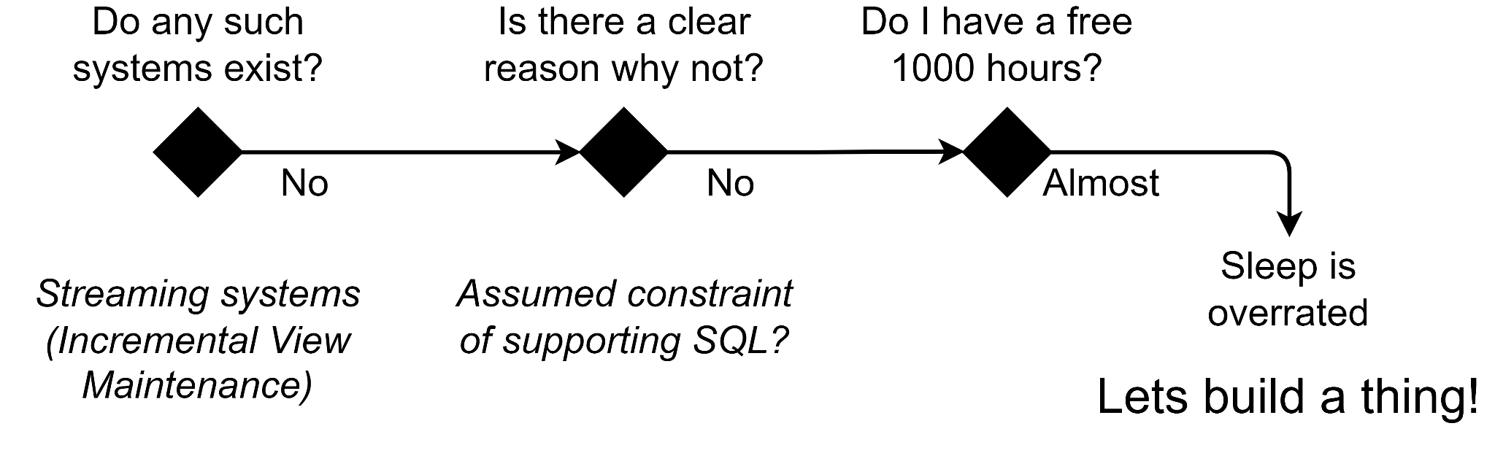

Slide 6
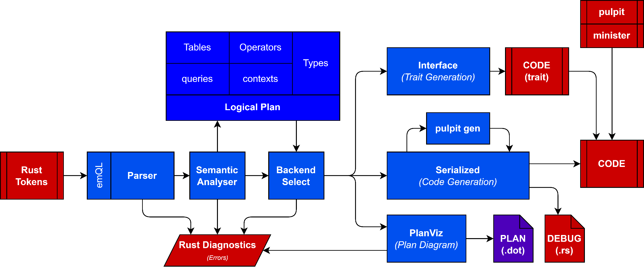
Limited logical optimisation
Significant time dedicated to making internals easy to work with
At application compile time

Slide 7
Code Comparison

Slide 8
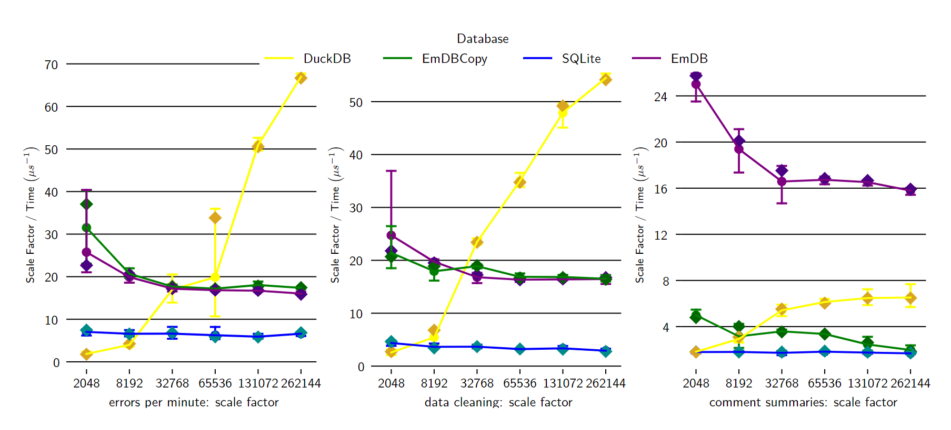

Slide 9
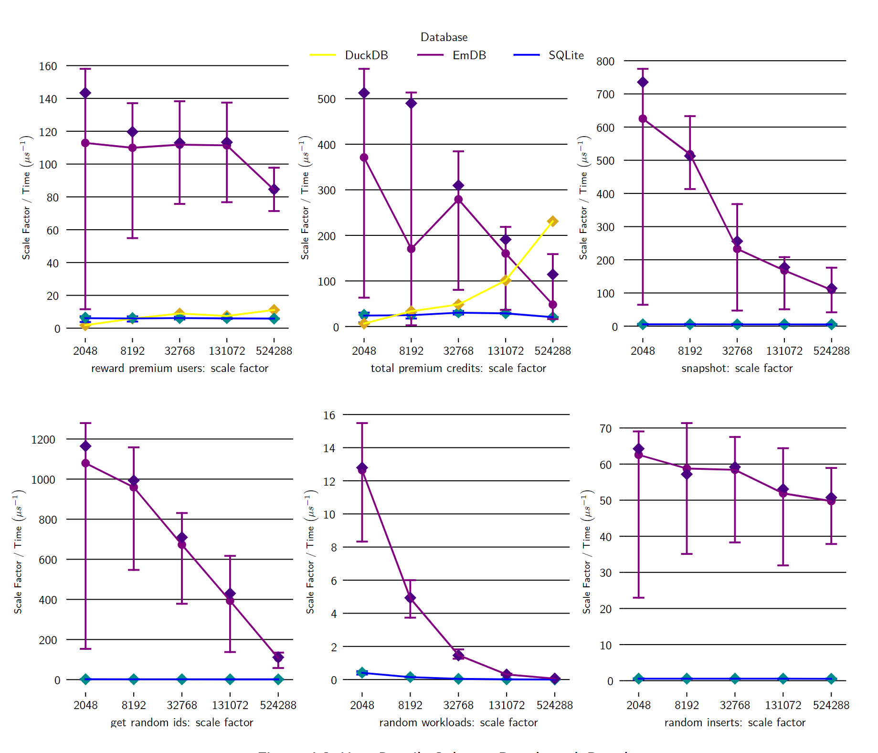
Schema: User Details

Slide 10
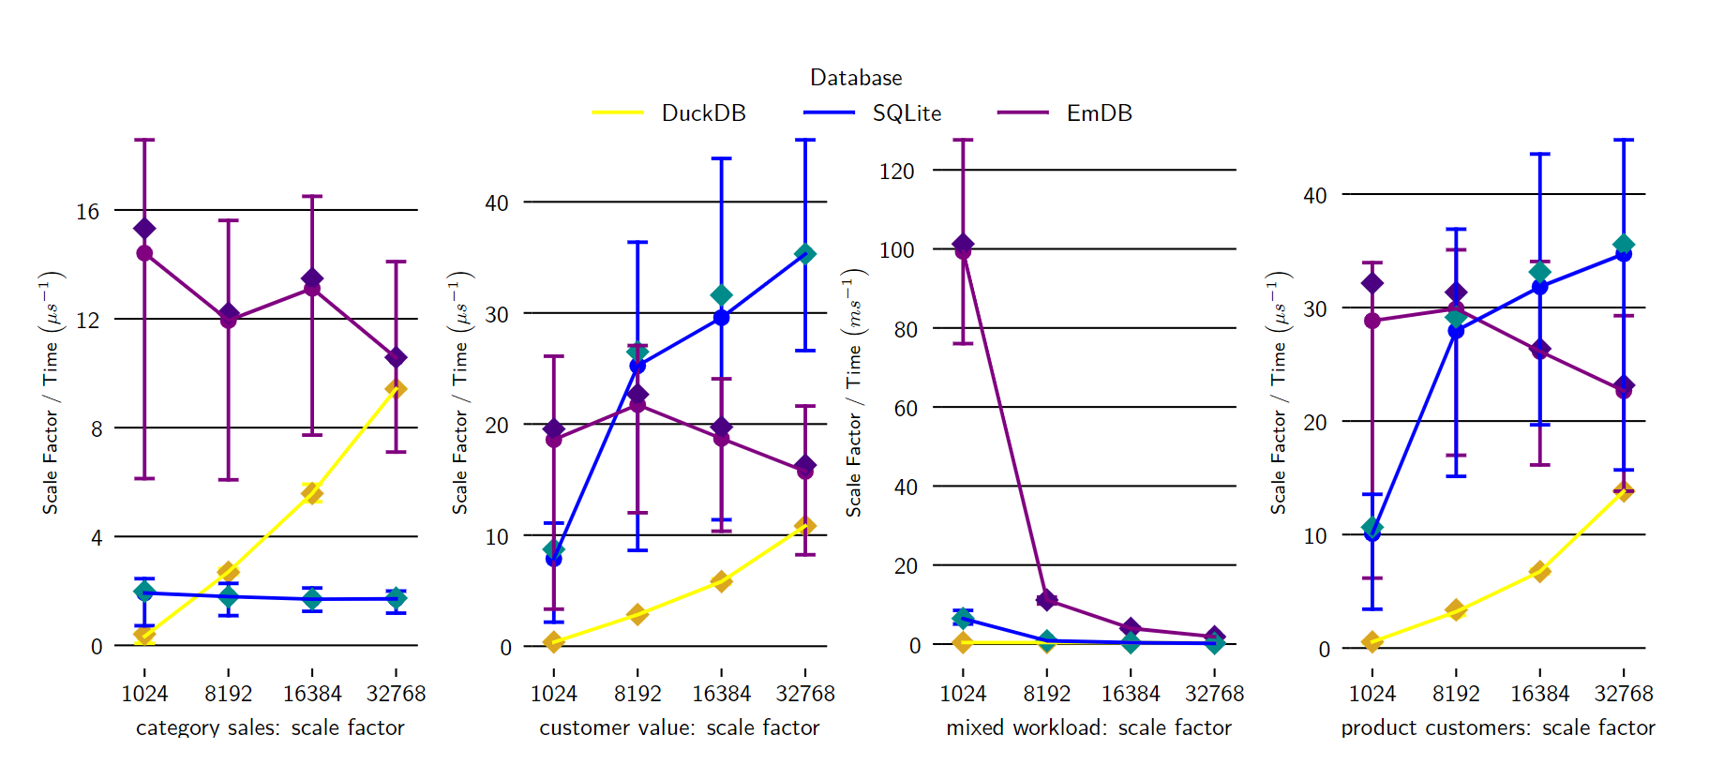
Schema: Sales Analytics

Slide 11
Contributions
Schema compilers as embedded databases, not only possible, but very easy to use, and with competitive performance
A unique rust token-parsing & combinator library.
Significant feature contribution (under review) to the divan benchmarking library
Minor contributions to rustc errors, bug report for cargo, duckdb-rs.
Future Work:
Bug reports for rustc internal errors.
Test more, measure better, and optimise Serialized backend!
Improved PlanViz backend.
Incremental view maintenance backend.

Slide 12


Thank you for listening!
Presentation, Report, Benchmarks, and all associated libraries are contained in the github repo
oliverkillane/emDB
Questions please!
(for Github vanity points)

Slide 13
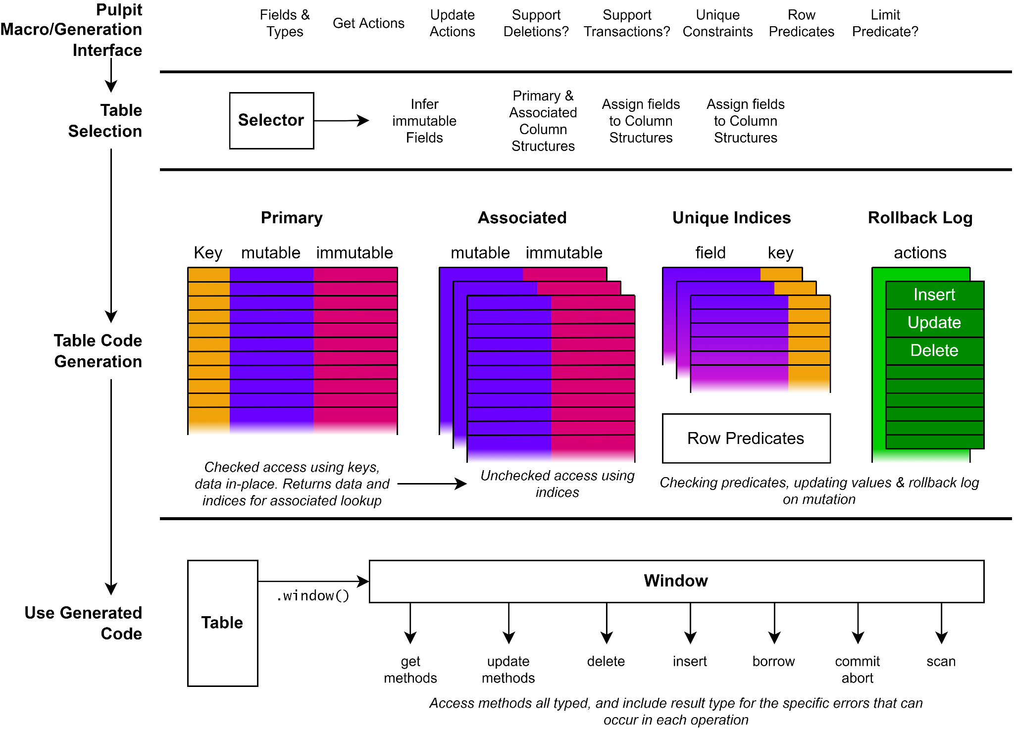

Slide 14
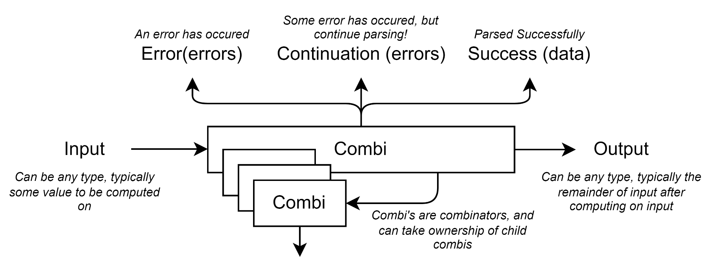

Slide 15
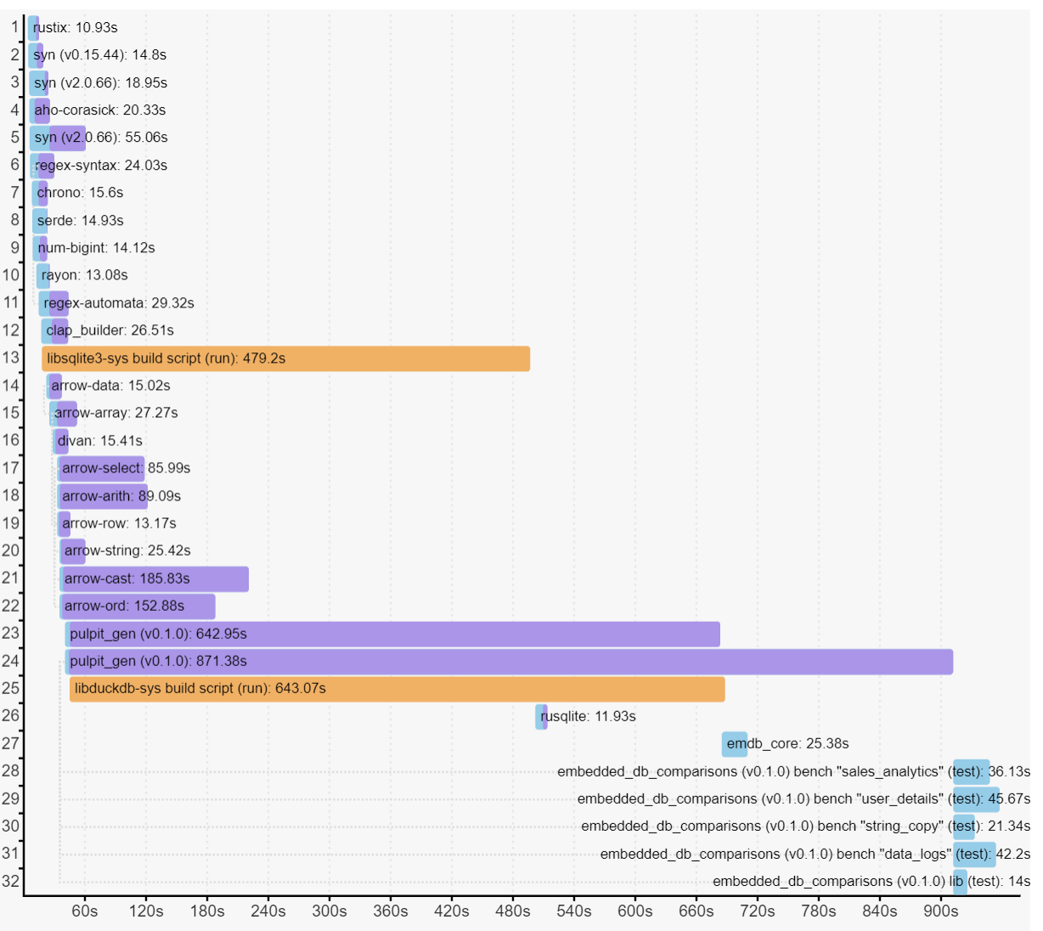

Slide 16
