Slide 1
g4ds.cc
DSPhysicsList
Define the physical processes
DSDetectorConstruction
Build the detector
DSRunAction
Start/end the run, open/close binary and log files
DSPrimaryGenerator
Select the event generator
DSStackingAction
Select the stacking class (if needed), where primary is created but not yet tracked
DSTrackingAction
Store “photon” and “daughter” event info
DSSteppingAction
Store “deposit” event info
DSEventAction
Write the output

Slide 2
Always active
The Event
To activate with user command
Event info
Standard event info (energy, time, position, …)
Info about particles induced by the primary; by default only 1 level depth
Vector of daughters
Vector of deposits
Info about energy deposits
Vector of users
User defined variables (for developers)
Vector of photons
Info about all the generated photons
Vector of p.e.
Info about photoelectrons of the TPC
Vector of veto p.e.
Info about photoelectrons of the Veto
Vector of mu p.e.
Info about photoelectrons of the Water Tank

Slide 3
The Event Substructures
Event info
Daughters
Deposits
int EventID;
int PDG;
double Time;
float Energy;
float VisEnergy;
float Position[3];
float Direction[3];
float CenterOfMass[3];
int NPE;
int VetoNPE;
int MuNPE;
int NPH;
int NDaughters;
int NDeposits;
int NUsers;
int Id;
int PDG;
int PID;
int Process;
double Time;
float Energy;
float Position[3];
float Direction[3];
int PID;
float Energy;
float Position[3];
float Step;
double Time;
Users
int UserInt1;
int UserInt2;
float UserFloat1;
float UserFloat2;
double UserDouble;
Photons
int VolumeID;
int PID;
float Wavelength ;
float Position[3];
double Time;
PhotoElectrons
int PMT;
double Time;

Slide 4
The Event Handler
Event structure definition:
DSEventStructure.hh
Define getters and setters for each event variable
Event manager:
DSEventHandler
g4ds
DSEventHandler::Get()->GetVariable()
DSEventHandler::Get()->SetVariable(variable)
DSEventHandler::Get()->GetVector()[i].variable
How the Event is Written to the Output
Event Size
Event info
N1
N1xDaughter Struct
N2
N2xDeposit Struct
N3
N3xUser Struct
N4
N4xPhoton Struct
N5
N5xPE Struct
N6
N6xVeto PE Struct
N7
N7xMu PE Struct
Event Size

Slide 5
Other Singletons
Manage streaming of files
If binary file (.fil) or log file (.log) exists, change the filename adding _v1, _v2, _v3, etc
DSIO
Instead using “cout”, DSLog(severity) << “text” << endlog;
Where severity = debugging, development, trace, routine, warning, fatal
It writes simultaneously to standard output and to log file
DSLogger
Store internal variables:
DSStorage
DSManagerMessager
Store external variables:
DSParameter
DSManager

Slide 6
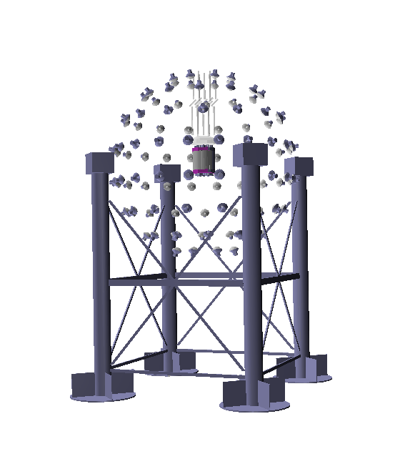
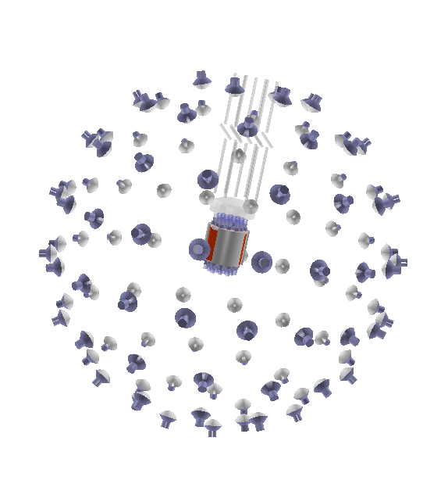
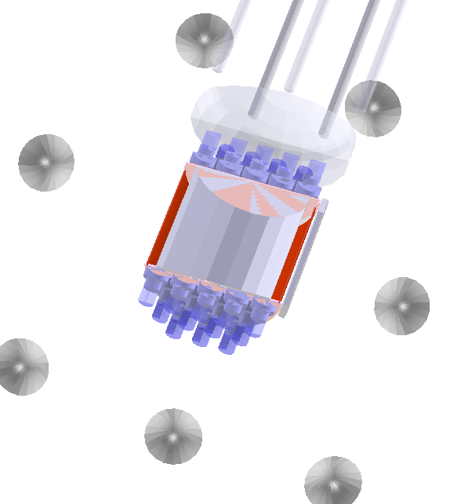
The Detector
DSDetectorConstruction
DSDectorDS50
DSDectorNeutronVeto
DSDectorWaterTank
DSDectorPMTDS50
DSDectorPMTNeutronVeto

Slide 7
DS50
Trunk
TrunkAr
GaseousArgon
PMT
PMTAssemblyTop
BellTop
TeflonCapDiskTop
GasPocket
BellRim
TeflonSupport
FieldRings
InnerLiqArgonBetween
Reflector
ActiveLAr
CathodeWindow
InnerLiqArgon
OuterLiquidArgon
TeflonCapDiskBottom
InnerCryostat
PMTAssemblyBottom
VacuumCryostat
Framework Origin
86 mm above the Cathode Window
285 mm below the Bell Top
OuterCryostat

Slide 8
PMTBodyVac_X_Logic
PMTTopVac_X_Logic
PMTBody_X_Logic
PMTTopVac_X_Logic
LAr
myMotherVolume
Teflon – PMT Surrounding
myTeflonCapDiskVolume
PMTHead_X_Logic
PMTJoinVac_X_Logic
PMTWindow_X_Logic
PMTHeadVac_X_Logic

Slide 9
DS10
Dewar
LArBath
Framework Origin
3 mm below the Top Window
17 mm above the LAr-GAr interface
SupportRod (4)
CompressionPlate
InnerVesselWindowTop
GasPocket
ThreeMLowerFoil +
ThreeMMiddleFoil +
ThreeMTopFoil +
SupportRing (3) +
TopLiqSupportRing +
TopGasSupportRing
Grid
SteelRod (12)
InnerLAr
InnerVesselWall
BubblerTubes (2)
FieldRing and KaptonBand
PMTWindow
InnerVesselWindowBottom
PMTBody
PMTVacuum
PMTs (7+7)

Slide 10
The Generators
Select the generator:
DSPrimaryGeneratorAction
DPrimaryGeneratorActionMessenger
Virtual class from which all the generators inherit methods.
In particular spatial, angular and energy distributions, or fixed values, with GetVParticlePosition(), GetVParticleDirection(),
GetVParticleEnergy(G4ParticleDefinition*)
DSVGenerator
DSGeneratorG4Gun
DSGeneratorRDM
DSGeneratorMultiEvent
DSGeneratorNeutronAtGs
DSGeneratorCosmicRayMuons

Slide 11
The Generators
DSGeneratorG4Gun
Standard generator for single particles
DSGeneratorMultiEvent
Several particles in the same position with random directions
DSGeneratorRDM
Radioactive decays and decay chains
DSGeneratorNeutronAtGs
Neutrons from the rock
DSGeneratorCosmicRayMuons
Cosmic muons

Slide 12
The Rooter
g4rooter
- source file: g4rootered.C
it’s in “g4ds/tools” folder
“compile_rooter” to compile it
“tools” is added to $PATH (no need to look for the path)
g4rooter filename.fil [OPTIONS]
includes DSEventStructure.hh
each leaf array is defined with the correct dimension:
(e.g. dstree->Branch("dau_id", Did, "Did[theEvent.NDaughters]/I");)
allows to introduce a preliminary reconstruction
extremely fast
can be applied while g4ds is running
allows to skip the first N events
easy to add variables

Slide 13
Tips for Developers
The code must be clear for the other developers:
please, use clear variable names, even if long
maintain the global style:
methods with capital letters and no underscores (GetVariableName())
private variables in the Geant4 style (fVariable)
The code must be clear for the users:
use messengers associated with the correspondent class
use clear command names, maintaining the logical structure:
/ds/ directory for our commands
/ds/xxxx/ where xxx has to remind the correspondent class
/ds/xxxx/yyyy where yyyy should remind the meaning of the command
Update the manual:
g4ds/manual/g4dsman.tex and g4ds/manual/g4dsman.pdf

