Slide 2

The CDF Mission
The Continuous Delivery Foundation seeks to improve the world’s capacity to deliver software with security and speed.

Slide 3
Purpose of the CDF
The Continuous Delivery Foundation (CDF) exists to:
Establish best practices
of software delivery automation, from the standpoints of people, processes and technology.
Propel the education and adoption
of Continuous Delivery tools throughout industries across the globe for both traditional and modern architecture.
Facilitate cross-pollination across emerging technologies in order to improve the world’s capacity to progress software updates with security and speed.

Slide 4




Who We Are
The Continuous Delivery Foundation is led by a team of accomplished professionals passionate about delivering beautiful software swiftly and simply. We will do this by:
Growing a world-wide, user-first, collaborative ecosystem with a vision for the future.
Serving as a home to new and mature projects dedicated to a continuous delivery model.
Creating a cohesive body of educational materials for practitioners of all levels.
Governing with fairness, integrity and intention to support a vendor neutral community.

Slide 5

Why Join?
Whether you’re using, selling or creating Continuous Delivery technologies, your membership at the Foundation grants you unfettered access to proven methodologies, real-time innovation and a seat at the table to steer the conversation.

Slide 6
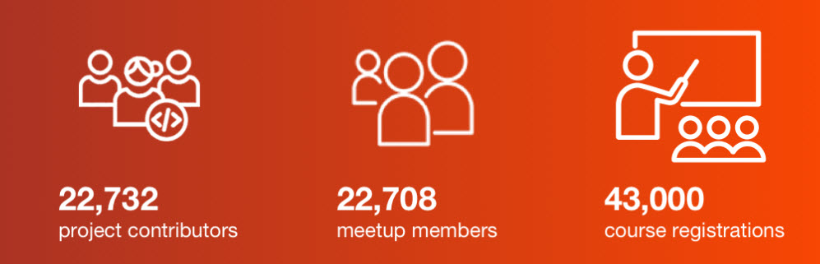
Our Growing Community

Slide 7






























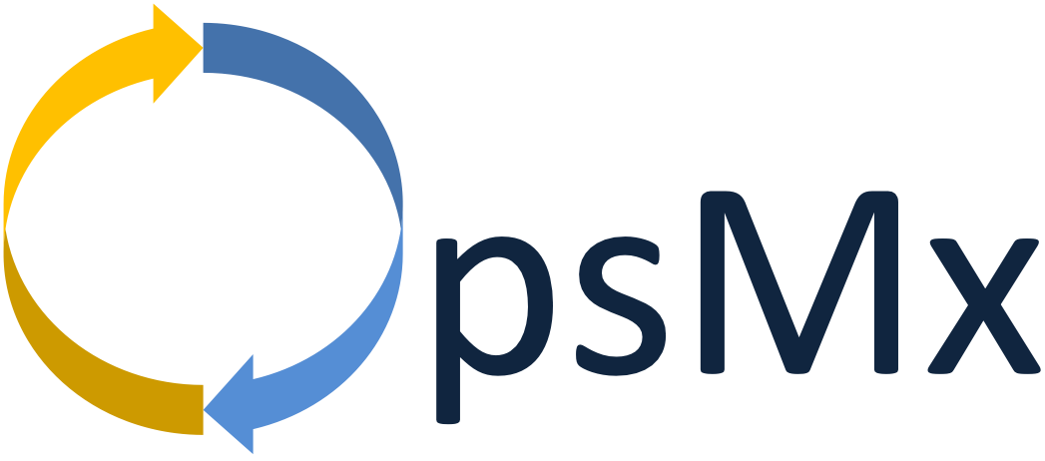


Innovative Members
PREMIER
GENERAL AND END USER MEMBERS

