Slide 1
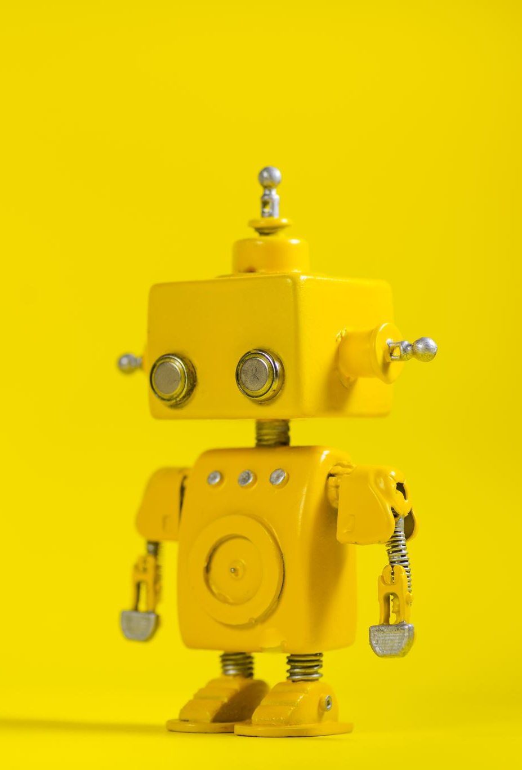

Artificial Intelligence II
PROJECTS
WS 20-21

Slide 2
Project 1: Ghostbusters
We are reusing projects of UC Berkeley.
Implementation in Python.
Source code and project details are available at:
https://inst.eecs.berkeley.edu/~cs188/fa19/project4/
Files to edit:
bustersAgents.py
inference.py
Update only the required functions while keeping other code intact.
Use the autograder regularly to check the correctness of your code!
Important: you need to submit your two edited files and not a token (contrary to the original Berkeley description)!

Slide 3
Organization
Bonus credit of 0.3 if you submit solutions for BOTH projects.
You may participate individually or in groups of two.
Send your solution to 'zuehlke@l3s.de'.
Subject line of the email: AI2Project1: [your name(s)].
Email must have your matriculation number(s).
Deadline: 21.12.2020

