Slide 1
FDE Midterm Report
Presenter: Xingzhou Tang
Perm Number：20300750006

Slide 2
CONTENTS
01
02
03
LCD display
Gluttonous Snake
Problems

Slide 3
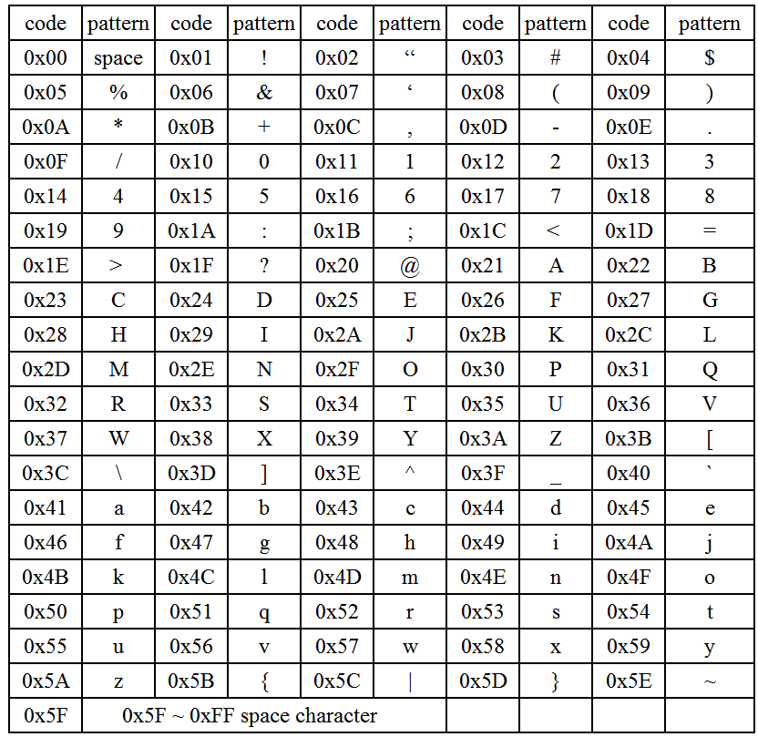
Lcd Display

Slide 4
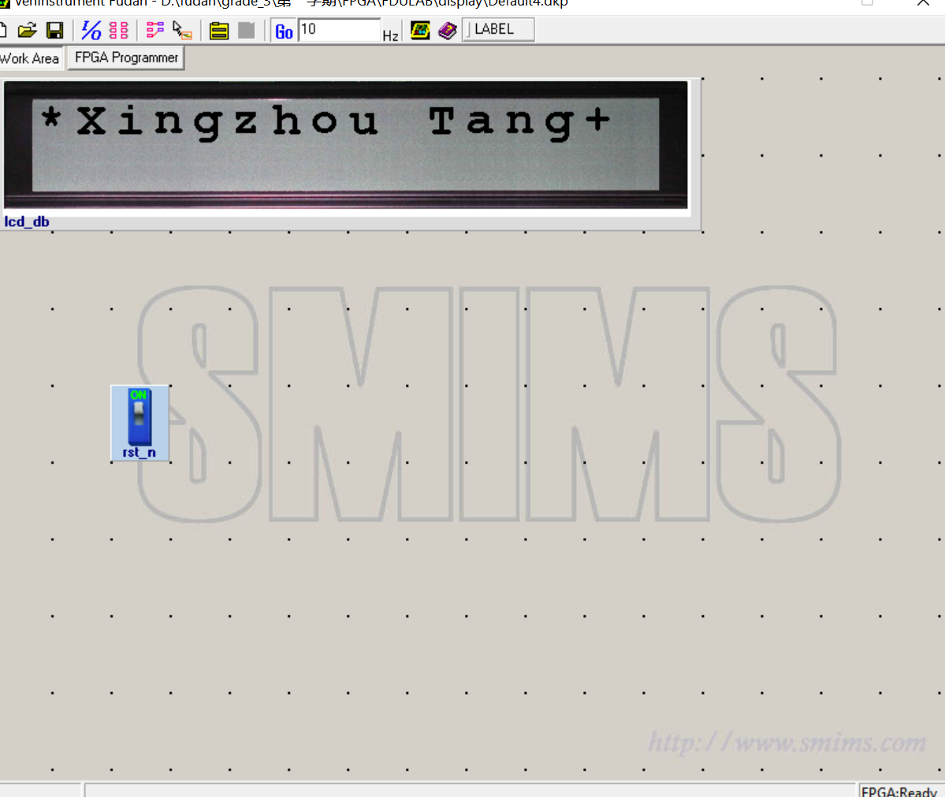
Outcome

Slide 5
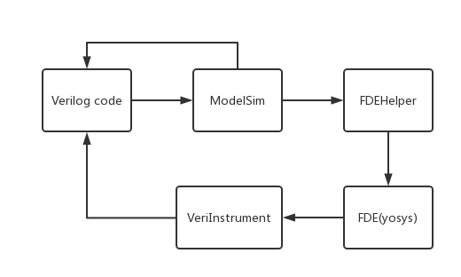
Procedure

Slide 6
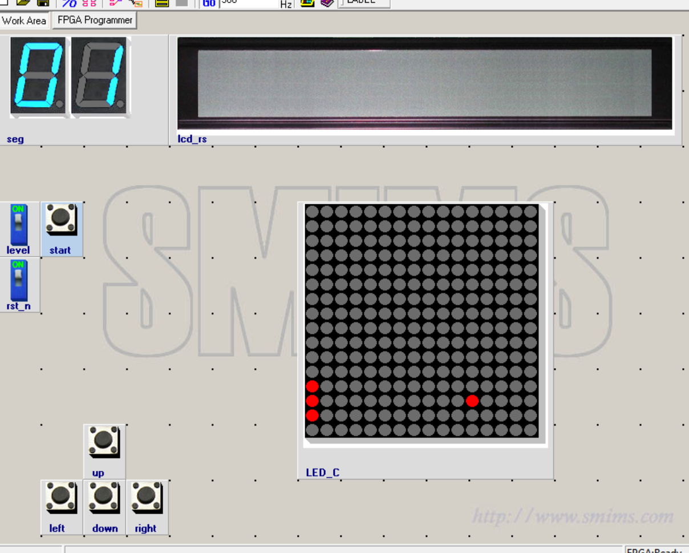
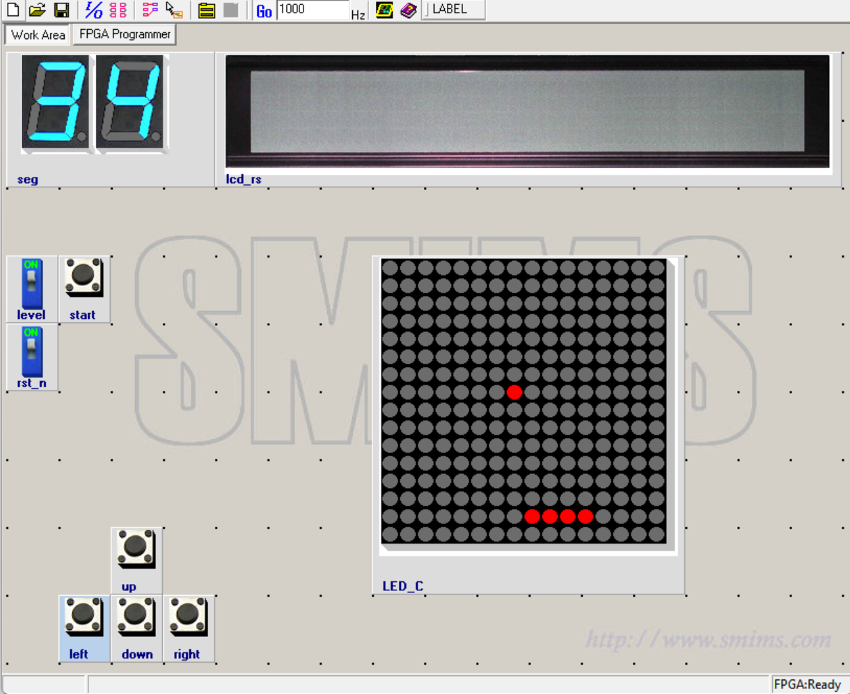
Gluttonous Snake

Slide 7
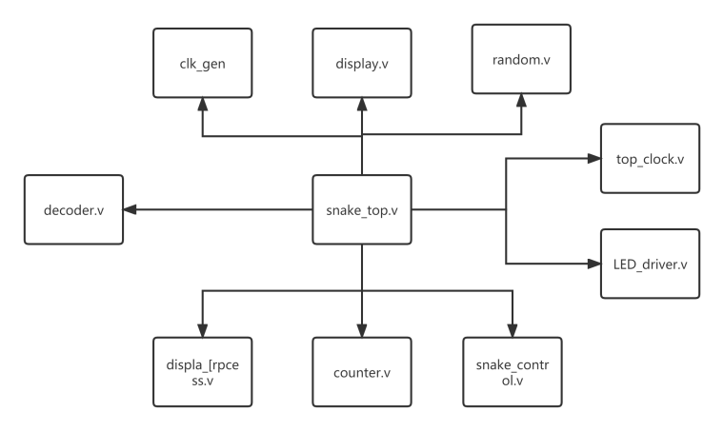
Structure of Module
Module | Function
Snake_top | Connect all the rest of the module
Clock_gen | Change the frequency of the input clk signal, provide the clock signal used by snake_ctrl module.
Random | After the spot is eaten by snake, a new food can be generated randomly.
Display_mux | Control the image of beginning
Led_driver | Use to drive the Led Matric
Top_clock | Control the Nixie tube to show how long has player played.
display | Power the Lcd to remind players if they have played for too long
Snake_contrl | respond to the input signal(up, down, left, right, rst_n, etc.) and also the food signal generated by themodule random
Display_process | Display the snake and food

Slide 8
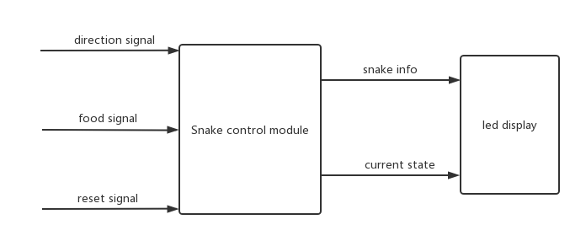
Snake_ctrl

Slide 9
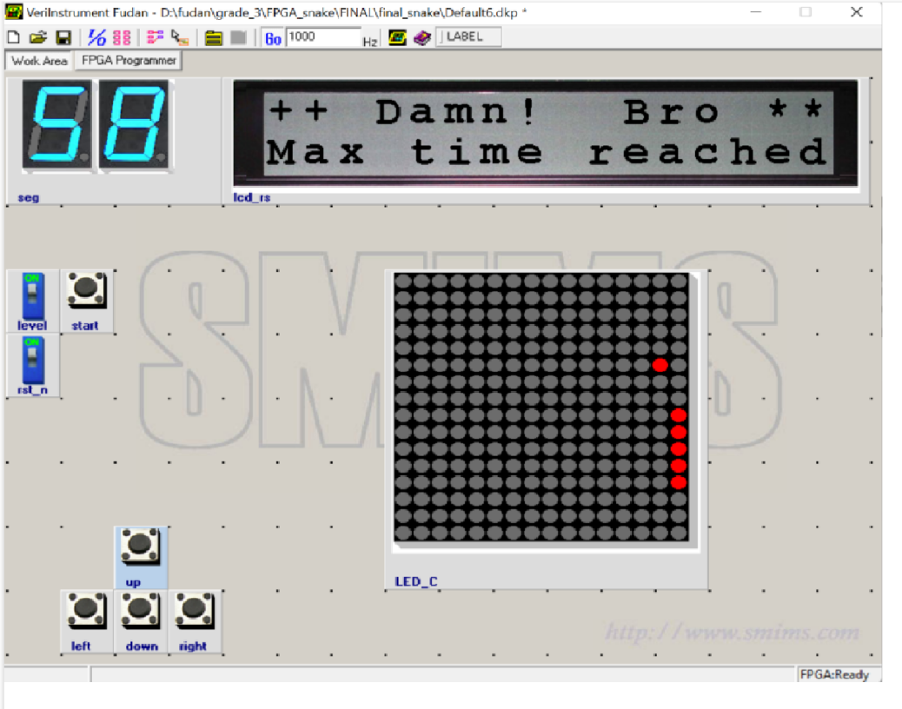
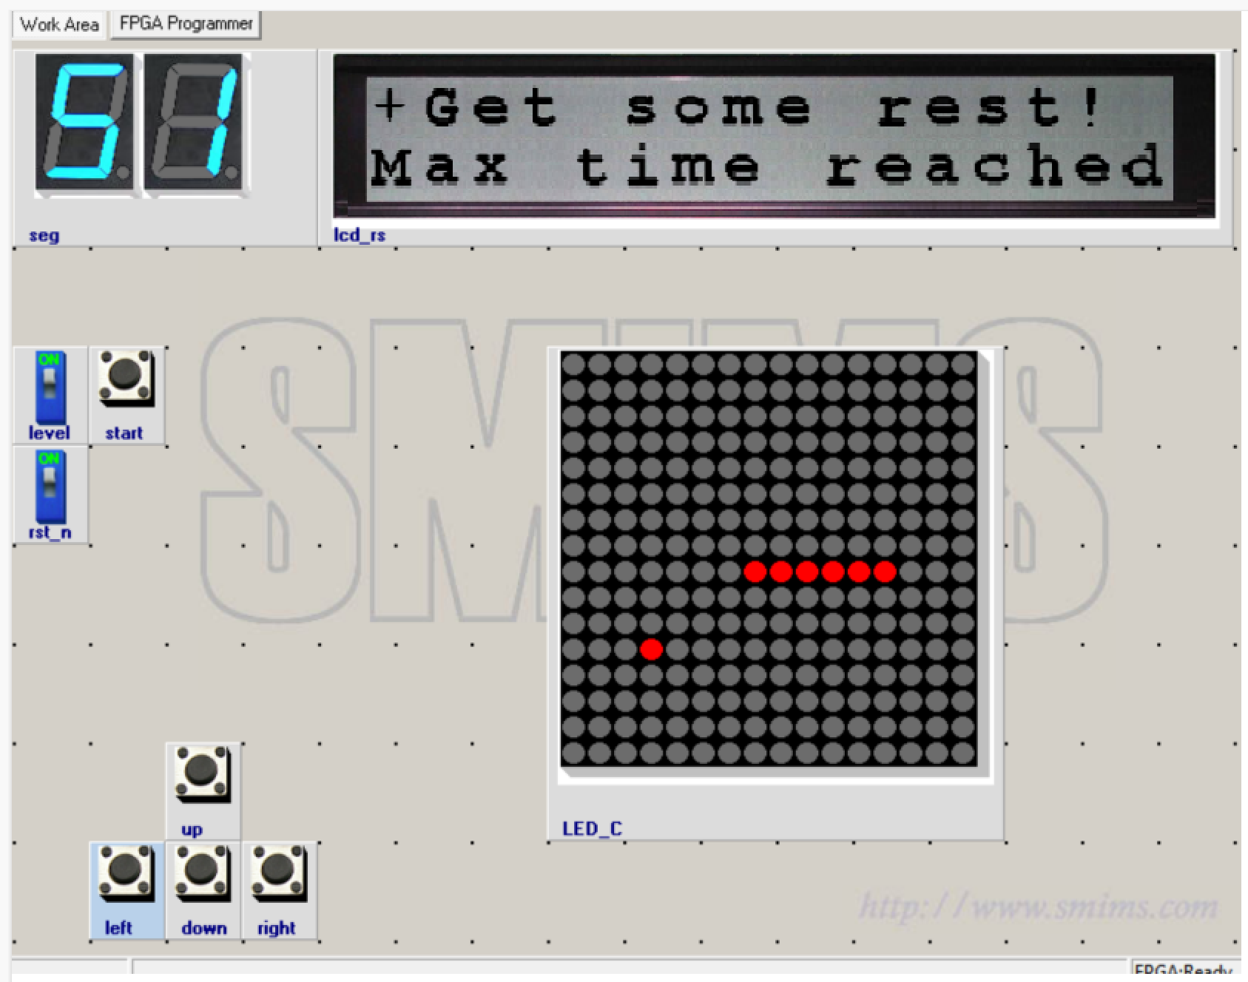
Addiction protection

Slide 10
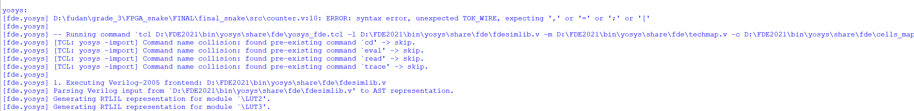
Problems
(1) Carelessness
Wrong next_state sytax error assign wrong wire....

Slide 11
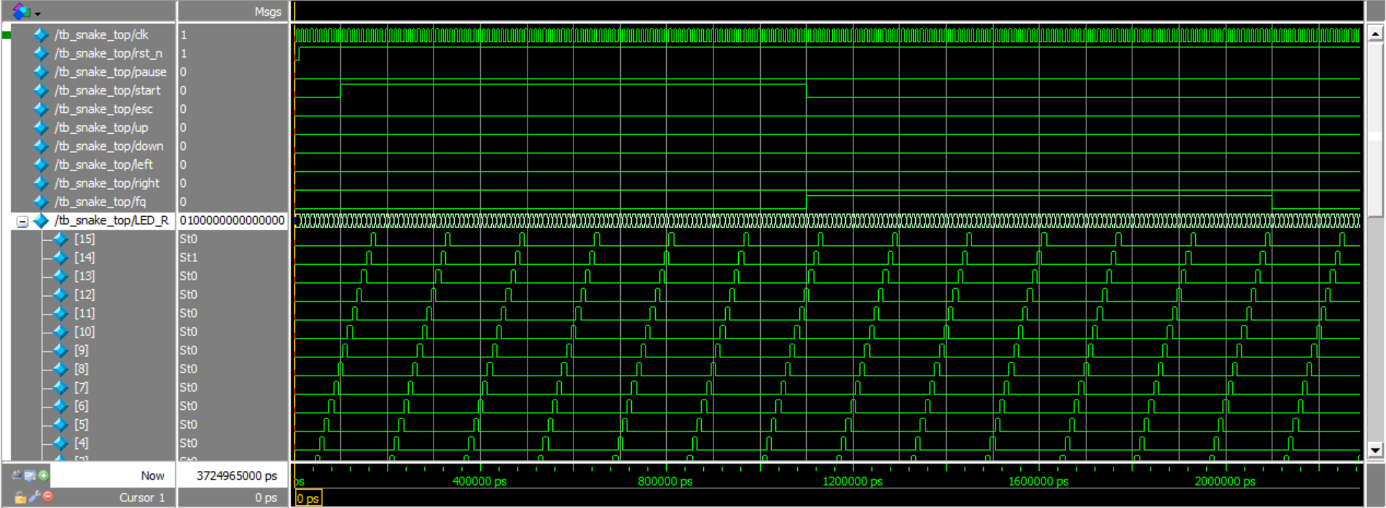
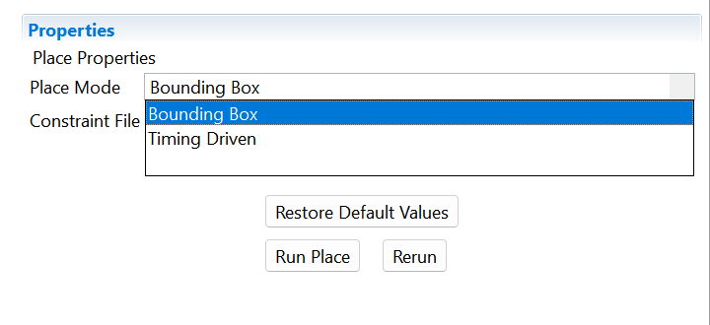
Problems
(2) Bitfile Problem
Bounding Box:
The placement constraint in FPGA physical design
Timing Driven:
The priority consideration of timing constraints in the FPGA design process

Slide 12
Problems
(3) Sensitivity of button

Slide 13
Thank you

