Slide 1
ELEC6228 Design Project
Dimitar Dzhapunov, Oliver Schamp, Martin Grigorov, Nikhil Bhumireddy, Matthew Sutcliffe
Notes:
Matthew

Slide 2
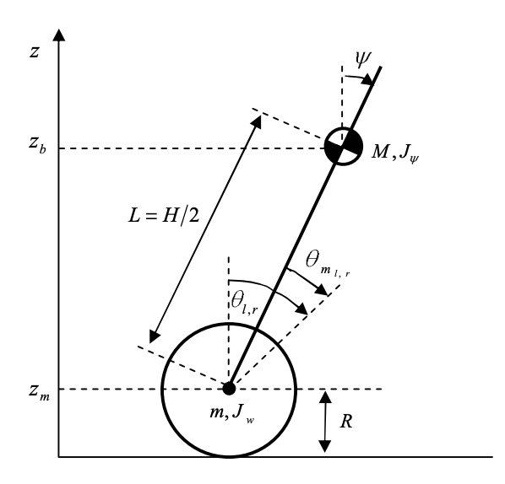
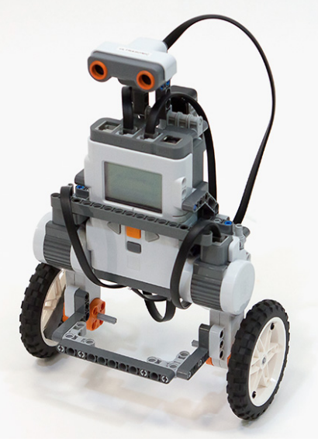
Part A – Controlling Lego Mindstorms NXT
The task:
Understand and verify the mathematical model – dual wheel inverted pendulum
Apply PID and MPC to the model
Reflect on the performance of different types of controller
Notes:
Matthew

Slide 3
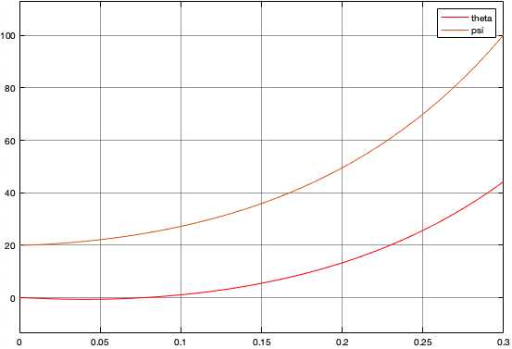
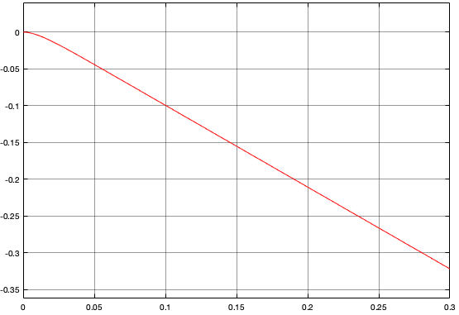
Verifying our implementation of the model
When initialised at psi=20 degrees, the robot fell over in 0.3s ->
The yaw angle model (independent from the 1D inverted pendulum) at opposite input voltages:
Notes:
Dimitar

Slide 4
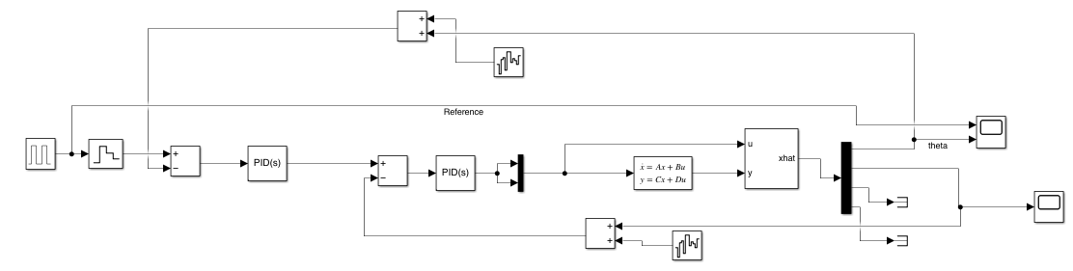
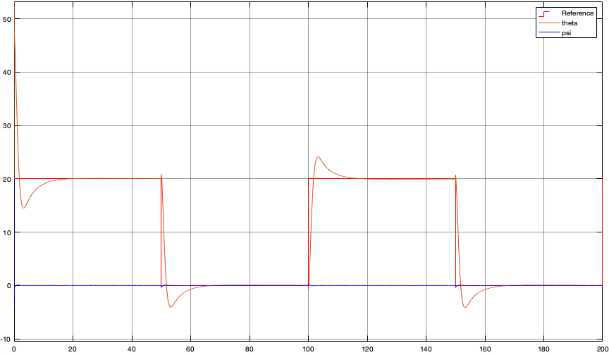
PID Controller
Notes:
Dimitar

Slide 5
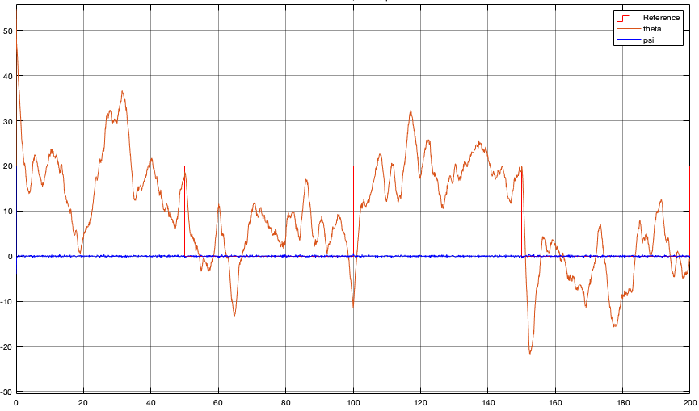
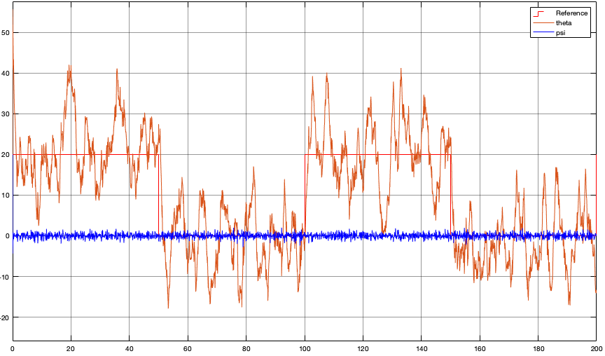
PID Controller + Noise
More sensitive to noise
Less sensitive to noise
Psi noise power 0.1:
Theta noise power 90
Noise in the second (psi) PID controller amplifies the noise in the first (theta) PID
Notes:
Dimitar

Slide 6
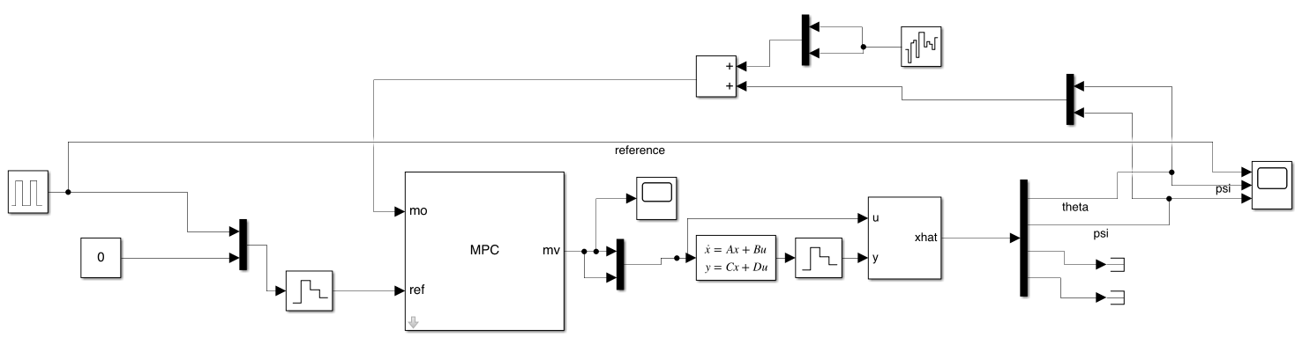
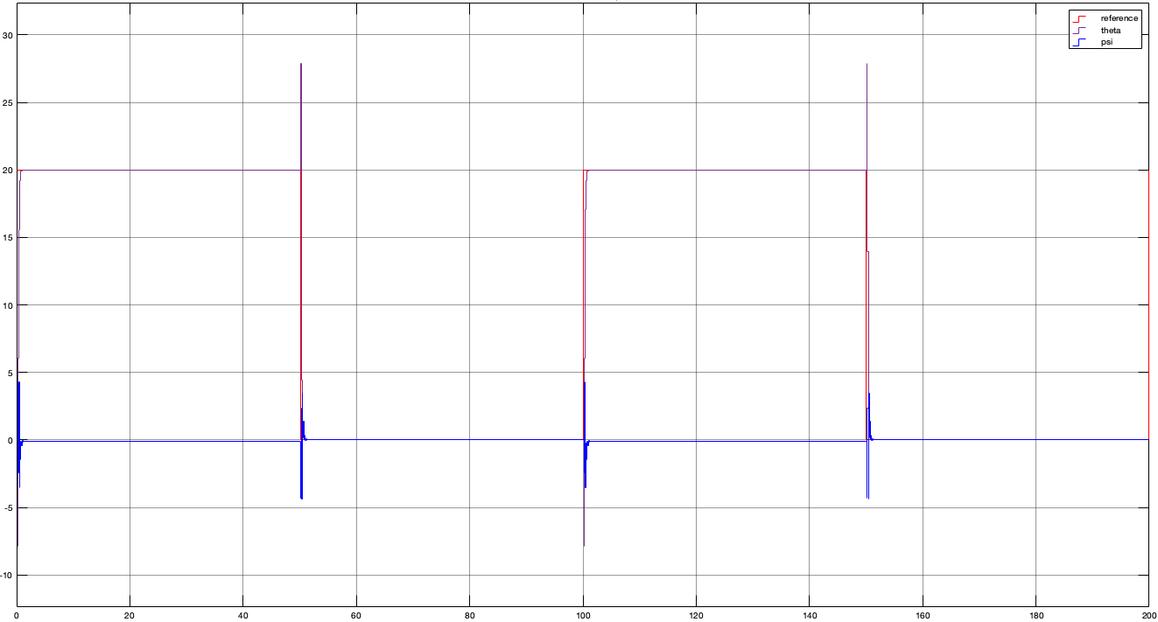

MPC Controller
Far better at tracking square wave than PID with no noise present
Notes:
Dimitar

Slide 7
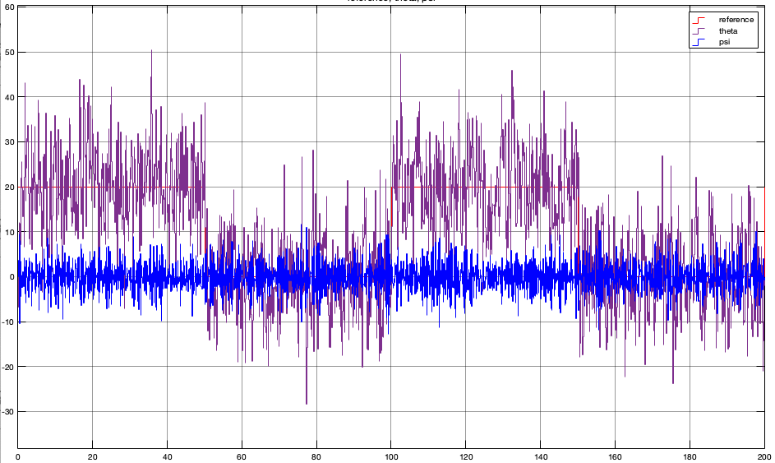
MPC Controller with noise
MPC noise with theta and psi both affected by AWGN noise power 0.1.
Overall, PID is more robust to noise than MPC
However, when the MPC signal is averaged it still follows the reference more closely than PID under noise
Notes:
Dimitar

Slide 8
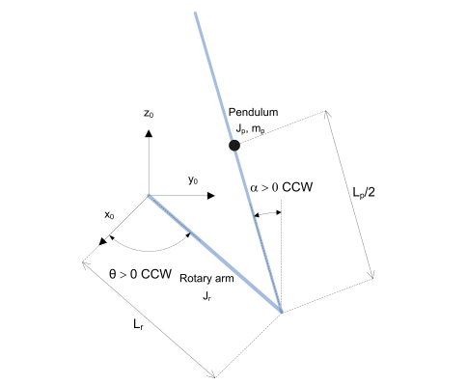
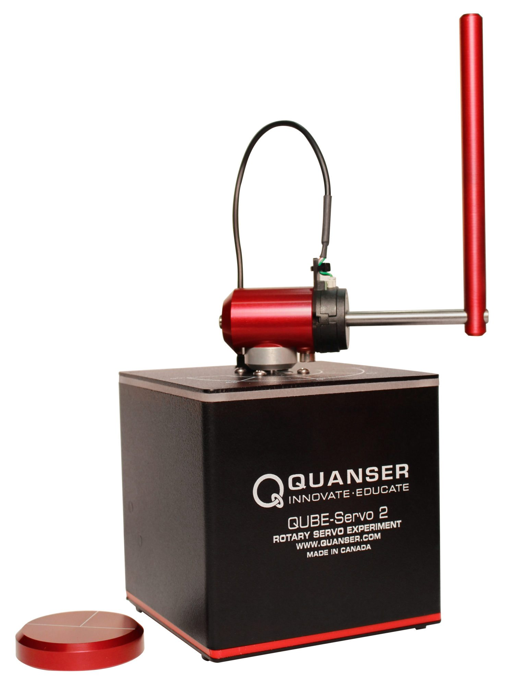
Part B – Controlling Quanser Qube Servo
The task:
To understand the mathematical model
Control either rotary pendulum or disc using LQR, MPC, ILC
Reflect on the performance of different control techniques
Notes:
Matthew:
Using the mathematical model we have established, we want to apply the various control methods acting on the rotary pendulum. Then extract performance data to determine the relative advantages and disadvantages of each control scheme. After obtaining baseline results, we will add disturbances to the system and determine the robustness of the control method.

Slide 9
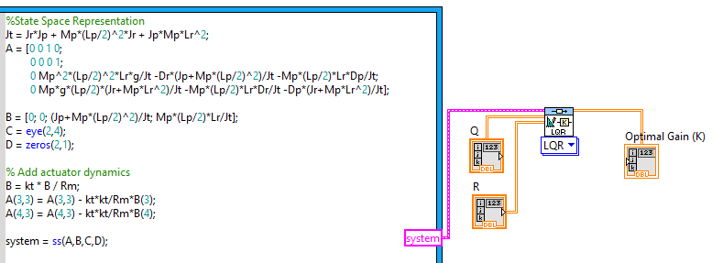
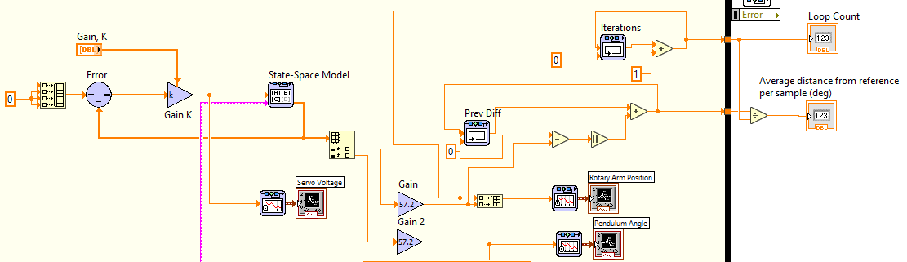
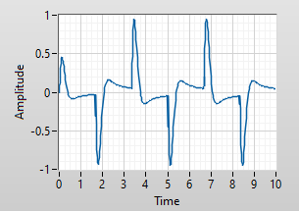
Simulating LQR
Used LabVIEW LQR block to produce an ideal starting gain for Q,R = I
Tuned gain in simulation to reduce instability in the pendulum angle graph
Quantifying performance
Control loop
Notes:
Matthew – First we created a simulation for LQR to establish a baseline model. To do this, we input our state-space representation and initial Q and R values from the cost function to the LQR block. Then our 'optimal' gain is computed, which we plug into our control loop. Then we add outputs to extract our performance data. In this case we chose average distance from the reference as one of our main performance metrics to be used for all control schemes. ***
*** (Ollie) Further comment – we decided on our optimal gain after changing Q and R a few times until good performance in the pendulum angle graph (bottom left) and the quantifying metric was found in the control loop simulation (obviously in experimental data this did not work so well and required further tuning).

Slide 10
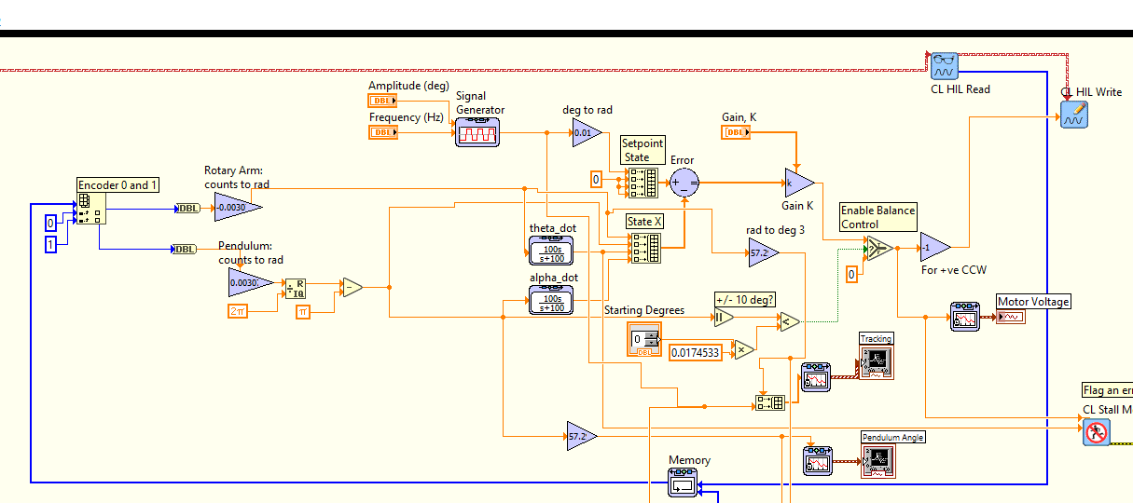
Applying LQR to the Qube
State - R
Controller
Read from plant
Notes:
Matthew – Now we apply the LQR controller to the QUBE servo, first servo and pendulum angles are processed and input into our controller. We also input our square wave reference for theta. Then send our control signal to the CL HIL block which interfaces with the QUBE to produce the servo voltage which turns the rotary arm. The following state is obtained on the next iteration of the control loop via the CL HIL read block.
(Ollie) Some comments on why I’ve circled parts of the diagram:
Read from plant-how the servo angle and pendulum angle are processed from the output of CL HIL Read into +/-90 and +/-180 degrees
State-R-the reference is a square wave for theta, and 0 for the other values as we ideally want a still [dalpha=0], upright [alpha=0] inverted pendulum
Controller-The feedback loop goes through the Qube -> the output voltage value is given to CL HIL write, which applies this voltage to the Qube servo. The next state is acquired on the following iteration of the labview control and simulation loop via CL HIL read, which is converted into the format as in State X. The transfer functions used to model our state-space system were 100s/(s+100) - applying these we could find dtheta and dalpha.
Martin – changing the starting angle and anything else you did or you feel is relevant (e.g. ODE solver, …)

Slide 11
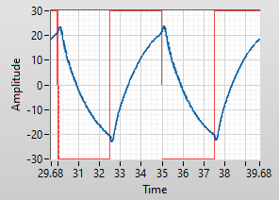
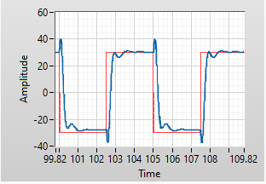
Tuning LQR for Optimal Performance
Retuned from simulation to experimental
Final error of 8.7 degrees for 30deg, 0.2Hz tracking (our constant reference)
From LabVIEW LQR block (Sim)
Tuned LQR (Experimental)
Notes:
Martin

Slide 12
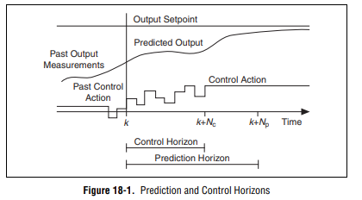
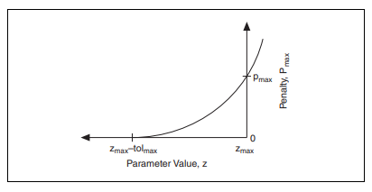
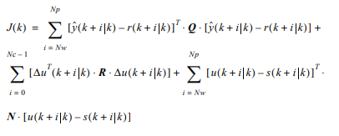
MPC Design Choices
First attempted to simulate MPC explicitly with MathScript
Decided on LabVIEW's own blocks due to ease of changing prediction/control horizon and for more speed
Cost function and Barrier constraints
Notes:
Oliver
In our control lectures, we learned about the MPC tracking method, constructing G with C,A,B and using a solver to solve the cost quadratic given by expanding out the finite horizon cost function. We at first tried to implement this method explicity with mathscript blocks, but smoothly running simulations were difficult to make. Therefore, we decided to implement MPC using Labview blocks.
The reason for this was not only speed, and therefore a greater prediction/control horizon before time constraints were exceeded, but also variety in the constraints and types of constraints we could apply. The prediction horizon deals with looking ahead in time to calculate a cost for the deviation from the output reference, and the control horizon is the second term in the cost function which deals solely with the input values to the plant. In the equation, Q is the output error weighting and R is the control action change weighting.
For our constraints, we used barrier constraints over hard constraints to allow for a small amount of flexibility in our constrained factor. The idea was that if constraints were unforgiving, the system could quickly lose balance when those constraints were activated. The graph here shows the barrier function, with a tolerance on the x axis and a penalty on the y axis controlling the gradient of the quadratic that returns the overall value to be added to the cost function.

Slide 13
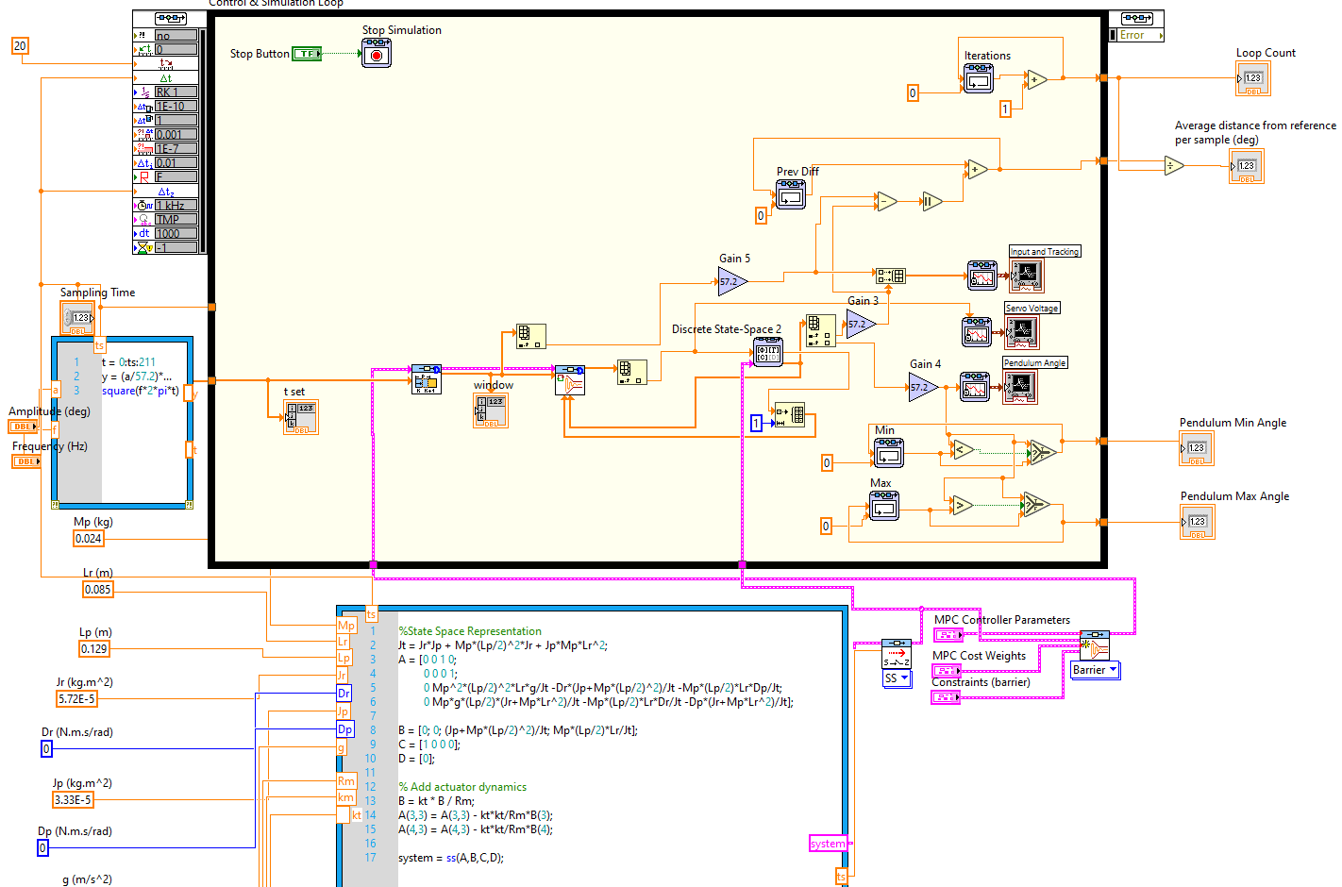
Simulating MPC
'Global' sampling time
Dynamic MPC
Discretization
Entire reference
Simulation only
Discretization and Initialization
Notes:
Oliver
Implementing MPC in simulation required many changes compared to the LQR simulation. As MPC works by sampling time and is therefore a discrete process, the mathematical model had to be discretised via a global sampling rate, which was fed into the control and simulation loop, and the continuous to discrete converter block. The sampling time was also given to the mathscript block on the left, which generated the entire reference ahead of time and fed this to the horizon block, which incremented a window of length prediction horizon across the full reference vector with every iteration of the control and simulation loop.
The state-space model was discretised, the ODE solver was changed to discrete states only. The parameters fed into the MPC setup concern one cluster specifying the control and prediction horizons, one cluster specifying the output error and control action change weightings, and one cluster specifying constraints to the system.

Slide 14
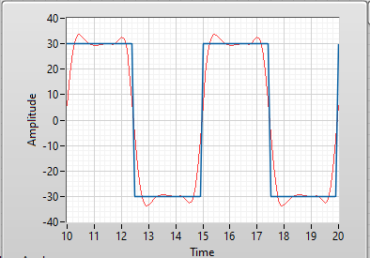
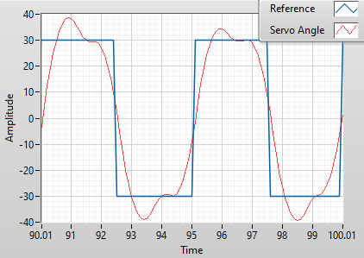
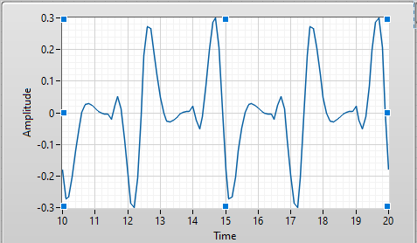
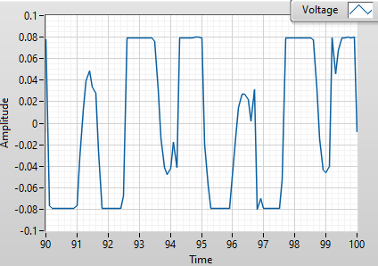
MPC Simulation Results (Q,R = 1)
Unconstrained:
Constrained:
Tracking
Deviation: 4.6
Deviation: 11.8
Voltage
Notes:
Oliver
The results for implementing MPC with Q and R equal to 1, and therefore their full matrices equal to the identity of size prediction/control horizon, gave the expected results. As you can see, on the left the servo voltage has the same period as the reference, on the right the servo voltage loses its periodicity as constraining the voltage at +/- 0.08 causes the MPC to continually re-evaluate its control decisions. As expected, the deviation also becomes larger with constraints.

Slide 15
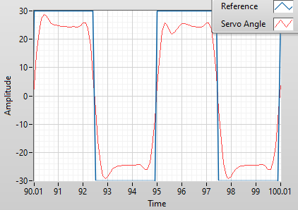
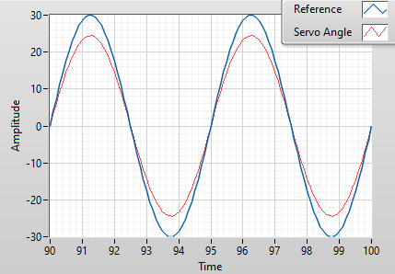
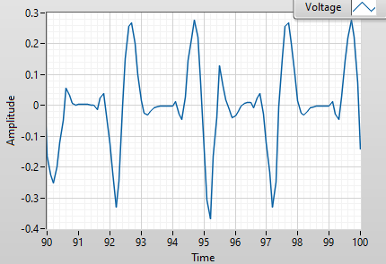
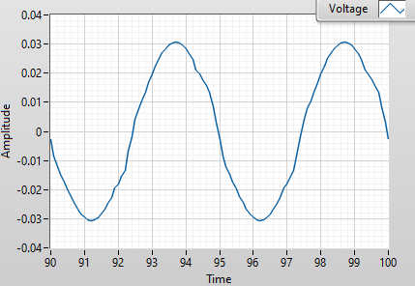
More MPC Simulation - Output Constraints
Notes:
Here you can see that output constraints can also be applied. The voltage graphs show some small signs of deviating from periodicity here too.

Slide 16
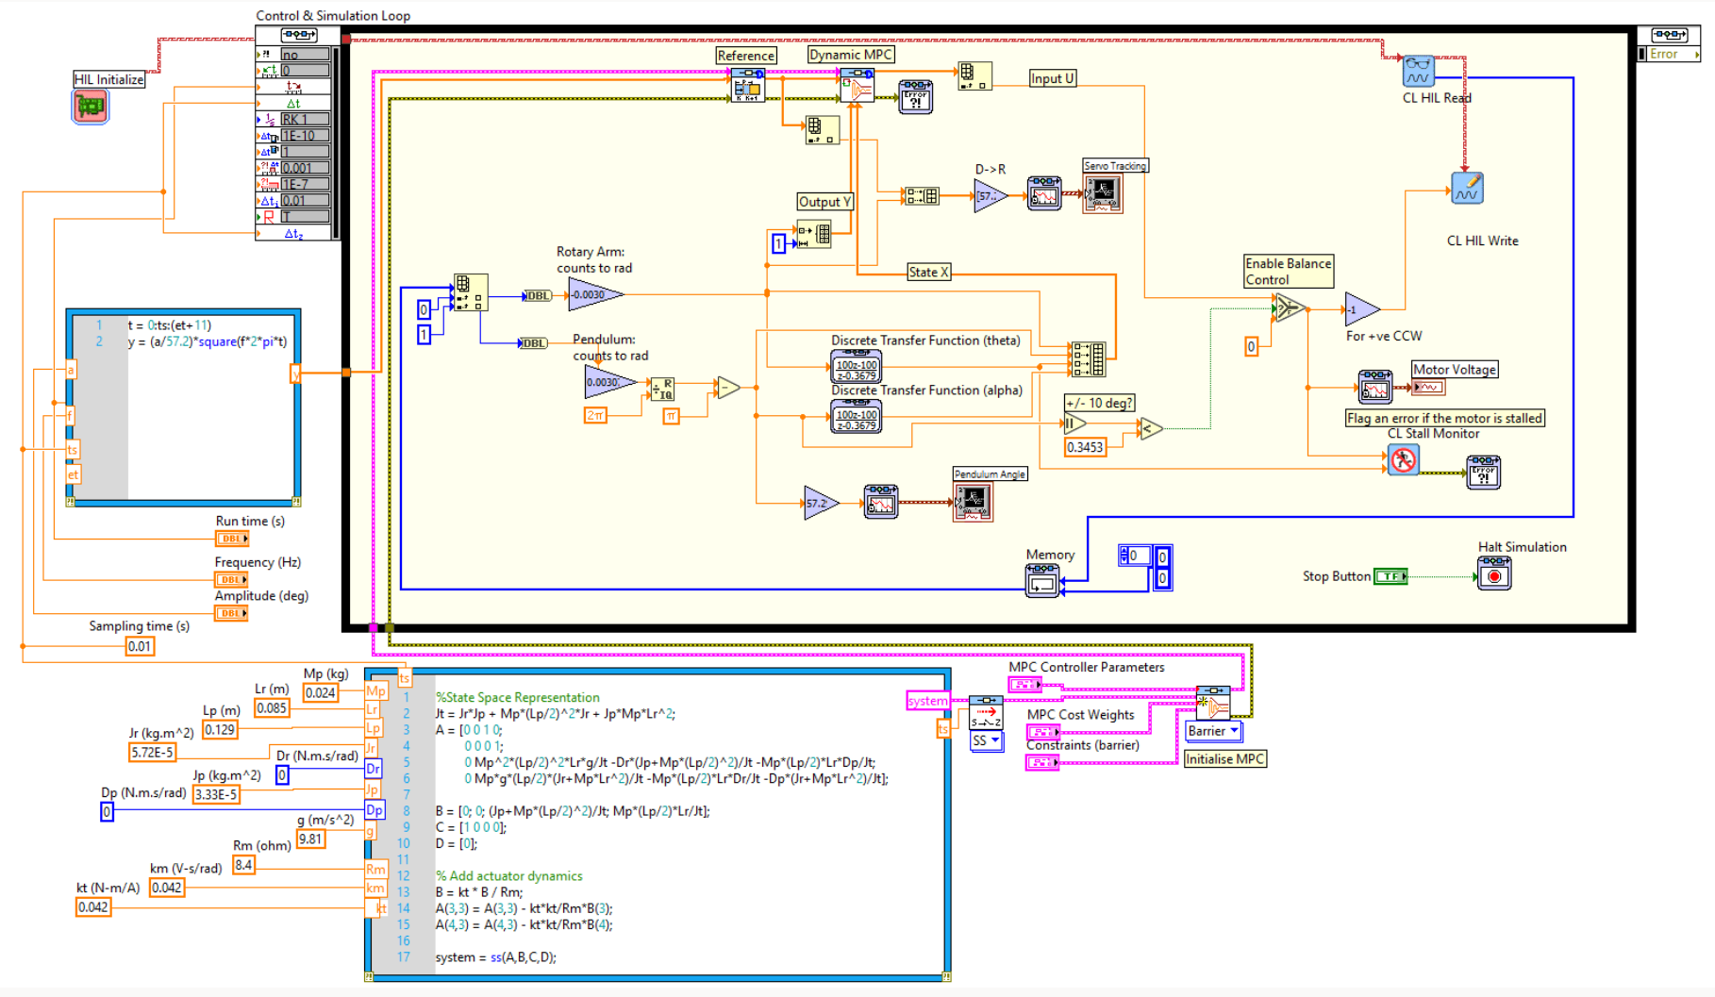
MPC On Qube Servo
Discretize
Mathematical model needed (unlike LQR)
Notes:
Oliver
With regards to taking the simulation and making it compatible with the Qube servo, MPC is mostly the same as LQR. Theta was used as our output only, given that we set y to being one dimensional, the state was fed to the MPC controller along with the reference. I'll now hand over to martin to talk about the main process of producing a balancing pendulum with MPC.
Martin – discretising and other changes to the qube servo system (e.g. increasing the threshold angle from 10 degrees)

Slide 17
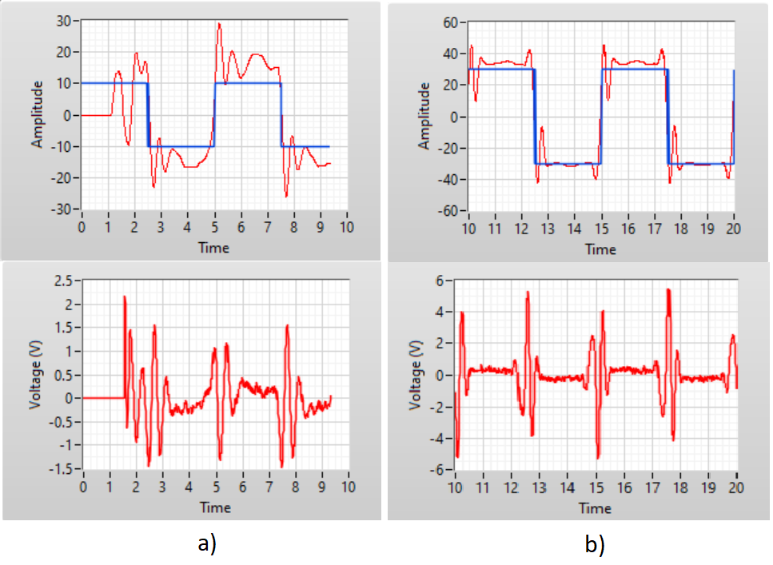
Tuning MPC for optimal performance
Very large prediction horizon
More cost weighting on tracking error than control input
Final error of 6.2 degrees - better than LQR
We couldn't get constraints working on hardware
Notes:
Martin

Slide 18
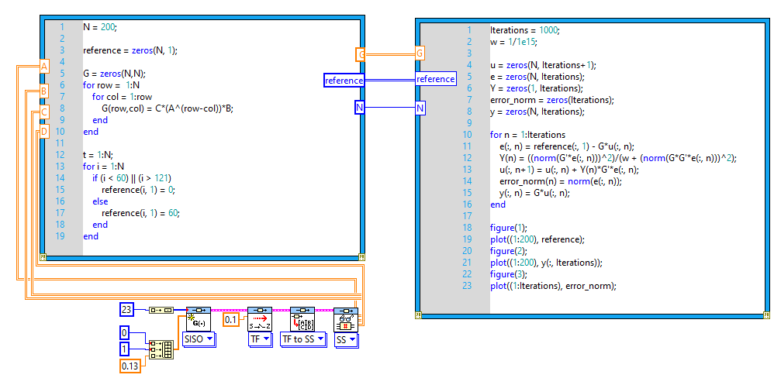

ILC
Servo Tracking
Gradient Based Algorithm
Simulation in LabVIEW using MathScript blocks
Notes:
Niks

Slide 19
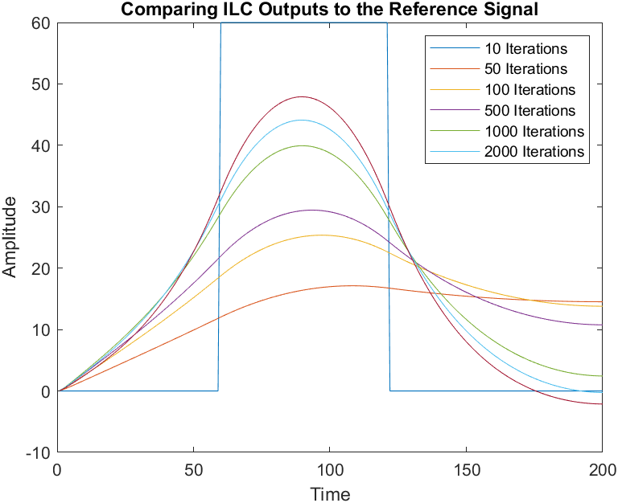
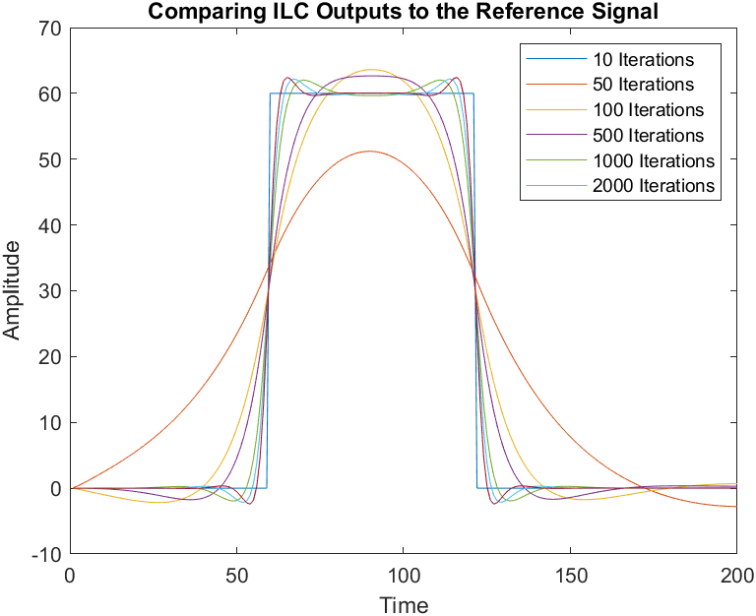
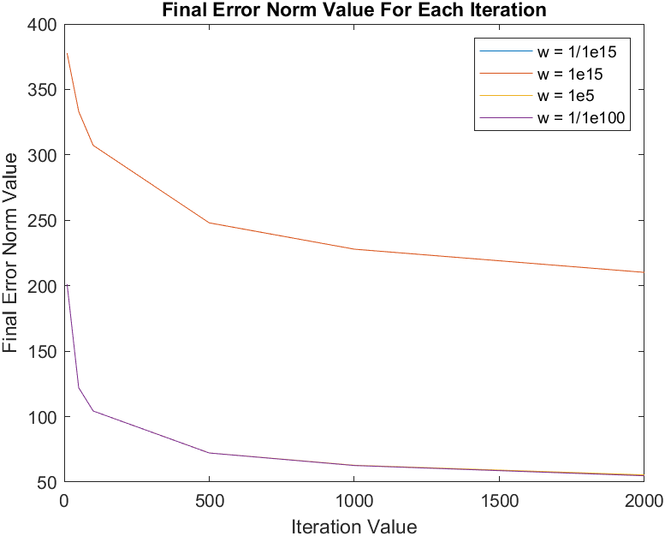
ILC Simulation Results
Different values for the scalar of the learning gain
1e-100
1e-15
1e5
1e15
1e15 the only one to produce drastically different results
Monotonic Convergence

Slide 20
Conclusions
MPC is better at tracking than LQR – but unless tuned very finely it is less robust on a real system
MPC requires more computational power than LQR
Constraining the input in this case put a barrier on the rate at which the servo could move, lowering gradients in the reference tracking graph
ILC shows the expected results, but it remains to be experimentally tested
Observation: Always simulate a system before applying the theory to real hardware
Notes:
Oliver

