Slide 1
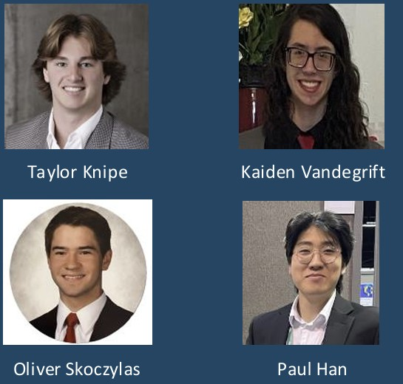
SPRINT 3
SXM GO
Gamified Island Exploration
PRESENTATION
TEAM MEMBERS
Oliver Skoczylas (Dev 1) – Core Auth & User Management
Kaiden Vandegrift (Dev 2) – Map, Location & Check-In
Taylor Knipe (Dev 3) – Gamification Engine
Paul Han (Dev 4) – Social Features & Leaderboards
Taylor Knipe
Kaiden Vandegrift
Oliver Skoczylas
Paul Han
🌐 https://sxmgo.vercel.app/
💻 https://github.com/OliverSkoczylas/SXM-GO

Slide 2
PRIORITIZED SPRINT 3 GOALS
P1
Itinerary Builder UI
P1
Activity Route Tracking
Full itinerary creation and editing UI (3–20 stops); pre-made routes: Foodie, Beach Hopper, Cultural Explorer; share via unique link + QR code.
GPS start/stop route recording; route displayed on map; activity statistics: distance, duration, pace, elevation.
Owner: Dev 4
Owner: Dev 3
P1
Friend System & Groups
P2
Full Push Notification Pipeline
Friend search, requests, and profiles; group competition with invite codes and group leaderboard.
End-to-end FCM/APNs delivery for badge, challenge, and leaderboard events; <30s delivery SLA.
Owner: Dev 1 & Dev 4
Owner: Dev 4
P2
GDPR/CCPA Compliance + Profile UI
P3
Map Polish & Infra
Data export (JSON), consent controls, deletion; profile update screen (name, photo, preferences).
Route overlay on map; location detail view polish; clustering for 50+ pins; Supabase paid tier upgrade; WCAG 2.1 AA accessibility audit.
Owner: Dev 1
Owner: Dev 2 / All

Slide 3
PROJECT BACKLOG · SPRINT BACKLOG
PROJECT BACKLOG (Selected Items)
SPRINT 3 BACKLOG
FR-001–013 User Auth & Profiles
DONE
Itinerary Builder UI (create, edit, share)
Dev 4
FR-014–026 Map, Locations & Check-In
Pre-made itineraries (Foodie, Beach, Cultural)
Dev 4
DONE
Full push notification delivery pipeline
Dev 4
FR-027–035 GPS Anti-Fraud & Security
DONE
Group competition & invite code system
Dev 4
FR-036–043 Points, Badges & Challenges
DONE
Friend system UI (search, requests, profiles)
Dev 1 & 4
FR-072–075 Leaderboard System
DONE
Friend system backend (send/accept/decline)
Dev 1
FR-044–058 Itinerary System
DONE
GPS activity route tracking (start/stop)
Dev 2
FR-084–096 Activity / Route Tracking
Activity statistics screen
Dev 2
DONE
Streak bonus & badge tier UI
Dev 3
FR-097–103 Social Features & Friends
DONE
Route visualization overlay on map
Dev 2
TR-027–035 GDPR / Compliance
DONE
Location detail view polish
Dev 2
Profile update UI & GDPR compliance
Dev 1
Supabase paid tier + clustering
Dev 2
Accessibility audit (WCAG 2.1 AA)
All

Slide 4
🔒 CYBERSECURITY ASSESSMENT
Authentication Security
COMPLETE
Data Privacy & GDPR
IN PROGRESS
Passwords bcrypt hashed
JWTs in Keychain/Keystore
Sessions expire 30d; rate limiting 5/min on login
Google & Apple OAuth live
HTTPS/TLS 1.3 on all endpoints
GDPR data export endpoint (Sprint 3)
CCPA consent controls (Sprint 3)
User deletion operational
GPS Anti-Fraud
COMPLETE
API Security
IN PROGRESS
Impossible-travel-speed detection live
Mock location flag detection active
QR code fallback for poor GPS zones
Manual review queue for flagged check-ins
API keys server-side via proxy
Input validation on all endpoints
SQL injection protection via Supabase ORM
OWASP Top 10 audit planned Sprint 3

Slide 5
SPONSOR FEEDBACK
CURRENT STATE
LOOKING FORWARD
Sponsor was very satisfied with the current product
Faculty advisor liked the current feature set on the user side
Only questions were about adding business functionality
Next team will be responsible for adding the business portal
They will also be in charge of final deployment for the UA team

Slide 6
LESSONS LEARNED
1. OAuth Config Takes Longer Than Estimated
4. Integration Tests Before Demo
Provider edge cases (Apple on Android) require extra time. Budget 1.5× the estimate for OAuth work.
Check-in → points → badge pipeline had edge cases found late. Integration tests before sprint review are mandatory.
2. Seed Data Quality Matters Early
5. Supabase Realtime Tier Planning
Placeholder pins slowed Dev 2. Real coordinates should be seeded before frontend pin work starts.
Free tier connection limits hit during load test. Upgrading to paid tier is required.
3. Security Must Be Sprint 1 Scope
TLS rate limiting on all routes should have been in Sprint 1. Retrofitting security costs more than building it in.

Slide 7
ACCESSIBILITY & INCLUSIVE DESIGN
1. WCAG 2.1 AA Compliance
4. Multi-Language & RTL Ready
Touch targets minimum 44 x 44 pt; color contrast 4.5:1 for body text, 3:1 for large text.
Every interactive element has an accessibility label for TalkBack (Android) and VoiceOver (iOS).
All UI strings are externalized to a localization layer, no hard-coded English in components.
2. Color-Blind Safe Palette
5. Touch & Motor Accessibility
Palette tested against deuteranopia and protanopia simulations before finalizing.
Large spaced touch targets with 8 pt minimum gap between all interactive elements.
3. Scalable Typography
6. Offline & Low-Bandwidth Access
Base font 14–16 sp, 1.4x line height. Text scales with OS Dynamic Type / Font Scale settings.
Leaflet/OpenStreetMap tiles cache offline, critical for rural and low-bandwidth users.

Slide 8
TEAM CONTRIBUTIONS
Developer 1 – Oliver Skoczylas
Developer 2 – Kaiden Vandegrift
Auth, Security & GDPR
Map, Route & Polish
Completing:
Completing:
Profile update UI, GDPR data export + consent, friend system backend, security audit
Route overlay on map, location detail polish, map clustering, Supabase upgrade
Developer 3 – Taylor Knipe
Developer 4 – Paul Han
Gamification & Activity
Social, Itineraries & Notifications
Completing:
Completing:
Project Documentation
API Standardization and Docs
Test suite for shared components
Leaderboard UI Refinements
Itinerary builder UI Refinements
Itinerary sharing
Social sharing feature

Slide 9
LIVE DEMO
Sprint 2 Feature Walkthrough
01
02
03
04
Social OAuth
(Google Login)
Offline Map &
QR Check-In
Badge Unlock
Notification
Weekly
Leaderboard

