Slide 1
Stone Weirs, Shared Futures
Governance-First AI Question Answering and Guided Narratives for Maritime Heritage
Yu-Hsin TAI¹ · Chen-Min LAI² · Jen-Fu LEE³ · Yun-Fang CHANG⁴
¹ Department of Psychology, Fu Jen Catholic University, Taiwan
² National Central University; Dream Maker
³ College of Hakka Studies, National Central University, Taiwan
⁴ Independent Researcher, Taiwan
An ethics-forward design study at Technology Readiness Level 3
Notes:
Genre declaration. DSR produces an ARTIFACT; NASA TRL-3 is "analytical and experimental critical function / characteristic proof of concept". Validation in a relevant environment is TRL-5, which this study does not claim. Say this in the first thirty seconds and the small-n objection never lands. OPTIONAL: a full-bleed photograph of the Kejian weirs at low tide could sit behind this title.

Slide 2
ACT 0 · FRAME
The claim in one sentence
Governance before generation.
This study addresses this gap through a governance-before-generation approach.
The contribution is an operational paradigm: governance-before-generation for cultural heritage AI.
INFERENCE The ordering is a falsifiable claim, not a slogan: if governance were merely additive, constraining the retrieval scope would not change the error profile. Act VI tests exactly that, and Act VII concedes what the test cannot separate.
Verbatim: Abstract; §1 Introduction
2
Notes:
External anchor — Menotti (2025), "The model is the museum" (AI & Society): generative systems act as epistemic infrastructures that expropriate heritage through extraction without consent, erasure of authorship, and decontextualisation. All three occur UPSTREAM of the prompt, which is the strongest available argument that a post-hoc fix cannot work.

Slide 3
ACT 0 · FRAME
Roadmap
I. Background — Xinwu, stone weirs, and knowledge held by a community
II. Problem — three epistemic risks and the missing pathway
III. Position — governance as architectural constraint
IV. Design — the three-layer artifact
V. Case and instrument — 35 governed records, 24 QA items
VI. Evidence — RQ1, RQ2, RQ3
VII. Reading the evidence honestly
VIII. Contribution · IX. Forward and close
INFERENCE The talk follows the artifact's own dependency order, not the paper's section order: each act supplies the precondition the next one consumes.
Structural slide
3
Notes:
Also signals that a limits section is planned rather than extracted under questioning.

Slide 4
ACT I · BACKGROUND
The place
Stone weirs along Taiwan's coast embody socio-ecological production landscapes recognized by the Satoyama Initiative (UNU-IAS & IGES, 2010).
Xinwu lies on Taoyuan's western coast, along Provincial Highway 61: a coastal protection forest of 黃槿, 木麻黃, 白千層, 朴樹, 烏臼 and 構樹; wind turbines; a gravel beach; and intertidal flats worked at every tide.
待補照片 · PHOTOGRAPH TO BE ADDED
海岸全景：低潮時的礫石灘與潮間帶，遠方地平線上是台 61 線的白色風車。橫幅構圖。目的是建立尺度感——石滏應該讀起來像一段仍在運作的海岸線，而不是紀念物。
A wide coastal shot: the gravel beach and intertidal flats at low tide, with the wind turbines of Highway 61 on the horizon. Landscape orientation. Its job is to establish scale — the weirs should read as part of a working shoreline, not a monument.
INFERENCE The SEPLS designation is not scene-setting. It asserts that this landscape is produced by human practice — so the data describing it is community-authored, and authority over that data is a community right, not a courtesy.
Para. 1 verbatim: §2. Para. 2: source narrative (Chi, n.d.)
4
Notes:
External anchor — IPSI's "Indicators of Resilience in SEPLS" toolkit (2024 ed.) is a community-based SELF-assessment instrument: the community scores its own landscape. The governance records here are the same move applied to data rather than to ecology.

Slide 5
ACT I · BACKGROUND
Three layers of the landscape
Algal reef (藻礁) — formed by crustose coralline algae that calcify after death and settle on the gravel beach. Unlike the coral reef most people know, it is not animal-formed. It grows about one centimetre every ten years.
Coastal protection forest (保安林) — 黃槿, 木麻黃, 白千層, 朴樹, 烏臼, 構樹.
Stone weirs — on the intertidal zone, where the tide does the fishing.
待補照片 · PHOTOGRAPH TO BE ADDED
藻礁表面的低角度特寫：層疊而略帶孔隙的質地，最好是濕潤反光的狀態。畫面中放一枚硬幣或一隻手作為比例尺——因為這一頁的重點是：一公分花了十年。
A close, low-angle detail of the algal reef surface — the layered, slightly porous texture, ideally wet and catching light. Include a coin or a hand for scale: the point of this slide is that one centimetre took ten years.
INFERENCE One centimetre per decade is exactly the kind of fact a language model approximates rather than retrieves — right order of magnitude, wrong value. Slide 15 shows it doing precisely that.
Source narrative (Chi, n.d.); the growth rate is governed record OB-02
5
Notes:
External anchor — the 2025 review of hallucination mitigation for RAG (Mathematics 13(5):856) identifies over-reliance on parametric knowledge as a primary failure mode; quantitative approximation is its visible signature.

Slide 6
ACT I · BACKGROUND
What a stone weir is — and what it is called here
A stone weir is a tidal fish trap: a wall built at the shore that takes its catch from the fall of the tide.
In Xinwu, Hakka communities developed unique fishing-specific vocabulary — shihwen (石塭) for stone weirs, liushueilai (流水來) for rising tide.
Hakka shihwen (石塭) vs Mandarin shihhu (石滬) retained across records.
Penghu builds from coral rock and basalt; Xinwu gathers local cobbles (鵝卵石).
待補照片 · PHOTOGRAPH TO BE ADDED
低潮時從堤上或空中俯瞰石滏的弧形滏堤，讓圍捕結構一眼可辨。空拍最佳。若只有地面視角，請選能看見鵝卵石砧法（而非哾咕石）的那一張。
The curved arm of a weir seen from above or from the seawall at low tide, so the enclosure reads as a deliberate structure. An aerial frame is ideal; if only a ground-level shot exists, choose one where the cobble construction — not coral rock — is visible.
INFERENCE Two lexicons for one object mean a retrieval system must preserve the distinction rather than normalise it. Normalisation is silent cultural loss: a fluent answer, wrong in a way no fluency check detects.
Paras. 2–3 verbatim: §2; §5.2. Para. 4: source narrative
6
Notes:
External anchor — CARE's "Authority to Control" and Carroll et al. (2021) on cultural metadata: the record must carry the community's own terms, not a canonical form imposed for retrieval convenience. This is why vocabulary precision is scored as its own dimension in §5.3.

Slide 7
ACT I · BACKGROUND
Hakka at the sea — the stereotype this overturns
In Xinwu, Hakka communities developed unique fishing-specific vocabulary … that challenges the stereotype of Hakka as exclusively mountain-dwelling people. This knowledge exists primarily in qualitative narratives.
A 2010 Hakka fishing-village cultural resource survey (College of Hakka Studies, NCU) recorded vocabulary with no counterpart inland: 流水來 rising tide, 湧 waves, 鐵甲仔 armoured fish, 蚵咾石 coral rock.
近山識鳥聲，近海知魚性 — by the hills you learn birdsong; by the sea, the ways of fish.
INFERENCE If a 2010 field survey was needed to record this vocabulary, it is by definition thin in any web-scale training corpus. Under-representation — not model size — predicts the failure shown at slide 15.
Para. 1 verbatim: §2. Paras. 2–3: source narrative (Chi, n.d.)
7
Notes:
External anchor — Menotti (2025) argues generative systems homogenise non-dominant cultures by compressing them into statistical patterns; the long tail is not merely missing, it is smoothed toward the dominant form. Here that means 石滬 displacing 石塭.

Slide 8
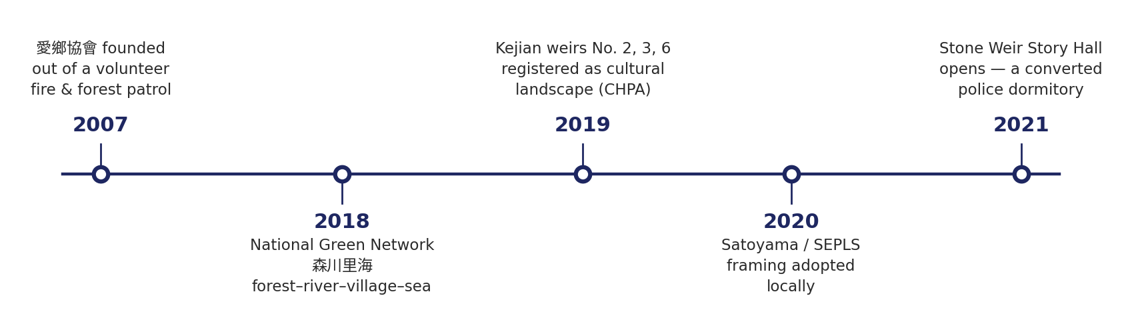
ACT I · BACKGROUND
Knowledge held by a community, not an institution
Stone weir knowledge in Xinwu, maintained by Hakka fishing communities, exemplifies this challenge: centuries of ecological practice, linguistic heritage, and place-based identity encoded in context-rich narratives that resist direct ontological formalization.
The patrol grew from single-digit volunteers to more than thirty formal members. Yongxing's weirs were lost to years without maintenance, date unrecorded.
INFERENCE The custodian is an association of volunteers, not an institution with a registrar. Any governance scheme that presumes institutional capacity is unusable here — P3 arriving three slides early, as a fact rather than a claim.
Para. 1 verbatim: §1. Timeline: source narrative (Chi, n.d.)
8
Notes:
External anchor — CIDOC's own guidance "Documenting Cultural Heritage in Small Museums" concedes the same capacity gap from inside the standards community. Two payoffs on this timeline: the 2021 police-dormitory conversion returns as the fabricated-specificity failure (PL-03), and the 2007 patrol-to-association transition is the record later compressed into a single E5 Event.

Slide 9
ACT I · BACKGROUND
Governance already exists on the ground
The weirs are distributed across three villages — 蚵間, 深圳, 永興. The weirs at Yongxing are already gone, lost to years without maintenance.
In 2019 Taoyuan City registered Kejian weirs No. 2, 3 and 6 as a cultural landscape under the Cultural Heritage Preservation Act.
Repair runs on a tide schedule, not a work schedule. The volunteers are electricians, taxi drivers, factory owners — whoever has hours flexible enough to come when the water allows.
待補照片 · PHOTOGRAPH TO BE ADDED
退潮時志工徒手搬石修復石滏的畫面，最好有數人同時彎腰工作。這是全份簡報最重要的一張照片：它是「此地的治理是依潮汐排程的無償勞動」的視覺證據，而這正是第 47 頁轉化為規模限制的那件事。
Volunteers rebuilding a weir at low tide — several people, bent over, moving cobbles by hand. The most important photograph in the deck: visual evidence that governance here is unpaid physical labour on a tide schedule, which is what slide 47 turns into a scaling constraint.
INFERENCE Governance is already here in three forms — legal, social and lossy. The system does not introduce governance to this community; it makes the governance they already practise machine-readable.
Source narrative (Chi, n.d.); the Act also appears as a baseline QA item in §5.3
9
Notes:
This reframes the contribution and defuses the "you are imposing a framework" objection. Note also that the Cultural Heritage Preservation Act is the one item the unconstrained baseline answers well (§5.3) — precisely because it is general legal knowledge rather than local specificity.

Slide 10
ACT I · BACKGROUND
Living knowledge that was never written down
xianhaifan (鹹醢飯) cultural transformation captured in cross-referenced narrative and object records.
The dish began as preservation: surplus catch kept with salt, garlic and rice wine, served over rice.
Alongside it: 月桃 leaves that scent rice cakes; 朴樹 seeds used as air-gun pellets; 蔓荊, thriving in drought, wind and salt, read locally as the Hakka 硬頸 — stiff-necked — spirit.
待補照片 · PHOTOGRAPH TO BE ADDED
二選一：故事館供應的鹹醢飯，或開闊沙地上開花的蔓荊。若希望隱喻在視覺上成立，選蔓荊：一株在鹽風中仍然鮮亮的小植物，不需旁白就能帶出「硬頸」的讀法。也可做成雙圖並置。
Either a bowl of 鹹醢飯 as served at the Story Hall, or 蔓荊 flowering on the open sand. Prefer the 蔓荊 if you want the metaphor to land visually — a small bright plant surviving salt and wind carries the 硬頸 reading without narration.
INFERENCE A recipe, a metaphor and an embodied practice are exactly the record types with no natural CIDOC class. The ontology strain reported at slide 35 begins here, in the material, not in the modelling.
Para. 1 verbatim: §5.2. Paras. 2–3: source narrative; ingredients are record OB-04
10
Notes:
Concretely: 鹹醢飯 is simultaneously an object and a procedure (E22 vs E29); 蔓荊 is simultaneously a plant and an identity claim (E20 vs E73). Both are resolved in §5.2 by choosing a class and documenting the loss.

Slide 11
ACT I · BACKGROUND
…and today it exists as one published narrative
A single representative narrative was selected: a published cultural reportage on Xinwu stone weir heritage by Chi Wen-Fen (~4,000 Chinese characters). The case-based strategy prioritizes governance completeness over scale.
Already public. Already attributed. About a living community.
INFERENCE Once community knowledge becomes a published text the consent question changes shape: consent to publish is not consent to machine ingestion. The paper's "assumed" FPIC status is a placeholder for a distinction the governance literature has not settled.
Para. 1 verbatim: §3.2 Case-Based Mini Dataset
11
Notes:
External anchor — Local Contexts' TK Labels exist precisely for cultural material "digitally circulating outside community contexts" where consent was never obtained. They are graded (Provenance / Protocol / Permission) rather than binary, and informational rather than legal. This is the vocabulary the FPIC field is missing — see slide 46.

Slide 12
ACT I · BACKGROUND
Everything in Act I returns as evidence
Background fact | Returns as | Slide
Algal reef ≈ 1 cm / 10 years | Quantitative distortion (OB-02) | 15 · 38
石塭 vs 石滬 | Vocabulary precision 6/6 vs 3/6 | 15 · 34 · 36
Story Hall = former police dormitory | Fabricated specificity (PL-03) | 15 · 38
Volunteer patrol → association, 2007 | E5 Event compression | 35
蚵間 / 深圳 / 永興 hierarchy | Geo-privacy tiering (PL-05/06/07) | 24 · 33
鹹醢飯 = salt, garlic, rice wine | Ingredient fabrication (OB-04) | 38
蔓荊 / 硬頸 metaphor | E73 vs E20 strain (NE-05) | 35
Published, attributed, living community | FPIC "assumed" → the CARE gap | 42 · 46
Volunteers with day jobs | Human-in-the-loop throughput limit | 47
INFERENCE Nothing in this act is scene-setting. Each fact is a seed planted so that the audience recognises the failure at slide 15 before it is explained — and so that each later finding lands as a return rather than as a new claim.
Structural slide — the spine of the talk
12
Notes:
If you are short on time this is the slide to cut, but read it yourself beforehand: it is the map of every callback in the deck. Saying the principle out loud once — "everything I just told you comes back as a measurement" — is usually enough.

Slide 13
ACT II · PROBLEM
Capability has outpaced accountability
AI is entering cultural heritage domains with powerful generation capabilities, yet epistemic risks — hallucination, misattribution, and location exposure — are acute when the underlying data comprises community-held qualitative narratives rather than structured institutional collections (Lewis et al., 2020; Shuster et al., 2021).
Epistemic risk in this paper | Expropriation mechanism (Menotti 2025) | Where it is measured
Hallucination | Decontextualisation — artifacts stripped of material and historical specificity | Hallucination rate · slide 36
Misattribution | Erasure of authorship — sources compressed into statistical pattern | Citation accuracy · slide 36
Location exposure | Extraction without consent — material taken from its governance context | Geo-privacy incidents · slide 32
INFERENCE The three risks are not three bugs. They are three consequences of one architectural choice — letting the model, rather than the data, decide what counts as an answer — and an independent 2025 analysis of generative AI in heritage arrives at the same triad from the opposite direction.
Row 1 verbatim: §1 Introduction. Mapping: Menotti (2025), AI & Society
13
Notes:
Citing an independent paper for the same triad makes the framing look derived rather than invented. Menotti's argument is that generative systems are epistemic infrastructures — they behave like museums, deciding what is shown and how — which is exactly why a fix applied after generation arrives too late.

Slide 14
ACT II · PROBLEM
Why the Act I material amplifies all three
Centuries of ecological practice, linguistic heritage, and place-based identity encoded in context-rich narratives that resist direct ontological formalization.
 | A structured institutional collection | Community-held narrative (this case)
Custodian | A registrar and a catalogue department | A thirty-member volunteer association
Form of the record | Conforms to a schema before it is used | Metaphor, memory and embodied practice
Corrective signal for a model | A catalogue it can be checked against | None — there is nothing to be wrong against
Bound on the error rate | The catalogue's coverage | Only how much the model is willing to guess
Consent status | Held and recorded by the institution | Undocumented until this study created the field
INFERENCE This is the precise sense in which the domain is harder than the museum-catalogue case most cultural-heritage AI work assumes. Do not let the audience hear "heritage data" generically.
Quoted line verbatim: §1 Introduction. Comparison added for this talk
14
Notes:
Row 3 is the load-bearing one: a structured collection gives a model something to be wrong against, and community narrative supplies nothing of the kind.

Slide 15
ACT II · PROBLEM
Concrete failure, before any theory
The question asked | What the unconstrained model produced | Failure mechanism
The Stone Weir Story Hall's previous use | "a former community centre or administrative office" | Invented category — fabricated specificity
The Hakka term for stone weirs | "a distinct word", without ever producing the term | A non-answer shaped like an answer
The algal reef growth rate | "a few millimetres per year, or roughly one centimetre every several decades" | Approximated magnitude — quantitative distortion
INFERENCE Three errors, three distinct mechanisms, one prompt style. That is why no prompt-level fix covers them — and why the audience, who learned all three facts ten minutes ago, can catch each one before it is explained.
Quoted answers verbatim: §5.3 AI Reliability. Mechanism column added for this talk
15
Notes:
The strongest structural beat in the deck: it converts listeners into witnesses. Pause after each row. Do NOT reveal the correct answers here — they arrive at slide 37 and closing that loop is the payoff.

Slide 16
ACT II · PROBLEM
Existing frameworks are individually robust
Existing frameworks — FAIR, CARE, CIDOC-CRM, PROV-O — are individually robust but presuppose institutional capacities that small community organizations lack.
Framework | What it provides | The role it presupposes | Present in Xinwu?
FAIR (Wilkinson et al., 2016) | Machine-actionable metadata | A repository, with staff to maintain it | No
CARE (Carroll et al., 2020) | Community authority over data | A designated data steward | No
CIDOC-CRM (Doerr, 2003) | Semantic interoperability | A trained cataloguer | No
PROV-O (W3C, 2013) | Provenance traceability | A workflow system that emits it | No
INFERENCE Each framework assumes a role that does not exist in Xinwu. The gap is organisational before it is conceptual — which is why the answer has to be a schema cheap enough for volunteers, not a better standard.
Sentence verbatim: §1 Introduction. Role and presence columns added for this talk
16
Notes:
External anchor — Carroll et al. (2021) state that FAIR "emphasises machine-actionable data sharing without adequately addressing relationships, power differentials, and the historical conditions associated with the collection of data". The same observation from the standards side.

Slide 17
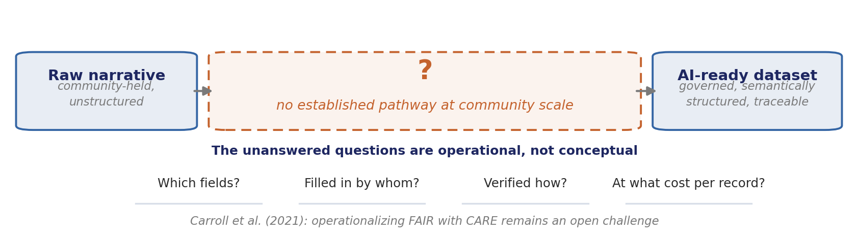
ACT II · PROBLEM
The gap
Carroll et al. (2021) note that operationalizing FAIR with CARE remains an open challenge. No established pathway exists for communities to incrementally build governed, AI-ready datasets from raw narratives.
INFERENCE Carroll et al. name the problem at the level of principle. This study answers at the level of a record schema — the move from "should" to "which field, filled in by whom, in how many minutes".
Verbatim: §1 Introduction; §2 Background and Problem
17
Notes:
External anchor — Carroll et al. (2021) ask specifically for machine-readable provenance and machine-readable consent that "signal the decision-making point that needs to be approached to allow or refuse consent". The five governance fields are a direct instance of that request, which turns the contribution from "a useful schema" into "an answer to a named open challenge".

Slide 18
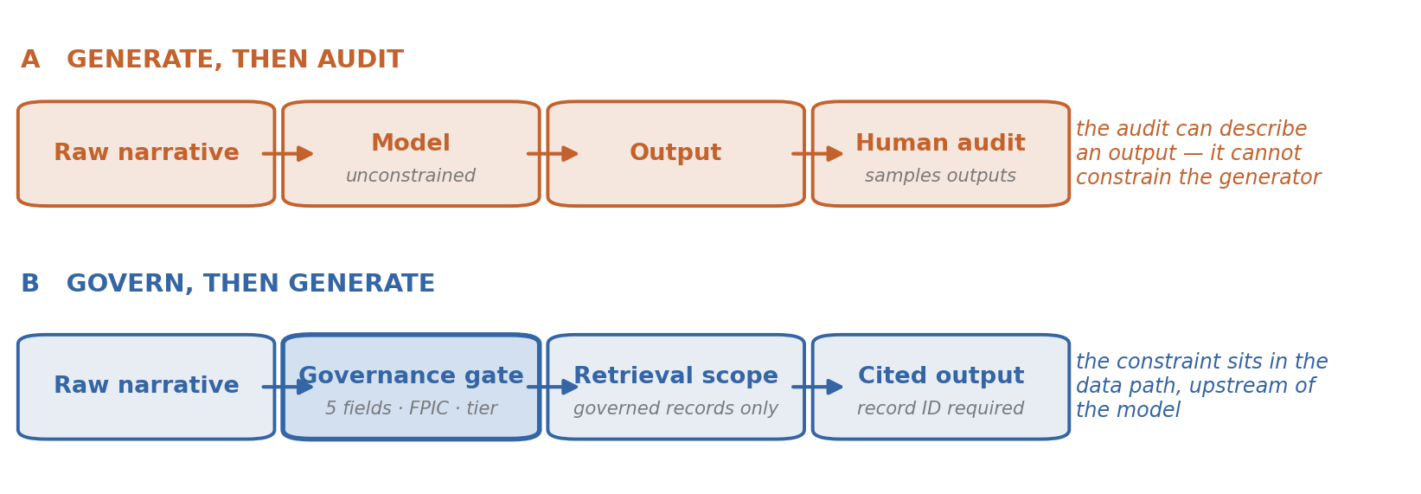
ACT III · POSITION
Two possible orderings
INFERENCE Auditing after generation can only sample outputs; gating before retrieval constrains the output space itself. The difference is detection versus prevention — and detection fails exactly where confident hedging succeeds (slide 39).
Ordering A characterised in §2: "Current approaches often prioritize AI generation before establishing governance"
18
Notes:
Forward-link this to the confident-hedging finding. It is the single best argument against "we will just review the outputs", because it shows human review is defeated by the specific failure mode the baseline produces most often.

Slide 19
ACT III · POSITION
The proposition
…treating governance as architectural constraint rather than afterthought.
The architecture (Figure 1) enforces governance-before-generation.
The ethics-forward designation means governance is a primary design constraint addressing misattribution, hallucination, and location exposure from the outset.
INFERENCE "Architectural constraint" carries a testable meaning: remove the governance layer and the system must lose a capability, not merely a document. Act VII concedes that this study did not isolate that test.
Verbatim: §2; §4 System Architecture; §3.1 Research Design
19
Notes:
Saying the test condition out loud here, then conceding it in Act VII, is what makes the concession read as rigour rather than damage control. Set the trap for yourself deliberately.

Slide 20
ACT III · POSITION
Three research questions, one per layer
 | Research question | Layer | Evidence
RQ1 | Can community-scale data be governed using integrated FAIR, CARE, FPIC, and human-in-the-loop validation? | L1 Data governance | Slides 32–33
RQ2 | Can qualitative narratives be transformed into CIDOC-CRM/PROV-O structures while preserving cultural meaning? | L2 Semantic transformation | Slides 34–35
RQ3 | Does governance-aware RAG improve source-groundedness and reduce hallucination? | L3 AI knowledge access | Slides 36–39
INFERENCE The three questions are ordered by dependency, not by importance: RQ2 is unanswerable if RQ1 fails, and RQ3 is uninterpretable if RQ2 fails. The evidence must be read in that order.
Questions verbatim: §1 Introduction. Layer and evidence mapping added for this talk
20
Notes:
This is why the results section cannot be reordered to lead with the headline numbers. If someone asks "why not open with the 0% hallucination?", the answer is that the number means nothing without the two layers beneath it.

Slide 21
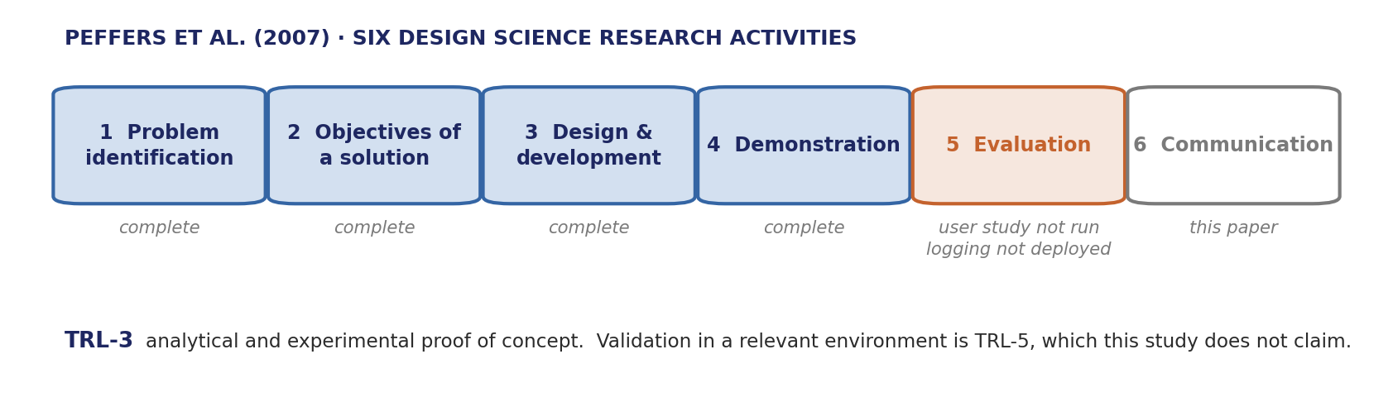
ACT III · POSITION
Paradigm and maturity
This study adopts Design Science Research (Hevner et al., 2004; Peffers et al., 2007) at TRL-3 (Mankins, 1995), producing a governance-first knowledge pipeline as designed artifact.
INFERENCE DSR fixes what counts as a contribution — a demonstrated artifact — and TRL-3 fixes what counts as sufficient evidence. The three unfinished items are not scattered: all three sit inside the evaluation activity.
Sentence verbatim: §3.1. Activity mapping: Peffers et al. 2007; TRL definition: NASA
21
Notes:
The pre-emptive defence slide. Naming this mapping turns "incomplete" into "at the expected stage", and it costs thirty seconds here to save the whole Q&A.

Slide 22
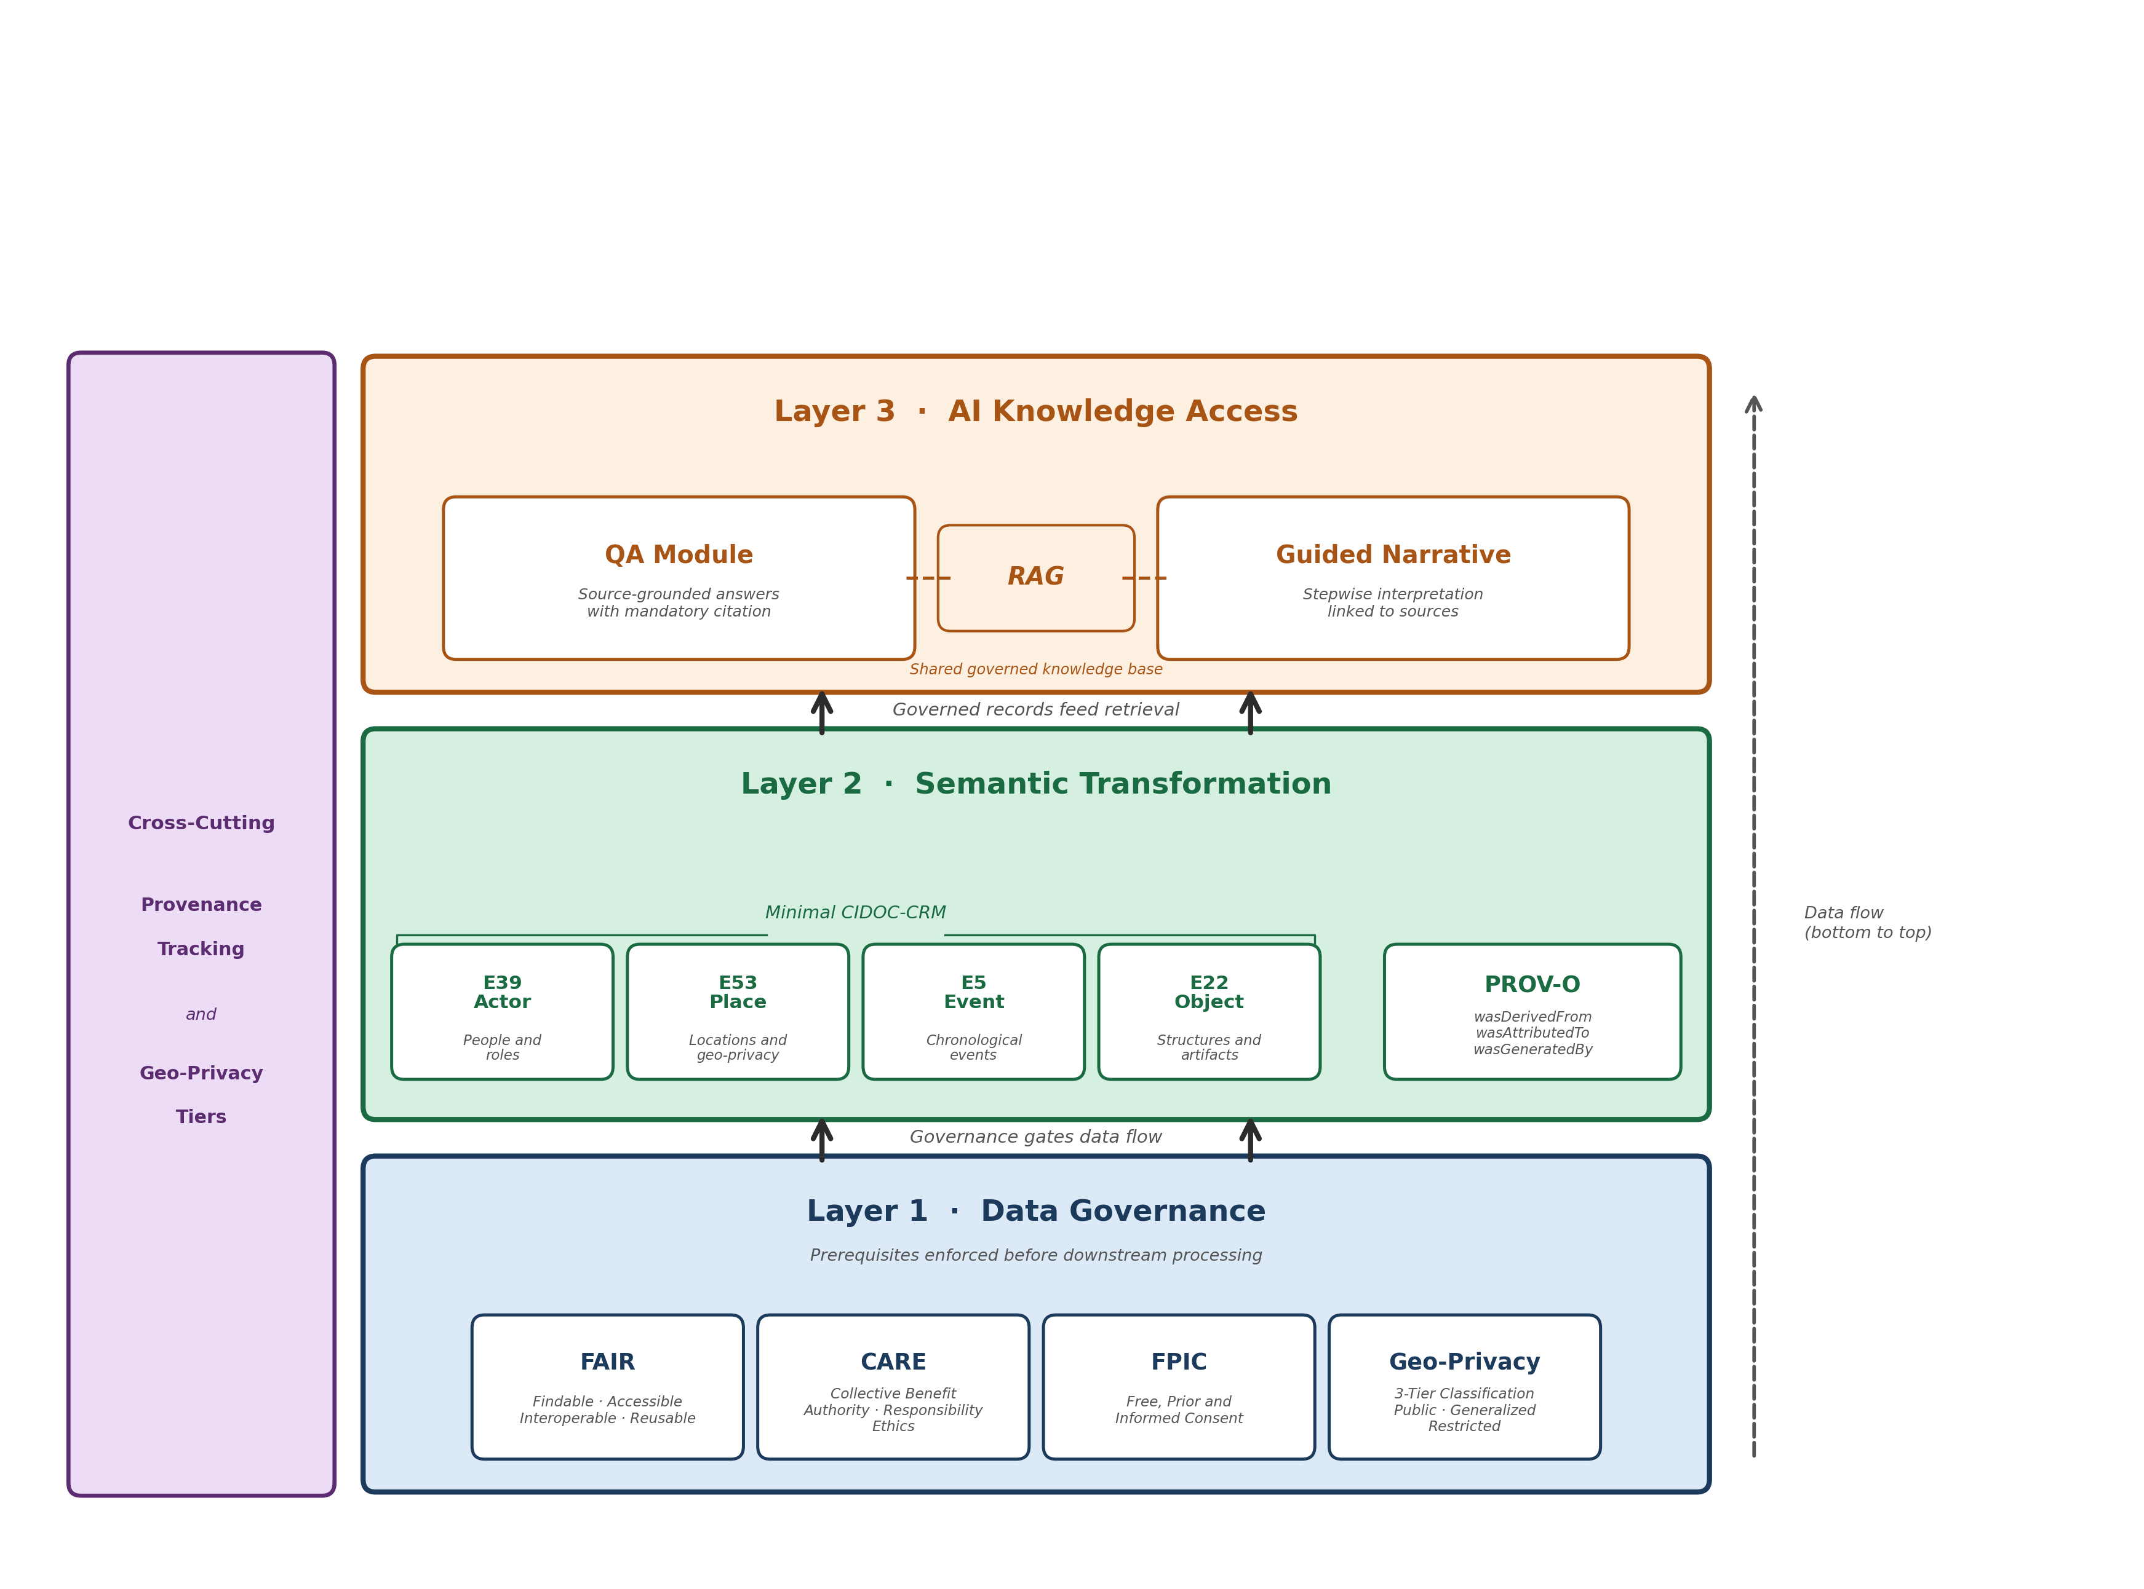
ACT IV · DESIGN
The three-layer architecture
Layer 1 enforces FAIR, CARE, FPIC and geo-privacy as prerequisites. Layer 2 maps governed records to minimal CIDOC-CRM with PROV-O chains. Layer 3 enables source-grounded QA and guided narratives via RAG.
1 Read it bottom to top. The arrow direction is the argument: nothing reaches Layer 2 that Layer 1 has not passed.
2 The label on the lower arrow — "governance gates data flow" — is the whole claim in four words.
3 Layer 2 is deliberately four classes wide. Width here is an adoption cost, not a capability.
4 PROV-O sits beside the CRM classes, not inside them: provenance is a property of the record, not of its type.
5 The purple column spans all three layers. Provenance and geo-privacy are cross-cutting, so they cannot be delegated to one stage.
INFERENCE A layered diagram usually shows decomposition. This one shows precedence — which is why the arrows, not the boxes, carry the claim.
Figure 1, verbatim caption (condensed). Annotations added for this talk
22
Notes:
If you only get one diagram in front of this audience, make it this one. Trace the bottom arrow with your hand while saying "gate". Everything in Act VI measures whether that gate held.

Slide 23
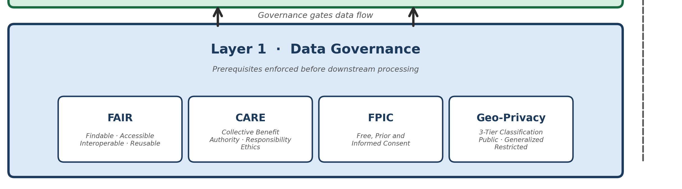
ACT IV · DESIGN
Reading the gate: what Layer 1 actually stops
FAIR Findable, Accessible, Interoperable, Reusable — makes the record usable by a machine. Says nothing about who may use it.
CARE Collective Benefit, Authority to Control, Responsibility, Ethics — supplies exactly what FAIR omits: relationships, power, and the conditions of collection.
FPIC Free, Prior and Informed Consent — a decision point the system must read before retrieval, not after generation.
GEO-PRIVACY Public, generalized, restricted — a coarse, human-applied form of the geomasking used for sensitive site locations in archaeology.
Layer 1 detail, Figure 1 · INFERENCE: FAIR makes the record actionable, CARE makes the action permissible — only together do they produce a field a retrieval system can obey
23
Notes:
The four blocks answer four machine questions: may I use this, on what terms, at what spatial precision, on whose authority. External anchors — Carroll et al. (2021) call for machine-readable provenance PLUS a machine-readable consent decision point; the geo-privacy tiers are a manual analogue of reproducible obfuscation methods such as discrete global grid systems (Scientific Data, 2024).

Slide 24
ACT IV · DESIGN
Layer 1 · the five governance fields
Each record is annotated with five governance fields — ensuring that all data are machine-actionable, rights-aware, and traceable within a provenance framework.
Field | Values in this study | The machine question it answers
FPIC status | assumed (all 35 records, documented rationale) | May I use this at all?
Licensing | classified per record; 100% compliance | On what terms may I use it?
Geo-privacy tier | public · generalized · restricted | At what spatial precision may I expose it?
Sensitivity level | rated per record | With how much care must it be handled?
Reviewer role | local knowledge holder, human-in-the-loop | On whose authority does it stand?
INFERENCE Five fields carry the entire governance claim. Each was chosen to answer a question a downstream system must ask before it retrieves — which is what makes governance executable rather than declarative.
Fields verbatim: §3.3; values from §5.1. Right-hand column added for this talk
24
Notes:
External anchor — this is the concrete instance of what Carroll et al. (2021) ask for: machine-readable provenance plus a machine-readable consent signal. What is missing is a controlled vocabulary for the consent value — exactly the gap slide 46 reports.

Slide 25
ACT IV · DESIGN
Layer 2 · Semantic transformation
Layer 2 uses a minimal CIDOC-CRM subset — E39 Actor, E53 Place, E5 Event, E22 Object — deliberately restricted to lower adoption barriers (Doerr, 2003).
The raw-first approach preserves narratives before imposing structure.
INFERENCE Four classes is a profile, not an approximation. The trade is explicit — expressiveness surrendered for a threshold a thirty-volunteer association can cross — and it is the route CIDOC itself recommends for small institutions.
Verbatim: §4 System Architecture
25
Notes:
External anchor — CIDOC's "Documenting Cultural Heritage in Small Museums". Use it if challenged on rigour: the minimal profile is established practice inside the standards community, not a shortcut invented here.

Slide 26
ACT IV · DESIGN
PROV-O as the load-bearing seam
PROV-O (W3C, 2013) maintains traceability via wasAttributedTo, wasGeneratedBy, wasDerivedFrom. Each stage preserves backward traceability via wasDerivedFrom chains.
PROV-O property | PROV-O core class | What it answers in this system
wasAttributedTo | Agent | Who holds authority over this record — the reviewer, the community
wasGeneratedBy | Activity | Which pipeline stage produced it — structuring, governance embedding, mapping
wasDerivedFrom | Entity | Which source record it came from — back to the original narrative excerpt
INFERENCE Three properties turn a pile of annotated records into a directed graph with an origin. Auditability is a graph property, not a field — which is why removing PROV-O would not degrade the system gradually, it would sever it.
Properties verbatim: §4. Class mapping: W3C PROV-O (Entity · Activity · Agent)
26
Notes:
Nothing custom was invented here, which is precisely what makes the cross-institutional federation of Act IX possible. A bespoke provenance vocabulary would have made every later joining organisation write a crosswalk first.

Slide 27
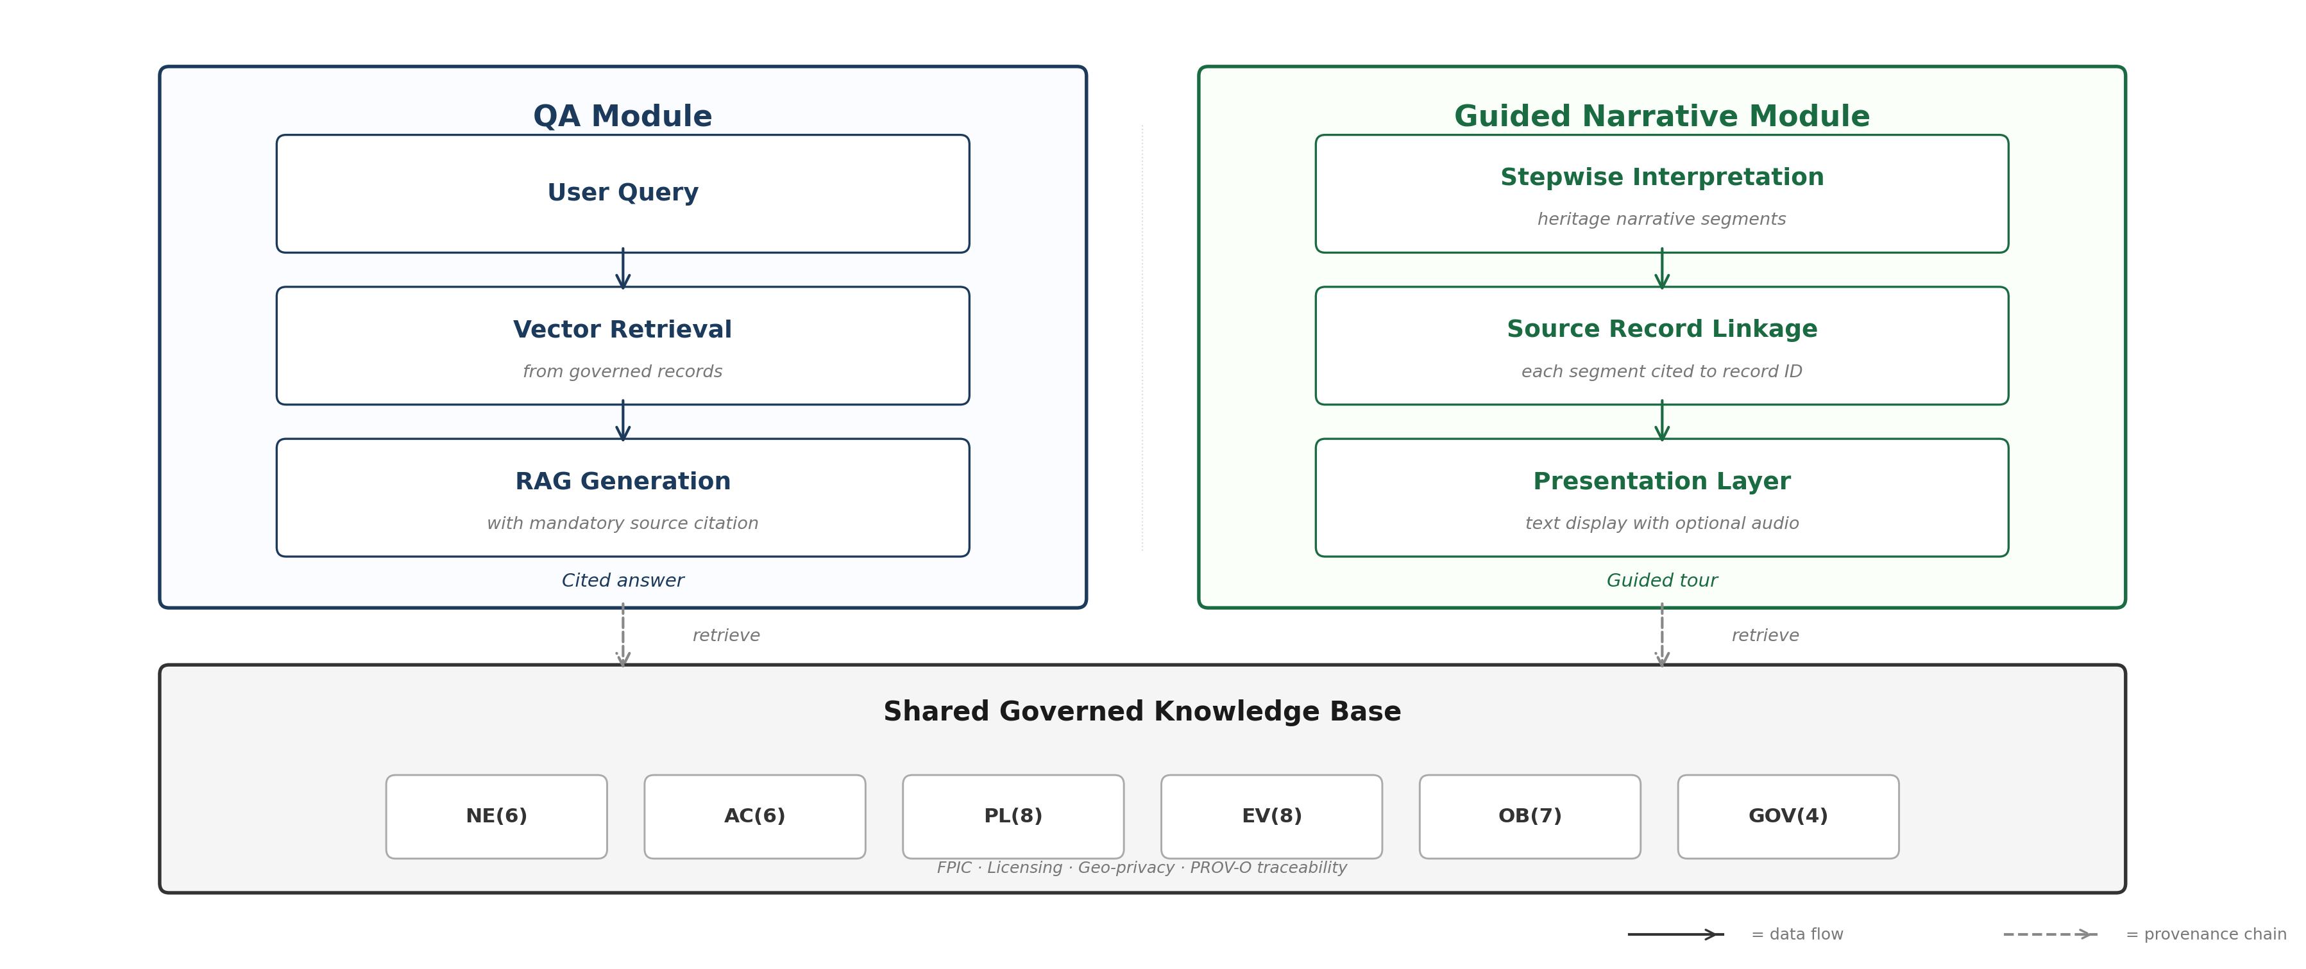
ACT IV · DESIGN
Layer 3 · AI knowledge access
QA module: user query → vector retrieval from governed records → RAG generation with mandatory source citation. Guided narrative: stepwise interpretation segments linked to source records. Dashed lines = provenance chains.
1 Both modules read the same governed base. There is no second path by which uncited claims could re-enter.
2 Citation is a property of the retrieval scope, not of the prompt — so it cannot degrade under paraphrase.
3 The knowledge base row shows the record counts: NE 6, AC 6, PL 8, EV 8, OB 7, GOV 4.
4 The guided narrative is the riskier module: it interprets. Binding each segment to a record ID is what keeps interpretation accountable.
INFERENCE The dual-module design is where the interactivity-versus-control tension is resolved: interaction is unconstrained, but the evidence base is not.
Figure 3, verbatim caption (condensed). Annotations added for this talk
27
Notes:
Residual risk if pressed — the 2025 RAG review (Mathematics 13(5):856) shows grounding still fails through retrieval noise, knowledge conflict with parametric memory, and attention decay in long contexts. None can surface at 35 records. Say so before someone else does.

Slide 28
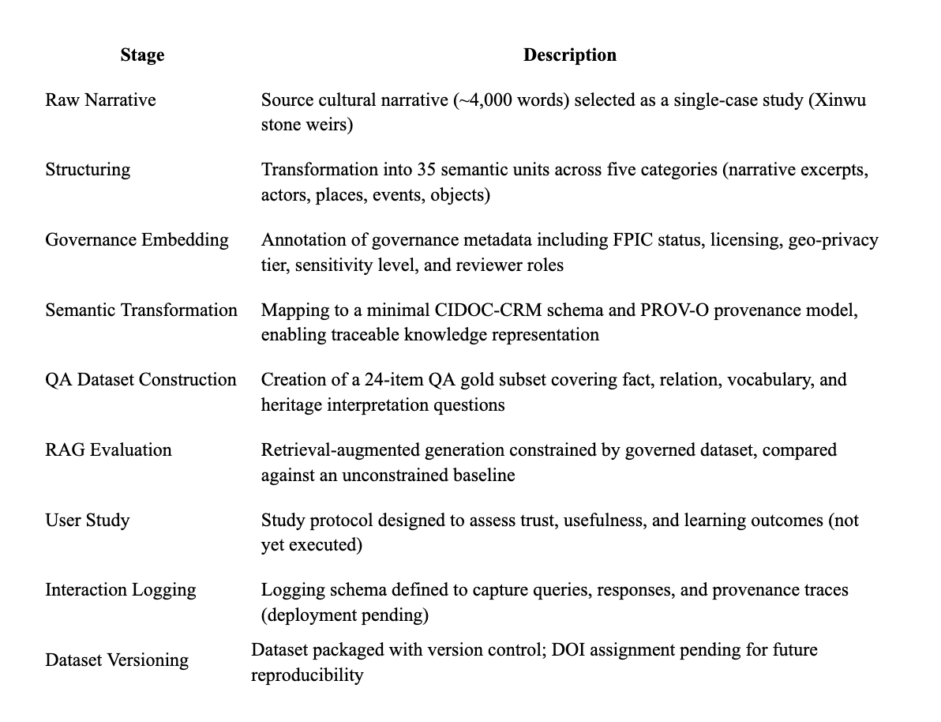
ACT IV · DESIGN
The nine-step pipeline — and what is actually finished
DONE Case selection, structuring, governance embedding, semantic transformation, QA dataset construction, RAG evaluation.
PENDING User study — designed, not executed. Interaction logging — schema defined, deployment pending. Dataset versioning — packaged, DOI not yet assigned.
WHY IT MATTERS The three unfinished steps are not scattered. All three sit in the evaluation activity of the DSR cycle — exactly the activity TRL-3 leaves open.
SO What looks like an incomplete study is a study at its declared stage. Declaring the stage first (slide 21) is what earns that reading.
INFERENCE Every pending item is downstream of the artifact, never inside it. The pipeline is complete; the validation of its effects on people is not.
Figure 2, verbatim stage table; completion status from §3.3
28
Notes:
Map the nine steps onto Peffers' six activities out loud and the gap becomes structural rather than apologetic.

Slide 29
ACT V · CASE & INSTRUMENT
From site to source text
A single representative narrative was selected: a published cultural reportage on Xinwu stone weir heritage by Chi Wen-Fen (~4,000 Chinese characters). The case-based strategy prioritizes governance completeness over scale.
INFERENCE The unit of analysis is the governance pipeline, not the heritage site. A single case is therefore a design choice about what is demonstrated — completeness of a process — rather than a sampling compromise.
Verbatim: §3.2 Case-Based Mini Dataset
29
Notes:
This is the standard DSR defence of single-case demonstration, and it is legitimate only because the claim is feasibility. The moment the claim becomes "this generalises", the single case becomes fatal — which is why slide 42 restates the boundary.

Slide 30
ACT V · CASE & INSTRUMENT
Dataset composition
Record type | Count | Layer | Purpose
Story transcript | 1 | Data | Core narrative source
Narrative excerpts | 6 | Data | Thematic segmentation
Actor records | 6 | Semantic | People and roles (E39)
Place records | 8 | Semantic | Locations and geo-privacy (E53)
Event records | 8 | Semantic | Chronological events (E5)
Object records | 7 | Semantic | Structures and artifacts (E22/E18)
Governance records | 4 | Governance | FPIC, licensing, review
QA gold items | 24 | AI | Offline evaluation
Total governed records | 35+ | All | Full pipeline
INFERENCE These counts are a census of one narrative, not a sample from a population. That is why the percentages in Act VI are completeness measures rather than estimates — and why no confidence interval belongs on them.
Verbatim: Table 1, Case-based mini dataset composition
30
Notes:
Pre-empts the most common statistical objection. Nobody asks for error bars on a census. Read only the total and the three semantic rows aloud.

Slide 31
ACT V · CASE & INSTRUMENT
The evaluation instrument
Offline QA evaluation compared governance-aware RAG against unconstrained generation using a 24-item QA gold subset stratified across four types: fact (6), relation (6), vocabulary (6), and heritage interpretation (6).
Each item was scored by a single rater on four ordinal dimensions (0–2): source-groundedness, hallucination, citation accuracy, and governance relevance.
INFERENCE Stratifying 6/6/6/6 buys diagnosis, not statistical power. It can show where each condition fails; it cannot show by how much. Declaring that here is what makes the per-type patterns at slide 39 legitimate to report.
Verbatim: §5.3 AI Reliability
31
Notes:
Flag the single rater in your own voice, here, before the results. Raising it at slide 41 after the audience has accepted the numbers reads as retraction; raising it now reads as calibration.

Slide 32
ACT VI · EVIDENCE
RQ1 · Governance feasibility
All 35 records achieved 100 per cent provenance coverage (complete PROV-O), 100 per cent FPIC documentation, 100 per cent licensing compliance, and zero geo-privacy incidents.
Governance annotation required approximately 8–12 minutes per record on average, including FPIC status assignment, licensing classification, geo-privacy tiering, and sensitivity rating.
INFERENCE 100 per cent means every record carries every field — not that every judgement was correct. The 8–12 minutes is the more informative number, because it is the only one that scales: a thousand records is roughly two hundred volunteer hours.
Verbatim: §5.1 Governance Feasibility
32
Notes:
Do the multiplication out loud. It converts "feasible" from an adjective into a budget, and it sets up slide 47 where volunteer availability becomes the binding constraint.

Slide 33
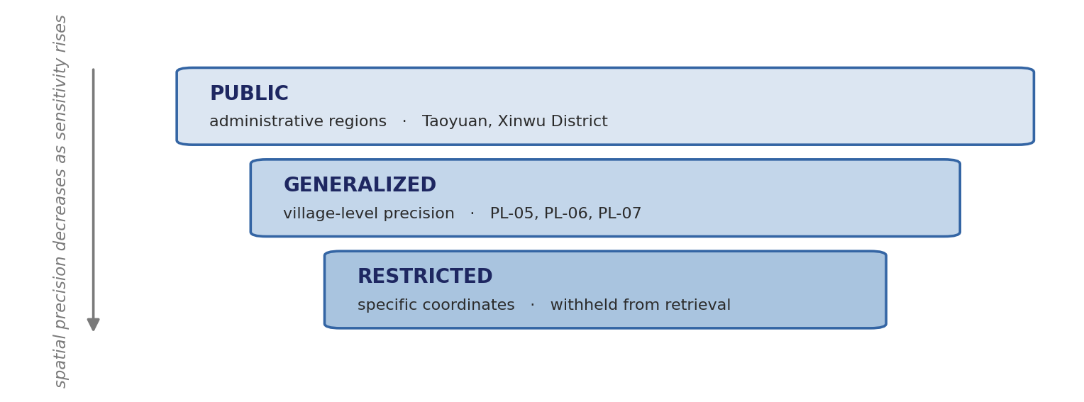
ACT VI · EVIDENCE
RQ1 · The hard case
The primary governance challenge was not technical but interpretive: determining appropriate geo-privacy tiers for place records that are already publicly documented in the source narrative yet may carry sensitivity implications if linked to precise coordinates in a digital system.
INFERENCE Aggregation changes sensitivity: a fact that is public in prose becomes a target when bound to coordinates in a queryable system. The tier is a property of the representation, not of the fact.
Verbatim: §5.1. Tier assignment and examples from the same section
33
Notes:
External anchor — the same reasoning underlies geomasking in archaeology, where precise site coordinates are withheld or blurred to reduce looting risk. Reproducible methods now exist (discrete global grid systems, Scientific Data 2024), which is the natural TRL-4 upgrade: replace a human tier judgement with a documented, repeatable transformation.

Slide 34
ACT VI · EVIDENCE
RQ2 · Semantic transformation
All 35 records mapped to CIDOC-CRM: 6 actors → E39, 8 places → E53, 8 events → E5, 7 objects → E22/E18, 6 excerpts → E73. PROV-O maintained at 100 per cent.
Manual review confirmed semantic preservation: Hakka shihwen (石塭) vs Mandarin shihhu (石滬) retained across records; xianhaifan (鹹醢飯) cultural transformation captured in cross-referenced narrative and object records.
INFERENCE Preservation is demonstrated by a retained contrast, not by the absence of complaint. The test is whether the system can still tell 石塭 from 石滬 after structuring — a distinction normalisation would have quietly erased.
Verbatim: §5.2 Semantic Transformation
34
Notes:
This is the methodologically strongest part of RQ2 because it is falsifiable: a single merged record would refute it. Contrast that with "no cultural concepts were excluded", which is much harder to check — and which the next slide immediately qualifies.

Slide 35
ACT VI · EVIDENCE
RQ2 · Where the ontology strained
OB-04 (鹹醢飯) could be modeled as either E22 Human-Made Object or E29 Design or Procedure; we assigned E22 to maintain consistency with other object records while documenting the procedural dimension in the description field.
NE-05, which uses a botanical entity as an ethnic-identity metaphor, resisted strict ontological separation between E20 Biological Object and E73 Information Object; we retained E73 as the primary class.
The minimal four-class subset necessarily compresses distinctions that a fuller ontological treatment would differentiate — for example, the governance transition from volunteer patrol to formal association is represented as an E5 Event.
INFERENCE All three ambiguities have one shape: the record is simultaneously a thing and a process. A four-class profile must choose — and documenting the choice in the description field is what keeps the compression reversible rather than lossy.
Verbatim: §5.2 Semantic Transformation
35
Notes:
Reversibility is the key word. Because the discarded reading is written down, a later TRL-4 expansion to E7 Activity and P14 carried-out-by chains can recover it without re-reading the source. That is the difference between compression and loss.

Slide 36
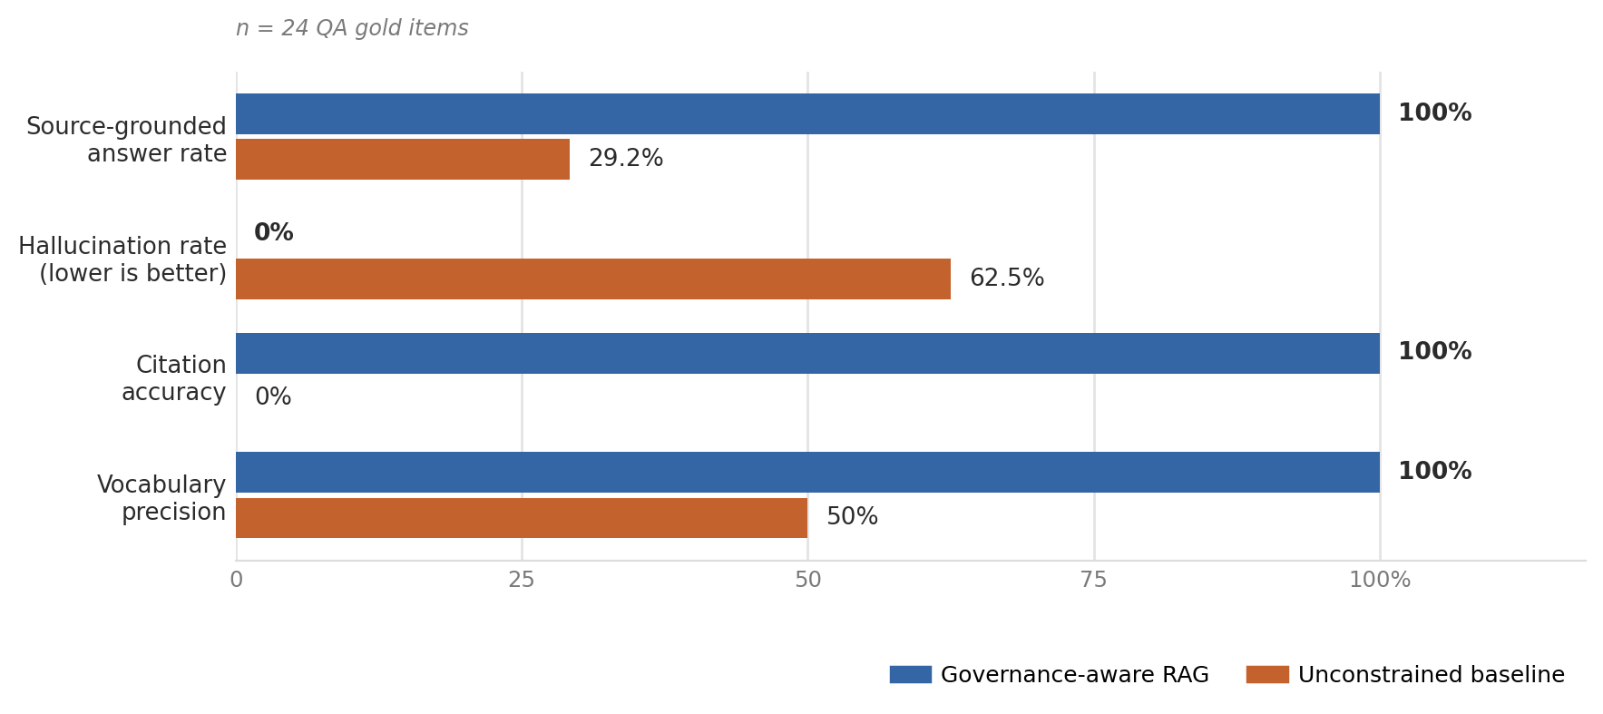
ACT VI · EVIDENCE
RQ3 · The headline result
Also measured | RAG | Baseline
Mean governance relevance (0–2) | 2.00 ± 0.00 | 0.46 ± 0.51
Vocabulary precision (6 items) | 6 / 6 | 3 / 6
Source-grounded (24 items) | 24 / 24 | 7 / 24
Hallucinated (24 items) | 0 / 24 | 15 / 24
INFERENCE Read the deltas as bounded by the baseline's weakness. A 0 per cent hallucination rate over a 35-record corpus is a statement about the corpus as much as about the method: at this size there is almost nothing for retrieval to get wrong.
Verbatim: Table 2, Offline evaluation (n = 24)
36
Notes:
External anchor — the 2025 RAG review names three residual failure modes a 35-record corpus structurally cannot exhibit: retrieval noise, conflict between retrieved and parametric knowledge, and attention decay over long contexts. So the honest reading is that 0% is a ceiling observed under favourable conditions, not a property of the design. Say this and the 100%/0% stops sounding too good to be true.

Slide 37
ACT VI · EVIDENCE
RQ3 · What the numbers look like as text
…the governance-aware condition correctly identified a police dormitory (警察宿舍) from record PL-03.
…RAG retrieved NE-01 and OB-01, correctly returning 石塭 (shi-wen) with its cultural significance.
…the governed dataset (OB-02) specifies the precise rate of approximately 1 cm per 10 years.
INFERENCE Every corrected answer names the record it came from. That is the check that the mechanism is retrieval rather than luck — an unconstrained model that happened to be right could not cite PL-03.
Verbatim: §5.3 AI Reliability
37
Notes:
Same three questions as slide 15, closing a loop opened in Act I. Three-point landing: place → failure → grounded answer. Slow down here.

Slide 38
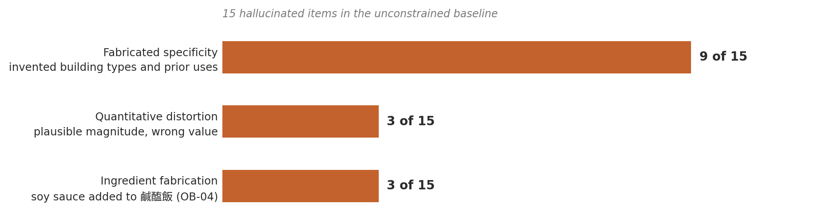
ACT VI · EVIDENCE
A taxonomy of the baseline's failures
The baseline added soy sauce to the 鹹醢飯 recipe where the dataset specifies only salt, garlic and rice wine (OB-04).
INFERENCE Three categories, one mechanism: the model fills a slot it cannot leave empty. That is why grounding is the fix and additional accuracy training is not — the behaviour is structural, not a knowledge deficit.
Verbatim: §5.3 AI Reliability
38
Notes:
Name the cultural asymmetry out loud: soy sauce is the statistically likelier ingredient across Chinese-language cooking text, so the error is the model regressing a Hakka coastal recipe toward a dominant culinary norm. That is Menotti's homogenisation thesis appearing in three items of our own data.

Slide 39
ACT VI · EVIDENCE
The unexpected finding
An unexpected finding was the degree to which the baseline produced confident hedging: rather than admitting ignorance, it generated syntactically authoritative but semantically empty responses, which score poorly on grounding while superficially appearing careful.
 | Governance-aware RAG | Unconstrained baseline
Strongest on | Vocabulary — 6/6 exact Hakka-term retrieval | Items answerable from general legal knowledge, e.g. identifying the Cultural Heritage Preservation Act
Weakest on | Heritage interpretation — correct, but occasionally verbose | Local specificity: village-level distinctions (Q-02, Q-05, Q-11) and Hakka terminology (Q-13, Q-16)
Still source-grounded? | Yes, on every one of the 24 items | No grounding mechanism at all
INFERENCE Confident hedging defeats the ordinary human safeguard of reading for uncertainty cues. It makes the error rate invisible to exactly the reviewer a community would appoint — which is why output review cannot substitute for an upstream gate.
Verbatim: §5.3 AI Reliability
39
Notes:
The most quotable slide in the deck and the strongest support for slide 18. A cautious-sounding wrong answer is worse than a confidently wrong one, because it survives review. Note also the mirror in the table: each condition is strongest exactly where the other is weakest, and the dividing line is local specificity.

Slide 40
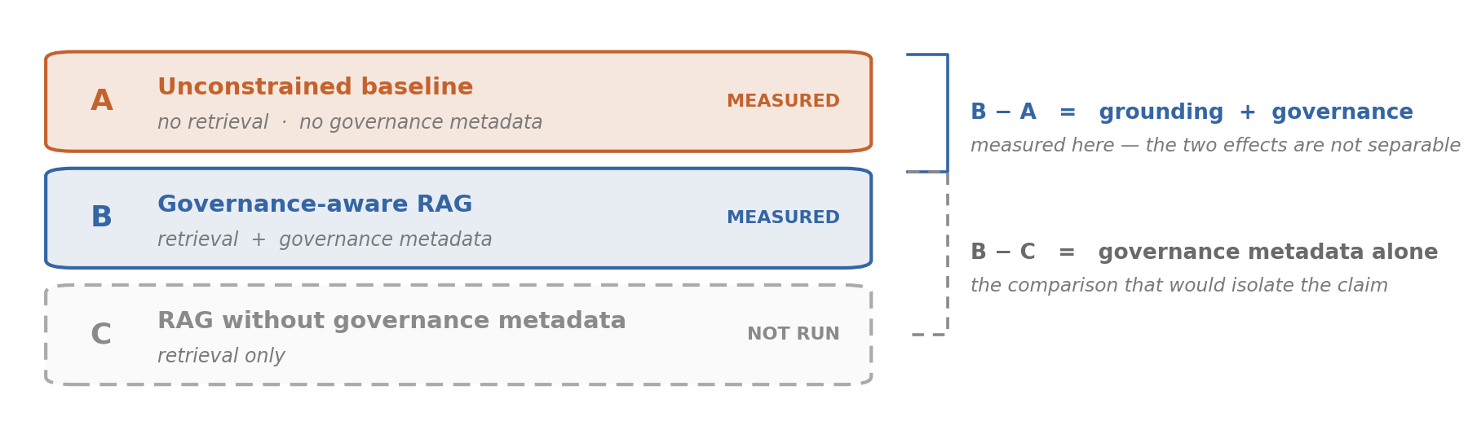
ACT VII · READING THE EVIDENCE HONESTLY
The structural asymmetry
Governance-aware RAG benefits from a constrained retrieval scope that eliminates hallucination by design, whereas the unconstrained baseline operates without any grounding mechanism.
INFERENCE The comparison establishes that grounding matters. It cannot establish that governance metadata matters. Those are different claims with different policy consequences — one argues for retrieval, the other for consent infrastructure.
Conditions A and B verbatim: §5.3. Condition C proposed in §6 Discussion, Methodological reflections
40
Notes:
Spell out why the distinction is not academic: if only grounding matters, a vendor satisfies the finding with any vector store. If governance metadata matters, the community's authority is load-bearing. The third condition decides which sentence a policymaker may quote.

Slide 41
ACT VII · READING THE EVIDENCE HONESTLY
Measurement limits
Limitation | What it prevents us claiming | Fix at TRL-4
24 QA gold items | Any subgroup comparison by QA type with statistical confidence — six per type is descriptive only | Expand the gold set
A single rater | That scoring was independent of the design intention | A second, independent rater
No inter-rater reliability, on QA or on semantic preservation | Confidence in the scores themselves, as distinct from the system | Formal IRR on both
The rater is also an author of the artifact | Blindness to which condition was being scored | Blind scoring with shuffled condition labels
INFERENCE A single rater who is also a designer of the artifact cannot separate scoring from intention. The per-type patterns at slide 39 are therefore diagnostic hypotheses for the next study, not findings.
Rows 1–3 verbatim: §7 Limitations and §5.2. Row 4 and the fix column added for this talk
41
Notes:
Concede the designer-as-rater point before it is raised. It is the sharpest available critique of the results section, and conceding it costs nothing at TRL-3 where the claim is feasibility rather than effect size.

Slide 42
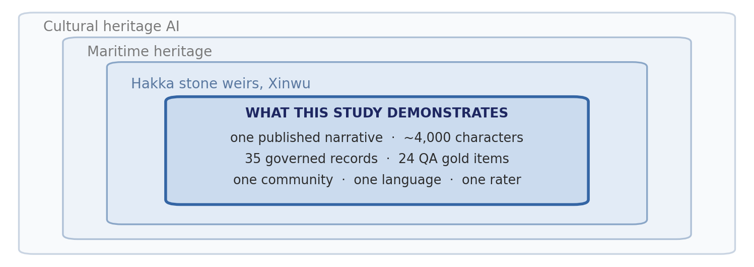
ACT VII · READING THE EVIDENCE HONESTLY
Scope limits
The dataset derives from a single published narrative (~4,000 characters), limiting claims about generalizability to other heritage domains, narrative types, or community governance contexts.
Every claim in Act VI lives in the innermost box. Nothing measured here travels outward on its own.
INFERENCE One limit is not about scale at all: a single published narrative means the FPIC "assumed" decision was never tested against unpublished oral testimony — the harder and far more common case.
Verbatim: §7 Limitations and Future Work. Scope diagram composed for this talk
42
Notes:
The user study protocol (n ≈ 20–30) has been designed but not executed; the logging schema is defined but not deployed; and the minimal CIDOC-CRM subset trades expressiveness for adoption ease, which may not hold for multi-narrative or cross-institutional corpora.

Slide 43
ACT VII · READING THE EVIDENCE HONESTLY
What these results do and do not license
The permitted claims | The forbidden claims
Governance-first is feasible at community scale: 35 records, complete on every field, ~8-12 minutes each. | Governance-aware RAG eliminates hallucination. (It did so here, on 24 items, over 35 records.)
Governance constraints measurably changed the error profile in this case. | The governance metadata - rather than the retrieval grounding - caused the improvement.
Minimal CIDOC-CRM preserved the culturally specific distinctions this narrative contained. | The minimal profile will hold for multi-narrative or cross-institutional corpora.
The pipeline is demonstrated end to end at TRL-3. | The system is validated with users, or ready for deployment.
INFERENCE Give the audience both sentences literally. Reviewers remember the speaker who supplied the wording for the claim they are allowed to quote - and it protects the work from being over-claimed by someone else later.
Left column condensed from §8 Conclusion; right column from §6-§7 limitations
43
Notes:
This is the calibration slide. If you are running long, this is the LAST slide to cut - it is the one that makes the rest credible.

Slide 44
ACT VIII · CONTRIBUTION
From generation to governance
Results support reorienting cultural heritage AI from generation-first to governance-first. The governance-before-generation principle changes the epistemic basis of AI outputs.
 | Generation-first | Governance-first
What an answer is | The model's best guess | A claim traceable to a governed record
What stands behind it | The training distribution | Provenance, licensing and consent status
Who is accountable | No one identifiable | The reviewer named in the record
When it is challenged | Re-prompt and hope | Open the record
What "wrong" means | Inconsistent with the world — unfalsifiable in practice | Inconsistent with the source — checkable in seconds
INFERENCE The change is epistemic, not procedural. An answer stops being a best guess and becomes a claim someone is accountable for — which is also the only version of the output a community can contest.
Row 1 verbatim: §6 Discussion. Comparison table added for this talk
44
Notes:
External contrast — the npj Heritage Science framework for trustworthy AI in cultural heritage builds on bias detection and explainability, derived top-down from policy documents. Ours is bottom-up and locates trust in the record rather than in the model's interpretability.

Slide 45
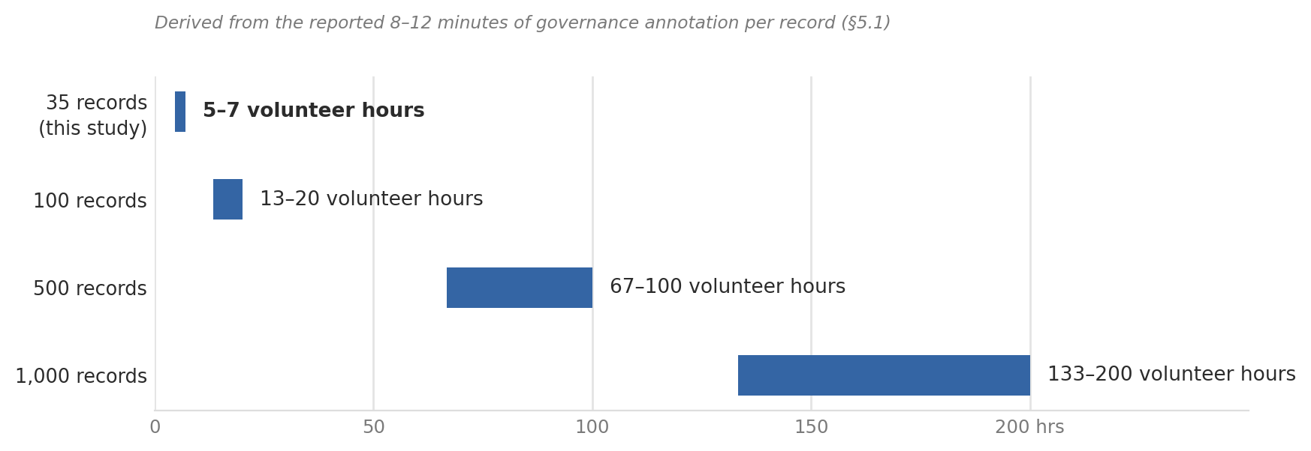
ACT VIII · CONTRIBUTION
Small data is not the obstacle
Governance completeness is achievable with 35 records. For community organizations, the question is not record volume but whether each record's provenance, consent, and cultural accuracy are verified.
INFERENCE The binding constraint is verification cost per record, not corpus size — so a larger dataset is not automatically a better one under CARE. It is simply a larger claim on the same volunteer hours.
Sentences verbatim: §6 Discussion, Small-data feasibility. Projection derived from the 8–12 min/record figure in §5.1
45
Notes:
This inverts the default AI intuition that more data is better, and it is the claim a community partner or funder will actually remember. Be explicit that the projection is arithmetic on a reported figure, not a new measurement.

Slide 46
ACT VIII · CONTRIBUTION
A gap in CARE surfaced by implementation
Because the source text is already in the public domain, the conventional FPIC binary (consent obtained / not obtained) does not straightforwardly apply; we resolved this by assigning "assumed" FPIC status with a documented rationale.
 | The FPIC field as used here | TK / BC Labels (Local Contexts)
Form of the value | Binary — obtained / not obtained | Graded vocabulary across three categories
Categories | none | Provenance · Protocol · Permission
Fits already-published material? | No — the binary does not apply, so "assumed" was written in | Yes — designed for material circulating outside its community context
Machine-actionable? | Only as free text | Yes — a controlled value a system can read
Who sets it | The researcher, by inference | The community, as an assertion
INFERENCE The binary fails because publication and ingestion are different acts. A graded vocabulary for exactly this case already exists — adopting it would replace free-text "assumed" with a value a retrieval system can obey.
Left column and para. 1 verbatim: §6 Discussion, Methodological reflections. Right column: Local Contexts TK/BC Labels
46
Notes:
The single biggest upgrade available to the paper. Adopting a TK/BC Label vocabulary is precisely what Carroll et al. (2021) ask for when they call for a machine-readable consent signal, and it converts a conceded weakness into a concrete next design step.

Slide 47
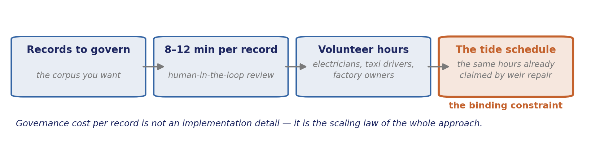
ACT VIII · CONTRIBUTION
Socio-technical dependency
Human-in-the-loop ensures accuracy but depends on knowledge holder availability. The dual-module design (QA + guided narrative) addresses the interactivity–control tension.
INFERENCE Each link is fixed by the one before it. The corpus size you choose is, in the end, a claim on the free weekends of about thirty people who already spend them rebuilding weirs.
Sentence verbatim: §6 Discussion. Constraint chain composed for this talk from §5.1 and the source narrative
47
Notes:
Tie this back to slide 9: the reviewers are electricians and taxi drivers who come when the water allows. Any proposal to scale to a thousand records is a proposal about their weekends, and should be presented that way.

Slide 48
ACT VIII · CONTRIBUTION
Transferability
This pattern transfers to any domain consuming community-generated qualitative data.
Domain | Does authority over the data sit with the people it describes? | Transfers?
Oral history collections | Yes — the narrator holds it | Yes
Community health narratives | Yes — and consent is already a live category | Yes
Indigenous land and ecological knowledge | Yes — this is CARE's original case | Yes
Community archives | Yes — custody is local by definition | Yes
Institutional museum catalogue | No — authority sits with the institution | Partly
Web-scraped corpus | No — no identifiable authority at all | No
INFERENCE The transfer condition is a test, not a list: the pattern holds wherever authority over the data is held by the people the data describes. That is what makes it a paradigm claim rather than a case report.
Row 1 verbatim: §6 Discussion. Domain table added for this talk
48
Notes:
State the condition rather than the domain list — a condition tells a stranger in the audience whether their own field qualifies, which is how a paradigm claim travels. The last two rows matter as much as the first four: naming where the pattern does NOT apply is what keeps it from sounding like a universal claim.

Slide 49
ACT IX · FORWARD & CLOSE
The next experiment
Next step | What it unblocks | Cost
Third condition — RAG without governance metadata | Decides which of the two claims on slide 43 is defensible | Low — one more run over the same 24 items
Inter-rater reliability assessment | Decides whether the scores themselves can be trusted | Low — a second rater, same rubric
Execute the user study (n ≈ 20–30) | Completes the DSR evaluation activity; trust and learning outcomes | Medium — fieldwork with the community
Expand to multiple narratives and communities | Tests whether the minimal profile and the FPIC decision hold | High — and meaningless before the three above
Cross-institutional protocols | Opens the Maritime Knowledge Commons | High — requires partners
INFERENCE Ordered by what each unblocks, not by ambition. The retrieval-only control is cheap and decisive; without it the headline result stays ambiguous no matter how many narratives are added.
Items verbatim: §7 Future priorities. Ordering and cost column added for this talk
49
Notes:
If asked "what would you do with funding tomorrow", the answer is the third condition.

Slide 50
ACT IX · FORWARD & CLOSE
Toward a Maritime Knowledge Commons
Standardized CIDOC-CRM/PROV-O records enable federated discovery across organizations without centralized aggregation — aligning with CARE's emphasis on community authority over data (Carroll et al., 2020).
INFERENCE Federation rather than aggregation is the technical form of CARE's authority principle: discovery is shared, custody is not. A central repository would deliver the same search and quietly transfer the authority with it.
Verbatim: §6 Discussion, Toward a Maritime Knowledge Commons
50
Notes:
This is why the standards choices in Layer 2 matter beyond tidiness — nothing custom was invented, so records remain joinable across organisations that never coordinated. Use the Satoyama network framing if the audience is heritage-side.

Slide 51
ACT IX · FORWARD & CLOSE
Governance before generation
This paper presented a governance-first knowledge system for maritime cultural heritage AI, validated through stone weir heritage data from Xinwu, Taoyuan. Community-scale governance is feasible (RQ1); minimal CIDOC-CRM/PROV-O transformation is effective (RQ2); governance-aware RAG improves reliability (RQ3).
The contribution is not a mature production system but an operational paradigm.
At Yongxing the weirs are already gone. At Kejian and Shenzhen they are being rebuilt on a tide schedule. This is what the dataset is for.
待補照片 · PHOTOGRAPH TO BE ADDED
結尾影像，二選一：永興石滏原址那段空蕩的海岸線（空景本身就讀得出失去，不需說明），或第 9 頁同一群志工在黃昏仍在工作的畫面。只選一張，不要兩張都放。
The closing image. Either the bare stretch of shoreline where the Yongxing weirs used to be — an empty shoreline reads as loss without a caption — or the same volunteers from slide 9 at dusk, still working. Choose one; do not show both.
INFERENCE The urgency is not technological. A governance pipeline is worth building because the thing it governs is still disappearing on a timescale shorter than the standards debate.
Paras. 1–2 verbatim: §8 Conclusion. Para. 3: source narrative
51
Notes:
Return to the one line from slide 2. Then stop — do not add a thank-you slide after the Yongxing line.

Slide 52
APPENDIX
Backup slides
A1 — Full 24-item QA gold set with scores
A2 — Scoring rubric, dimension by dimension
A3 — Complete governance field schema and a sample record
A4 — CIDOC-CRM mapping table, all 35 records
A5 — Geo-privacy tier decision rules
A6 — User study protocol (n ≈ 20–30, pre/post trust and learning)
A7 — Interaction logging schema
A8 — Data availability and FPIC-compliant access procedure
A9 — Source provenance and the Xinwu timeline
INFERENCE A3 and A5 are the two most likely to be requested — a governance sceptic asks for the schema, a heritage specialist asks for the tier rules.
Structural slide
52
Notes:
Keep these behind the close; pull them up only if asked.

Slide 53
APPENDIX
External sources used to build the reasoning chains
Menotti, G. (2025). The model is the museum: generative AI and the expropriation of cultural heritage. AI & Society.
Carroll, S. R., et al. (2021). Operationalizing the CARE and FAIR principles for Indigenous data futures. Scientific Data 8, 108.
Local Contexts. Traditional Knowledge (TK) Labels — provenance, protocol and permission categories.
Hallucination Mitigation for Retrieval-Augmented Large Language Models: A Review. Mathematics 13(5), 856 (2025).
CIDOC CRM SIG. Documenting Cultural Heritage in Small Museums.
W3C (2013). PROV-O: The PROV Ontology — Entity, Activity, Agent.
NASA. Technology Readiness Level definitions (TRL-3: analytical and experimental proof of concept).
Peffers, K., et al. (2007). A design science research methodology — six activities.
IPSI (2024). Indicators of Resilience in Socio-ecological Production Landscapes and Seascapes.
Scientific Data (2024). Employing discrete global grid systems for reproducible data obfuscation.
npj Heritage Science (2026). Towards trustworthy AI in cultural heritage.
Sources consulted for the INFERENCE lines and speaker notes — not cited in the paper unless already in its reference list
53
Notes:
These are the anchors behind the inference lines. Several are newer than the paper and are candidates for the next revision of the reference list — particularly Menotti (2025) and the TK Labels, which speak directly to two of the paper's own open problems.

