Slide 1
CS 537: INTRO TO OPERATING SYSTEMS
Yuvraj Patel
University of Wisconsin-Madison
Summer 2021

Slide 2
Who am I?
6th Year PhD Student (Graduating this summer)
Advisors – Remzi Arpaci-Dusseau & Andrea Arpaci-Dusseau
Research Area – Operating Systems, Storage, Concurrency & Security
Thesis: Process Synchronization as a resource in Concurrent Systems
Teaching for the first time (preparing for being a Professor)
Learn the nuances of teaching
Share the knowledge with others
Teaching Philosophy – Use teaching as a tool to build future

Slide 3
Who am I (contd..)?
Prior to Grad School:
Spent 9 years writing Operating System and File System code
Code written by me executes thousands of times every second
Bank transactions
Car production – BMW, Daimler Chrysler
Movie production - Avatar
Large Hedron Collider and many more….

Slide 4
Call Me
Yuvraj or Yuvi or UV (but not IR)
Please do not address me as Professor/Prof. Yuvraj

Slide 5
Today’s Agenda
What will you do in this course?
How will you be successful?
What is an operating system and why do we need one?

Slide 6
1) Attend Lectures + Take Notes
Cover conceptual ideas
Attendance and “participation” highly encouraged - 10% of final grade
Synchronous course
Many zoom polls – Use for attendance
Check your understanding
Realtime feedback - Alters what I talk about!
Lecture Notes available ahead of time
Annotate; not complete, expect you to fill in details
However, lectures will be recorded and available
Additional lectures will be provided

Slide 7
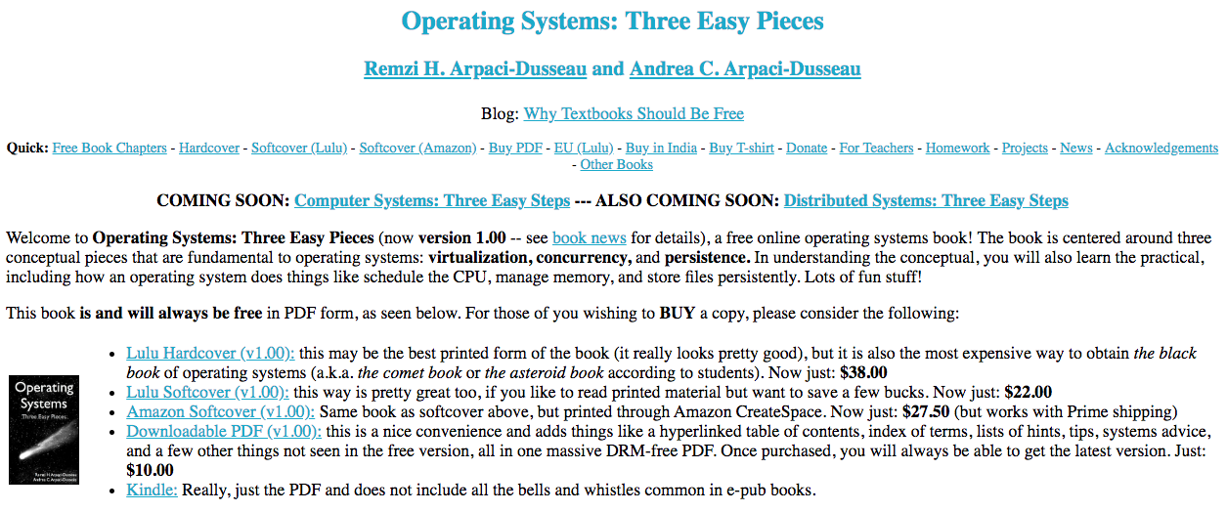
2) Read the Textbook
Free

Slide 8
3) Start Projects Promptly
Projects (50% of final grade)
Seven programming projects done on CS Linux labs
All in C
Some use xv6 – toy OS
Gain hands-on experience, Build your own OS system calls!
Take significant amount of time (about 2 weeks each)
Specifications are longer than you may be used to
Provide test cases; grade based on how many you pass
3 slip days to use throughout semester
First 2 work on alone
Last 3 with one project partner (can change)
Someone you know or we are happy to match

Slide 9
4) Don’t Cheat: Academic Integrity
It is OK to:
- discuss project or specification in general terms (when to return an error?)
- discuss how different library routines/system calls work
- ask peer mentors, TAs, and professor for help
It is NOT OK to:
- use code samples for similar problems you may find on-line
- bug someone else for a lot of help
- share your code directly with other people/project groups
- post your code in a public place
We will run tools to check for similar code across individuals

Slide 10
5) Attend Discussion Sections
Teaching assistants:
Akshat Sinha
Luke Swanson
Zoom links on Canvas
2 sections on Wednesday …
Explain programming projects
Code walk through/ debugging code
Led by TAs

Slide 11
6) Review Material for Exams
Exam (30% of final grade)
Assess OS concepts discussed in class
One evening midterm and a final exam
Final exam will not include material before midterm
Multiple choice questions
Learn through
Lecture Material
Projects
Piazza discussion
Group study
Encouraged to discuss with others

Slide 12
7) Ask for Additional Help
Many TA + Peer Mentor Lab Hours
Projects
Use google form to ask question
Piazza (10% of final grade)
Tends to be active and prompt
Learn and help others
Instructor Office Hours (Zoom)
Peer mentors:
Ritika Mittal

Slide 13
Today’s Agenda
What will you do in this course?
What is an operating system and why do we need one?

Slide 14
Learning Outcomes
High-level understanding of an Operating System and role it plays
Understand how OS virtualizes physical resources, the abstractions the OS provides and how they are efficiently implemented w/ current hardware
Create correct multi-threaded applications using synchronization primitives
Understand how OS ensures information persists despite power outages, crashes, and failures
Implement open-ended programming projects (alone and w/ partner)
Use existing system calls and add functionality to a simplified OS

Slide 15
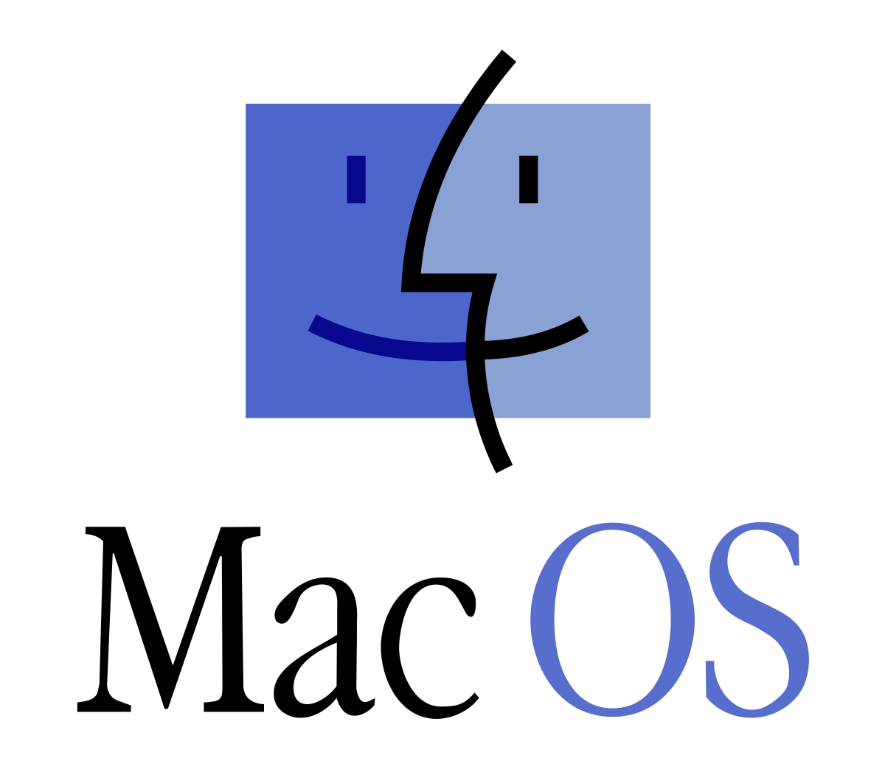


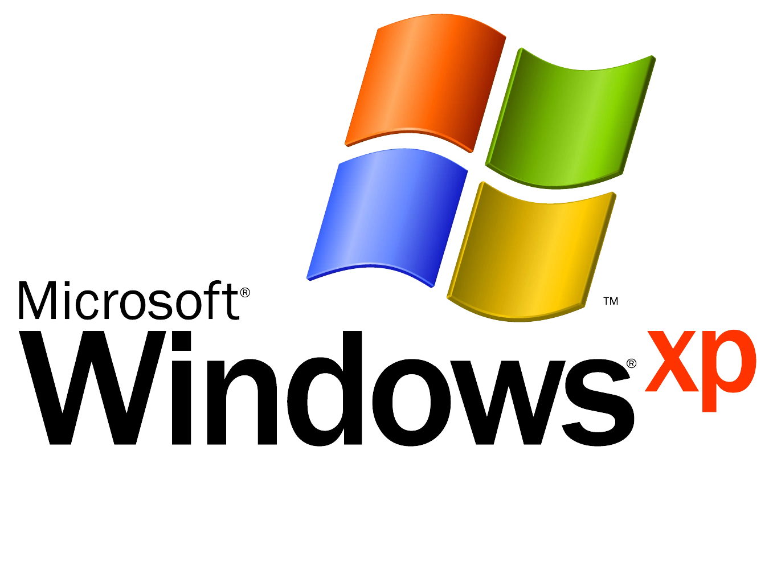


Examples

Slide 16



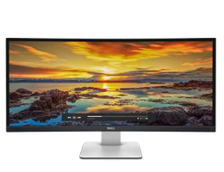

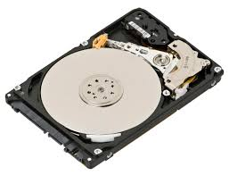
OS Definition
Users
Applications
Operating System
Hardware
Software that converts hardware into a useful form for applications

Slide 17
What does OS provide: Role #1
Abstraction: Provide standard library or interface for resources
What is a resource?
Anything valuable (e.g., CPU, memory, disk)
What abstraction does modern OS typically provide?
CPU: process and/or thread
Memory: address space
Disk: files

Slide 18
Why should OS provide Abstractions?
Advantages of OS providing abstraction?
Provide higher-level or more useful functionality than raw device
Allow applications to reuse common facilities
Make different devices look the same
Challenges
What are the correct abstractions?
How much of hardware should be exposed?

Slide 19
What does OS provide: Role #2
Resource management – Share resources well
What is sharing?
Multiple users of the system
Multiple applications run by same user

Slide 20
Why should OS Manage Resources?
Advantages of OS providing resource management?
Protect applications from one another at a common layer
Provide efficient access to resources (cost, time, energy)
Provide fair access to resources
Challenges
What are the correct policies? (which? when?)
What are the correct mechanisms? (how?)

Slide 21
Summary: OS Roles
Two main roles
- Abstraction
- Resource management
Common layer between applications and hardware
Number of design, implementation challenges

Slide 22
Break Time?
You form a unique community
Get to know your classmates
Introduce yourself to people around you
Your name
What year are you in school?
What other classes are you taking?
Have you already taken any that they are – if so, advice?

Slide 23
Operating Systems: Three Easy Pieces
1. Virtualization
2. Concurrency
3. Persistence

Slide 24
1) Virtualization
Make each application believe it has each resource to itself
Demo: Virtualize CPU and memory

Slide 25
2) Concurrency
Events occur “simultaneously” and may interact with one another
Reading and updating a variable in memory
Need to
Hide concurrency from independent processes
Manage concurrency with interacting processes
Provide synchronization primitives for interacting processes to use (locks, semaphores, condition variables, etc.)
Demo: Threads

Slide 26
3) Persistence
Lifetime of data is longer than lifetime of any one process
Machine may lose power or crash unexpectedly
Issues:
High-level abstractions: Files, directories (folders), links
Crash consistency: Correctness with unexpected failures
Performance: disks are very slow!
Demo: Persistence

Slide 27
4) Advanced Topics
Virtualization
Concurrency
Persistence
Advanced Topics
Other Storage Devices: Flash-based SSDs
Network and Distributed File Systems (NFS + AFS)

Slide 28
Why Study Operating Systems?
1) Build, modify, or administer an operating system
2) Fun and challenging to understand large, complex, concurrent systems
3) Behavior of OS impacts applications and every other layer of system
Understand and tune workload performance
Apply knowledge across many layers
Notes:
Computer architecture, programming languages, data structures and algorithms, and performance modeling

Slide 29
Next Steps
Check out Canvas pages and Piazza
Project 0 available – Complete it ASAP (no grading)
Project 1 available now
More details in discussion on Wednesday
Due soon…
Office hours of TAs and Peer Mentors start Wednesday
Welcome to CS 537!

