Slide 1



FedIris: Towards More Accurate and Privacy-preserving Iris Recognition via Federated Template Communication
Notes:
Hello，everyone. I am zhengquan luo. From... Today my presentation title is: ...

Slide 2
Outline
Motivation
Methods
Results
Notes:
today talk is divided into three parts

Slide 3
Outline
Motivation
Methods
Results
Notes:
The first is the motivation

Slide 4
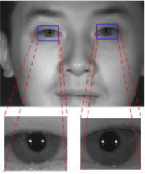
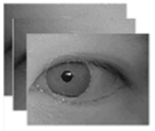
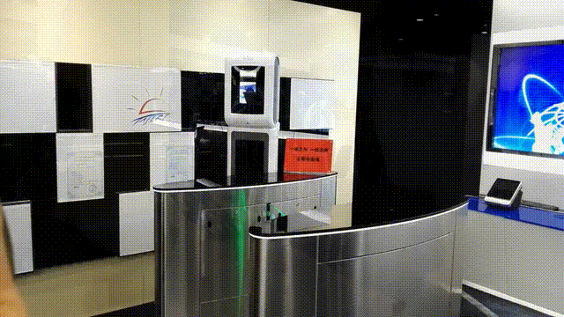








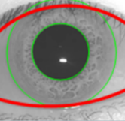

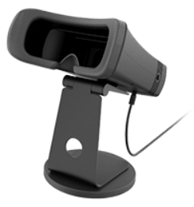


Motivation
Iris Recognition
Dilemma
Iris Image
Collection
Image Quality Assessment
Iris Segmentation and Localization
Norma-
lization
Centralized
High privacy
Risk of leakage
Texture Enhancement
Distributed Application
Diversity of Subject, Devices, Environment
Feature
Extraction
Large
Scale
Database
Matching
Recog-
nition
Notes:
Before introducing our work, I want to briefly introduce the iris recognition .
As one famous biometrics method, iris recognition has established a complete system. An iris image that can be used for training needs to through collection, IQA, segmentation, Localization normalization, and enhancement. Then the iris template is obtained through the feature extractor.
However, Traditional feature extraction model training requires the construction of a centralized iris image dataset, but it contains a large amount of personal privacy and high risk of leakage.
On the other hand, the distributed application is the current challenge for the promotion of iris. The reason is that the Diversity of Subject, Devices, Environment during clients brings great heterogeneity resulting in inability to accurately identify
These forced us to think about whether there is a better solution.

Slide 5
Motivation
Triplet-> FedTriplet
Negative
Negative
Triplet
Anchor
Anchor
LEARNING
Positive
Positive
Negative
Negative
Cross-domain
Negative
Fed-Triplet
Cross-domain
Negative
Anchor
Anchor
LEARNING
Positive
Positive
Notes:
Metric learning is now the common training strategy for iris template extractor model.
As the classical methods, Triplet loss drives the same class aggregation and the different classes leave away from each other as demonstrated in the animation.
when the data is dispersed, the Triplets of one single client may not be sufficient to continue driving the model to achieve better classification capabilities. But as the animation shown, the negative templates transfered from other clients may further support better training
This process inspired us to build a federated learning framework based on template communication

Slide 6
Outline
Motivation
Methods
Results
Notes:
Then we introduce our methods

Slide 7
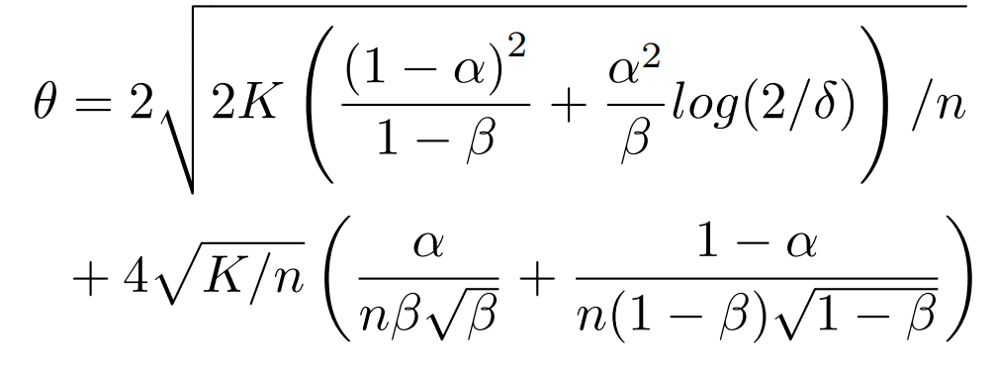

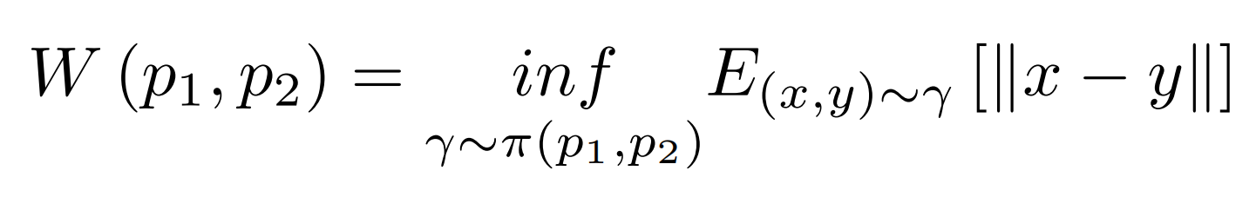
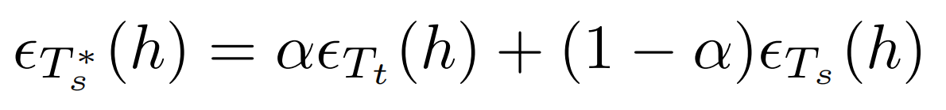
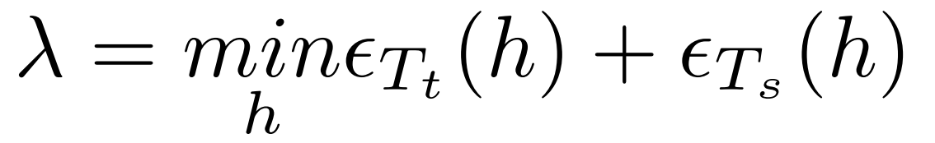


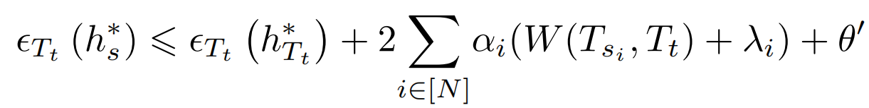
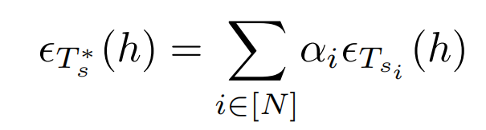
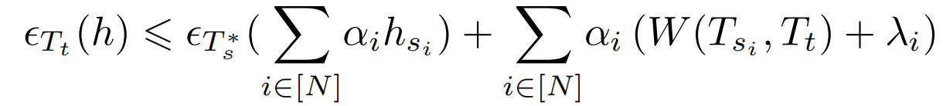
Methods
Generalization Error Bound
Generalization error bound with best hypothesis:
Generalization error bound with multi-source templates introduction:
Generalization error bound in any hypothesis:
Error Mixture
Distribution Distance
Notes:
Before introducing the framework, we first provide more theoretical support for template communication by generalization error bound analysis.
For simplicity, we will first discuss the case of introducing templates from one other client,where the local client is named target and the other client is called source.
h hat is the minimization of a convex combination of errors on the source and target templates, H star is the minimization of errors on target. W means the Wasserstein distribution distance measurement. lambda and theta depend on the template distributions and the selection of Hyperparameters.
This Theorem means The best generalization error of the target domain, with the introduction of source templates, performs better than the best hypothesis of training only on the target templates.
Then, We generalize the theorem to multi-source template introduction. we can get the samailar foundations.
furthher, we generalize the generalization error bound with any hypothesis, which like:
from this Theorem, we get that If the hypothesis space is fixed, this bound depends on two items: 1) the generalization error of the multi-source templates mixture; 2) the distribution
distances between multi-source domains and the target domain.
This analysis explains why we need reweighting global aggregation.

Slide 8
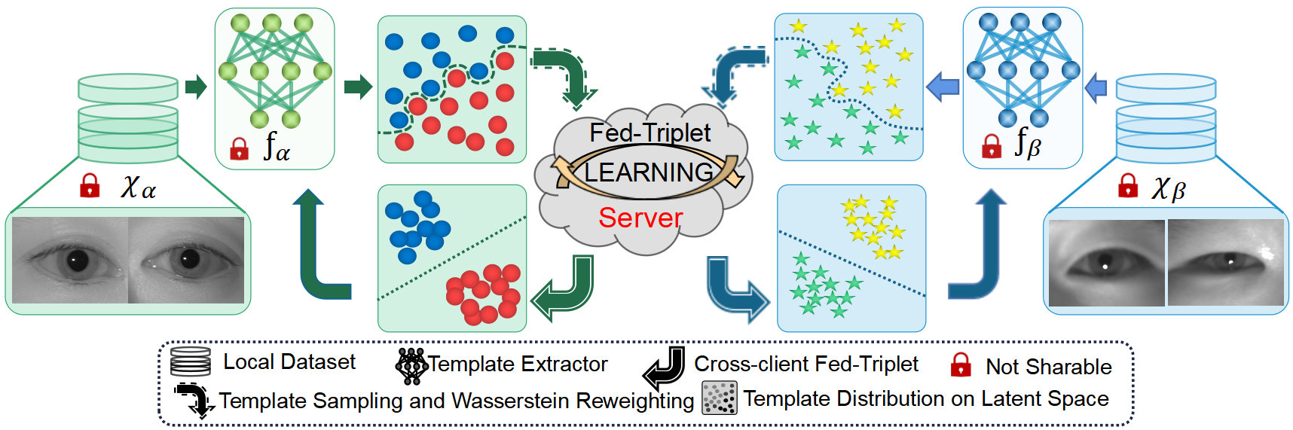
Methods
Federated Template Communication for Iris Recognition Framework
Notes:
After having a sound theoretical foundation, the Framework is constructed as shown in the figure
Throughout the training process, the raw iris image and template extractor of each client remain locally untransferred, and only the extracted templates are involved into global communication.

Slide 9
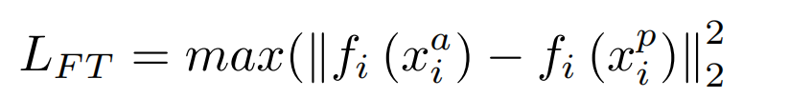
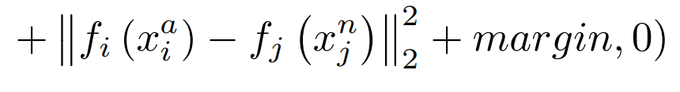

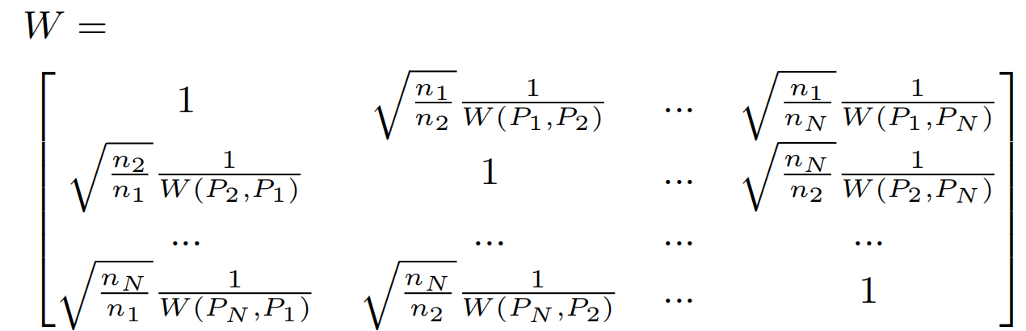
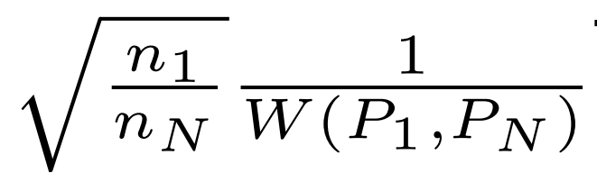
Methods
Federated Triplet Loss
Negative
Anchor
Cross-domain
Negative
Positive
Distribution Similarity Aggregation
Scale Balance
Distance Reweight
Notes:
In order to better transfer knowledge through template communication, two new techniques are proposed
As the principle shown in motivation part, With the insertion of enough cross-domain negative templates by fedtriplet, the local inner-class boundary is tightened and the inter-class distance is enlarged.The former enhance the robustness of model generalization, and the later enhances the distinguishability of local identities.
In an other hand, Inspired by the foundations, The Distribution Similarity Aggregation is proposed to reweight the heterogeneous distributions. The left part applied for scale balance and the right part is employed for Distance Reweight. This reweighting aggregation drives the clients with more similar template distributions to contribute more

Slide 10
Outline
Motivation
Methods
Results
Notes:
After building the template communiction FL framework, we performed extensive experimental on some iris datasets

Slide 11
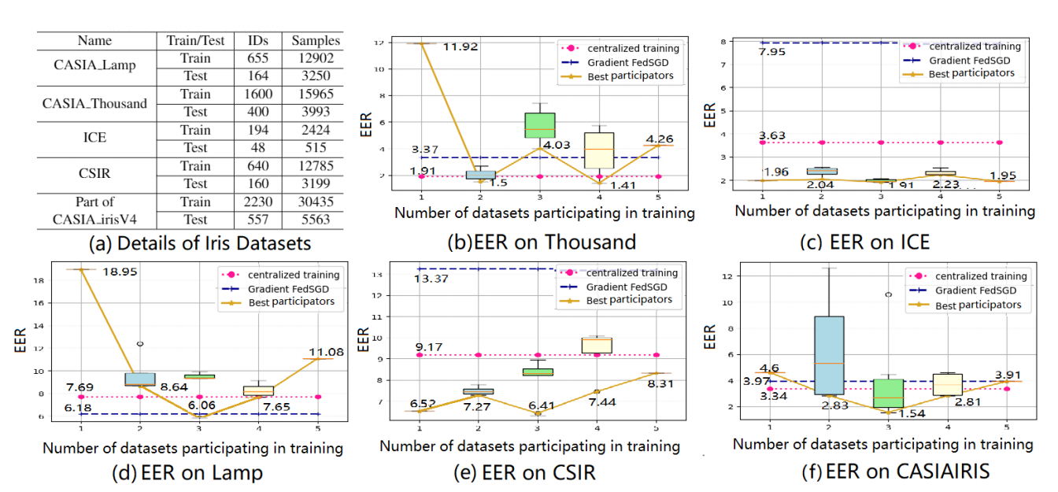
Results
Notes:
At first, a group of experiments are conducted to verify the influence caused by the introduction of heterogeneous iris template. The results show that the distribution shifts between the communication participators may cause negative transfer for EER performances. So It is unreasonable to train the model on aggregating more datasets while ignoring distribution shifts.

Slide 12
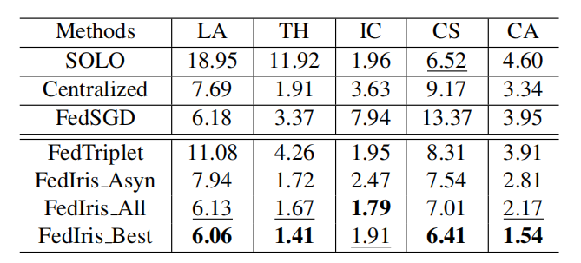
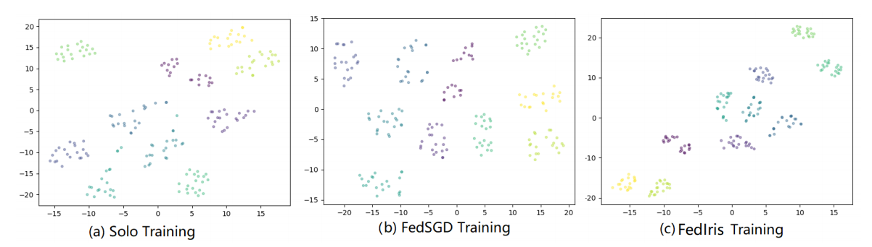
Results
Notes:
Then, to verify the effectiveness of the proposed method, we conducted many comparative experiments.
The results of the model trained by FedSGD or FedTriplet are close to the results of centralized training, which are much better than SOLO training. It verifies the competitiveness of federated template communication.
FedIris All means that all the clients participate in the communication rounds. which is much better than Fed-Triplet. It proves that the reweighting aggregation significantly mitigates the negative transfer. Besides, FedIris All is only slightly inferior to FedIris Best, which is the theoretically optimal but unknown before hand in practice.
The visualization demonstrats that FedIris successfully reduces intra-class variance and tightens the intra-class distribution when compared with SOLO and FedSGD training.

Slide 13
THANK YOU
Notes:
That all for my presentation, Thank you for your listening

