Slide 1

D2 科学发现案例：
环境
—— Geology Knowledge Engine for Image, Data and Text
环境
（金梦 郑冠杰）
分子网络（健平）
污染物疾病（曾博义）
方法生成（苏梓阳，黄哲睿）

Slide 2


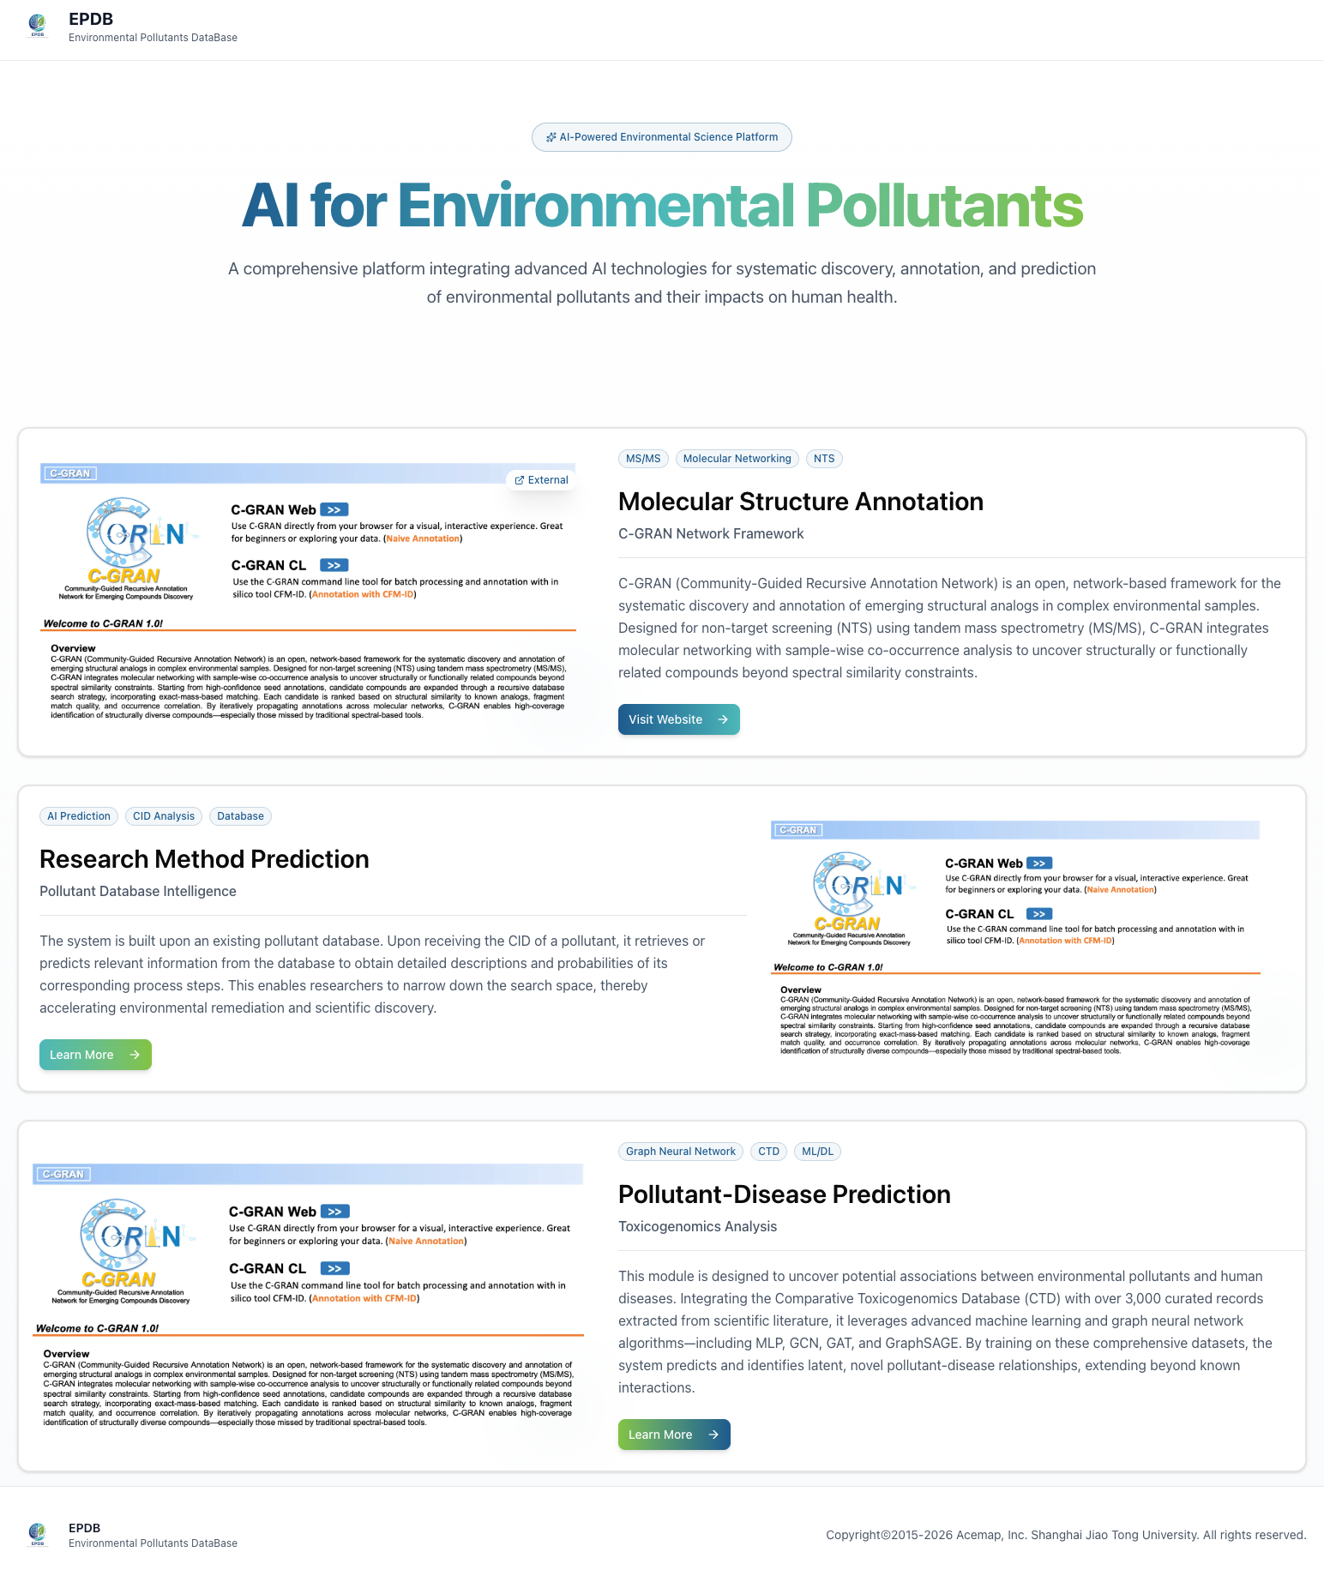
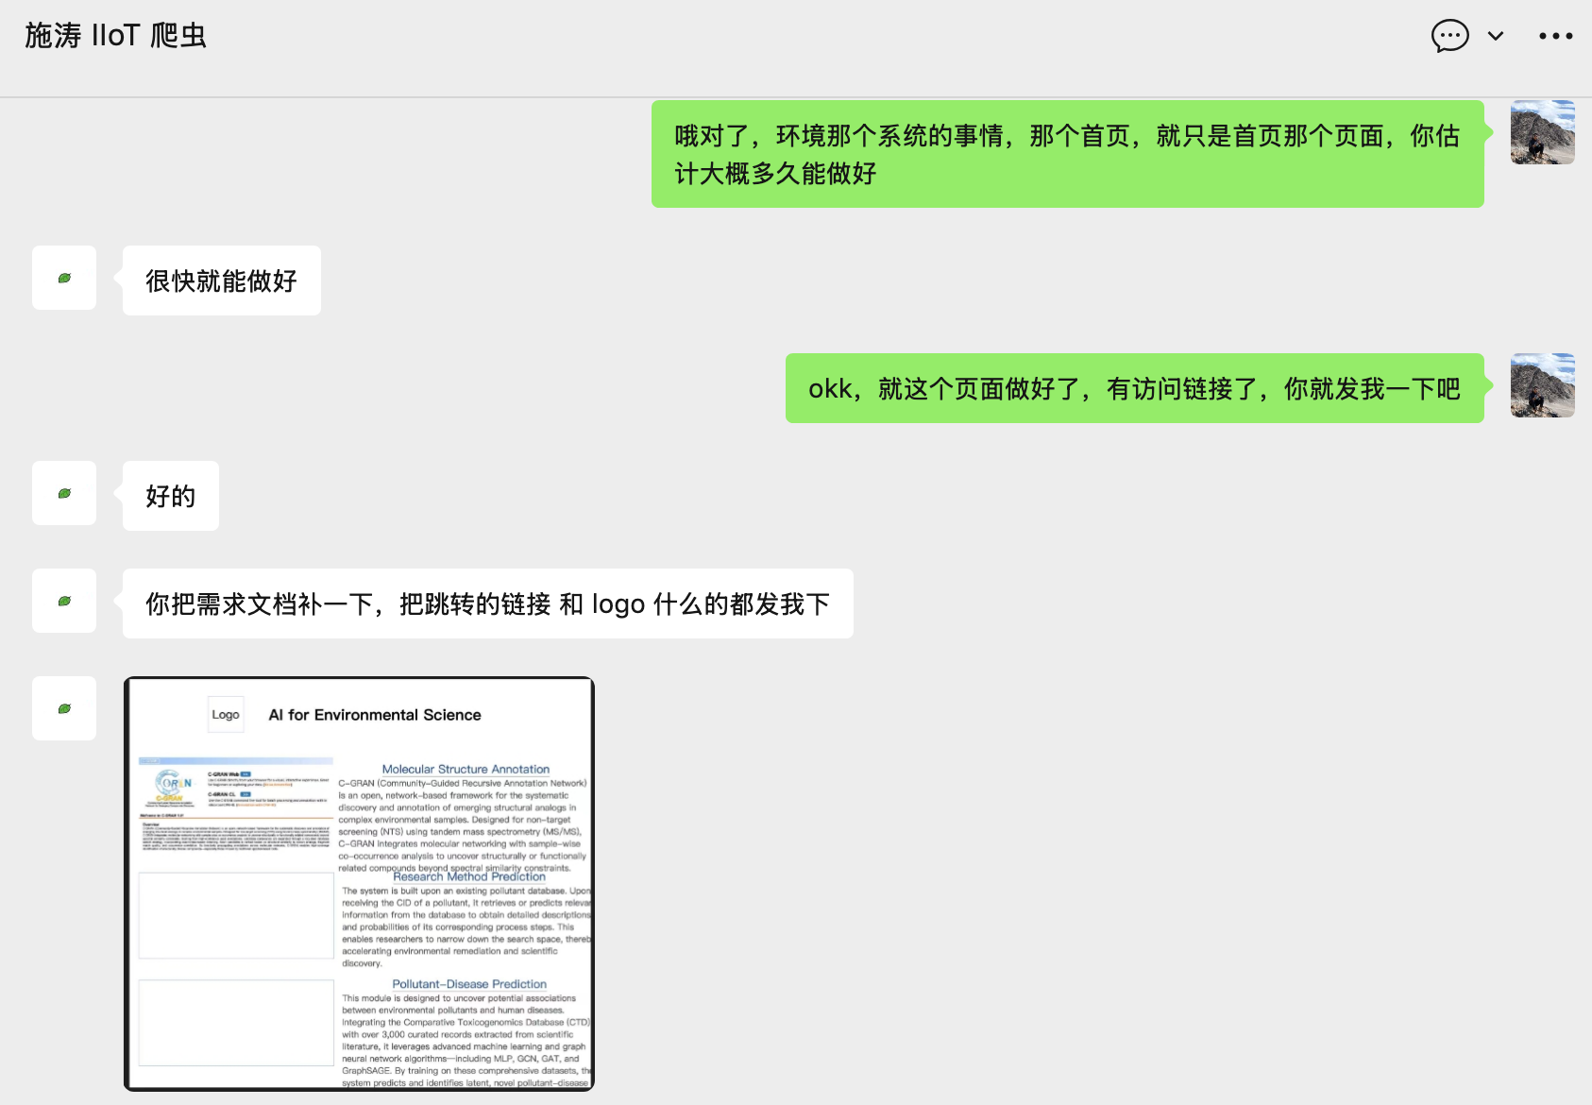

污染物分子网络预测（周健平）
新任务 | √
新功能
新指标
新调研
本周增量：本周完成了系统logo的设计，以及对接工程师完成项目主页的开发
下周计划：与小组同学和工程师对接系统开发，测试子页面
https://epdb.acemap.cn/

Slide 3
污染物数据库（曾博义）
上周任务：解决 GAT 模型在全量 CTD 数据上显存占用过高的问题
本周增量：搜集数据集外新发现的疾病污染物关系是否有文献证据支持
新任务
新功能
新指标 | √
新调研
Compound | Disease | Paper title (hyperlink)
Sulfamethoxazole | Acute Generalized Exanthematous Pustulosis | Acute generalized exanthematous pustulosis due to sulfamethoxazol with positive lymphocyte transformation test (LTT)
Methadone | Hyperglycemic Hyperosmolar Nonketotic Coma | Nonketotic hyperglycemic coma in toddlers after unintentional methadone ingestion
Fibrinolytic Agents | Vertebrobasilar Insufficiency | Long-term outcome after intravenous thrombolysis of basilar artery occlusion
Lithium | Hyperglycemic Hyperosmolar Nonketotic Coma | Hyperosmolar nonketotic coma precipitated by lithium-induced nephrogenic diabetes insipidus
Octreotide | Pancreatic Pseudocyst | Treatment of pancreatic pseudocysts with octreotide
Ritonavir | Pancreatic Pseudocyst | Lipid lowering therapy in patients with HIV infection
Ceftazidime | Articulation Disorders | Neurotoxicity with Antimicrobials in the Elderly: A Review
Phenytoin | Lipomyelomeningocele | Use of Antiepileptic Medications in Pregnancy in Relation to Risks of Birth Defects
Acetazolamide | Brain Death | Extensive brain infarction involving deep structures during an acetazolamide-challenged single-photon emission computed tomography scan in a patient with moyamoya disease
Cocaine | Pneumopericardium | Cocaine-Induced Pneumopericardium: Safe for Discharge? A Case Report and Literature Review
下周计划：搜集更多新发现的疾病污染物关系是否有文献证据支持，构建系统
Notes:
单击此处添加文本

