Slide 1
Airbnb Insights
Ali, Oliver, John, Ana

Slide 2
Part 1

Slide 3
Data
Datasets used:
  ls.with.rws.csv
  host_attribute.csv
  Guest_attribute.csv
  Rows (2500-2999)

Slide 4
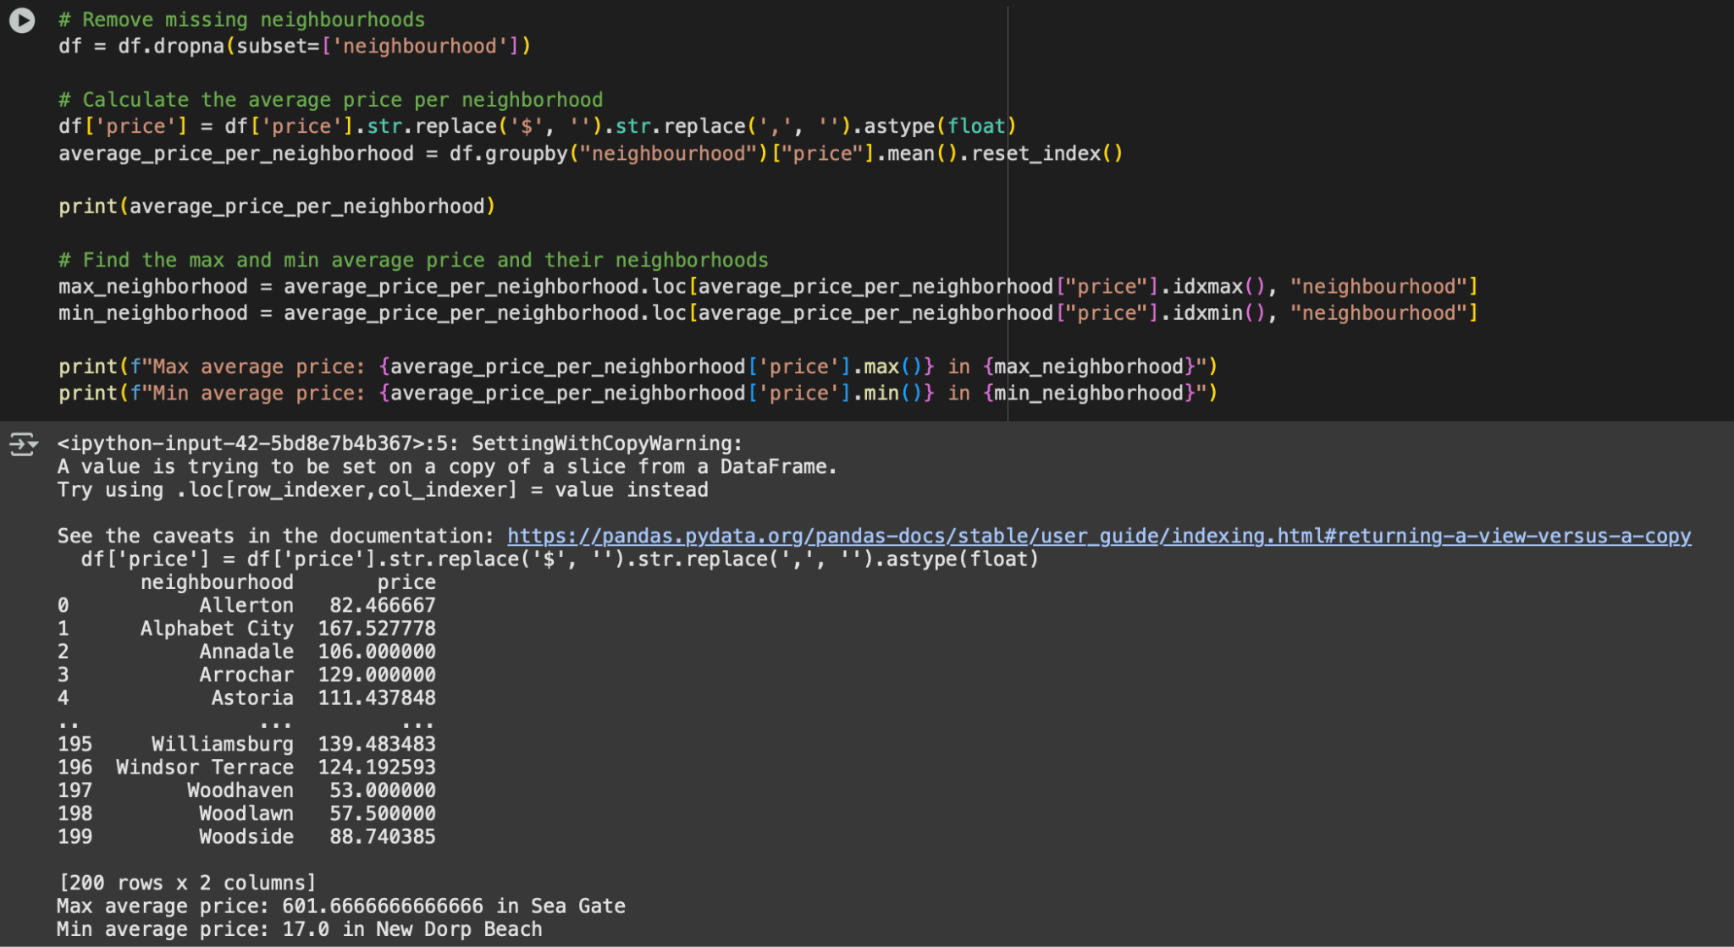
Code For Price

Slide 5
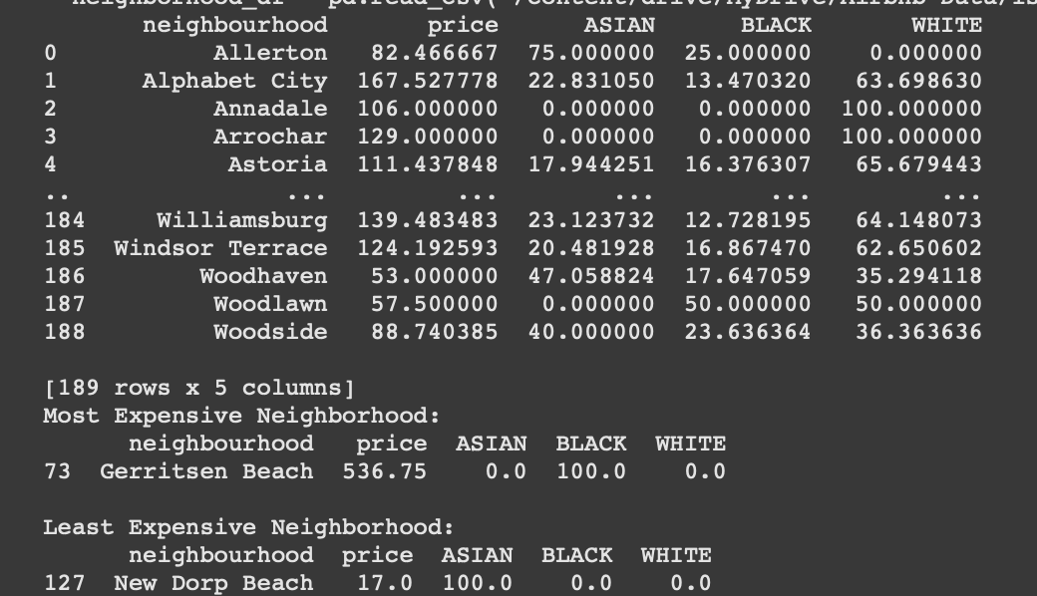
Racial Composition of Hosts

Slide 6
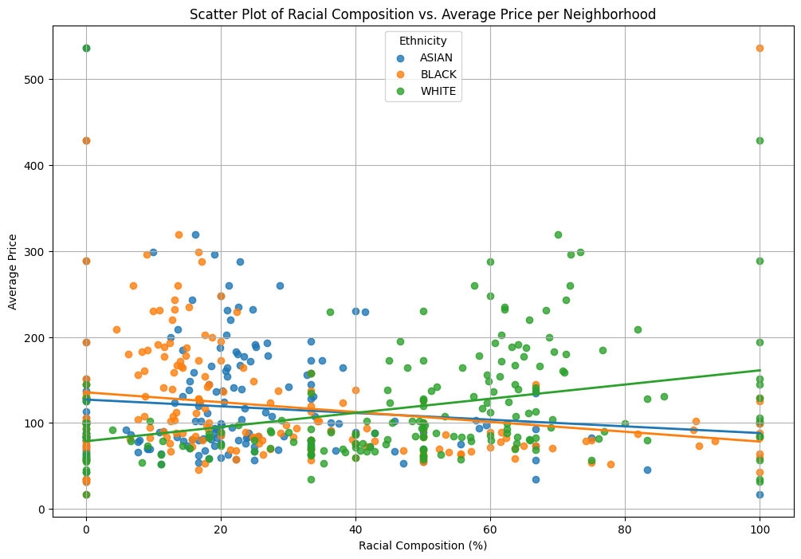
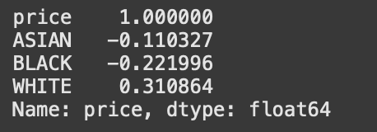
Scatter Plot and Correlation (Host)

Slide 7
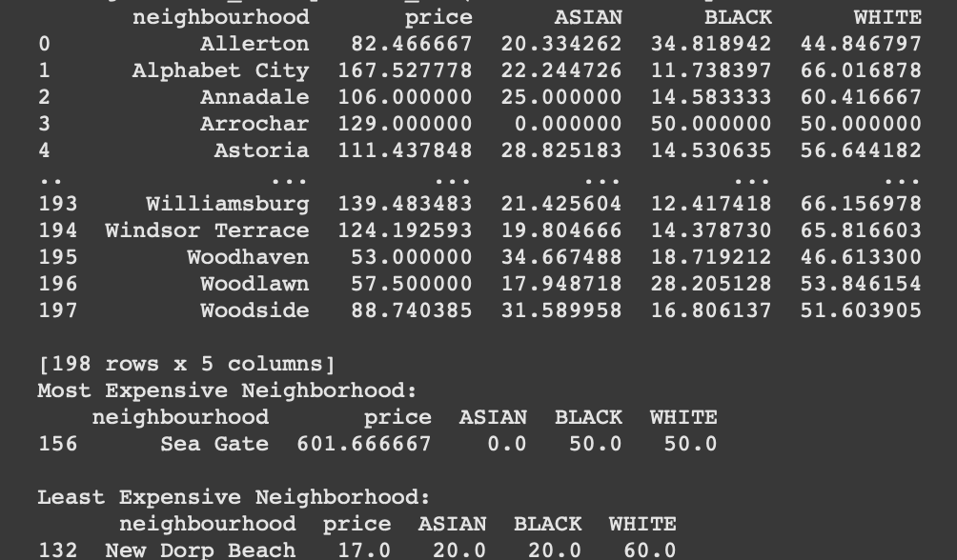
Racial Composition of Guests

Slide 8
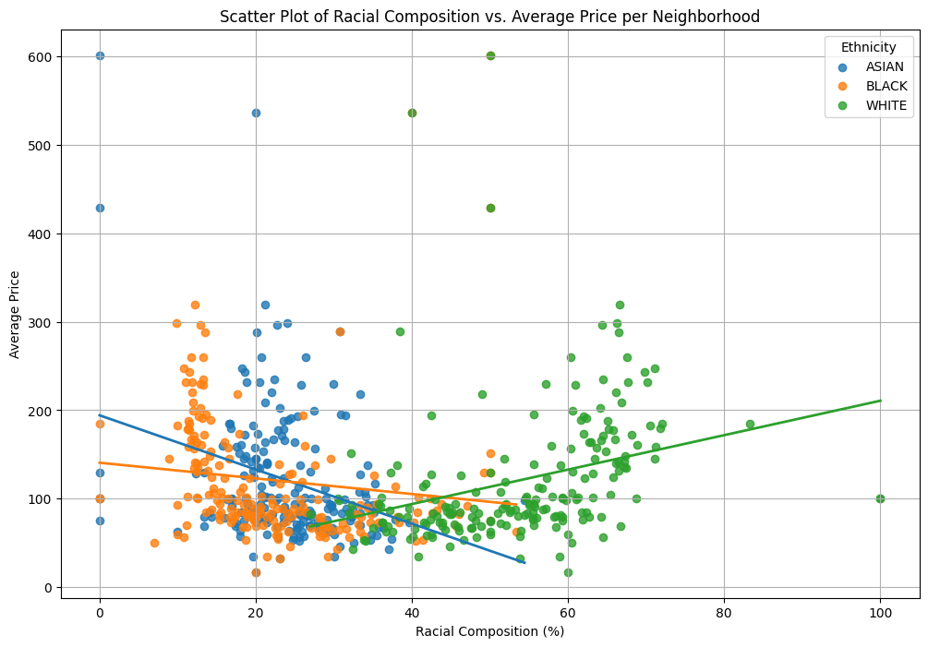
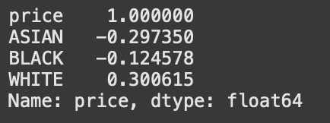
Scatter Plot and Correlation (Guests)

Slide 9
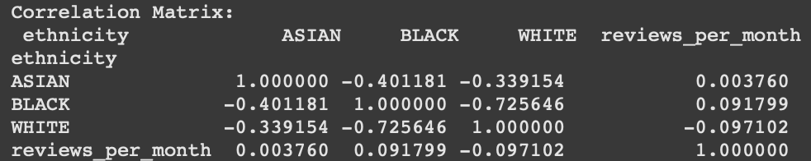
Reviews Per Month (Correlation Matrix)
Correlation matrix on reviews per month by neighborhood and race

Slide 10
Part 2

Slide 11
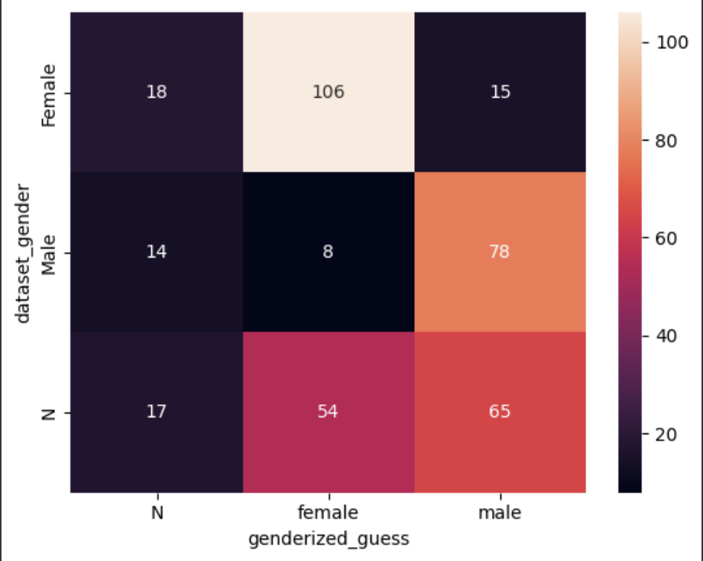
Correlation Plot between Actual and Predicted

Slide 12
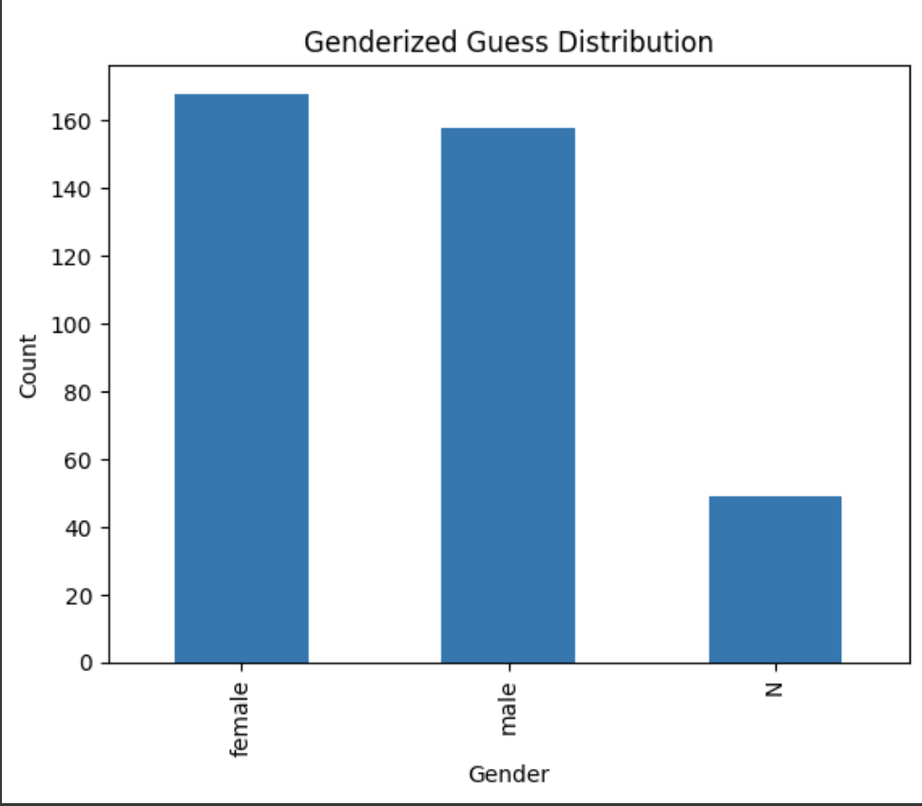
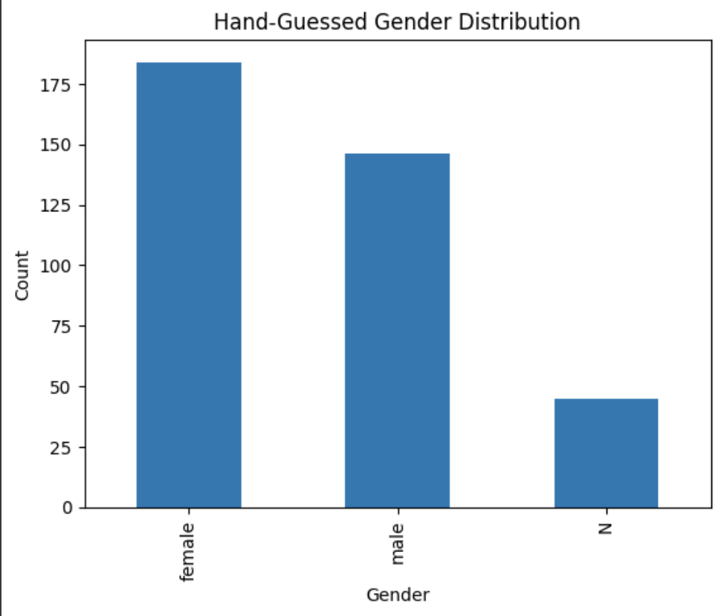
Distribution Comparison

Slide 13
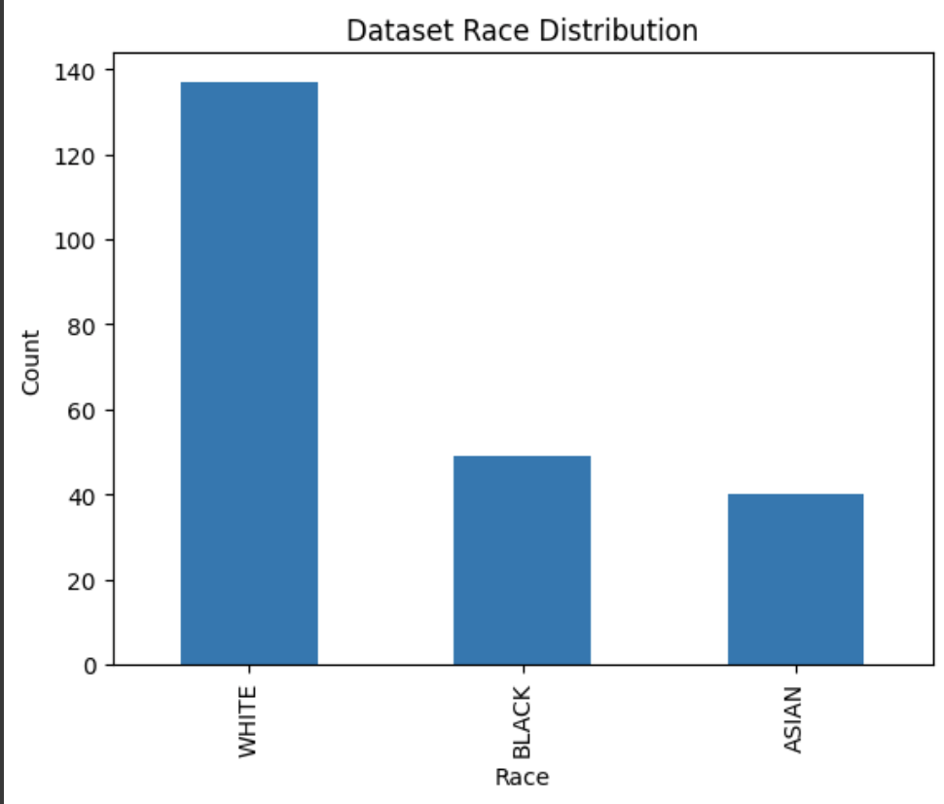
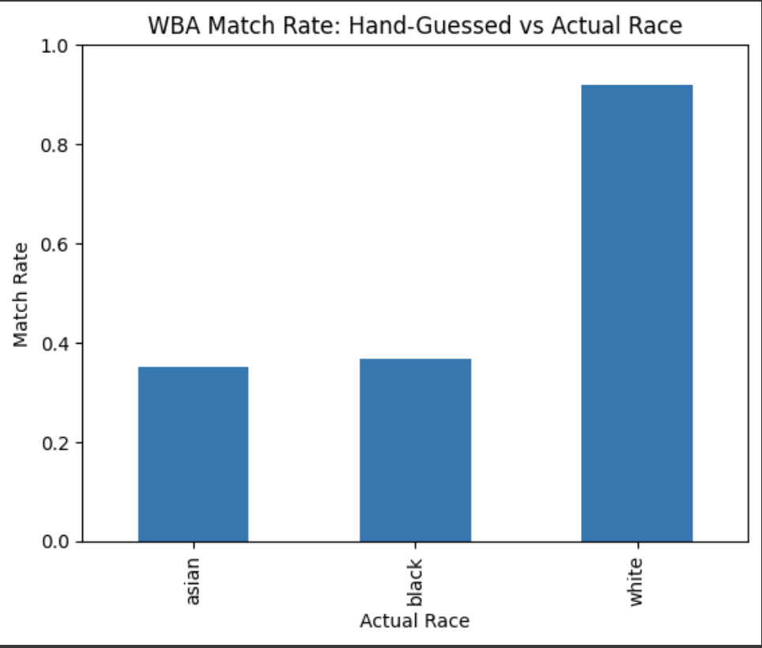
Race Distribution Comparison

Slide 14
