Slide 1
The normal distribution
Chapter 4

Slide 2
Introduction: What is NORMAL?
Medical researchers have determined so-called normal intervals for a person’s blood pressure, cholesterol, triglycerides, and the like. For example, the normal range of systolic blood pressure is 110 to 140. The normal interval for a person’s triglycerides is from 30 to 200 milligrams per deciliter (mg/dl). By measuring these variables, a physician can determine if a patient’s vital statistics are within the normal interval or if some type of treatment is needed to correct a condition and avoid future illnesses. The question then is, How does one determine the so-called normal intervals?

Slide 3
Introduction: What is NORMAL?
In this chapter, you will learn how researchers determine normal intervals for specific medical tests by using a normal distribution. You will see how the same methods are used to determine the lifetimes of batteries, the strength of ropes, and many other traits.

Slide 4
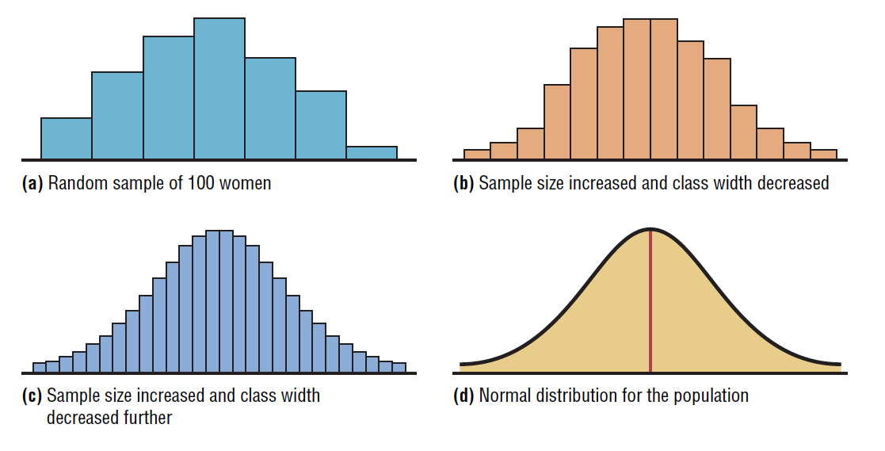
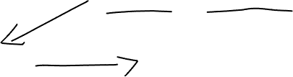
Histograms for the Distribution of Heights of Adult Women

Slide 5
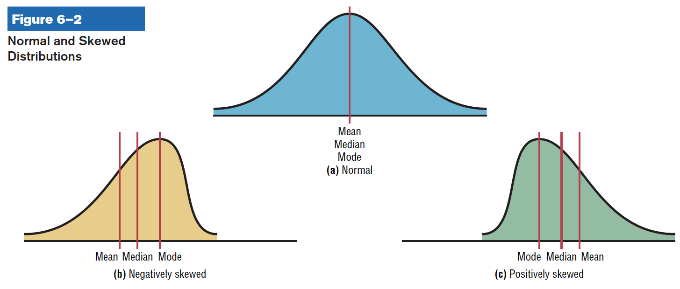
Normal and Skewed Distributions

Slide 6
Normal and Skewed Distributions
When the data values are evenly distributed about the mean, a distribution is said to be a symmetric distribution. (A normal distribution is symmetric.)
When the majority of the data values fall to the left or right of the mean, the distribution is said to be skewed. When the majority of the data values fall to the right of the mean, the distribution is said to be a negatively or left-skewed distribution. The mean is to the left of the median, and the mean and the median are to the left of the mode.

Slide 7
Normal and Skewed Distributions
When the majority of the data values fall to the left of the mean, a distribution is said to be a positively or right-skewed distribution. The mean falls to the right of the median, and both the mean and the median fall to the right of the mode.
The “tail” of the curve indicates the direction of skewness (right is positive, left is negative). These distributions can be compared with the ones shown in the previous lessons.

Slide 8
Properties of a normal distribution
Lesson 6.1
Notes:
1111``

Slide 9
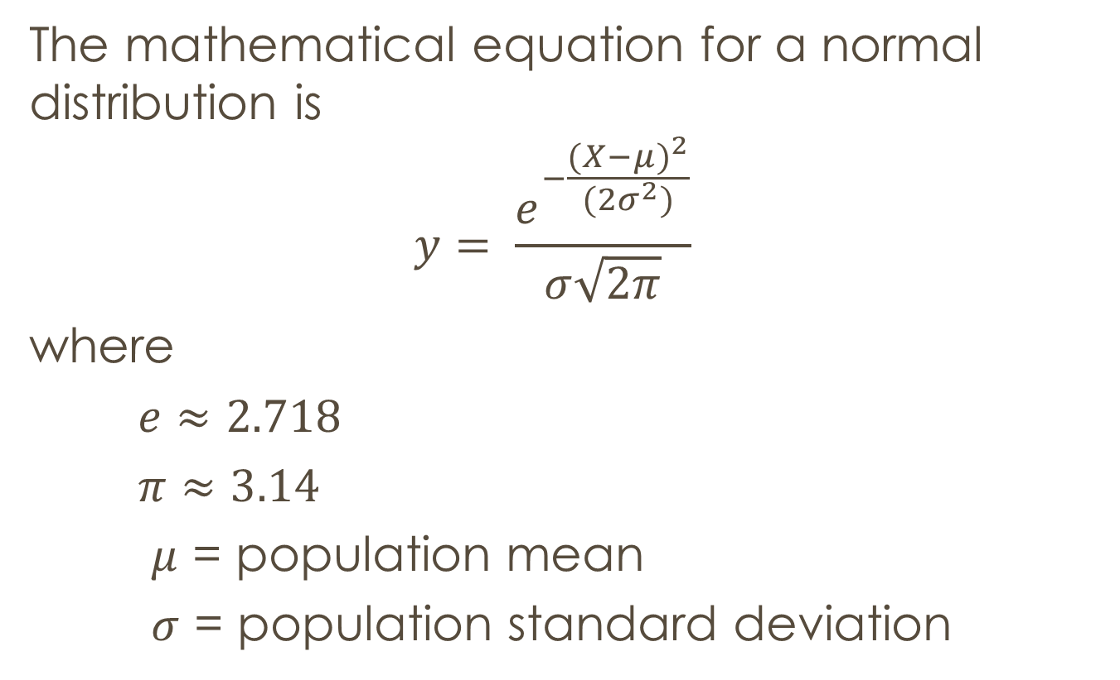
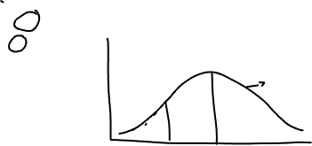
Properties of a normal distribution
The mathematical equation for a normal distribution is
$$y= \frac{e^{−\frac{{(X−μ)}^{2}}{(2σ^{2})}}}{σ\sqrt{2π}}$$
where
$e≈2.718$
$π≈3.14$
$μ$ = population mean
$σ$ = population standard deviation

Slide 10
Normal Distribution
The shape and position of a normal distribution curve depend on two parameters, the mean and the standard deviation.
Each normally distributed variable has its own normal distribution curve, which depends on the values of the variable’s mean and standard deviation.

Slide 11
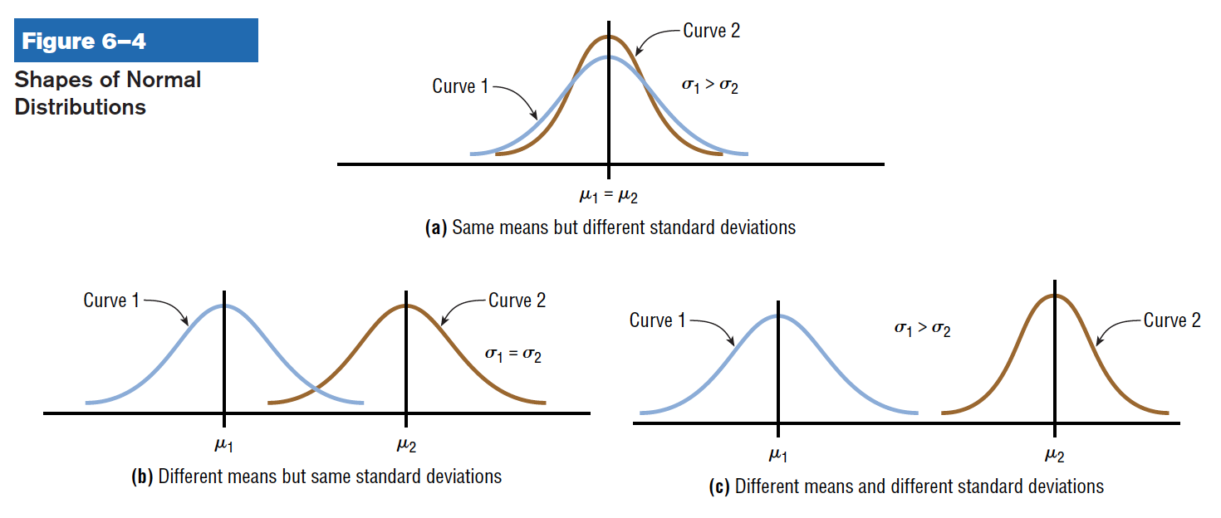
Normal Distribution

Slide 12
Normal Distribution
A normal distribution is a continuous, symmetric, bell-shaped distribution of a variable.

Slide 13
Properties of a normal distribution
A normal distribution curve is bell-shaped.
The mean, median, and mode are equal and are located at the center of the distribution.
A normal distribution curve unimodal.

Slide 14
Properties of a normal distribution
4. The curve is symmetric about the mean, which is equivalent to the saying that its shape is the same on both sides of a vertical line passing through the center.
5. The curve is continuous, that is there are no gaps or holes. For each value of X, there is a corresponding value of Y.

Slide 15
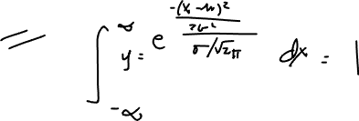
Properties of a normal distribution
6. The curve never touches the x-axis. Theoretically, no matter how far in either direction the curve extends, it never meets the x-axis – but it gets increasingly closer.
7. The total area under a normal distribution curve is equal to 1.00 or 100%.

Slide 16
Properties of a normal distribution
8. The area under the part of a normal curve that lies within 1 standard deviation of the mean is approximately 0.68 or 68%; within 2 standard deviations, about 0.95 or 95% and within 3 standard deviations, about 0.997 or 99.7%.

Slide 17
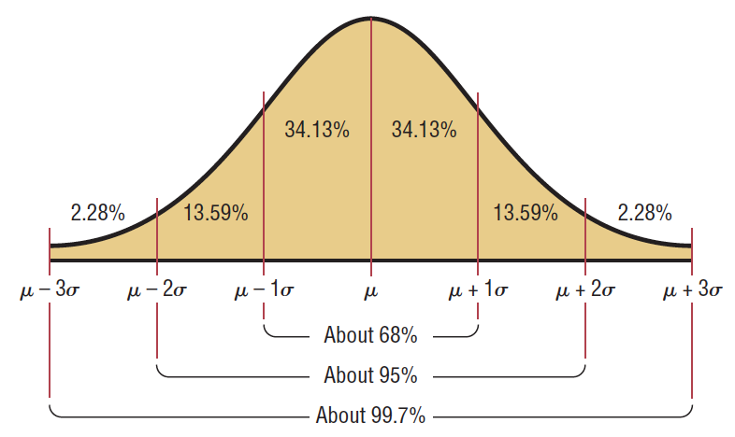
Properties of a normal distribution

Slide 18
THE STANDARD normal distribution
Lesson 6.2

Slide 19
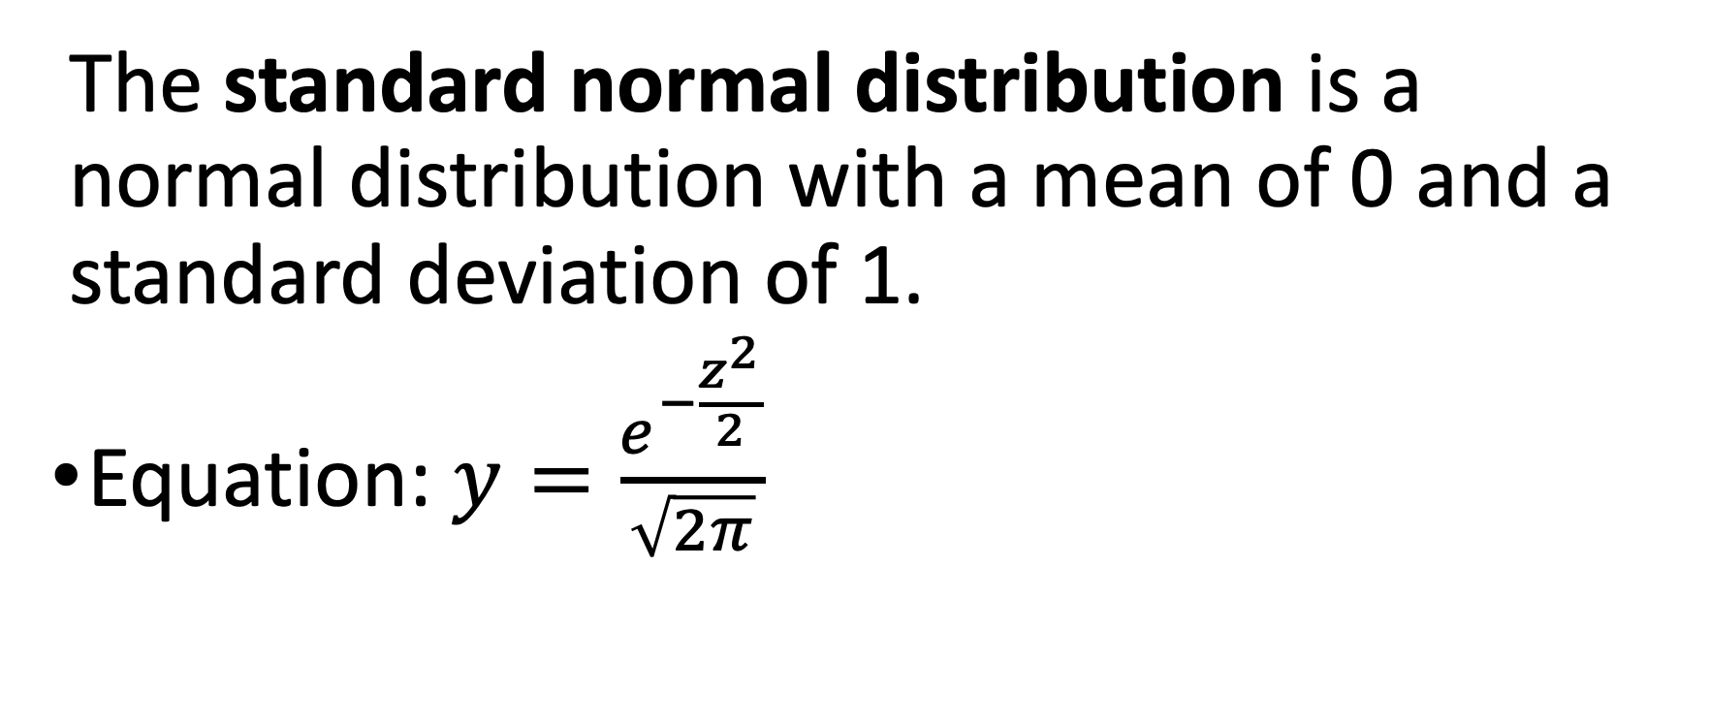
Standard normal distribution
The standard normal distribution is a normal distribution with a mean of 0 and a standard deviation of 1.
Equation: $y=\frac{e^{−\frac{z^{2}}{2}}}{\sqrt{2π}}$

Slide 20
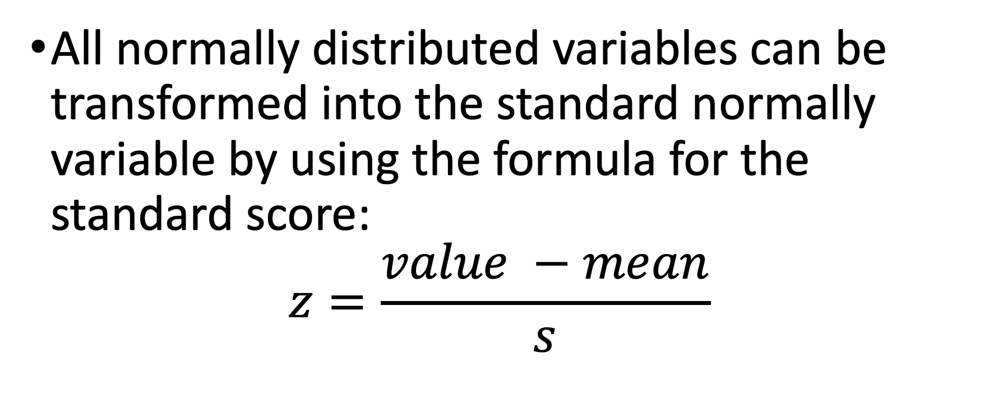
Standard normal distribution
All normally distributed variables can be transformed into the standard normally variable by using the formula for the standard score:
$$z=\frac{value −mean}{s}$$

Slide 21
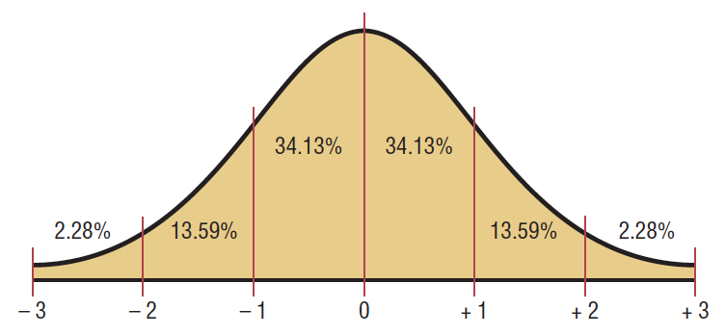

Standard Normal Distribution

Slide 22
Finding Areas Under the Standard Normal Distribution Curve
Step 1 Draw the normal distribution curve and shade the area.
Step 2 Find the appropriate figure in the Procedure Table and follow the directions given.

Slide 23
Finding Areas Under the Standard Normal Distribution Curve
Step 1 Draw the normal distribution curve and shade the area.
Step 2 Find the appropriate figure in the Procedure Table and follow the directions given.

Slide 24
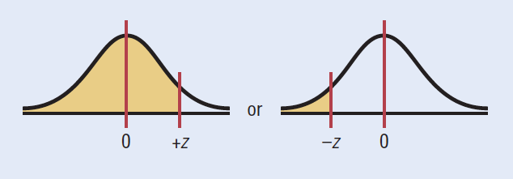
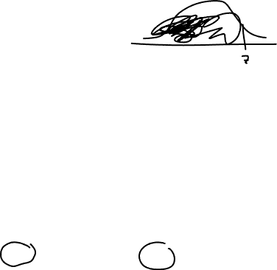
Finding Areas Under the Standard Normal Distribution Curve
To the left of any z value:
Look up the z value in the table and use the area given.

Slide 25
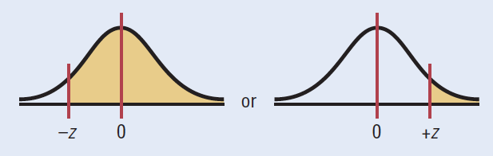
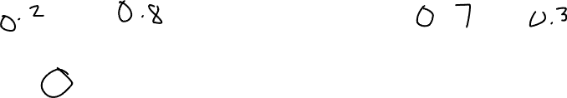
Finding Areas Under the Standard Normal Distribution Curve
To the right of any z value:
Look up the z value and subtract the area from 1.

Slide 26
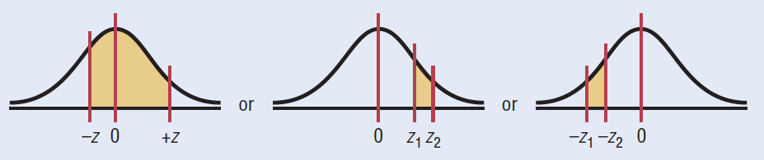

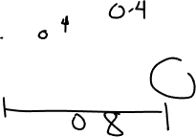
Finding Areas Under the Standard Normal Distribution Curve
Between any two z values:
Look up both z values and subtract the corresponding areas.

Slide 27
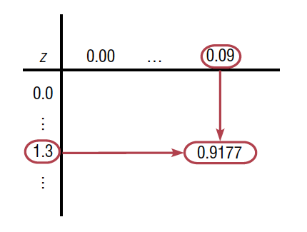
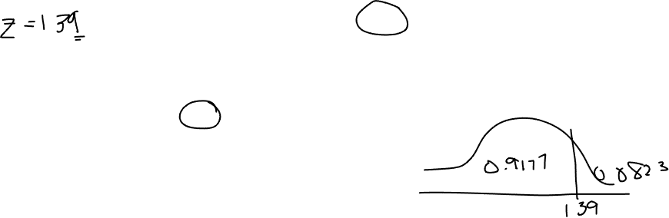
Finding Areas Under the Standard Normal Distribution Curve

Slide 28
Finding Areas Under the Standard Normal Distribution Curve
Find the area to the left of z = 1.99.

Slide 29
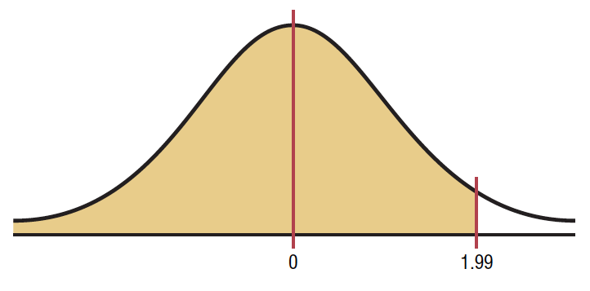
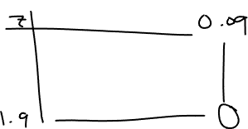
Finding Areas Under the Standard Normal Distribution Curve
Find the area to the left of z = 1.99.
Step 1 Draw the figure.

Slide 30

Finding Areas Under the Standard Normal Distribution Curve
Find the area to the left of z = 1.99.
Step 2 We are looking for the area under the standard normal distribution curve to the left of z 1.99.
Since this is an example of the first case, look up the area in the table. It is 0.9767.
Hence 97.67% of the area is less than z 1.99.

Slide 31
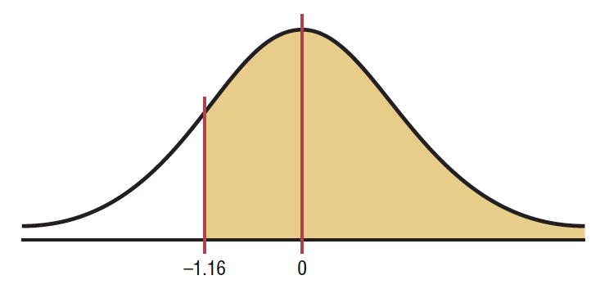
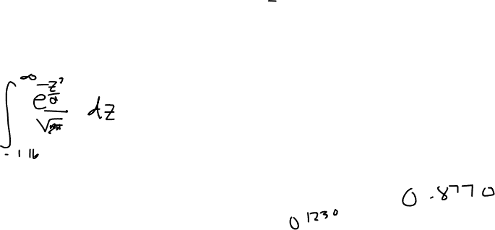
Finding Areas Under the Standard Normal Distribution Curve
Find the area to the right of z = 1.16.
Step 1 Draw the figure.

Slide 32
Finding Areas Under the Standard Normal Distribution Curve
Find the area to the right of z = 1.16.
We are looking for the area to the right of z1 = 16. This is an example of the second case.
Look up the area for z = 1.16. It is 0.3770. Subtract it from 1.000. 1.000 - 0.1230 = 0.8770.
Hence 87.70% of the area under the standard normal distribution curve is to the left of z1.16.

Slide 33
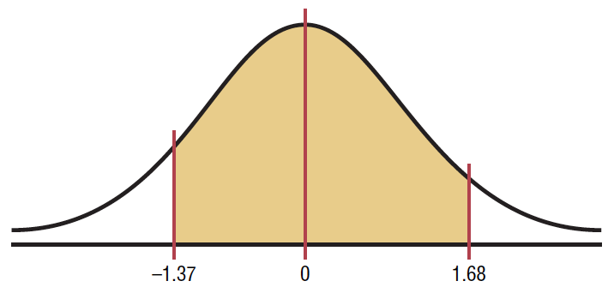
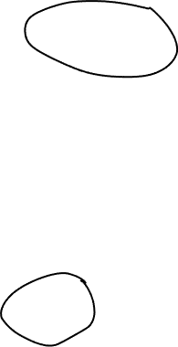
Finding Areas Under the Standard Normal Distribution Curve
Find the area between z= 1.68 and z= -1.37.
Step 1 Draw the figure

Slide 34
Finding Areas Under the Standard Normal Distribution Curve
Find the area between z= 1.68 and z= -1.37.
Since the area desired is between two given z values, look up the areas corresponding to the two z values and subtract the smaller area from the larger area. (Do not subtract the z values.)
The area for z = 1.68 is 0.9535, and the area for z = - 1.37 is 0.0853.
The area between the two z values is 0.9535 - 0.0853 = 0.8682 or 86.82%.

Slide 35
A Normal Distribution Curve as a Probability Distribution Curve
For probabilities, a special notation is used. For example, if the problem is to find the probability of any z value between 0 and 2.32, this probability is written as P(0 < z < 2.32).

Slide 36
A Normal Distribution Curve as a Probability Distribution Curve
For probabilities, a special notation is used. For example, if the problem is to find the probability of any z value between 0 and 2.32, this probability is written as P(0 < z < 2.32).
Note: In a continuous distribution, the probability of any exact z value is 0 since the area would be represented by a vertical line above the value. But vertical lines in theory have no area.

Slide 37
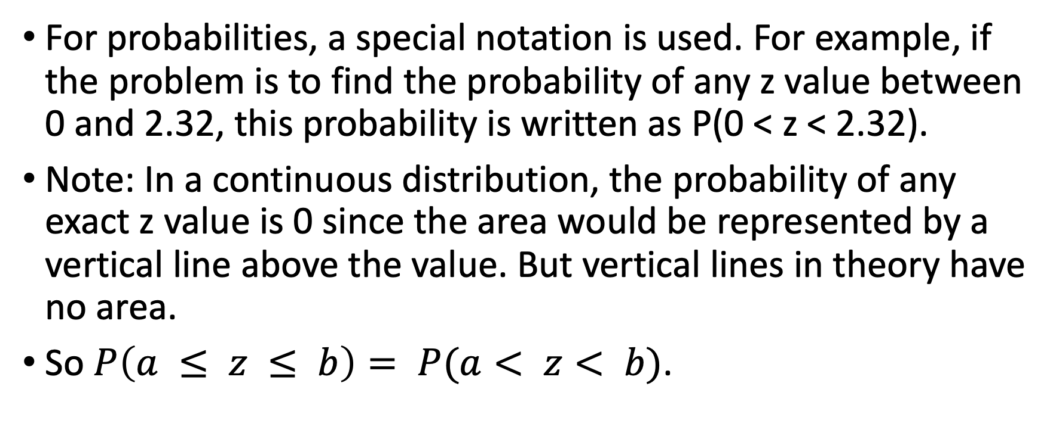
A Normal Distribution Curve as a Probability Distribution Curve
For probabilities, a special notation is used. For example, if the problem is to find the probability of any z value between 0 and 2.32, this probability is written as P(0 < z < 2.32).
Note: In a continuous distribution, the probability of any exact z value is 0 since the area would be represented by a vertical line above the value. But vertical lines in theory have no area.
So $P\left(a ≤ z ≤ b\right)= P(a< z< b)$.

Slide 38

A Normal Distribution Curve as a Probability Distribution Curve
F$ind the probability of P(0<z<2.32)$.

Slide 39
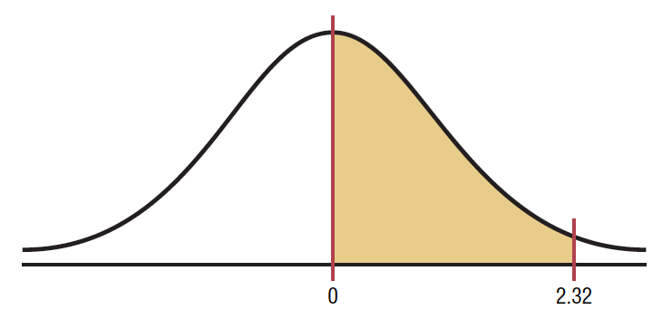
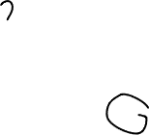
A Normal Distribution Curve as a Probability Distribution Curve
F$ind the probability of P(0<z<2.32)$.

Slide 40

A Normal Distribution Curve as a Probability Distribution Curve
F$ind the probability of P(0<z<2.32)$.
Subtract the two areas:
$0.9898−0.5000=0.4898$.
Hence the probability is 0.4898, or 48.98%.

Slide 41

A Normal Distribution Curve as a Probability Distribution Curve
F$ind the probability of P(z<1.65)$.

Slide 42
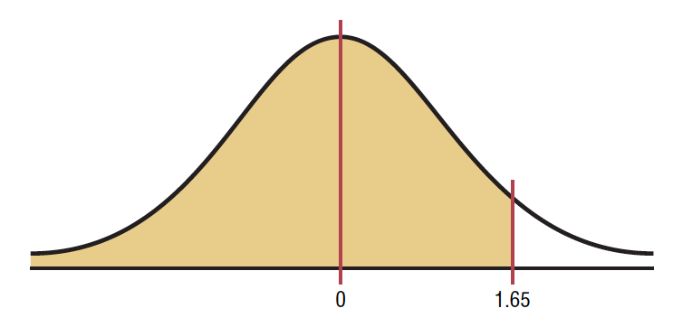
A Normal Distribution Curve as a Probability Distribution Curve
F$ind the probability of P(z<1.65)$.

Slide 43

A Normal Distribution Curve as a Probability Distribution Curve
F$ind the probability of P(z<1.65)$.
$$P(z<1.65)\text{=}0.9505$$

Slide 44

A Normal Distribution Curve as a Probability Distribution Curve
F$ind the probability of P(z>1.91)$.

Slide 45
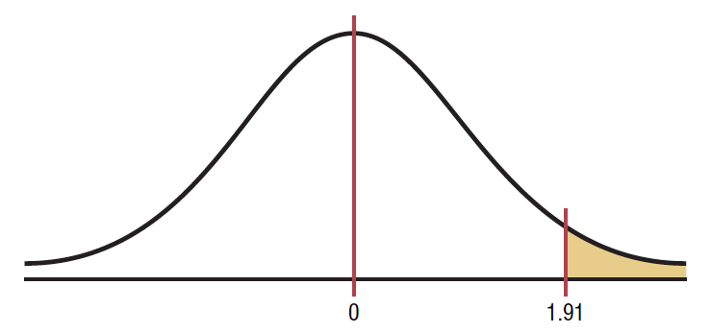
A Normal Distribution Curve as a Probability Distribution Curve
F$ind the probability of P(z>1.91)$.

Slide 46

A Normal Distribution Curve as a Probability Distribution Curve
F$ind the probability of P(z>1.91)$.
Look up the area that corresponds to $z=1.91 which$is 0.9719.

Slide 47
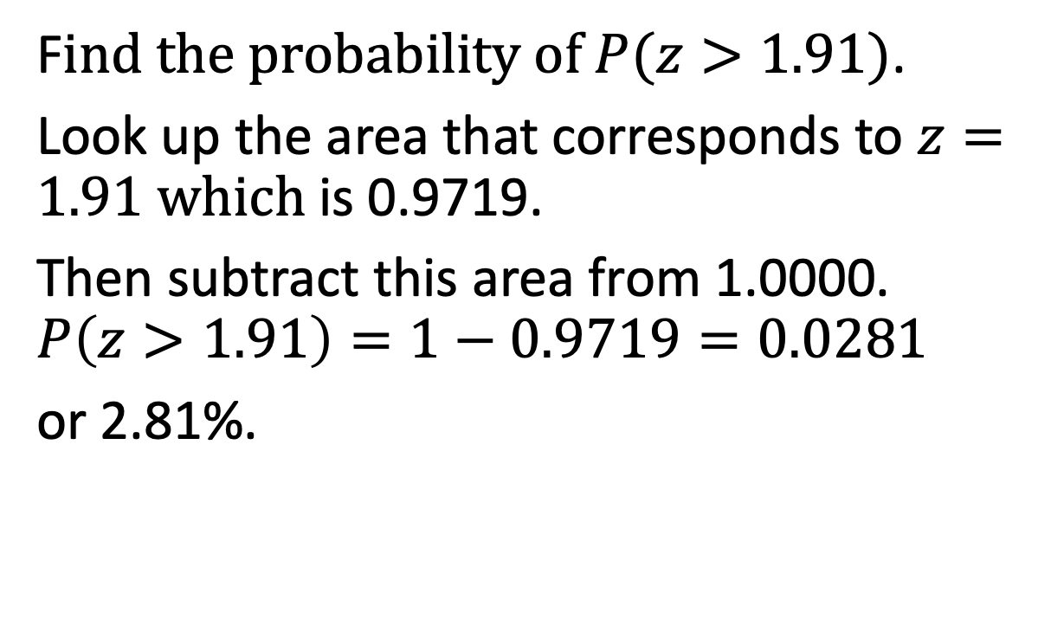
A Normal Distribution Curve as a Probability Distribution Curve
F$ind the probability of P(z>1.91)$.
Look up the area that corresponds to $z=1.91 which$is 0.9719.
Then subtract this area from 1.0000.
$$P\left(z>1.91\right)=1−0.9719=0.0281$$
or 2.81%.

Slide 48
A Normal Distribution Curve as a Probability Distribution Curve
Find the z value such that the area under the standard normal distribution curve between 0 and the z value is 0.2123.

Slide 49
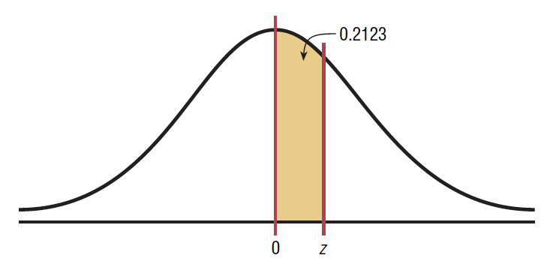
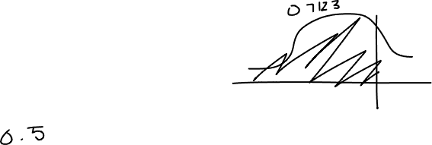
A Normal Distribution Curve as a Probability Distribution Curve
Find the z value such that the area under the standard normal distribution curve between 0 and the z value is 0.2123.

Slide 50
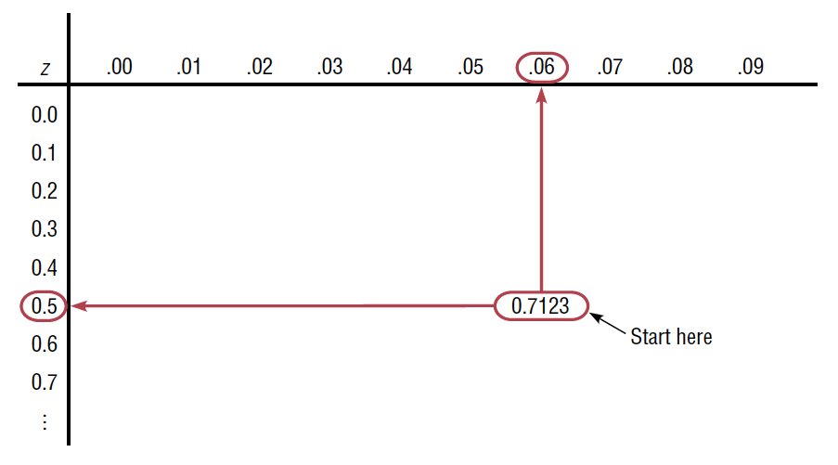
A Normal Distribution Curve as a Probability Distribution Curve
Find the z value such that the area under the standard normal distribution curve between 0 and the z value is 0.2123.

Slide 51
Standard normal distribution
Find the Area under the Standard Normal Distribution Curve
Between z = 0 and z = 2.34
Left of x = -1. 93
Between z = 2.00 and z = 2.47
Between z = -2.48 and z = -0.83

Slide 52
Standard normal distribution
Find the Area under the Standard Normal Distribution Curve
Between z = 1.68 and z = -1.37
Left of z = 1.99
Right of z = -1.16
Right of z = 2.43 and left of z = -3.01

Slide 53
Standard normal distribution
A normal distribution curve can be used as a probability distribution curve for normally distributed variables.
P(a<z<b)
P(z<a)
P(z>a

Slide 54
Standard normal distribution
Find the probability for each:
P( 0 < z < 2.32)
P ( z < 1.65)
P ( z > 1.91)
Find the value of z
1. Area between 0 and z = value is 0.2123.

Slide 55
Applications of the normal distribution
Lesson 6.3

Slide 56
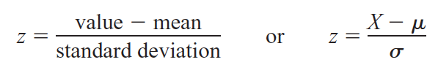
Applications of Normal Distribution
To solve problems by using the standard normal distribution, transform the original variable to a standard normal distribution variable by using the formula:

Slide 57
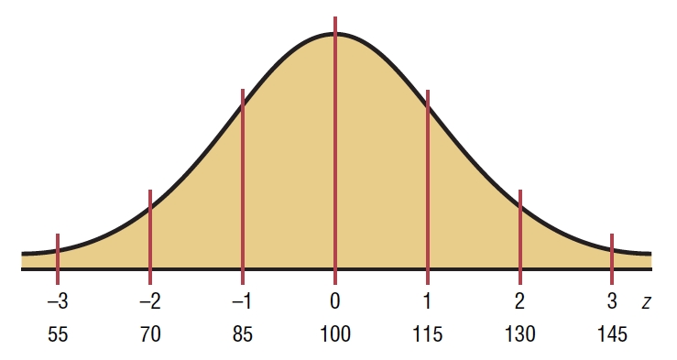

Applications of Normal Distribution
For example, suppose that the scores for a standardized test are normally distributed, have a mean of 100, and have a standard deviation of 15.

Slide 58
Applications of Normal Distribution
When the scores are transformed to z values, the two distributions coincide.

Slide 59
Applications of Normal Distribution
Recall that the z distribution has a mean of 0 and a standard deviation of 1.

Slide 60
Applications of Normal Distribution
To solve the application problems in this section, transform the values of the variable to z values and then find the areas under the standard normal distribution

Slide 61
Applications of Normal Distribution
A survey by the National Retail Federation found that women spend on average $146.21 for the Christmas holidays. Assume the standard deviation is $29.44. Find the percentage of women who spend less than $160.00. Assume the variable is normally distributed.

Slide 62
Applications of Normal Distribution
A survey by the National Retail Federation found that women spend on average $146.21 for the Christmas holidays. Assume the standard deviation is $29.44. Find the percentage of women who spend less than $160.00. Assume the variable is normally distributed.
Draw the figure and represent the area

Slide 63
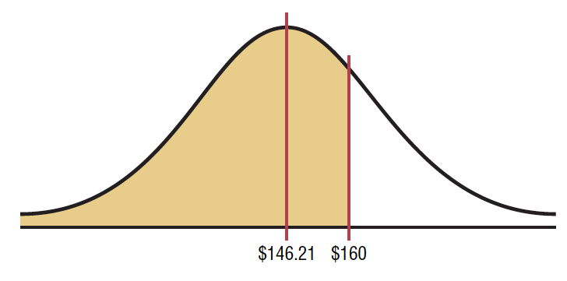
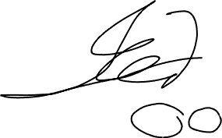
Applications of Normal Distribution
A survey by the National Retail Federation found that women spend on average $146.21 for the Christmas holidays. Assume the standard deviation is $29.44. Find the percentage of women who spend less than $160.00. Assume the variable is normally distributed.
Draw the figure and represent the area

Slide 64
Applications of Normal Distribution
A survey by the National Retail Federation found that women spend on average $146.21 for the Christmas holidays. Assume the standard deviation is $29.44. Find the percentage of women who spend less than $160.00. Assume the variable is normally distributed.
Draw the figure and represent the area
Find the z value corresponding to $160.00.

Slide 65



Applications of Normal Distribution
A survey by the National Retail Federation found that women spend on average $146.21 for the Christmas holidays. Assume the standard deviation is $29.44. Find the percentage of women who spend less than $160.00. Assume the variable is normally distributed.
Draw the figure and represent the area
Find the z value corresponding to $160.00.

Slide 66
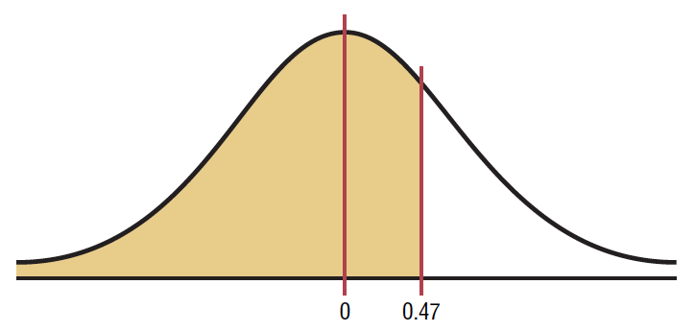

Applications of Normal Distribution
A survey by the National Retail Federation found that women spend on average $146.21 for the Christmas holidays. Assume the standard deviation is $29.44. Find the percentage of women who spend less than $160.00. Assume the variable is normally distributed.
Find the z value corresponding to $160.00.
Hence $160.00 is 0.47 of a standard deviation above the mean of $146.21

Slide 67
Applications of Normal Distribution
A survey by the National Retail Federation found that women spend on average $146.21 for the Christmas holidays. Assume the standard deviation is $29.44. Find the percentage of women who spend less than $160.00. Assume the variable is normally distributed.
Find the area, using Table E. The area under the curve to the left of z = 0.47 is 0.6808.

Slide 68
Applications of Normal Distribution
A survey by the National Retail Federation found that women spend on average $146.21 for the Christmas holidays. Assume the standard deviation is $29.44. Find the percentage of women who spend less than $160.00. Assume the variable is normally distributed.
Find the area, using Table E. The area under the curve to the left of z = 0.47 is 0.6808.
Therefore 0.6808, or 68.08%, of the women spend less than $160.00 at Christmas time.

Slide 69
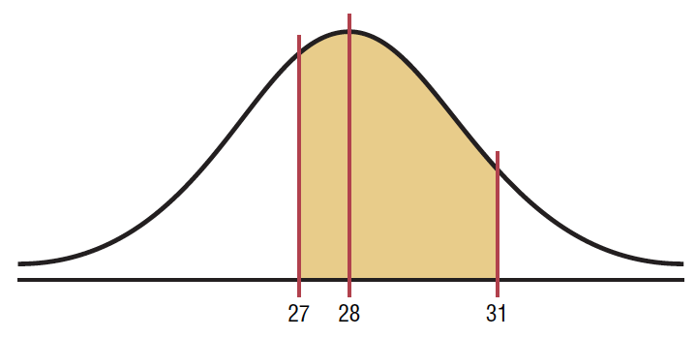

Applications of Normal Distribution
Each month, an American household generates an average of 28 pounds of newspaper for garbage or recycling. Assume the variable is approximately normally distributed. The standard deviation is 2 lbs. If a household is selected at random, find the probability of it generating
Between 27 and 31 pounds per month
Draw the figure and represent the area.

Slide 70

Applications of Normal Distribution
Each month, an American household generates an average of 28 pounds of newspaper for garbage or recycling. Assume the variable is approximately normally distributed. The standard deviation is 2 lbs. If a household is selected at random, find the probability of it generating
Between 27 and 31 pounds per month
Find the two z values.

Slide 71
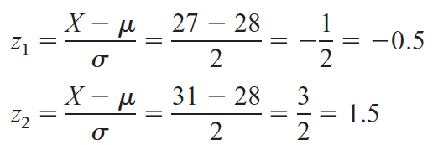
Applications of Normal Distribution
Each month, an American household generates an average of 28 pounds of newspaper for garbage or recycling. Assume the variable is approximately normally distributed. The standard deviation is 2 lbs. If a household is selected at random, find the probability of it generating
Between 27 and 31 pounds per month
Find the two z values.

Slide 72
Applications of Normal Distribution
Each month, an American household generates an average of 28 pounds of newspaper for garbage or recycling. Assume the variable is approximately normally distributed. The standard deviation is 2 lbs. If a household is selected at random, find the probability of it generating
Between 27 and 31 pounds per month
Find the two z values.

Slide 73
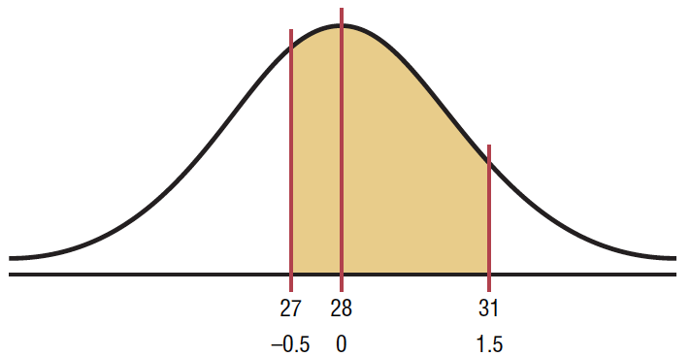
Applications of Normal Distribution
Each month, an American household generates an average of 28 pounds of newspaper for garbage or recycling. Assume the variable is approximately normally distributed. The standard deviation is 2 lbs. If a household is selected at random, find the probability of it generating
Between 27 and 31 pounds per month
Find the appropriate area.

Slide 74
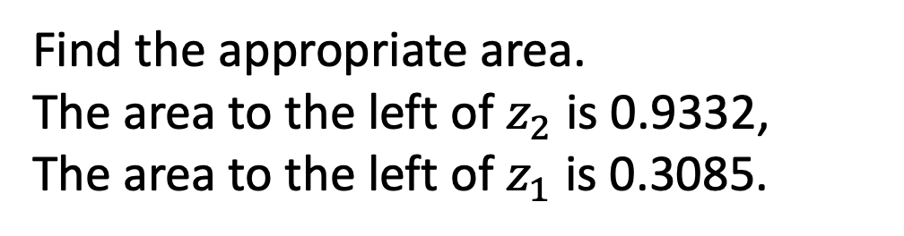
Applications of Normal Distribution
Each month, an American household generates an average of 28 pounds of newspaper for garbage or recycling. Assume the variable is approximately normally distributed. The standard deviation is 2 lbs. If a household is selected at random, find the probability of it generating
Between 27 and 31 pounds per month
Find the appropriate area.
The area to the left of $z_{2}$ is 0.9332,
The area to the left of $z_{1}$ is 0.3085.

Slide 75
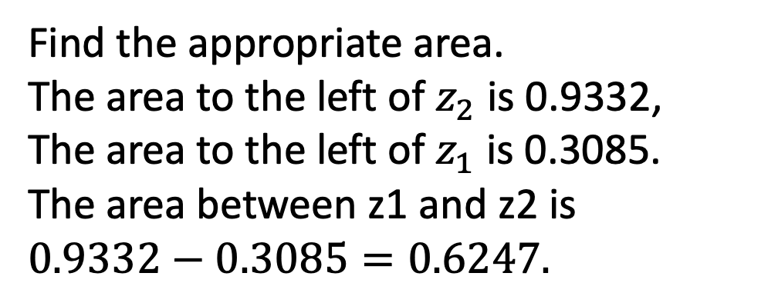
Applications of Normal Distribution
Each month, an American household generates an average of 28 pounds of newspaper for garbage or recycling. Assume the variable is approximately normally distributed. The standard deviation is 2 lbs. If a household is selected at random, find the probability of it generating
Between 27 and 31 pounds per month
Find the appropriate area.
The area to the left of $z_{2}$ is 0.9332,
The area to the left of $z_{1}$ is 0.3085.
The area between z1 and z2 is
$$0.9332−0.3085=0.6247.$$

Slide 76
Applications of Normal Distribution
Each month, an American household generates an average of 28 pounds of newspaper for garbage or recycling. Assume the variable is approximately normally distributed. The standard deviation is 2 lbs. If a household is selected at random, find the probability of it generating
Between 27 and 31 pounds per month
Hence, the probability that a randomly selected household generates between 27 and 31 pounds of newspapers per month is 62.47%.

Slide 77
Applications of Normal Distribution
Each month, an American household generates an average of 28 pounds of newspaper for garbage or recycling. Assume the variable is approximately normally distributed. The standard deviation is 2 lbs. If a household is selected at random, find the probability of it generating
More than 30.2 pounds per month

Slide 78

Applications of Normal Distribution
Each month, an American household generates an average of 28 pounds of newspaper for garbage or recycling. Assume the variable is approximately normally distributed. The standard deviation is 2 lbs. If a household is selected at random, find the probability of it generating
More than 30.2 pounds per month
Draw the figure and represent the area.

Slide 79

Applications of Normal Distribution
Each month, an American household generates an average of 28 pounds of newspaper for garbage or recycling. Assume the variable is approximately normally distributed. The standard deviation is 2 lbs. If a household is selected at random, find the probability of it generating
More than 30.2 pounds per month
Find the z value for 30.2.

Slide 80

Applications of Normal Distribution
Each month, an American household generates an average of 28 pounds of newspaper for garbage or recycling. Assume the variable is approximately normally distributed. The standard deviation is 2 lbs. If a household is selected at random, find the probability of it generating
More than 30.2 pounds per month
Find the z value for 30.2.

Slide 81

Applications of Normal Distribution
Each month, an American household generates an average of 28 pounds of newspaper for garbage or recycling. Assume the variable is approximately normally distributed. The standard deviation is 2 lbs. If a household is selected at random, find the probability of it generating
More than 30.2 pounds per month
Find the appropriate area.
The area to the left of z = 1.1 is 0.8643.
Hence the area to the right of z =1.1 is
$1.0000−0.8643=0.1357$.

Slide 82
Applications of Normal Distribution
The American Automobile Association reports that the average time it takes to respond to an emergency call is 25 minutes. Assume the variable is approximately normally distributed and the standard deviation is 4.5 minutes. If 80 calls are randomly selected, approximately how many will be responded to in less than 15 minutes?

Slide 83
Applications of Normal Distribution
The American Automobile Association reports that the average time it takes to respond to an emergency call is 25 minutes. Assume the variable is approximately normally distributed and the standard deviation is 4.5 minutes. If 80 calls are randomly selected, approximately how many will be responded to in less than 15 minutes?
To solve the problem, find the area under a normal distribution curve to the left of 15.
Draw a figure and represent the area.

Slide 84

Applications of Normal Distribution
The American Automobile Association reports that the average time it takes to respond to an emergency call is 25 minutes. Assume the variable is approximately normally distributed and the standard deviation is 4.5 minutes. If 80 calls are randomly selected, approximately how many will be responded to in less than 15 minutes?
To solve the problem, find the area under a normal distribution curve to the left of 15.
Draw a figure and represent the area.

Slide 85
Applications of Normal Distribution
The American Automobile Association reports that the average time it takes to respond to an emergency call is 25 minutes. Assume the variable is approximately normally distributed and the standard deviation is 4.5 minutes. If 80 calls are randomly selected, approximately how many will be responded to in less than 15 minutes?
Find the z value for 15.

Slide 86

Applications of Normal Distribution
The American Automobile Association reports that the average time it takes to respond to an emergency call is 25 minutes. Assume the variable is approximately normally distributed and the standard deviation is 4.5 minutes. If 80 calls are randomly selected, approximately how many will be responded to in less than 15 minutes?
Find the z value for 15.

Slide 87

Applications of Normal Distribution
The American Automobile Association reports that the average time it takes to respond to an emergency call is 25 minutes. Assume the variable is approximately normally distributed and the standard deviation is 4.5 minutes. If 80 calls are randomly selected, approximately how many will be responded to in less than 15 minutes?
Find the area to the left of $z=−2.22$.
It is 0.0132.

Slide 88
Applications of Normal Distribution
The American Automobile Association reports that the average time it takes to respond to an emergency call is 25 minutes. Assume the variable is approximately normally distributed and the standard deviation is 4.5 minutes. If 80 calls are randomly selected, approximately how many will be responded to in less than 15 minutes?
To find how many calls will be made in less than 15 minutes, multiply the
sample size 80 by 0.0132 to get 1.056. Hence, 1.056, or approximately 1, call
will be responded to in under 15 minutes.

Slide 89


Applications of Normal Distribution
To qualify for a police academy, candidates must score in the top 10% on a general abilities test. The test has a mean of 200 and a standard deviation of 20. Find the lowest possible score to qualify. Assume the test scores are normally distributed.

Slide 90
Applications of Normal Distribution
To qualify for a police academy, candidates must score in the top 10% on a general abilities test. The test has a mean of 200 and a standard deviation of 20. Find the lowest possible score to qualify. Assume the test scores are normally distributed.
Since the test scores are normally distributed, the test value X that cuts off the upper 10% of the area under a normal distribution curve is desired.

Slide 91
Applications of Normal Distribution
To qualify for a police academy, candidates must score in the top 10% on a general abilities test. The test has a mean of 200 and a standard deviation of 20. Find the lowest possible score to qualify. Assume the test scores are normally distributed.
Since the test scores are normally distributed, the test value X that cuts off the upper 10% of the area under a normal distribution curve is desired.
Work backward to solve this problem.

Slide 92


Applications of Normal Distribution
To qualify for a police academy, candidates must score in the top 10% on a general abilities test. The test has a mean of 200 and a standard deviation of 20. Find the lowest possible score to qualify. Assume the test scores are normally distributed.
Subtract 0.1000 from 1.000 to get the area under the normal distribution to the left of x:
$$1.0000−0.10000=0.9000$$

Slide 93

Applications of Normal Distribution
To qualify for a police academy, candidates must score in the top 10% on a general abilities test. The test has a mean of 200 and a standard deviation of 20. Find the lowest possible score to qualify. Assume the test scores are normally distributed.
Find the z value that corresponds to an area of 0.9000 by looking up 0.9000 in the area portion.

Slide 94
Applications of Normal Distribution
To qualify for a police academy, candidates must score in the top 10% on a general abilities test. The test has a mean of 200 and a standard deviation of 20. Find the lowest possible score to qualify. Assume the test scores are normally distributed.
If the specific value cannot be found, use the closest value.

Slide 95
Applications of Normal Distribution
To qualify for a police academy, candidates must score in the top 10% on a general abilities test. The test has a mean of 200 and a standard deviation of 20. Find the lowest possible score to qualify. Assume the test scores are normally distributed.
If the specific value cannot be found, use the closest value.
In this case 0.8997

Slide 96
Applications of Normal Distribution
To qualify for a police academy, candidates must score in the top 10% on a general abilities test. The test has a mean of 200 and a standard deviation of 20. Find the lowest possible score to qualify. Assume the test scores are normally distributed.
If the specific value cannot be found, use the closest value.
In this case 0.8997
The corresponding z
value is 1.28.

Slide 97
Applications of Normal Distribution
To qualify for a police academy, candidates must score in the top 10% on a general abilities test. The test has a mean of 200 and a standard deviation of 20. Find the lowest possible score to qualify. Assume the test scores are normally distributed.
If the area falls exactly halfway between two z values, use the
larger of the two z values.

Slide 98
Applications of Normal Distribution
To qualify for a police academy, candidates must score in the top 10% on a general abilities test. The test has a mean of 200 and a standard deviation of 20. Find the lowest possible score to qualify. Assume the test scores are normally distributed.
For example, the area 0.9500 falls halfway between
0.9495 and 0.9505. In this case use 1.65 rather than 1.64 for the z value

Slide 99

Applications of Normal Distribution
To qualify for a police academy, candidates must score in the top 10% on a general abilities test. The test has a mean of 200 and a standard deviation of 20. Find the lowest possible score to qualify. Assume the test scores are normally distributed.

Slide 100
Applications of Normal Distribution
To qualify for a police academy, candidates must score in the top 10% on a general abilities test. The test has a mean of 200 and a standard deviation of 20. Find the lowest possible score to qualify. Assume the test scores are normally distributed.

Slide 101

Applications of Normal Distribution
To qualify for a police academy, candidates must score in the top 10% on a general abilities test. The test has a mean of 200 and a standard deviation of 20. Find the lowest possible score to qualify. Assume the test scores are normally distributed.

Slide 102
Applications of Normal Distribution
To qualify for a police academy, candidates must score in the top 10% on a general abilities test. The test has a mean of 200 and a standard deviation of 20. Find the lowest possible score to qualify. Assume the test scores are normally distributed.
A score of 226 should be used as a cutoff. Anybody scoring 226 or higher qualifies.

Slide 103


Applications of Normal Distribution

Slide 104


Applications of Normal Distribution

Slide 105


Applications of Normal Distribution

Slide 106

Applications of Normal Distribution

Slide 107
Applications of Normal Distribution
For a medical study, a researcher wishes to select people in the middle 60% of the population based on blood pressure. If the mean systolic blood pressure is 120 and the standard deviation is 8, find the upper and lower readings that would qualify people to participate in the study.

Slide 108
Applications of Normal Distribution
For a medical study, a researcher wishes to select people in the middle 60% of the population based on blood pressure. If the mean systolic blood pressure is 120 and the standard deviation is 8, find the upper and lower readings that would qualify people to participate in the study.
Assume that blood pressure readings are normally distributed; then cutoff points are as shown

Slide 109



Applications of Normal Distribution
For a medical study, a researcher wishes to select people in the middle 60% of the population based on blood pressure. If the mean systolic blood pressure is 120 and the standard deviation is 8, find the upper and lower readings that would qualify people to participate in the study.

Slide 110
Applications of Normal Distribution
For a medical study, a researcher wishes to select people in the middle 60% of the population based on blood pressure. If the mean systolic blood pressure is 120 and the standard deviation is 8, find the upper and lower readings that would qualify people to participate in the study.
Shows that two values are needed, one above the mean and one below the mean.

Slide 111

Applications of Normal Distribution
For a medical study, a researcher wishes to select people in the middle 60% of the population based on blood pressure. If the mean systolic blood pressure is 120 and the standard deviation is 8, find the upper and lower readings that would qualify people to participate in the study.
To get the area to the left of the positive z value, add 0.5000+0.3000=
0.8000 (30%=0.3000). The z value closest to 0.8000 is 0.84

Slide 112

Applications of Normal Distribution
For a medical study, a researcher wishes to select people in the middle 60% of the population based on blood pressure. If the mean systolic blood pressure is 120 and the standard deviation is 8, find the upper and lower readings that would qualify people to participate in the study.

Slide 113

Applications of Normal Distribution
For a medical study, a researcher wishes to select people in the middle 60% of the population based on blood pressure. If the mean systolic blood pressure is 120 and the standard deviation is 8, find the upper and lower readings that would qualify people to participate in the study.
The area to the left of the negative z value is 20%, or 2.000. The area closest to 0.2000 is 0.84.

Slide 114


Applications of Normal Distribution
For a medical study, a researcher wishes to select people in the middle 60% of the population based on blood pressure. If the mean systolic blood pressure is 120 and the standard deviation is 8, find the upper and lower readings that would qualify people to participate in the study.

Slide 115

Applications of Normal Distribution
For a medical study, a researcher wishes to select people in the middle 60% of the population based on blood pressure. If the mean systolic blood pressure is 120 and the standard deviation is 8, find the upper and lower readings that would qualify people to participate in the study.
Therefore, the middle 60% will have blood pressure readings of
$$113.28<X<126.72.$$

Slide 116

Applications of the normal distribution
Determining Normality
Drawing a histogram
Pearson’s Index or PI of skewness
Normal Quantile Plot
Chi-Square Goodness-of-fit
Kolmogorov-Smirnov
Shapiro-Wilk Test
Lilliefors test

Slide 117


Applications of the normal distribution
Pearson’s Index (PI) of Skewness
$$PI= \frac{3(\overline{X}−median)}{s}$$
Decision: If the $PI≥+1$ or $PI≤−1$, it can concluded that the data are significantly skewed.

Slide 118
Applications of the normal distribution
Example1. A survey of 18 high-technology firms showed the number of day’s inventory they had on hand. Determine if the data are approximately normally distribute.
5 | 29 | 34 | 44 | 45 | 63 | 68 | 74 | 74
81 | 88 | 91 | 97 | 98 | 113 | 118 | 151 | 158

Slide 119


Applications of the normal distribution

Slide 120

Applications of the normal distribution

Slide 121
Applications of the normal distribution

Slide 122
Applications of the normal distribution

Slide 123
Applications of the normal distribution

Slide 124
Applications of the normal distribution

Slide 125
Applications of the normal distribution
Example2. The data shown consist of the number of games played each year in the career of Baseball Hall of Famer Bill Mazeroski. Determine if the data are approximately normally distributed.
81 | 148 | 152 | 135 | 151 | 152 | 159 | 142 | 34
162 | 130 | 162 | 163 | 143 | 67 | 112 | 70

Slide 126

Applications of the normal distribution

Slide 127

Applications of the normal distribution

Slide 128
Applications of the normal distribution

Slide 129

Applications of the normal distribution

Slide 130
Applications of the normal distribution

Slide 131

Applications of the normal distribution

Slide 132
Applications of the normal distribution

Slide 133
Applications of the normal distribution
In summary, the distribution is somewhat negatively skewed.

Slide 134
CENTRAL LIMIT THEOREM
LESSON 6.4

Slide 135
Central Limit Theorem
Distribution of Sample Means
Suppose a researcher selects a sample of 30 adult males and finds the mean of the triglyceride levels for the sample subjects to be 187 milligrams/deciliter. Then suppose a second sample is selected, and the mean of that sample is found to be 192 milligrams/deciliter. Continue the process for 10 samples. The sample means constitute a sampling distribution of sample means.

Slide 136
Central Limit Theorem
Distribution of Sample Means
A sampling distribution of sample means is a distribution using the means computed from all possible random samples of a specific size taken from a population.

Slide 137
Central Limit Theorem
Distribution of Sample Means
Sampling error is the difference between the sample measure and the corresponding population measure due to the fact that the sample is not a perfect representation of the population.

Slide 138
Central Limit Theorem
Properties of the Distribution of Sample Means
The mean of the sample means will be the same as the population mean.
The standard deviation of the sample means will be smaller than the standard deviation of the population, and it will be equal to the population standard deviation divided by the square root of the sample size.

Slide 139
Central Limit Theorem
Consider these data set:
A – 2, 6, 4, 8

Slide 140

Central Limit Theorem
Consider these data set:
A – 2, 6, 4, 8

Slide 141

Central Limit Theorem
Consider these data set:
A – 2, 6, 4, 8

Slide 142


Central Limit Theorem

Slide 143


Central Limit Theorem

Slide 144

Central Limit Theorem

Slide 145

Central Limit Theorem

Slide 146


Central Limit Theorem

Slide 147

Central limit theorem
Properties of the Distribution Samples
1. The mean of the sample means will be the same as the population mean.

Slide 148

Central limit theorem

Slide 149
Central limit theorem

Slide 150
Central limit theorem

Slide 151

Central limit theorem
Properties of the Distribution Samples
2. The standard deviation of the sample mean is called the standard error of the mean. Hence,
$$σ_{x}=\frac{σ}{\sqrt{n}}$$

Slide 152
Central limit theorem
Properties of the Distribution Samples
3. Shape of the distribution of sample means – central limit theorem.

Slide 153

Central limit theorem
As the sample size n increases without limit, the shape of the distribution of sample means taken with a replacement from a population with mean $μ$ and standard deviation $σ$ will approach a normal distribution. As previously shown, this distribution will have a mean $μ$ and a standard deviation $\frac{σ}{\sqrt{n}}$.

Slide 154

Central limit theorem
The Central Limit Theorem can be used to answer questions about individual values, but a new formula must be used:
$$z= \frac{\overline{X}−μ}{σ/\sqrt{n}}$$

Slide 155

Central limit theorem

Slide 156
Central limit theorem
To use the Central Limit Theorem:
1. When the original variable is normally distributed, the distribution of the sample means will be normally distributed, for any sample size n.

Slide 157
Central limit theorem
To use the Central Limit Theorem:
2. When the distribution of the original variable might not be normal, a sample size of 30 or more is needed to use a normal distribution to approximate the distribution of the sample means. The larger the sample, the better the approximation will be.

Slide 158

Central limit theorem
Example 1: A.C. Nielsen reported that children between the ages 2 and 5 watch an average of 25 hours of television per week. Assume the variable is normally distributed and the standard deviation is 3 hours. If 20 children between the ages 2 and 5 are randomly selected, find the probability that the mean of the number of hours they watch television will be greater than 26.3 hours.

Slide 159
Central Limit Theorem
Since the variable is approximately normally distributed, the distribution of sample means will be approximately normal, with a mean of 25. The standard deviation of the sample means is

Slide 160

Central Limit Theorem
Since the variable is approximately normally distributed, the distribution of sample means will be approximately normal, with a mean of 25. The standard deviation of the sample means is

Slide 161


Central Limit Theorem
Since the variable is approximately normally distributed, the distribution of sample means will be approximately normal, with a mean of 25. The standard deviation of the sample means is

Slide 162

Central Limit Theorem

Slide 163
Central Limit Theorem
The area to the right of 1.94 is 1.000 - 0.9738 = 0.0262, or 2.62%.
One can conclude that the probability of obtaining a sample mean larger than 26.3 hours is 2.62%

Slide 164

Central limit theorem
Example: The average age of a vehicle registered in the United States is 8 years, or 96 months. Assume the standard deviation is 16 months. If a random sample of 36 vehicles is selected, find the probability that the mean of their age is between 90 and 100 months.

Slide 165



Central limit theorem

Slide 166
Central limit theorem
To find the area between the two z values of -2.25 and 1.50, look up the corresponding area in the z table and subtract one from the other.
The area for z = -2.25 is 0.0122, and the area for z = 1.50 is 0.9332.

Slide 167
Central limit theorem
To find the area between the two z values of -2.25 and 1.50, look up the corresponding area in the z table and subtract one from the other.

Slide 168

Central limit theorem
Hence the area between the two values is 0.9332 - 0.0122 = 0.9210, or 92.1%.
Hence, the probability of obtaining a sample mean between 90 and 100 months is 92.1%;
P(90 < $\overline{X}$ < 100) = 92.1%.

Slide 169

Central Limit Theorem

Slide 170
Central Limit Theorem
should be used to gain information about a sample mean

Slide 171

Central Limit Theorem
should be used to gain information about a sample mean
used to gain information about an individual data value obtained from the population

Slide 172
Central limit theorem
Example: The average number of pounds of meat that a person consumes a year is 218.4 pounds. Assume that the standard deviation is 25 pounds and the distribution is approximately normal.
a. Find the probability that a person selected at random consumes less than 224 pounds per year.

Slide 173
Central limit theorem
Find the probability that a person selected at random consumes less than 224 pounds per year.
Since the question asks about an individual person, the formula used is:

Slide 174

Central limit theorem
Find the probability that a person selected at random consumes less than 224 pounds per year.

Slide 175

Central limit theorem
Find the probability that a person selected at random consumes less than 224 pounds per year.

Slide 176

Central limit theorem
Find the probability that a person selected at random consumes less than 224 pounds per year.
The area to the left of $z=0.22$is 0.5871.
$$P(X<224)=0.5871$$

Slide 177
Central limit theorem
Find the probability that a person selected at random consumes less than 224 pounds per year.
The probability of selecting an individual
who consumes less than 224 pounds
of meat per year is 0.5871, or
58.71%

Slide 178
Central limit theorem
Example: The average number of pounds of meat that a person consumes a year is 218.4 pounds. Assume that the standard deviation is 25 pounds and the distribution is approximately normal.
b. If a sample of 40 individuals is selected, find the probability that the mean of the sample will be less than 224 pounds per year.

Slide 179
Central limit theorem
If a sample of 40 individuals is selected, find the probability that the mean of the sample will be less than 224 pounds per year.
Since the question concerns the mean of a sample with a size of 40, the formula used is:

Slide 180

Central limit theorem
If a sample of 40 individuals is selected, find the probability that the mean of the sample will be less than 224 pounds per year.

Slide 181

Central limit theorem
If a sample of 40 individuals is selected, find the probability that the mean of the sample will be less than 224 pounds per year.

Slide 182
Central limit theorem
If a sample of 40 individuals is selected, find the probability that the mean of the sample will be less than 224 pounds per year.
The area to the left of z=1.42 is 0.9222.

Slide 183
Central limit theorem
If a sample of 40 individuals is selected, find the probability that the mean of the sample will be less than 224 pounds per year.
Hence, the probability that the mean
of a sample of 40 individuals is less
than 224 pounds per year is 0.9222,
or 92.22%.

