Slide 1

SMART INDIA HACKATHON 2026
TITLE PAGE
Problem Statement ID – SIH26042
Problem Statement Title- Al-Powered Vernacular Pedagogy and Real-Time Translation Tool for Mother Tongue-Based Primary Education
Theme- Smart Education
PS Category- Software
Team Name - SHROT

Slide 2
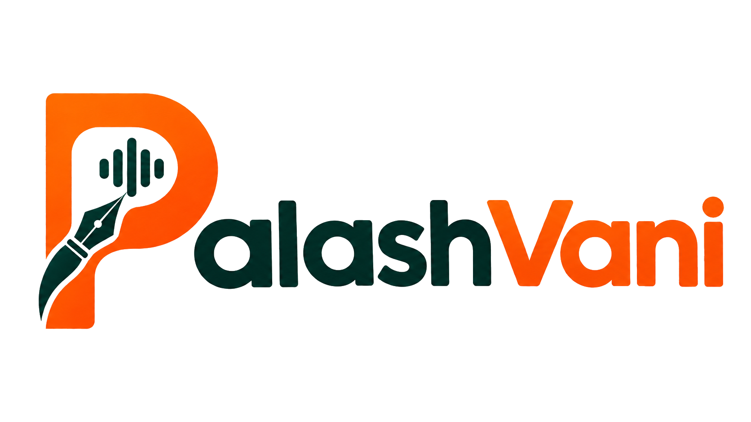





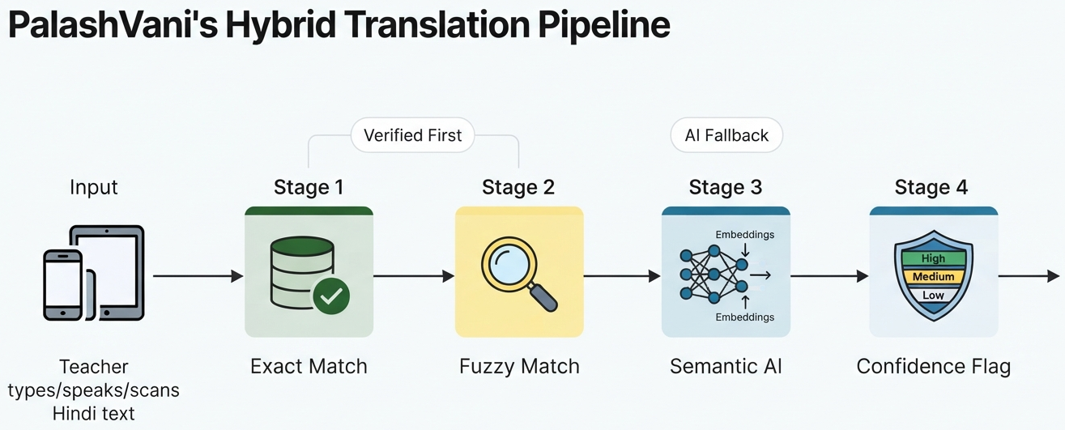
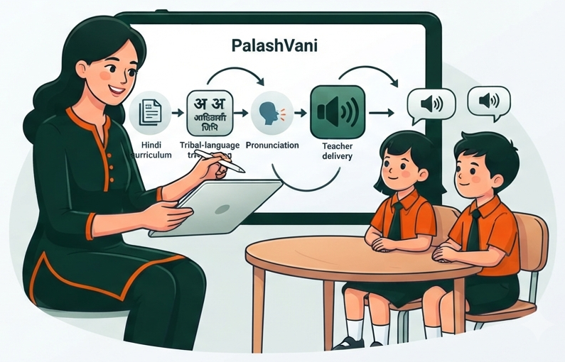
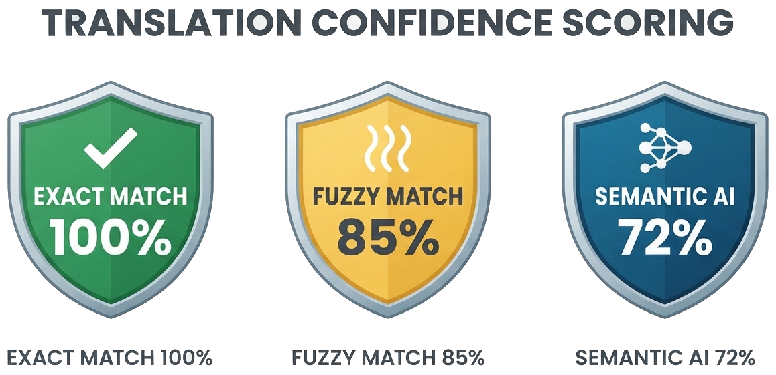

Your Team Name
PS 26042
SOFTWARE
SMART EDUCATION
A hybrid Hindi↔Mundari translation system with verified-first matching, semantic AI, and honest confidence flags — text, Hindi-script pronunciation and AI-synthesized audio — plus real-time voice translation and AI Scan & Translate with clear verification flags.
PART A · THE VERIFIED CORE
PART B · THE GENUINE AI CORE
WHY IT'S DIFFERENT
Offline Curriculum Library
AI Scan & Translate
Innovation & Uniqueness
JCERT-aligned structure — Grade → Subject → Chapter, based on available Jharkhand curriculum sources.
Four layers per unit — Hindi text → tribal-language text → Hindi-script pronunciation → AI-synthesized audio.
AI-synthesized TTS audio — generated from the selected tribal-language text.
Rights-aware sources — official curricula, licensed research, and open educational content with tracked asset attribution.
Offline after one sync — PWA + service worker, per-chapter content packs.
Point the camera at any Hindi or tribal-script textbook page.
OCR extracts the text — Google ML Kit / Tesseract, low-end Android.
Verified index first — semantic search returns source-linked text + synthesized audio..
Bhashini fills the gap — live NMT/TTS only when no match exists.
Confidence Flag — unverified output is marked ⚠ AI-generated.
Camera → OCR → language detection → verified semantic retrieval → translation/TTS fallback → confidence flag
Target latency: ≤ 3 seconds
Real research/licensed resources — 97,826 sourced Hindi–tribal sentence pairs, used for translation support and semantic retrieval.
Honesty as a feature — the Confidence Flag is our strongest card with a govt jury.
Semantic, not keyword — MiniLM embeddings are the genuine AI/ML core.
Offline-first by design — built for zero-connectivity schools, not despite them.
Bilingual worksheets + visual flashcards generated against NIPUN Bharat learning outcomes.
HOW IT ADDRESSES THE PROBLEM
THE GAP WE CLOSE
5,000+ tribal-area primary schools teach in a language children don't speak at home → verified Class 1–5 mother-tongue content on the teacher's own phone, offline
Teachers may be Hindi-medium trained and unfamiliar with tribal languages → Hindi-script pronunciation plus AI-synthesized audio supports classroom delivery without requiring fluency.
Digital NLP resources remain limited for several tribal languages → research corpora + Bhashini services provide translation support, with unverified output clearly flagged.
Existing edtech is online-only and Hindi- or English-first → a PWA that runs at zero connectivity on hardware teachers already own
Built from official curriculum resources, language references, research corpora and open educational content — with provenance and verification status tracked for every item.
PALASH has established a substantial school network — but language accessibility for non-native teachers remains a practical classroom gap PalashVani is designed to bridge. Supports FLN lesson scripts, activity instructions and assessment prompts.
1,041+
PALASH schools live
6
districts in Jharkhand
5
tribal languages
1–5
target grade range

Slide 3


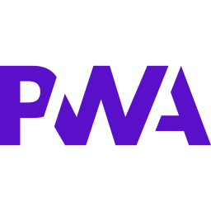
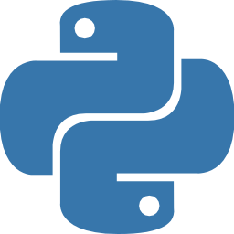







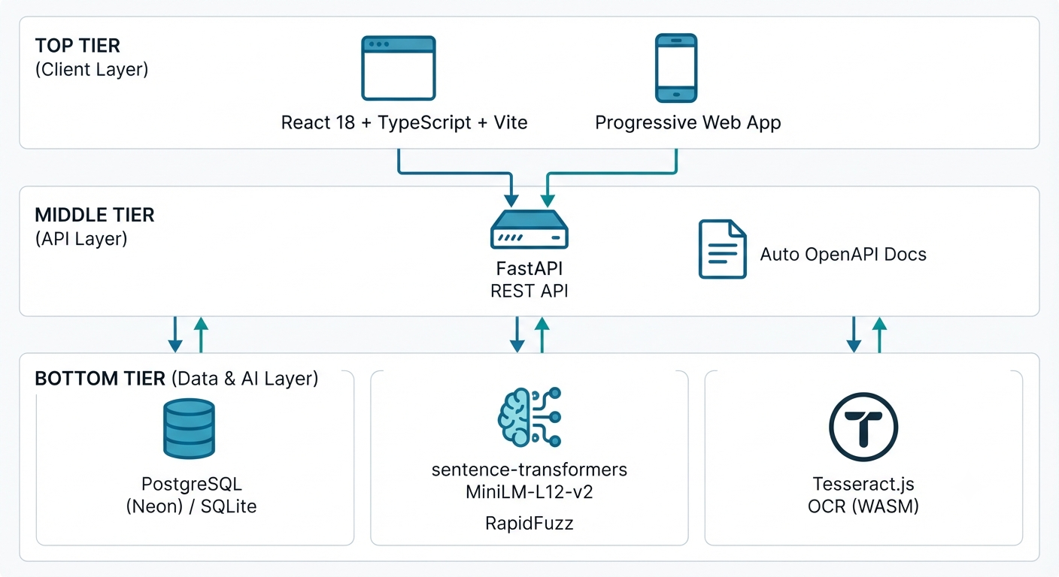
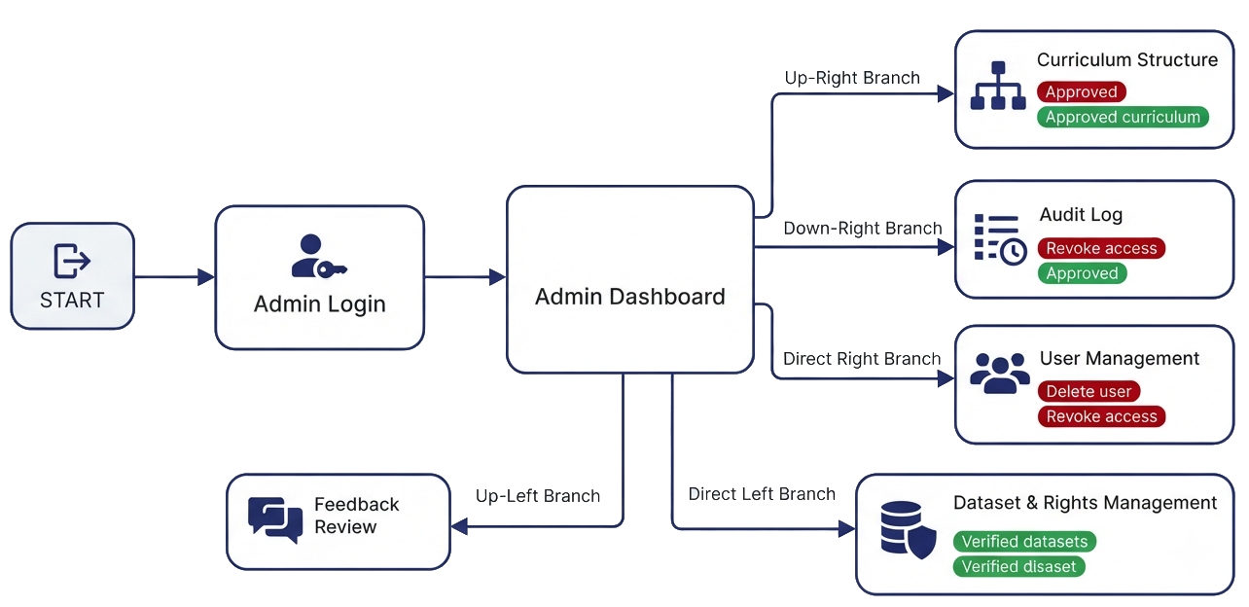
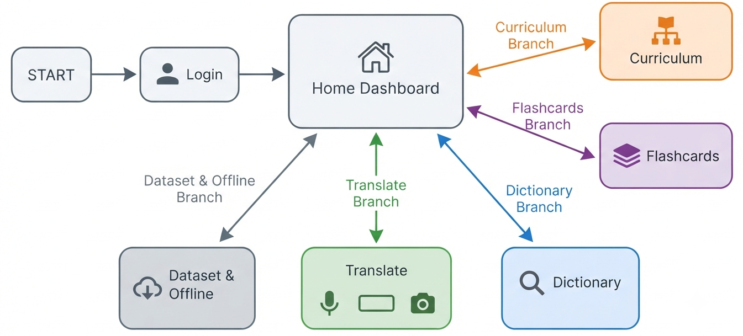




TECHNICAL APPROACH
FRONTEND
BACKEND
AI / ML CORE
SERVICES & DEPLOY
React.js (PWA) + React Native shell
Tailwind CSS · Service Worker + Cache API
Progressive Web App with offline support
Single codebase, lazy-loaded routes for performance
Icon-first, one-tap UI for low-literacy use
Python 3 + FastAPI — REST endpoints
SQLite/local database + sync layer
Alembic migrations + JWT auth + role-based access control
Natural fit for the OCR and ML calls
RESTful API with automatic OpenAPI/Swagger docs
sentence-transformers — MiniLM-L12-v2
OCR — Tesseract / Google ML Kit
Bhashini ASR + NMT + TTS — where language/service coverage is available
RapidFuzz for fuzzy matching + cosine similarity for embeddings
Cosine-similarity threshold drives the flag
Vercel frontend · Render backend
Cloudinary audio CDN · Firebase / Auth0
Zero paid dependencies - fully open source stack
AI-synthesized TTS audio; Bhashini TTS where supported
No servers to procure, nothing for JCERT to host
MAIN APPLICATION
SYSTEM ARCHITECTURE
ADMIN PANEL FLOW
APP SITEMAP — SEVEN SCREENS, HOME TO OFFLINE
mirrors the real JCERT Grade → Subject → Chapter tree
01 Home
02 Dictionary
03 Curriculum
04 Scan & Voice Translation
05 Flashcards
06 Offline Dataset
07 About & Confidence
Grade → Subject → Chapter
Text + pronunciation + audio
Bilingual Worksheets
Auto-generated · NIPUN Bharat-aligned
Bilingual Worksheets
Auto-generated · NIPUN Bharat-aligned
Camera → OCR → verified or flagged
Hindi ↔ Tribal language · ≤3 sec target
Picture + word + audio
Per-chapter sync ✓
Sourcing + what the flag means

Slide 4





FEASIBILITY AND VIABILITY
FEASIBILITY
POTENTIAL RISKS & OUR MITIGATION STRATEGY
LEVEL | RISK | MITIGATION STRATEGY
HIGH | Bhashini's live MT/TTS coverage for Mundari is unconfirmed | Verify through Bhashini's pipeline-config API before the demo. If Mundari is unavailable, Scan & Translate returns an honest “no verified match” rather than guessing.
HIGH | Full JCERT / PALASH catalogue is not bulk-downloadable | Deployed with 57-row hand-sourced, citation-backed seed corpus. Admin panel ready for expanded corpus import.
MED | TTS quality for tribal languages | Validate pronunciation against authoritative references and native reviews, exposing limitations via verification status..
MED | Low digital comfort among some teachers | One-tap UI, icon-first navigation and voice walkthroughs; training folded into PALASH's existing teacher-training calendar.
LOW | Connectivity gaps in remote schools | Offline-first PWA: one-time sync over any available connection, then full zero-connectivity classroom use afterwards.
LOW | Licence terms on the corpora we depend on | Attribution is recorded per asset in the database. StoryWeaver is CC-BY-4.0, Karya is used subject to its stated non-commercial licence terms and attribution requirements.
Technical: Open-source core with free-tier services; designed for low-end Android via Chrome.
Content: Rights-aware mix of official curriculum resources, research/licensed corpora and open educational content.
Modular: supports the Class 1–5 target range and expands grade-by-grade and language-by-language.
Build risk: Integration and language validation are the main risks, while core components use proven tech.
Demo-ready: Phase 1 buildable within the hackathon window.
VIABILITY
Ready channel: 1,041+ PALASH schools, PALASH multilingual education network
Policy tailwind: supports NEP 2020's recommendation to use the mother tongue / home language wherever possible.
Language-agnostic: Architecture extends to Odisha, Chhattisgarh, and MP tribal-language programmes.
Already recognised: Jharkhand tribal-language textbooks catalogued on the National Digital Repository.
Sustainable: designed for existing Android hardware and an open-source/free-tier prototype stack.
DATA-ACQUISITION & ROLLOUT ROADMAP
Prototype uses only accessible/licensed sources; expanded JCERT access follows formal validation.
PHASE 0 — This week
›
PHASE 1 — SIH prototype
›
PHASE 2 — Formal partnership
›
PHASE 3 — Beyond Jharkhand
Download permitted open educational content, integrate available research corpora, and configure Bhashini services for supported languages.
Build the source-linked retrieval index over available research/open content and selected JCERT curriculum references; demo the verified-first workflow.
Formal partnership with JCERT / Department of Higher & Technical Education for expanded Class 1–5 curriculum access and validation.
Re-point the same pipeline at Odisha, Chhattisgarh and MP tribal-language programmes.

Slide 5






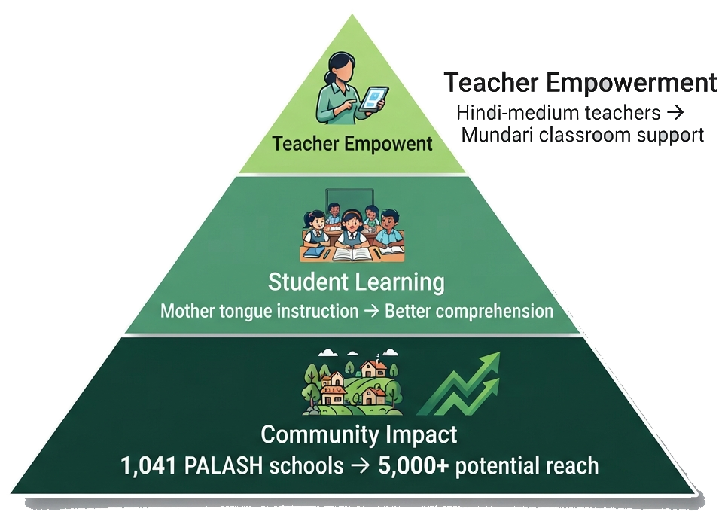
IMPACT AND BENEFITS
Teachers
Students
JCERT & PALASH
Beyond Jharkhand
Teachers get instant Hindi↔Mundari translation with confidence scores, searchable dictionary, and curriculum browser
Students benefit from flashcard practice, bilingual worksheets, and offline-ready content after first download
Admin dashboard for content management with rights-clearance workflow and complete audit trail
The same architecture supports other Indian tribal programs by swapping the language and curriculum data layer.
Social
Educational
Economic
Technological
Scalability
Bridges the teacher-language gap inside the 1,041-school PALASH network. Reduces teacher reliance in target tribal languages through pronunciation, translation, and audio support.
Supports NEP 2020's recommendation for mother-tongue / home-language instruction wherever possible and strengthens foundational learning support.
Designed to minimise deployment cost by using existing Android devices and an open-source/free-tier prototype stack.
Honest AI: every translation shows exact/fuzzy/semantic match type with confidence score - never silently guesses
The language layer is modular, allowing the same application architecture to expand to Kurukh, Kharia and other languages with new validated data.
DEPLOYMENT HEADROOM — PRIMARY SCHOOLS
MEASURED REACH — EVERY NUMBER HAS A NAMED SOURCE
1,041+
5,000+
97.8K
₹Low Cost
The opportunity is grounded in an existing education network, available language resources and devices already familiar to teachers. PalashVani adds the missing language-access layer.
Sources: PALASH pilot and current coverage — UNICEF / JCERT; addressable school count — SIH PS 26042 background.

Slide 6


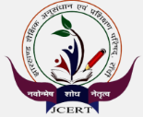



RESEARCH AND REFERENCES
Sources and citations are provided for verification; prototype data and AI-generated outputs are clearly identified.
GOVT
GOVT
GOVT
Bhashini / ULCA
CIIL / SPPEL
JCERT
Govt of India (MeitY) National Language Translation Mission. Santali and Ho are officially listed; ULCA hosts MT / ASR / TTS / OCR datasets and a live inference API.
Ministry of Education scheme documenting Ho, Mundari and Santali — grammar sketches, bilingual dictionaries, pictorial glossaries and audio archives.
Jharkhand Council of Educational Research & Training — the state's own textbook PDF repository for Classes I–XII, and the authority our PS owner recognises.
We use it for: runtime ASR / translation / TTS where the required language-service combination is available.
We use it for: authoritative language reference, pronunciation and linguistic validation. Formal collaboration is proposed for future validation.
We use it for: curriculum structure and available textbook references; prototype scope uses only accessible curriculum material.
Govt of India · free developer key (userID + ulcaApiKey) [runtime]
Ministry of Education · part public, rest by formal request
Govt of Jharkhand · not bulk-scrapeable; MoU in Phase 2
bhashini.gov.in · github.com/bhashini-dibd/ulca
sppel.org · ciil.org · sanchika.ciil.org
jcert.jharkhand.gov.in/home/textbook
DATASET
RESEARCH
CONTENT
Karya
arXiv — AdiBhashaa
StoryWeaver
17,826 real Hindi→Mundari sentence pairs, human-collected by Karya with Microsoft Research India and IIT Kharagpur. Single UTF-8 TSV, ready to clone.
80,000-sentence parallel corpus, Hindi ↔ Bhili / Mundari / Gondi / Santali — 20,000 pairs per language, from school and civic material, native-speaker validated.
Pratham Books' open library — professionally illustrated early-grade storybooks already versioned into Santali and Mundari, many with read-aloud audio.
We use it for: Hindi–Mundari translation support and semantic retrieval..
We use it for: research-based Hindi–tribal translation support and evaluation..
We use it for: supplementary multilingual early-grade reading and prototype learning materials, subject to the licence of each asset.
Karya Public License — non-commercial, attribution required
Research release · built for exactly this education domain
CC-BY-4.0 — free to download, remix and redistribute
github.com/karya-inc/dataset-hindi-mundari-translation
arXiv:2512.04765 · Dec 2025
storyweaver.org.in
PALASH Programme
NEP 2020
AI4Bharat
Adi-Vaani
National Digital Repository
Santali open corpus
UNICEF + JCERT. 259-school pilot → 1,041+ schools, 6 districts, 5 tribal languages.
National Education Policy — recommends mother tongue or home language use in early education wherever possible.
Open-source Indic NLP and speech research, IIT Madras. ai4bharat.iitm.ac.in
AI and language initiative showing growing public-sector interest in Indian tribal-language tech.
repository.education.gov.in lists “Textbooks in tribal language, Jharkhand”.
Prasanta-Hembram Santali translation and Ol Chiki dictionary files — CC0 1.0.
DEMO LINKS :- Teacher Webapp: https://palashvani-sih26042.vercel.app
Admin Portal: https://palashvani-sih26042-admin.vercel.app

Slide 7
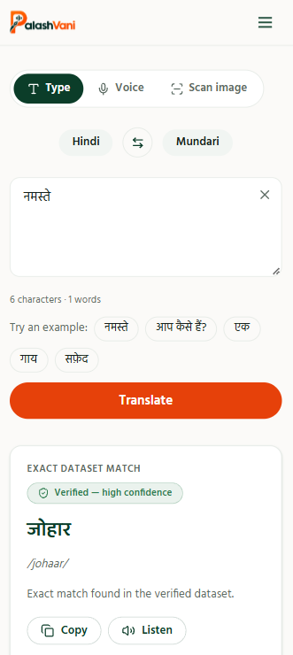
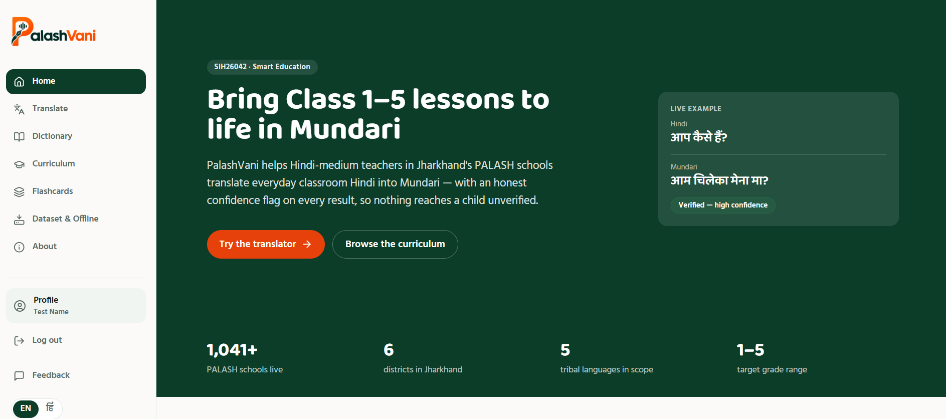
PROJECT DEMONSTRATION
COLLEGE / INTERNAL PRESENTATION ONLY — WILL REMOVE THIS SLIDE BEFORE THE OFFICIAL SIH PORTAL SUBMISSION
PROTOTYPE PREVIEW OF
An offline-first teacher companion delivering verified, JCERT/PALASH-aligned Class 1–5 content in Ho, Mundari & Santali —text, pronunciation guidance and AI-synthesized tribal-language audio— plus an AI Scan & Translate mode for anything outside the verified library, always honestly flagged.
DEMO LINKS :- Teacher Webapp: https://palashvani-sih26042.vercel.app
Admin Portal: https://palashvani-sih26042-admin.vercel.app

