Slide 1


Fall 2025
CS 329
Modeling with Spotify Data
By: Olivia Pan & Jamie Ngo

Slide 2





01 - INTRODUCTION
02 - VISUALIZE THE DATA
03 - METHOD
04 - RESULTS
05 - CONCLUSION
03 - OUR PROJECTS

Slide 3
Fall 2025
CS 329
INTRODUCTION

Slide 4
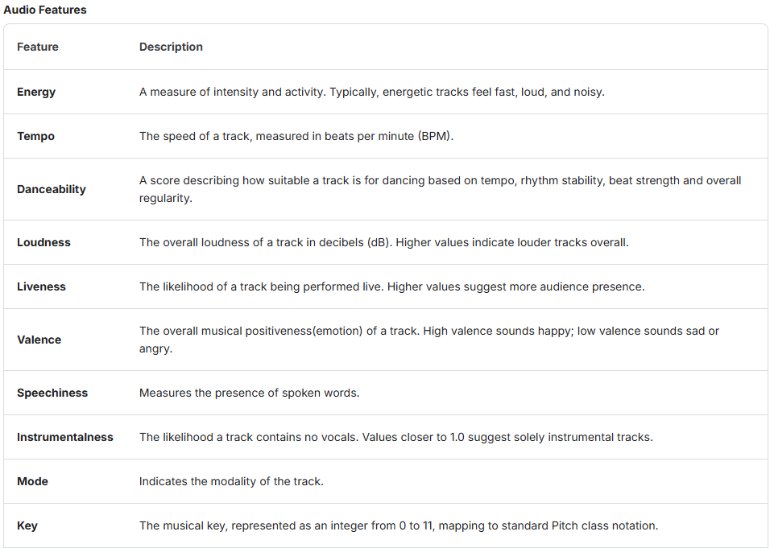
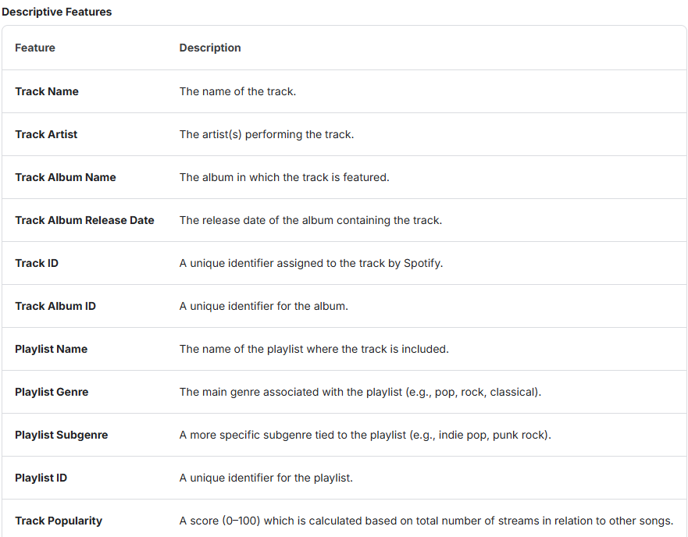
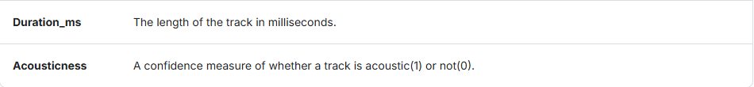
Fall 2025
CS 329
Dataset Introduction
Spotify Dataset in Kaggle
The dataset is collated from Spotify's API using two separate python scripts to extract popular and non-popular songs and their associated audio and descriptive features.

Slide 5
Fall 2025
CS 329
Project Question
What features are determinant for predicting track popularity of a song?

Slide 6
Fall 2025
CS 329
Our expectation
We do expect genre and artist to be influential for music popularity prediction, but we do not expect the regression after feature selection to work well (R squared>0.8) because music popularity is hard to predict.

Slide 7
Fall 2025
CS 329
VISUALIZE THE DATA

Slide 8
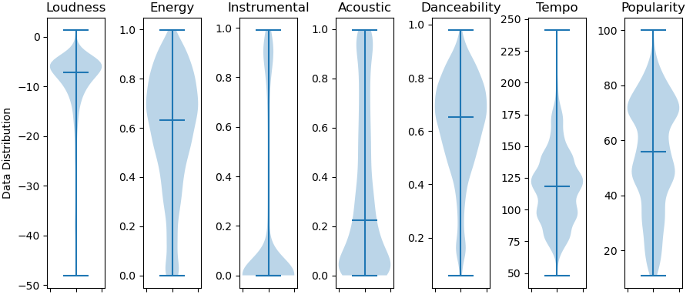
Fall 2025
CS 329
Data Distribution

Slide 9
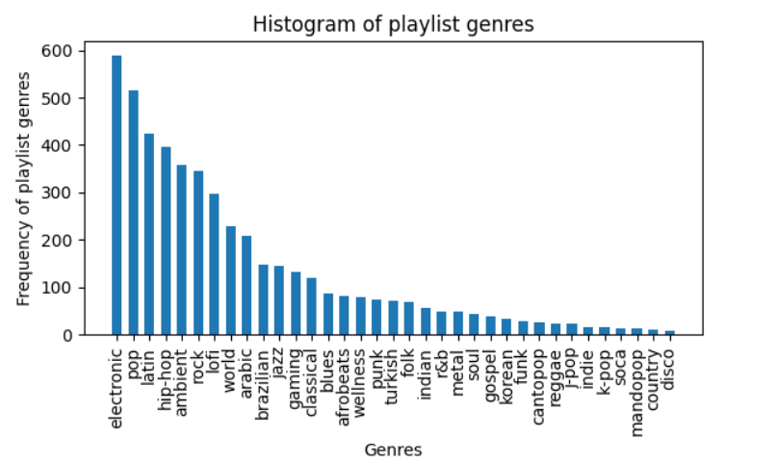
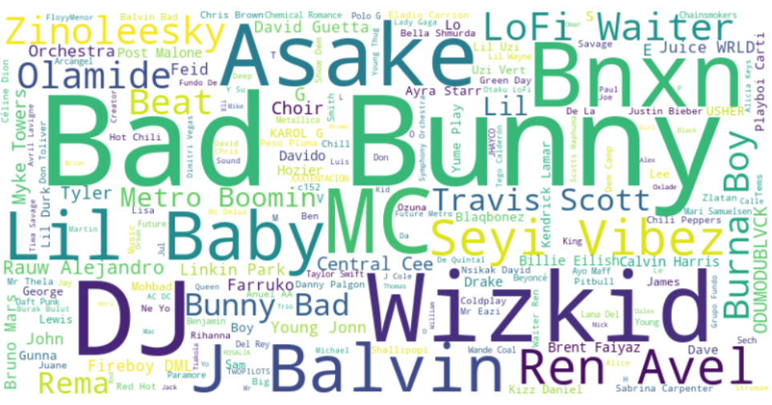
Fall 2025
CS 329
Data Distribution

Slide 10
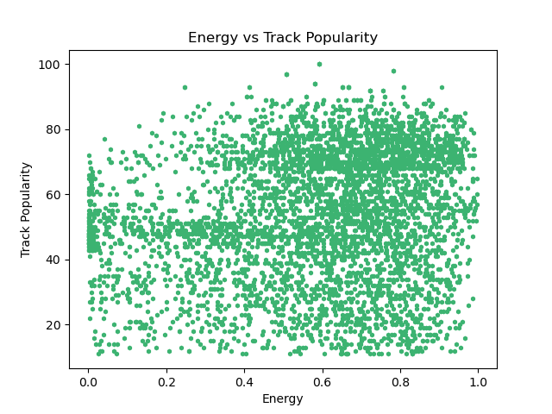
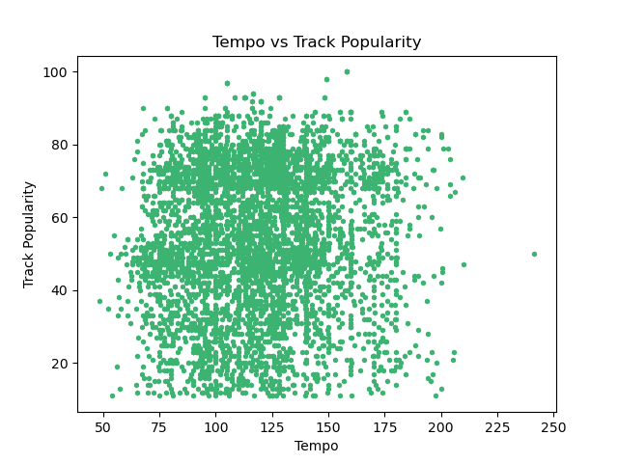
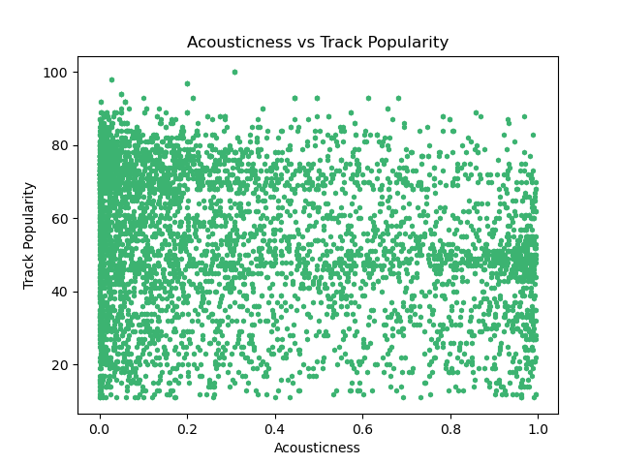
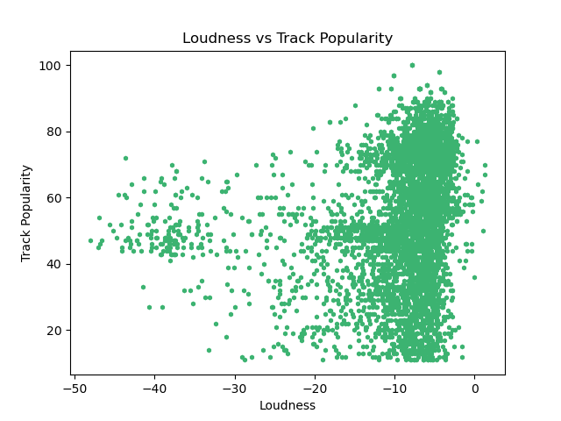
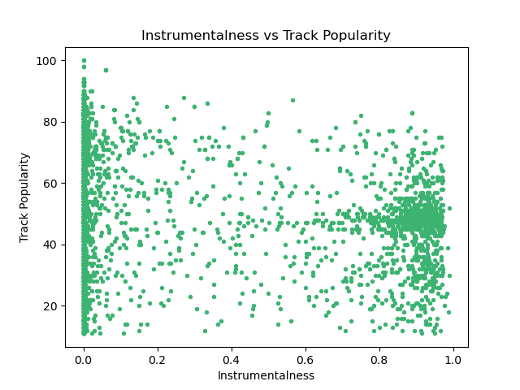
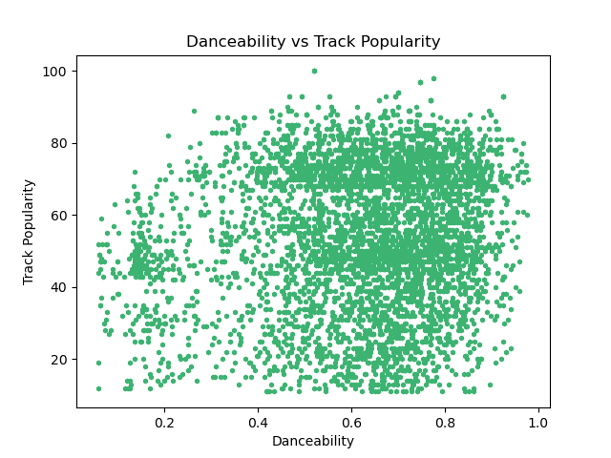
Fall 2025
CS 329
Feature VS Target

Slide 11
Fall 2025
CS 329
METHOD

Slide 12
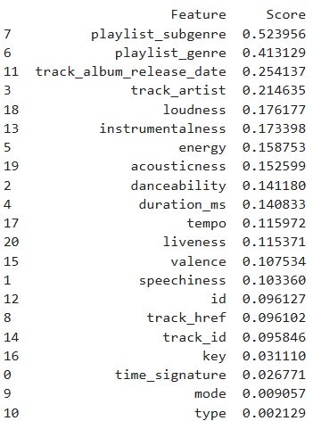

Fall 2025
CS 329
Mutual_info_regression
Mutual information (MI) measure how much information one variable provides about another: for a feature X and target Y, MI quantifies the reduction in uncertainty of Y given X
Model-agnostic: does not assume a specific model, so is useful for preprocessing before modeling
Is able to detect non-linear relationships between features and target
Robust to monotonic transformations
Downside is it looks at each feature independently, ignoring feature interactions

Slide 13
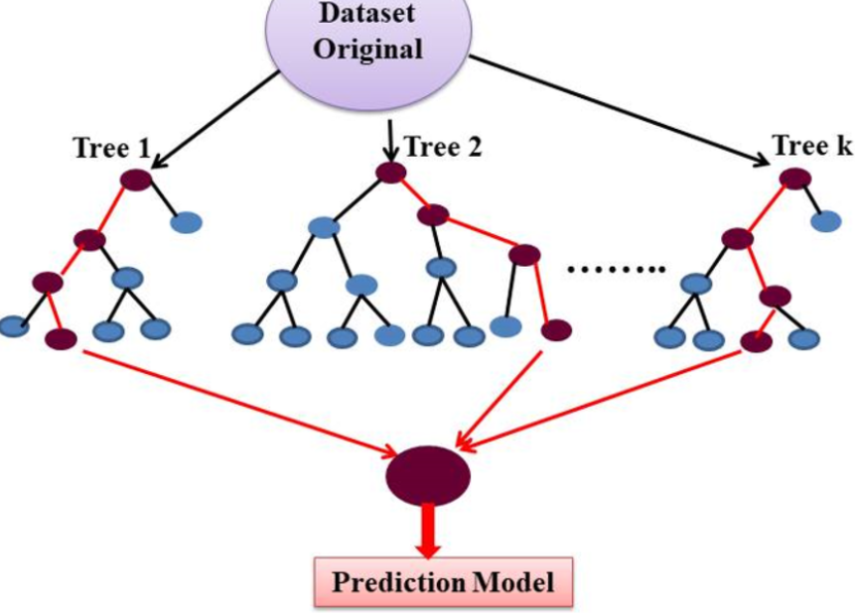

Fall 2025
CS 329
Extra Trees is an ensemble method similar to Random Forest, but with more randomness
Chooses random split among a random subset of features, resulting in lower variance
More suitable for noisy dataset and high-dimensional data
Extra Trees Regressor

Slide 14

Fall 2025
CS 329
PROCESS
Download dataset
2. Data wrangling
3. Feature selection
Obtained the spotify dataset from Kaggle
high popularity
low popularity
Combined the datasets and cleaned it up
drop ‘na’ rows
drop unwanted columns like playlist name and album name
encode categorical columns
Ran mutual_info_regression
playlist_genre, artist, loudness, energy, instrumentalness, acousticness, danceability, tempo
4. Graphing
5. Regression
Visualize the dataset features
Violin plots
Scatter plots
Bar charts
Word cloud
Ran ExtraTreesRegressor
plot the predictions and results

Slide 15
Fall 2025
CS 329
RESULTS

Slide 16
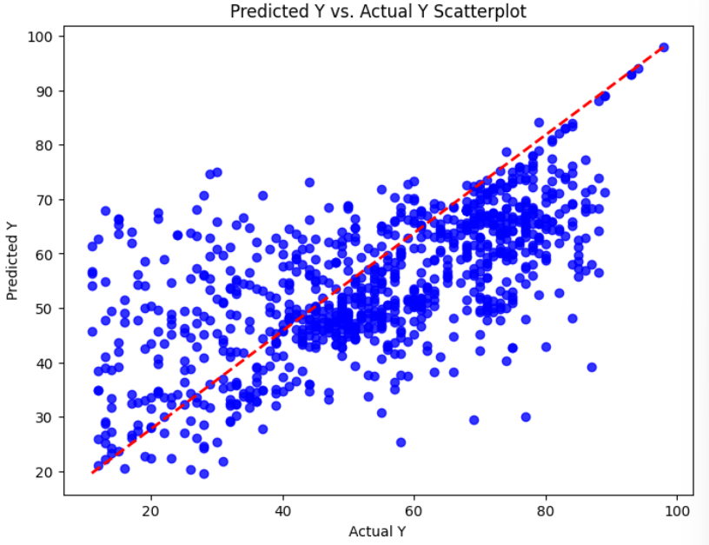
Fall 2025
CS 329
ExtraTreesRegressor results
RMSE: 222.78
R² Score: 0.427

Slide 17
Fall 2025
CS 329
CONCLUSION

Slide 18
Fall 2025
CS 329
Strongest factors were genre and artist
Music is diverse and difficult to predict popularity
Many factors contribute to popularity
Need to think about current trends
playlist_genre, artist, loudness, energy, instrumentalness, acousticness, danceability, tempo are able to capture some trend in track_popularity with some limitations
Potential improvements:
group songs by genres (controlled for genre variable) or artists
Test out other datasets with different variables

Slide 19
Fall 2025
CS 329
References
Ameh, S. (2025, January 7). Spotify Music dataset. Kaggle. https://www.kaggle.com/datasets/solomonameh/spotify-music-dataset?resource=download
https://scikit-learn.org/stable/modules/generated/sklearn.ensemble.ExtraTreesRegressor.html
https://scikit-learn.org/stable/modules/generated/sklearn.feature_selection.mutual_info_regression.html

