Slide 1
Array Technologies Inc Acquisition Presentation
Team: Enfincers
Member: Olivia Pan, Lingya Qiao • 10.04.2024

Slide 2
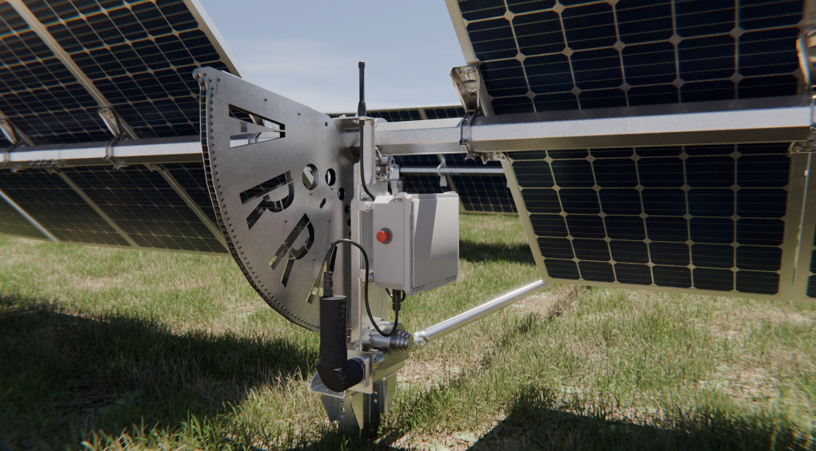
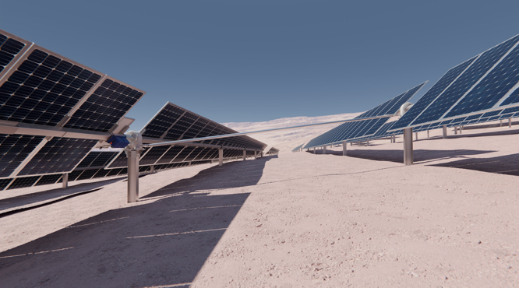
Overview
Array Technologies Inc.
Headquarter in NM, USA, went public in year 2020
Focuses on utility and distributes generation solar energy projects globally.
Offers a portfolio of integrated solar tracking systems which can adjust angle, increased 10-25% energy output
Key components of the systems include:
- Steel tubing
- Steel supports, etc.

Slide 3
Market and Industry Information
Market and Industry Overview
Market Size: The global solar tracking market has been experiencing significant growth because of demand for renewable energy
Growth Rate: The solar tracking market is expected to grow at a robust CAGR (Compound Annual Growth Rate) over the coming years, also fueled by governmental policy
Key Market Strength: Advanced solar tracking technology for utility-scale projects​
Sustainability Focus: Strong ESG (Environmental, Social, Governance) principles, driving renewable energy adoption.
Notes:
Market Size: driven by increasing demand for renewable energy and advancements in solar technology.
Growth Rate: fueled by governmental policies promoting renewable energy and decreasing costs of solar installations.
Headquarters: Albuquerque, New Mexico, USA.
Founded: 1989
Why we choose it: because there is relatively constant positive free cash flow for the future years which guarantee the ability to pay back debt with normal operation in the future.

Slide 4
Market and Industry Information
Competitive Landscape
Nextracker
SolarFlex
SunPower
Differentiation: innovative designs, reliability, and a focus on performance efficiency.
Key Products: DuraTrack, STI H250, SmarTrack (machine learning-based optimization software).

Slide 5
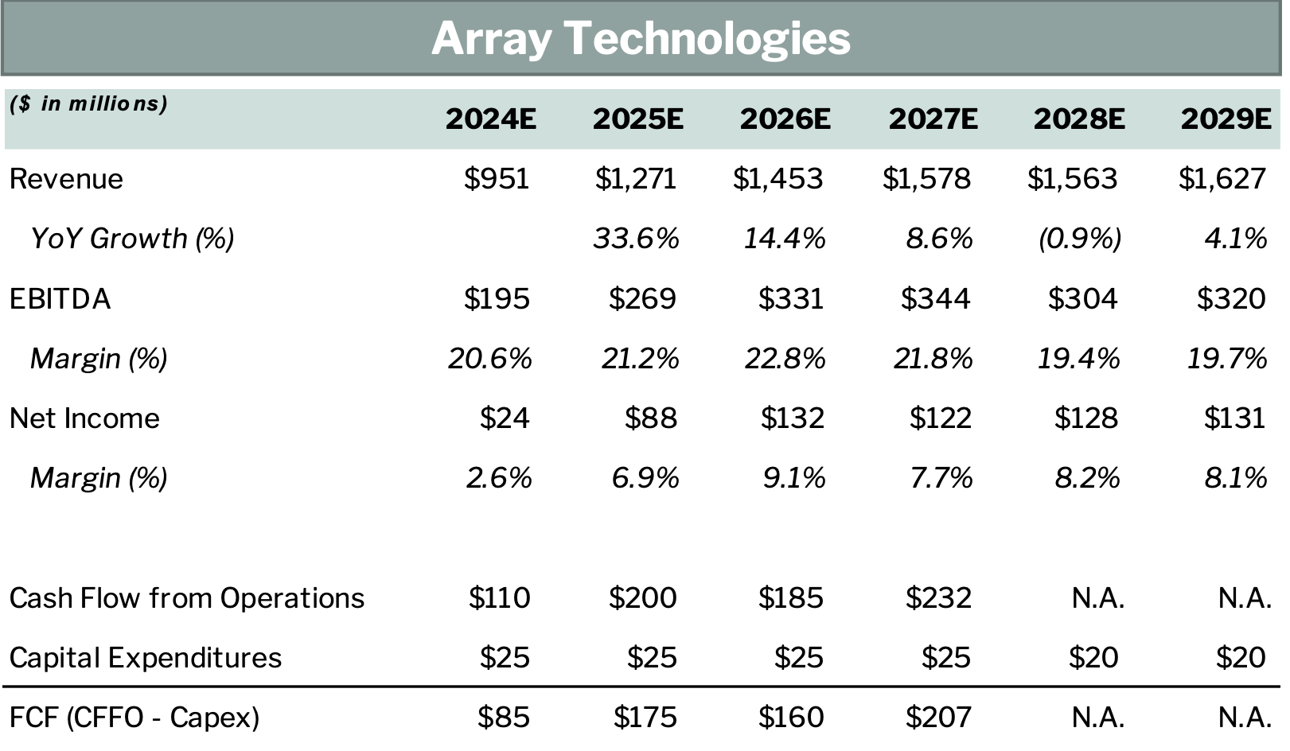

Slide 6
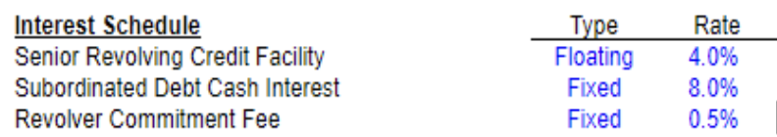
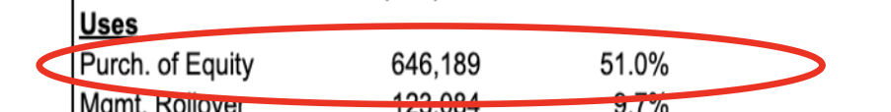
Financial Projection
Market Positioning
There could be a divergence in perspectives on the company's ability to maintain or expand its market position, particularly in a competitive industry like solar energy.
Risk-averse Assumption
In contrast to the consensus, our financial projections may reflect more conservative or risk-averse assumptions, leading to negative IRR for the previous years
Notes:
Say more specific on market positioning, maybe highly competitive, product hard to differentiate.

Slide 7
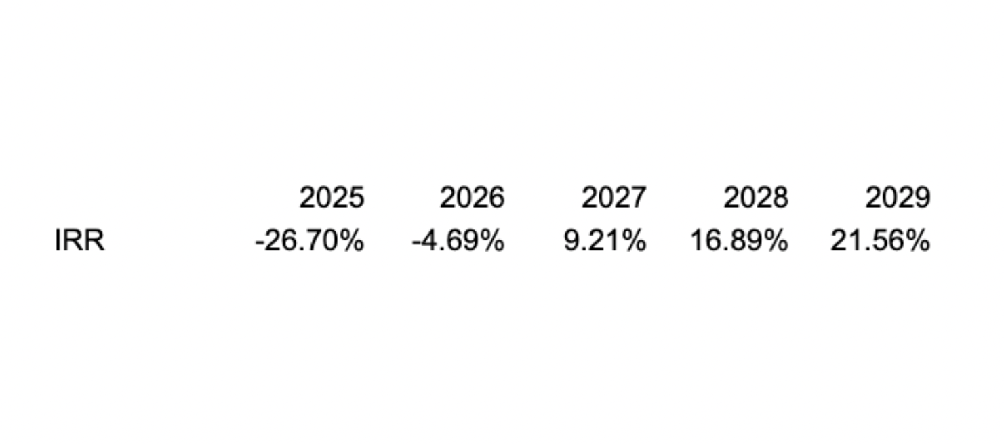
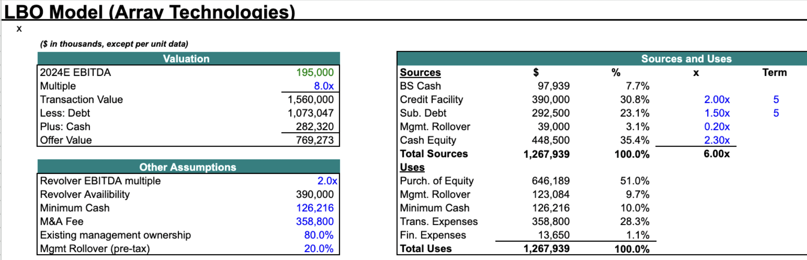
Attention areas
Notes:
Generally, large portions of sources will be used at purchase of equity and the management rollover percentage is really low. The interest of debt is lower than consensus.

Slide 8
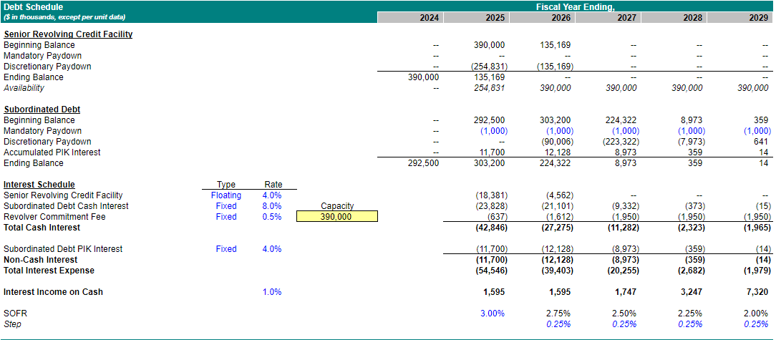

Slide 9
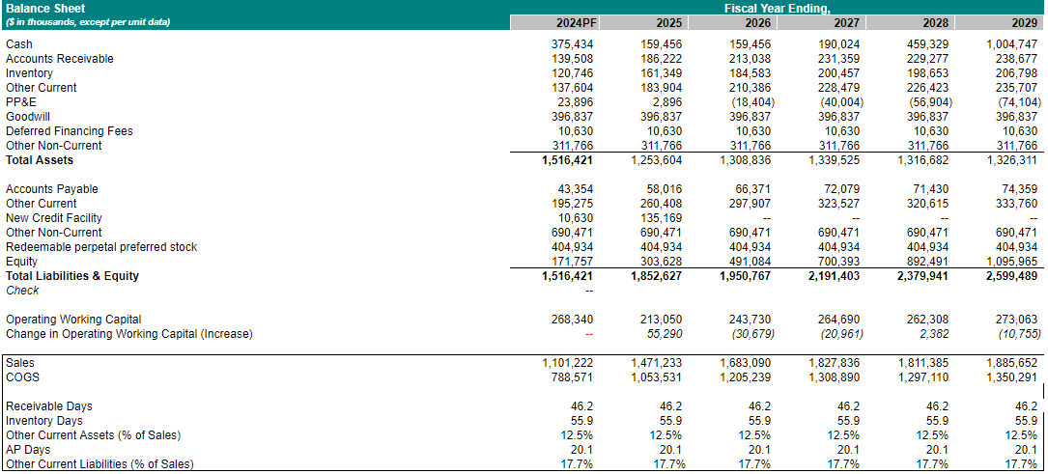

Slide 10
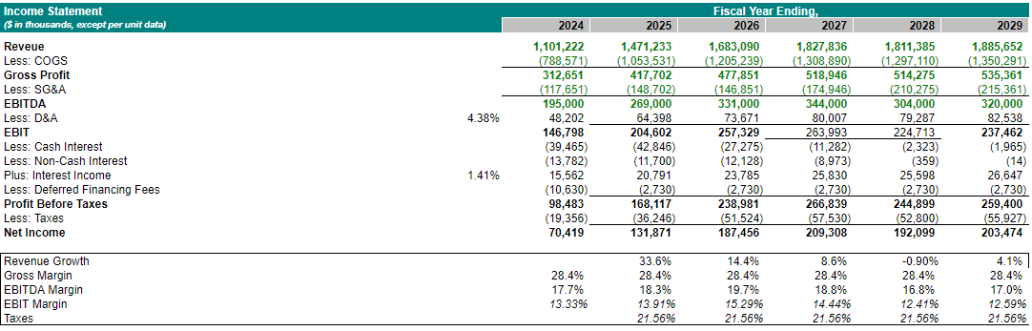
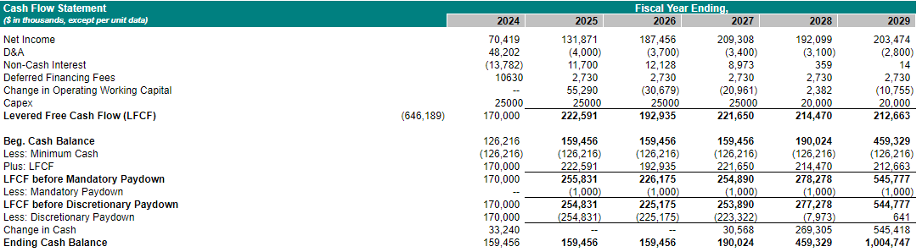

Slide 11
Valuation and Transaction Structure
Premium, leverage, and downside protection
We assume 20% premium on the market share price.
The debt-to-equity ratio is around 67%.
Contingent Value Rights (CVR)
Performance based bonus
Compare Trade and transaction comps
Array’s EV TO EBITDA vs. NextEra Energy’s EV TO EBITDA
Array’s acquisition premium vs. NextEra Energy’s acquisition premium
Notes:
Higher premium: 1) Strategic value (access to new markets or technologies). 2) High future growth potential in the clean energy sector. 3) Favorable industry trends (e.g., growth in utility-scale solar).
Leverage reason:
Risk Factors: Solar energy companies can face variable cash flows due to project delays, regulatory shifts, or supply chain challenges, so excessive leverage might increase financial risk.
Cash Flow: Array's ability to generate stable cash flows from long-term solar contracts may support higher leverage, but care should be taken to avoid over-leveraging due to the industry's cyclical nature.
CVRs for downside protection by tying part of the payout to future performance metrics, also help on aligning interest of shareholders
Performance based bonus to incentive array’s employee to meet the objectives of post-acquisition
Review current valuation multiples for publicly traded solar and renewable energy companies, focusing on EV/EBITDA, P/E ratios, and Revenue multiples
Compare trade
Array ev: 1,560 million, ebitda:195million, ev/ ebitda =8 (less than 10 means undervalued, good!)
NextEra ev: 250152 million, ebitda: 14767 million, ev/ebitda = 16.94
Array a premium: 20%, nextera energy’s premium: ~25%

Slide 12
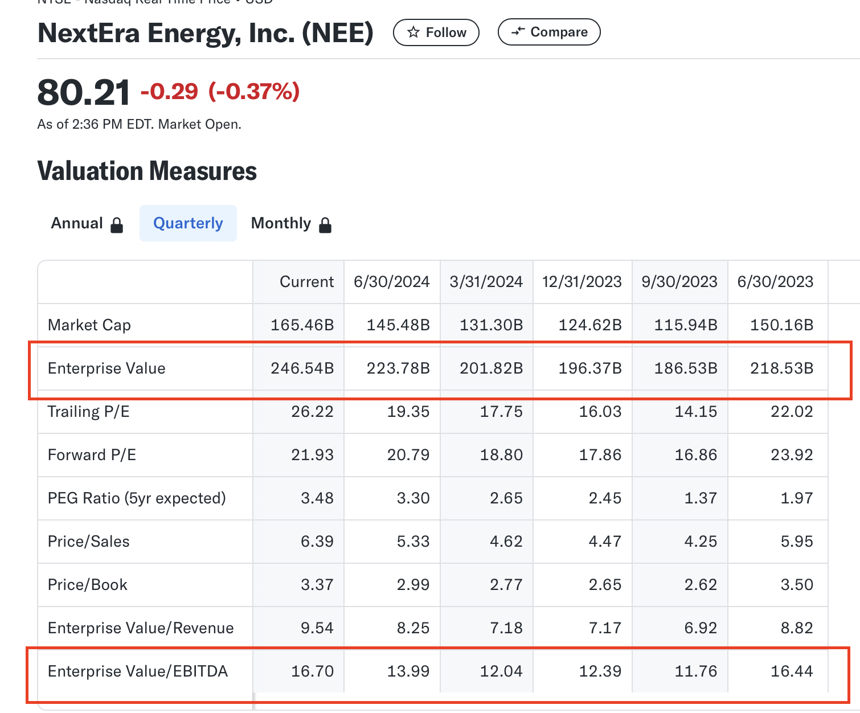
Notes:
Duiltive securities change of control provision!!!

Slide 13
Approach
Approach Management team
Directly and Privately
Avoid hostile reactions
Align interest with performance bonuses, leadership roles, etc
Approach to shareholders
Tailoring offer to maximize returns
Direct negotiation to avoid poison pills
Buyouts stake (unwanted)
Notes:
Initiating the discussion with Array Technologies' management team. Management knows the company’s operations. Approaching them directly and privately gives you a chance to negotiate a more collaborative deal. This approach also minimizes the risk of hostile reactions or the spread of negative sentiments within the company or market.
Compelling premium 20%-40%

Slide 14
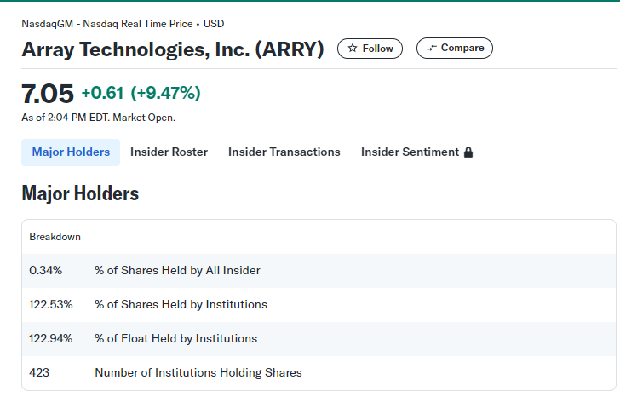
Notes:
Large portion of the shares are held by other institutions.

Slide 15
Post-Acquisition Value Creation
Operational Efficiency Initiatives
Resource Reallocation
Integration of Digital Tools
Supply Chain Optimization
Market Share Growth Initiatives
Global expansion
Strategic Partnerships
Potential M&A Targets
Competitors
Expansion into Adjacent Products or New End-Market
Solar-agriculture strategy
Notes:
Digital tools: implementing advanced data analytics, IoT sensors, and AI-driven monitoring systems can optimize operations in real-time, from manufacturing to the performance of solar trackers in the field. enhance predictive maintenance, reducing downtime and increasing efficiency.
Supply chain optimization: securing long-term contracts with key suppliers, increasing domestic content sourcing (which they are already focusing on), and streamlining logistics to reduce delays and costs in solar tracking installations.
Strategic partnerships: ally with engineering firms or utility firms to increase the likelihood of winning large-scale contracts, improving market share through stronger bids.
Competitors: acquire small competitor to increase control of key components and lower costs
Solar-wind strategy: integrate with wind energy and agriculture activities to attract more investors and in new end market

Slide 16
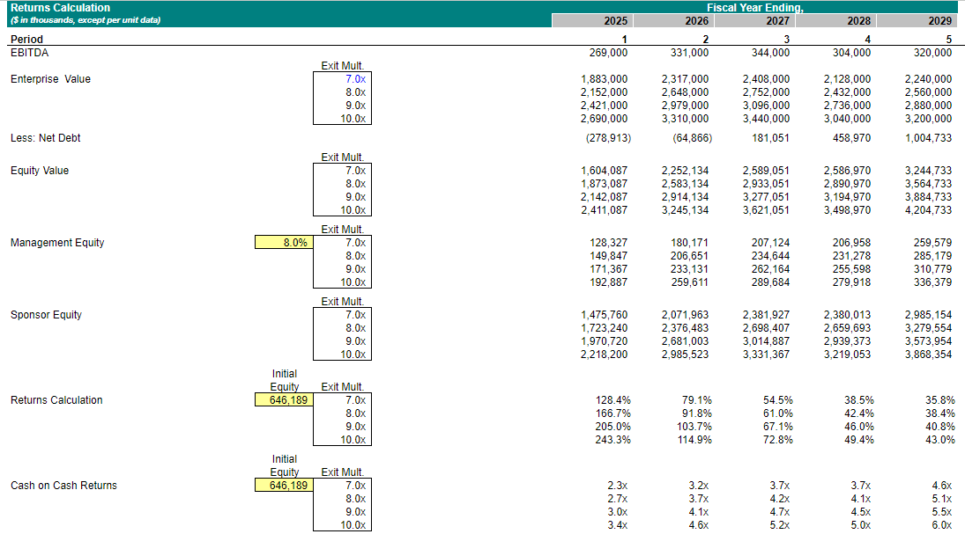
Exit Assumption and Returns with Sensitivity
Notes:
Exit timing: after 5 years. Sales to strategic buyers or initial public offering

Slide 17
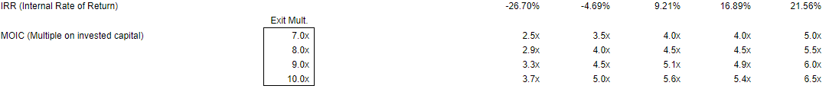
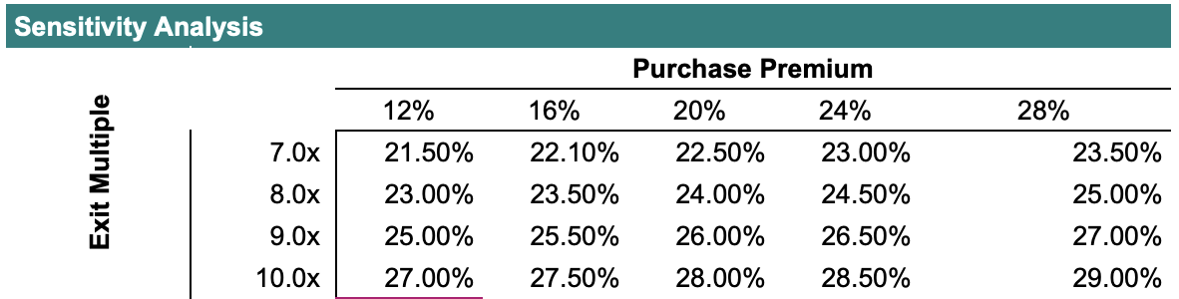
Notes:
Higher exit multiples and higher purchase premiums both lead to higher returns.
Increasing the exit multiple has a more significant impact on returns than the purchase premium, as the values shift more considerably across the rows compared to across columns.

Slide 18
Risk and Mitigants
Market Competition
Product Differentiation
Supply Chain Disruption
Strategic Partnerships
Leverage and Financing Instability
Operational improvement to ensure strong cash flow from operations and maintaining reasonable leverage ratio

Slide 19
Thank you!

