Slide 1
Moon Trip
Booking System
Moonlight
Travel
Phuong Anh Dang (Olivia)
Fast Track Sydney, 2021

Slide 2
Welcome!!
Fly you to the Moon
Moonlight Travel’s mission is to empower your dream about space travel, making it come true

Slide 3
Agenda Style
01
Overview
Overall structure of Moon Trip Booking System
02
Development Process
From idea to application design and deployment
03
Features
Main features of Moonlight Travel application
04
Challenges
Errors, bugs and difficulties

Slide 4
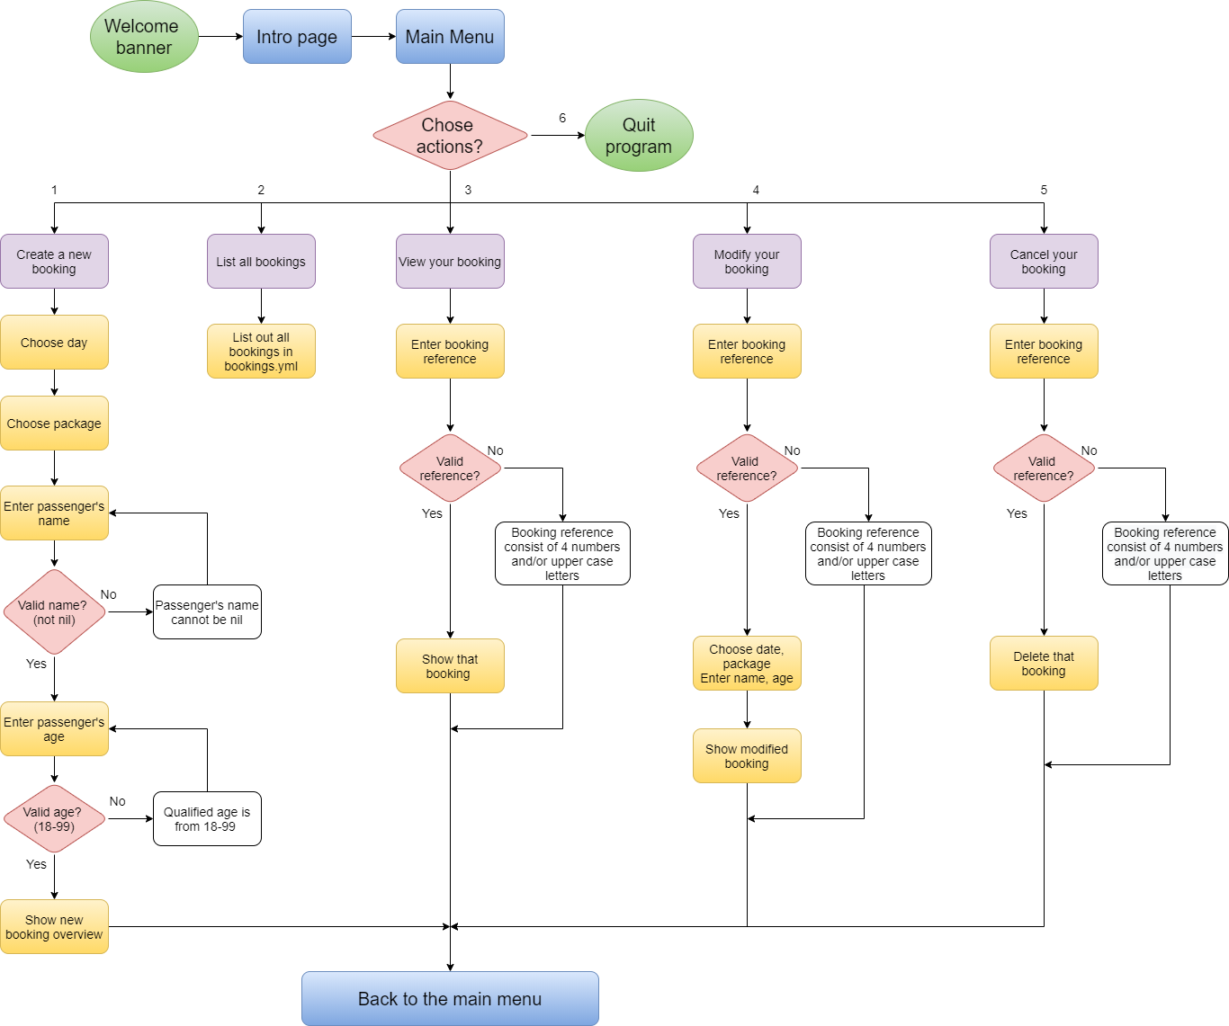
Overview
Basically, this is a very simple tour booking system.
When the app runs, it will show a welcome banner and then description about the Moon Trip.
The main menu is followed. Users will choose which action to take. Unless users choose to quit, the program will always go back to the main menu after each action is taken.

Slide 5
Development process
Idea
Design
Code & test MVP, fix bugs
Add more features
I know that I’m still in “kindergarten level” when it comes to reading about Objects, class, YAML, testing …, so I’ll try to make an “enough-to-pass” MVP first, and then fancier features later, and then refactoring, syntactic sugar or pretty code later.

Slide 6

Idea
When I heard about the terminal app assignment, I kept thinking what I would like to do? I looked up in the night sky and smiled: “Let’s go to the moon”. And that’s how I started making a Moon Trip Booking System.
At first, I want to make a flight booking system to the Moon only, but people can't just take a flight by rocket to the Moon, because they cannot travel by themselves, book an Airbnb elsewhere and find their own food. Therefore, it makes more sense if I offer a Full Package Moon Trip with date and package options.

Slide 7
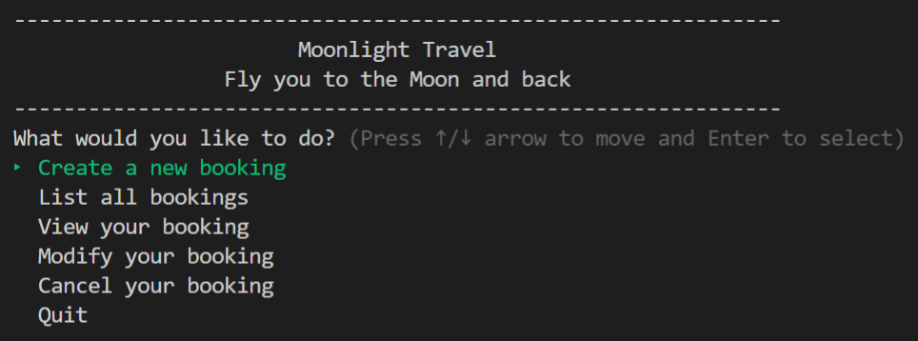
Features
As a tourism booking application, this app can create a booking, modify a booking, view a booking, delete a booking. Those are basic functions that end-users (tourists) would like to do when booking a tour. I also created "list all bookings" function. This is basically just for the tourism company to manage all bookings.
Target audience: tourism company and tourists (end-user)

Slide 8
CRUD Feature
Create a new booking
Users can create a booking in the system: Choose date, choose package, enter name, age
Modify your booking
List all bookings
Users can update a booking using booking reference
Users can see all bookings stored in bookings.yml as a persistent database
Cancel your booking
View your booking
Users can delete a booking using booking reference
Users can enter booking reference to see a specific booking

Slide 9
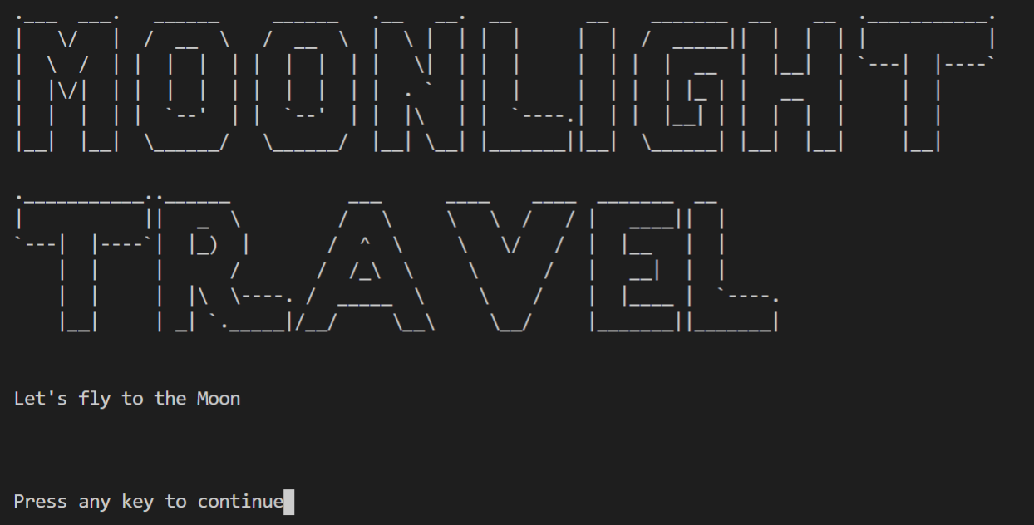
Ruby Gems
tty-font

Slide 10
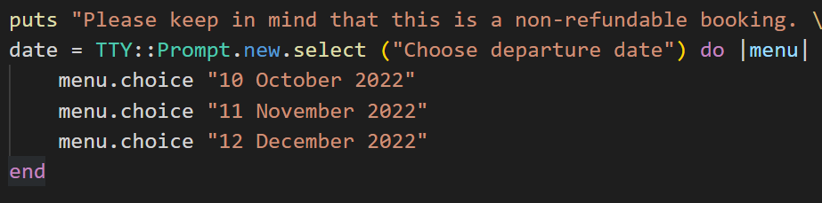
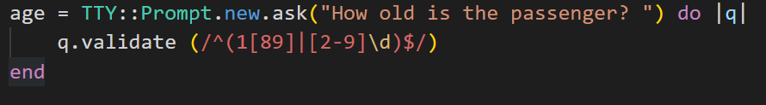
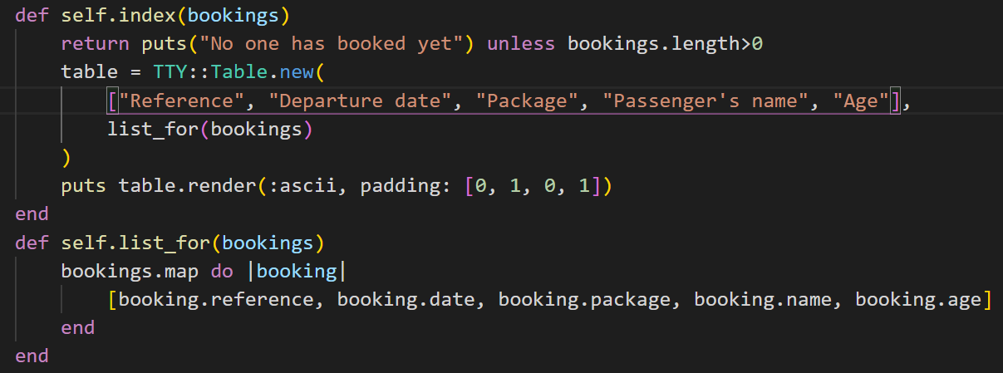
Ruby Gems
tty-prompt
tty-table

Slide 11
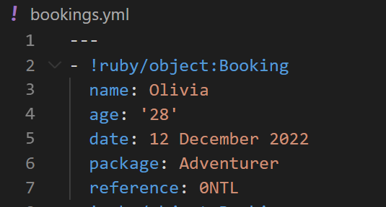
Persistent storage
YAML

Slide 12
Challenge
YAML error
It took me 3 days to code "create function". The most difficult part is using YAML as a database. I thought of .txt, but when I did research on the internet, professionals don't usually use file.txt to store data. So I tried to play around with YAML, create an instant called BOOKINGS:
BOOKINGS = YAML.load(File.read('bookings.yml')) rescue []
CRUD worked fine. However, whenever I “quit” app and run again, the storage file “booking.yml” cannot load existing data at start and kept overwriting with new bookings. This is very annoying and no longer permanently store data as a database.
I knew the problem but couldn’t fix it. I watched Michael's lecture again and again, from the basic design until he successfully moved the database to YAML. Following his steps, he said we shouldn’t use a constant to store data. Maybe this is my problem.
I didn't fully understand in class but after many failures, I finally nailed it.

Slide 13
Challenge
Add more features
Errors Handling
I want the app to show availability of each trip and each travel package, but I still don’t know how to.
I also want the app to create Users, but this is too tough can I’m afraid I don’t have enough time to learn and code.
I spent 10 hours doing challenges.
I didn't understand what is standardError, what's not
the difference between raise and rescue.
Now I got it. 15 attempts for the Invalid Words challenge and 19 attempts for Invalid Division.
BUT I still cannot handle all possible errors, for example nil name input.

Slide 14
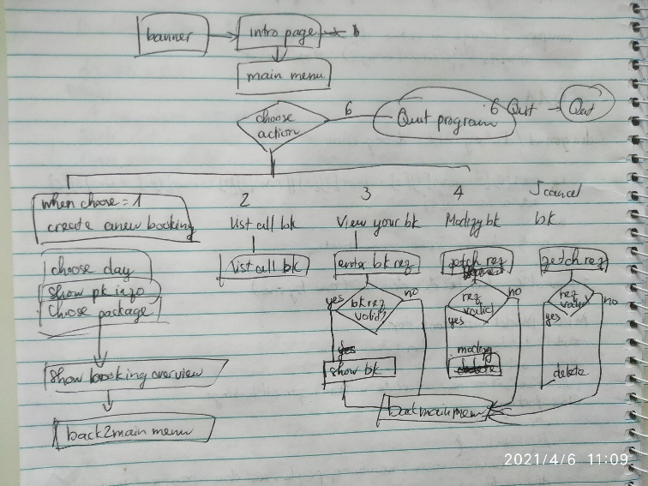
Challenge
TDD
It was not until yesterday (Tuesday) that I listen to the TDD videos. I can understand them and understand Michael’s lecture, but I cannot actively use rspec to write tests for now. Maybe too much new technology to learn so I was overwhelmed.
Although it seems like I happened to follow Red/Green/Refactor when I code. I wrote out the app idea and started making a simple MVP. I always test along the way whenever I moved code snippets to a new file or new module, change the variables' name, after creating a new method that may break existing function.

Slide 15
Thank you
See you at our Space Station

