Slide 1

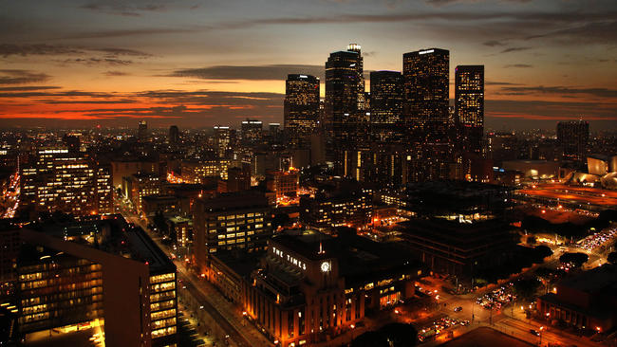

DSO-545 MyLA311 Project
December 9, 2016
Chang (Olivia) Bian, Manwen (Momo) Hu,Jiayue (Echo) Huang,TzeChieh (Jerry) Lin, Jiatong (Jackie) Zhong

Slide 2


Project Objectives
311 Call Center Tracking Data
Visualize Distribution, Trend and Other Facts
311_Call_Center_Tracking_Data (2011-15)
MyLA311_Service_Request_Data_2016
Tools: R & Tableau
Interpret Graphs and Figure Out Insights
Identify potential challenges or current issues call center faces
Provide recommendations that city of Los Angeles may offer residents and local community better services
Objectives
Introductions
Dataset 2011-2015
Dataset 2015-2016
Recommendations
Next steps

Slide 3
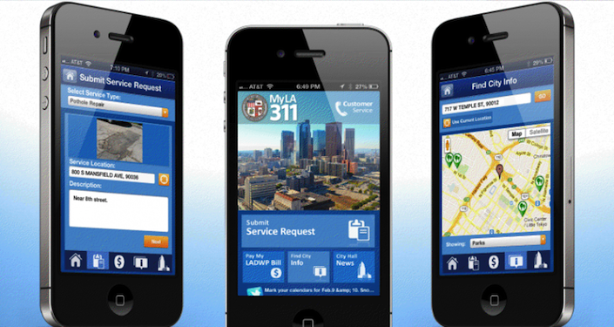
Background Information
The purpose of 311 call center is to help Los Angeles residents complain about graffiti, abandoned furniture, potholes, broken street lights and fallen trees
Popular services include Animal Services, Bulky Item Collection, Public Safety and Emergency Services and more…
The website launched 18 years ago
2013: The app was launched on mobile devices and was available for download both in the iTunes store and Google Play store in March
Objectives
Introductions
Dataset 2011-2015
Dataset 2015-2016
Recommendations
Next steps

Slide 4
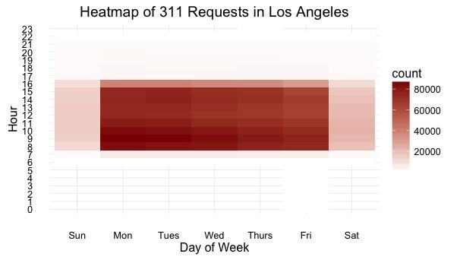
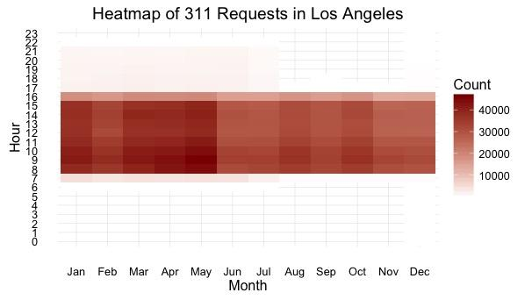
Visualization of Peak Season/Month/Hour
May stand out with more calls than other months
Consider signing contractors during peak hours (9-11am) and peak season such as May to improve efficiency
Objectives
Introductions
Dataset 2011-2015
Dataset 2015-2016
Recommendations
Next steps

Slide 5
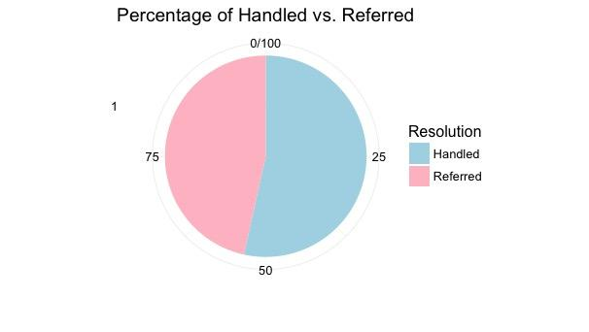
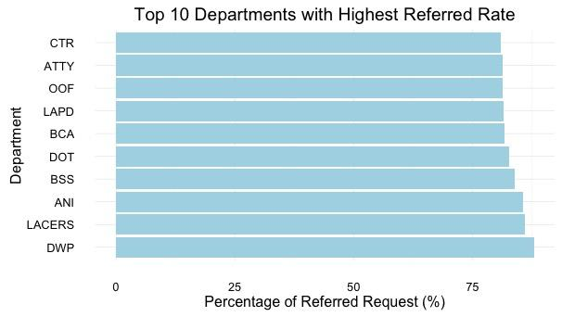
Handle Rate vs. Referred Rate
47%
53%
There are many departments with high referred rate (even greater than 75%)
Citizens might be confused about the duty or responsibility of each department
Promote and guide residents what kind of services each department could offer
Objectives
Introductions
Dataset 2011-2015
Dataset 2015-2016
Recommendations
Next steps

Slide 6
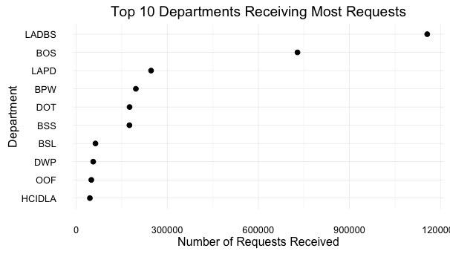
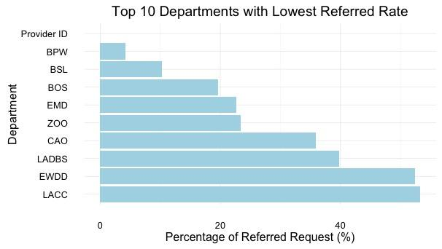
Handle Rate vs. Referred Rate (Cont’d)
LADBS, BOS, BPW and BSL have high volumes of requests, yet their rates of transferred calls are quite low – residents understand what kind of services these departments could offer
Objectives
Introductions
Dataset 2011-2015
Dataset 2015-2016
Recommendations
Next steps

Slide 7
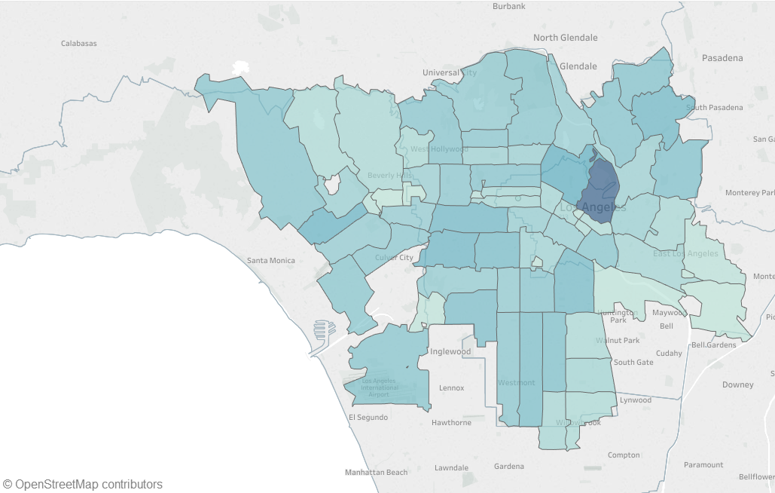

Visualize Request Distribution on Geographic Level
Requests are quite widely spread out among different regions
Downtown LA area receives most requests
Objectives
Introductions
Dataset 2011-2015
Dataset 2015-2016
Recommendations
Next steps

Slide 8
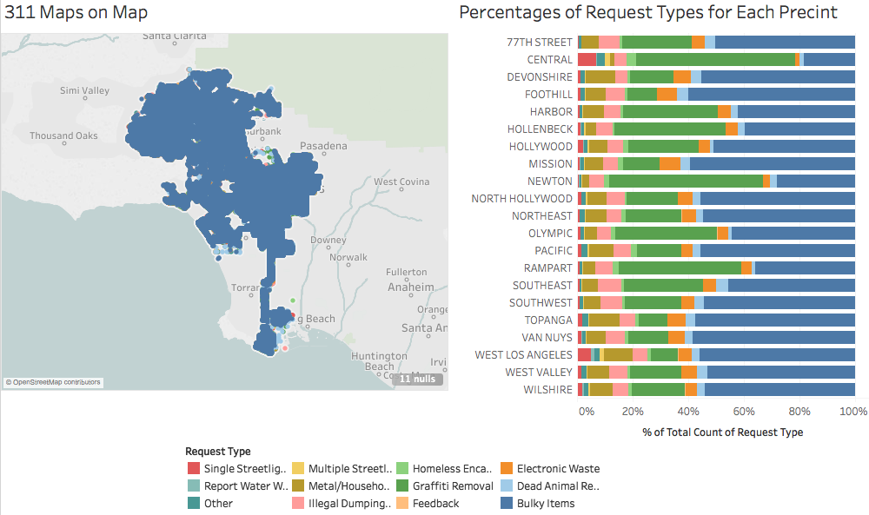
Visualization of 311 Request Type
Objectives
Introductions
Dataset 2011-2015
Dataset 2015-2016
Recommendations
Next steps

Slide 9
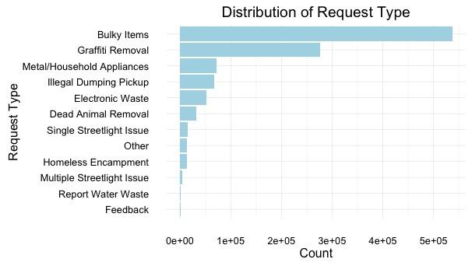
Visualization of 311 Request Type (Cont’d)
Top 3 request types: Bulky Items, Graffiti Removal, Metal/ Household Appliances
Residents’ impressions on 311 Call Center is heavily restricted within the service of “Bulky Items”-- it takes up the most portion for each police precinct
Promote other services to residents as well (311 can help residents more than this !)
Objectives
Introductions
Dataset 2011-2015
Dataset 2015-2016
Recommendations
Next steps

Slide 10
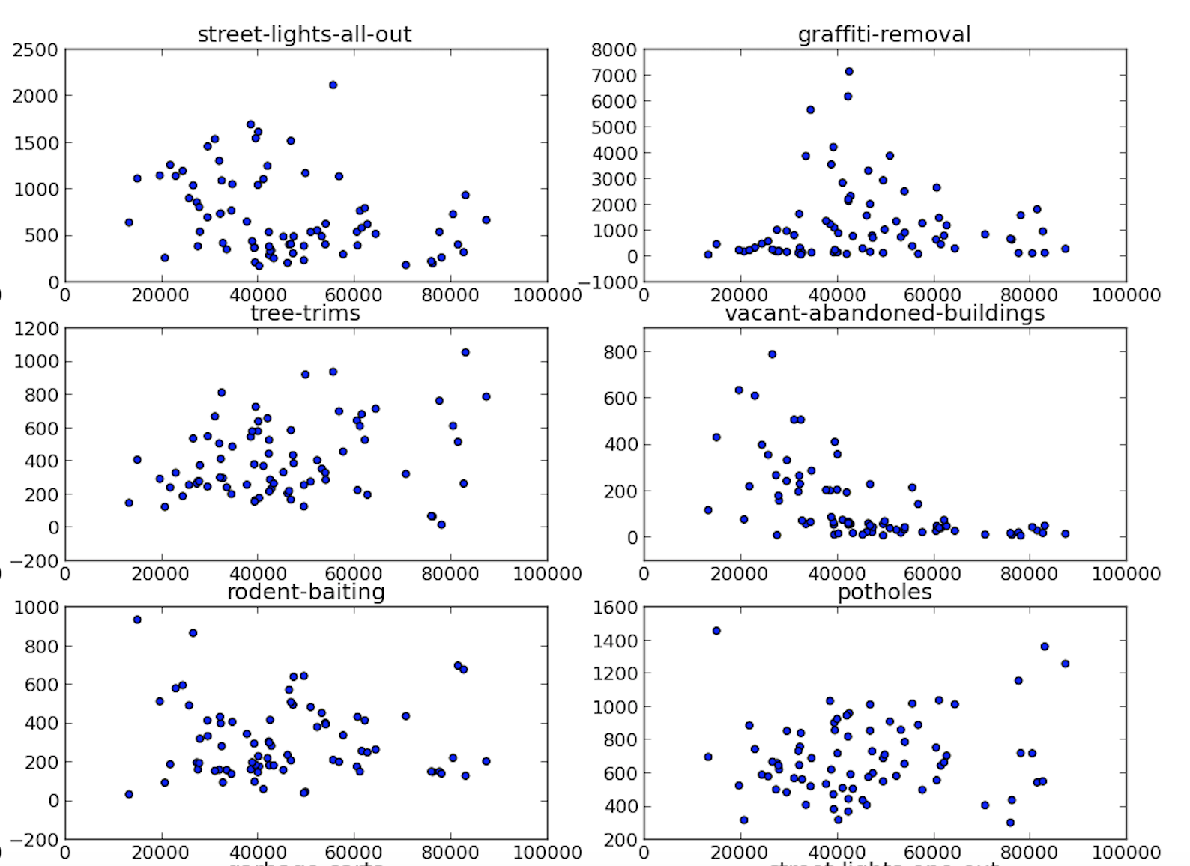

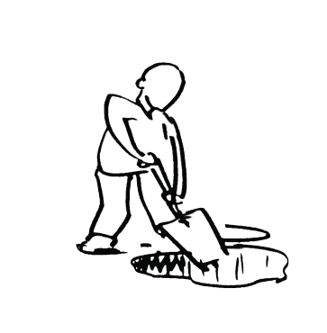
311 Request Type CHC vs. LA
Top 3 request types in Chicago
Graffiti-removal
Street-lights-all-out
Potholes
Data resource: https://github.com/dssg/411-­‐‑on-­‐‑311
Objectives
Introductions
Dataset 2011-2015
Dataset 2015-2016
Recommendations
Next steps

Slide 11
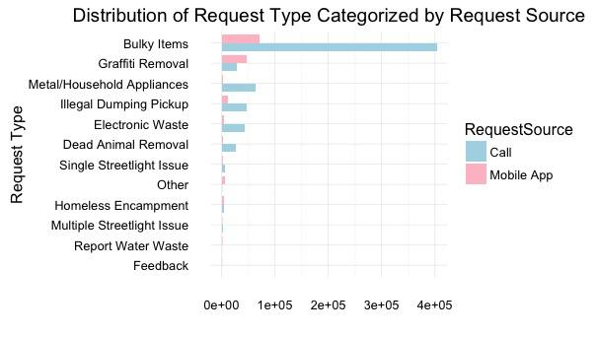
Visualization of Top Request Types Filled by Channel
Requests for bulky items generally are made by call rather than mobile App
Residents might be agitated with bulky items and therefore unconsciously choose calls which better lets out their emotion
Objectives
Introductions
Dataset 2011-2015
Dataset 2015-2016
Recommendations
Next steps

Slide 12
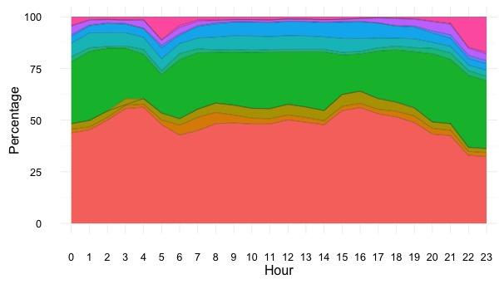
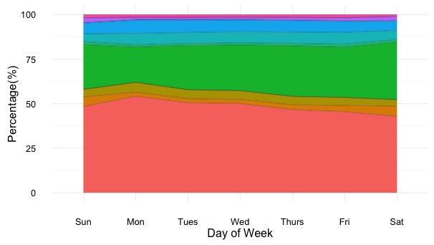
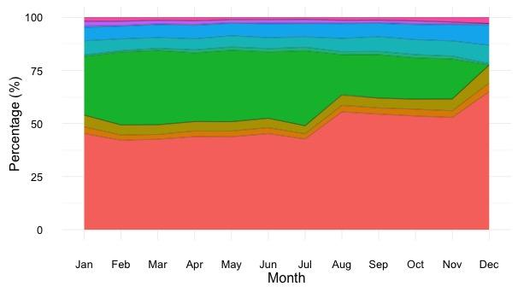
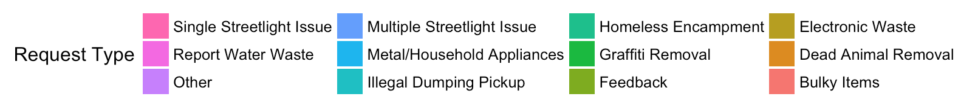
Visualization of Request Types by Hour/DoW/Month
Requests for single streetlight issues increase at 4 AM and 10 PM
Requests for bulky items account for nearly half of all requests throughout the year—validate the idea that residents’ impression on 311 call center service
Graffiti removal has second largest portion of requests, yet its request sharply decreases toward the end of the year, which is December
Objectives
Introductions
Dataset 2011-2015
Dataset 2015-2016
Recommendations
Next steps

Slide 13
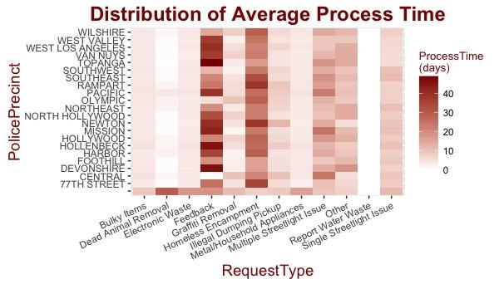
Visualization of Average Process Time
Feedback and Homeless Encampment both require more process time as they are activities involved with more communication
There are quite a few requests with no assigned police precinct, and they generally take up more process time
Objectives
Introductions
Dataset 2011-2015
Dataset 2015-2016
Recommendations
Next steps

Slide 14
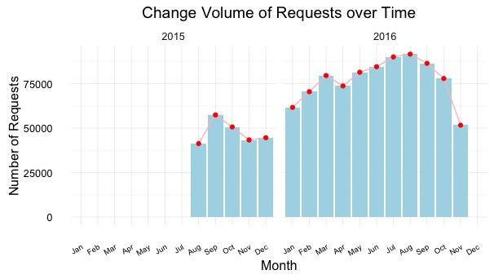
Visualization of Total Requests Over Time
From 2015 to 2016, the overall total number of requests is increasing
There are less requests toward the end of the year regardless of lack of data in November, 2016
Objectives
Introductions
Dataset 2011-2015
Dataset 2015-2016
Recommendations
Next steps

Slide 15
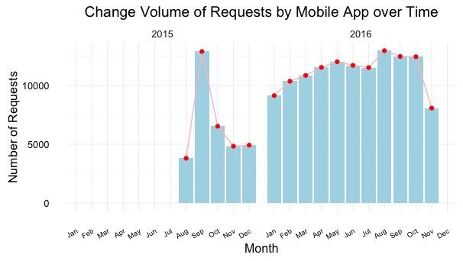
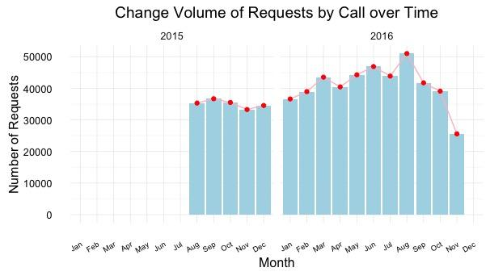
Visualization of Total Requests Over Time (Cont’d)
The distribution of requests by mobile App is quite volatile in 2015 with a peak in September--maybe there is new update on the App around that time
Request by Call is still most popular-- almost 3 times of the requests by mobile App
Objectives
Introductions
Dataset 2011-2015
Dataset 2015-2016
Recommendations
Next steps

Slide 16
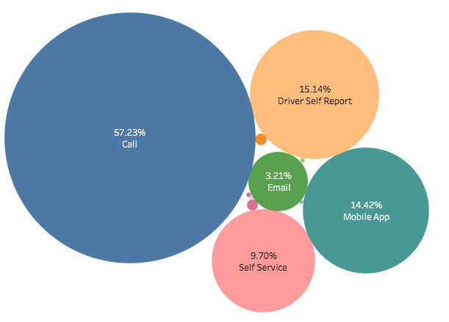
How People Call 311 ?
Validate our previous statement: request by call is still the most popular channel
Email only takes up 3.21%--has potential to grow
Encourage residents to report some of the non-urgent problems via emails to reduce overhead cost
Objectives
Introductions
Dataset 2011-2015
Dataset 2015-2016
Recommendations
Next steps

Slide 17
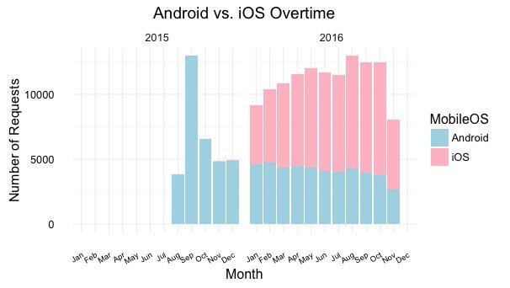
Visualization of Operating System Usage
There is VERY LIMITED iOS user during 2015 given our data, whereas iOS users account for more than half of total users during 2016
Data for Year of 2015 is biased? Missing data? (MyLA311 app launched on iOS and Android in 2013)
Objectives
Introductions
Dataset 2011-2015
Dataset 2015-2016
Recommendations
Next steps

Slide 18

Recommendation and Conclusion
Potential in increasing online user --- Promote its app and make it more user-friendly
Save human resource in call center to answer phone calls
Users could add more details such as photos
Low efficiency in some requests--- Redistribute requests by the usage of resources of all police precincts to a specific one
Expect to have faster response time
High referred and transferred rate --- Clarify the function of each department to the public
Reduce communication time in phone calls to understand resident’s requests
Improve efficiency when handling requests
Objectives
Introductions
Dataset 2011-2015
Dataset 2015-2016
Recommendations
Next steps

Slide 19
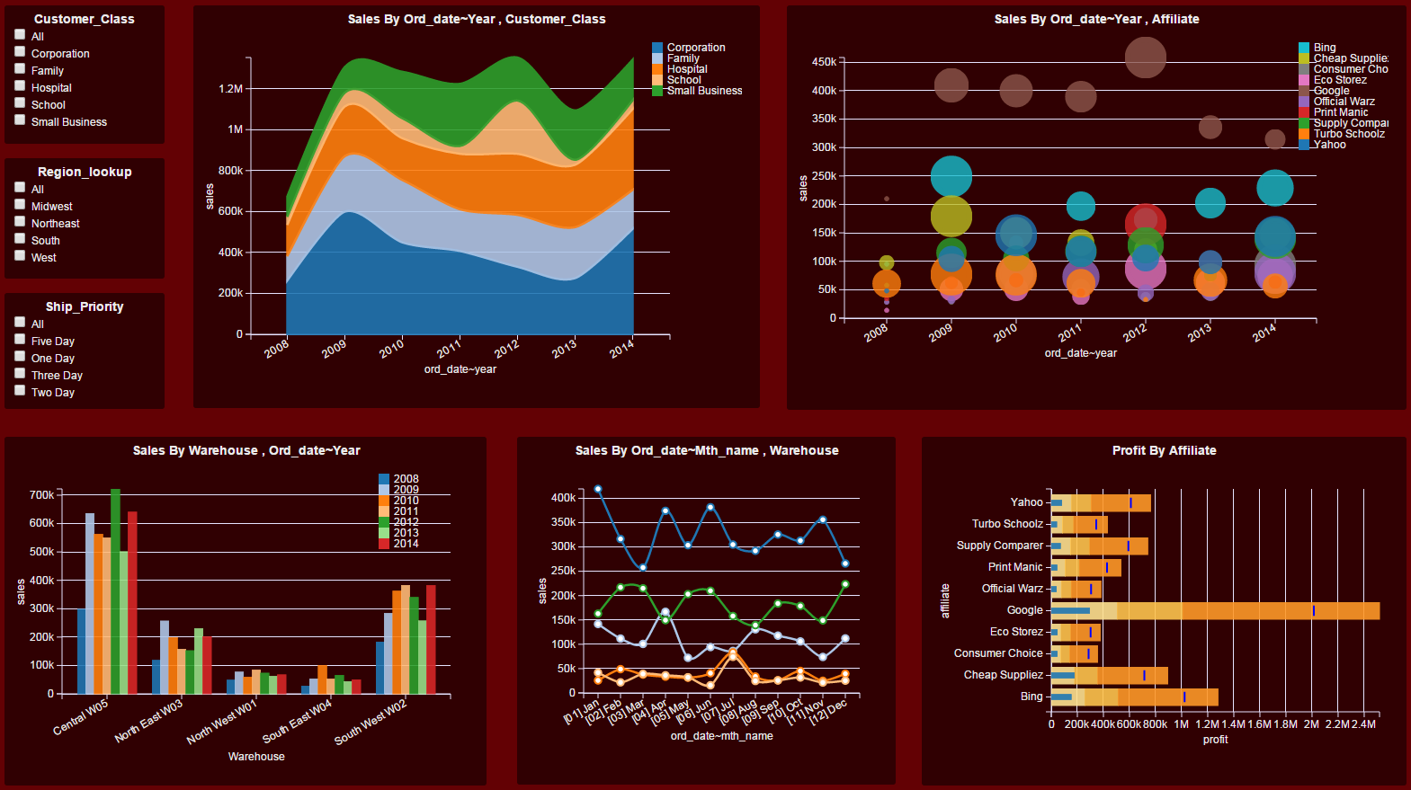
Nest Steps…
We want to combine 311 call center tracking data with demographic information if it is available. Several grouping may include:
Age Group
Income Group
Race
By having these information, we might be able to analyze what kind of services be requested more in specific group so we can improve efficiency and predict future demand.
Objectives
Introductions
Dataset 2011-2015
Dataset 2015-2016
Recommendations
Next steps

Slide 20

Thank You
Questions

