Slide 1
Bios 520-Clinical Trials
Jan 25, 2021

Slide 2
Today’s outline
Introduction
Class dynamics
Syllabus
Lecture

Slide 3
Introduction
Welcome comments
Who am I
Notes:
Design and analysis of clinical trials

Slide 4
Class dynamics
‘Large’ lecture style course
Final exam
1% Canvas
Can this be interactive?
This room!

Slide 5
Class dynamics-’Keeping it 100’
Feedback (slides, canvas, etc)
Classroom etiquette
Eating
Talking
Cell
Diversity of class composition
ALL are welcome

Slide 6
Prerequisites and why
Bios 500 or Bios 510
SAS or R knowledge
Programming/software options
Survey
Homework programming instructions will be discussed later

Slide 7
Syllabus
Syllabus on canvas.
Schedule is subject to change
Homework/Projects/tests
Honor code is given in https://www.sph.emory.edu/rollins-life/enrollment-services/honor-code/index.html

Slide 8
Syllabus highlights-Office hours
TA introduction and availability
Office hours as an adjunct
Email/Text/Zoom/Face to face options

Slide 9
Class evaluation
No text book but several will be referenced during the course
Homeworks

Slide 10
Lecture
Introduction
Characteristics of Clinical trials
Why history is really relevant here
Terminology/Definitions
Clinical Trial by Phase

Slide 11
What is a clinical trial
CLINICAL TRIALS: The evaluation of intervention (treatment) on disease in a controlled experimental setting.
A clinical trial is a study in human subjects in which treatment (intervention) is initiated specifically for therapy evaluation.
A prospective trial the effect of an intervention in humans
Intervention can be:
Drug
Biologic (e.g blood, vaccine)
Device
Procedure

Slide 12
Putting it together…
A clinical trial is an experiment on humans for the purpose of evaluating one or more potentially beneficial therapies where the investigator has control of some features of the trial.

Slide 13
NIH definition
Does the study involve human participants?
Are the participants prospectively assigned to an intervention?
Is the study designed to evaluate the effect of the intervention on the participants?
Is the effect being evaluated a health-related biomedical or behavioral outcome?

Slide 14
‘Clinical trial’ will generally be a randomized clinical trial
HOWEVER we will be discussing some clinical trials that are not randomized

Slide 15
Why Are Clinical Trials Needed?
1. Most definitive method of determining whether a treatment is effective.
Other designs have more potential biases
One cannot determine on the basis of uncontrolled observation whether an intervention has made a difference to outcome.

Slide 16
Why are clinical trials needed
Most definitive method of determining whether a treatment is effective
Other designs have more potential biases
One cannot determine on the basis of uncontrolled observation whether an intervention has made a difference to outcome

Slide 17
Why are clinical trials needed
Determine incidence of side effects and complications
From Coronary Drug Project, detection of side effect (Cardiac Arrhythmias)
Clofibrate 33.3%
Niacin 32.7%
Placebo 28.2%
Nausea side effects
Clofibrate 7.6%
Placebo 6.2%

Slide 18
Why are clinical trials needed
Therapy/Standard of care accepted with no trial
IPPB Trial ⇒ no benefit
Retrolental Fibroplasia, high [O₂] in premature infants ⇒ Harmful
Tonsillectomy ⇒ Reduced use
Bypass Surgery ⇒ Restricted use

Slide 19
Observational Studies
Issue - Correlation vs. Causation
Examples of False Positives
1. High cholesterol diet and rectal cancer
2. Smoking and breast cancer
3. Vasectomy and prostate cancer
4. Red meat and colon cancer
5. Red meat and breast cancer
6. Drinking water frequently and bladder cancer
7. Not consuming olive oil and breast cancer
Replication of Observational Studies
E.g. smoking and lung cancer
May not overcome confounding and bias
Beta-carotene

Slide 20
Why are Trials Needed ? To Evaluate New Frontiers
Genomics
Diagnostic Trials
Prevention Trials
Gene Therapy
Trials
Drug
Development
(Speed Up Process)
Selected Targets
Selected Patients
Francis Collins (3/2001)

Slide 21
Hallmarks of clinical trials
Perceptions and measurements are instrumentalized in a repeatable and quantifiable manner.
Plans and memory (e.g., written records) are externalized for facilitation of future references and defense
Extraneous factors are controlled through use of internal controls and other methods to control for bias.
Completed work is submitted for external recognition, verification, and disproof.

Slide 22
Future
Clinical trials, being part of the empirical arm of science, are just now catching up to the consequences of the new discoveries.
Genome-based medicine will affect clinical trial design and conduct
Moderate or small size BUT biologically significant treatment effects that could be obscured by uncontrolled natural variation or bias in poorly designed studies will require more rigorous clinical trials

Slide 23
Is personalized medicine a clinical trial?
Have you heard of personalized or precision medicine?
When you have an N=1 (You!) This perspective is derived from awareness of the implications of gene expressions, epigenetic factors, gene–environment interactions, gene–gene interactions, and the proteosome.
This idea is driving therapeutics via genomics resulting in the testing of new therapeutic approaches.

Slide 24
Examples of personalized medicine
Targeted therapy HER2 in breast cancer OR PDL1 expression in NSCLC
Immunotherapy: CAR-T in lymphoma
Gene therapy
Antiogenesis
Do you think the trials of these therapeutics constitute a clinical trial?

Slide 25
The focus of this class
Not entirely a high level, administrative course on clinical trials
Clinical trials represent the application of statistical and scientific reasoning to clinical research questions.

Slide 26
Design types in this course
Parallel designs, crossover designs, group allocation, factorial
Equivalency, non-inferiority and adaptive designs
These are not mutually exclusive or exhaustive design types.
A specific trial may fall into one of these types or more of these types.
And there are other possible trial designs that we will not discuss in this lecture.

Slide 27
Nothing can save you from a bad design
Good designs are paramount
You can’t ‘adjust’ for some confounder if the underlying design is terrible
AND, the conclusions from a badly designed clinical trial can be invalid

Slide 28
Role clinical trials play
Primary tool for evaluation of new drug, biologic, device, procedure, nutritional supplement or behavioral modification
Reliance on fundamental statistical principles
Development of statistical methodology

Slide 29
It’s the gold standard but….
“Randomized trials have been the centerpiece of development because of bias control, but their complexity, changing role, and other pressures on the acquisition of medical knowledge have now made them a focal point of conflicting interests”

Slide 30
There are some con’s to clinical trials
Currently there is a premium on evidence generated by clinical trials and regulatory requirements to use them.
Also many obstacles to their implementation and success. This is especially true in the broad scope of trial applications in the search for effective prevention agents, therapeutics, comparing competing therapies, establishing optimum treatment combinations and schedules, assessing devices, and surgical treatments.

Slide 31
The state of today’s clinical trials did not automatically ‘happen’
First attempts to evaluate therapeutic procedures date back to prehistoric times
What trials in Babylonia or on adventure ships to the ‘New World’ really tell us now?
Even before scientific method was established, people found a way to test hypotheses
However, many have failed due to lack of scientific method and failure to quantify assessments

Slide 32
Clinical trials come of age
Use of streptomycin for treatment of pulmonary tuberculosis (1948) was first clinical trial to use a properly randomized control group (drug vs bed rest)
Multi site clinical trial
Independent and blinded evaluation of patient x-rays by two radiologists and a clinician
Trial of antihistaminic drugs for treatment of common cold (1950) used placebo control in a double blind manner.

Slide 33
Why is this relevant?
Since 1969, evidence from randomized controlled trials (“adequate and well controlled trials”) is necessary for obtaining marketing approval from Food and Drug Administration for drugs.
In order to obtain this approval, the sponsor must demonstrate that the drug is effective for the indication and is safe. FDA also requires that each potential new drug has an Investigational New Drug application (IND) prior to use in clinical trials.

Slide 34
Relevance, part II
It is important to know the clinical trial history due to the precedence that has been set
Survival improvement is considered an appropriate measure of clinical benefit.
Oncology has history used objective response rate (ORR), determined by tumor assessments from radiological tests or physical examinations
Now the FDA bases drug approval on more direct evidence of clinical benefit, such as improvement in survival, improvement in a patient’s quality of life, improved physical functioning, or improved tumor-related symptoms. These benefits may not always be predicted by, or correlate with, ORR.

Slide 35
Quality of life
How does one analyze that?
Do the other clinical endpoints have to improve?

Slide 36
Lastly…
There are lessons learned in previously conducted clinical trials that we will be discussing this semester
Endpoints/outcomes
Retention
Design

Slide 37
Clinical Trials Natural Experiment
General Lancaster (1600)
East Indian Shipping Co.
4 ships - Lancaster’s ship fortuitously had lemon juice on board
Lancaster’s ship remained free of scurvy
Natural Experiment, not planned

Slide 38
Clinical Trials Planned Experiment
Smallpox Experiments (1721)
Perhaps first planned experiment (Lady Mary Wortley Montaqu)
Six death row inmates of Newgate Prison Sentence commuted if they volunteered for inoculation
All remained free ⇒ Inoculation effective
No concurrent control group

Slide 39
Clinical Trials Concurrent Control
Scurvy Experiment - Lind (1747)
Used control group (concurrent)
12 patients with scurvy
Evaluated 6 treatments (2 subjects/treatment)
One treatment (oranges and lemons) had two men recover

Slide 40
Clinical Trials Use of Randomization
Multicenter Trials (1944) - Common Cold
Medical Research Council
Treatment of common cold
Different sites all using common protocol
Patulin vs. Placebo
MRC Tuberculosis Trial (1948) - Grandfather Trial
(Ref: British Medical Journal, 1948)
Randomized (by random numbers)
Streptomycin vs. Placebo
Based on work of Bradford Hill, founder of modern day clinical trial
Supported Concept of Randomization

Slide 41
First off… definitions

Slide 42
Components of clinical trials
Having a good question
Uncertainty/equipoise in the scientific community
An appropriate level of risk–benefit for the interventions
Receptivity in the context for the trial
A design appropriate to the scientific question
The necessary resources and technology to perform the study.
A deficiency in any of these components will stop the trial from either getting underway or being successful.

Slide 43
Single & Double Blind Clinical Trial
Single Blind: A clinical trial where the participant/patient does not know the identity of the treatment received
Double Blind: A clinical trial in which neither the patient nor the treating physician knows the identity of the treatment being administered.
Triple blind: Much less frequent

Slide 44
Placebo control clinical trials
Placebo: An inert substance made up to physically resemble a treatment being investigated for therapeutic benefit.
Used as a control treatment
Not an absence of treatment
Design options include Treatment vs placebo
How to interpret a response to a placebo?

Slide 45
Clinical trials by phase

Slide 46
Types of Clinical Trials
Phase I:
New treatment (usually drugs) is to be tried on humans for the first time. Aim is to find acceptable range of doses and schedules.
Phase II:
Treatment is to be given to humans to determine if it has any beneficial activity. Doses and schedules may not be optimum.
Phase III:
Comparative Trial. To compare experimental or new therapies with standard therapy or competitive therapies.

Slide 47
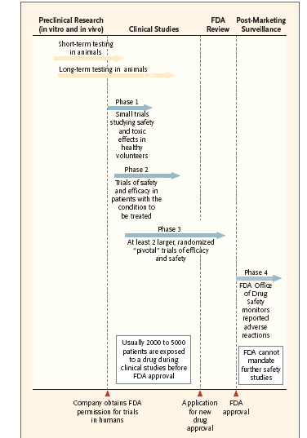

Slide 48
Types of Clinical Trials
Randomized
Assign patients to either the new treatment(s) or standard of care by a randomization method
The gold standard due to controling for (or minimizing) biases
Non-Randomized
Single Center
Multi Center
Phase I, II, III Trials

Slide 49
Characterization of Trials Randomized vs. Non-Randomized Multi-Center vs. Single Center
Phase | Single Center |  | Multi Center
 | Randomized | Non-Rand. | Randomized | Non-Rand.
I | Very rare | Yes | Rare | Sometimes
II | Rare | Yes | Yes | Sometimes
III | Yes | Use of Historical Controls | Yes | Use of Historical Controls
Carrying out a multi-center randomized clinical trial is the most difficult way to generate scientific information.

Slide 50
Intro to phases of Clinical trials
The phases of clinical trials refers to the sequence of trials that are necessary to bring a treatment into use.
The terms originally came from drug development, but had been extrapolated to other types of trials.

Slide 51
Phases not mutually exclusive
Phase one and two are usually considered the learning phases of clinical trials, and phase III is considered the demonstration phase.
Phase IV refers to a study after market approval. The objective of phase four studies is to see how an intervention works in the real world, and to examine long term safety.
Phase IV studies are frequently observational, but sometimes they are control trials.

Slide 52
Phase I
In summary, small number of patients to determine a MTD
How do you think researchers come up with a dose to study?
Evaluation of safety
Types of patients?

Slide 53
Phase I designs
Fibonacci standard for many years (2 plus 1)
Rolling 6 used more often now because allows more patients to be studied
Bayesian and other adaptive designs becoming more popular

Slide 54
Phase I - clinical pharmacology & toxicity
Examines drug safety
Determines single acceptable dosage
Features dose-escalation
Studies drug metabolism, bioavailability, pharmacokinetics, and pharmacodynamics

Slide 55
Phase I example
Combining dasatinib with fludarabine and cytarabine (FLU/Ara) reinduction chemotherapy in children with relapsed or refractory core binding factor acute myeloid leukemia (CBF AML)
Dasatinib is an FDA approved multi-tyrosine kinase inhibitor but not for this indication
Goal is to eventually move to de novo patients. Generally the oncology plan of attack

Slide 56
Enrollment based on safety
How are doses selected
What happens if you target too high of a dose to initially study?
What happens if you target too low of a dose to initially study?

Slide 57
Phase II
The primary purpose is to evaluate efficacy.
Only occurs after a MTD is determined
What other way can an investigator study a dose if it has not yet had a prior Phase I study?
Safety will also be an objective

Slide 58
Phase II - initial clinical investigation for treatment effect
Usually small in scale
Examines both safety and efficacy
Sometimes serves in screening

Slide 59
’2b’ or not 2b
There is a 2a and 2b distinction
A way to get one study approved even though there are different endpoints

Slide 60
Phase III
The comparative phase of a study to determine how ‘good’ a new treatment is
Sometimes you want to show that a new treatment is ‘just as good’ and sometimes you want to show it is ‘better’
Does not have to be a new drug.
Example: Autism and Applied behavioral analysis
The clinical trials phase we will focus on

Slide 61
Phase III - Full scale evaluation of treatment
Provides pivotal evidence of efficacy and safety
Comparative in nature

Slide 62
Phase IV
Post market surveillance
Often dictated by FDA
To further study safety profile
Monitoring for uncommon effects
Insurance/Government reimbursement analyses

Slide 63
For next week (on canvas)
Homework Assignment: next slides
Reading Assignment for next week: Hommel, E et al. “Effect of captopril on kidney function in insulin-dependent diabetic patients with nephropathy.” British medical journal (Clinical research ed.) vol. 293,6545 (1986): 467-70. doi:10.1136/bmj.293.6545.467

Slide 64
Efficacy of Captoril
One of the long-term complications of diabetes is kidney disease or nephropathy. One of the problems that can exacerbate this condition is raised blood pressure, and therefore it is important to investigate if medication can reduce blood pressure in this group of patients.
A randomized clinical trial was reported by Hommel et al. (1986) in which insulin-dependent patients with diabetic nephropathy were randomized to receive either Captopril, a drug intended to reduce blood pressure, or a placebo.

Slide 65
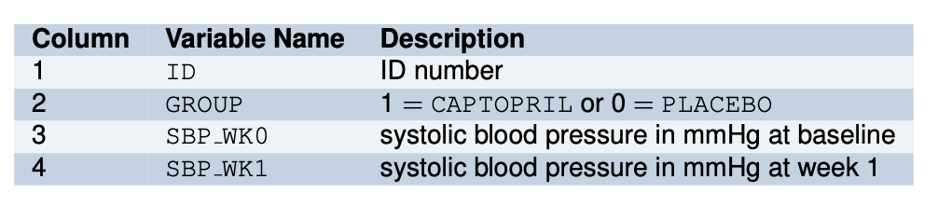
Data description
The systolic blood pressure was measured before randomization, giving a baseline value, and then again after one week of treatment. The data file contains 4 columns:
This was a small clinical trial with 16 participants. The research question is straightforward:
Was the intervention effective in reducing systolic blood pressure?

Slide 66
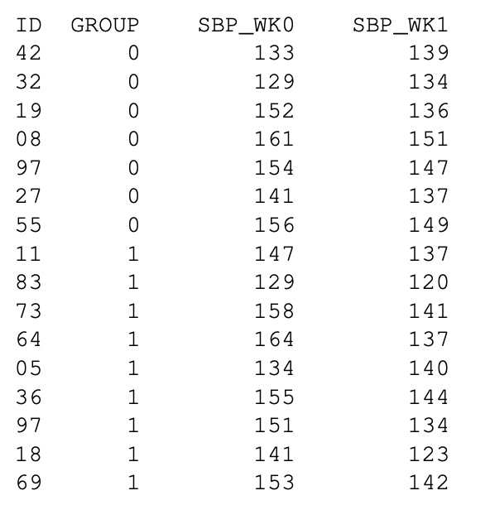
The data
How do you summarize the data?
What picture can you draw to visualize the data?
How do you answer the research question?

