Slide 1
Bios 520-Clinical Trials
January 19, 2023

Slide 2
Outline
Housekeeping
Bio break from 1:50-2pm
Class communication via canvas
Homework 1 update. R markdown as option
Roster
Survival bootcamp… Live?
Today’s lecture starts with last week’s ‘review’
Lecture 2: What is the question
Patient population
Dependent on design
Outcomes

Slide 3
Review & what I didn’t get to last week
Clinical trials umbrella
Clinical trials as the gold standard
Brief overview of organizational structure

Slide 4
Research Cycle
Clinical Trials Research
(human, comparative)
Translational Research
Basic Research
(bench, animal)
Observational Research
(human, epidemiological)

Slide 5
Evidence-Based Medicine
Ideally based on data from clinical trials
Need to understand fundamentals of good design and analysis
Not all published data of same quality

Slide 6
TYPES OF EVIDENCE
Randomized Clinical Trial (RCT) is gold standard
RCT minimizes bias
Can’t do RCTs for all important questions (time, funding, ethics)
Must make choices on what evidence to use for clinical guidelines

Slide 7
Why is it the gold standard?
Most definitive and efficient method for determining if a new treatment is more effective than current standard
Observational studies have potential for bias
One cannot conclusively determine from uncontrolled study whether differences in outcome can be directly attributed to new intervention

Slide 8
Gold standard contd
Controlled clinical trials are effective mechanism to distinguish incidence of side effects and Adverse effects due to therapy from those caused by disease itself.
In Coronary Drug Project 33% of intervention arm and 38% placebo arm experienced cardiac arrthythmias
Without a control arm, some might think the side effect is a result of the medication-not of the underlying disease

Slide 9
Gold contd
Without clinical trials, new (and harmful) treatments could be part of standard medical practice
In the 1940’s, premature babies were treated with high dose oxygen. Researchers also noted an increase of blindness in premature babies around that time.
A clinical trial later showed that 23% of high dose arm vs 7% of low dose arm resulted in blindness

Slide 10
Definition of a Clinical Trial
A prospective study comparing the effect and value of intervention(s) against a control in human subjects
NOTE:
Prospective not retrospective
Intervention/Equipment
preventive -drug
therapeutic -device
diagnostic -procedure
-biologic
Control Group
no intervention -current standard therapy
placebo -previous standard
Humans not animals
ethics
informed consent

Slide 11
Why are we taking this class?
Failure to master statistical concepts can lead to numerous and important errors and biases in medical research
Failure to accomplish fundamental biological and clinical concepts can also lead to serious methodological and inferential errors.
The clinical researcher who involves a statistician only in the analysis of data from a trial can expect a substantially inferior product overall.

Slide 12
Lecture 2
Study protocol
What is the study question & hypothesis
How should the treatment effect be assessed and interpreted

Slide 13
A Trial Protocol
Required for all trials
Basis of Review
IRB/Ethics
Funding

Slide 14
Purposes of a protocol
To assist the investigator in thinking through the research.
To ensure that both patient and study management are considered at the planning stage.
To provide a “sounding board” for external comments.
To orient the staff for the preparation of forms and data processing procedures.
To guide the treatment of the patient on the study.
To provide a document which can be used by other investigators who wish to “confirm” the results or use the treatment in practice.

Slide 15
Protocol Outline: “A Blueprint” In Canvas
A. Background & Rationale
B. Objectives (today’s topic!)
1. Primary Question
2. Secondary Question
3. Subgroup Questions
4. Toxicities

Slide 16
Protocol Outline: “A Blueprint” (2)
C. Design
1. Population
-Inclusion criteria
-Exclusion criteria
2. Sample Size Rationale
3. Enrollment
-Recruitment strategy
-Informed consent
-Eligibility assessment
-Baseline exam
4. Randomization
5. Intervention
6. Follow-up Schedule
7. Outcome Ascertainment
-Data collection

Slide 17
Protocol Outline: “A Blueprint” (3)
D. Data Monitoring
1. Quality Control
2. Recruitment
3. Benefit/Risk
4. Early Termination
E. Data Analysis/ Reporting
F. Organization
1. Investigators
2. Committees

Slide 18
Protocol Outline: “A Blueprint” (4)
Appendix
Definitions
Combined Outcomes
Examples
fatal or non fatal MI
CHD or stroke
ARC or AIDS or Death

Slide 19
Two documents in canvas
Protocol template
Investigator checklist

Slide 20
Manual of Operations (MOO or MOP)
Describes in detail how to implement the protocol at the clinic, laboratories, and Coordinating Center
Generally includes:
1. Design portion of protocol,
possibly in more detail
2. Definitions of criteria
3. Standardization of procedures
Laboratory (chemical or mechanical)
Equipment
Clinical
4. Forms and instructions for completion

Slide 21
BIOS 520 Introduction to Clinical Trials “What’s the Question?”

Slide 22
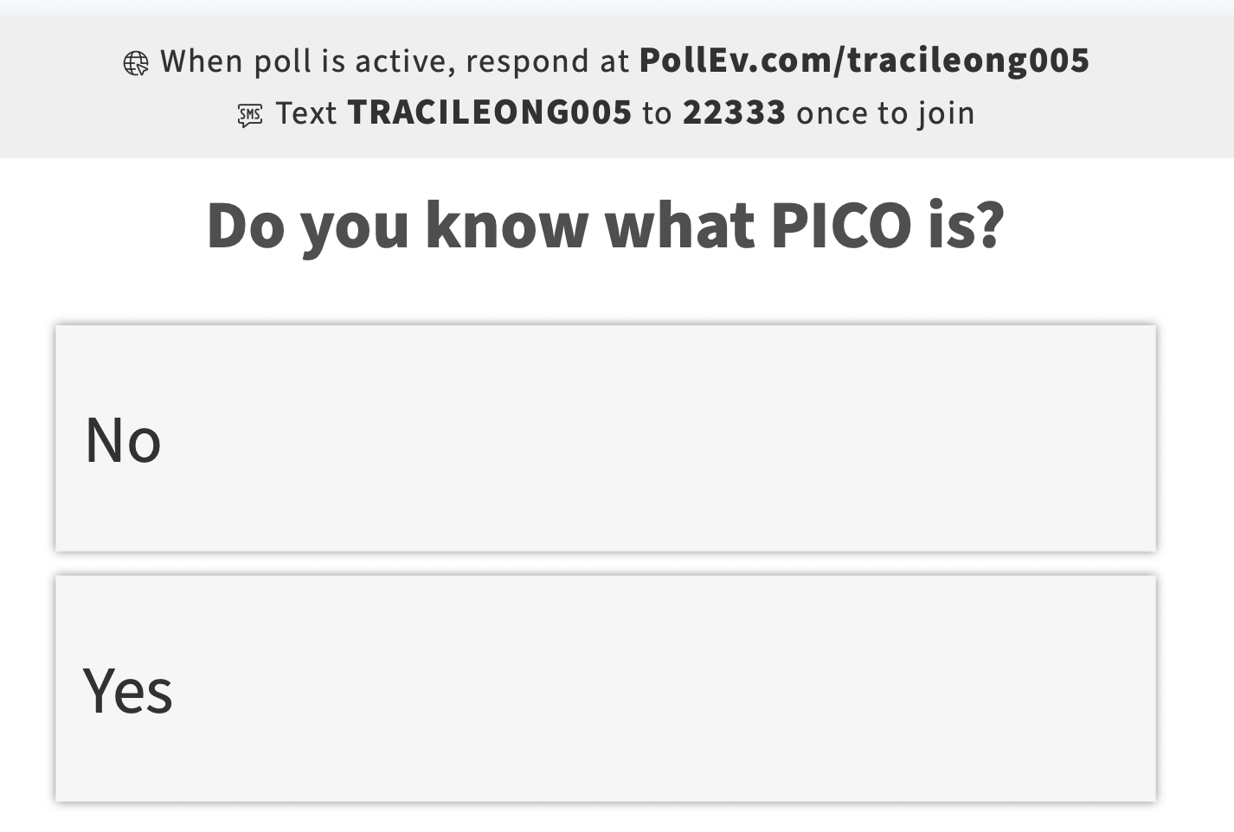
Survey to activate…. ‘A’ for No and ‘B’ for Yes

Slide 23
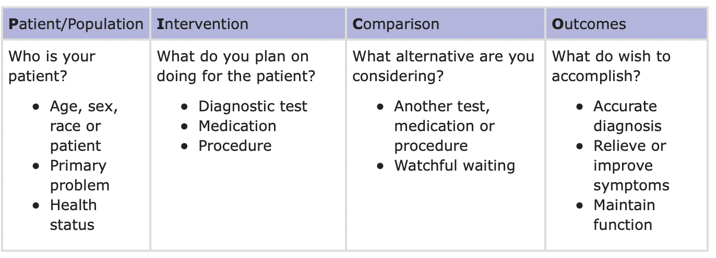
PICO model in Evidence based medicine

Slide 24
From week 1 to week 2
Ultimate goal of clinical trial is to establish safety and effectiveness of an intervention on a target population
Safety is straightforward to define
How do you define ‘effectiveness’?
Would ‘effectiveness’ for Acute Leukemia be the same as Autism?

Slide 25
Primary vs. Secondary Question
Primary
most important, central question
ideally, only one
stated in advance
basis for design and sample size
Secondary
related to primary
stated in advance
limited in number

Slide 26
Example: Physicians Health Study (PHS)
Testing 2 primary hypotheses (prevention) in healthy US males physicians (example of factorial design)
Aspirin vs placebo
Primary: cardiovascular mortality
Secondary: fatal + nonfatal myocardial infarction (MI)
Initial study conducted for aspirin’s MI indication

Slide 27
Examples: Eastern Cooperative Oncology Group (ECOG - 1178)
Adjuvant breast cancer in elderly women
tamoxifen vs. placebo
primary: tumor recurrence/relapse, disease-free survival
secondary: total mortality

Slide 28
Example: Chronic Study of Intermittent Positive Pressure Breathing (IPPB)
A multicenter trial compared intermittent positive pressure breathing (IPPB) therapy with compressor nebulizer therapy in 985 ambulatory patients with chronic obstructive pulmonary disease.
primary: forced expiratory volume (FEV₁) (lung function)
secondary: quality of life

Slide 29
A-HEFT
1050 African Americans with Class III-IV CHF
Isosorbide Dinitrate + Hydrolyzine vs. Placebo
Composite outcome (death, HF hospitalizations, change in QoL)
DMC terminated trial early
Notes:
Ref: NEJM, Nov 11,2004

Slide 30
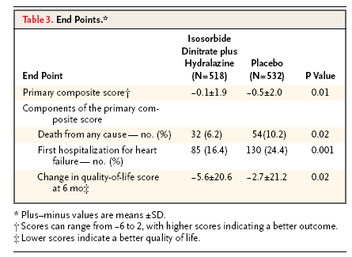
A-HEFT

Slide 31
Secondary outcomes CAN include Subgroup Questions
Questions about effect of therapy in a sub-population of subjects entered into the trial
Assess internal consistency of results
Confirm previous hypothesis
Generate new hypotheses

Slide 32
Subgroup Analyses
Examples:
Breast Cancer: Does the benefit of treatment depend on: menopausal status, stage of disease, age, etc.
AIDS: Does the benefit of treatment depend on: gender, age, initial CD4 counts, race, etc.
Analyses of a trial by subgroup results in a separate statistical test for each subgroup. As a result the probability of false positive conclusions arising in the analysis of a trial will increase.

Slide 33
False Positive Rates
The greater the number of subgroups analyzed separately, the larger the probability of making false positive conclusions.
How does this affect the interpretation of the clinical trial?
# subgroups | Pr (at least 1 false positive)
1 | .05 (What is this called?)
2 | .097
3 | .143
4 | .186
5 | .226

Slide 34
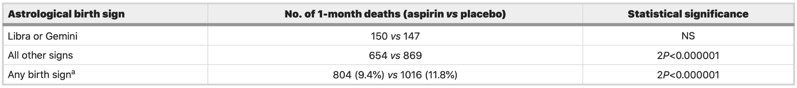
Example - Subgroup Concern
Second International Study of Infarct Survival (ISIS 2)
2 x 2 factorial design
(aspirin vs. placebo and streptokinase vs. placebo)
vascular and total mortality in patients with an acute myocardial infarction (MI)
Gemini or Libra astrological birth signs did somewhat worse on aspirin while all other signs and overall results impressive and highly significant benefit from aspirin

Slide 35
Subgroup Considerations-No ‘fishing'
Rules for Subgroups
1. Stated in advance (in protocol)
2. Limited in number
3. Interpreted cautiously, qualitatively
4. Look for consistency of results
May be used to
1. Confirm or answer specific questions generated in a previous trial (e.g. Metroprolol <65 vs. >65 age total mortality
2. Generate new hypothesis to be tested in some future trial
3. Consistency of primary outcomes

Slide 36
What kind of outcome is safety or Adverse Effects?
Depending on the phase of clinical trial, this outcome can be primary or secondary.
HOWEVER, any intervention should do more benefit than harm
Not always easy to specify in advance
Many variables will be measured (clinical, laboratory)
Some are not measured objectively (e.g. QOL)
Usually not willing or interested in demonstrating an intervention to be harmful
May be known adverse effects from earlier trials

Slide 37
Adverse Events
Challenges
Short term vs longer term
Longer term follow-up in face of early benefit
Rare AEs may be seen only with very large numbers of exposed patients and long term follow-up
Recent Example – COX II s
Immediate pain reduction vs longer term increase in cardiovascular risk
Vioxx now withdrawn (see reading) & Celebrex (black box warning)

Slide 38
Black box warning
Black box warnings are the strictest labeling requirements that the FDA can mandate for prescription drugs.
For Celebrex: All prescription NSAIDs, like CELEBREX, ibuprofen, naproxen, and meloxicam, increase the risk of heart attack or stroke that can lead to death. This may happen early in treatment and may increase with increasing doses of NSAIDs and with longer use of NSAIDs.

Slide 39
Serious Adverse Events (SAEs)
Death
Life-threatening
Requires hospitalization

Slide 40
Serious Adverse Events (SAEs)
MUST be reported to regulatory agencies and IRBs
Clinical trial team defines ‘Life threatening’ SAE’s
What do you think that is based on?

Slide 41
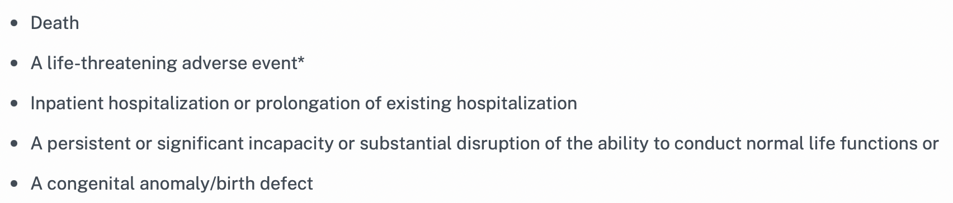
FDA definition

Slide 42
AEs, SAEs vs side effects?
It is important to know the difference
Is this a side effect or (serious) adverse event?
Nausea and Ibuprofen
Stroke and Ibuprofen
Adverse events are unintended pharmacologic effects that occur when a medication is administered correctly
Side effect is a secondary unwanted effect that occurs due to drug therapy
What do you quantify in a Phase II trial? In a Phase III trial? In a phase IV?

Slide 43
Other questions to answer in a clinical trial: Natural history
Question not related to intervention
Control group, often a “placebo,” may be used to describe how prognostic factors relate to eventual subject outcome (predictive, not causative)
Coronary Drug Project: Aided greatly in defining natural history of patients following a heart attack
Randomized, double-blind, fixed sample. A total of 8,341 patients were randomly assigned to six treatment groups consisting of 2.5 mg/day of conjugated estrogens, 5.0 mg/day of conjugated estrogens, 1.8 gm/day of clofibrate, 6.0 mg/day of dextrothyroxine sodium, 3.0 gm/day of niacin, or 3.8 gm/day of lactose placebo.

Slide 44
Ancillary questions
Questions not related at all but still of scientific interest
Usually piggy-backed onto trial
Must not interfere with trial!
Example: laboratory studies

Slide 45
Summary Exploratory questions
Most studies conducted to test some hypothesis
Most studies can generate new hypotheses
Multiple analyses often conducted
Y increased false positive (Type I) error rate
Could demand reduced significance level (or p-value) for each test
e.g. α/K (assuming independent variables)
α = .05, K = 10 → α/K =.005
But can’t afford this usually
Could be selective in number of primary hypotheses
Should state key comparisons in advance
Relegate other comparisons to either
Confirmatory or Exploratory

Slide 46
Outcome Assessment

Slide 47
What’s the Response Variable?
Used to answer primary/secondary questions
Characteristics for primary/secondary outcomes
1. Well defined & stable
2. Ascertained in all subjects
3. Unbiased
4. Reproducible
5. Specificity to question

Slide 48
Typical response variables by disease
Cardiovascular Disease Trials
Total mortality
CHD mortality (like PHS)
Non-fatal MI
Diabetes
Mortality
Glucose control
Visual impairment
Cancer
Tumor response
Tumor progression
Mortality
What type of data are the above?

Slide 49
What if you can’t measure what you want to measure?
HIV/AIDs is an immune disease. How do you measure your success in this disease?
What do you do if there is no direct way to measure an intervention?

Slide 50
Surrogate Response Variables
Used as alternative to desired or ideal clinical response
Examples
Suppression of arrhythmia (sudden death)
T4 cell counts (AIDS or ARC)
Used often - therapeutic exploratory
(Phase I, Phase II)
Use with caution - therapeutic confirmatory
(Phase III)

Slide 51
Surrogate Response Variables (2)
Frequent Criticism of Clinical Trials
Too long
Too large
Too expensive
Advantages
Perhaps smaller sample size
Detect earlier effect → shorter trial
According to AIDSinfo, it takes at least 10 years without treatment for most people with HIV to develop AIDS.
Do you want to wait for 10 years of followup to determine which HIV+ positive patient develops AIDS?
Easier

Slide 52
Examples of FDA Approval of Drugs Using Surrogates (1)
Lower cholesterol without evidence of survival benefit
Lower blood pressure without evidence of benefit for stroke, MI, congestive heart failure, or survival
Increase bone density without evidence of decreased fractures in osteoporosis
Today, change in biomarker level or tumor size on imaging studies (see reading)

Slide 53
From reading.. Image of surrogate approval for cancer
See figure on page 913
“.. the strength of association between the surrogate end point and OS is often absent or weak.”
HOMEWORK for this week:
Why do you think that FDA is relaxing its requirements for some cancer medications?
Do you agree that the FDA should do this? Why or why not?

Slide 54
Not just cancer: Examples of FDA Approval of Drugs Using Surrogates
Increase cardiac function in congestive heart failure without evidence of survival benefit
Decrease rate of arrhythmias (VPBs) without evidence of survival benefit
Lower blood glucose and glycosylated hemoglobin without evidence about diabetic complications or survival benefit

Slide 55
Concerns about Surrogates
Relationship between surrogate and true endpoint may not be causal, but coincidental to a third factor
Other unfavorable effects of the drug
Effect on surrogate may correlate with one clinical endpoint, but not others
How accurate are all the assumptions we have to make about surrogates?

Slide 56
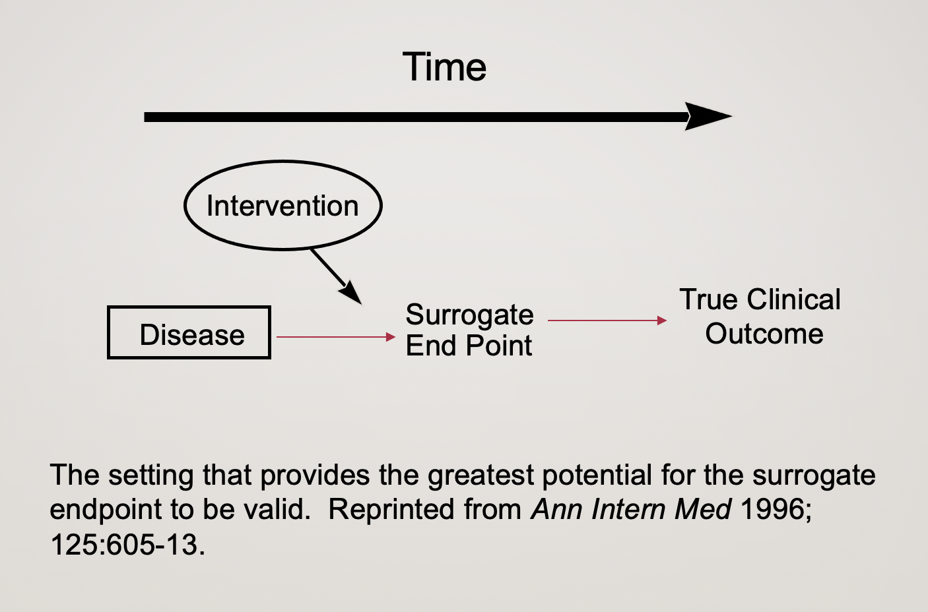
Surrogate relationship

Slide 57
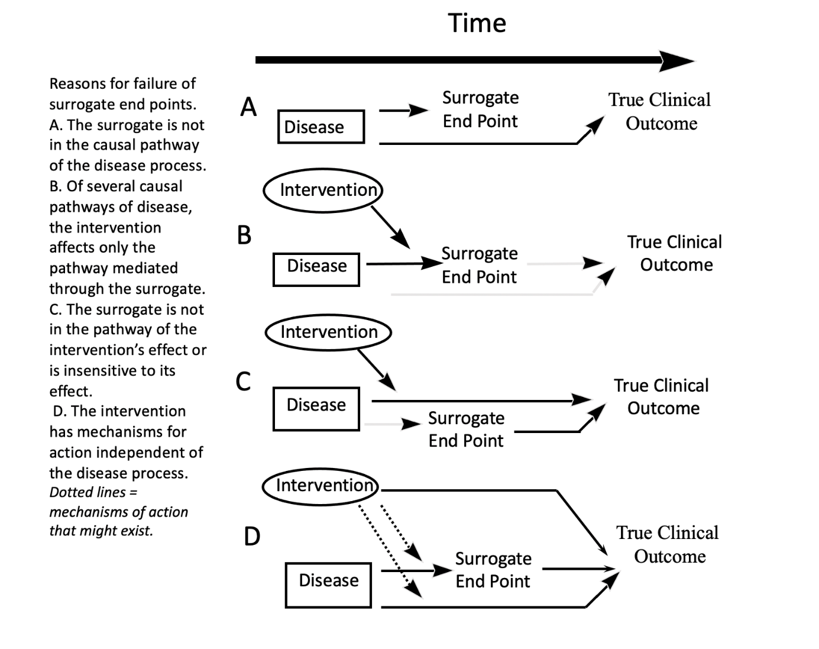
Surrogate relationship

Slide 58
Example AIDS Clinical Trials
Clinical Outcomes
Death
Progression to AIDS
Progression to ARC
Surrogate Outcome
CD4 Cell Count

Slide 59
Community program for Clinical research in AIDS
Comparative trial of ddl vs ddC
HIV infected patients, AZT intolerant
Randomized open label
467 patients
Primary outcome: Time to AIDS or death
Secondary outcome: changes in CD4 cell count

Slide 60
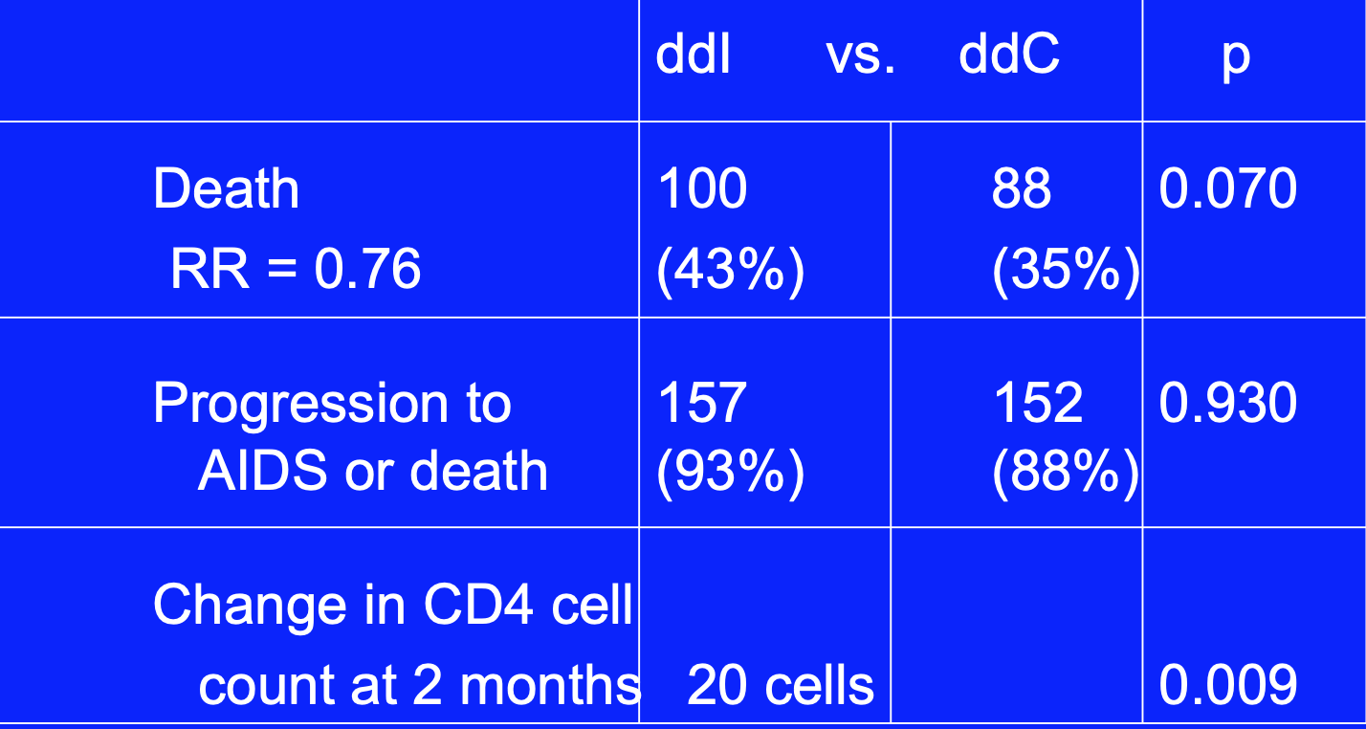
Results

Slide 61
State-of-the-Art Conference
Results
AIDS/Death
*8 trials positive
7/8 had positive CD4 cell changes
*8 trials negative
6/8 had positive CD4 cell change
Death
*4 trials positive
2/4 CD4 positive
*7 trials negative
6/7 CD4 cell positive

Slide 62
Concluding Remarks on Surrogates
Surrogates play an important role in the development of Phase I, II, and pilot Phase III studies
Treatments may affect more than one mechanism
“Surrogates” do not reliably predict treatment on clinical outcome
Reliance on “surrogates” should be minimized

Slide 63
Composite Outcomes
Defined as having occurred if any one of several components is observed
e.g. death, MI, stroke, change in severity,…..
Should be clinically relevant
Each component ascertainable without bias
Must be sensitive to intervention
Made up of fatal & nonfatal events

Slide 64
Composite Endpoint Rationale
May reduce Sample Size by increasing event rates
Assumes each component sensitive to intervention
Otherwise, power can be lost
Avoids competing risk problem
Death is a competing risk to all other morbid events, probably not independent

Slide 65
Problems with Composite Outcomes
Interpretability if individual components go in different directions
e.g. WHI global index–
Death: similar
Fractures: positive
DVTs, PEs: negative
Relevance of a mixed set of components
Adding softer outcomes
Could have a loss of power
Failure to ascertain components

Slide 66
Study Population

Slide 67
What Is The Study Population? (1)
Subset of the general population determined by the eligibility criteria
GENERAL POPULATION
eligibility criteria
STUDY POPULATION
enrollment
STUDY SAMPLE
observed

Slide 68
What is the study population
Defined by eligibility criteria
Define in advance
Characterize population
Impact of results
Replication of study
Biased sample does not imply biased trial!

Slide 69
The General Flow of Statistical Inference
Patient Population
Sample* Protocol Patients On Study
Observed Results
Inference about Population
*Sample of Opportunity: random or non-random?

Slide 70
The General Flow of Statistical Inference
Protocol
Entry
Criteria
Patient Population
Sample Patients On Study
Observed Results
C
B
A
Inference about Population

Slide 71
Who Should Be Studied?
Homogeneous vs. Heterogeneous
1. Well defined Can’t specify easily
2. Mechanism of action Don’t know if one group
known will respond differently
3. Don’t dilute results Easier subject recruitment
4. Infer results specifically Easier to generalize

Slide 72
Eligibility Criteria
Need to describe who we intend to study
State in advance
Precision related to importance
Consider
Potential for benefit
Homogeneous population
Heterogeneous population
Ability to detect benefit ⇒ High risk but not too high
No contraindications
No competing risk
Compliance likely
Impact
Generalization
Ease of recruitment
Risk or event rates

Slide 73
Recruitment
More difficult than anticipated
Yield not 100%
Eligibility criteria (age, prior history, prior treatment, etc.)
Exclusion Criteria
Physician Refusal
Patient Refusal
Many trials yield 10-15% randomized of those screened
Must be a team effort
Physicians
Nurses
Data Manager or Coordinator
Healthy Screening Effect ⇒ lower risk than expected!

Slide 74
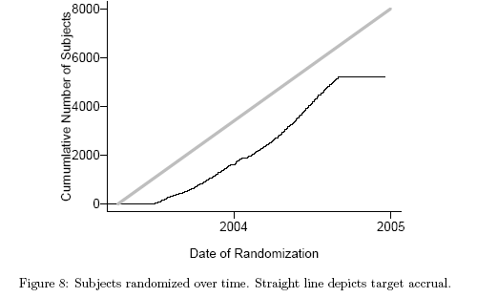
Accrual Tracking

Slide 75
Summary Defining the Question
Defined carefully in advance
Must be clinically relevant
Prioritize into primary, secondary, …
Design built around primary question(s)
Eligibility criteria define population studied and inferences to be made
Surrogates desirable but risky
Need the relevant measure of efficacy (next week)

Slide 76
Homework
Read FDA Acceptance of Surrogate End Points for Cancer Drug Approval: 1992-2019
Answer few short questions

