Slide 1
Bios 520-Clinical Trials-Sample size and Implications
March 2, 2023

Slide 2
Outline
Syllabus update
Final exam guide.. Review day?
Survey
Lecture
Time to event
Non compliance: When sample size is not the end of the design story

Slide 3
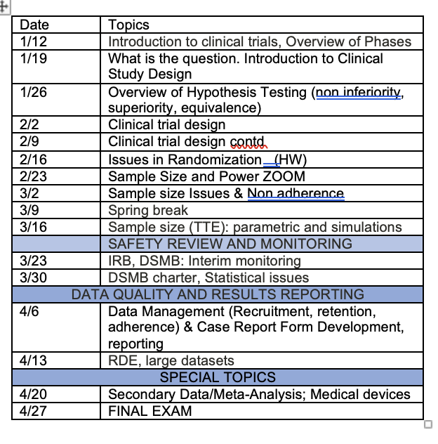
Timeline update

Slide 4

True randomization story
70 patients is calculated sample size for medical device vs sham control for pediatric Enuresis
This condition affects twice as many boys as girls
Age can be an important factor since most kids ‘grow out of it’
The investigator wants a stratified randomization to include sex (M vs F) and age (<7yr, $≥$7 yrs).
Would you recommend or not recommend? Why?

Slide 5
Last week review
Calculated sample size for proportions/rates and continuous data
We based the sample size on the statistical test we would use

Slide 6
Quantitative Outcomes-Time to event
To compute sample size for time to event data, we need the same parameters as we did last week:
Alpha
Beta
Statistical test
Power
Effect size
Here the effect size is not mean or proportion
AND we have to make patient enrollment distribution assumptions

Slide 7
Comparing Time to Event Distributions
Primary efficacy endpoint is the time to an event
Compare the survival distributions for the two groups
Measure of treatment effect is the ratio of the hazard rates in the two groups, ratio of the medians, or specific instances in survival distribution
Must also consider the length of follow-up

Slide 8
Hazard ratio/rate/function
Before we do an example of sample size calculation, review of hazard ratio
The hazard function h(t) is NOT the probability that the event (such as death) occurs at time t or before time t
h(t)dt is approximately the conditional probability that the event occurs within the interval [t, t + dt] given that the event has not occurred before time t.
Hazard function=conditional density, given that the event in question has not yet occurred prior to time t or instantaneous risk of death/event

Slide 9
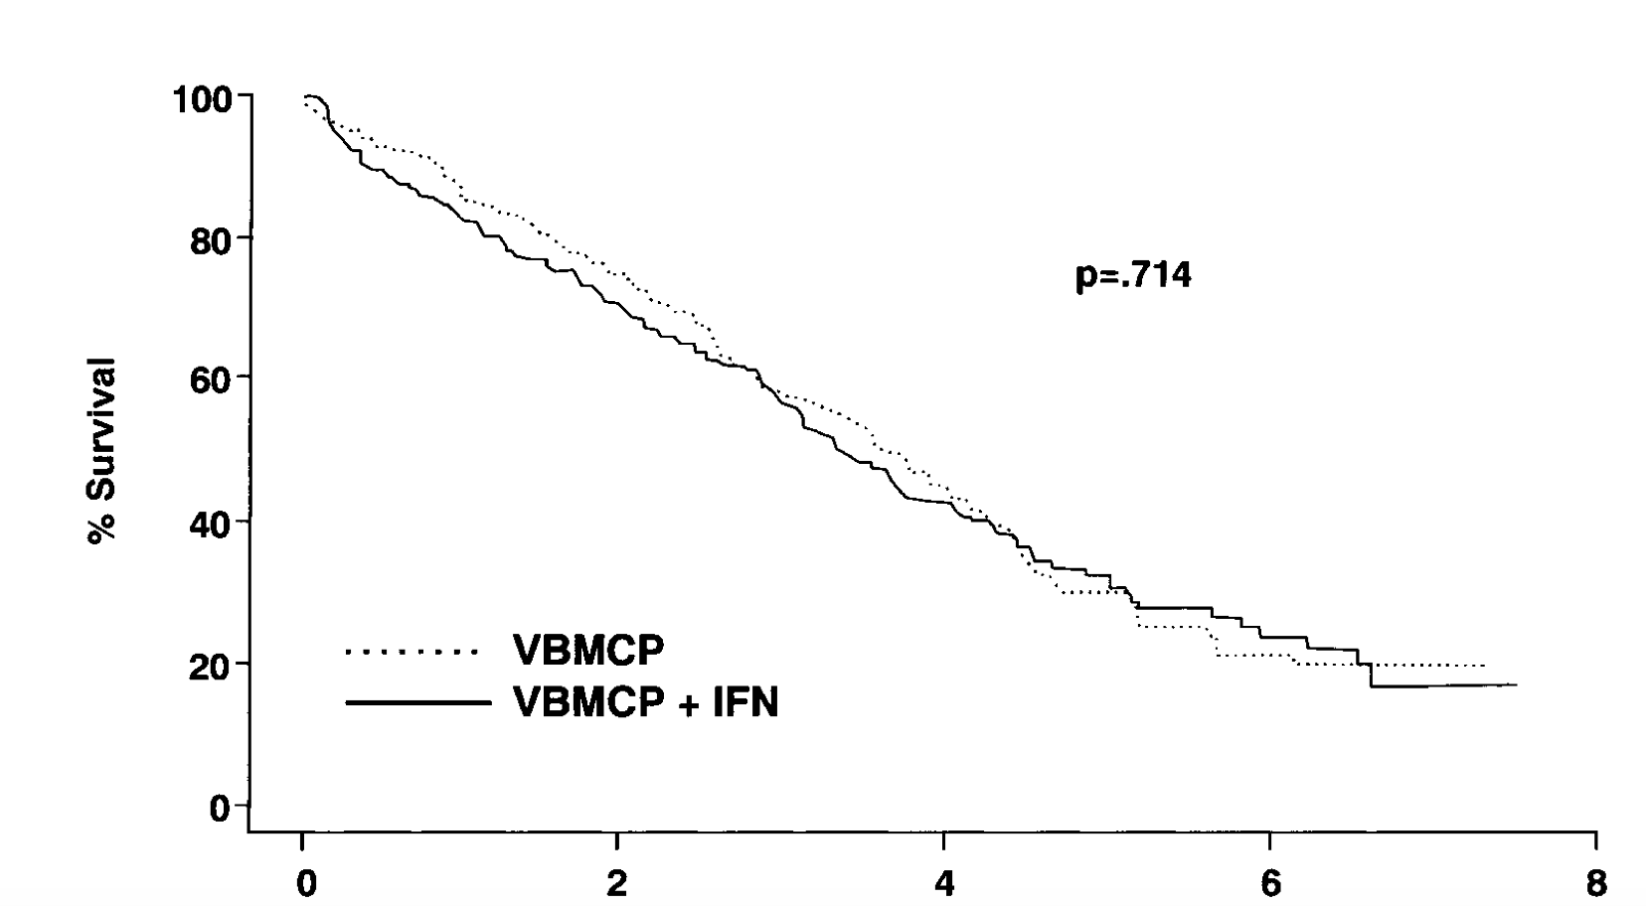
Comparing survival curves-non parametric

Slide 10
Assuming Exponential (parametric!!) Survival Distributions
Then define the effect size by
Standard difference

Slide 11
Exponential approximation
The main idea behind George & Desu’s (later slide) approach is to assume constant hazards (i.e., exponential distributions) for the sake of simplicity
Power/sample size one obtains from assuming constant hazards is fairly close to the empirical power of the log-rank test, provided that the ratio between the two hazard functions is constant
Typically in a power analysis, we are simply trying to find the approximate number of subjects required by the study, and many approximations/guesses are involved, so using formulas based on the exponential distribution is usually good enough

Slide 12
Impact (?) of censoring on sample size
The exponential distribution, therefore, has the somewhat remarkable property that we arrive at the exact same inference if we follow d subjects until all have failed or if we follow some larger number n until d have failed
Thus, we can carry out our calculations ignoring censoring, provided that we think of the sample size we obtain as the number of events that must be observed in order to achieve the desired power
This is incredibly convenient for sample size planning, as it allows one to completely separate treatment effect concerns from censoring concerns

Slide 13
Time to Failure: No censoring
Use a parametric model for sample size
Common model - exponential
S(t) = e^{-λt} λ = hazard rate
H₀: λ_{I} = λ_{C}
Estimate N (per group sample size)
Assumes all patients followed to an event
(no censoring)
Notes:
George & Desu (1974)

Slide 14
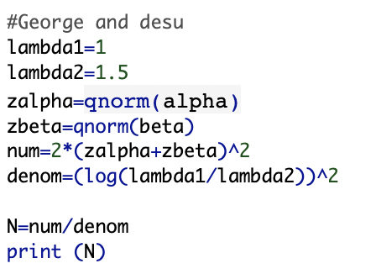
How to calculate
Plugging you get per group N=104.1818
Lambda1 and lambda2 don’t need to be explicit
What will happen to sample size if lambda2=2?

Slide 15
Assuming Exponential Survival Distributions
Re-writing previous formula
The statistical test is powered by the total number of events observed at the time of the analysis, d.
Denominator is our ‘difference to detect’

Slide 16
What do you think d is from last example?
We showed 104.1818 per group in slide 12.
What do you think d is?

Slide 17
We need example WITH censoring
Not realistic to design study without censoring

Slide 18
QUANTITATIVE OUTCOMES TIMES TO EVENTS
Let λ₁ = hazard rate anticipated in group 1.
Let λ₂ = hazard rate anticipated in group 2.
Δ = λ₁/λ₂
α, β are defined as usual

Slide 19
EXAMPLE
Suppose we anticipate that λ₁ = 1.0 in our treated group and λ₂ = 1.75 in our control group. We want to calculate the number of patients necessary to detect this difference at the 0.05 level with power of 90%.

Slide 20
Example using Hazard rates
Suppose we anticipate that λ₁ = 1.0 in our treated group and λ₂ = 1.75 in our control group. We want to calculate the number of patients necessary to detect this difference at the 0.05 level with power of 90%.
Using the formula in slide 14, we will need to observe D=110 events over the course of the trial. Thus we will need to enroll a sufficient number of patients in order to yield 110 events during the trial.

Slide 21
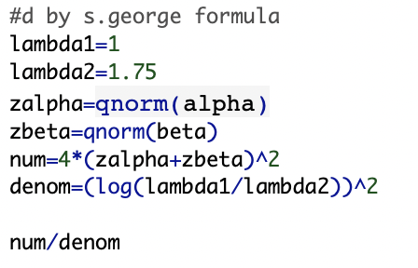
Computation
See R below D=109.3828…we will need to observe D=110 events
How many patients to enroll?

Slide 22
From events to patients
Suppose that previous studies have suggested that approximately 30% of subjects remain event free at the end of the trial.
The number of subjects necessary then is D/Probability of event
2n = 110/(1 - 0.3) = 158

Slide 23
You don’t need to know λ directly
Note that we do not even need to specify λ1 and λ2 to calculate power and sample size: we only need their ratio, ∆
Furthermore, note that for the exponential distribution, the median survival time is λ⁻¹ log 2
Thus, the effect size can be equivalently thought of as a ratio of median survival times, rather than a hazard ratio, which in my experience is convenient as non-statisticians typically prefer to think in terms of median survival times than hazards

Slide 24
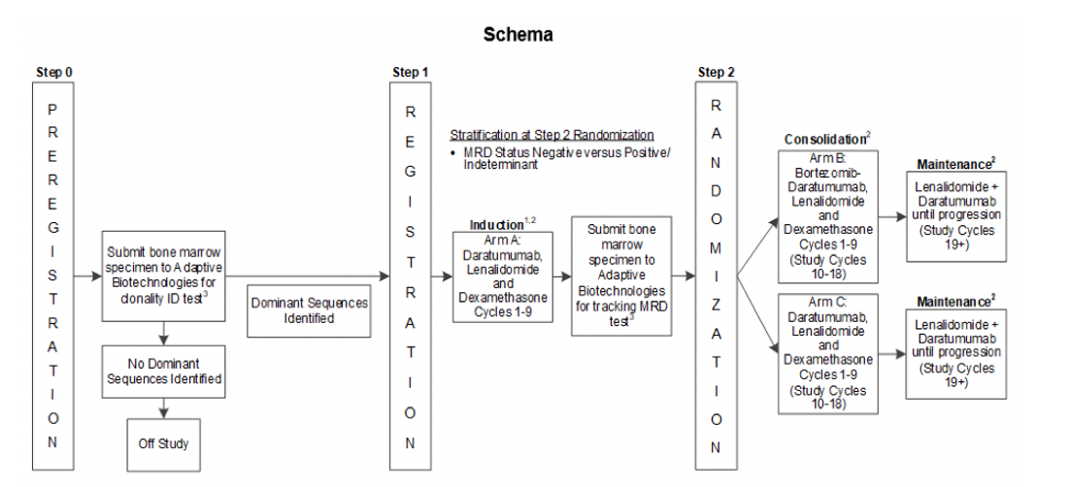
Ex: Participants not followed until event
Example: Patients not followed until the event

Slide 25
Time to failure issues that affect sample size
In most clinical trials:
Not all patients are followed to an event (ie censoring)
Patients are recruited over some period of time (ie staggered entry)
Why will your sample size increase

Slide 26
More General formula (Lachin, 1981)
where g(λ) is defined in following slide…..

Slide 27
1. Instant Recruitment Study Censored At Time T
2. Continuous Recruiting (O,T) & Censored at T
3. Recruitment (O, T₀) & Study Censored at T (T > T₀)

Slide 28
Example
Assume α = .05 (2-sided) & 1 - β = .90
λ_{C} = .3 and λ_{I} = .2
T = 5 years follow-up (i.e. 5 yr study)
T₀ = 3
0. No Censoring, Instant Recruiting
N=128
1. Censoring at T, Instant Recruiting
N=188
2. Censoring at T, Continual Recruitment
N = 310
3. Censoring at T, Recruitment to T₀
N = 233

Slide 29
When we don’t have hazard rates
Median survival
Survival times

Slide 30
Why do we use median vs mean survival times?
The median survival time is defined as the value at which 50% of the individuals have longer survival times and 50% have shorter survival times.
The reason for reporting the median survival time rather than the mean survival time is because the distributions of survival time data often tend to be skewed, sometimes with a small number of long- term ‘survivors’.
Another reason is that we can not calculate the mean survival time for the survival time with censored data.

Slide 31
Definition of Mean Survival time
Mean time to an event is estimated by the area under the survival function. If the largest time is an event time, then the survival function will go to zero.
If subjects survive beyond the study time, survival curve does not go down to zero and the mean time cannot be estimated.

Slide 32
Review: How to calculate median survival
If there are no censored data, the median survival time is estimated by the middle observation of the ranked survival times.
In the presence of censored data the median survival time is estimated by first calculating the Kaplan-Meier survival curve, then finding the value of survival time when survival rate=0.50 (50%)

Slide 33
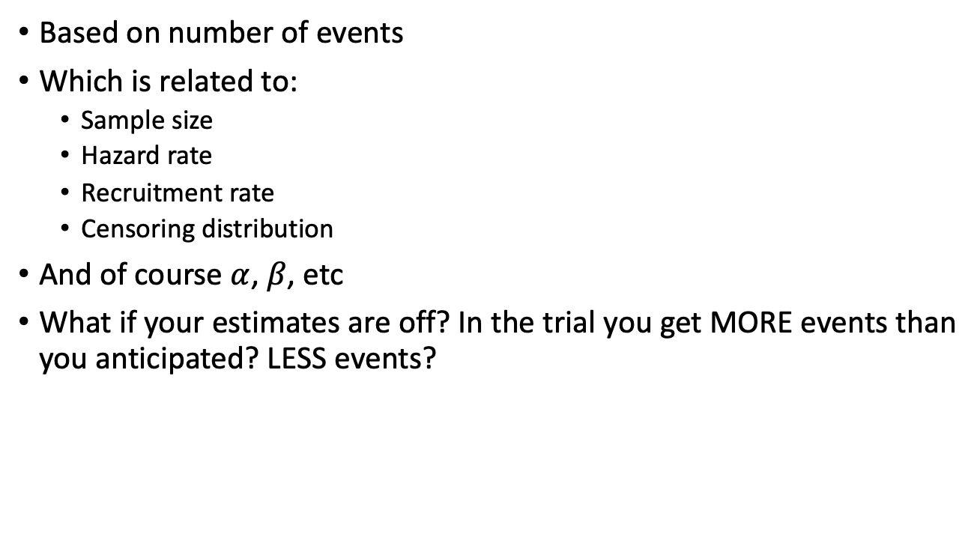
Review Statistical power
Based on number of events
Which is related to:
Sample size
Hazard rate
Recruitment rate
Censoring distribution
And of course $α$, $β$, etc
What if your estimates are off? In the trial you get MORE events than you anticipated? LESS events?

Slide 34
Biliary Atresia example
Biliary atresia occurs in 1:5000 to 1:18 000 live births and progresses to end-stage cirrhosis in more than 70% of affected children and leading cause for liver transplants in the world
Randomized study proposed to compare a new drug with the current standard of care.
With our primary objective is survival of native liver (SNL) at 2 years, we make several assumptions in order to calculate sample size such as time to loss of native liver is exponentially distributed with a constant hazard rate. We also assume the following:
Up to 3 yrs of enrollment
Up to 3 yrs follow up
50% have native liver at 2 yrs
How many patients are needed?

Slide 35
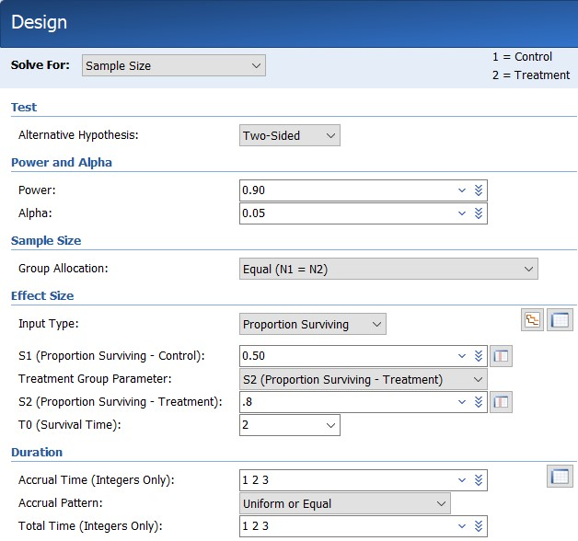
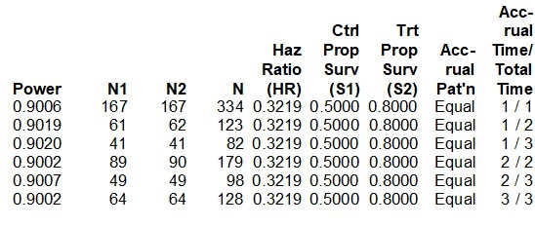
Results using PASS software

Slide 36
Computer Resources
Besides R (e.g. TrialSize package) and SAS (proc power), they are several computer programs that can aid in sample size calculation
PASS ($$$)
Nquery ($$$)
G*Power

Slide 37
PASS
Many data analysts use PASS to perform sample size and power calculations because it is relatively easy to use.
http://www.ncss.com/software/pass/
The software is expensive. There is, however, a 7-day trial-version.
The software also comes with full documentation.

Slide 38
Final thoughts
Note Formula for events or subjects.
You may also need to inflate this number to account for study dropouts. You will usually need to increase n for non-adherence, loss to follow-up, etc. (to be discussed later in class)
You will also need to figure out how many patients you will need to approach in order to derive the number you need to randomize.
Sample size is influenced by
accrual time
duration of follow-up

