Slide 1
Bios 520-Clinical Trials-Time to event Sample size and Equivalence
March 16, 2023

Slide 2
Outline
Housekeeping
Graders
Review session
Solutions on canvas
Last homework
Calendar
What have we done up until now?
Today’s lecture-2 parts-different but related

Slide 3
Calendar
Last homework assigned (due April 6)
Review April 22. Not recorded. 1-3pm
Final April 27 1-3pm

Slide 4
Review
Sample size formula have same basic components
Survival trials are more complicated due to additional assumptions:
Enrollment duration and distribution
Follow up duration
We calculated # events (i.e. deaths) and then inflated from there
Nature of estimate was emphasized but now TIME is a factor

Slide 5
What are we doing today?
The assumptions we made were based on the exponential distribution
We will expand on the previous lecture by:
Showing software (commercial, SAS, R) that accounts for enrollment and follow up time
Deviations from exponential distribution
Changing hypotheses to equivalence and non-inferiority

Slide 6
Biliary Atresia example
Biliary atresia occurs in 1:5000 to 1:18 000 live births and progresses to end-stage cirrhosis in more than 70% of affected children and leading cause for liver transplants in the world
Randomized study proposed to compare a new drug with the current standard of care.
With our primary objective is survival of native liver (SNL) at 2 years, we make several assumptions in order to calculate sample size such as time to loss of native liver is exponentially distributed with a constant hazard rate. We also assume the following:
Up to 3 yrs of enrollment
Up to 3 yrs follow up
50% have native liver at 2 yrs
How many patients are needed?

Slide 7
What is needed for Sample Size for Survival Analysis
median survival (or other parameter) for both treatment and placebo groups
accrual rate
follow-up period
significant level = alpha
power = 1 - beta

Slide 8
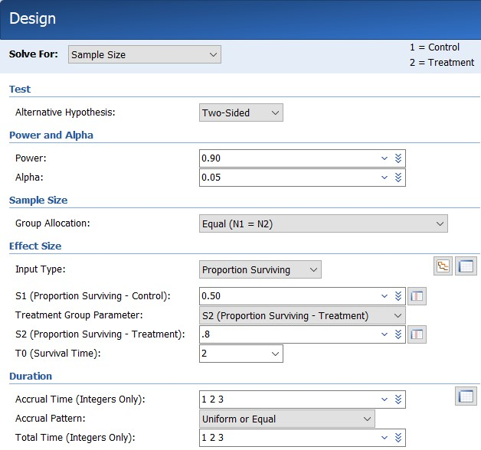
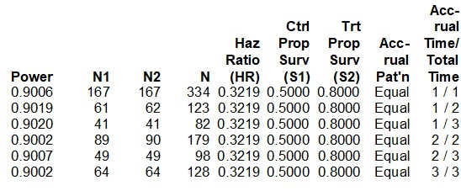
Results using PASS software

Slide 9
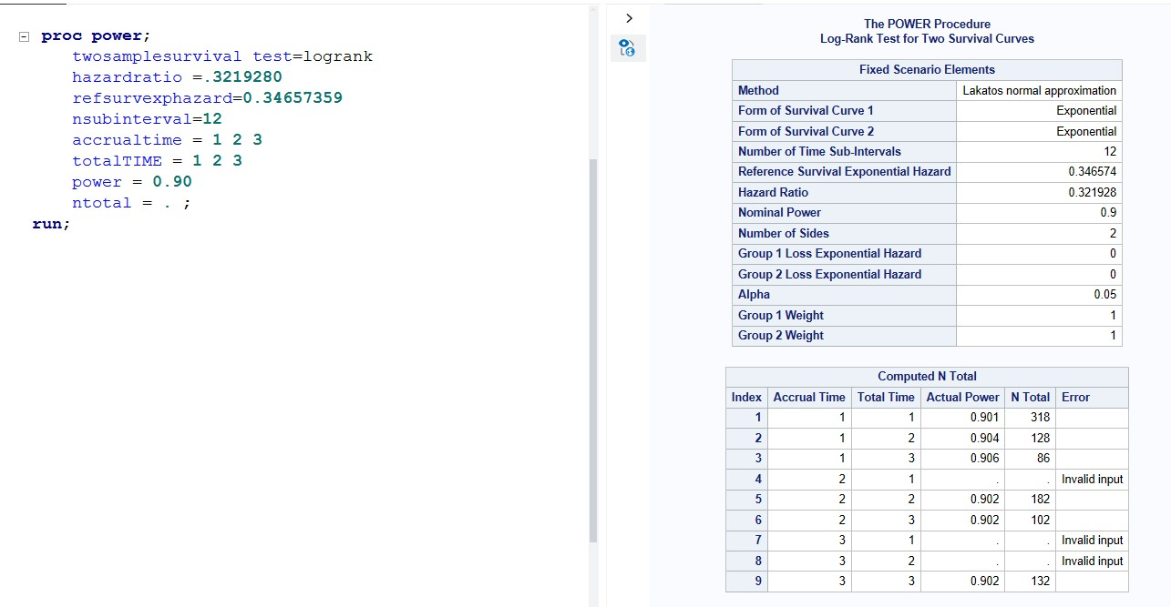
Results via SAS

Slide 10
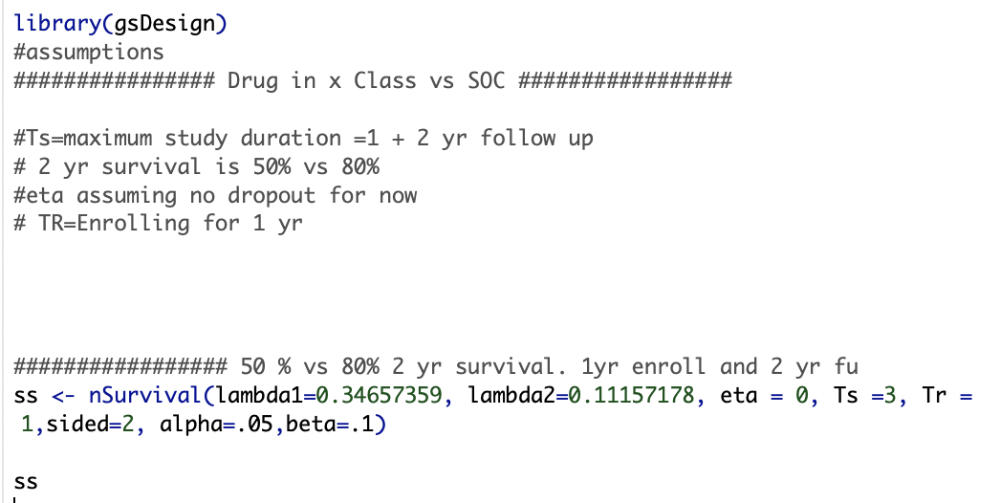
Results via R

Slide 11
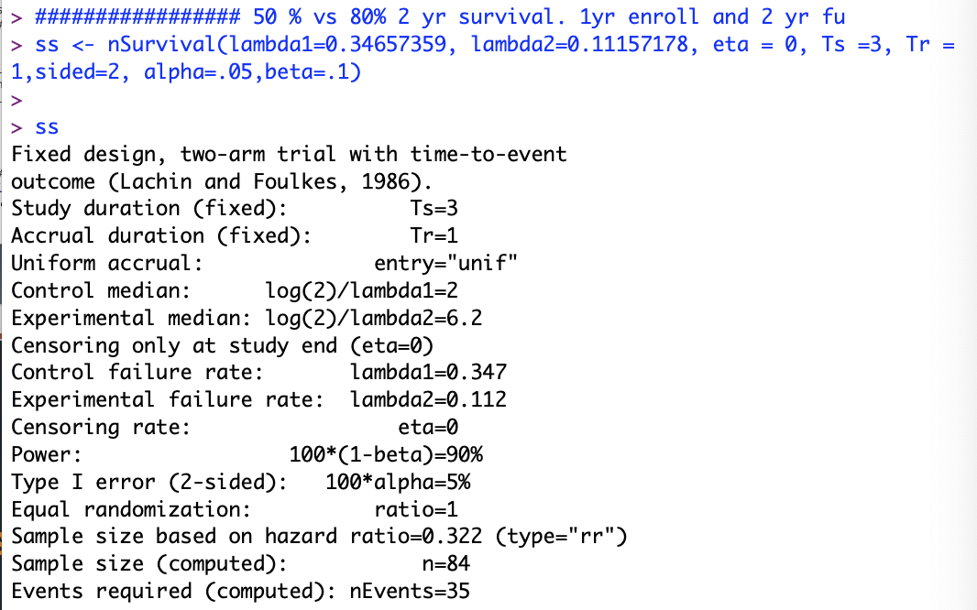
R results

Slide 12
Let’s summarize
Assuming 1 yr enrollment; 2 years of follow up
Why do you think the numbers are not the same?
Software | Sample size
Pass (commercial) | 82
SAS | 86
R | 84

Slide 13
When you don’t have all of the parameters
Original study hypothesis did not include the hazard ratio or reference hazard
Many times you need to utilize survival relationships in order to use software programs

Slide 14
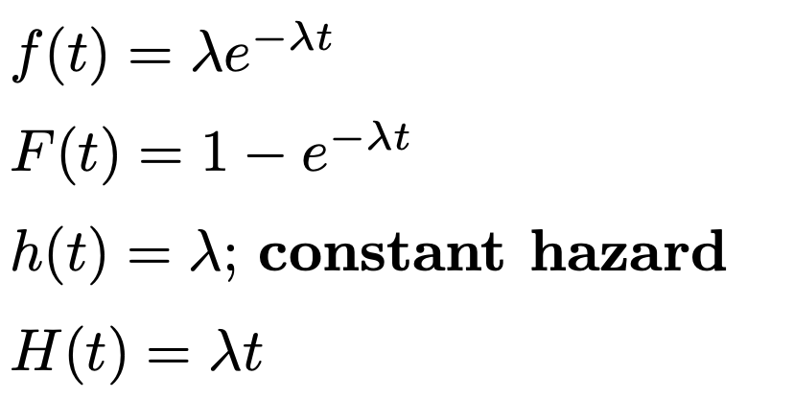
How to calculate by hand
Even with software, it is important to understand relationships

Slide 15

Putting relationships together
The probability of surviving the first t years is S(t)=e⁻$λt$
The mortality (probability of an adverse event during the first t years) is 1-S(t) or 1- e⁻$λt$
For an exponential distribution, the mean survival is 1/$λ$, and the median is ln(2)/$λ$.
The median survival time is transformed to a hazard rate using the relationship $λ$=ln(2) / Median
Proportion surviving until a given time T0 is specified. The proportion surviving is transformed to a hazard rate using the relationship $λ$ = –ln(S(T0)) / T0.

Slide 16
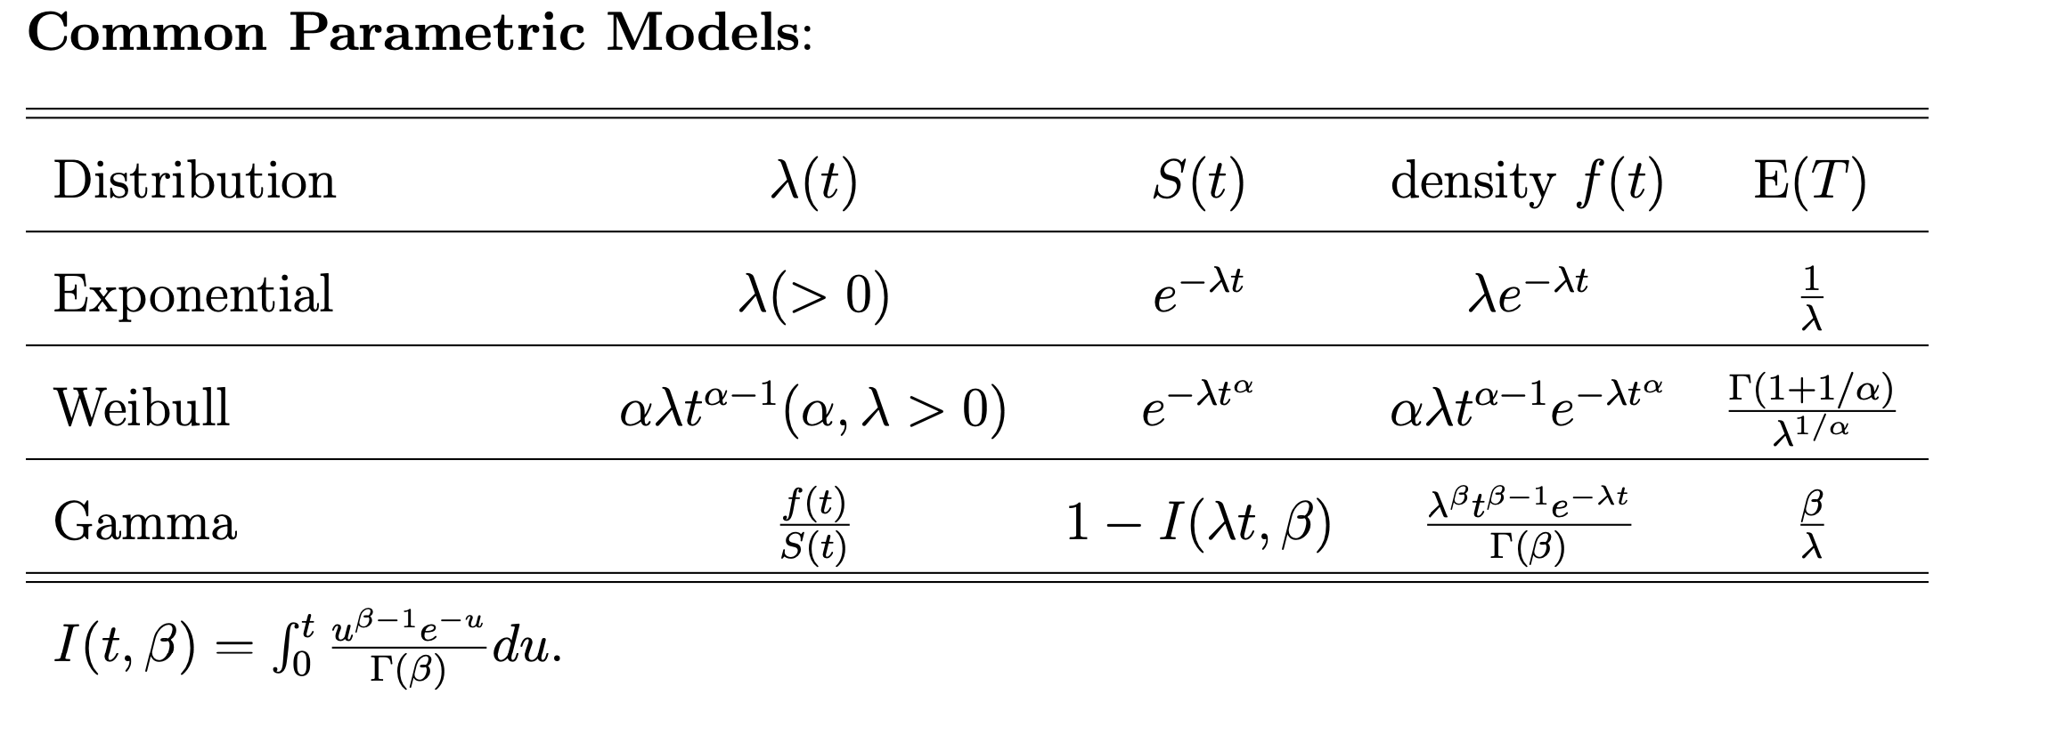
Distributions
There are several distributions that characterize time to event data
Under exponential distribution, median and hazard can be derived from one another

Slide 17
Computer Resources
Besides R (e.g. TrialSize, gsDesign package) and SAS (proc power), they are several computer programs that can aid in sample size calculation
PASS ($$$)
Nquery ($$$)
G*Power
Many websites calculators

Slide 18
Final thoughts on survival sample size
Calculating ‘D’ is going to be one of the more relevant estimates
The actual SS may differ from person to person so ensure REPRODUCIBILITY
D is based on the study assumptions but based on what happens over time, the final sample size can differ

Slide 19
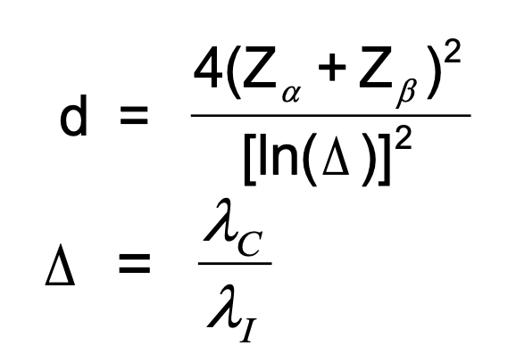
From last time: Calculating ‘D’

Slide 20
Not all survival distributions are exponential
Weibull another used distribution
Not discussed but possible: gamma,lognormal, gamma/exponential conjugate, accelerated failure time model
Weibull distribution sometimes more appropriate because it includes the shape parameter (p in next slide) in addition to the scale parameter lambda
Shape p =degree of acceleration (>1) or deceleration (<1)
In advanced stage cancer studies, the survival rate usually dramatically drops towards the end of the study-better approximated by a Weibull distribution.

Slide 21
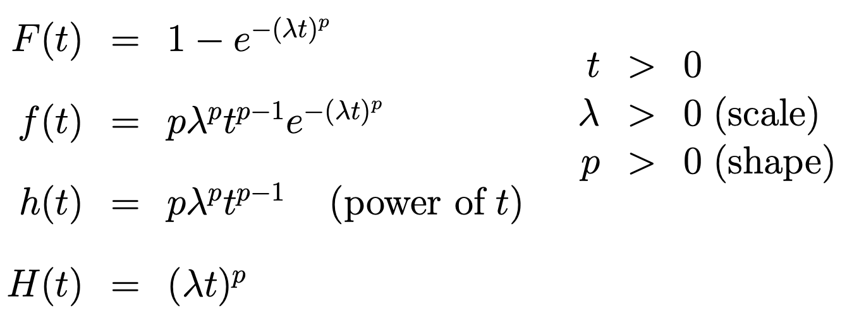
Weibull is generalization of exponential

Slide 22
Hypotheses

Slide 23
Motivation
FDA’s regulations on adequate and well-controlled studies describe four kinds of concurrently controlled trials that provide evidence of effectiveness.
placebo
no treatment
dose-response controlled trials
These designs are superiority trials that seek to show that a test drug is superior to the control (placebo, no treatment, or a lower dose of the test drug).

Slide 24
Motivation
The 4th type of study:
Comparison with an active treatment (active control)
To show that the new drug is more effective than the control, superiority design
More commonly: to show that the difference between the new and active control treatment is small — small enough to allow the known effectiveness of the active control, based on its performance in past studies and the assumed effectiveness of the active control in the current study, to support the conclusion that the new test drug is also effective.

Slide 25
Equivalence vs Non inferiority
Active controlled trials that are not intended to show superiority of the test drug but rather to show that the new treatment is not inferior to an unacceptable extent were once called clinical equivalence trials.
The intent of an NI trial, however, is not to show that the new drug is equivalent, but rather that it is not materially worse than the control. Therefore, the interest is one-sided. The new drug could be better than the control, and therefore at a minimum non- inferior, but it would not be equivalent.
In an NI study, the goal is to demonstrate that the test drug has an effect by showing that its effect is sufficiently close to the effect of an active control.

Slide 26
The risk you take….
Treatment A vs Treatment B. Superiority study. If you see a difference, then that is the end of the conversation
Treatment A vs Treatment B. Non inferiority study. If you detect a small difference BUT the effect of the active control arm is not clinically relevant, then the result is meaningless
For an NI trial to be interpretable, that the active control had its expected effect in the trial.

Slide 27
From FDA…
If the intent of the trial is to show similarity of the test and control drugs, the report of the study should assess the ability of the study to have detected a difference between treatments.
Similarity of test drug and active control can mean either that both drugs were effective or that neither was effective. The analysis of the study should explain why the drugs should be considered effective in the study, for example, by reference to results in previous placebo-controlled studies of the active control drug.
There is no placebo arm in the study; therefore, the effect of the active control is not measured in the study but must be assumed.

Slide 28
Types of hypotheses
Comparative Trial (a.k.a. Superiority Trial)
Objective: to demonstrate that a new therapy (n) is superior to standard therapy (s) in terms of incident outcome (I)
HO: In = Is HA: In < Is (one tailed) or HA: In ≠ Is (two tailed) at some minimally detectable ∆ judged to have clinical significance

Slide 29
Types of hypotheses
Equivalence (non-inferiority trial)
Objective: to demonstrate that a new therapy (n) is no worse than standard therapy (s) in terms of incident outcome (I)
HO: In > Is HA: In = Is at some ∆, the maximum tolerable difference considered to be clinically acceptable

Slide 30
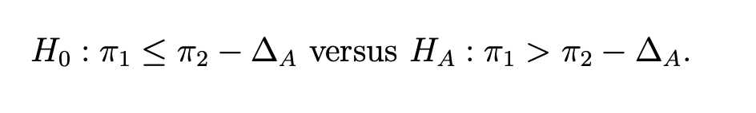

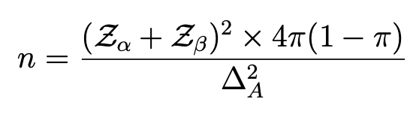
Sample Size formula
Let π2 denote the population response rate for the positive control, and π1 be the population response rate for the new treatment.
Or If we denote by the parameter ∆ the treatment difference π1 − π2, then the null and alternative hypotheses are
The null hypothesis corresponds to the new treatment being inferior to the positive control. tested against the alternative hypothesis that the new treatment is at least equivalent to the positive control.

Slide 31
Example
Suppose the clinical trial that was used to demonstrate that the positive control was significantly better than placebo had a 95% confidence interval for ∆ (treatment difference) that ranged from .10- .25. Conservatively, one can only be relatively confident that this new treatment has a response rate that exceeds the response rate of placebo by .10.
FDA will only allow a new treatment to be declared equivalent to the positive control if the company can show that their new drug has a response rate that is no worse than the response rate of the positive control minus .05. Thus they require a randomized two arm equivalency trial to compare the new drug to the positive control with a type I error of α = .05. The response rate of the positive control is about .30.
The company believes their drug is similar but probably not much better than the positive control. Thus, they want to have good power, say 90%, that they will be successful (i.e. be able to declare equivalency by rejecting H0) if, indeed, their drug was equally efficacious.

Slide 32
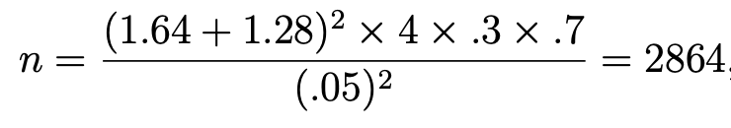
How many patients do we need?
Assuming a delta=.05
1432 patients per treatment arm
Is this the same thing as 30% vs 35% superiority study?

Slide 33
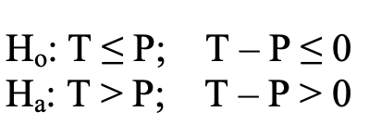
Superiority and interpretation
In a placebo-controlled trial, the null hypothesis (Ho) is that the beneficial response to the test drug (T) is less than or equal to the response to the placebo (P); the alternative hypothesis (Ha) is that the response to the test drug is greater than P.
In most cases, the test for a treatment effect corresponds to showing that the lower bound of the two-sided 95% confidence interval (equivalent to the lower bound of a one-sided 97.5% confidence interval) for T-P is > 0. This result shows that the effect of the test drug is greater than 0

Slide 34
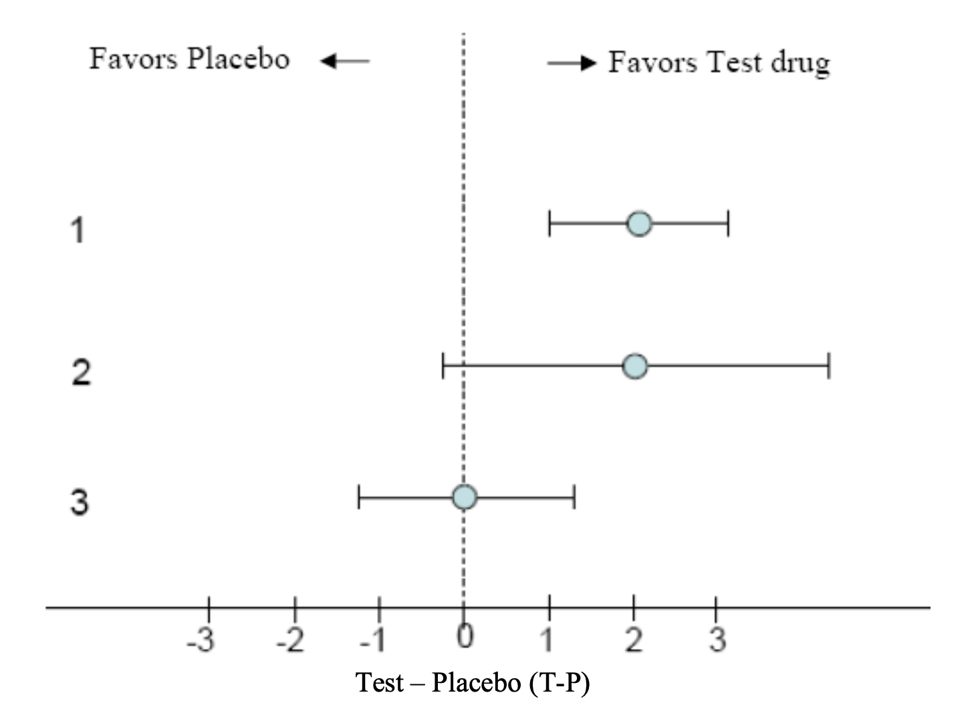
Possible Results of a Placebo-Controlled Superiority Study (Point Estimate and 95% Confidence Interval (CI))

Slide 35
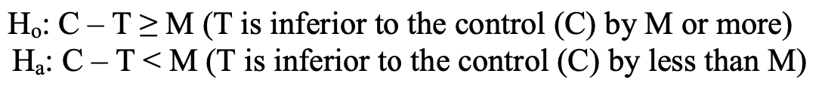
Non Inferiority hypothesis
The null and alternative hypotheses correspond to a null hypothesis of inferiority and an alternative hypothesis of non-inferiority, as follows:
A statistical test of the above hypothesis is provided by comparing the upper bound of the two- sided confidence interval for C-T with the NI margin, M, which is specified in advance.
If the upper bound is less than M, non-inferiority of T relative to C is established.

Slide 36
NI example
Post kidney transplant study of Belatacept vs standard maintenance
Design: Non inferiority study with eGFR as endpoint
Kidney function was measured every 2 months for 3 yrs
NI margin: 6mL/min/1.73m²

Slide 37
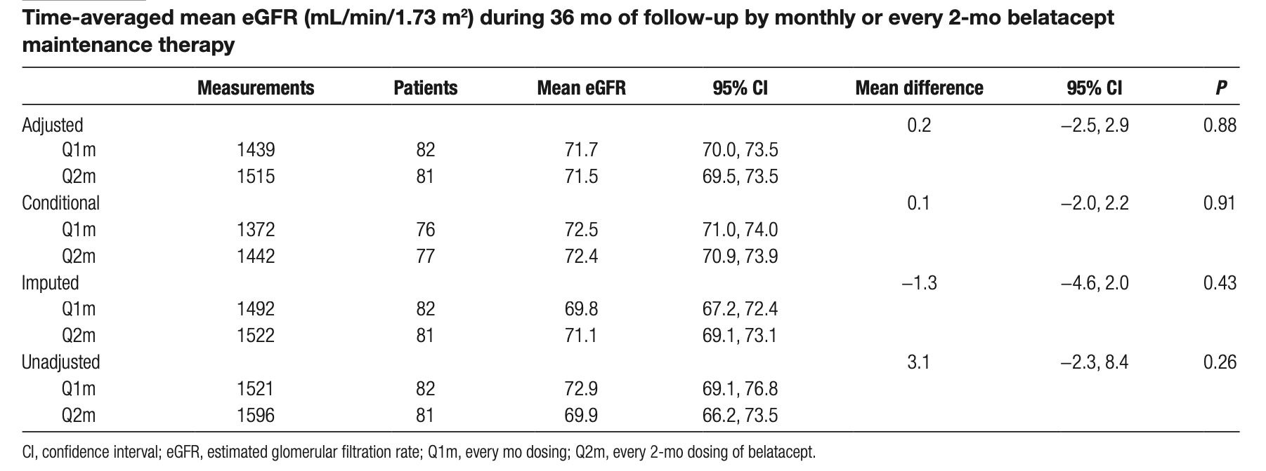
Example results
Adjusted (for baseline eGFR) was primary analysis.
So what is the conclusion?

Slide 38
So how to get the margin?
One choice for M (the largest possible value) is to set it equal to the entire known effect of the active control relative to placebo, based on past randomized controlled trials. With this choice for M, called M1, and assuming the control drug attains this level of efficacy in the NI study, a finding of non-inferiority means that the test drug has an effect greater than 0
A more usual choice is to set M equal to some clinically relevant portion of M1, namely, the portion of the control drug effect it is important to preserve with the test drug, based on clinical judgment.
M1 cannot be directly measured in the NI study, because there is no concurrent placebo group. It must be estimated based on the past performance of the active control, preferably in placebo-controlled trials, and then assumed to hold for the NI study based on a comparison of prior test conditions to the current test environment

Slide 39
Consequences of Margin M1
The smaller the margin, the lower the upper bound of the 95% two-sided confidence interval for C-T must be, and the larger the sample size needed to establish non-inferiority.
Showing that the upper bound of the 95% CI of C-T is less than M1 demonstrates that the test drug has some effect (i.e., an effect > 0).
The margin of interest, however, as noted above, is usually smaller than M1 (to show that an adequate portion of the clinical benefit of the control is preserved), in which case it is called M2.

Slide 40
Sample size implications
Important to plan the sample size for an NI clinical trial so that the trial will have adequate statistical power to conclude that the NI margin is ruled out if the test drug is truly non-inferior.
Both the size of the margin and the estimated variance of the treatment effect (T vs C) will affect the sample size determination.
What happens to power if the test drug is much better than control than you originally planned?
If the test drug is not much different?

Slide 41
Other differences of Superiority vs NonInferiority
Primary analysis of a randomized clinical superiority trial follows the intention-to-treat (ITT) principle
What does that buy you?
Avoid various biases from non adherence, switching treatment protocol violations, drop out, etc)
Why is this a conservative approach? Will the bias be towards the null or alternative?

Slide 42
Opposite is true for NonInferiority
Quality issues could result in treatment groups appearing similar (i.e., biasing the results towards the alternative hypothesis for NI trials), when, in fact, the test drug may be inferior
Many problems that may cause a superiority trial to fail, such as non-adherence, misclassification of the primary endpoint, or attrition, can bias the results toward no treatment difference (success) and undermine the validity of the trial, creating apparent non-inferiority when the test drug is in fact inferior.
Imputation of missing data under the inferiority null hypothesis is one possible approach to countering the bias due to attrition.

Slide 43
Motivation of equivalence
Sometimes a new therapy may bring certain advantages over the current standard maybe with reduced side-effects profile, easier administration or cost.
Nevertheless, it may not be anticipated to be better with respect to the primary efficacy variable.
Under such conditions, the new approach may be expected to be at least ‘equivalent’ to the standard in relation to efficacy.

Slide 44

Is equivalence the same as non-inferior?
Specify some $δ$ where interventions with less than this difference might be considered equally effective
H0: |$γ\text{SOC}$- $γ\text{New}$|>$δ$ , $δ$>0
H1: $γ\text{SOC} =γ\text{New}$. (indicates equivalence)
Non inferiority has same null but alternative can indicate a superiority of SOC but the difference is too small to detect without large trial.
H1: |$γ\text{SOC}$- $γ\text{New}$|$≤$ + $δ$ Non-inferiority trials aim to show that the new drug is no worse than standard treatment. Equivalence trials aim to show the new treatment is no better and no worse.

Slide 45

Equivalence formula
Trick is… what is $δ$?
Sometimes there are governmental guidelines:
The acceptance criteria between the instruments require that the 95% confidence interval be within ±12% for method comparison and bias, and ±10% for precision.

Slide 46
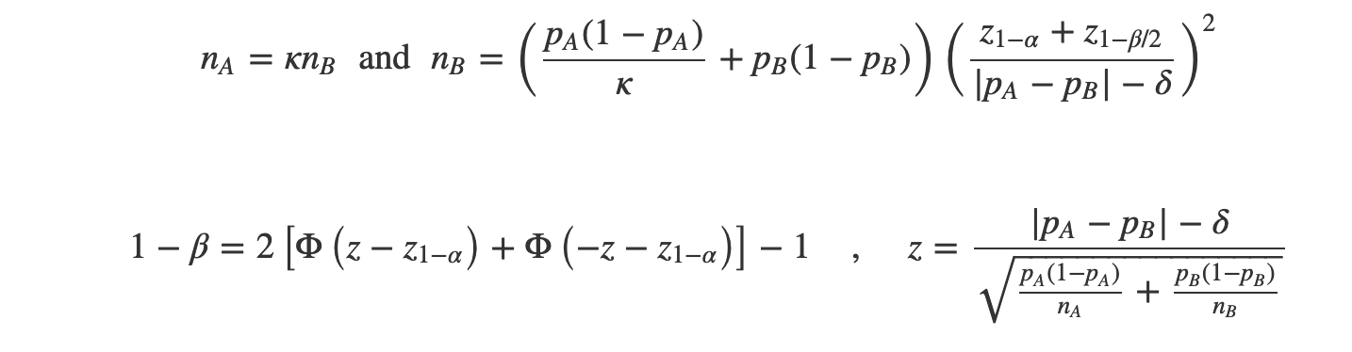
Equivalence for a proportion
κ=nA/nB is the matching ratio
Φ is the standard normal distfunciton
Φ⁻¹ is standard normal quantile
α is Type I error
β is Type II error
δ is the testing margin
Notes:
Chow S, Shao J, Wang H. 2008. Sample Size Calculations in Clinical Research. 2nd Ed. Chapman & Hall/CRC Biostatistics Series. page 91.

Slide 47
Example
pA=.5
Alpha=.1
Power=.9
Testing margin=.1
Equal allocation per group
Calculate the sample size PER group
What will happen to sample size if delta increases to .15?

Slide 48
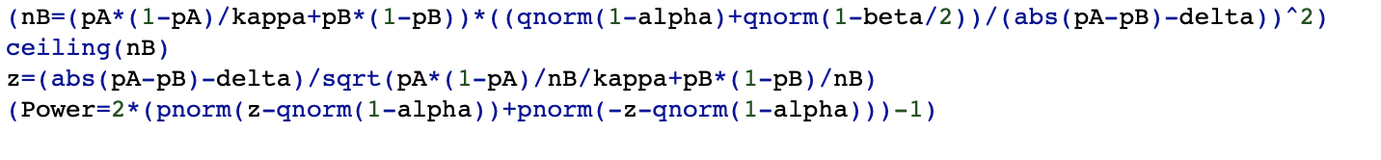
R code
Sample size per group is nB

Slide 49
In summary: “Equivalency” or Non-Inferiority Trials
Compare new therapy with standard
Wish to show new "as good as"
Rationale may be cost, toxicity, profit, FDA devices
Examples
Intermittent Positive Pressure Breathing Trial
Expensive IPPB vs. Cheaper Treatment
Nocturnal Oxygen Therapy Trial (NOTT) in COPD
12 Hours Oxygen vs. 24 Hours (SOC)
Problem
Why Can’t we show H₀:Δ = 0
A Solution
Specify minimum difference = Δ min

Slide 50
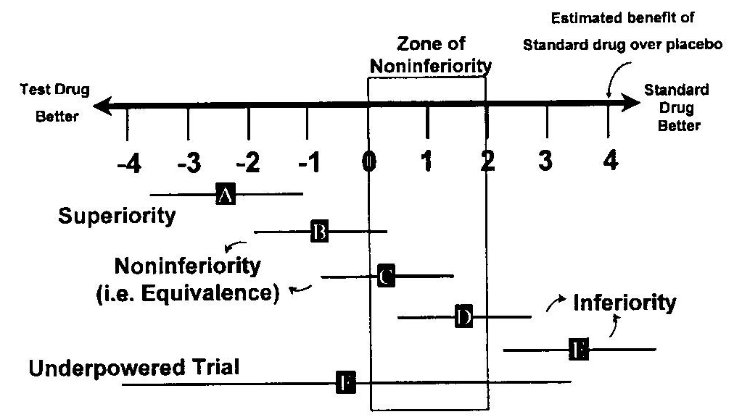
Difference in Events
Test Drug – Standard Drug

Slide 51
Equivalence Example: medical device
Anemia check vs predicate
CBC is SOC
Average (SD) hgb is 13 (.9) mg/dL which is an estimate
How many samples do you need to establish equivalence if you are willing to accept a delta=1?

Slide 52
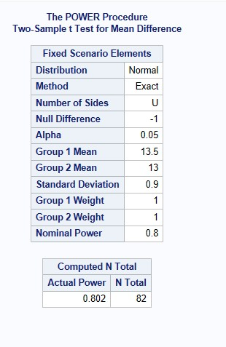
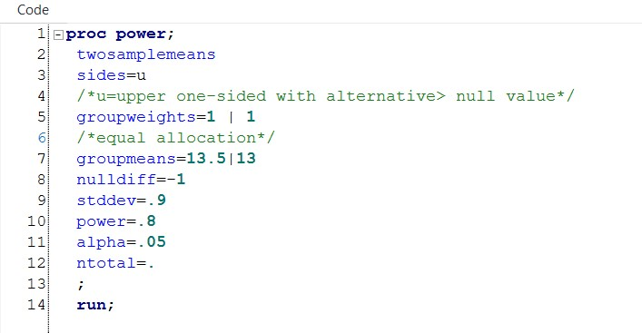
SAS example

Slide 53
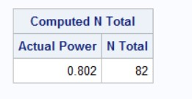
Sample size results
The TWOSAMPLEMEANS statement in PROC POWER doesn’t have an explicit option to represent the noninferiority margin, but you can use the NULLDIFF= option

Slide 54
Example
Study of weight gain in pre-term infants
Premise: if two treatments show mean increases in weight to within 25 g per week then they may be considered as therapeutically equivalent.
Note that in this example 25 g is not the mean weight gain that is expected per week – we would hope that would be much more. But if infants receiving one feeding regimen had a mean increase of 150 g per week then we would consider an alternative treatment to be equivalent if the mean weight gain were between 125 and 175 g per week.

Slide 55
Example study design
To show a treatment difference: state the null hypothesis as no difference between the treatments. Goal to find evidence to refute that null hypothesis.
In the case of equivalence we specify the range of equivalence, (25 g per week in the above example) and then test two null hypotheses.
We test that the observed difference is statistically significantly greater than +delta; and that the observed difference is statistically significantly less than -delta.
In practice it is much easier to consider a confidence interval for the difference between the treatment means and draw this on a graph with the agreed limits of equivalence (see later slide).

Slide 56
Why is this true and why does it matters?
Proving the null hypothesis’ in a significance testing scenario is never possible
A level of ‘therapeutic equivalence’ should be defined and this is a medical question, not a statistical one.
Why is it it is unlikely that two different treatments will ever exert truly identical effects.

Slide 57
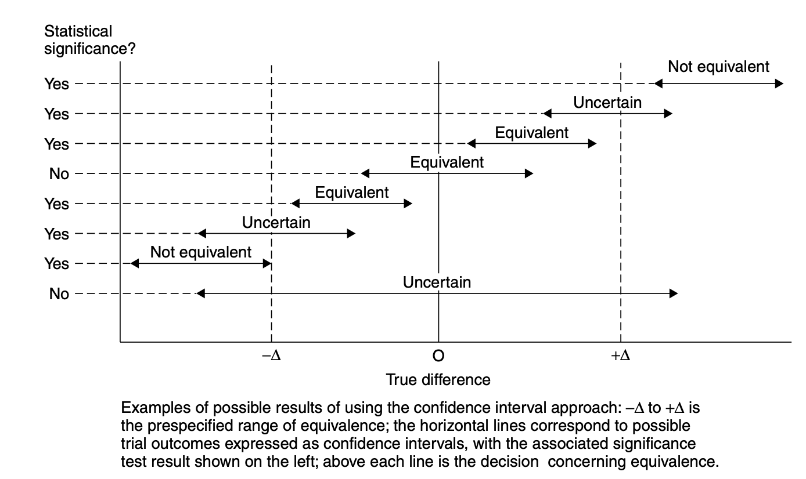
Graph of 8 studies and equivalence interpretation

Slide 58
What graph shows/
It is quite possible to show a statistically significant difference between two treatments yet also demonstrate therapeutic equivalence.
These are not contradictory statements
Although there is evidence that one treatment works better than another, the size of the benefit is so small that it has little or no practical advantage.

