Slide 1
File utilities and command environments
Curtis Huttenhower (chuttenh@hsph.harvard.edu)
Eric Franzosa (franzosa@hsph.harvard.edu)
http://huttenhower.sph.harvard.edu/bst281

Slide 2
Midterm: journal club
Sign up for a journal club presentation by end of day Wednesday!
Email instructional team with:
Group members (2-5, names + CCed).
Paper to present.
~2-4 sentence justification.
Recent and/or high-impact quantitative biology.
Date of presentation (March 1, 6, 8).
3-4 presentations / day.
First come, first served.
20 minute presentation + 5 minutes questions.
All group members must present.
Background, overview/results, methods, discussion/interpretation, questions.

Slide 3
The unix and linux (*nix) philosophy
Work at the command line (terminal)
Manipulate data as text
Build/use programs that perform specific tasks very well
Chain together small programs to perform complex tasks
“Chaining” involves passing data as STDIN/STDOUT streams

Slide 4
The command line and you
Being comfortable on the command line is helpful for data analysis/coding:
Command line tools save you from reinventing the wheel
The data analysis programming trifecta:
Command line experience
A utility language for data manipulation (e.g. Python)
A statistical analysis and graphics language (e.g. R, though Python works too)
The command line is a 90/10 learning process:
90% of the data questions you’ll encounter can be answered with 10% of the command line functionality (which you can master in a few weeks)
The rest you pick up bit-by-bit over your career

Slide 5
Using command-line tools
If you’re on a mac (or Linux), you have all of these built-in
Not available by default in Windows command prompt, but a few options:
Windows PowerShell
Cygwin (mini-Linux that runs as a terminal program on Windows)
Windows 10 Bash shell (experimental)
GOW (Gnu on Windows) lightweight Cygwin alternative

Slide 6
*nix utilities: man
What does it do?
Displays a “manual” page for another tool, detailing expected input data and optional flags
Usage
$ man less
Options | What does it do?
Q | [within program] Exits the current man page

Slide 7
*nix utilities: man
LESS(1) General Commands Manual LESS(1)
NAME
less - opposite of more
SYNOPSIS
less -?
less --help
less -V
less --version
less [-[+]aABcCdeEfFgGiIJKLmMnNqQrRsSuUVwWX~]
[-b space] [-h lines] [-j line] [-k keyfile]
[-{oO} logfile] [-p pattern] [-P prompt] [-t tag]
[-T tagsfile] [-x tab,...] [-y lines] [-[z] lines]
[-# shift] [+[+]cmd] [--] [filename]...
(See the OPTIONS section for alternate option syntax with long option names.)
DESCRIPTION
Less is a program similar to more (1), but it has many more features. Less does not have to read the entire input file before starting, so with large
input files it starts up faster than text editors like vi (1). Less uses termcap (or terminfo on some systems), so it can run on a variety of terminals.
There is even limited support for hardcopy terminals. (On a hardcopy terminal, lines which should be printed at the top of the screen are prefixed with a
caret.)
Commands are based on both more and vi. Commands may be preceded by a decimal number, called N in the descriptions below. The number is used by some com‐
mands, as indicated.
COMMANDS
In the following descriptions, ^X means control-X. ESC stands for the ESCAPE key; for example ESC-v means the two character sequence "ESCAPE", then "v".
h or H Help: display a summary of these commands. If you forget all the other commands, remember this one.
SPACE or ^V or f or ^F
Scroll forward N lines, default one window (see option -z below). If N is more than the screen size, only the final screenful is displayed. Warn‐
ing: some systems use ^V as a special literalization character.
z Like SPACE, but if N is specified, it becomes the new window size.

Slide 8
*nix utilities: ls
What does it do?
List files in the current directory
Usage
$ ls
$ ls *.txt # list all text files
Options | What does it do?
-l | List file details
-h | Human-readable file sizes (e.g. 3.3MB vs. 3354123)
 | Lots of build in sorting options (size, type, last update, etc.)

Slide 9
*nix utilities: rm
What does it do?
Deletes (removes) a file PERMANENTLY
Usage
$ rm my_file
Options | What does it do?
-r | Force-remove a directory (will fail by default)
-i | Confirm each deletion event

Slide 10
*nix utilities: cp
What does it do?
Copy a file
Usage
$ cp my_file my_copy
Options | What does it do?
-i | Warn before overwriting a file
-r | Copy recursively (needed for copying directories)

Slide 11
*nix utilities: mv
What does it do?
Move a file to a new location (or rename a file)
Usage
$ mv my_file MY_FILE # rename my_file as MY_FILE
$ my /my_dir/my_file . # move file “here” (.)
Options | What does it do?
-i | Warn before overwriting a file

Slide 12
Path syntax
$ is used to indicate the start of a command (your prompt may look different)
$ command
/ is the root of the file system (C:\ on Windows, typically; note the backslash)
$ ls /
A subdirectory of the root directory
$ ls /my_dir/
. refers to the current directory
$ wc –l ./my_file.txt $ cp /my_dir/my_file.txt . # copy file “here”
.. refers to the parent directory
$ mv ../my_file.txt .

Slide 13
*nix utilities: cat
What does it do?
Dumps a file on disk to STDOUT (for feeding into another program)
Usage
$ cat my_file # lines of file scroll over screen
$ cat my_file | program # lines of file enter program as STDIN

Slide 14
*nix utilities: less
What does it do?
View a file or data stream with navigation options
Usage
$ less my_file
$ cat my_file | less # less often used at the end of a chain
Options | What does it do?
-S | Don’t wrap long lines
←↑→↓ | Arrow keys to navigate in file (PageUp, PageDown, Home, End work too)
/ | [in program] Search for text, use n and N to see next/previous matches
Notes:
Put my_file to the output, less get the output to a program

Slide 15
*nix utilities: grep
What does it do?
Isolate lines of a data stream (file or STDIN) that match a pattern
Usage
$ grep pattern my_file
$ cat my_file | grep pattern
Options | What does it do?
-P | Richer pattern options (regular expressions); more on these in a later lecture
-v | Isolate lines that DO NOT match the pattern (invert the match)
-i | Case-insensitive match
-f | Specify a file of patterns to match (slow if there are lots of options)
Notes:
Cat *fasta | grep “>”|less put out fasta file, give the lines start with >, show it.

Slide 16
*nix utilities: cut
What does it do?
Isolate tab-delimited columns of a data stream. First column is #1 (not #0 as in Python).
Usage
$ cut -f2 my_file # isolate the 2nd column of the file
$ cut -f2,3 my_file # isolate columns 2 and 3
$ cut -f2-5 my_file # isolate columns 2 THROUGH 5
$ cut -f3- my_file # isolate columns 3 to END (python [2:] slice)
Options | What does it do?
-f | Select columns (fields)
-t‘C’ | Break columns on the specified character instead of tab, e.g. –t‘,’ for .csv file

Slide 17
*nix utilities: sort
What does it do?
Sort the lines of a data stream (alphabetically, by default)
Usage
$ sort my_file
Options | What does it do?
-r | Reverse the sort
-k N | Sort on the value of WHITESPACE-delimited column N
-t‘C’ | Specify the delimiter character (e.g. –t‘\t’ for tab)
-n | Perform a numeric sort (otherwise 10 comes before 2)

Slide 18
*nix utilities: uniq
What does it do?
Isolate the unique ADJACENT lines of a data stream
Usage
$ sort my_file | uniq # w/o sorting, non-adjacent repeats missed
Options | What does it do?
-c | Count the unique lines instead of printing them
Notes:
Collapse replicative lines(concecutive data) does not work with ABABAB
Only works with AAABBB
Sort first, then uniq

Slide 19
*nix utilities: wc
What does it do?
Counts the lines, words, and characters of a data stream
Usage
$ wc my_file
Options | What does it do?
-l | Only report line count (faster, and often all you want)
-w | Only report word count
-c | Only report character count

Slide 20
*nix utilities: head/tail
What does it do?
Stream the first/last (tail/head) lines of a data stream (default 10)
Usage
$ head my_file
$ head –n 100 my_file | tail # Stream lines 91-100
Options | What does it do?
-n N | Stream N lines instead of default 10

Slide 21
*nix utilities: column
What does it do?
“Normalize” the widths of column entries (Excelify your data)
Usage
$ column –t my_file
Options | What does it do?
-s‘C’ | Specify the delimiter character (e.g. –s‘\t’ for tab); default = any whitespace

Slide 22
*nix utilities: sed
What does it do?
Edit a data stream, most often used for find/replace operations
Usage
$ sed “s/find/replace/g” my_file
$ sed “s/apple/banana/g” my_file # replace all instances of “apple” with “banana”
Options | What does it do?
-i | Edit file “in place” (dangerous)
 | “find” can be a regular expression, and “replace” can use captured elements of the pattern (this will make more sense after our regular expressions lecture).
Notes:
g: everywhere
Sed “s/T/U/g”
S: substitute

Slide 23
*nix utilities: diff
What does it do?
Compare two TEXT files and display differing lines
Usage
$ diff my_file1 my_file2

Slide 24
Chaining programs
Most programs read from STDIN and write to STDOUT
Start a chain by supplying a file name as an argument:
grep “Hello” my_file.txt
You will sometimes see this syntax (“<” reads a file on disk to STDOUT):
grep “Hello” < my_file.txt
Use the pipe ‘|’ to direct STDOUT of program N as STDIN of program N+1
grep “Hello” my_file.txt | sort
Can do this repeatedly
grep “Hello” my_file.txt | sort | uniq | wc –l
Dump the results to a file (OVERWRITES!)
grep “Hello” my_file.txt | sort | uniq | wc –l > hello_count.txt
Output/redirect to a file

Slide 25
Chaining programs
patient_data.tsv
UNIQUE_ID | SUBJECT_NAME | SUBJECT_ZIP
134245 | Smith, John | 02135
145623 | Doe, John | 02134
... | ... | ...
What does this do?
$ cut –f3 patient_data.tsv | grep “02135” | wc -l
What does this do?
$ cut –f3 patient_data.tsv | sort | uniq | wc -l
What does this do?
$ sed “s/, Jon/, John/g” | grep “, John” | wc –l

Slide 26
Chaining programs
Consider hmp2012_metadata.tsv
(Simplified) metadata for Human Microbiome Project samples
Each sample comes from a body site of a particular subject at a given visit
Questions:
How many unique subjects? Body sites?
cat hmp2012_metadata.tsv|cut -f4|sort|uniq|wc -l
What are the six most commonly sampled body sites?
cat hmp2012_metadata.tsv|cut -f4|sort|uniq -c|sort| tail -n 6
How many “retroauricular_crease” (ear) samples, ignoring left/right distinction?
cat hmp2012_metadata.tsv|cut -f4|grep "_crease"|wc -l
cat hmp2012_metadata.tsv|cut -f4|sed "s/[LR]_//g"|sort|uniq -c
How many subjects contributed more than 10 samples?
How many (subject, body site) pairs were sampled 3 times?
Are there any technical replicates?
Unique samples with same (subject, body site, visit) triple

Slide 27
Calling command-line tools in Python: subprocess
import subprocess
subprocess.call( “ls –l | wc -l”, shell=True )
Runs the given command
Output goes to the screen when command is FINISHED
subprocess.check_output( “ls –l | wc -l”, shell=True )
Runs the given command
Output returned as a STRING when command is FINISHED
Can then be manipulated in Python
Multiline output delimited by “\n”
subprocess.Popen( ) for more advanced options
Provides a “handle” to the process that you can interact with (like a file handle)
E.g. live-stream output rather than waiting for process to finish

Slide 28
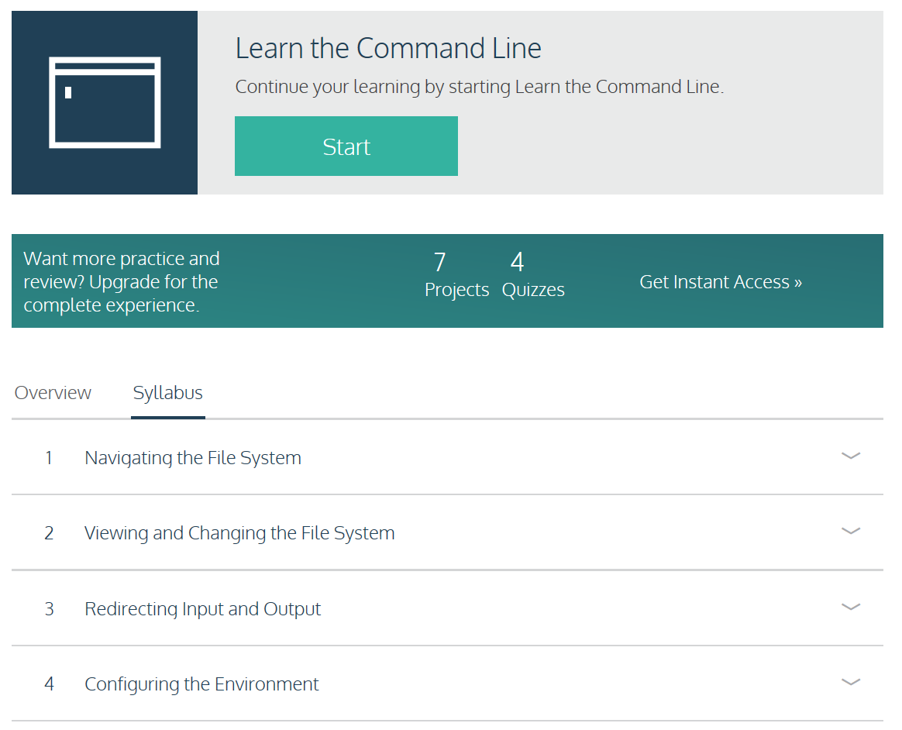
https://www.codecademy.com/learn/learn-the-command-line

