Slide 1
Regular Expressions
Curtis Huttenhower (chuttenh@hsph.harvard.edu)
Eric Franzosa (franzosa@hsph.harvard.edu)
http://huttenhower.sph.harvard.edu/bst281

Slide 2
Summary
Syntax for regular expressions (REs)
REs in Python
REs on the command line
Pattern sensitivity and precision
RegexOne activity

Slide 3
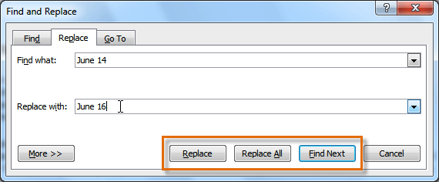
Regular expressions
Also called “regexps” or “regexes” or “REs” as shorthand
A language for describing patterns in strings
Useful for
Asking if a pattern occurs in a text
“Capturing” all or part of the pattern for manipulation
Replacing all or part of the pattern
A much more powerful version of find-and-replace, implemented in many text editors and programming languages (including Python)
Notes:
Pattern->text: match?
dot(.) will march anything(wild char) a.c=abc
\d will match 0-9(digit char)
\d\d\d\d:year
\D: match anything except digits
\w: word digit A-Z a-z 0-9 underline char for title
\W: non word
Define your own expression:
[A]: only match upper A
[AB]: A or B
[a-z]: anything from a to z
[^AB]: anything except A and B

Slide 4
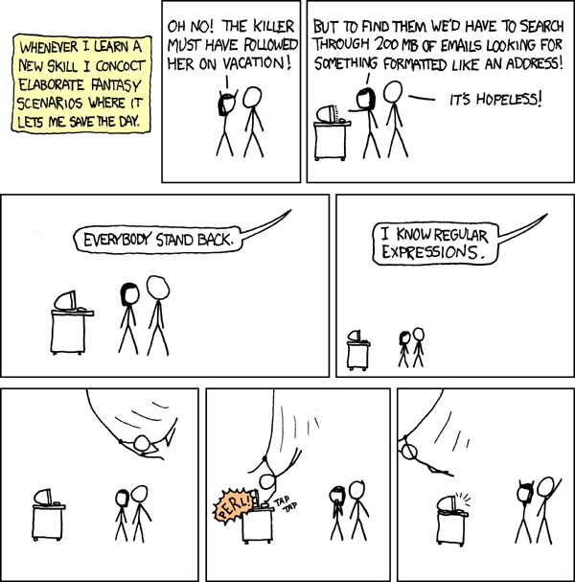
https://xkcd.com/208/
Regexps!

Slide 5
Introduction to slide style
Description of RE pattern concept / use cases
Pattern using the concept
Text with a match to the pattern
Text without a match (possibly a near-miss)

Slide 6
Trivial regular expressions: exact matching
A RE pattern is coded as a string
Hello # pattern
Hello, world # text
hello, world # matching is case-sensitive

Slide 7
The wildcard character
A dot (.) represents a wildcard (matches any character)
Use \. to specifically match a dot (similar for other special characters)
.ello
Hello, world
hello, world
Mellow yellow
..e..
Jennifer and Marty went to the store
Notes:
只要e不是第一个或者最后一个就match

Slide 8
Pre-defined character classes
\d matches any digit (0-9)
\D matches any non-digit character (letters, punctuation, etc.)
\s matches any whitespace character (space, tab, newline)
\d\d\d\d
Yesterday, December 7, 1941--a date which will live in infamy
\d\D
In 2265, starship crew members enjoy playing 3D chess
\s\s
Some people add two spaces after a sentence. Others add one.
Notes:
句末要是有空格可被检测出来

Slide 9
Pre-defined character classes
\w matches any “word” character (A-Z, a-z, 0-9, and “_”)
\W matches any non-word character (punctuation and space)
\W\w\w\w\w\W
It’s my party and I’ll cry if I want to
In 2265, crew member enjoy playing 3D chess

Slide 10
Pre-defined character classes
\t (tab) \n (newline) and \\ (backslash) match as in Python
\t\d\d\d\d\n
1981 1982 1983 1984 1985
1986 1987 1988 1989 1990

Slide 11
Custom character classes (square brackets, [])
[AB] matches “A” and “B”
[A-E] matches any character “A” through “E”
[A-Za-z0-9_] matches any word character (equivalent to \w)
[ACGT]
A DNA sequence is represented by the letters A, C, G, and T
[D-M]r
Dr. Grant has a Ph.D., while Mr. Hammond does not

Slide 12
Custom character classes
Negate a character class with an initial “^”
[^ABC] matches any character EXCEPT “A” or “B” or “C”
[^A-E] matches any character EXCEPT “A” through “E”
[^ACGT]
A DNA sequence is represented by the letters A, C, G, and T
[^D]r
Dr. Grant has a Ph.D., while Mr. Hammond does not
Notes:
Something followed by r
一个方括号对应一位的搜索

Slide 13
Boundaries
^ matches the start of a string (outside of a character class)
$ matches the end of a string
\b matches a “word boundary” (beginning/end of a line, whitespace, or a non-word character)match anything looking like a word
^John
John Smith, have you met my friend John Doe?
deer$
Doe, a deer, a female deer
deer\b don’t match deers, deery \bdeer\b:isolate deer as a single word
Doe, a deer, a female deer
Notes:
“ ^>”
“^[^>]”
Just deer matches everything contaning a part of deer

Slide 14
Repetition
? Indicates a single, optional match
AB?C B is optional
AC
ABC
ABBC

Slide 15
Repetition
? Indicates a single, optional match
* matches 0 or more occurrences
AB*C
AC
ABC
ABBC

Slide 16
Repetition
? Indicates a single, optional match
* matches 0 or more occurrences
+ matches 1 or more occurrences
AB+C any number of B
AC
ABC
ABBC
What’s another way of representing “AB+C”?
ABB*C

Slide 17
Repetition with subpatterns
To describe repetition of more than one character, enclose the “sub-pattern” in parentheses
(Parentheses have a 2nd function in REs that we’ll see shortly)
(CAT)+
ACTAGTGATCGATGCTGTAGTGCTAGCTGATCTGTAGCATGCTGACTAGCTGGTCTGCATCATTAGCTAGCTAGTACTAGTGTGCGT
(a[a-z])+
Who doesn’t like Bananarama?
Notes:
Save the search result

Slide 18
Bounded repetition
{n} matches exactly n repetitions
{n,m} matches n to m repetitions, inclusive
{n,} matches at least n repetitions
{,m} matches at most m repetitions
[A-Z][a-z]{2,12}
“Rutherfordium” is the longest chemical element name, while “Tin” is the shortest
(CAT){3,}
GATACGACATCATCATAGCATAG contains a DNA repeat region

Slide 19
Choice
| (pipe) behaves as a logical OR
Often combined with parentheses to indicate a choice of sub-patterns
\w+\.(txt|py)\b
my_script.py my_input.txt README.md my_output.txt
(a[a-z])+
Who doesn’t like Bananarama?
Notes:
\. : match actual dot
\w+ : search for file name

Slide 20
Summary
Syntax for regular expressions (REs)
REs in Python
REs on the command line
Pattern sensitivity and precision
RegexOne activity

Slide 21
REs in Python
Bundled in the re module
import re
Three (most-commonly used) functions in this module
re.search( )
re.finditer( )
re.sub( )

Slide 22
re.search
re.search( pattern, text )
“Pattern” and “text” are string data (possibly stored in variables)
re.search( r“C.T”, “CAT” )
# is equivalent to
strPattern = “C.T”
strText = “CAT”
re.search( strPattern, strText )
By convention, we use raw strings to define a pattern
strPattern = r“C\tT”
This means “see ‘\t’ as ‘\’ followed by ‘t’ and not the special ‘tab’ character”
Forces the RE engine to process “\t” as “tab” and not Python
Notes:
r : don’t process that char, raw string \t wont be taken as a tab
$: end of the text( line by line loaded)

Slide 23
re.search
re.search finds the first valid hit to a pattern
Consider re.search( r“A+”, “ABAAAAAAAAAAAAAAAAAAA” )
The match will be the single A before B and not the long string of As to follow
re.search returns a special “Match” data object if a hit is found
Otherwise it returns None
print( re.search( r“C.T”, “CAT” ) )
<_sre.SRE_Match object at 0x2b7c6b71c3f0>
print( re.search( r“C.T”, “BAT” ) )
None
Match = re.search( strPattern, strText )
if Match:
# do something with Match

Slide 24
The Match object
The Match object stores data about the Match
Match.start( ) and Match.end( ) return the (Python-style) coordinates of the match in the text
Match = re.search( r“.at”, “the cat with the hat sat on the mat” )
#...........................0123456789
print( Match.start( ), Match( end ) )
4 7
strText = “the cat with the hat sat on the mat”
Match = re.search( r“.at”, strText )
if Match:
iStart, iEnd = Match.start( ), Match.end( )
print( strText[iStart:iEnd] )
‘cat’

Slide 25
Capture groups
An important use for parentheses in REs is capturing parts of the matched pattern (and avoiding the start-end business of the previous slide)
strText = “the cat with the hat sat on the mat”
Match = re.search( r“(.at)”, strText )
if Match:
print( Match.group( 1 ) )
‘cat’
Match = re.search( r“(.at) (.at)”, strText )
if Match:
print( Match.groups( ) )
(‘hat’, ‘sat’)

Slide 26
Capture groups
Parentheses used to define sub-patterns are also captured
If you don’t want this behavior, use (?:subpattern)
Especially important when nesting
strText = “GGGCATCATCATGGG”
Match = re.search( r“((?:CAT){3})”, strText )
if Match:
print( Match.group( 1 ) )
‘CATCATCAT’

Slide 27
re.finditer
A Pythonic method for finding multiple matches to a pattern in a text
“iter” refers to “iterable” – the quality that allows data to be looped over in a Python for loop
strText = “the cat with the hat sat on the mat”
for Match in re.finditer( r“(.at)”, strText )
print( Match.group( 1 ) )
‘cat’
‘hat’
‘sat’
‘mat’

Slide 28
re.finditer
A Pythonic method for finding multiple matches to a pattern in a text
“iter” refers to “iterable” – the quality that allows data to be looped over in a Python for loop
strText = “AAAAAAAAAAAAA---AAAAAAAAAAAAA”
for Match in re.finditer( r“(A+)”, strText )
print( Match.group( 1 ) )
‘AAAAAAAAAAAAA’
‘AAAAAAAAAAAAA’
Why not “A” or “AA” or “AAA”?
REs are “greedy”
Starting from the left side of the string, find the longest match ending at position p, then start looking again at position p+1

Slide 29
Repetition extra
.* matches as much as possible (often as “filler” in a pattern)
Illustrates RE’s “greedy” pattern matching
.*? matches as little as possible
www\..*\.com
www.facebook.com and www.reddit.com are two popular websites
www\..*?\.com
www.facebook.com and www.reddit.com are two popular websites

Slide 30
re.sub
The RE equivalent of find-and-replace
Usage: re.sub( strFind, strReplace, strText )
Returns a new string (not a Match object)
re.sub( r“T”, “U”, “ATGAGTTAA” )
‘AUGAGUUAA’
re.sub( r“[AT]+”, “”, “AAAAGGCTTAGCATAGGCCAATA” )
‘GGCGCGGCC’ # note that ALL valid matches are replaced, similar to re.finditer

Slide 31
Substitution with capture groups
Usage: re.sub( strFind, strReplace, strText )
Groups captured from strFind can be used in strReplace
First group represented by \\1, second by \\2, and so forth
re.sub( r“Do you like (\w+)?”, “Yes, I like \\1!”, “Do you like Pigs?” )
‘Yes, I like Pigs!’
re.sub( r“([A-Z][a-z]+) ([A-Z][a-z]+)”, “\\2, \\1”, “John Doe” )
Doe, John

Slide 32
Summary
Syntax for regular expressions (REs)
REs in Python
REs on the command line
Pattern sensitivity and precision
RegexOne activity

Slide 33
*nix utilities: grep
What does it do?
Isolate lines of a data stream (file or STDIN) that match a pattern
Usage
$ grep pattern my_file
$ cat *.txt | grep pattern
Options | What does it do?
-P | Richer pattern options (regular expressions); more on these in a later lecture
Usage
$ grep -P ‘regexp’ my_file

Slide 34
*nix utilities: sed
What does it do?
Edit a data stream, most often used for find/replace operations
Usage
$ sed “s/find/replace/g” my_file
$ sed “s/apple/banana/g” my_file # replace all instances of “apple” with “banana”

Slide 35
*nix utilities: perl -pe
What does it do?
Edit a data stream, most often used for find/replace operations
Usage
$ perl -pe “s/find/replace/g” my_file
$ perl –pe “s/apple/banana/g” my_file
Perl is a scripting language, like Python, heavily geared toward text processing
Hence, REs are a core part of the language
Perl is famous for it’s one-liners, which can be executed on the command line
RE concepts that don’t work in sed will work with perl -pe

Slide 36
Summary
Syntax for regular expressions (REs)
REs in Python
REs on the command line
Pattern sensitivity and precision
RegexOne activity

Slide 37
Pattern sensitivity and precision
Think carefully about your REs and test them
Incorrect assumptions will lead to missed hits (loss of sensitivity)
Incorrect assumptions will lead to nonsense hits (loss of precision)
[A-Z][a-z]+ [A-Z][a-z]+ # matches a first name + last name
Jan Levinson
Jan Levinson-Gould
Jan R. Levinson
Puerto Rico
Potassium Chloride

Slide 38
Pattern sensitivity and precision
Think carefully about your REs and test them
Incorrect assumptions will lead to missed hits (loss of sensitivity)
Incorrect assumptions will lead to nonsense hits (loss of precision)
GENE#1234
GENE#1234
GENE#12345

Slide 39
https://xkcd.com/208/
F. Murray Abraham
123 East 21st Street
Suite 1B
Wilkes-Barre, PA 18701
USA
Wilkes-Barre, PA 18701
\b[A-Z]{2} \d{5}\b
Data that are well-defined tend to be easier to find with REs!
Regexps!

Slide 40
Summary
Syntax for regular expressions (REs)
REs in Python
REs on the command line
Pattern sensitivity and precision
RegexOne activity

