Slide 1
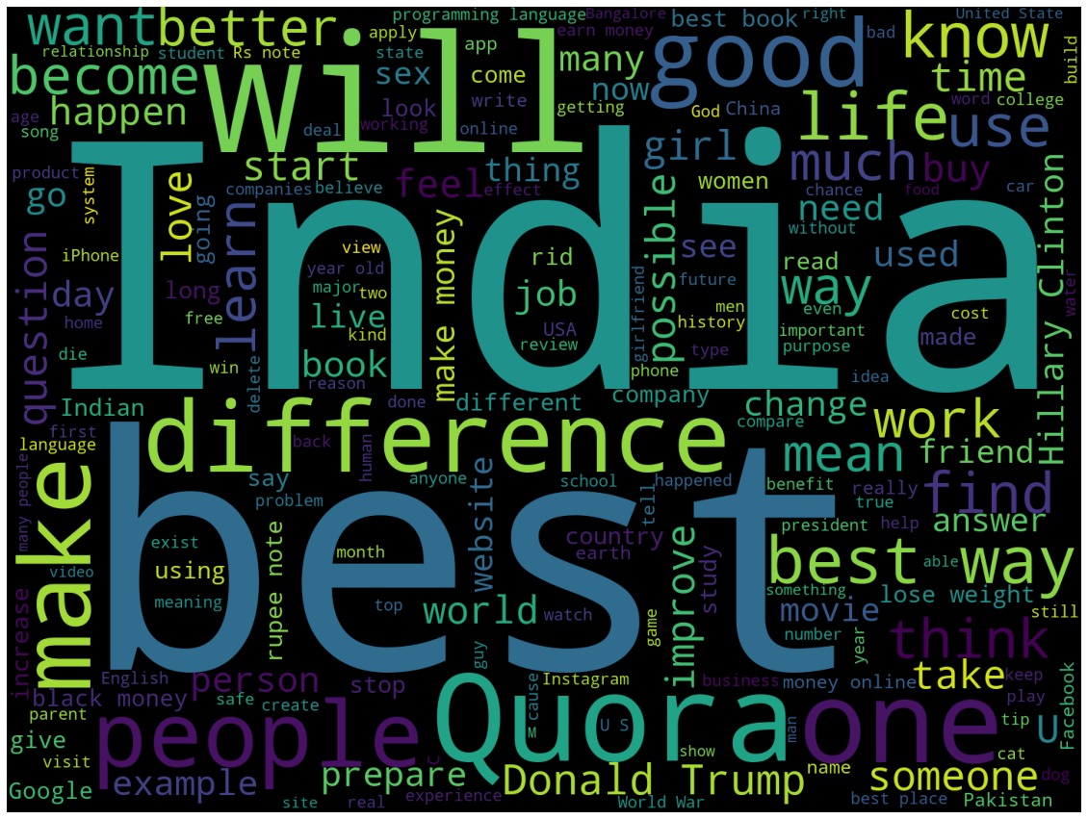

Duplicate Questions Detection
Mini Project - V
Olivia Han

Slide 2
Motivation
Identify the questions on Quora that are duplicated
A Natural Language processing problem by applying ML models that could classify whether a pair of questions are duplicate or not.

Slide 3
Project WorkFlow
Feature Engineering
Data Processing
Data Gathering
Model

Slide 4
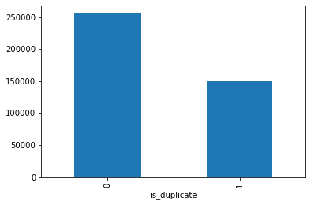
Data Overview
Imbalanced Dataset: There is 63% question pairs are not duplicate.
80:20 split on training and testing dataset.
There are about 480,000 questions and 68% questions appears only once.13% appear multiple times.
Notes:
https://www.ypppt.com/

Slide 5
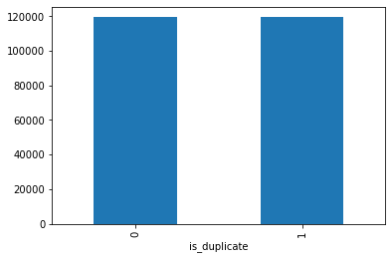
Data Overview
Imbalanced Dataset: There is 63% question pairs are not duplicate.
80:20 split on training and testing dataset.
There are about 480,000 questions and 68% questions appears only once.13% appear multiple times.
Notes:
https://www.ypppt.com/

Slide 6
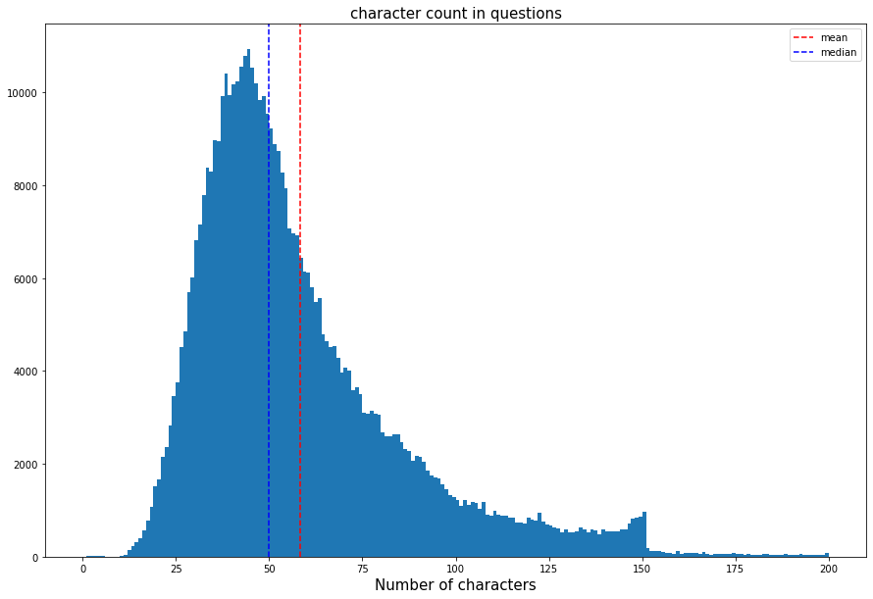
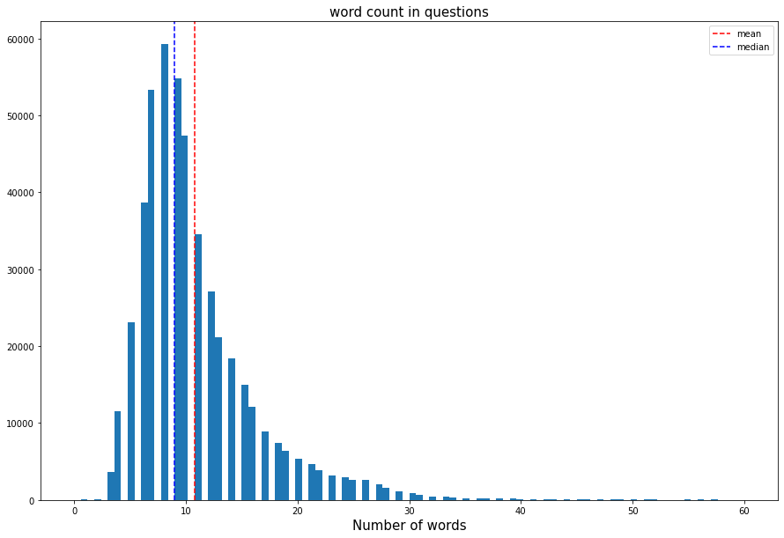
Characters and Words Analysis
Characters count vary mostly from 25 to 80. Most questions have 58 characters.
Word Count has a similar distribution. Most questions are 10 words long.
Notes:
https://www.ypppt.com/

Slide 7
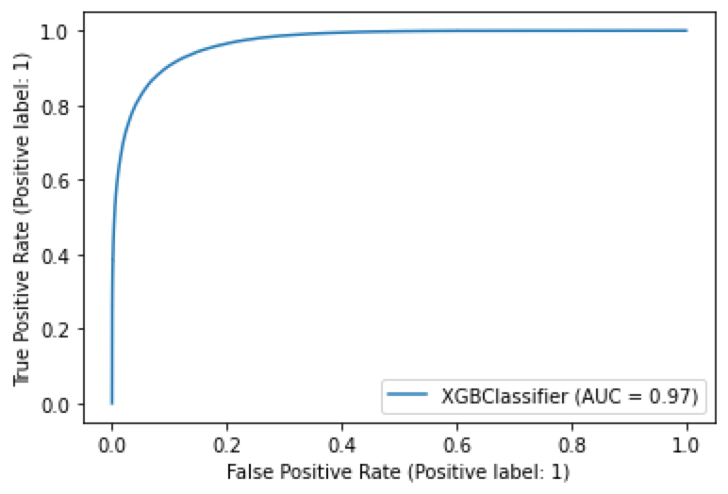
Feature Engineering and Model Selection
Normalization: Sparse matrix of occurrence counts using tf-idf
Logistic Regression:
73.5% accuracy score
XGBoost Classifier with tf-idf ;
87% accuracy score and 88.4% recall
Tried with LSTM:
Got 80.4% accuracy and crushed ☹
Notes:
https://www.ypppt.com/

Slide 8
Challenge & Improvement
Using Regular Expression to process the text
Words to vectors
LSTM

Slide 9
THANK YOU

