Slide 1
A/B Test Analysis: Performance of Marketing Popups

Slide 2
Background
A/B test conducted for 8 days between 3rd July 2020 – 10th July 2020
Onsite customers divided into two buckets and shown one of two possible marketing popups
Each popup asked user whether they would like to ‘refer a friend’
Users given the option to click yes, click no or take no action

Slide 3
Aim
To understand:
Which pop up performed better
Which users should be targeted with each popup

Slide 4
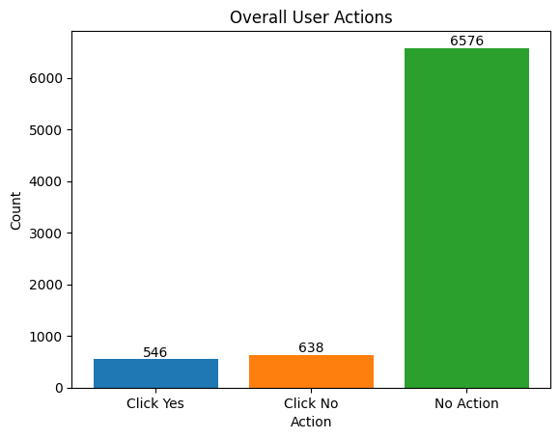
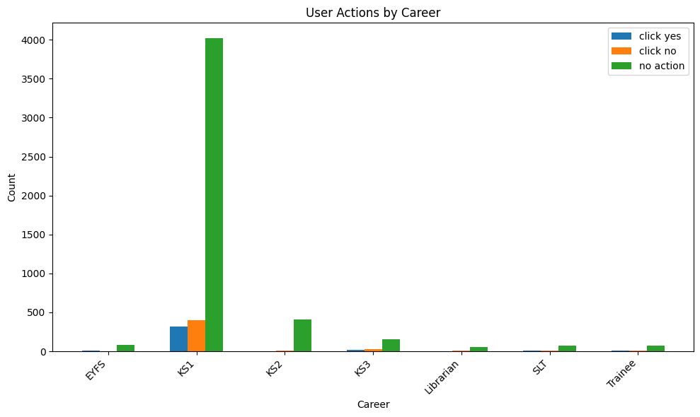
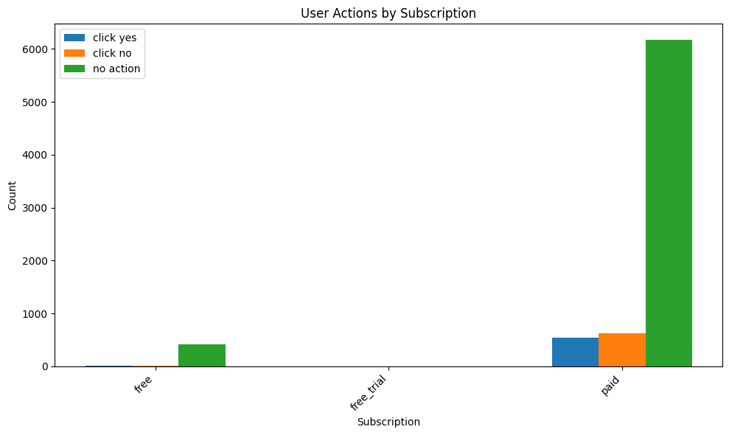
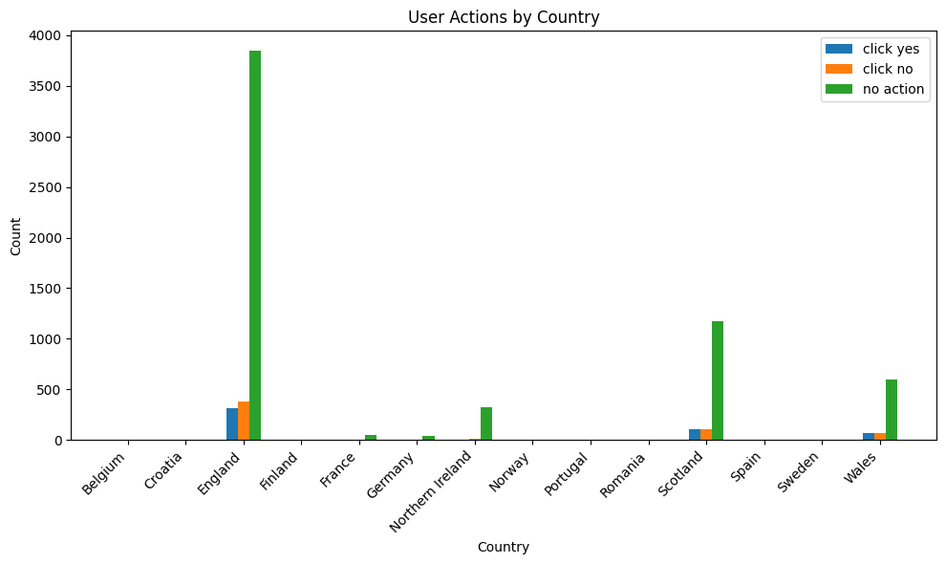
Demographics 7760 users

Slide 5
How was data utilized?
Data segmented based on following factors:
Overall dataset
Country
Career
Number of searches
Time of day
Missing and negative values were excluded from the analysis

Slide 6
How was aim addressed? 1/4
Statistical power
Is there enough participants for an accurate result?
If there was not enough people it is more likely to get a false positive result

Slide 7
Further information on methodology
Statistical power
Baseline conversion rate: 50-60% (chance/slightly above chance)
Minimum detectable effect/lift: 10-30% (~65% conversion rate for highest performing group)
Statistical Significance: 5%
Statistical Power: 80%

Slide 8
How was aim addressed? 2/4
Chi-squared test
Is there a significant difference in responses? Clicking yes or no and taking action in general
Is this effected by certain demographic e.g. country?
95% confidence intervals: if the test were repeated, responses to each popup would most likely be in this range of percentages

Slide 9
Bayesian inference/analysis
If there is a significant difference how significant?
What is the probability that the difference is due to change in popup?
How was aim addressed? 3/4

Slide 10
Further information on methodology
Bayesian analysis
Prior and likelihood function for Bayesian tests were estimated by segmenting data into two periods: first four days and last four days
Estimation of the prior and likelihood functions involved using a beta distribution for the priors and a binomial distribution for the likelihood function
The posterior distribution was inferred by combining the prior and likelihood functions, which represents updated beliefs about the parameters of interest

Slide 11
Logistic regression
How does time of day affect responses in the two groups? Is this specific to type of popup?
How was aim addressed? 4/4

Slide 12
Further information on methodology
Logistic regression
Logistic regression model examined the relationship between the predictors (group and time of day) and the probability of a positive outcome (taking action/clicking yes or no)
The main effects of group and time of day were investigated, as well as their interaction effect on the log-odds (or probability) of a positive outcome.

Slide 13
Hypotheses
Test 1:
Clicking yes or no
Test 2:
Taking any action vs no action
Null hypothesis: there is no difference in conversion rate between popup 1 and 2
Alternative hypothesis: there is a difference in conversion rate between popup 1 and 2

Slide 14
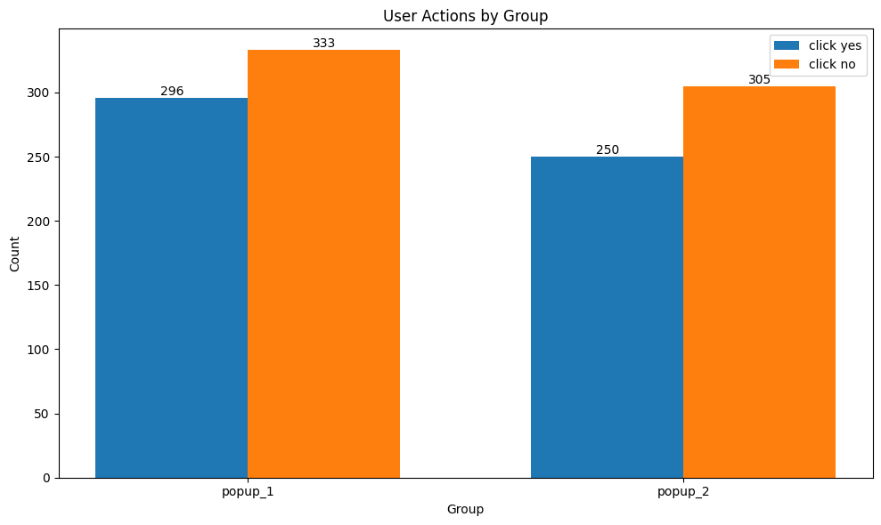
Overview of Results: Test 1
10.8% statistical power: high chance of false positive/negative
Conversion rates across all demographics: 44% to 50% (popup 1) and 43% to 51% (popup 2)
Results of all Chi-Squared tests (including demographics): non-significant
Bayesian inference not performed as non-significant results
Unique users = 629
Conversion rate = 47.1%
Unique users = 555
Conversion rate = 45%
Unique users = 629
Lift (% change) = -4.6%

Slide 15
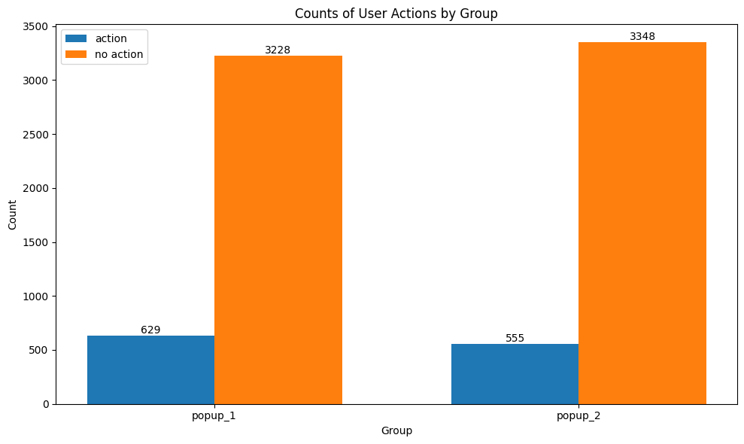
Overview of Results: Test 2
73% Statistical power: acceptable
95% confidence interval:
15.2% - 17.5% (popup 1)
13.1% - 15.4% (popup 2)
Results of all Chi-Squared tests (including demographics): significant but with very small effect size
Bayesian inference found around 99.6% chance that popup 1 led to more clicks
Unique users = 3857
Conversion rate = 16.3%
Unique users = 3903
Conversion rate = 14.2%
Unique users = 7760
Lift (% change) = -2.1%

Slide 16
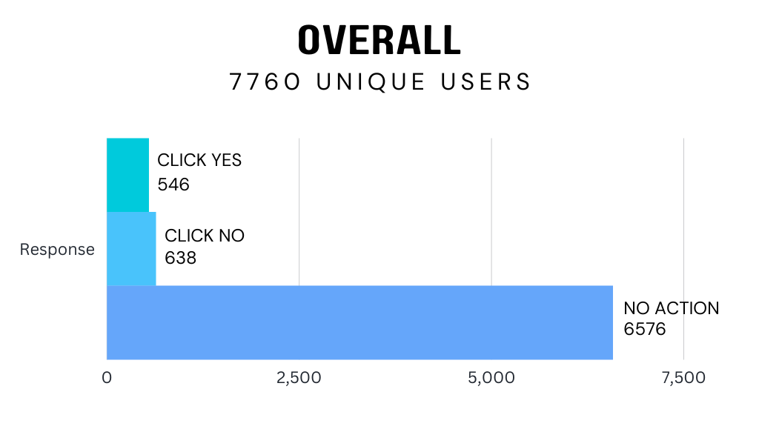
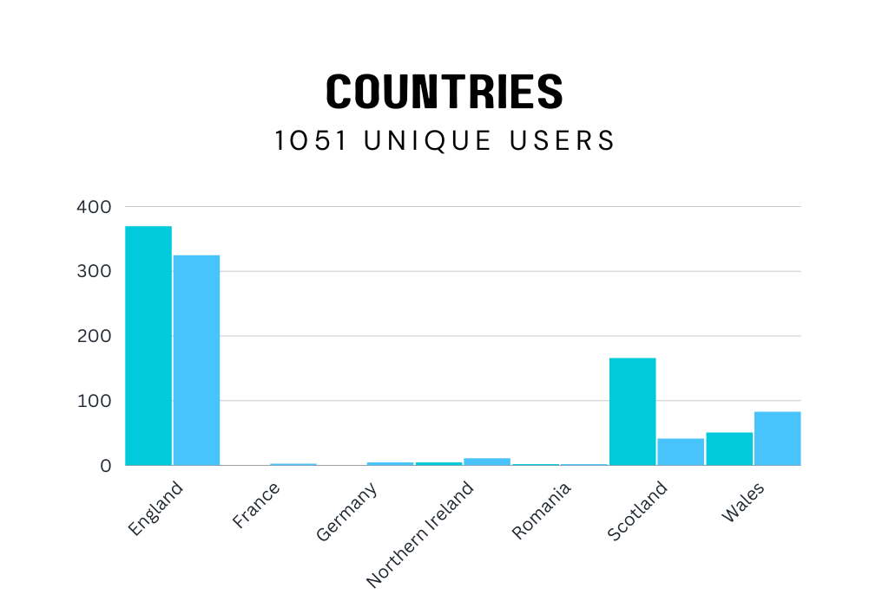
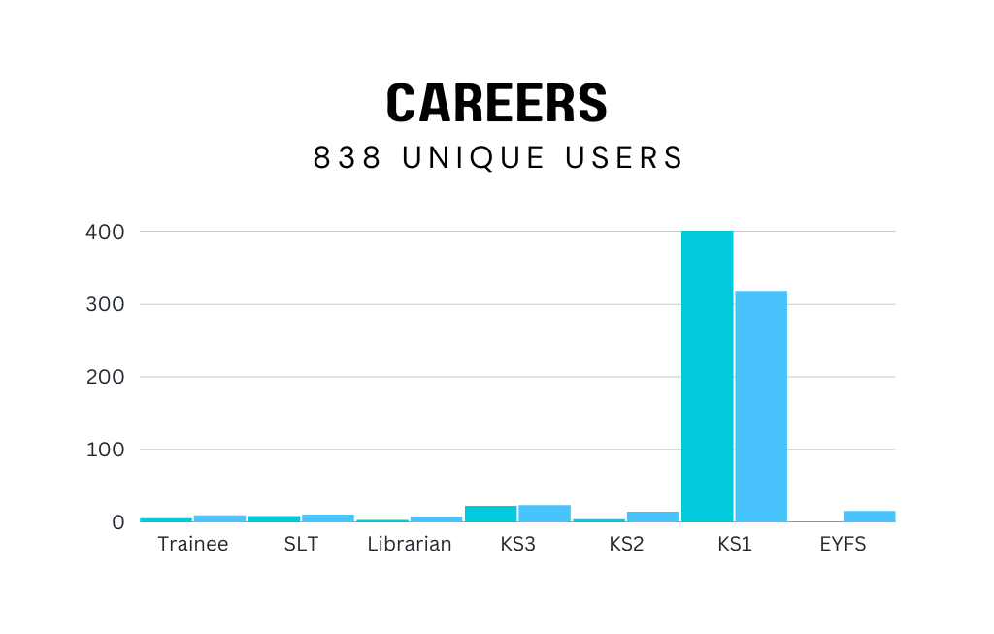
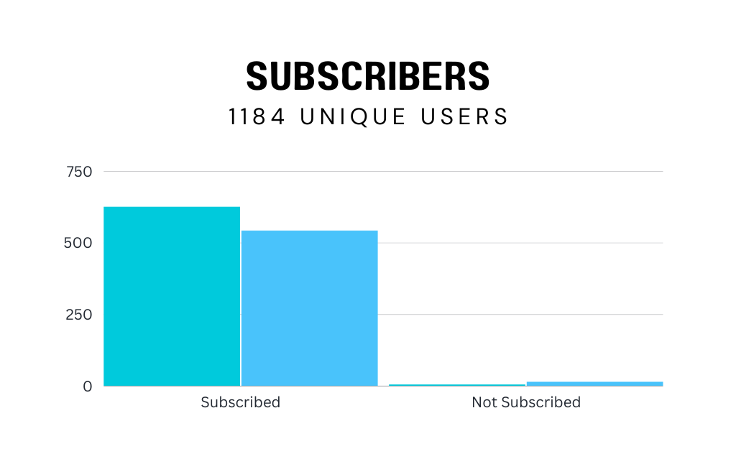
Demographics Test 1 non-significant for England users Test 2 significant for England users Samples sizes too small for other countries

Slide 17
Demographics Same results found for KS1 Samples sizes too small for other countries

Slide 18
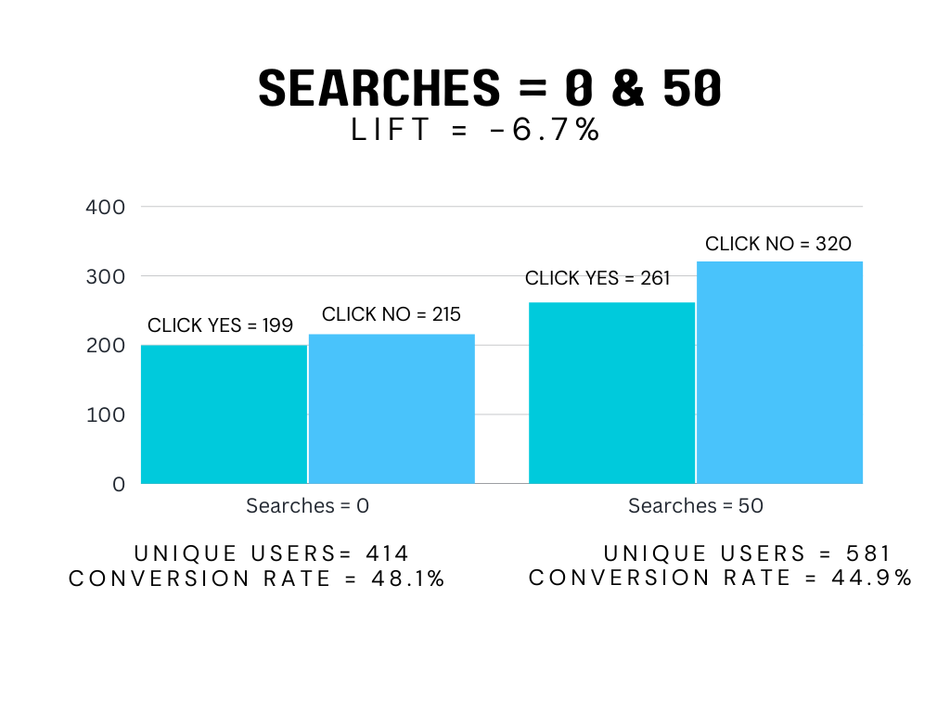
Overview of Results – Searches
Chi-squared test for both test 1 & test 2: non significant

Slide 19
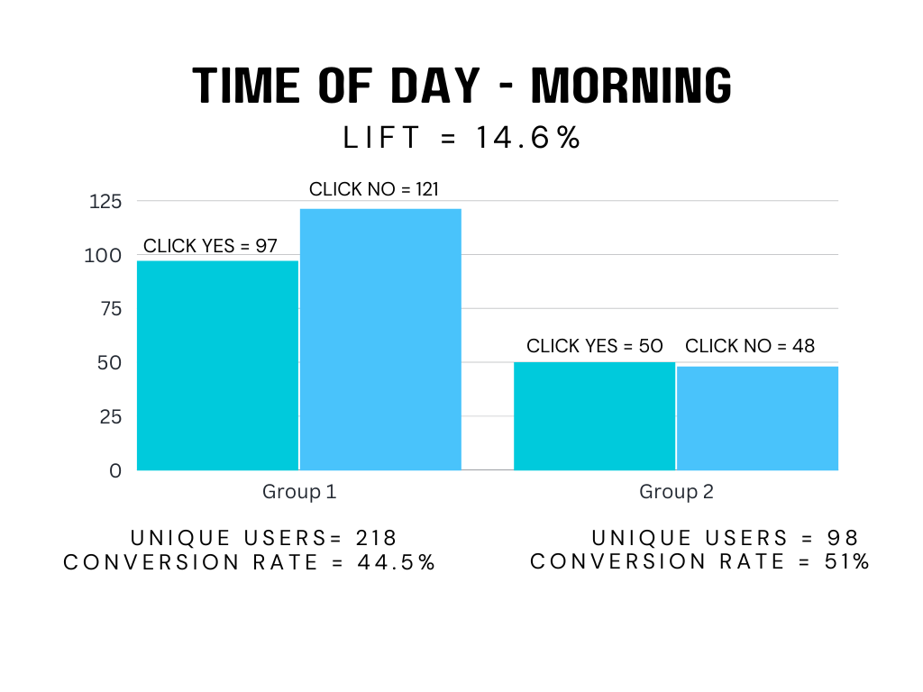
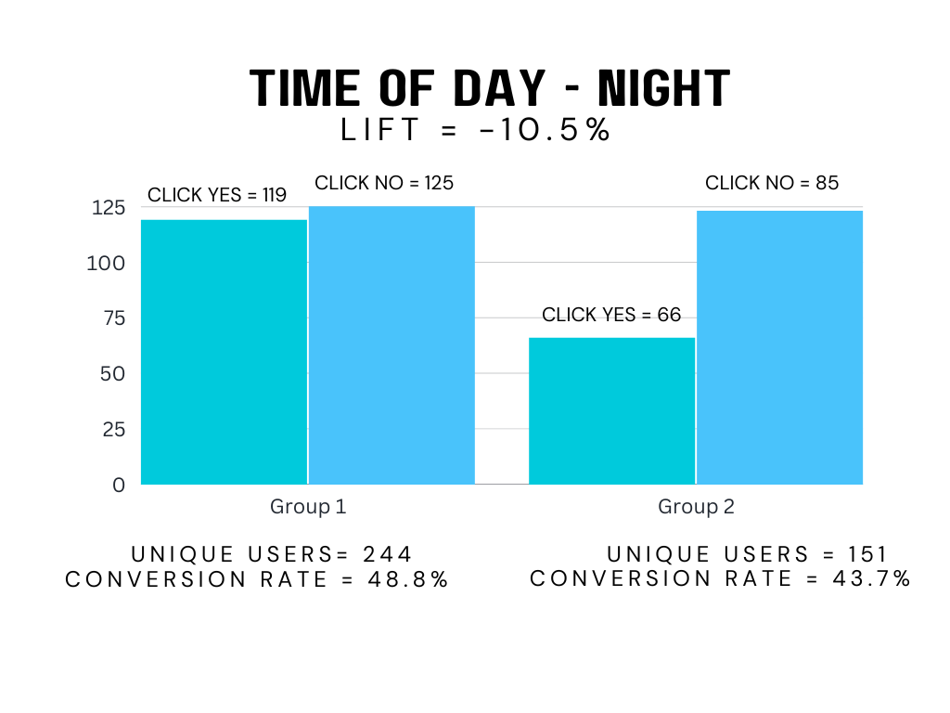
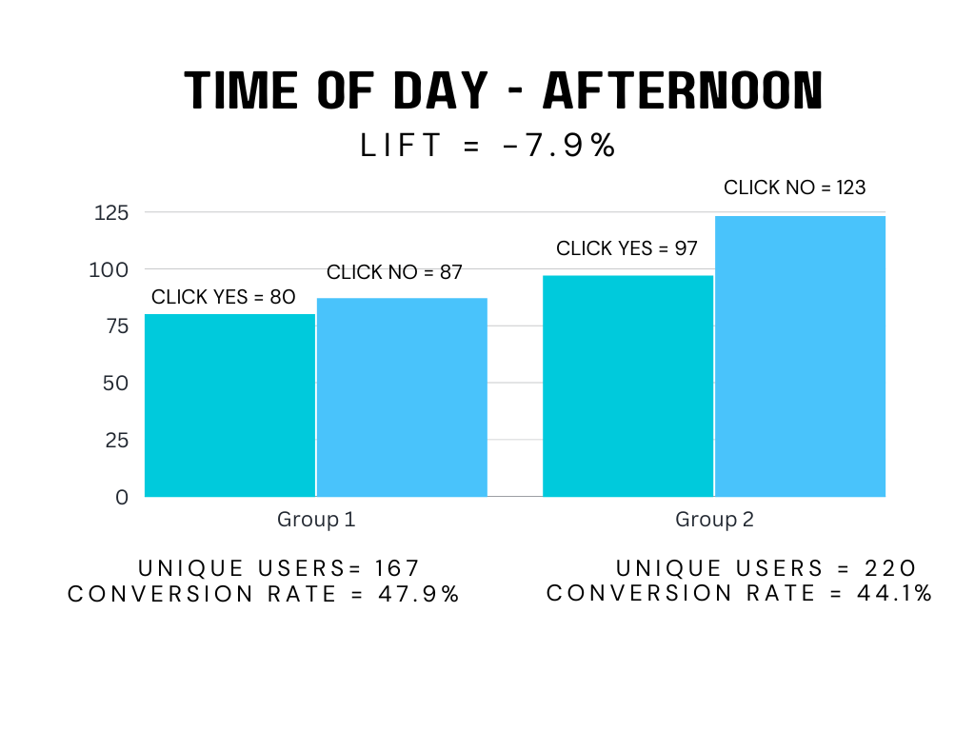
Overview of Results: Test 1 – Time of Day
Logistic regression results for interaction between time of day and group: non significant
Logistic regression results for time of day and group individually: non significant

Slide 20
Overview of Results: Test 2 – Time of Day
Logistic regression results for interaction between time of day and group: non significant
Logistic regression results for time of day and group individually: non significant for time of day, significant for group
The probability of taking action for a popup decreases by approximately 15.4% when moving from group 1 to group 2, holding all other variables constant.

Slide 21
Insights - Assessing the Impact of Popup Design on User Referral Decisions
Main findings:
Conversion rate around chance for clicking yes or no (random)
Design of popup did not influence users decision to refer a friend
Design of popup had attention grabbing effect (popup1)
Effect size small (approx. 2%)
Bayesian inference & logistic regression also confirm this is likely the case
Time of day did not influence attention to this popup or decision to refer a friend
However, if the effect is smaller than expected, statistical tests would need more participants to avoid false positives

Slide 22
Next Steps
Best choice would be popup 1 for attention grabbing effect
However, small effect
Possible that popup design does not influence users or different designs should be considered
Aspects of this popup could be integrated into web/app design
More participants needed to confirm whether popup design influences users to refer a friend
However, if popup design has small effect on users attention, it is unlikely that it would influence their opinion or decision making
To detect small effects a substantially larger sample size for each group would be needed (for users clicking yes or no)
Around 9700 per group needed, 19400 in total (for 2% difference, 45% and 47%)
Around 1184 users clicked yes or no over 8 days so it would take around 4-5 months to collect enough data
Further questions:
Do popups effect user experience? i.e. number of downloads, decision to renew subscription

Slide 23
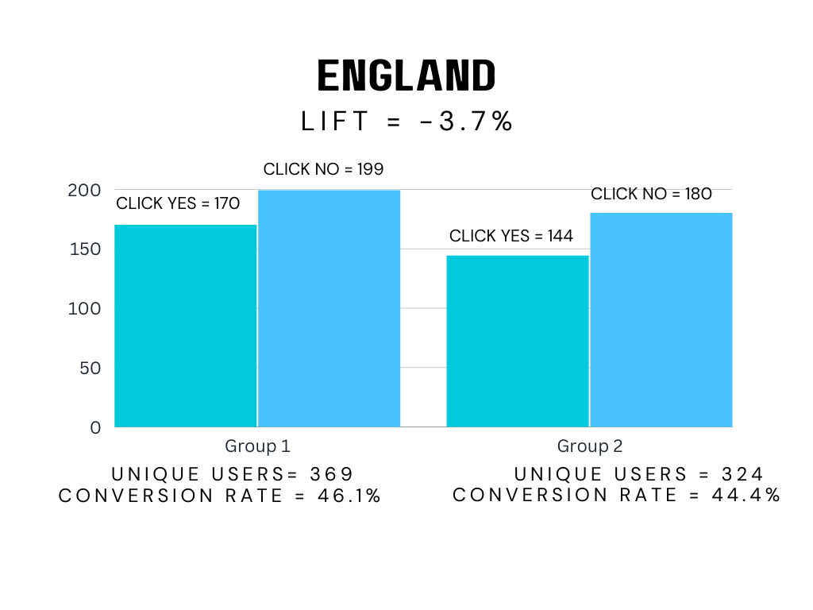
Overview of Results: Test 1 - England
Chi-squared test results:
Test statistic: 0.12
p-value: 0.72
Effect size: 0.02
95% confidence intervals:
Click Yes - Group 1: 0.4089858 - 0.5130588
Click Yes - Group 2: 0.3895214 - 0.5003924
Click No - Group 1: 0.4869412 - 0.5910142
Click No - Group 2: 0.4996076 - 0.6104786
Bayesian test:
Probability that Group 1 had higher conversion than Group 2: 66.7%

Slide 24
Overview of Results: Test 2 - England
Chi-squared test results:
Test Statistic: 12.30772
p-value: 0.0004510897
Effect size: 0.05265707
95% confidence intervals:
Action - Group 1: 0.1567963 - 0.189289
Action - Group 2: 0.1212664 - 0.1489564
No Action - Group 1: 0.810711 - 0.8432037
No Action - Group 2: 0.8510436 - 0.8787336
Bayesian test:
Probability that Group 1 had higher conversion than Group 2: 66.7%

Slide 25
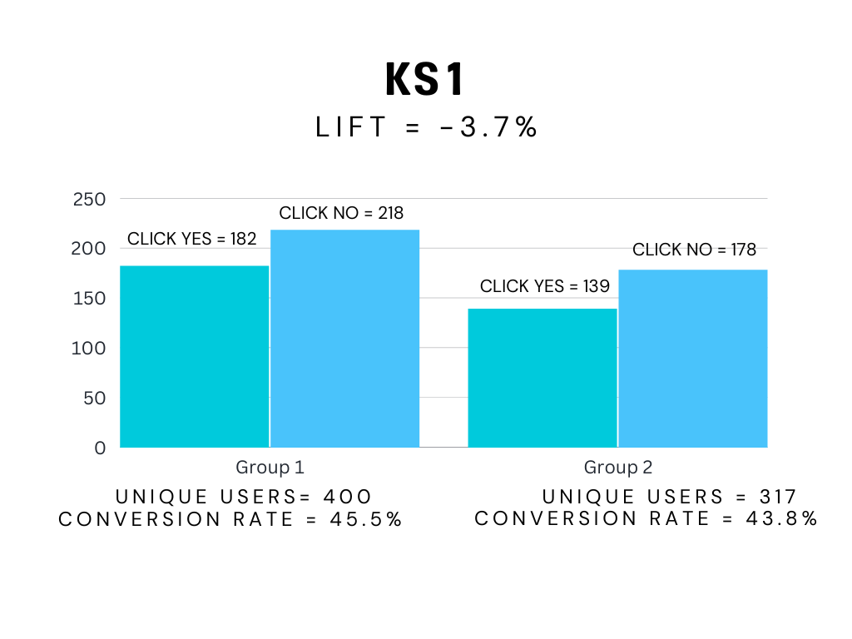
Overview of Results – KS1
Chi-squared test results:
Test statistic: 0.13
p-value: 0.71
Effect size: 0.02
95% confidence intervals
Click Yes - Group 1: 0.4054408 - 0.5052298
Click Yes - Group 2: 0.3830862 - 0.4950457
Click No - Group 1: 0.4947702 - 0.5945592
Click No - Group 2: 0.5049543 - 0.6169138
Bayesian test:
Probability that Group 1 had higher conversion than Group 2: 67.4%

Slide 26
Overview of Results – KS1
Chi-squared test results:
Test Statistic: 14.61181
p-value: 0.0001320845
Effect size: 0.05615214
95% confidence intervals
Action - Group 1: 0.1568393 - 0.1879297
Action - Group 2: 0.1184363 - 0.1458652
No Action - Group 1: 0.8120703 - 0.8431607
No Action - Group 2: 0.8541348 - 0.8815637

Slide 27
Overview of Results – Searches
Chi-squared test results:
Test statistic: 0.84
p-value: 0.36
Effect size: 0.03
95% confidence intervals:
Click Yes - Group 1: 0.4316289 - 0.5300019
Click Yes - Group 2: 0.4082659 - 0.4907038
Click No - Group 1: 0.4699981 - 0.5683711
Click No - Group 2: 0.5092962 - 0.5917341
Bayesian test:
Probability that Group 0 is better than Group 50: 83.70%

Slide 28
Overview of Results: Test 2 – Searches
Chi-squared test results:
Test Statistic: 6.400908
p-value: 0.0114062
Effect size: 0.03
95% confidence intervals:
Action - Group 1: 0.1517779 - 0.181408
Action - Group 2: 0.1321738 - 0.1539157
No Action - Group 1: 0.818592 - 0.8482221
No Action - Group 2: 0.8460843 - 0.8678262

Slide 29
Overview of Results – Time of Day
Logistic regression results:.
Time of Day:
Morning: The estimated coefficient for the Morning variable is 0.01553 with p-value 0.920 - represents the log-odds ratio between the morning and the reference level afternoon.
Night: The estimated coefficient for the Night variable is 0.03271 with p-value 0.822

Slide 30
Overview of Results – Time of Day
Logistic regression results:.
Intercept:
intercept value is -0.07405 with p-value of 0.738 - represents the log-odds of the outcome (clicking yes)
group: coefficient for the group variable is -0.06181 with p-value 0.622 - represents the log-odds ratio between the groups.

