Slide 1
Hypothesis Testing
Olivia Bryant
Thursday 26th October

Slide 2
VARIABLE = a measurement that varies between observations (e.g. height, sex, year of study).
Variables
Scale
Categorical
Continuous
Measurements take any value
Discrete
Counts or integers
Ordinal
Obvious order
Nominal
No meaningful order

Slide 3
Summary Statistics
Sample mean =
Standard deviation (SD) is a measure of how much the individuals differ from the mean. The variance is the square of SD.
Large SD = data is spread out.
Small SD = little variation from the mean.

Slide 4
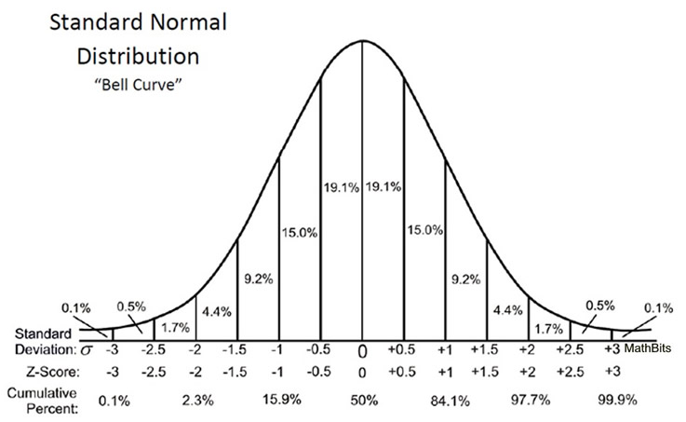

Slide 5
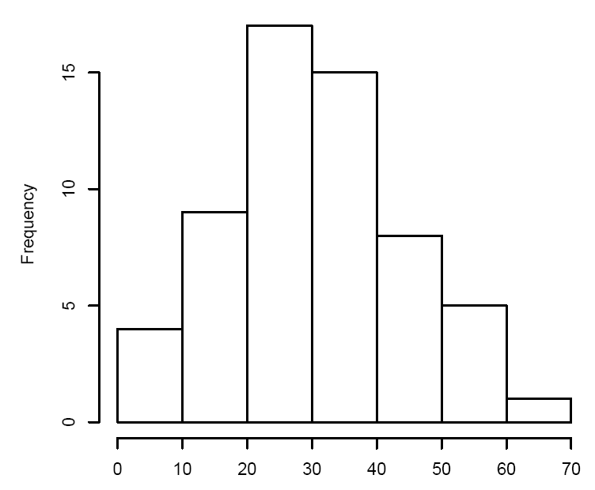
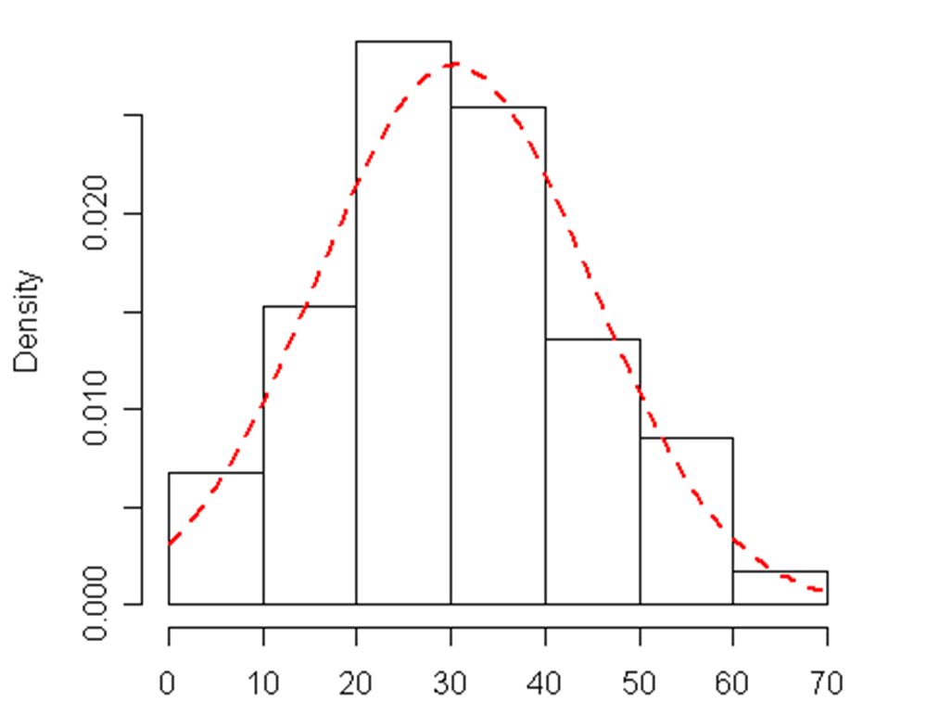
Histograms
Useful to visualize the distribution of the data.
Can plot a frequency or a density distribution (a histogram that looks at proportion of data of that value).

Slide 6
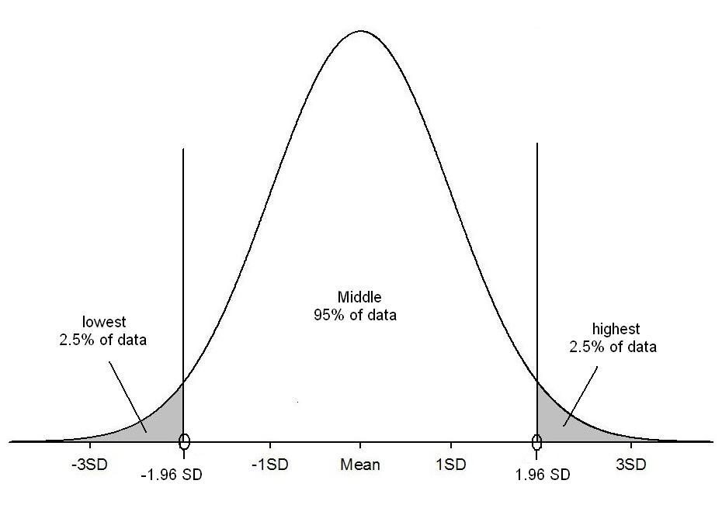
95% of the population lie within plus or minus, 1.96 x SDs from the mean
95% of values

Slide 7
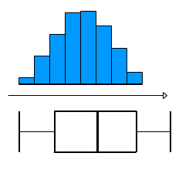
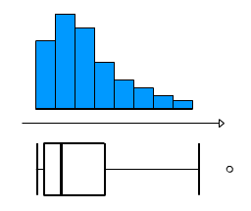
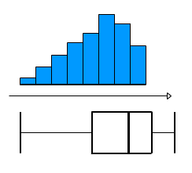
Box plots can be used to assess normality.
The mean and the median are different for skewed data. Currently the choropleths you have created show mean prescribing rates.
Median is more robust to extreme values
Normally Distributed
Skewed

Slide 8
Hypothesis Testing
An objective method for making inferences from sample data.
Comparing two hypotheses. Typically, we are comparing what we have observed to what we expect if one of the statement (null hypothesis) was true.
H_{A}: Research (alternative) hypothesis
What we aim to gather evidence of and usually, it relates to a difference/effect/relationship.
H₀ : Null hypothesis
What we assume is true to begin with. Typically that there is no difference/effect/relationship.

Slide 9
Define study question
Set null and alternative hypothesis
Calculate a test statistic
Calculate a p-value
Make a decision and interpret your conclusions

Slide 10
T-tests
Used to compare two population means.
Paired data for a paired t-test: same individuals studied at two different times or under two conditions.
Independent for an independent samples t-test: data collected from two separate groups
If we want to compare means between homeless GPs and non-homeless GPs, which type do you think we will use?

Slide 11
T-test Hypotheses
Example: we want to know whether petal length according to their species. You measure the petals of flowers of two different species.
Null hypothesis(H₀): the true difference between these two groups means is zero.
Alternative hypothesis(H_{A}): the true difference between the means of these two groups is not zero (i.e. there is a difference)
What are the hypotheses in the homeless GP example?

Slide 12
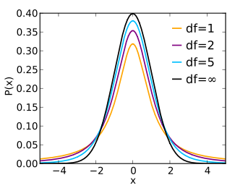
T-Distribution
Used to estimate the significance to of population parameters for small sample sizes or unknown variations.
For large n, this approximates to the normal distribution.

Slide 13
Assumptions for T-Tests
Normality: test this by plotting histograms of each group. Don’t have to be perfect, but ideally roughly symmetrical.
Equal population variance: compared the sample standard deviations.
Generally, t-tests are robust to violations of normality assumptions and equal variances, especially for moderate and larger sample sizes.

Slide 14
Mann-Whitney U/Wilcoxon Rank Sum Test
Used to compare means when the normality assumption is violated.
Used in very similar ways to the t-test.

Slide 15
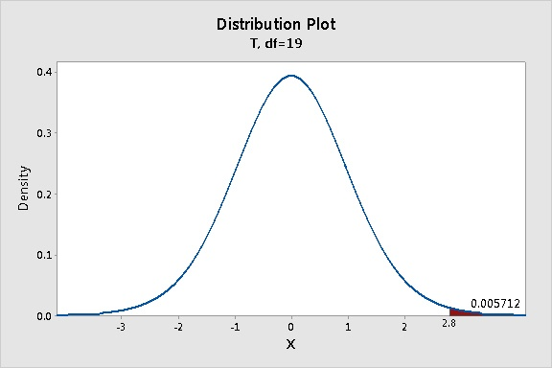
Interpreting T-Test results
T-statistic and p-value are linked. The higher the t-statistic, the more of a difference there is between the two means.
Typically p-value is reported.

Slide 16
 | Study reports NO difference (Limited evidence to reject the H₀) | Study reports IS a difference (Strong evidence to H₀)
H₀ is true Difference Does NOT exist in population
H_{A} is true Difference DOES exist in population

Slide 17
 | Study reports NO difference (Limited evidence to reject the H₀) | Study reports IS a difference (Strong evidence to H₀)
H₀ is true Difference Does NOT exist in population
H_{A} is true Difference DOES exist in population
Type 1 Error (typically restrict to a 5% level)
Type 2 Error (dependent on sample size

Slide 18
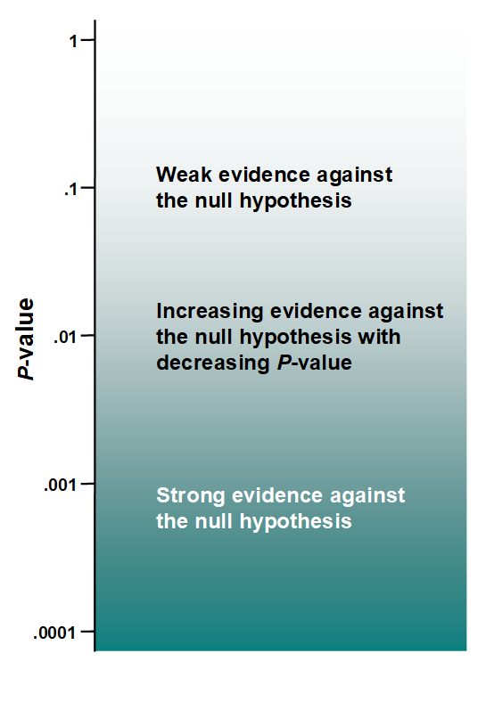
“Type I error”, rejecting the null hypothesis when it is true.
“Type II error”, accepting the null hypothesis when it is false.
Traditionally, the value of 0.05 has historically been used as a cut-off, with values of 𝑝<0.05 deemed “statistically significant” and values of 𝑝≥0.05 “not significant”. But is there really a difference between p=0.049 and p=0.051?
e.g. In the case of our flower example, we get a p-value of 0.04. Therefore, there is strong evidence against the null hypothesis, so strong evidence that there is a difference between the mean petal length of the two species.

Slide 19
Confidence Intervals
If we were to get a confidence interval of (1.2, 2), it is tempting to say that the probability that the population mean is between 1.2 and 2. BUT that is incorrect because it suggests that the variable has a distribution of potential values rather than 1 true value.
Strictly, the interpretation of a confidence interval has to be with respect to the process of repeated sampling: if we repeated the study an infinite number of times, 95% of the 95% confidence intervals calculated would include the true population mean.
We say we are 95% confident that the true value of the mean lies between 1.2 and 2.
If the confidence interval contains the null hypothesis (e.g. that the difference in means is zero), then the test is not significant.

Slide 20
Objectives
Write out your hypotheses.
Investigate the distributions of your data.
Run an appropriate test to assess the difference in means between the homeless and non-homeless GPs.
Run an appropriate test to assess the difference in means between the homeless GPs and the most deprived GPs.
Interpret your results.

