Slide 1
COMP 321 – Winter 2020 Problem Presentation Team Number: 1 Team Name: Nutmeg
Team Members:
Olivia Woodhouse, Bera Sogut, Syrine Enneifer
260734701, 260788386, 260856247

Slide 2
Section 0: Book-keeping
Team Members: Olivia Woodhouse, Bera Sogut, Syrine Enneifer
Team Roles: While all team members participated a fair amount, Bera was ultimately the one to figure out the working algorithm. However, all team members contributed to the project as a whole.
External Sources: COMP 321 Lecture Slides, https://docs.oracle (for java data structures and methods), http://cplusplus.com/ (for C++ data structures and methods).
We used Messenger to communicate.

Slide 3
Section 1: Problem Analysis
Juice: https://open.kattis.com/problems/juice2
Key Aspects:
The goal of this problem is to maximize the possible number of people that can be satisfied by a mixture of A, B, and C (where A + B + C ≤ 10000) given each person’s personal preferences.
A person is considered satisfied by the mixture if A, B, and C in the final mixture are all greater than or equal to the subsequent minimum fraction of each of the 3 juices that the person prefers. In other words, if a person’s minimum fraction for A is 1000, this person will only be satisfied by the mixture if the amount of A juice in the mixture is 1000 or more and same for juice B and juice C.

Slide 4
Section 1: Problem Analysis
Juice: https://open.kattis.com/problems/juice2
Problem Analysis:
Essentially, this problem is an optimization problem. We are trying to satisfy as many people as possible without exceeding the limit A + B + C ≤ 10000.
→ What we care about is not exceeding 10 000.
For example, if a portion of 200 of juice A satisfies the equation and so does a portion of 220, we can take anything between 200 and 220 as long as the sum of the fractions of each juice in the drink is not over 10 000.

Slide 5
Section 1: Problem Analysis
Juice: https://open.kattis.com/problems/juice2
Input:
1st line = integer T (the number of test cases in the input file).
The next T test cases each start with integer N (the number of people going to the party) followed by N lines indicating the preferences of the N people, each one of these lines contains three space-separated integers (indicating the minimum fraction of A, B, and C for each person).
Note that: A + B + C ≤ 10000, 1 ≤ T ≤ 2, and 1 ≤ N ≤ 5000.
Output:
The output must contain T lines and each line will read “Case #X: x” (where X := the test case number being referred to and x := the maximum number of people who will like the determined drink of that test case).
→ We want to maximize x (we want to satisfy as many people as possible).

Slide 6
Section 1: Problem Analysis
Juice: https://open.kattis.com/problems/juice2
Test cases on Kattis:
In the first case : For each juice, there is one person that wants the drink to have a minimum fraction of 10 000 of the juice being considered.
Clearly, we can only satisfy one of them.
In the second case : We can not satisfy everyone because if we do, we will go over 10 000 hence we can only satisfy any two of the three preferences.
In the third case : If we make the drink using equal thirds of each juice, all five people will be satisfied.

Slide 7
Section 2: Problem Analysis
Solution Concept #1: The Greedy Algorithm (Run-time Complexity: O(t*n^3))
The first algorithm we attempted consisted of 3 for loops (as indicated below). This algorithm, however, is too slow for the given constraints as the run-time complexity comes to O(t*n^3) for 1 <= n <= 5000 and 1 <= t <= 2.
It is sufficient to try only the amounts that people have as their desires. For example for juice A, let's say that when we sort the desires of juice A we get 13 99 117 520, we do not need to try the amounts between 13-99 because it will not increase the answer since it doesn't let us satisfy any more people. Having 13 of juice A, satisfies the person with 13 juice A, 14 will also satisfy that person but the next juice A is 99, so until we get to 99 it will not satisfy his juice A desire. Same goes for between 99-117 and 117-520.

Slide 8
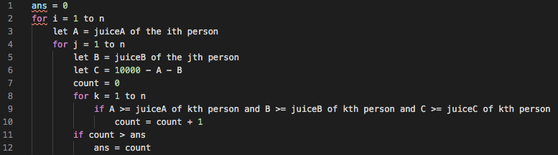
Section 2: Problem Analysis
Solution Concept #1: The Greedy Algorithm (Run-time Complexity: O(t*n^3))
This solution tries every juice A and juice B, since juice C could be up to 10000 - A - B, we set C to this value, and then see how many people satisfy these values and update the answer if we need to.
Pseudocode:

Slide 9
Section 2: Problem Analysis
Solution Concept #2: The Greedy Algorithm (Accepted)
The accepted solution tries everyone’s desire of juice A and juice B, when these are chosen, our juice C limit could be up to 10000-juice A-juice B thus we do not need to try juice C. We determine the number of people we satisfy with these values using a max heap and we update the answer if it is more than the previous answer. At the end we have our answer because we tried all values.

Slide 10
Section 2: Problem Analysis
Solution Concept #2: The Greedy Algorithm (Accepted)
The run-time complexity of this algorithm is O(t*n^2*log(n)). We have 2 nested for loops, first one is n steps, and the nested one could also be up to n steps, that is n^2, and inside we are using a max heap (priority queue) which pushes and pops the maximum element in O(log(n)) time, giving us a total runtime of O(n^2*log(n)).
The number of elements that could be popped from the priority queue is at most n since every element in the vector will be pushed but the vector can have at most n elements. Thus, the while loop will be true at most n times in a choice of juice A (n^2 in total), which does not lead to an increase in the run-time complexity.

Slide 11
Section 2: Problem Analysis
Solution Concept #2: The Greedy Algorithm (Accepted)
The memory complexity of this algorithm is O(n^2) since in each choice of juice A, we define a new vector and a new priority queue which both could have up to n elements, leading to O(n^2).

Slide 12
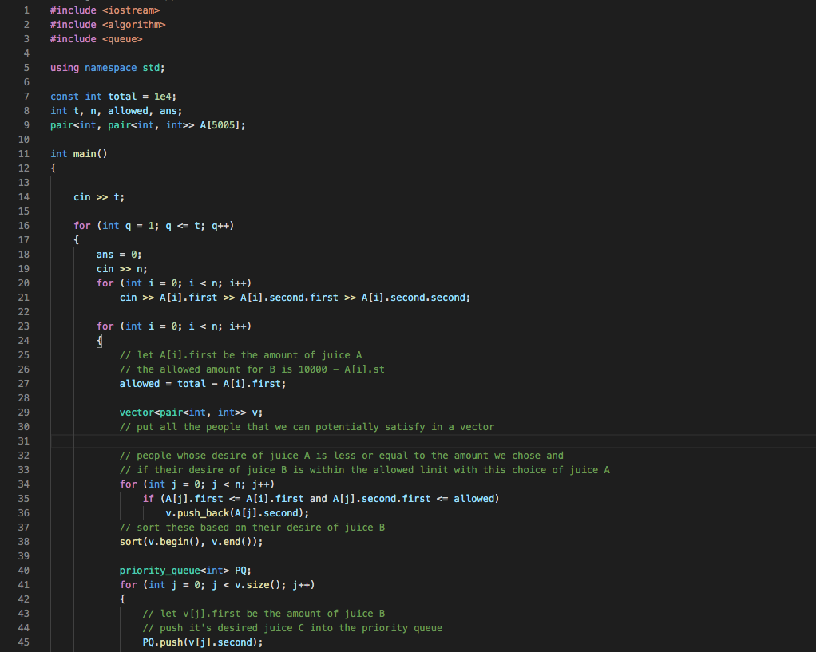

Slide 13
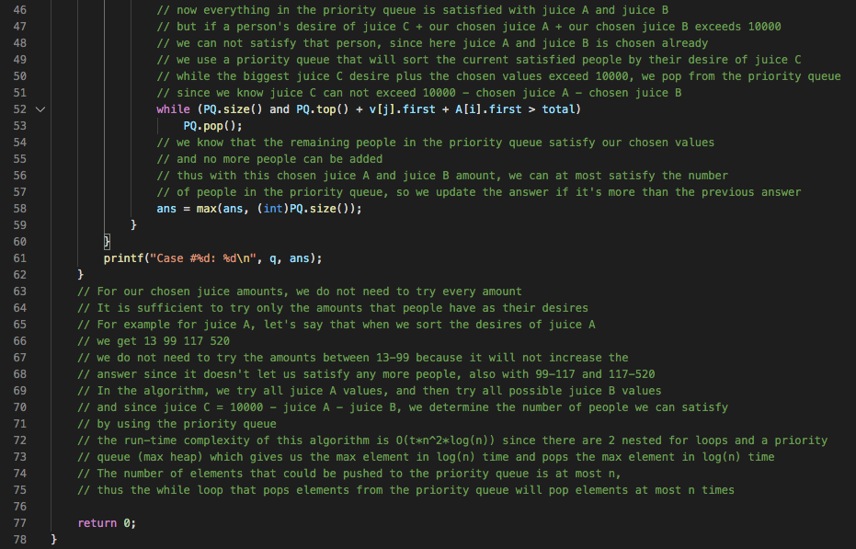

Slide 14
Section 2: Problem Analysis
Solution Comparison
The first solution which came to our mind at first is too slow for the given constraints, O(t*n^3) for 1 <= n <= 5000 and 1 <= t <= 2.
The second solution is O(n^2*log(n)) and that works for the given constraints
We thought about the second solution and tried it on Kattis, it worked and the runtime indicated 1.32 seconds. Since the time constraint on Kattis is 12 seconds, we felt that this solution was pretty efficient.
However, we do believe that there could be a better solution with run-time complexity O(10000*n) but this solution would have a worse memory complexity so we decided to keep our accepted O(n^2*log(n)) solution.

Slide 15
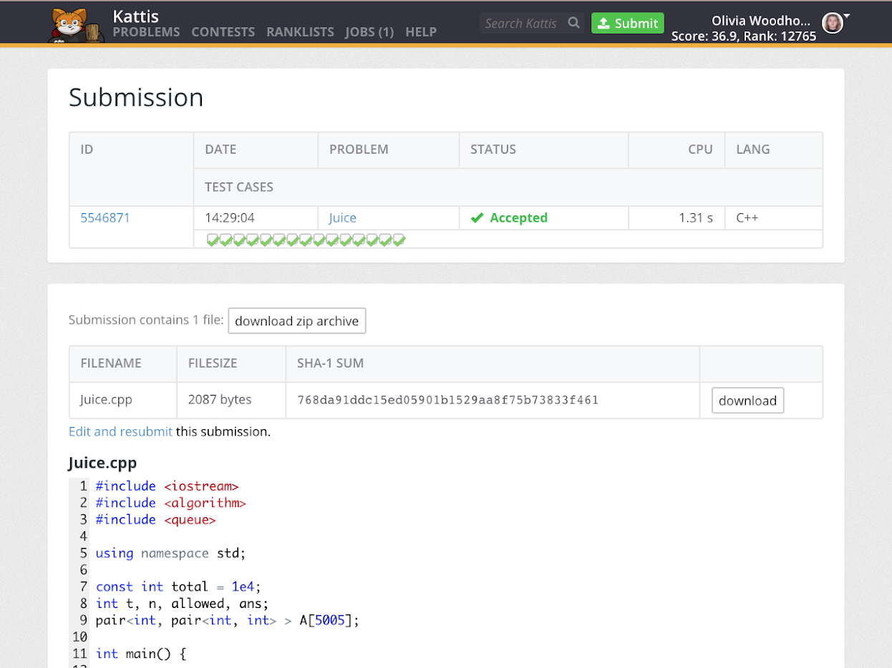
Section 3: Kattis Performance

