Slide 1
Pi Calculation using MapReduce

Slide 2
Overview
Introduction
Design
Implementation
Test
Conclusion
Enhancement Ideas
Reference

Slide 3
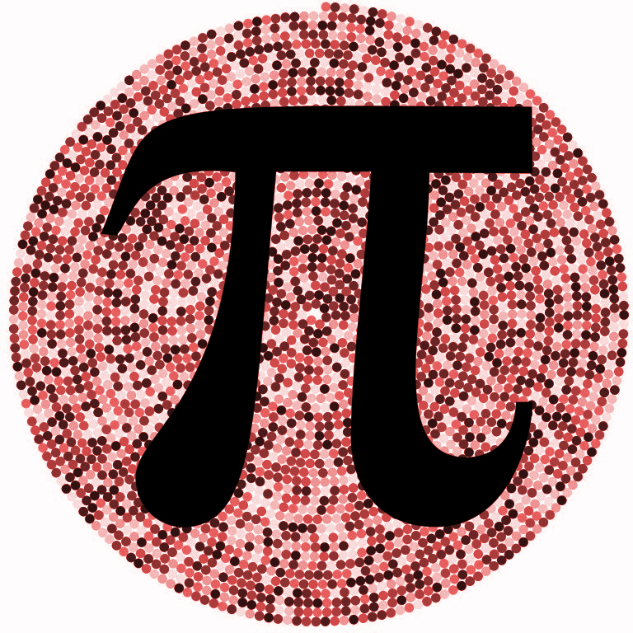


Introduction
The number π is a mathematical constant, approximately equal to 3.14159.
Many different ways to estimate its value.
In this project, we will use a mathematical- simulation way to estimate the value of π.
To speed up the speed of calculation, we deploy the whole process on MapReduce model to implement pi calculation.

Slide 4
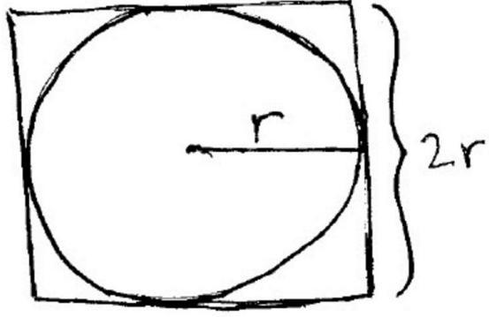
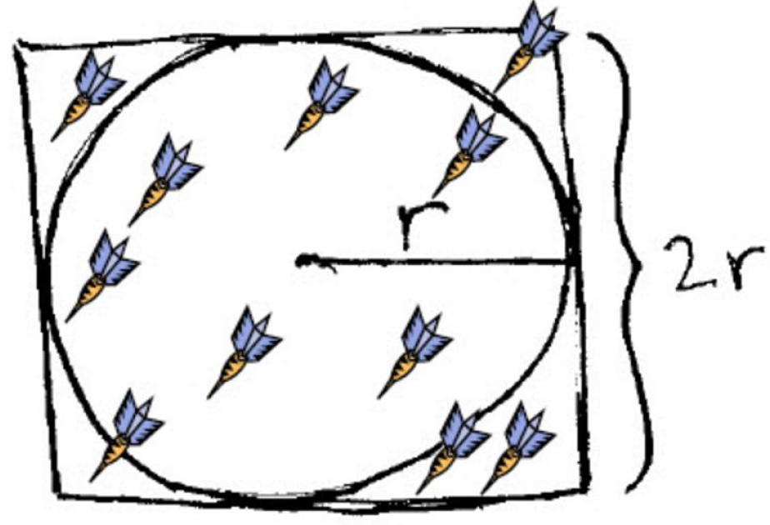
Design – Estimate Pi
Image you have a dart board, possibility of dart in circle is:
P = πr^2/r^2 = π/4 => π = 4*P
π is simply ( the ratio of darts that land inside
the circle to the total number of darts thrown ) times 4.

Slide 5
Design – Estimate Pi
How to calculate possibility P?
Throw N darts on the board, each dart lands at random position (x,y) on the board.
Take the total number of all darts land
inside circle as S.
P = S/N ==> π = 4 P = 4 * (S/N)
Assume you can throw enough darts to make the whole board is fully covered by darts, then the estimation is more accurate.

Slide 6
Design – Estimate Pi
How to check if one dart (x,y) lands inside the circle with radius r or not?
(x - center_x)² + (y - center_y)² compare r²
Inside: if compare is <
Outside: if compare is >
On the circle: if compare is =

Slide 7
Design – Map() function in MapReduce
Let us map each dart (x, y) to an output result which stands for if the dart is inside the circle (1) or not(0).
Examples ( Assume radius is 5 )
Input Result
(5, 5) → inside,1
(7,10) → outside,1
(4, 5) → inside,1

Slide 8
Design – Reduce() function in MapReduce
Sum them up to get the total number of inside and outside respectively as output for Reduce function.
Input Result
inside,1 inside, 2
outside,1 outside,1
inside,1
Calculate Pi:
S = inside = 2
N = (inside + outside) = 3
P = 2/3
Pi = 4*P = 4 * 2/3 = 2.67

Slide 9
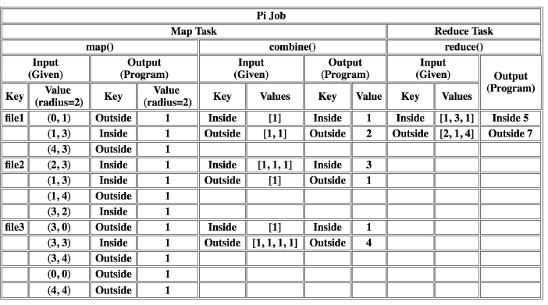
Design – MapReduce Table Example

Slide 10
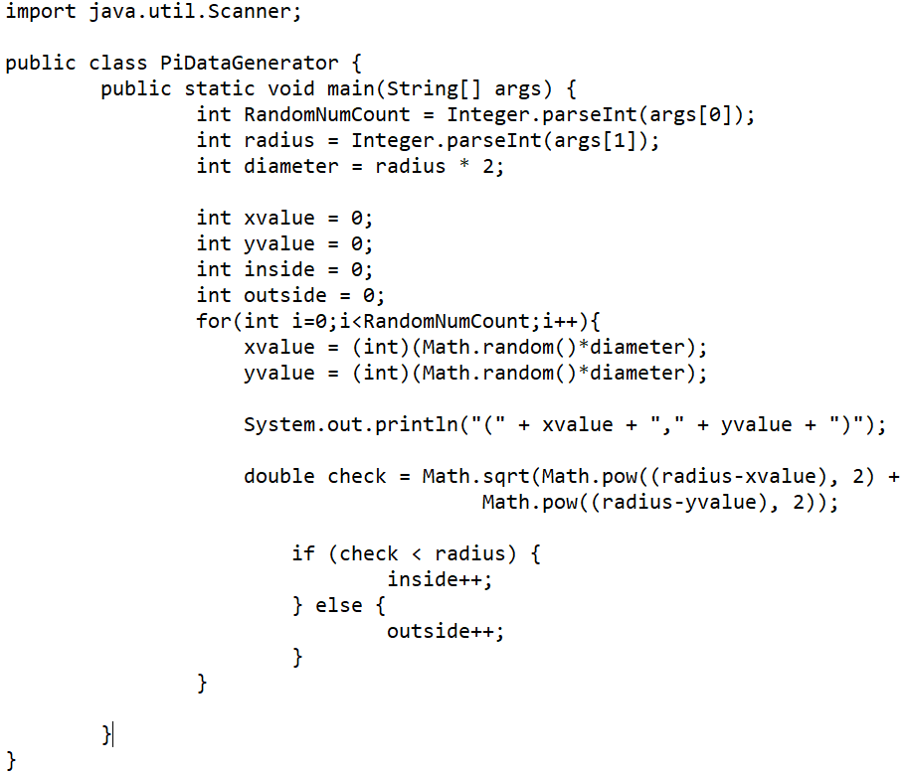
Implementation – Generate random number pairs
On GCP Ubuntu environment:
Create a java program
$ vi PiDataGenerator.java
Compile
$ javac PiDataGenerator.java
Run
1st argument: number of random number pairs
2nd argument: radius of circle
$ java PiDataGenerator 1000000 200 > r200_input_ref
Remove the last 4 redundant lines
$ head -1000000 r200_input_ref > r200_input

Slide 11
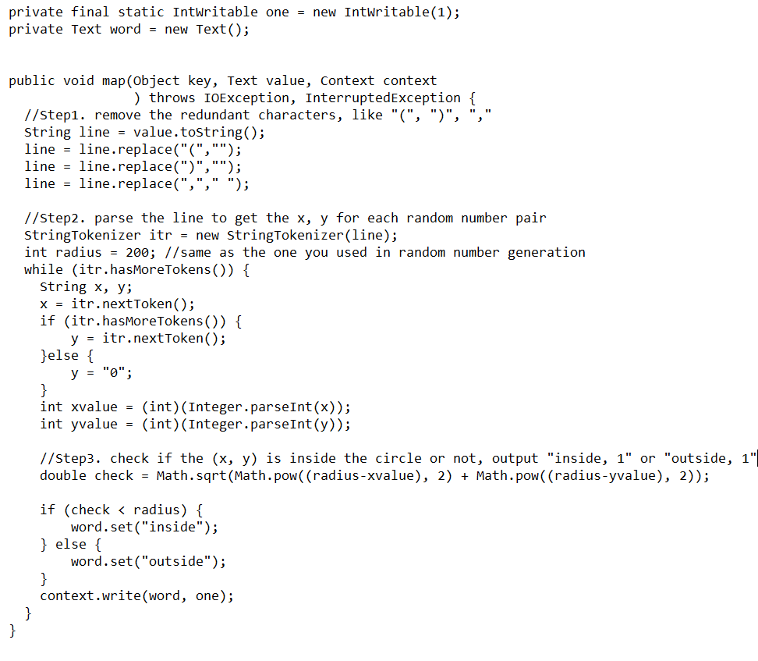
Implementation – Implement Map() function
Preprocessing the line content
Remove redundant characters
Parse the line to get (x,y)
Check if (x,y) is inside the circle or not, and display the result
(inside,1) or (outside,1)

Slide 12
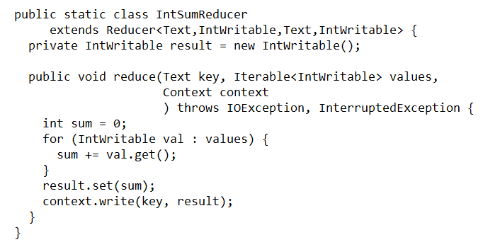
Implementation – Implement Reduce() function
Combine the same-key lines, get the final result:
inside, sum0
outside,sum1

Slide 13
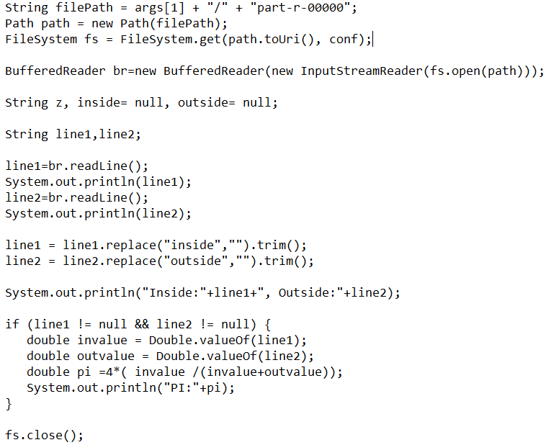
Implementation – Calculate Pi in main function
Read in the output file from reduce function, calculate pi using this formula:
pi = 4 * (sum0/(sum0 + sum1))
sum0 = inside value
sum1 = outside value

Slide 14
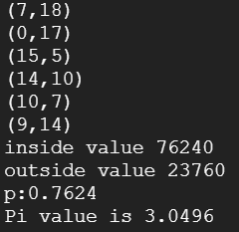
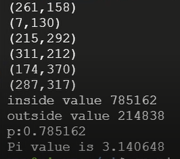
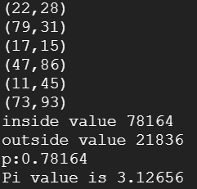
Random Numbers Pair Generation
N = 1000000
radius=200
N = 10000
radius=10
Test
N = 100000
radius=20
Picked

Slide 15
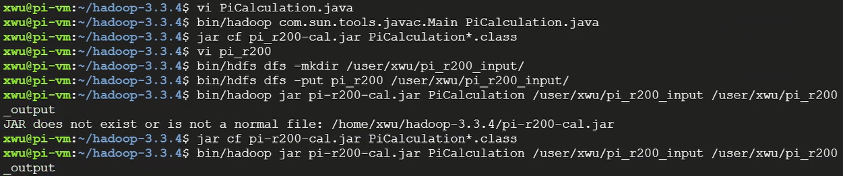
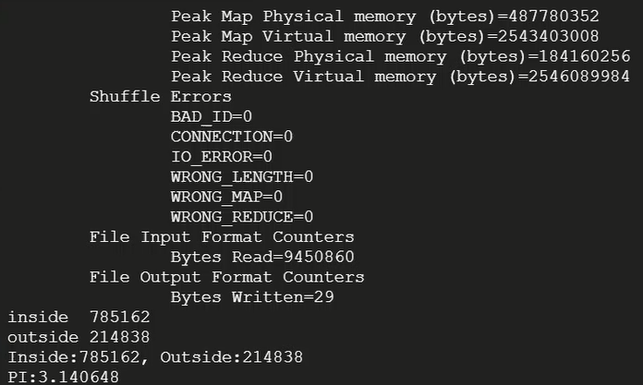
Hadoop MapReduce Run on GCP
Commands
Test
MapReduce Result Display
Pi Estimation

Slide 16
Conclusion
Hadoop/MapReduce could process the huge dataset so as to speed up the whole process of Pi Calculation.
Through practice on GCP, learn a lot about this platform.

Slide 17
Enhancement Ideas
Generate double-type of random number pairs instead of integer type…
Reduce the amount of input data
Higher accuracy
Implement a combine function for the MapReduce program...
Reduce the time taken for data transfer
Reduce the amount of data

Slide 18
Reference
Apache Hadoop 3.3.4 – MapReduce Tutorial
Apache Hadoop 3.3.4 – Hadoop: Setting up a Single Node Cluster.
[014] Provisioning a Linux server using Google Cloud Platform - YouTube
Overview of Pi calculation using MapReduce (sfbu.edu)

Slide 19
Thank you!

