Slide 1


IEOR E4574 Prediction： A Real-World Application
Electricity Load Prediction
Hugo Ginoux (hg2632)
Olivia He (qh2266)
Xinyu Wang (xw2814)
Zhening Zhang (zz3040)
Github for Code: https://github.com/OliviaaaHe/forecasting_proj2

Slide 2


CONTENTS
Introduction
Data Overview
Data Process
Visualization
Feature Engineering
Model
Result Analysis

Slide 3

Introduction
GOAL：Predict the Electricity Load Based on Historical Data.
IMPROVEMENTS:
Changing the spectral clustering parameter to ‘nearest_neighbors’ to get a more balanced division of clusters.
Get a slightly better prediction on SARIMA and facebook prophet as we select a more “center” client instead of randoming choosing the first one by the name.
Significantly improve the result to around 5% MAPE for prediction of the total electricity, by adding two features: time spent and the amount of present clients.
The purpose of this project is to learn the pattern from past electricity consumption data to forecast the quantity of electricity consumption in the future under the assumption that the pattern will resemble itself in the future.
Notes:
Change the improvement

Slide 4
Data Overview
Data Source:
Collected from UCI Machine Learning Repository
Data information
Data were collected for years from 2011 to 2014
140256 records in total, time difference between records are 15 minutes.
370 features in total, each feature represents one client

Slide 5
Data Preparation
Data Format
Replace the comma in value as decimal point
Convert the string value to float
Convert the unit from kW per 15 min to daily electricity load
Missing Value
The records before a client was generated were filled by 0
Almost half of the clients were generated in 2012, so only use the data after 2012
Time difference
In March time change day the values between 1:00 am and 2:00 am are zero
In October time change day the values between 1:00 am and 2:00 am aggregate the consumption of two hours

Slide 6
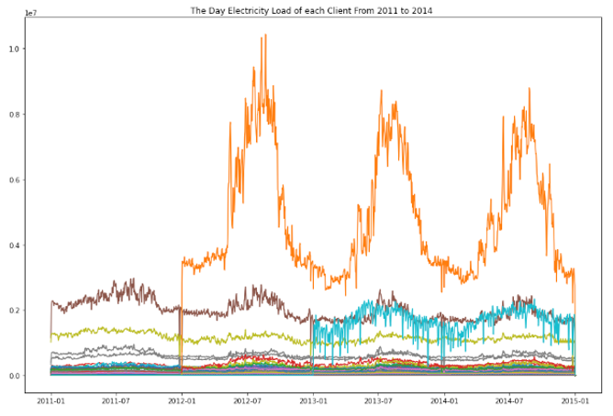
Visualization - Clients’ Electricity Load
Distribution of Electric Load of each client is different.
Seems like most clients has same periodic change in the amount usage: More electric load in the summer

Slide 7
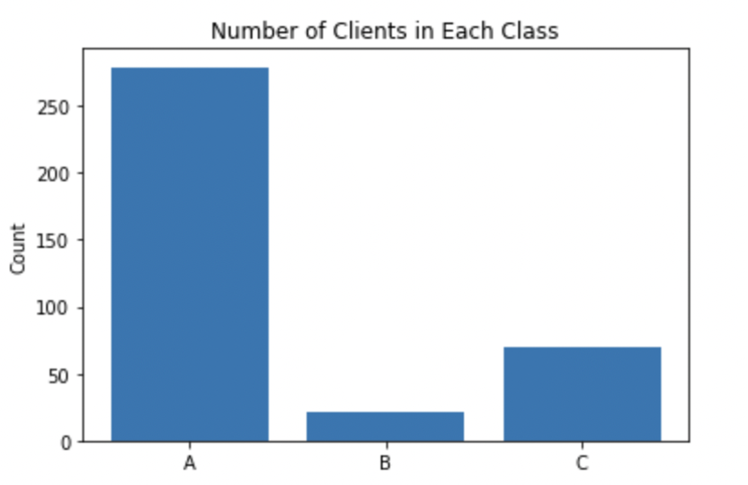
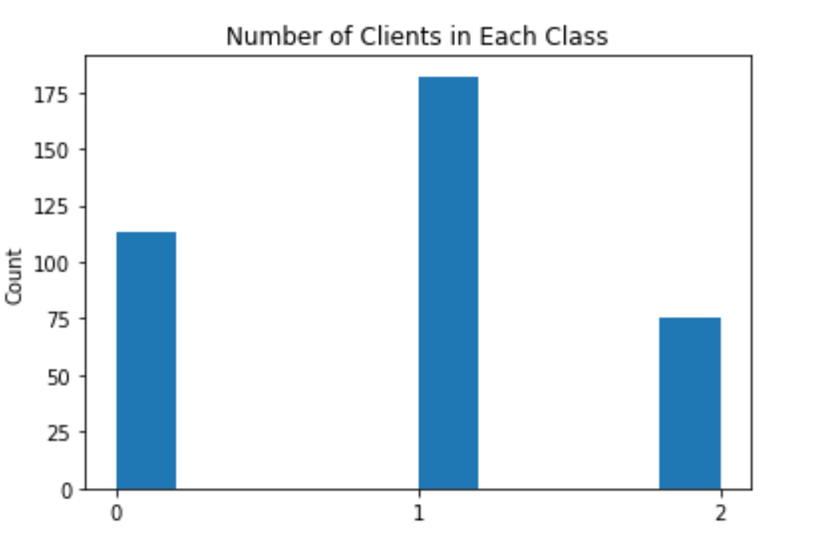
Visualization - Clients’ Class
On the left is the previous groups’ result and on the right is ours. It’s obvious that our result is more balanced.
113 clients in the Class A, 182 clients in the Class B and 75 clients in Class C.
Choose clients ‘MT_171’, ‘MT_047’, and ‘MT_250’ as the representative to build the predictive models for group A, B and C respectively based on affinity matrix.

Slide 8
Feature Engineering
Target Variables:
The electric load of clients in year 2014
The total electric load in year 2014
Predictive Variable:
Month: month of the date.
Weekday: Monday to Sunday.
Time spent: days spent from the start date.
People: the amount of present people (with usage > 0).
Changes: We removed two features “year” and “day”, because all the testing data are in the different year of training data and removing feature “day” can avoid overfitting.

Slide 9
Train & Test Split
Changes: for missing values, we didn’t delete all the data from 2011. Instead, we only remove the missing values (usage = 0) for the individual data.
Training Dataset:
Data collected from 2011 and 2013
Testing Dataset:
Data collected from 2014
Split to 3 groups with each includes 4 months data in 2014
* We split training set into development and validation sets only for the SARIMA model for hyperparameter tuning, the other 2 models do not require tuning

Slide 10
Model
GLM (Linear regression, XGBoost, Random Forest):
Predict 2014 electric load based on predictive features.
SARIMA Model :
Considers the trend and seasonal effect based on the ARIMA model.
Order of AR and MA: 0-10 and 1-10 respectively.
Facebook Prophet :
Decomposes a time series into trend, seasonality and holiday effects.
Added the weekday, month and day as exogenous features.
Notes:
Change linear regression to following models

Slide 11
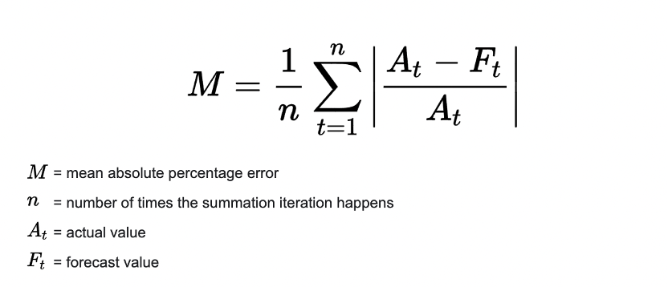
Evaluation Metric
MAPE: mean or average of the absolute percentage errors of forecasts

Slide 12
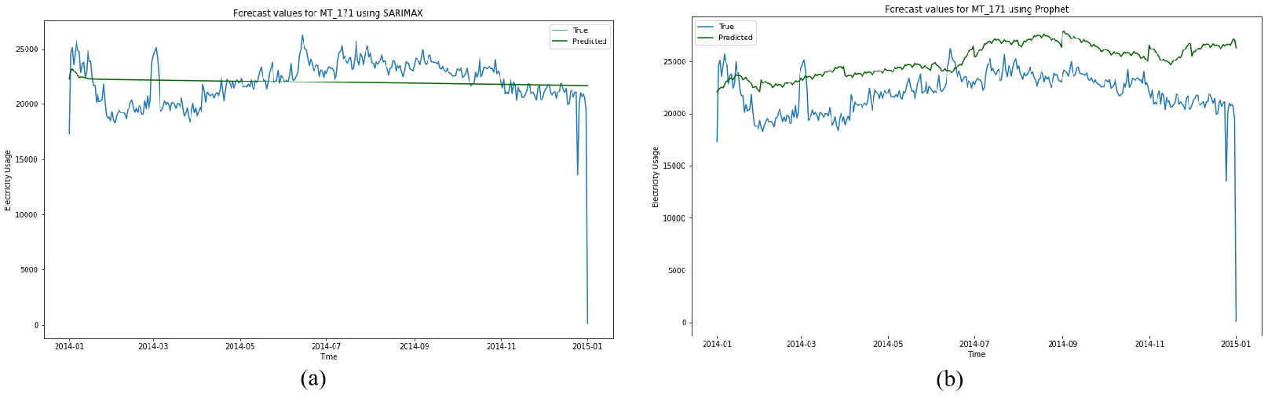
Model for Group A
Their model:
They used MT_001 to train their model and evaluated the overall performance by choosing the first 6 clients for each cluster and calculating the mean of their MAPEs to represent other clients for each group.
Our model:
GLM (Linear, XGBoost): We used every person's usage per day as target variable, along with their months, weekday, time lasting features.
Time series (SARIMA, Prophet):
1. We use MT_171 to train the model and use the median of the MAPE for all the other clients to represent the overall MAPE.
2. We train the model for each client in Group A and use the median of the MAPE as the overall MAPE.
Notes:
feel free to change the words and the figures

Slide 13
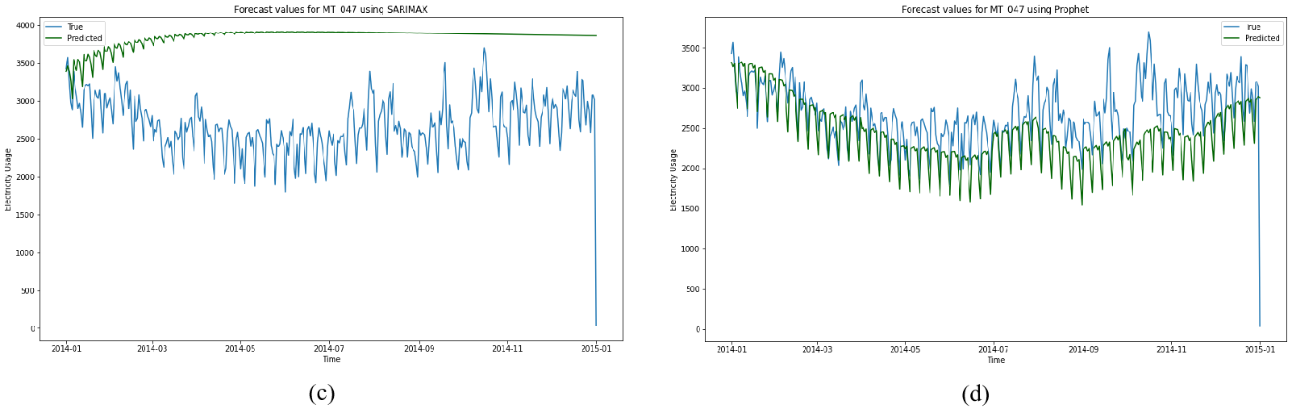
Model for Group B
Their model:
They used MT_017 to train their model, and evaluated the overall performance by choosing the first 6 clients for each cluster and calculating the mean of their MAPEs to represent other clients for each group.
Our model:
GLM (Linear, XGBoost): We used every person's usage per day as target variable, along with their months, weekday, time lasting features.
Time series (SARIMA, Prophet):
1. We use MT_047 to train the model.
2. We train the model for each client in Group B.
Notes:
feel free to change the words and the figures

Slide 14
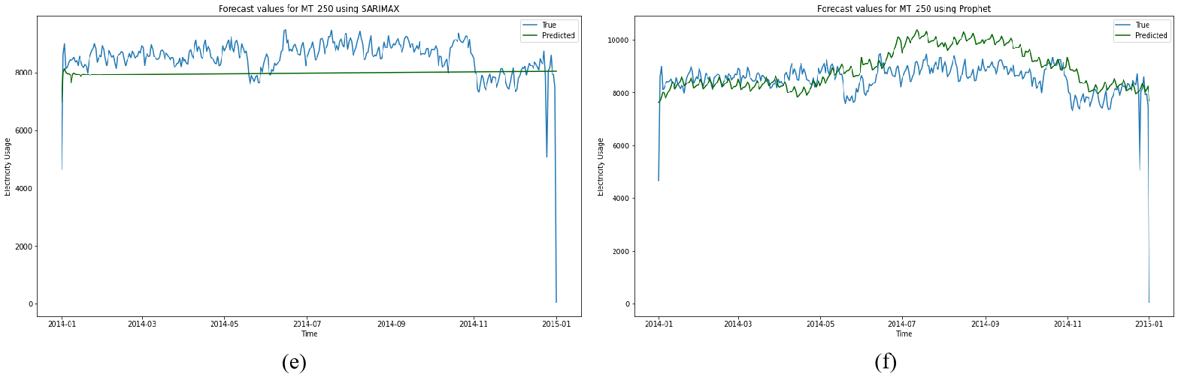
Model for Group C
Their model:
They used MT_005 to train their model, and evaluated the overall performance by choosing the first 6 clients for each cluster and calculating the mean of their MAPEs to represent other clients for each group.
Our model:
GLM (Linear, XGBoost): We used every person's usage per day as target variable, along with their months, weekday, time lasting features.
Time series (SARIMA, Prophet):
1. We use MT_250 to train the model.
2. We train the model for each client in Group C.
Notes:
feel free to change the words and the figures

Slide 15
Model for Total
Their model:
With the target variable of “daily total usage”, they trained a linear regression on the follow features: year, month, day, and weekday.
Our model:
With the same target variable, we trained the model use four different models (linear regression, XGBoost, Facebook Prophet, SARIMA) on the follow features: month, weekday, time spent, people.
Important changes:
1. We removed two features “year” and “day”, because all the testing data are in the different year of training data and removing feature “day” can avoid overfitting
2. We add two features:
time spent:days spent from the start date.
people: the amount of present people (with usage > 0).
The two changes end up significantly improving the model performance to 5% MAPE.

Slide 16
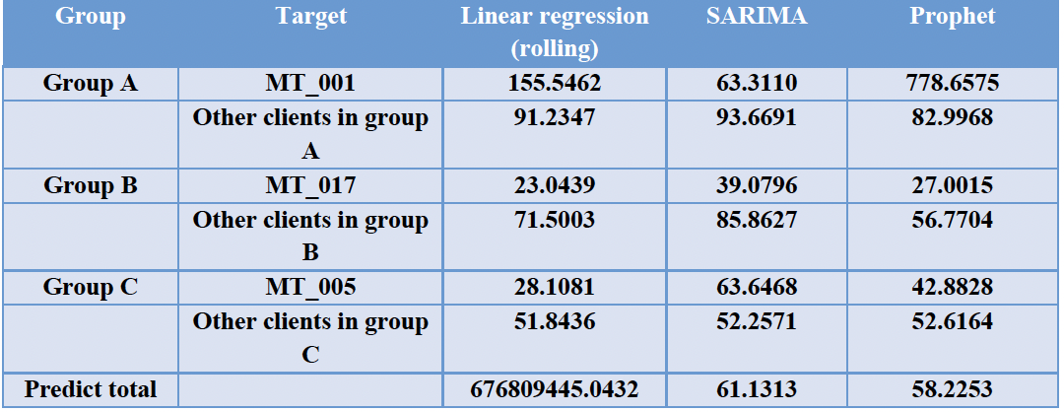
Results Comparison - Previous
Group A: SARIMA performs better on both MT_001 and other clients in same group
Group B: Although Regression performs best on Mt_017, Prophet has better performance on both Mt_017 and other clients in the same group
Group C:Regression performs best on both MT_005 and other clients
Total: Prophet has best performance

Slide 17
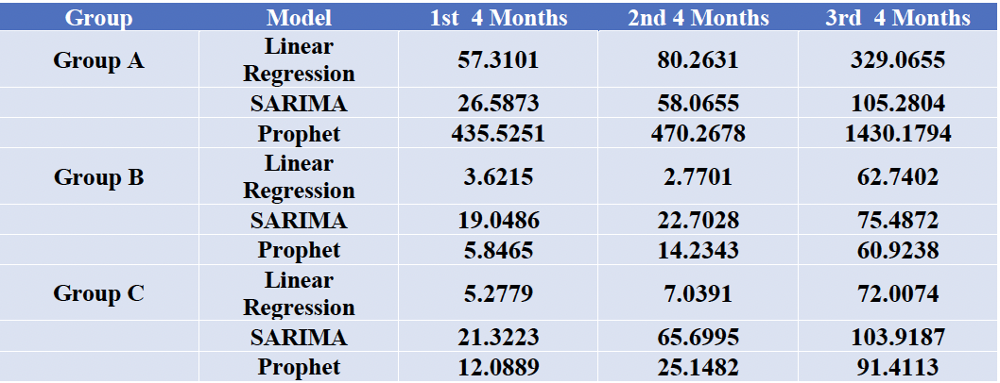
MAPE in Stages - Previous
MAPE is increasing as the time goes by
Reasonable since we use sliding windows in our predictions

Slide 18
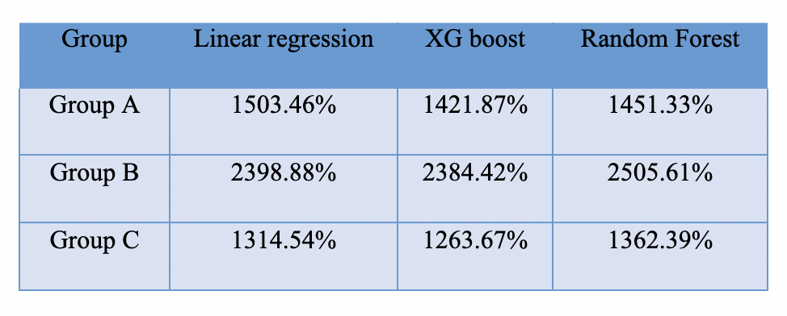
MAPE in GLM - Individual
Since these GLM models couldn’t capture every type of customer, there’s a large fluctuation inside each group, which gave us a large error in MAPE.
Notes:
Colin

Slide 19
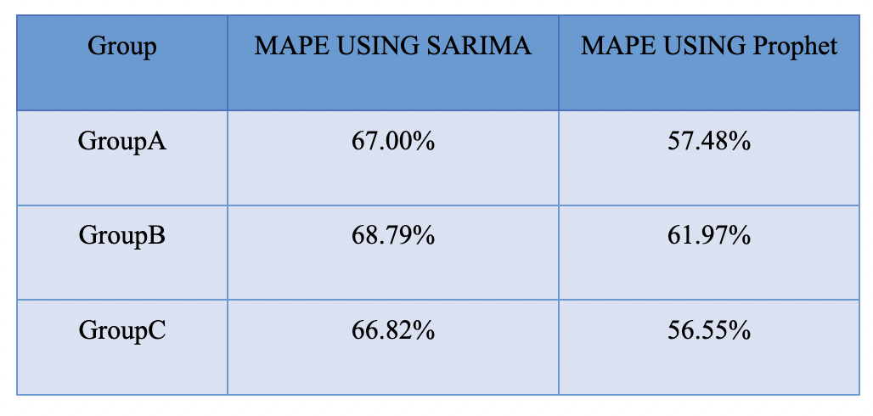
MAPE in Time Series - Individual
Both SARIMA and Prophet perform the best on Group C and worst on Group B, which is consistent with our result of the GLM models. So the patterns of the electricity usage of clients in Group C may be easier to capture than Group A and Group B.
Compared with the previous results, we get a better prediction as we select a more “center” client instead of randoming choosing the first one by the name.

Slide 20
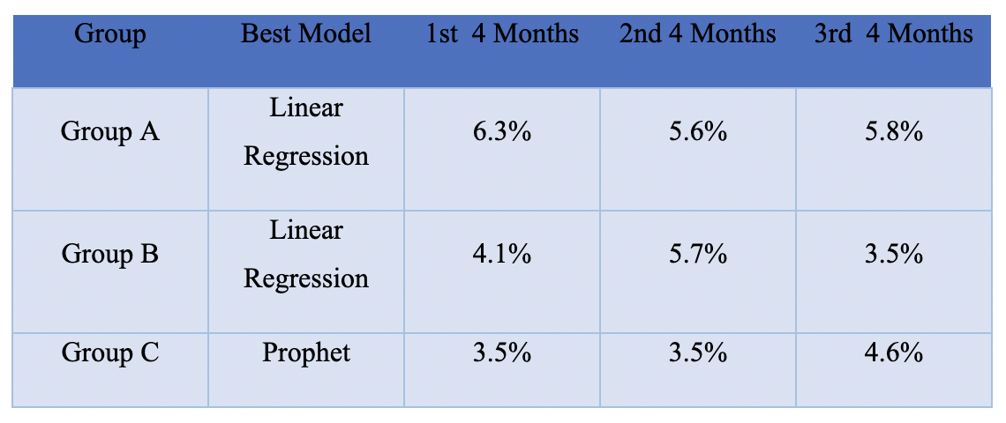
MAPE in GLM - Total
Obviously, our model have a very good prediction on the total electricity consumption for all the groups.
The best model for group A, B, C are linear regression model, linear regression model, and Facebook Prophet respectively.

Slide 21
Conclusion
By doing the following process:
Data Cleaning
Data Visualization
Client Classification
Feature
Engineering
Model
Building
Result Analysis
We get our conclusion:
For individual prediction, several improvements are made but all the models still have very high MAPEs (greater than 50%).
For total electricity consumption prediction, the best model are linear regression and facebook prophet.

Slide 22

Thanks For Watching

