Slide 1

Mission To Mars
FIT 5136 Assignment1
Group 22
Sifan Chen 29486084
Heming Chen 26264838
Bangyu Li 30879582
Shengdao Li 30202833

Slide 2

CONTENTS
Text-Based Prototype
01
Introduction
Brief introduction of prototype through flow chart
02
Feature 1
Creating a mission
03
Feature 2
Selecting a space shuttle
04
Feature 6
Registering as candidates

Slide 3
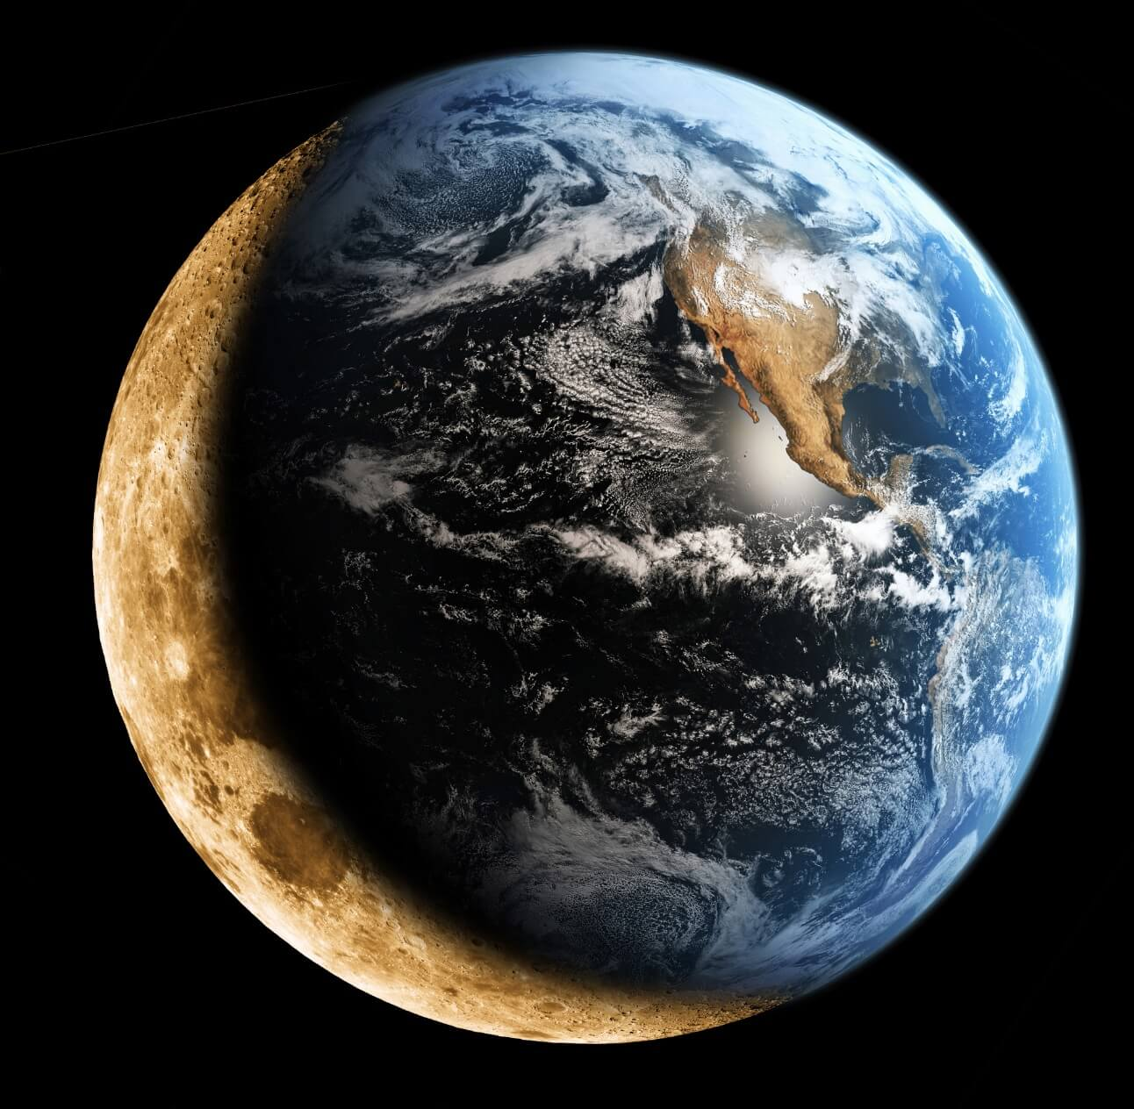
PART ONE
Introduction

Slide 4
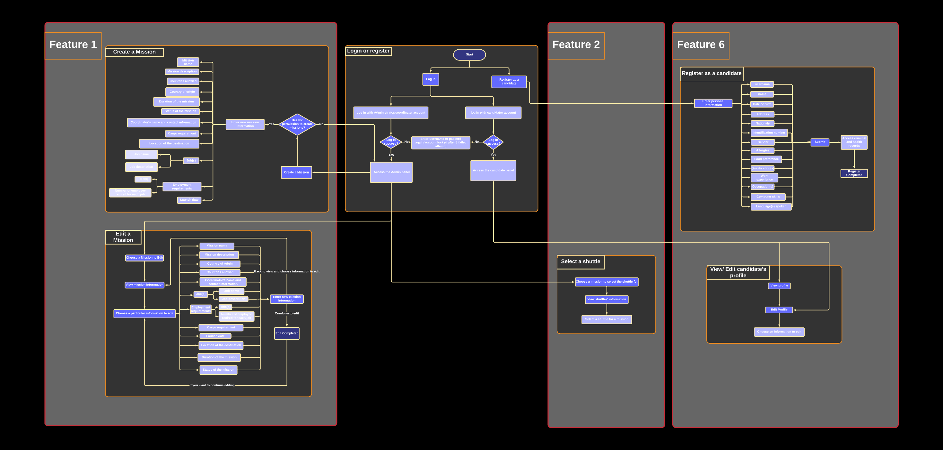
Text-Based Prototype

Slide 5
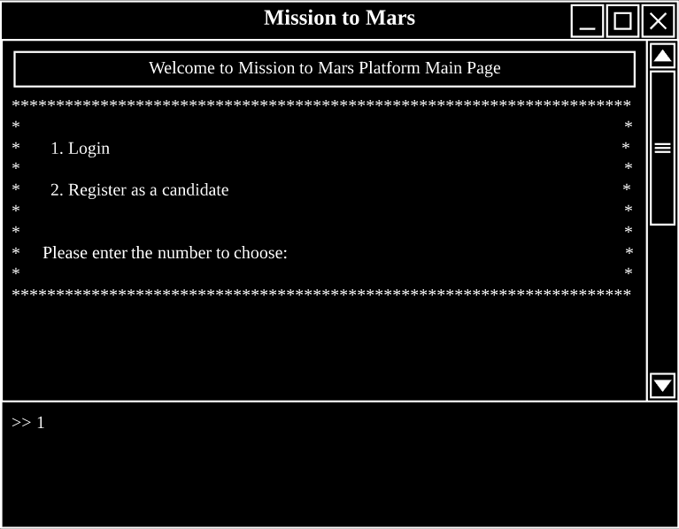
Main Page

Slide 6
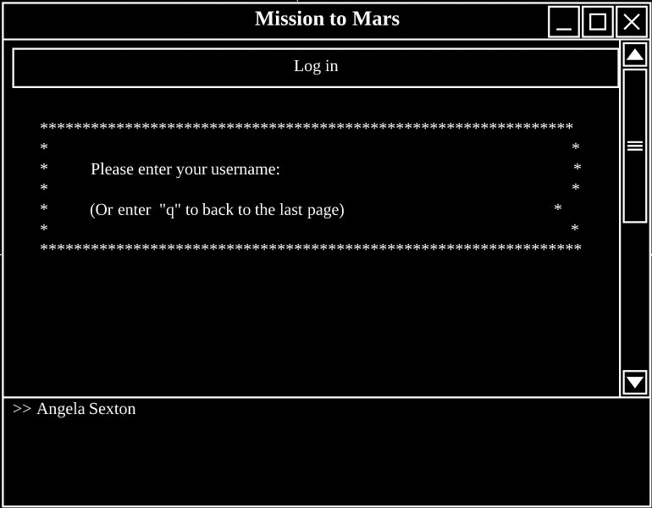
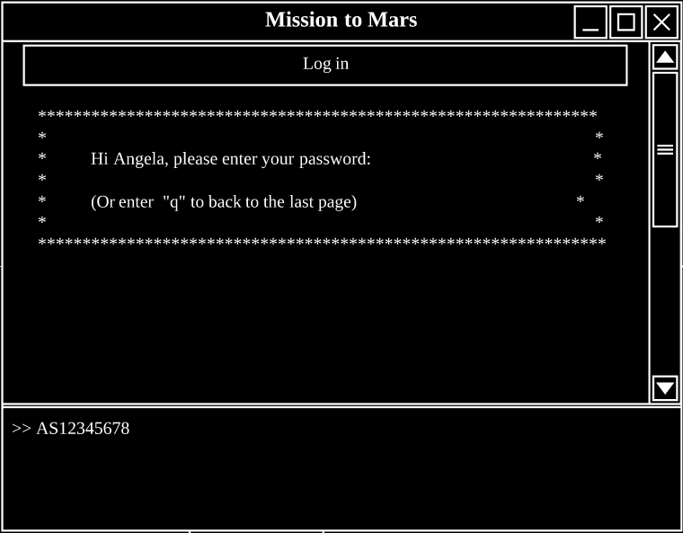
Log in Page

Slide 7
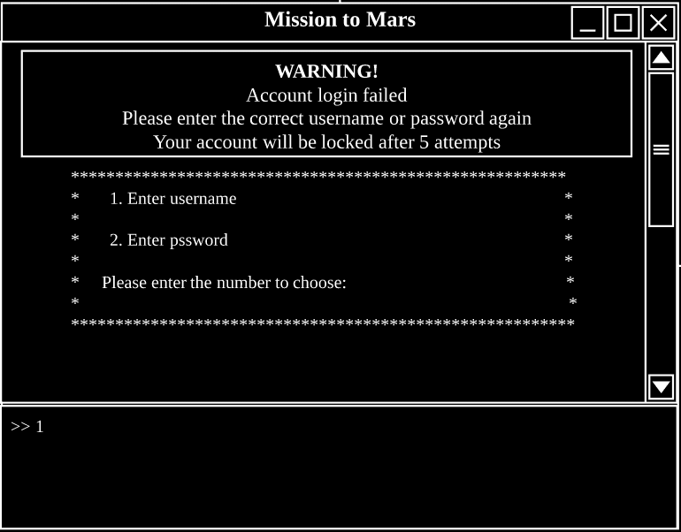
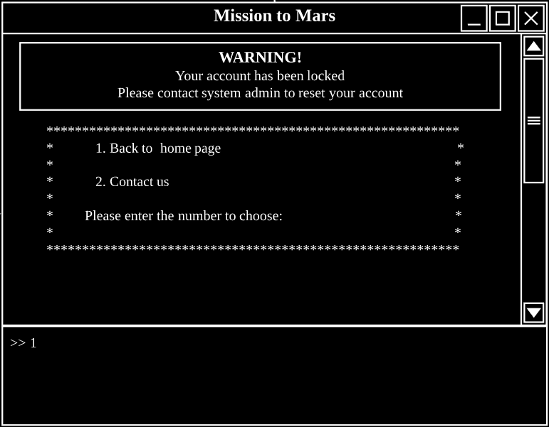
Log in Failed Page
Once log in failed
After logging failed 5 times

Slide 8
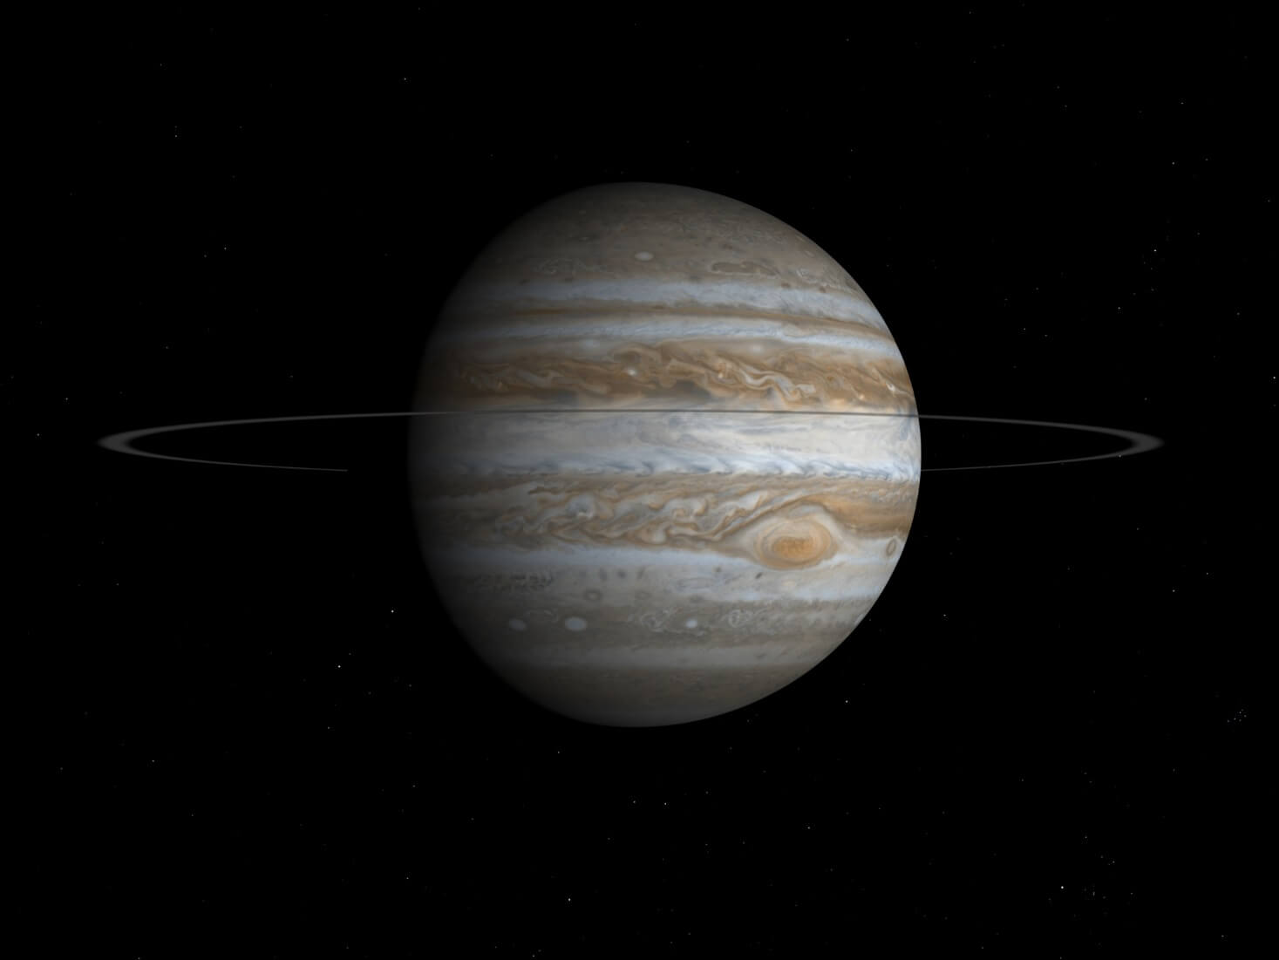
PART TWO
Feature 1 Creating a mission

Slide 9
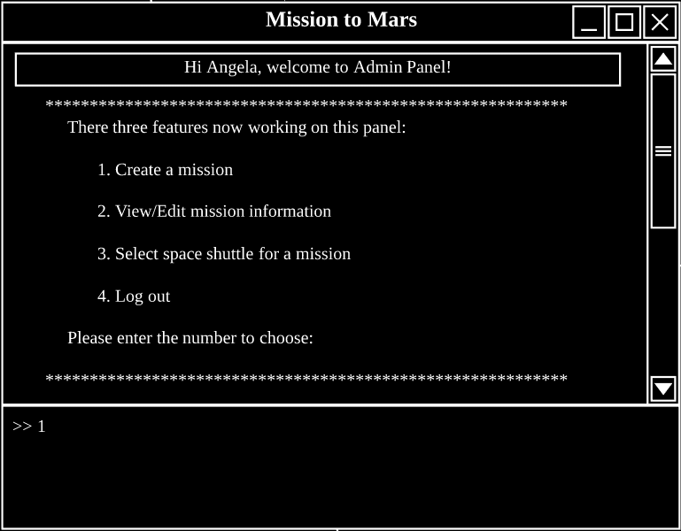
Feature 1 -- Admin Panel

Slide 10
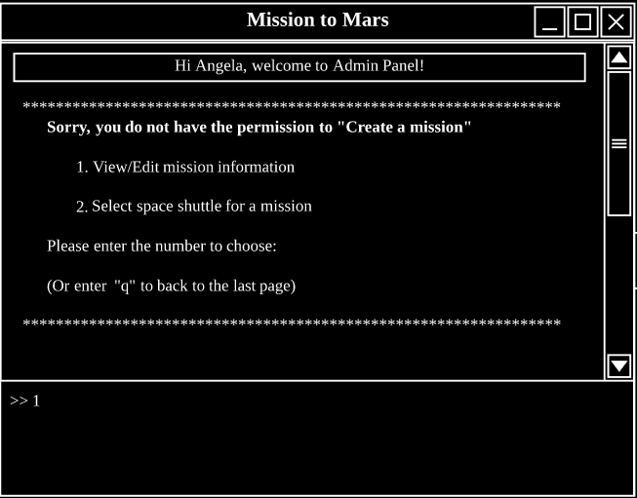
Feature 1 -- Mission Creation(user do not has the permission to create)

Slide 11
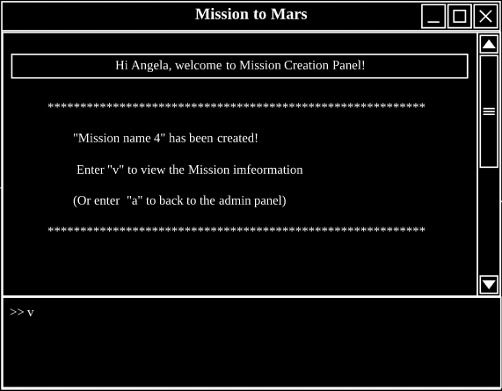
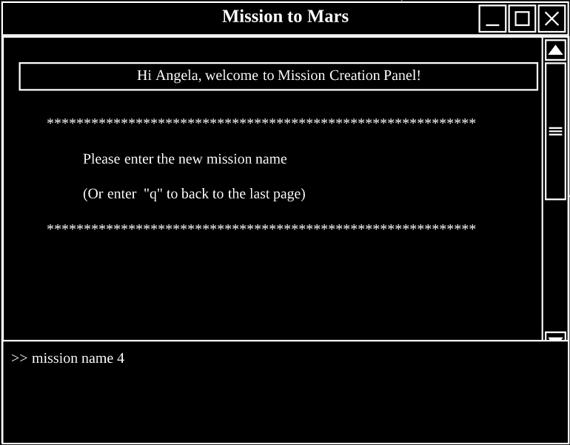
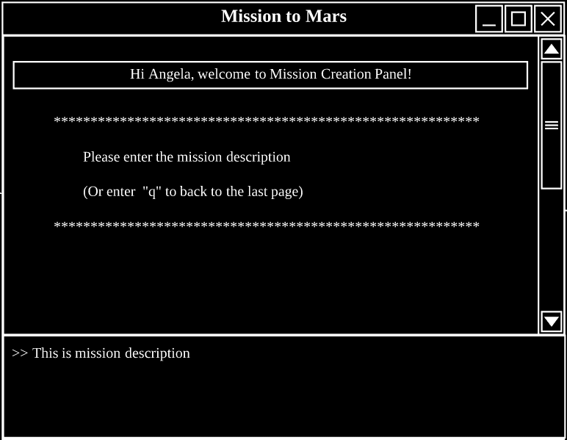
Feature 1 -- Mission Creation (user has the permission to create)
After entering all the information

Slide 12
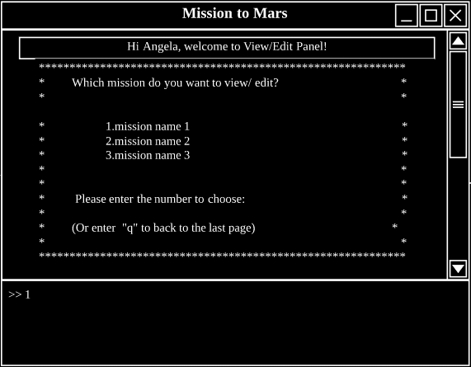
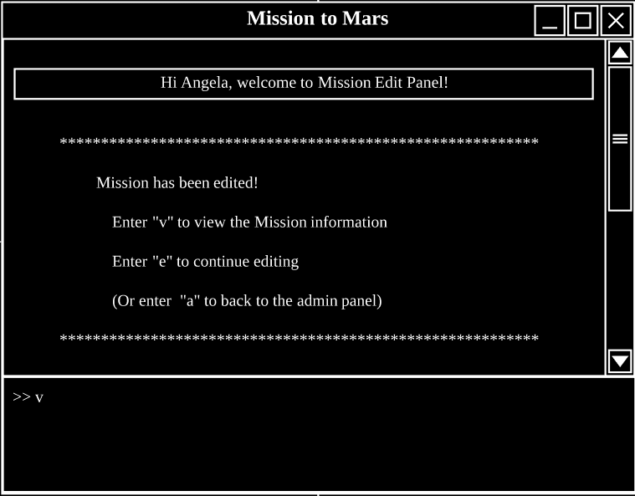
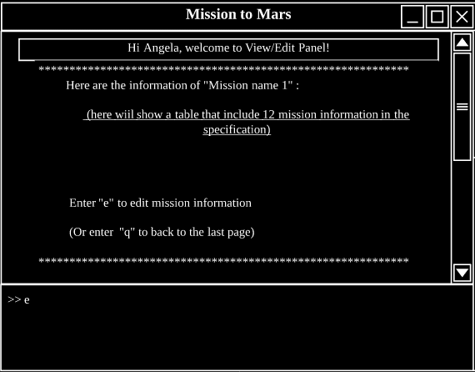
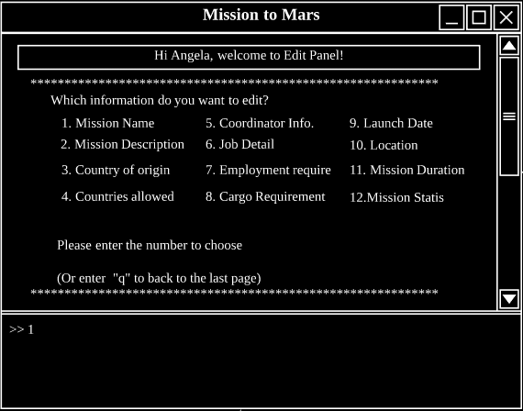
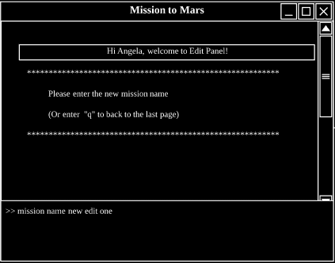
Feature 1 -- View & Edit Mission

Slide 13

PART THREE
Feature 2 Selecting a space shuttle

Slide 14
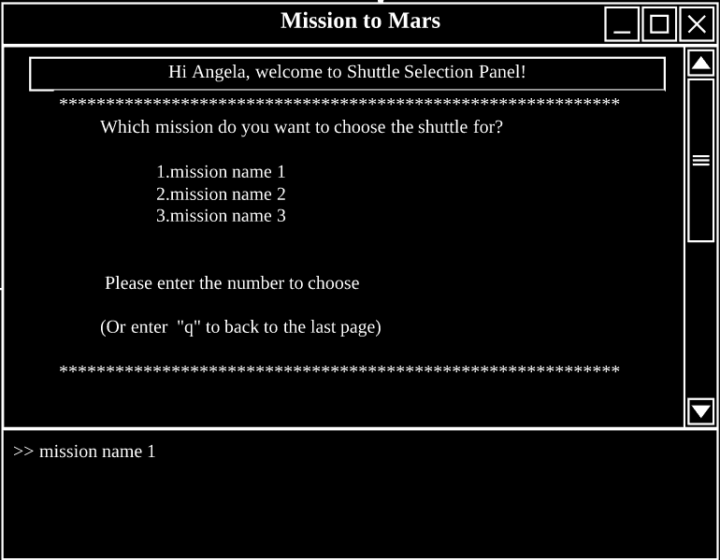
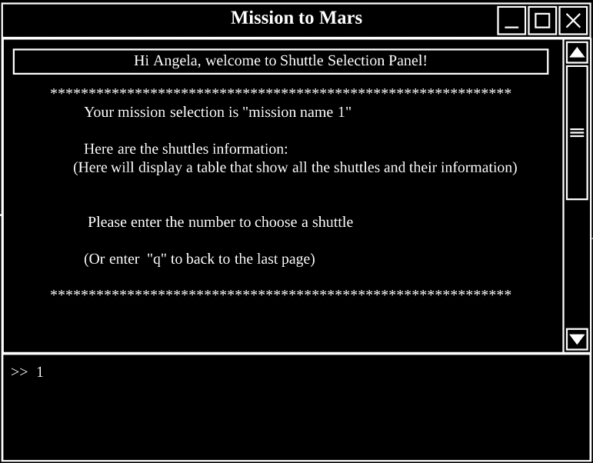
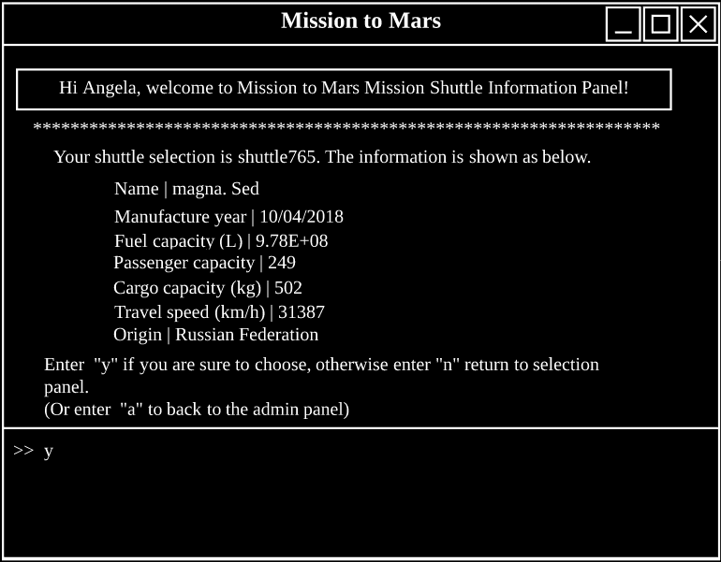
Feature 2 -- Shuttle Selection Page

Slide 15

PART FOUR
Feature 6 Registering as candidates

Slide 16
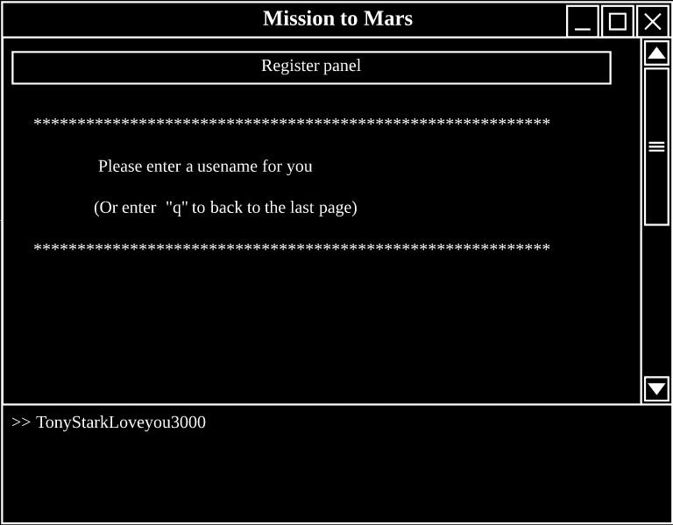
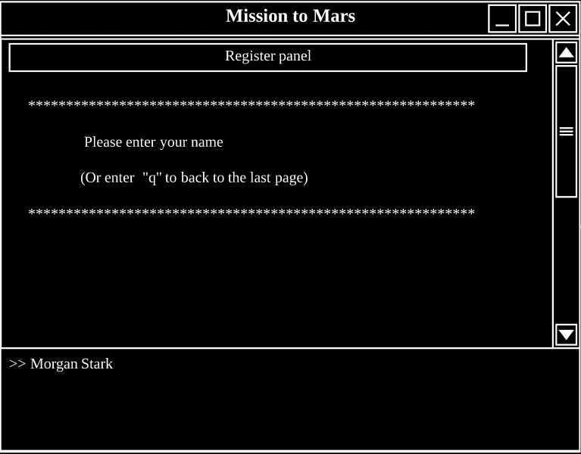
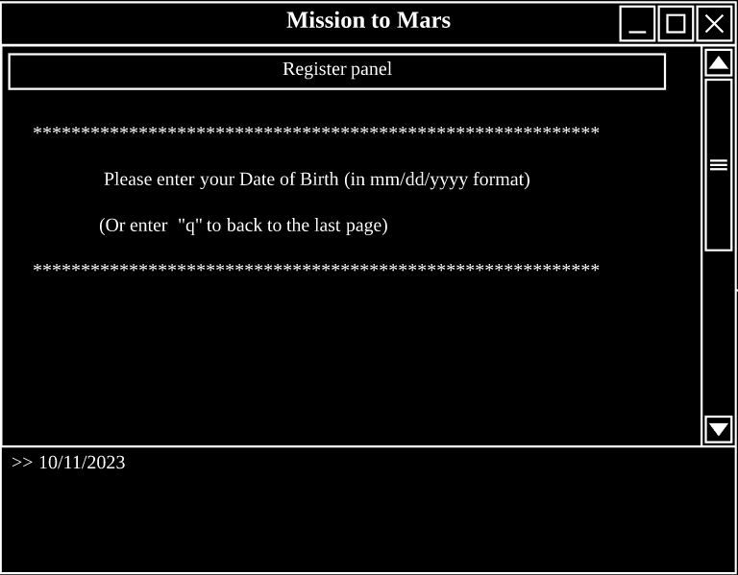
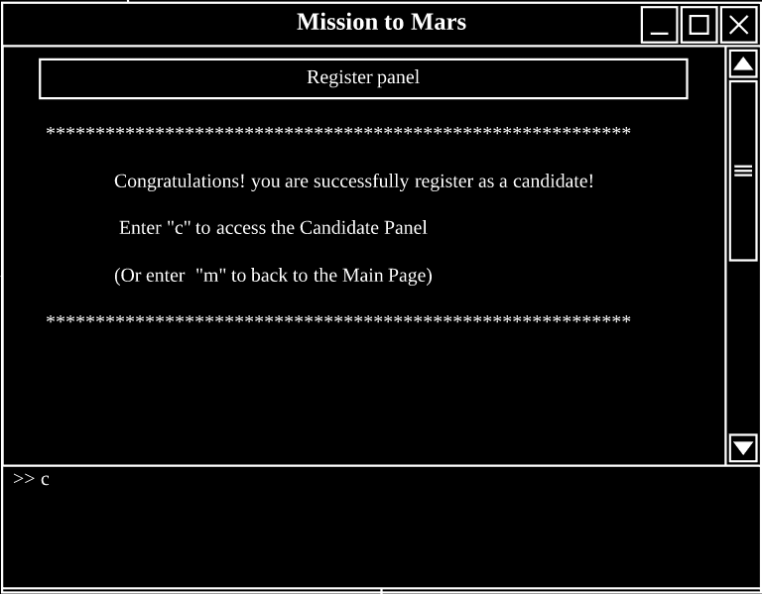
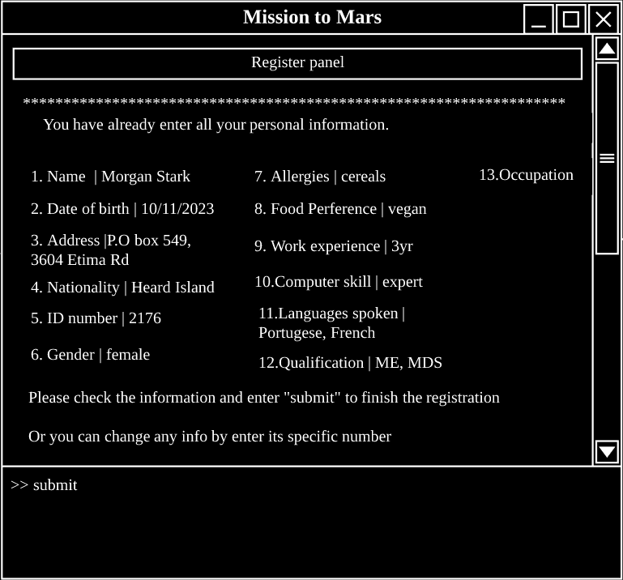
Feature 6 -- Registration Page
After entering all the information

Slide 17
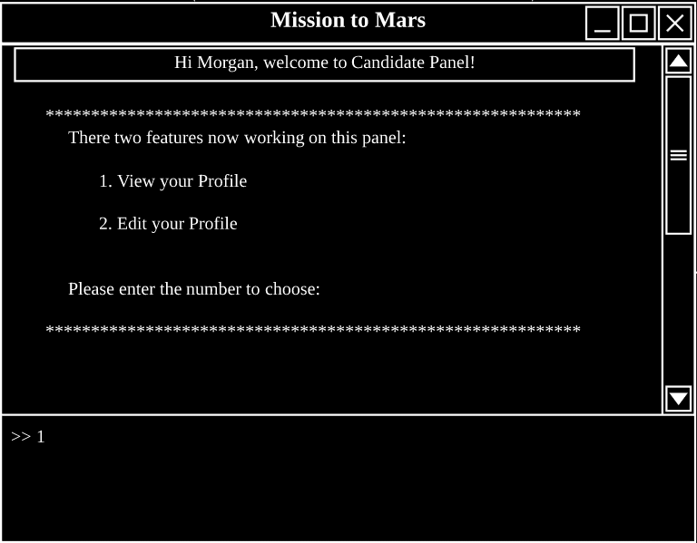
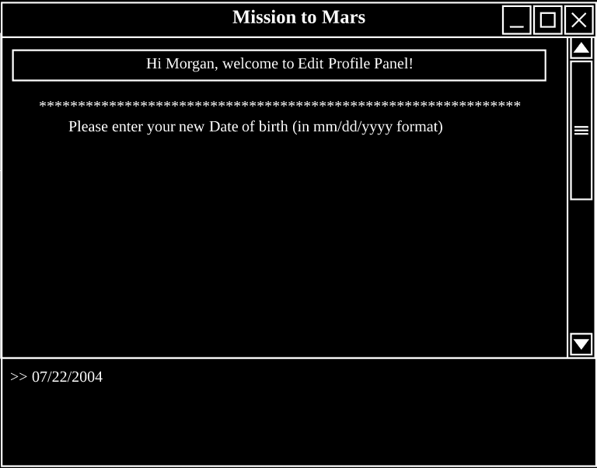
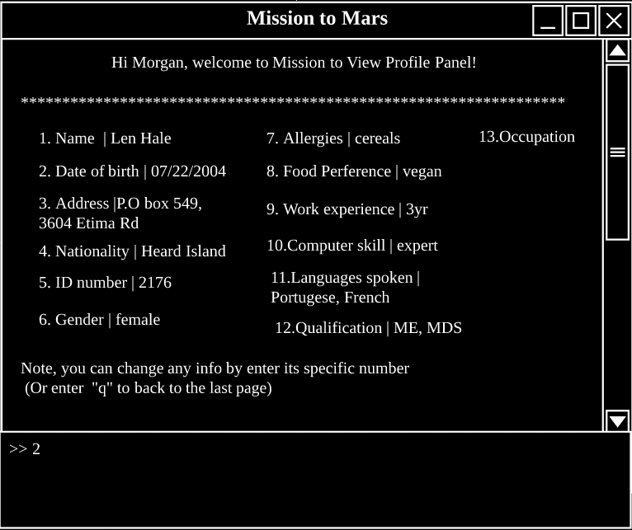
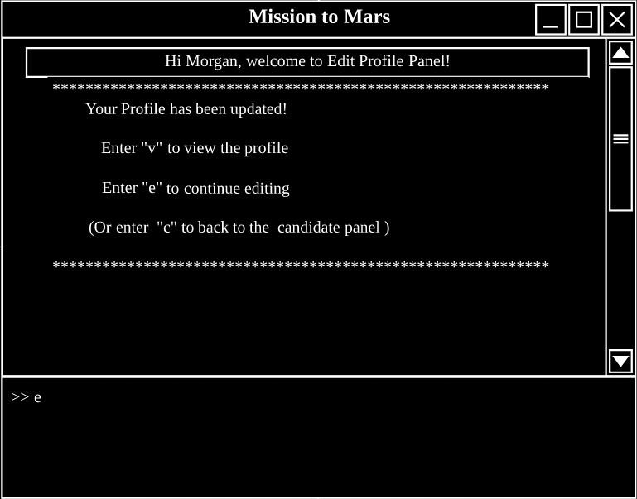
Feature 6 -- Profile Page
After logging in as a candidate or completing registration

Slide 18

THANK YOU
Any questions?

