Slide 1
Nutrition Calculator
XJCO3011Web Services and Web Data
答辩人：张珂睿
日期：2026/04

Slide 2
01
Introduction
02
Core Functions
CONTENTS
03
Technical Highlight
04
Project Achievements

Slide 3
01
Introduction
02
Core Functions
PART
ONE
03
Technical Highlights
04
Project Achievements

Slide 4
Project Introduction
Project Overview
A web-based nutrition calculation and management tool.
Users can manage their own food database.
Select foods and input weight in grams to automatically calculate total nutrition.
Supports batch import of external food data (CSV format).
Saves calculation history for easy dietary tracking.
Introduction
Functions
Technology Stack
Highlights
Backend Framework | Django 4.2
Database | SQLite3
Frontend | HTML + CSS + JavaScript
Data Processing | pandas
Version Control | Git + GitHub
Achievements

Slide 5
01
Introduction
02
Core Functions
PART
TWO
03
Technical Highlights
04
Project Achievements

Slide 6
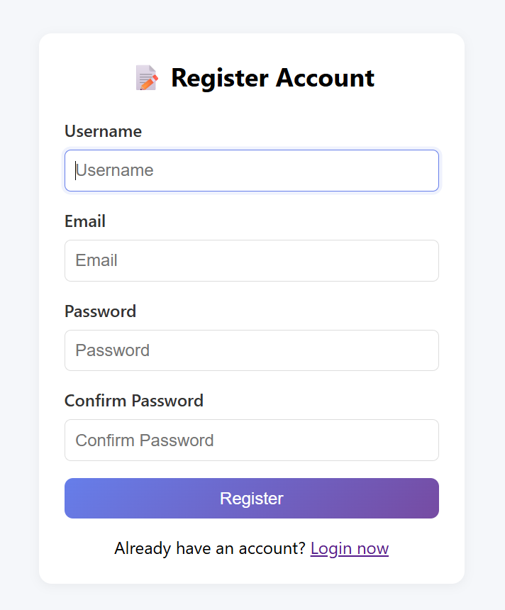
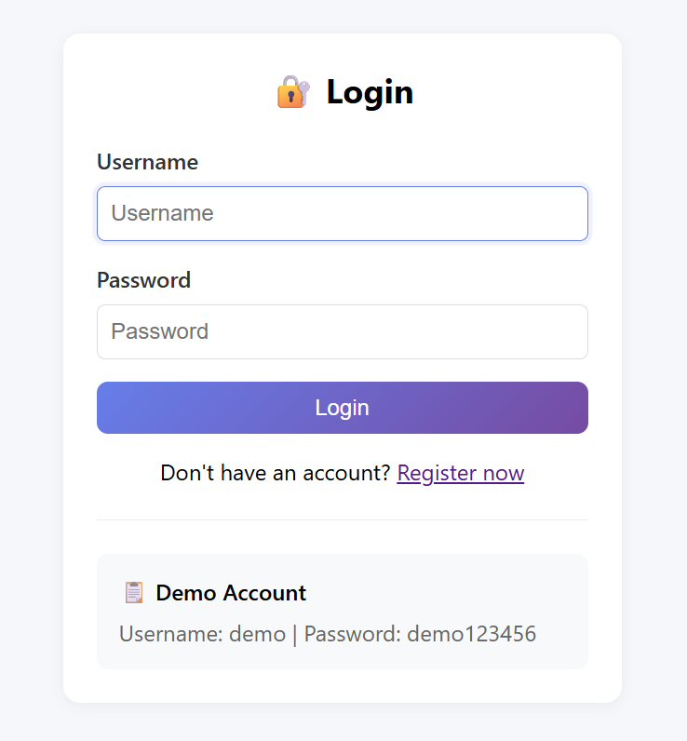
User Authentication
Introduction
Functions
Highlights
Achievements
User Registration
- Username, email, password
- Form validation and error handling
- Auto-login after successful registration
User Login
- Session-based authentication
- Redirect to home page after login

Slide 7
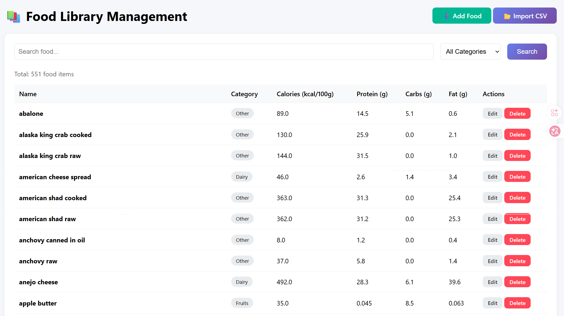
Food Library Management
Introduction
Functions
Highlights
Achievements
• View all foods in a searchable and filterable table
• Delete food items

Slide 8
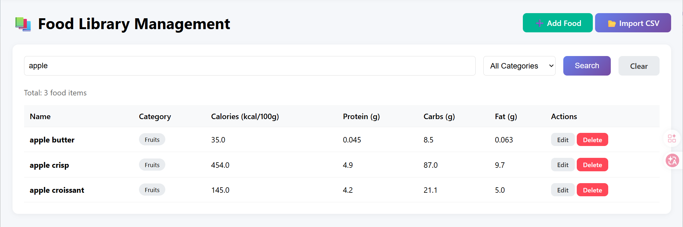
Food Library Management
Introduction
Functions
Highlights
• Search by food name or categories (case-insensitive)
Achievements

Slide 9
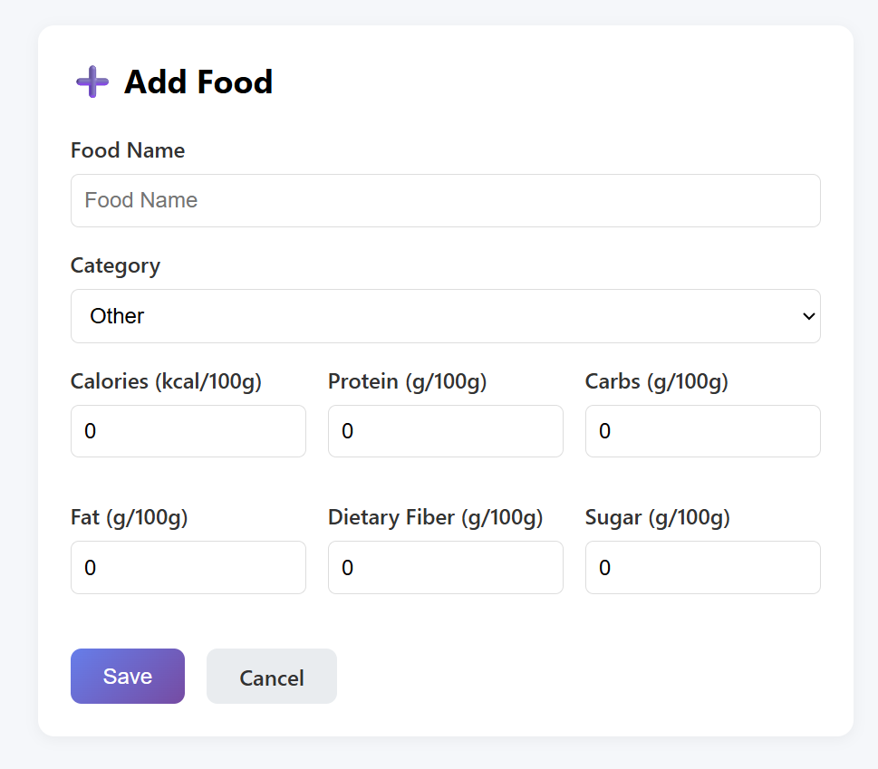
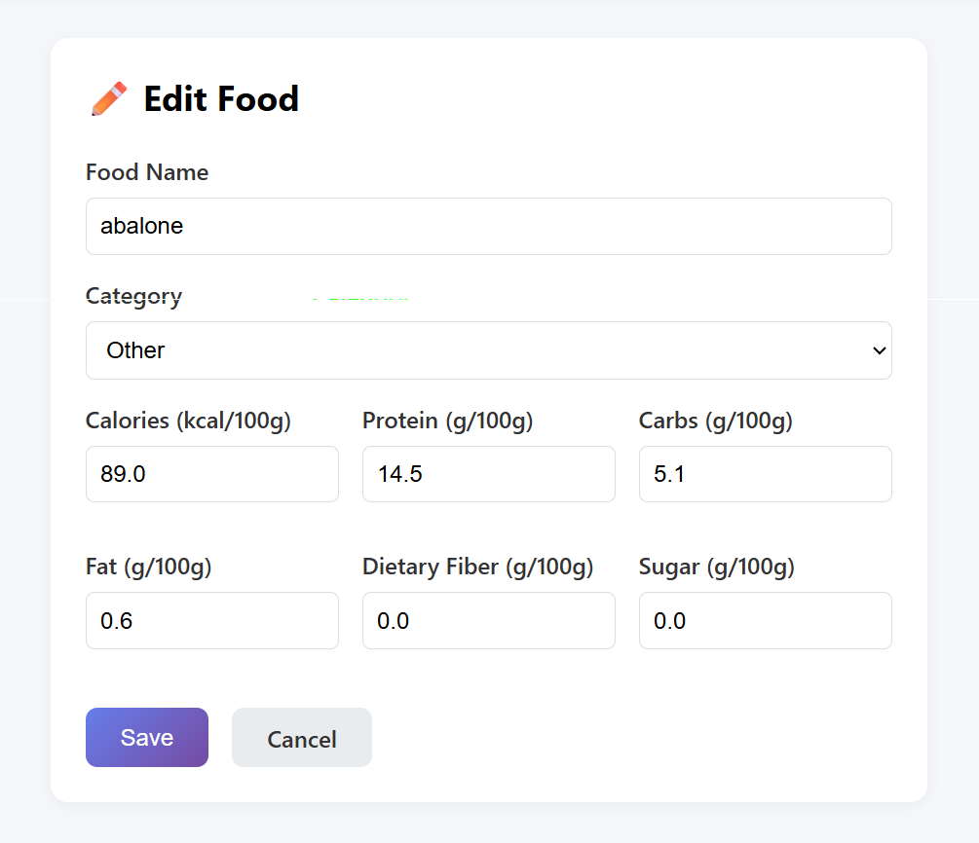
Food Library Management
Introduction
Functions
Highlights
Achievements
• Add new food manually with nutritional information
• Edit existing food items

Slide 10
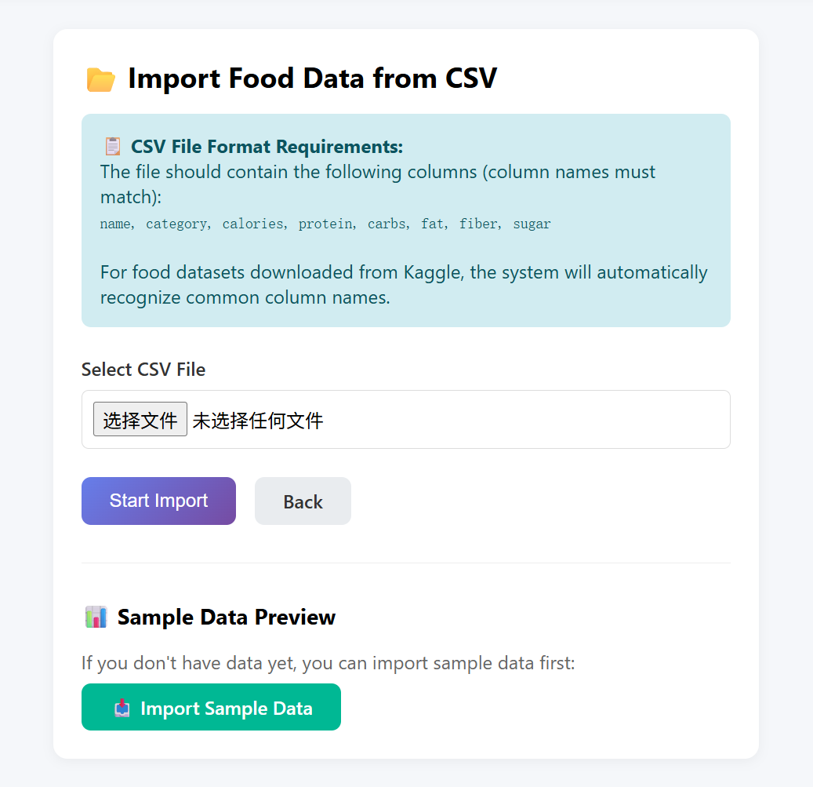
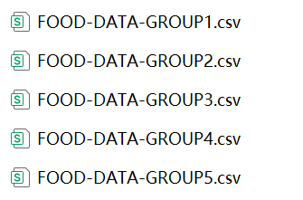
Food Library Management
Introduction
Functions
Highlights
• Batch import foods from
CSV files
Achievements

Slide 11
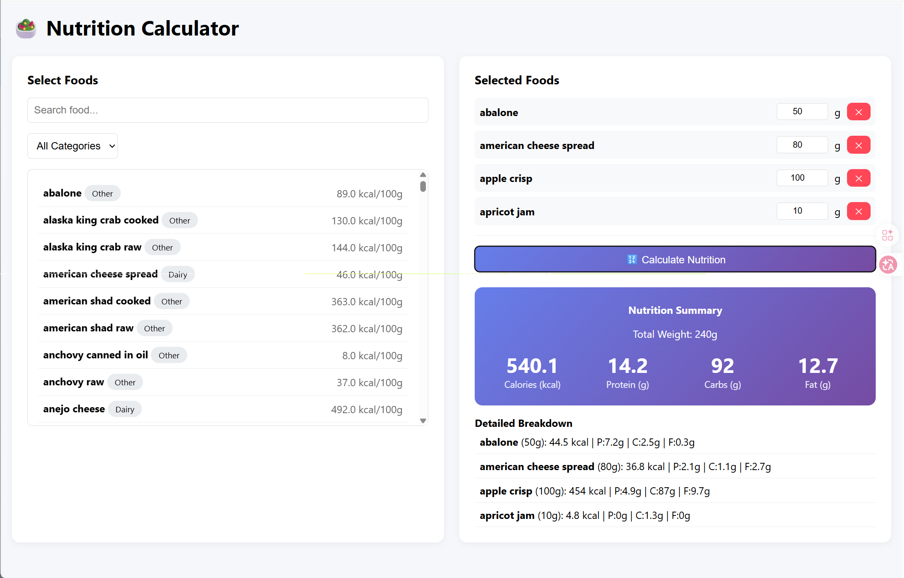
Nutrition Calculator
• Selected Foods
Panel (Right Side)
- Adjust weight in
grams for each food
- Remove foods
from selection
- Calculate total
nutrition with one
click
Introduction
Functions
Highlights
Achievements
• Food Selection Panel (Left Side)
- Search foods by name
- Filter foods by category
- Click to add foods to selection list
• Results Display
- Total weight
- Total calories, protein, carbs, fat
- Detailed breakdown per food item

Slide 12
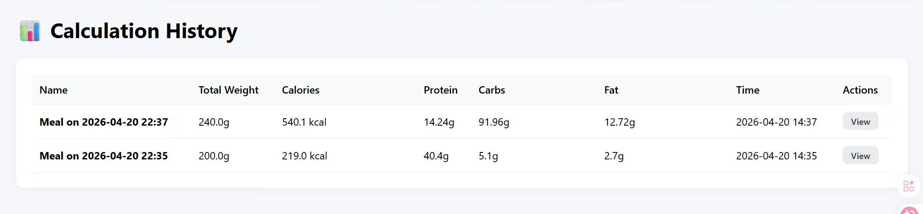
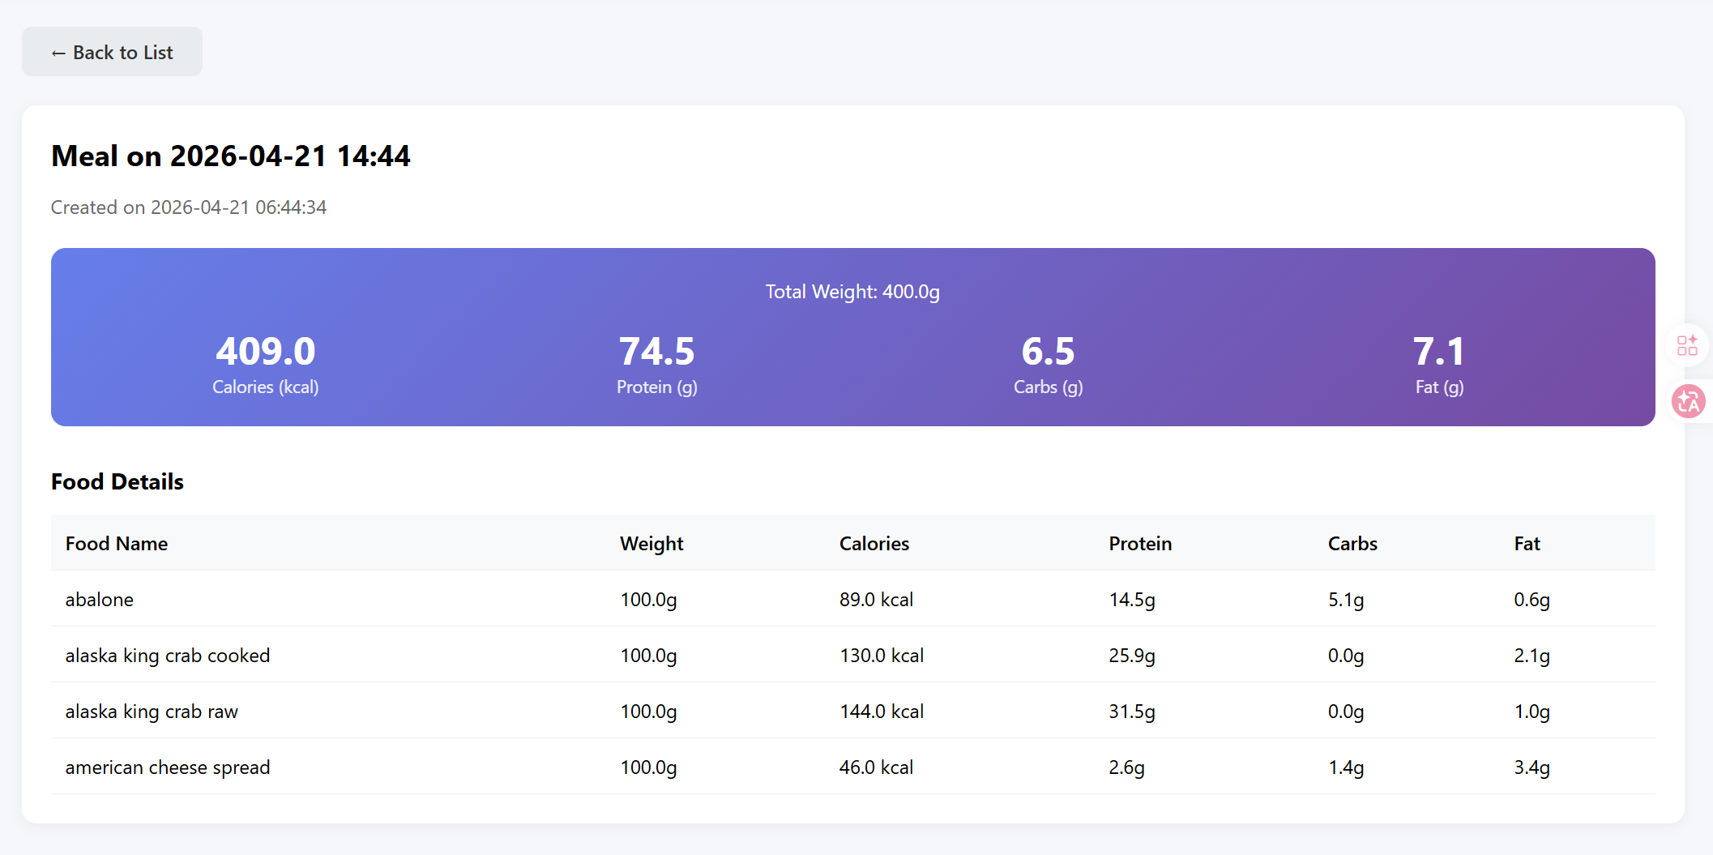
Calculation History
Introduction
Functions
Automatic History Saving
Shows date, total calories, and macros
Chronological order (newest first)
History Detail View
Complete nutritional breakdown
Per-food contribution details
Total weight and macronutrient summary
Highlights
Achievements

Slide 13
01
Introduction
02
Core Functions
PART
THREE
03
Technical Highlights
04
Project Achievements

Slide 14
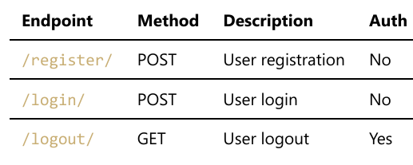
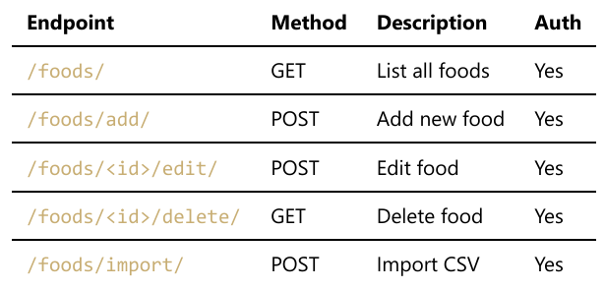
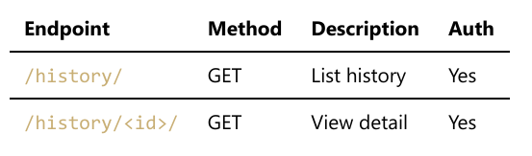
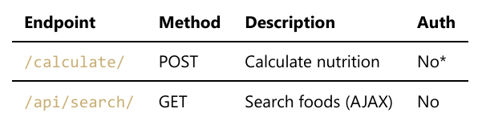
APIs
Introduction
Functions
Highlights
Achievements

Slide 15
Nutrition Calculation Algorithm
Calculation Formula
• Total Nutrient = Σ (Nutrient_per_100g × Weight / 100)
• Applied to calories, protein, carbs, fat, fiber, and sugar
Introduction
Functions
Automatic Aggregation
Standardized Data Storage
Intelligent category inference
Flexible column name mapping
Highlights
Duplicate prevention
AJAX-Based Calculation
Data Validation
JSON Response Handling
Achievements

Slide 16
01
Introduction
02
Core Functions
PART
FOUR
03
Technical Highlights
04
Project Achievements

Slide 17
Summary
Feature | Status | Description
User Registration/Login | ✅ Complete | Full authentication flow
Food CRUD Operations | ✅ Complete | Create, Read, Update, Delete
CSV Import | ✅ Complete | Batch import with auto-mapping
Nutrition Calculation | ✅ Complete | Multi-food calculation
History Tracking | ✅ Complete | Save and review past meals
Introduction
Functions
Highlights
Achievements

Slide 18
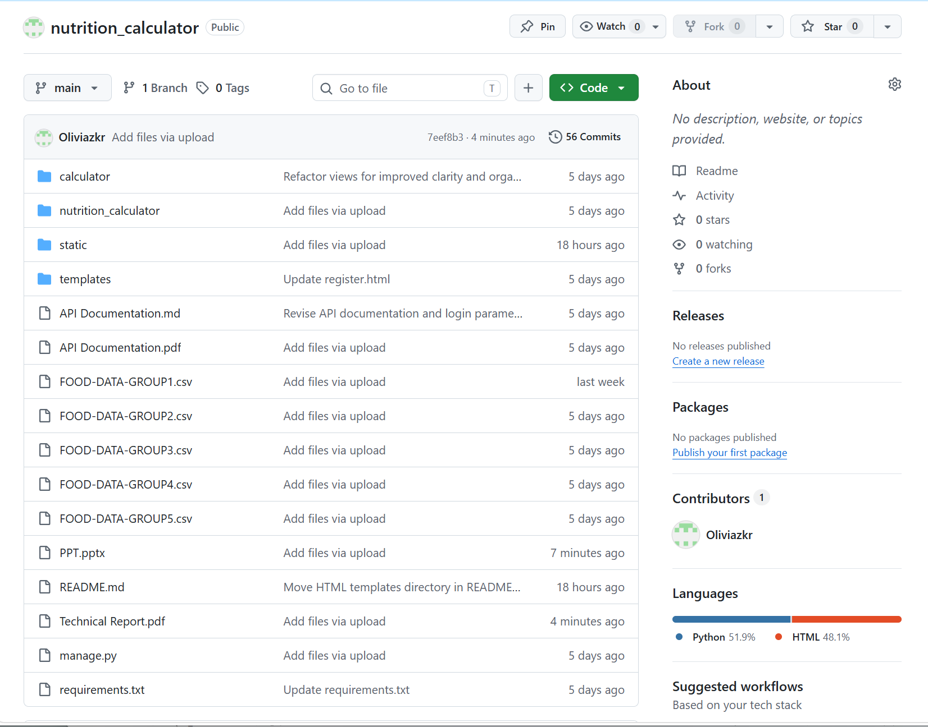
Commit History
Introduction
Functions
Highlights
Achievements

Slide 19
Thank You
For your attention!
GitHub: https://github.com/Oliviazkr/nutrition_calculator
答辩人：张珂睿
日期：2026/04

