Slide 2
Strategy Game Engine
TX52 – Villequey Olivier – Dulieu Romain
Tutor – Galland Stephane

Slide 3
Real-Time Strategy engine
Real time game : precise time cycle
Different kinds of AIs : Strategic, operational…
Multiple actions and units
Complex map

Slide 4
Problematic
Goal : Create a RTS engine

Slide 5
State of the art
Divide and conquer approach
No truly recent public work
Multi-Agent can answer the problem

Slide 6
Architecture
3 Differents parts :
Environment
Agent and Events
GUI

Slide 7
Environment Class Diagram

Slide 8
Agent Class Diagram

Slide 9
Cycle Timeline

Slide 10
BenchMark
ComputePerception

Slide 11
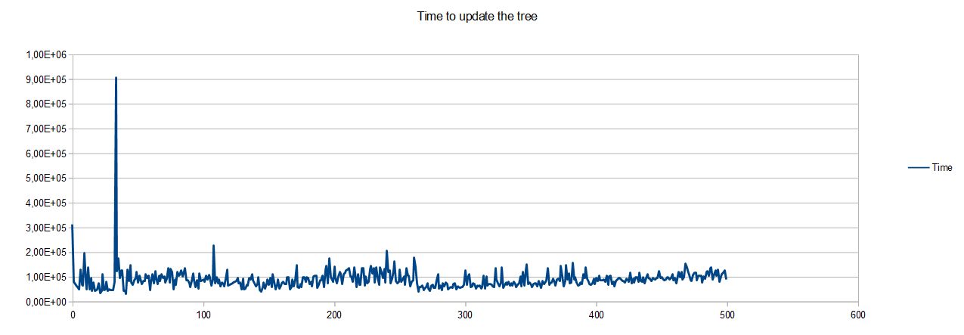
BenchMark

Slide 12
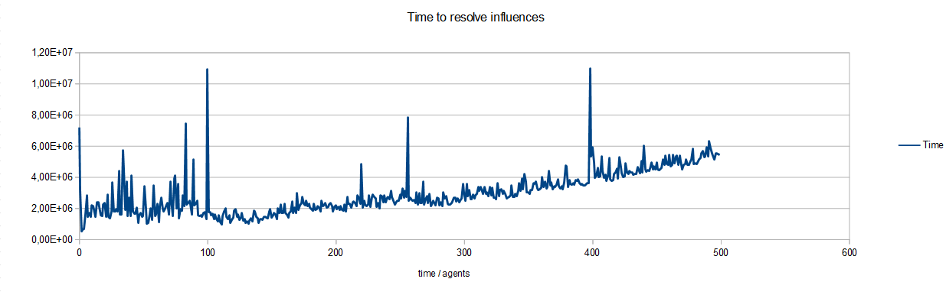
BenchMark

Slide 13
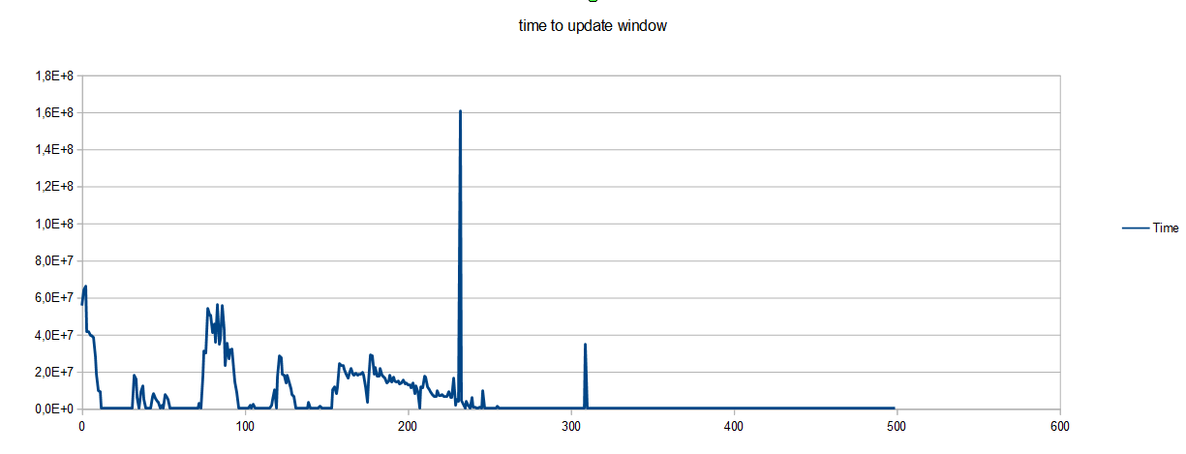
BenchMark

Slide 14
Conclusion

Slide 15
Thank you for your attention ! Do you have questions ?

Slide 16
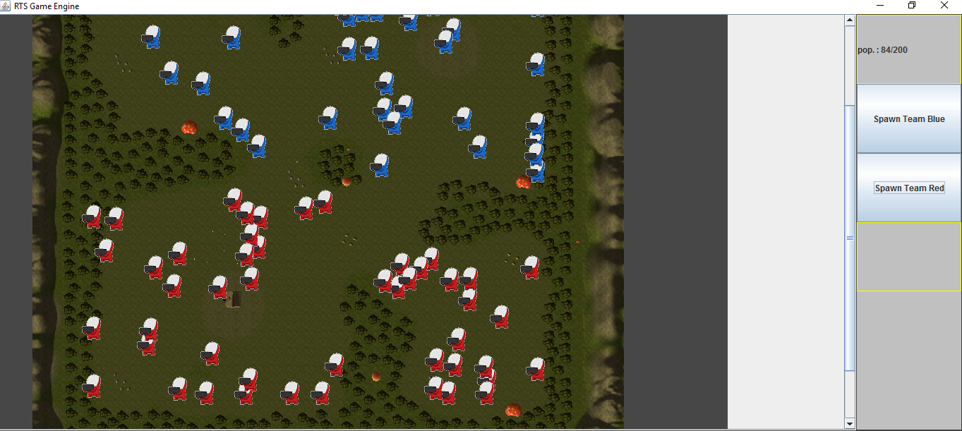
Example Application
1 kind of agent
Simple GUI in Swing
Regular spawn of agent

