Slide 2
Strategy Game Engine
TX52 – Villequey Olivier – Dulieu Romain
Tutor – Galland Stephane

Slide 3
Real-Time Strategy engine
Sarl language – Agent oriented based on Java
Differents kinds of IA
Multiple actions and units
Complex map

Slide 4
State of the art
Divide and conquer approach
High complexity
No truly recent public work
Multi-Agent can answer to the problem

Slide 5
Architecture
3 Differents parts :
Environment
Agent and Events
GUI

Slide 6
Environment Class Diagram

Slide 7
Agent Class Diagram

Slide 8
Cycle Timeline

Slide 9
BenchMark
ComputePerception

Slide 10
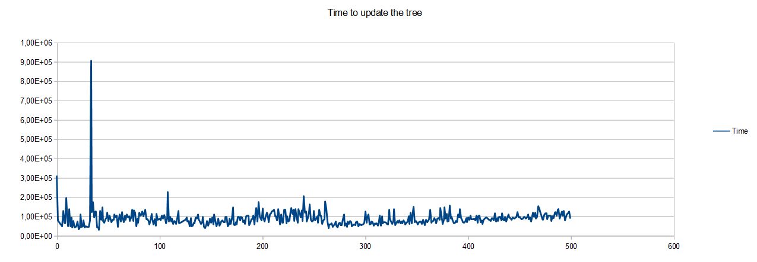
BenchMark

Slide 11
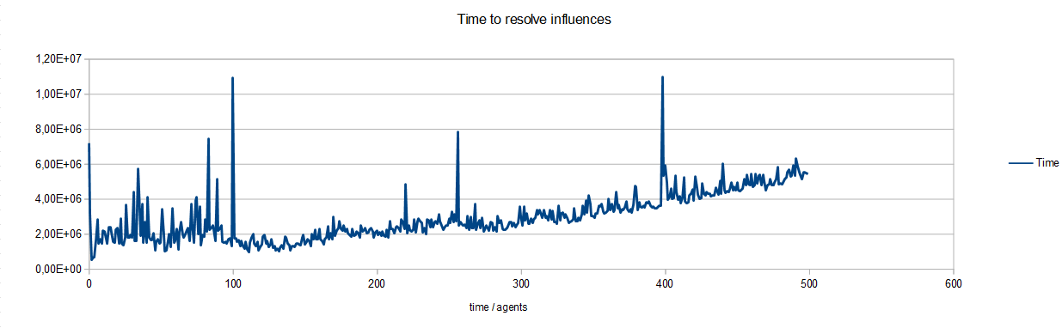
BenchMark

Slide 12
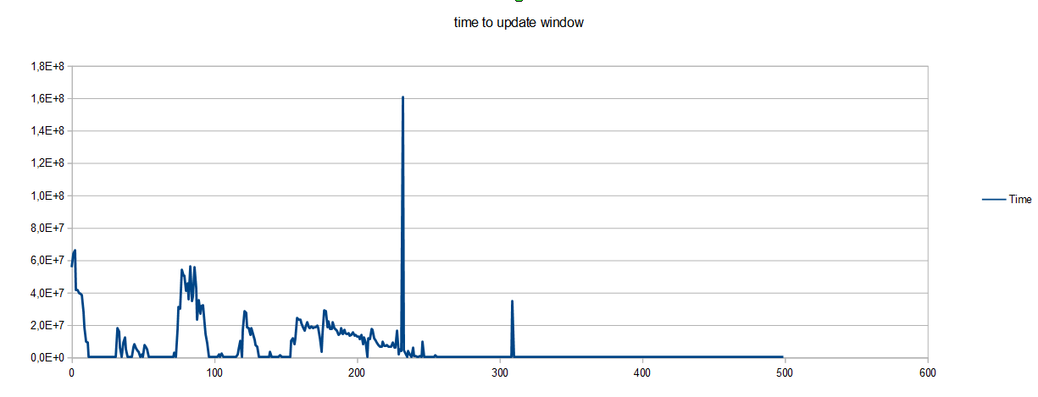
BenchMark

Slide 13
Conclusion

Slide 14
Thank you for your attention ! Do you have questions ?

Slide 15
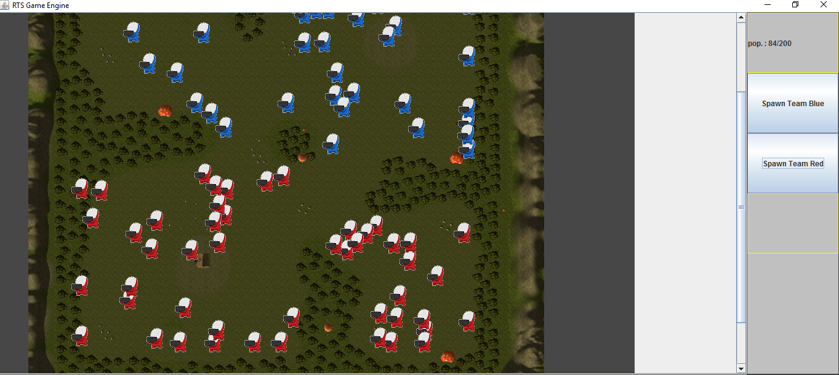
Example Application
1 kind of agent
Simple GUI in Swing
Regular spawn of agent

