Slide 1

A closer look
at hemoglobin
Kera explores a simpler first check for caregivers:
an experimental estimate from a fingernail photo.
Experimental research prototype
Notes:
Kera starts with a practical question: could a simple photo help caregivers notice when hemoglobin deserves a closer look? Our current answer is a working research prototype. The browser app uses a middle-fingernail image and a trained model to return an experimental estimate in grams per liter. We do not claim that it diagnoses anemia or replaces a blood test. The intended caregiver use remains a hypothesis that needs independent validation.
Sources: User's Kera handoff in /home/olivier-aud/.codex/attachments/3d7490ae-95ac-49fc-9e69-1dee6861d41e/Pasted text.txt (project mission and intended audience). Project implementation: web/README.md. Original logo: user-provided image, unchanged, web/dist/assets/kera-logo.png.

Slide 2
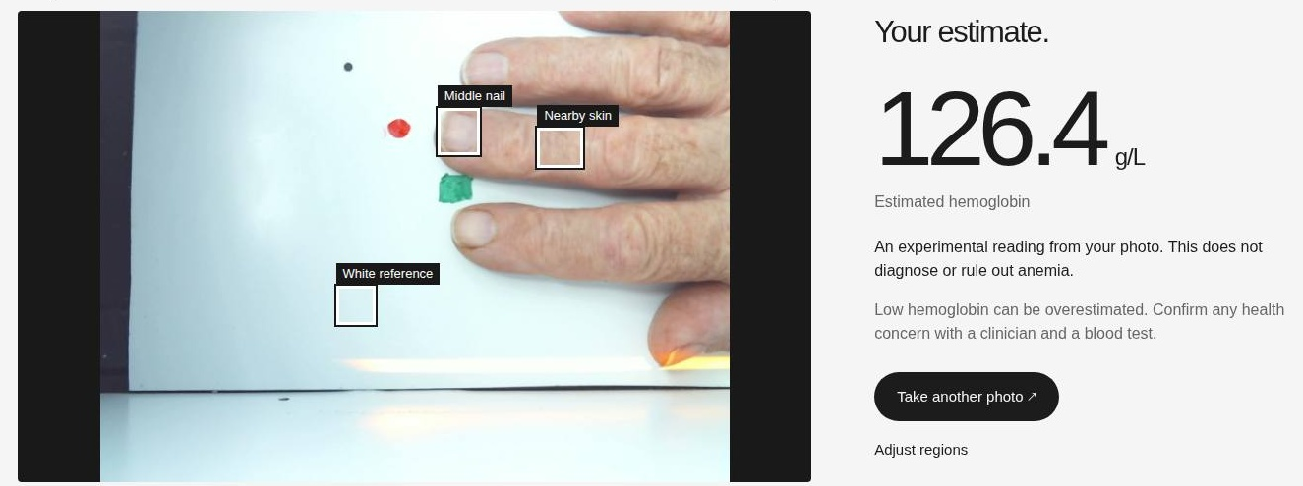
A scan stays on your device
Capture a photo. Mark the nail, skin and white reference. Get an estimate.
Demonstration uses a study image. Webcam performance remains unvalidated.
Notes:
The app is already working. A user connects a webcam, sees the live feed, and takes a photo. Uploading a photo is an alternative. The user then marks the middle nail, adjacent skin, and a white reference. We keep this annotation explicit because the trained regression model does not automatically find the nail. The app extracts the original 42 color descriptors and runs the frozen ensemble of three neural networks entirely in the browser. The photo does not leave the device, and the app adds no image storage or analytics. This screenshot is a real app run using a public-study image. The visible 126.4 g/L is a demonstration output, not a claim about an unmeasured person or validated webcam performance.
Sources: web/dist/app.js, web/dist/ml.js, web/dist/assets/model.json and web/README.md. Screenshot: web/reports/browser/desktop-result.jpg, captured during local app testing. Study image: Figshare article 25867432 version 1, file 49504041, patient image 1. Dataset license: CC0 according to references/figshare.json. Original study: https://www.nature.com/articles/s41597-024-03895-9 .

Slide 3
Model performance
15.96
g/L
Mean absolute error
on 50 held-out patients
250 study patients
200 for training, 50 held out
Low hemoglobin remains the hard case
The model overestimated Hb by 16.26 g/L on average
in the 11 test patients below 120 g/L.
Notes:
We trained and tested on the real published dataset of 250 labeled patients, with 200 for training and model selection and 50 held out. The app's frozen three-seed MLP ensemble achieved mean absolute error 15.96 g/L and RMSE 21.29 g/L on those held-out study patients. The mean predictor's MAE was 19.35 g/L. These are aggregate study errors, not an individual reading's confidence interval. For transparency, the project selected Elastic Net using training-only cross-validation. This app uses the requested neural network. Its smaller test error did not change the project selection after test access.
The model often overestimates lower hemoglobin. Among 11 held-out patients below the descriptive 120 g/L analysis band, the neural ensemble's average bias was +16.26 g/L. That band is not a universal diagnostic cutoff. A plausible-looking number must not reassure someone away from clinical assessment. Webcam and Kera Dock transfer remain unvalidated.
Sources: reports/test_metrics.json, reports/RESULTS.md, artifacts/selection.json, artifacts/split.json. The comparison chart uses the actual held-out MAE values 19.350399999999993 and 15.963409957885743. Patient-level split also groups the likely repeated photograph under IDs 42 and 51 together. Data source: https://springernature.figshare.com/articles/dataset/25867432 .

Slide 4
The next step:
Kera Dock validation
Seeking a care or clinical research partner to pair
Kera Dock scans with laboratory hemoglobin results.
Measure camera transfer and repeatability.
Validate across the intended older-adult population.
Notes:
The browser prototype is ready for a research conversation. The next step is to collect Kera Dock scans paired with laboratory hemoglobin results, starting with a care or clinical research partner. We need to control lighting and camera settings, measure repeatability, and test performance across the intended older-adult population and diverse skin and nail characteristics. We would then evaluate a locked model on independent patients. We do not yet have clinical validation, a validated Dock camera model, or demonstrated accuracy for tracking changes over time. The ask is a research partnership, not clinical deployment today.
Sources: reports/RESULTS.md, sections Limits and next steps; web/README.md, Research limitations; original Kera project handoff. Kera Dock is the planned hardware validation setting, not a claim that hardware testing has already occurred. Original logo reused as the required brand element.

