Slide 1
MACHINE LEARNING COURSE
Rossmann Store
Sales Forecasting
Leveraging Machine Learning to Drive Operational Excellence
across 1,115 Rossmann Drug Stores
March 2026 · Olivier ANDRIANOEL – Wassim BELABED – Thomas MAGALLON

Slide 2
AGENDA
Today's Presentation
01
04
Business Context & Dataset
Results & Model Comparison
Why sales forecasting matters for Rossmann operations
RMSPE vs MAE trade-off, actual vs predicted analysis
02
05
Data Exploration
Error Diagnostics
Seasonality, promotions, weekday patterns and store dynamics
Residual structure, store-level failures, calendar effects
03
06
Modelling Approach
Business Implications
Feature engineering, temporal validation and baseline benchmarks
Operational recommendations and path to production
ROSSMANN STORE SALES FORECASTING | QUANTITATIVE RESEARCH

Slide 3
SECTION 01 · BUSINESS CONTEXT
The Commercial Problem We Are Solving
Rossmann: 1,115 European drug stores. Daily revenue forecasting at store level.
OBJECTIVE
📦 Stock Replenishment
👥 Labor Scheduling
Without daily demand visibility, stores over-order or face stockouts, both of which destroy margin.
Scheduling staff without a demand forecast means overtime waste or understaffing peaks.
💰 Revenue Visibility
📣 Promo Optimization
Finance requires reliable near-term revenue projections for liquidity planning.
Promo ROI cannot be measured or optimized without isolating the demand uplift.
ROSSMANN STORE SALES FORECASTING | QUANTITATIVE RESEARCH

Slide 4
SECTION 01 · DATASET
Dataset at a Glance
Merged train.csv + store.csv • 2013-01-01 to 2015-07-31
1,017,209
1,115
844,338
2.5 years
Total Records
Unique Stores
Modelling Rows
Time Horizon
After merging train + store
Cross-sectional panel data
Open stores, sales > 0
Jan 2013 – Jul 2015
MODELLING PIPELINE
train.csv
(Sales History)
store.csv
(Store Metadata)
Merge on Store ID
Feature
Engineering
Filter Open
& Sales > 0
Train / Test
Split (90/10)
KEY MODELLING DECISIONS
✓ Target variable: Sales
Customers excluded, not observable at forecast origin (avoids future data leakage)
✓ Temporal train/test split (90/10)
Random splits contaminate the test set with future info, invalidated for time series
✓ Filter Open=0 and Sales≤0
Closed-day sales are deterministic business rules, not stochastic forecasting targets
ROSSMANN STORE SALES FORECASTING | QUANTITATIVE RESEARCH

Slide 5
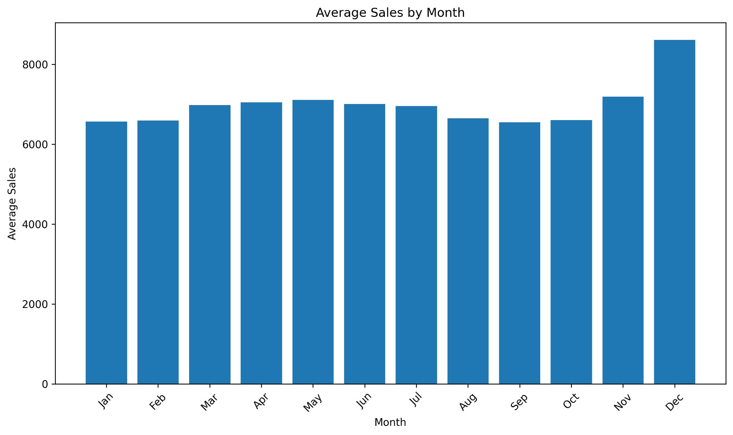
SECTION 02 · EDA
Monthly Sales Seasonality
Conditional on open days with positive sales • Average across all stores 2013–2015
€8,609
December Peak
Highest avg. daily sales
+30%
Dec vs Oct
Uplift vs weakest month
Nov
Pre-Xmas Lift
Second strongest month
💡 Business implication: Q4 inventory build-up, peak staffing in Nov–Dec, and tighter cash-flow forecasting in Q4 are directly supported by this pattern.
ROSSMANN STORE SALES FORECASTING | QUANTITATIVE RESEARCH

Slide 6
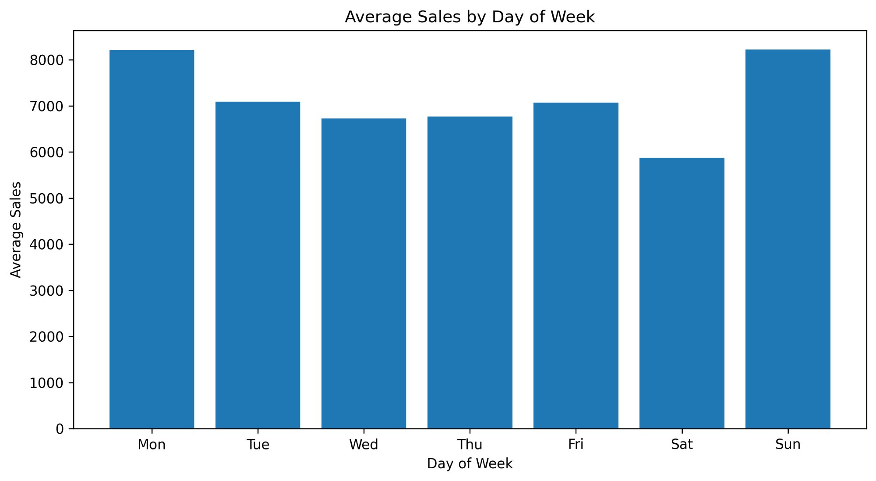
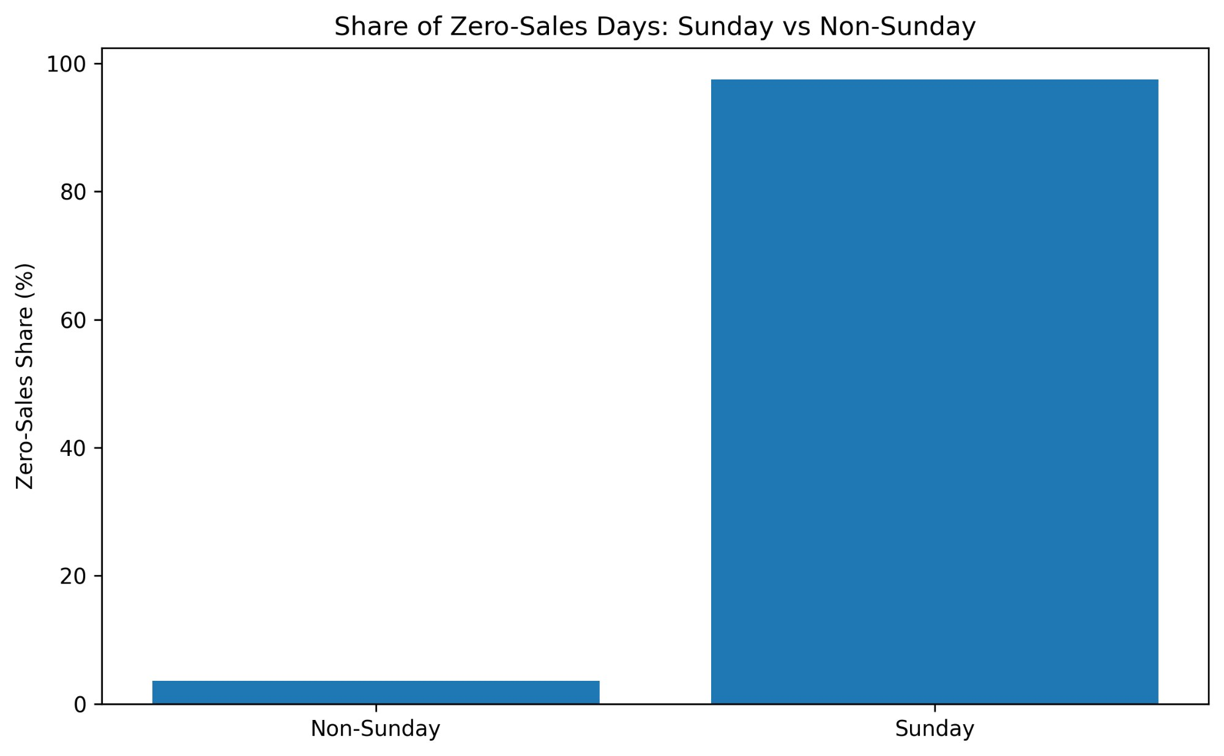
SECTION 02 · EDA
Day-of-Week Sales Patterns & Sunday Closure Effect
Warning: Sunday averages are conditional on the rare open Sunday — not representative of all Sundays
Chart A – Average Sales by Day (open days only)
Chart B – Share of Zero-Sales Days: Sunday vs Non-Sunday
Monday / Sunday high average
Exceptional open Sundays are high-volume but rare. ~97% of Sundays record zero sales.
Saturday is weakest weekday
Structural midweek trough. Saturday historically lower than Mon–Fri average.
Two-stage forecast logic
Production system should model P(store open | Sunday) separately from sales level.
ROSSMANN STORE SALES FORECASTING | QUANTITATIVE RESEARCH

Slide 7
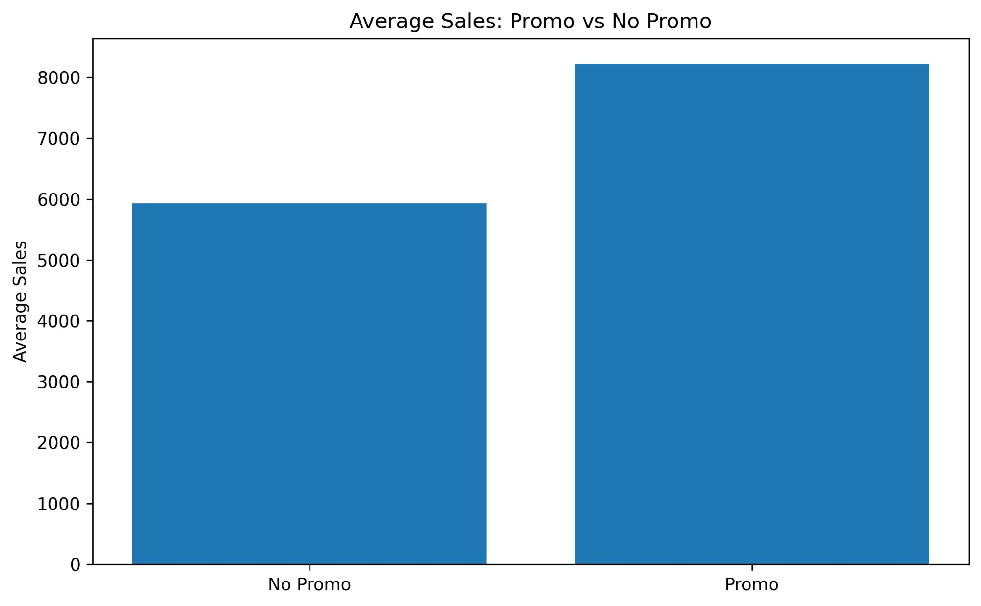
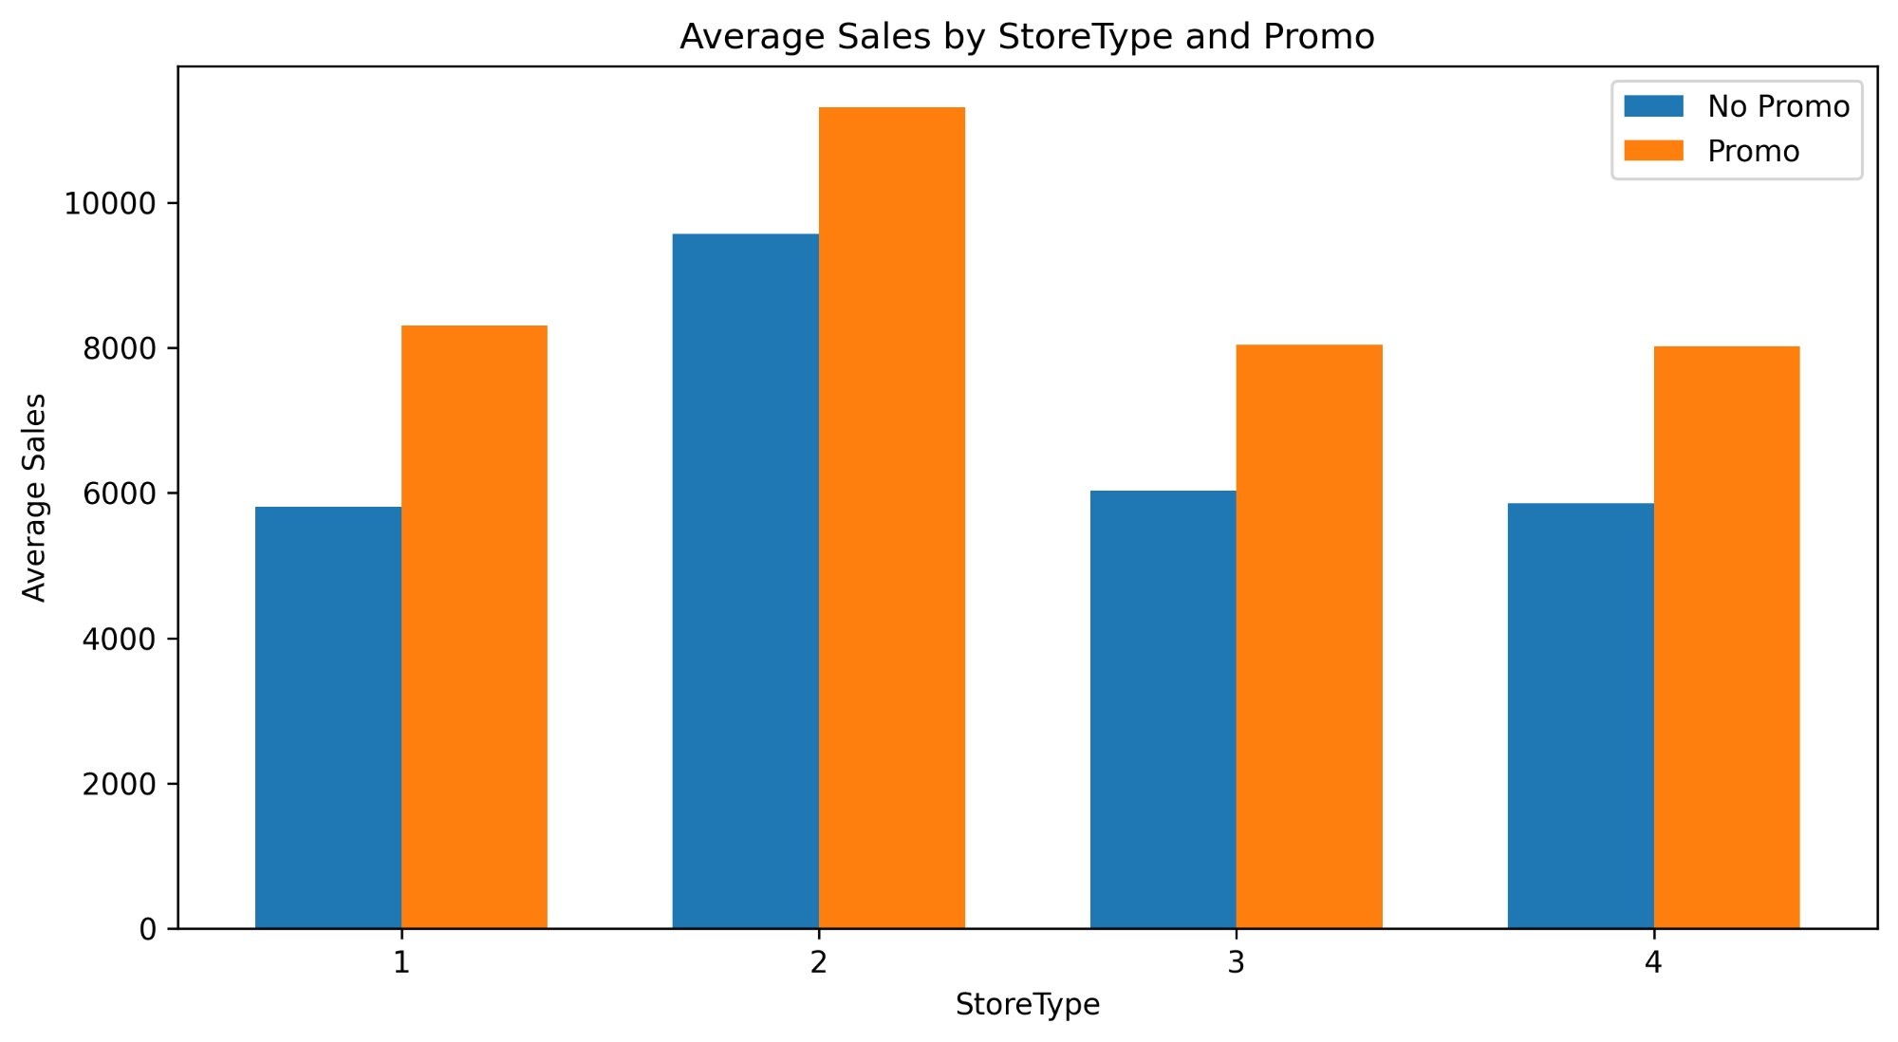
SECTION 02 · EDA
Promotional Uplift: The Single Strongest Commercial Lever
All store types respond to Promo, but response intensity varies by format
Aggregate Promo Effect
Promo × Store Type Interaction
+38.8%
Type 2
Promo
Average Promo Uplift
Best Promo Responder
#1 XGBoost Feature
Promo vs No-Promo days
Highest absolute uplift
By model importance score
ROSSMANN STORE SALES FORECASTING | QUANTITATIVE RESEARCH

Slide 8
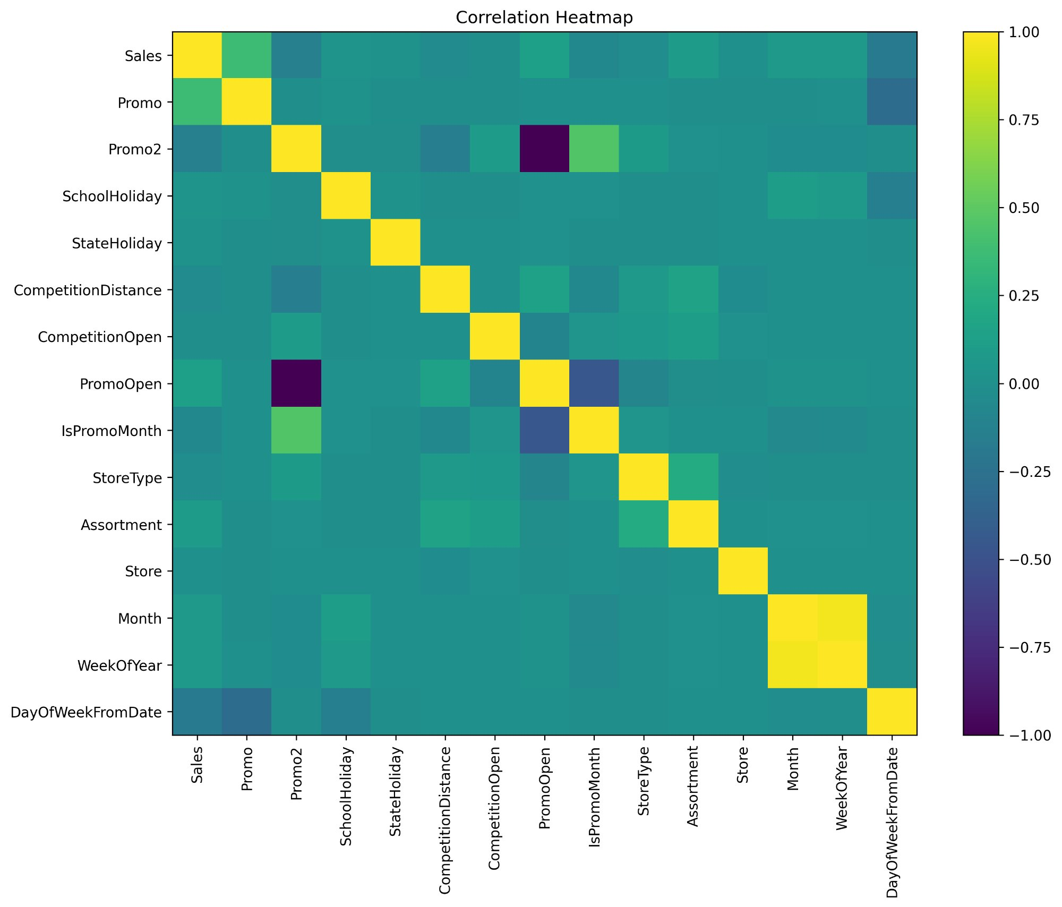
SECTION 02 · EDA
Variable Correlation Structure
Useful for feature screening — note: nonlinear relationships not captured here
Promo → Sales (+)
Strongest linear signal in the matrix. Promo activation meaningfully correlates with higher daily sales.
DayOfWeek → Sales (−)
Later-numbered days (Sat=6) are associated with lower sales, consistent with the EDA.
Month ↔ WeekOfYear
Near-perfect collinearity, only one should typically be used in linear models. Trees handle both.
PromoOpen ↔ IsPromoMonth (−)
Negative correlation is by construction: PromoOpen measures elapsed duration, IsPromoMonth flags the window.
StoreType encoding caveat
Integer encoding imposes false ordinal scale (a=1 < b=2). Works for XGBoost; misleading in linear models.
ROSSMANN STORE SALES FORECASTING | QUANTITATIVE RESEARCH

Slide 9
SECTION 03 · MODELLING
Forecasting Framework & Model Selection
Three models compared: Naive Baseline · Linear Regression · XGBoost Regressor
BENCHMARK
REFERENCE
CHAMPION
Naive Baseline
Linear Regression
XGBoost
› Store × Day-of-Week historical mean
› OLS on all engineered features
› n_estimators=100, max_depth=8
› Falls back to store mean, then global mean
› Integer-encoded categoricals
› learning_rate=0.1, subsample=0.8
› No parameters, no training overhead
› Assumes additive linear relationships
› colsample_bytree=0.8
› Surprisingly competitive on RMSPE
› Fails to capture nonlinearities & interactions
› Best MAE —> captures nonlinear promo effects
TEMPORAL VALIDATION DESIGN
TRAINING SET
TEST SET
NO DATA LEAKAGE
DUAL METRIC
Jan 2013 – Apr 2015
(90% of data)
May – Jul 2015
(10% of data)
Time-ordered sort
before split
Evaluate on RMSPE
and MAE
ROSSMANN STORE SALES FORECASTING | QUANTITATIVE RESEARCH

Slide 10
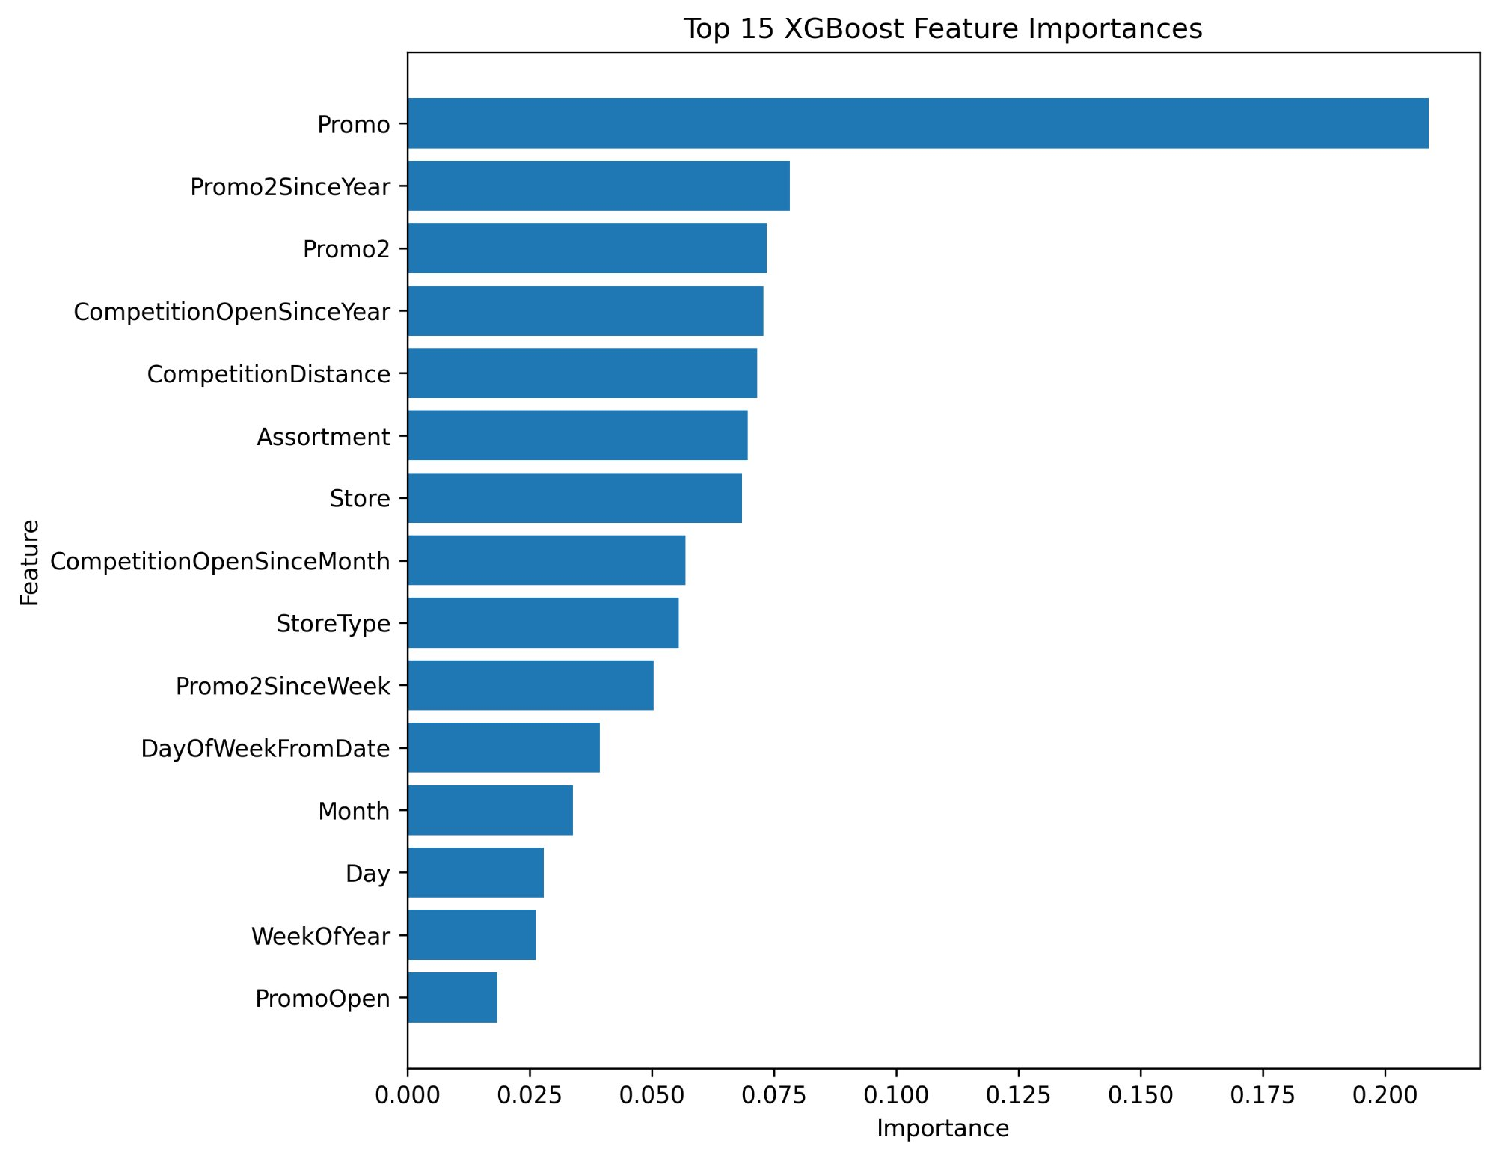
SECTION 03 · MODELLING
XGBoost Feature Importances: What Drives Sales ?
Gain-based importance. Note: directional interpretation requires SHAP (future work)
TIER 1 — DOMINANT
Promo
By far the strongest signal. 3× more important than the next feature. Promotions are the primary controllable lever.
TIER 2 — STRUCTURAL
Promo2SinceYear, Promo2, CompetitionOpenSinceYear, CompetitionDistance, Assortment, Store
Store identity and promotional programme design. Capture cross-sectional heterogeneity.
TIER 3 — CALENDAR
DayOfWeekFromDate, Month, Day, WeekOfYear, PromoOpen
Temporal rhythm. Important but secondary to the structural and promo signals.
ROSSMANN STORE SALES FORECASTING | QUANTITATIVE RESEARCH

Slide 11
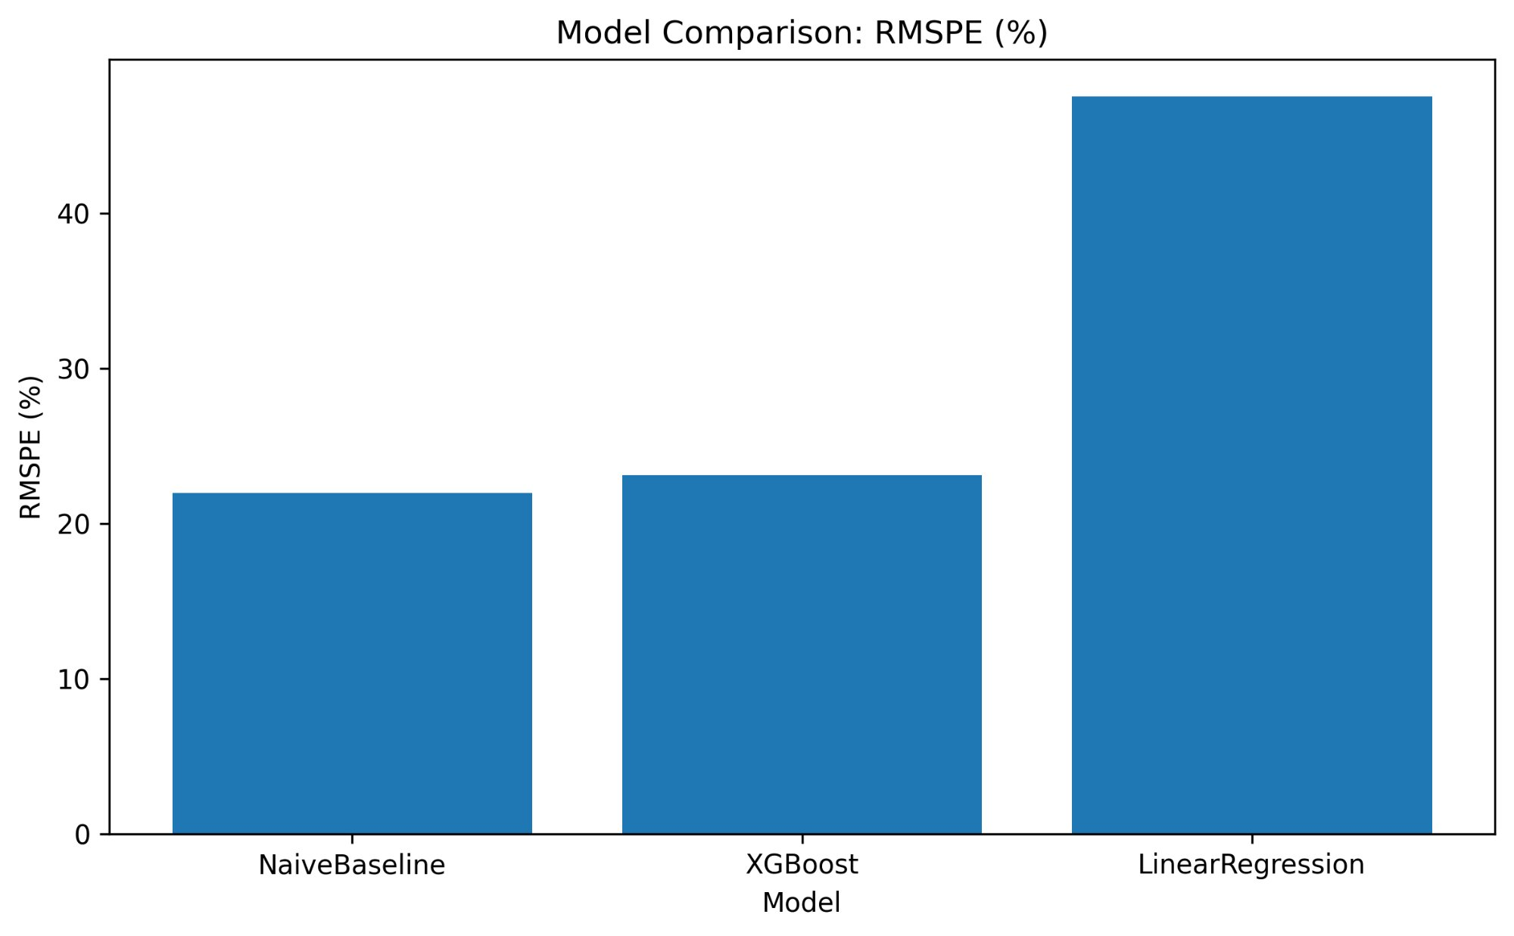
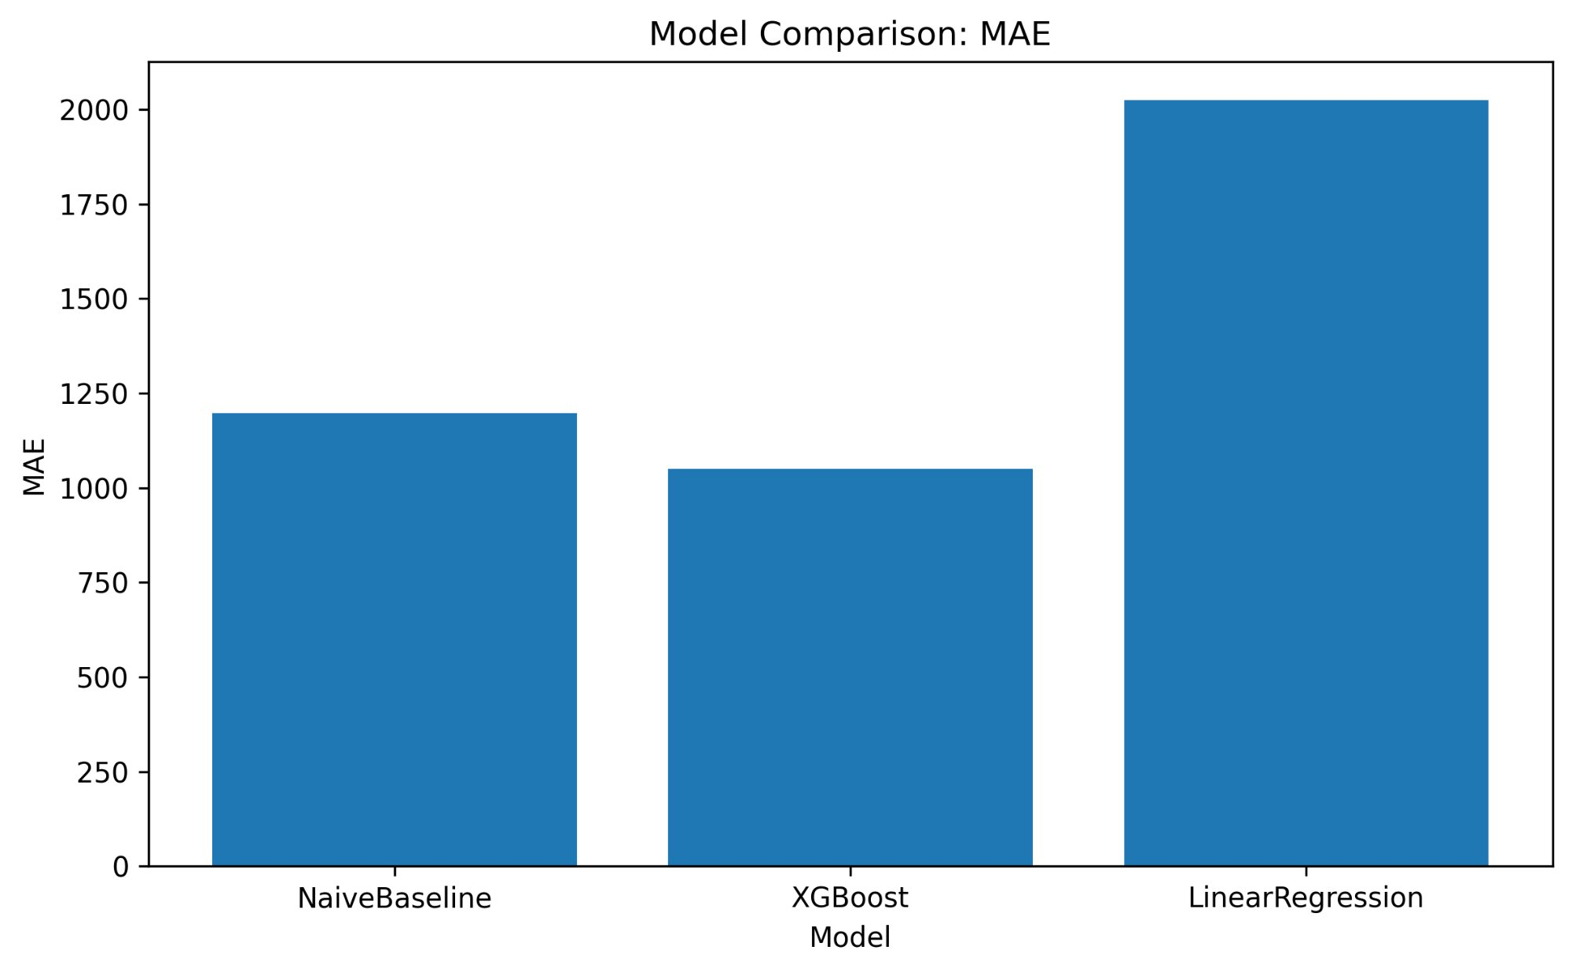
SECTION 04 · RESULTS
Model Performance: The Metric Divergence Story
XGBoost wins on MAE (€ error) but the Naive Baseline wins on RMSPE — both results matter
RMSPE (%) — lower is better
MAE (€) — lower is better
Model
RMSPE (%)
MAE (€)
RMSE (€)
Winner?
NaiveBaseline
21.98%
~1,200
~1,900
✓ RMSPE
XGBoost
23.0%
~1,051
~1,700
✓ MAE / RMSE
LinearRegression
47%+
~2,030
~2,800
✗ Weakest
ROSSMANN STORE SALES FORECASTING | QUANTITATIVE RESEARCH

Slide 12
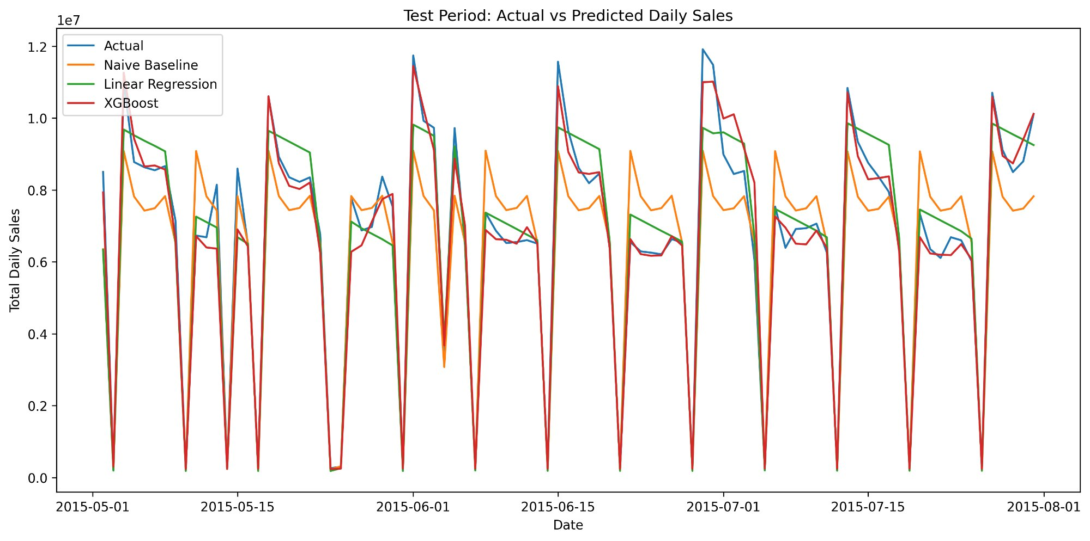
SECTION 04 · RESULTS
Aggregate Test Period: Actual vs Predicted Daily Sales
May – July 2015 • All stores summed • XGBoost tracks rhythm; Linear Regression too smooth
▶ XGBoost (Red):
Tracks weekly rhythm and major spikes well. Collapses correctly on Sunday closures.
▶ Naive Baseline (Orange):
Captures periodic structure, less responsive to promotional peaks vs XGBoost.
▶ Linear Regression (Green):
Too smooth, misses the amplitude of weekly swings. RMSPE confirms the failure.
▶ Aggregation caveat:
Chain-level fit can look clean while store-level errors cancel out. See store-level diagnostics.
ROSSMANN STORE SALES FORECASTING | QUANTITATIVE RESEARCH

Slide 13
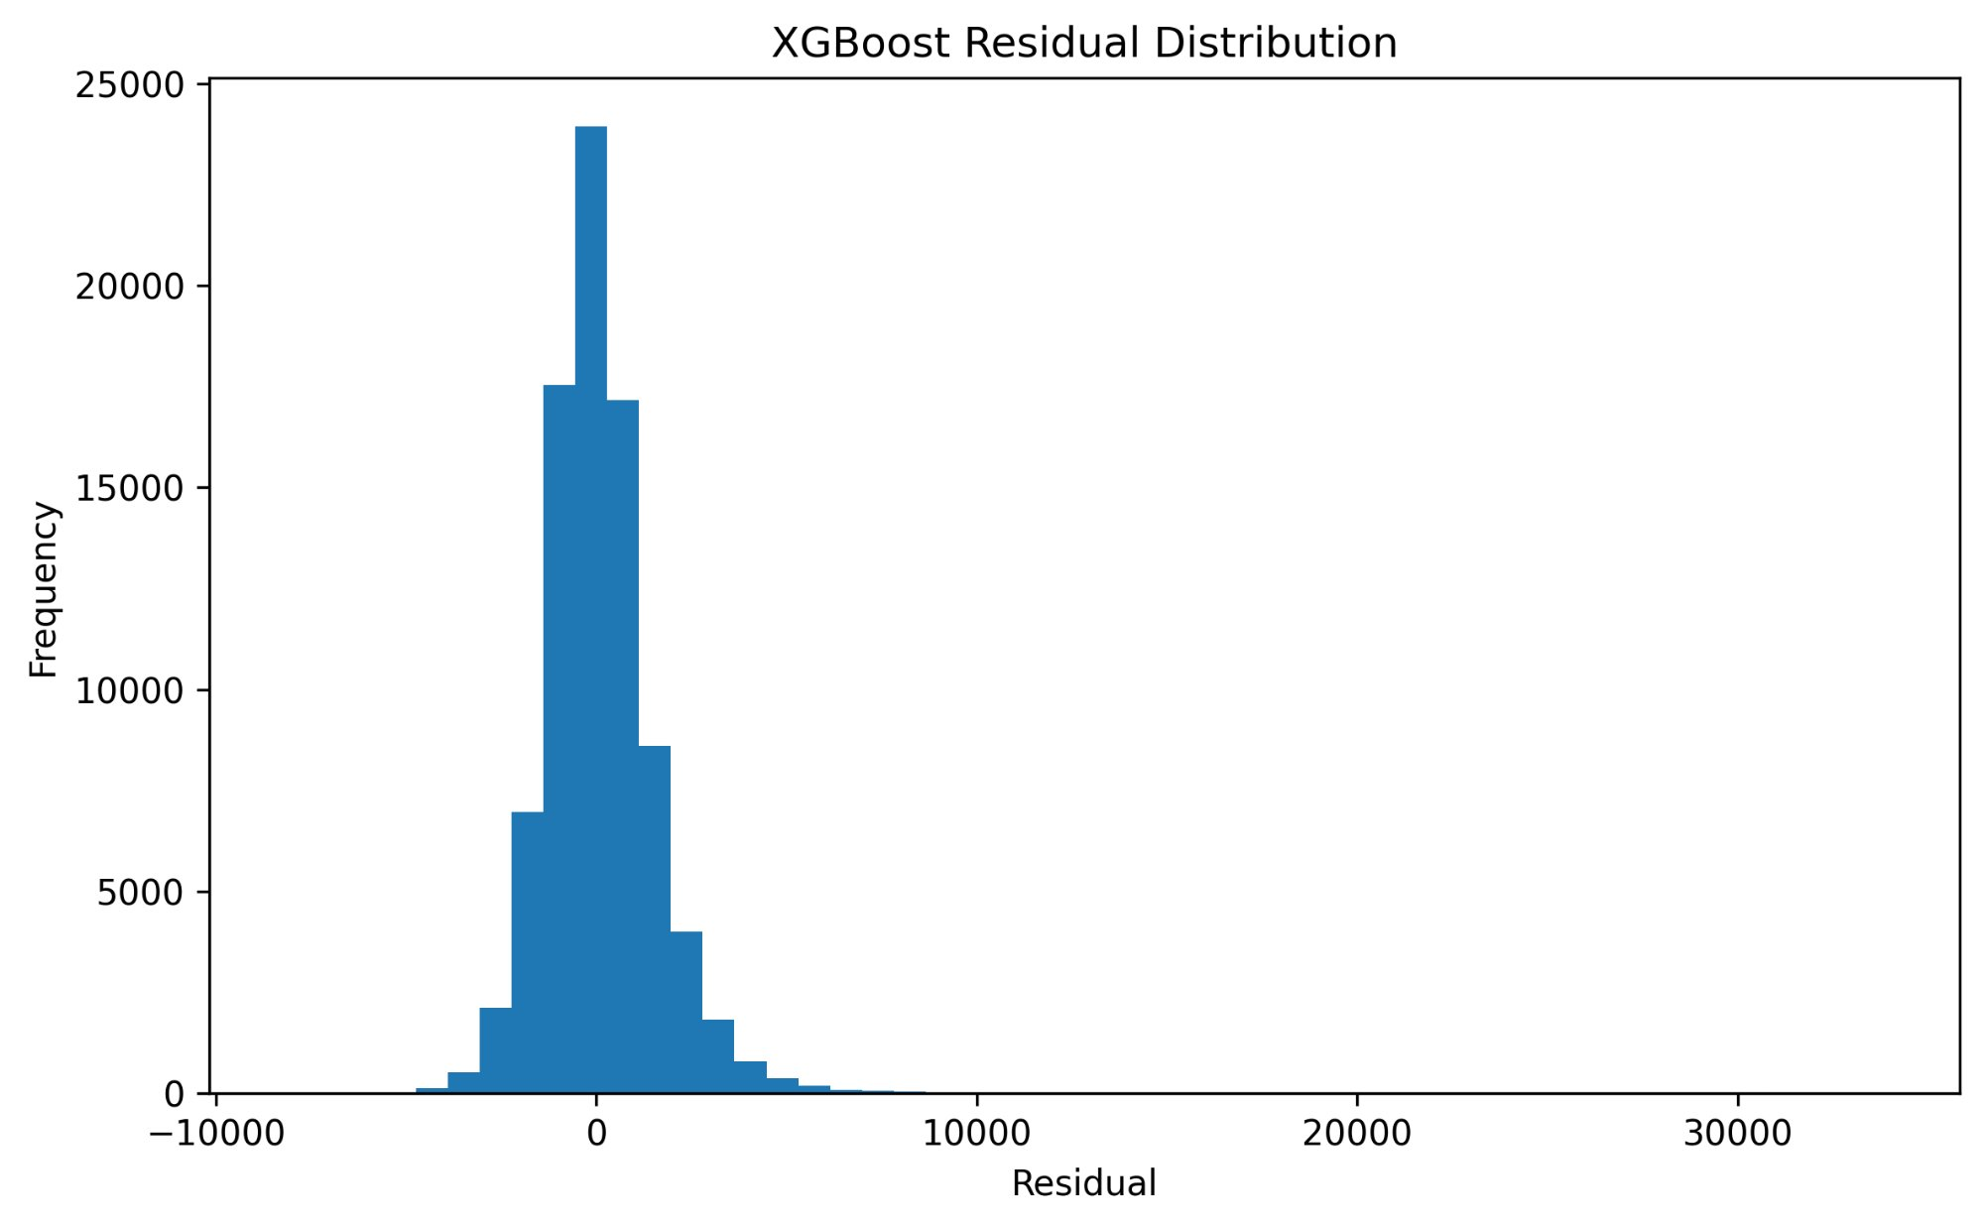
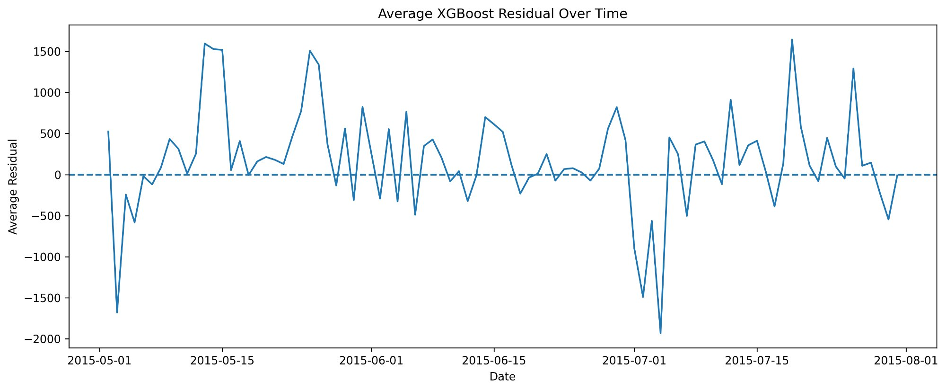
SECTION 05 · DIAGNOSTICS
Residual Structure: Model Errors Are Not Random
Right-skewed residuals and time-varying bias indicate unmodelled demand drivers
Residual Distribution (Actual − Predicted)
Average Residual Over Time
Right tail → underprediction of peaks
The model is biased in the upside tail. Stockouts during promotional spikes are the key operational risk.
Time-varying bias → non-stationary model
Large negative residuals in early July suggest unmodelled event or regime. Model should be monitored in production.
Center near-zero → adequate baseline
For typical trading days the model is unbiased. The challenge is at the extremes, not the average.
ROSSMANN STORE SALES FORECASTING | QUANTITATIVE RESEARCH

Slide 14
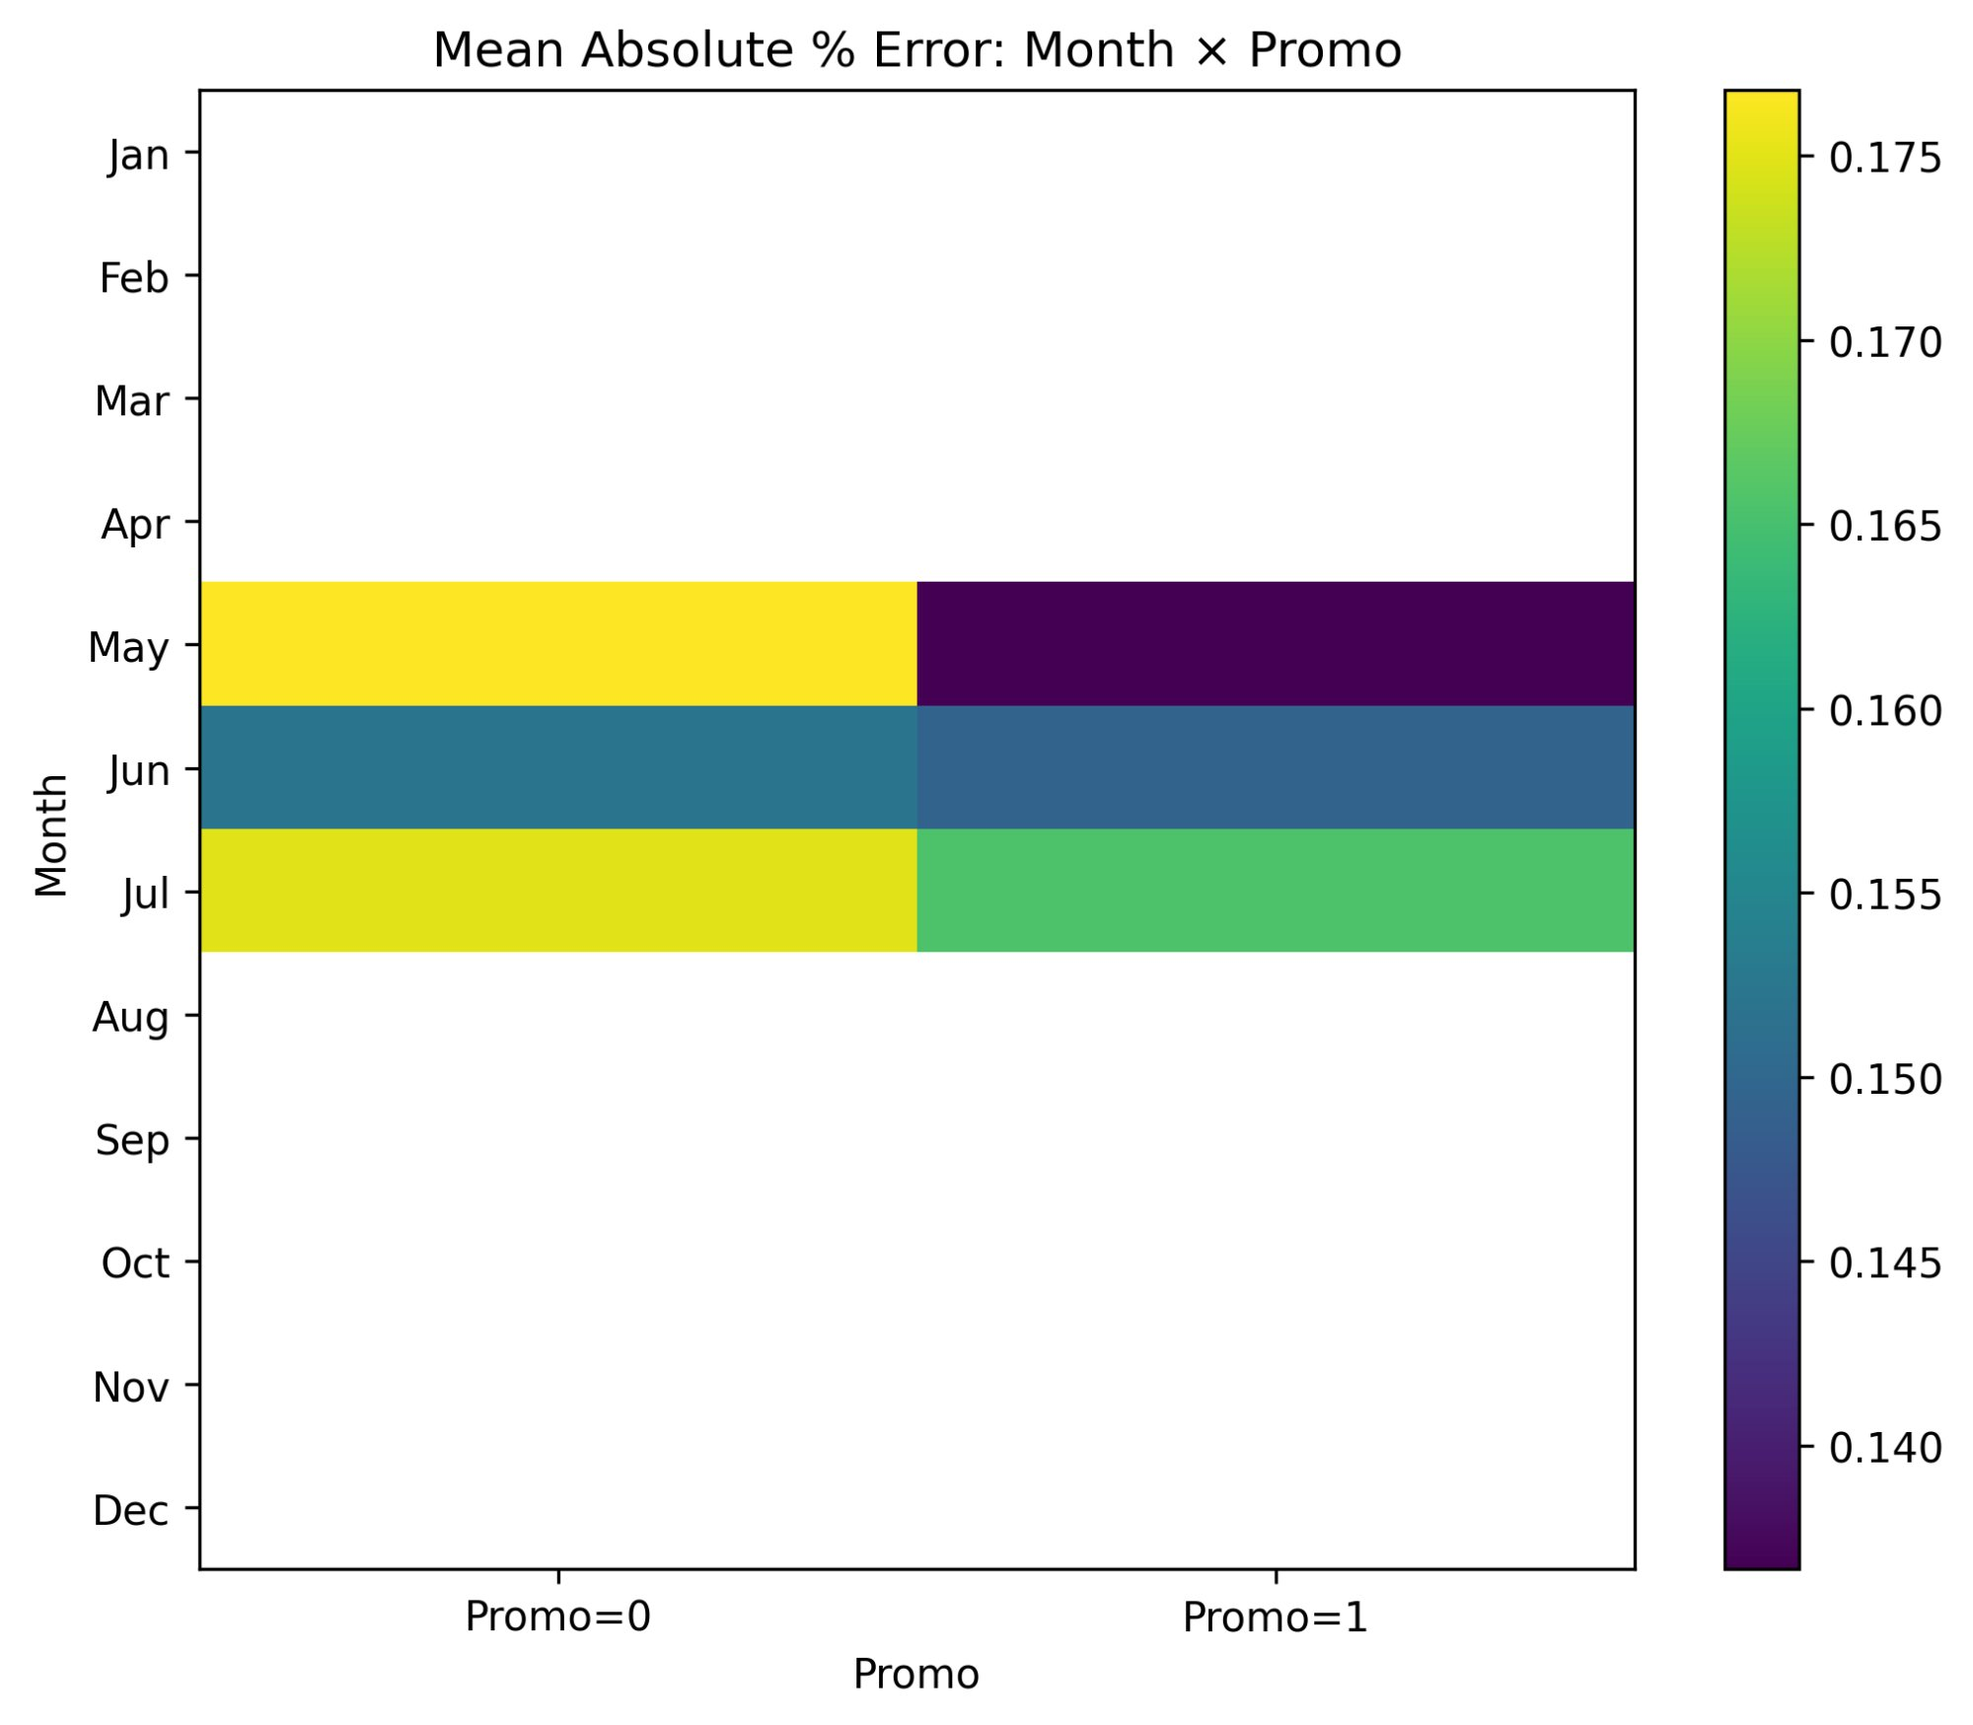
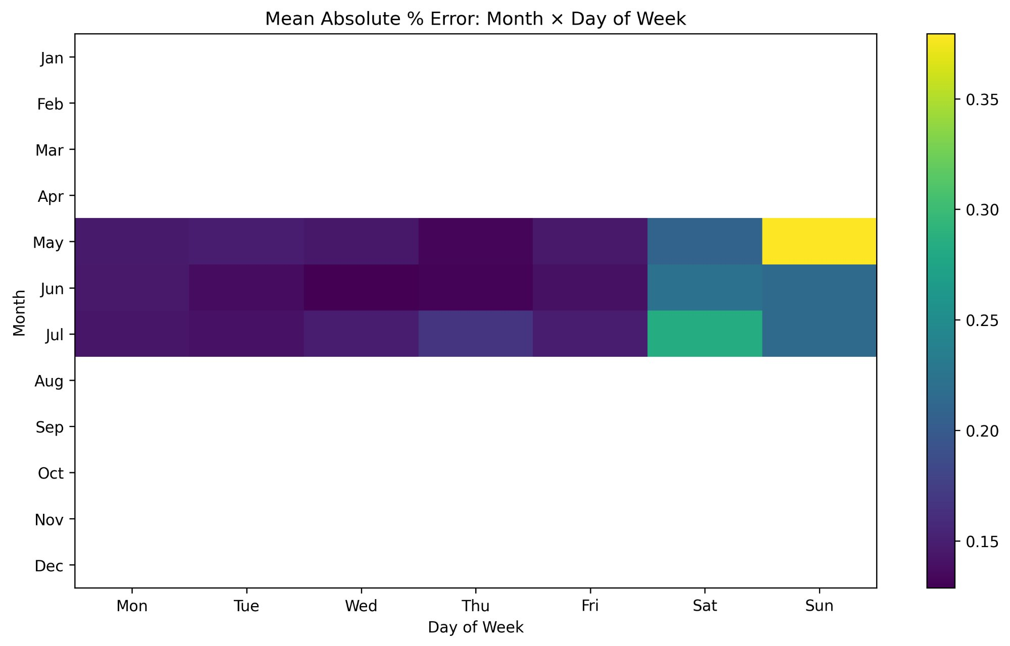
SECTION 05 · DIAGNOSTICS
Error Heatmaps: Where the Model Fails
Test period covers May–July 2015 only — blank months are not model failure, they are out-of-test
MAPE by Month × Promo Status
MAPE by Month × Day of Week
ROSSMANN STORE SALES FORECASTING | QUANTITATIVE RESEARCH

Slide 15
SECTION 06 · BUSINESS IMPLICATIONS
From Research to Operations: What This Means
Translating model findings into actionable operational decisions
📦 Inventory & Supply Chain
👥 Labor Planning
› Build seasonal stock positions from October — December demand is 30% above the annual average
› Align staffing calendars to the Month × Day-of-Week heatmap — nonlinear interactions require granular scheduling
› Promo periods require pre-positioned inventory — demand uplift is ~39% and model confirms it is the #1 driver
› December Monday peaks need maximum staffing; October Saturday needs minimum
› Weekend replenishment requires wider safety buffers: MAPE on Sunday is structurally highest
› Promo activation signals are known in advance — use them to drive staffing uplift weeks ahead
💰 Finance & Revenue Planning
📣 Promotion Strategy
› XGBoost provides ~€1,051 MAE at store level — suitable for bottom-up revenue aggregation
› Promo is the single largest controllable lever — 38.8% average uplift confirmed
› Positive right-tail residuals mean revenue upside is more frequently missed than downside: plan conservatively
› Store Type 2 has the highest absolute promo response — prioritise promo allocation to this format
› Store 1114-type systematic underprediction: flag high-volume stores for manual override review
› Model errors are lower on Promo=1 days in May — structured demand is more predictable than unstructured
ROSSMANN STORE SALES FORECASTING | QUANTITATIVE RESEARCH

Slide 16
SECTION 06 · NEXT STEPS
Roadmap: From Prototype to Production
Five prioritised improvements with estimated impact on forecast error
01
SHAP Value Analysis
Replace gain-based importance with SHAP. Enables directional interpretation and identifies which features push individual predictions up or down.
Immediate
High IMPACT
02
Rolling Window Backtesting
Validate on multiple test windows across seasons, not just one holdout. Stress-test model on holiday periods and promo regimes not seen in training.
2–4 Weeks
High IMPACT
03
Two-Stage Closure Model
Add a binary open/closed classifier as Stage 1. Feed its output to Stage 2 (sales level). Critical for Sunday and public holiday prediction.
4–8 Weeks
Medium IMPACT
04
Store-Level Hypertuning
High-MAE stores (e.g. Store 1114) warrant dedicated model calibration or ensemble blending with a local naive baseline.
6–10 Weeks
Medium IMPACT
05
Causal Promo Estimation
Move from associational promo uplift to causal estimates using Diff-in-Diff or synthetic control. Required for ROI calculation and budget allocation.
Ongoing
High IMPACT
ROSSMANN STORE SALES FORECASTING | QUANTITATIVE RESEARCH

Slide 17
KEY TAKEAWAYS
Metrics Summary
What This Research Proves
~23%
XGBoost RMSPE
Promotions are the #1 controllable commercial lever — 38.8% average uplift, confirmed across all store types
€1,051
December demand is 30%+ above the annual average — Q4 planning is the highest-stakes operational window
XGBoost MAE
XGBoost achieves €1,051 MAE and is suitable for bottom-up revenue aggregation at chain level
~22%
The model has a structural right-tail gap — peaks are underforecast — operational buffers remain essential
Naive RMSPE
Naive Baseline outperforms XGBoost on RMSPE: a disciplined evaluation requires both metrics
+38.8%
A two-stage closure + sales model and SHAP analysis are the clearest priority improvements
Rossmann Store Sales Forecasting · Quantitative Research · March 2026
Promo Uplift

