Slide 1
Local extremum
Speed
Brake
Inflections
Threshold
…
…
Time
Trace
Property of interest: Derivative

Slide 2
Event
Superclass of
Collected events
Driving descriptors
Lane Change descriptors
Eye track
Speed
Blinker
Accelerate
Glance
L.C. Indicator
L.C. Index
Type of
Ontology
Sequence
Abstraction
Inference
Time
Eye left duration: 0.2s
Speed acceleration: 1.1ms⁻²
Properties

Slide 3
Documentation System
Explanations
Models
Symbolic-Trace-System
Visualization system
Ontology
Transformation
engine
Inferences
Transfor-
mations
Ontology
editor
Style-
sheets
Modeled Trace
Collection System
Collected
trace
Visualization system
Collection agents
Videos
Notes,
Interviews
Logs
Sensors

Slide 4
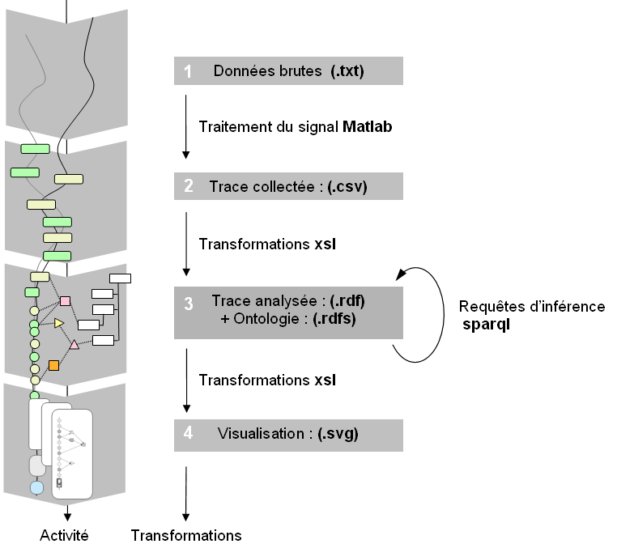
1. Raw trace
2. Symbolic trace
3. Modeled trace
4. Activity models
Analysis
Activity

Slide 5
1. Raw trace
2. Symbolic trace
3. Modeled trace
4. Activity models
Analysis
Activity

