Slide 1
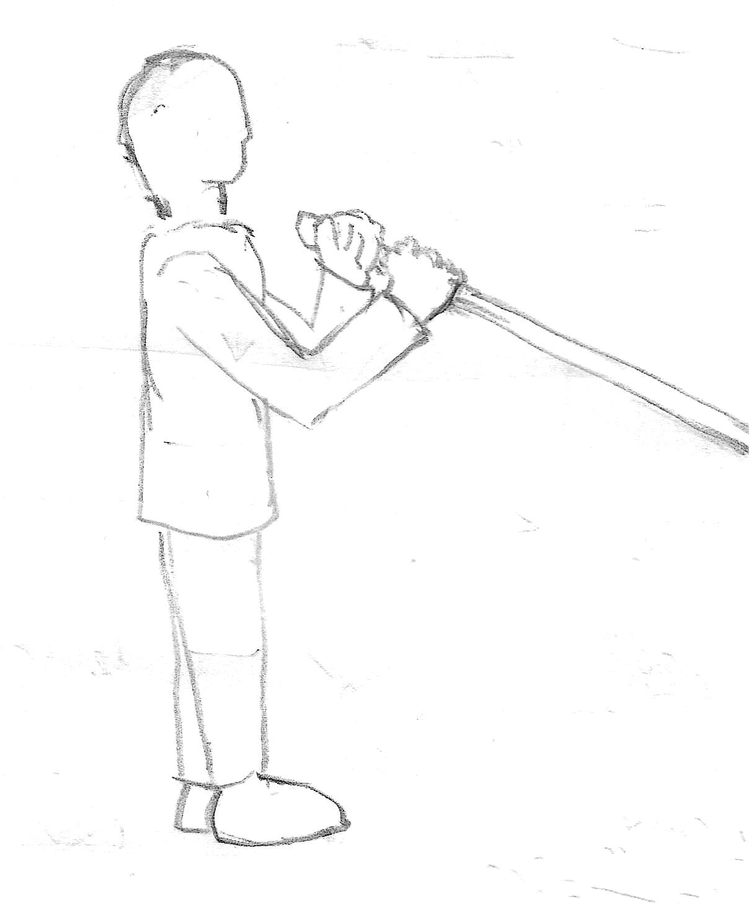
L1
L
H1
H3
L2
H2
α

