Slide 1
Diabetes Prediction Using Machine Learning and API Deployment
Group 5
Course / Lecturer: AI, ML and BigData analytics
Institution: University of Rwanda – CST
Date: 20-Jan-2026
Prepared by Mr. Olivier Niragire
Phone: 0787425009
Email: niragiolivier@gmail.com

Slide 2
Problem Definition
Diabetes is a chronic disease that affects millions of people worldwide.
Early prediction helps in prevention, timely treatment, and reduced healthcare costs.
Problem Statement:
Healthcare providers need a reliable system to predict whether a patient is diabetic
based on medical measurements.
Objective:
Build machine learning models to predict diabetes
Compare model performance
Deploy the best model as a production-ready API

Slide 3
Dataset Description
Dataset Name: Diabetes Dataset (Real-world medical dataset)
Source: Public dataset (e.g., Kaggle / UCI)
Features Include:
Pregnancies
Glucose
Blood Pressure
Skin Thickness
Insulin
BMI
Diabetes Pedigree Function
Age
Target Variable: Outcome (0 = Non-diabetic, 1 = Diabetic)

Slide 4
Data Exploration and understanding
Steps Performed:
Checked dataset shape and structure
Inspected data types
Analyzed class distribution
Identified missing and zero values
Key Observations:
Some medical features contained zero values
Dataset was moderately balanced
Numeric features required scaling

Slide 5
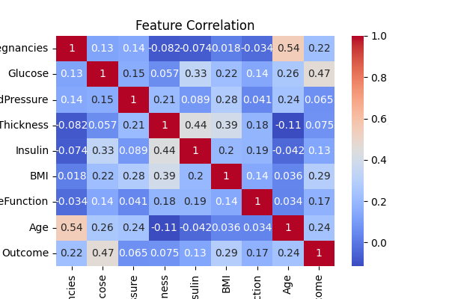
VISUALIZATION

Slide 6
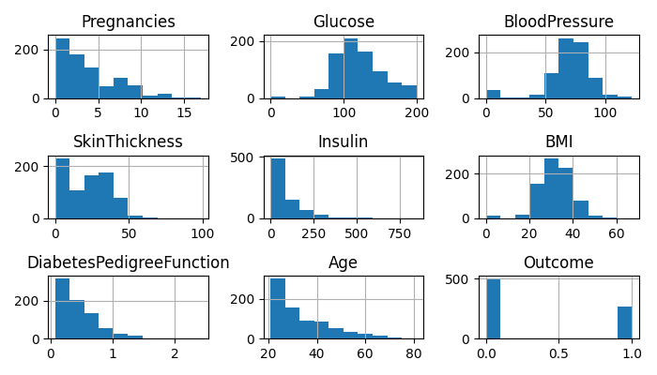
VISUALIZATION

Slide 7
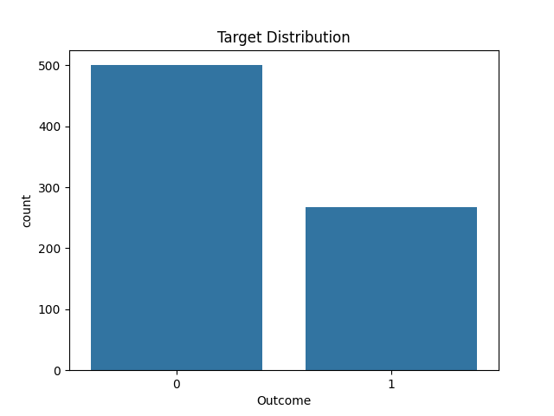
VISUALIZATION

Slide 8
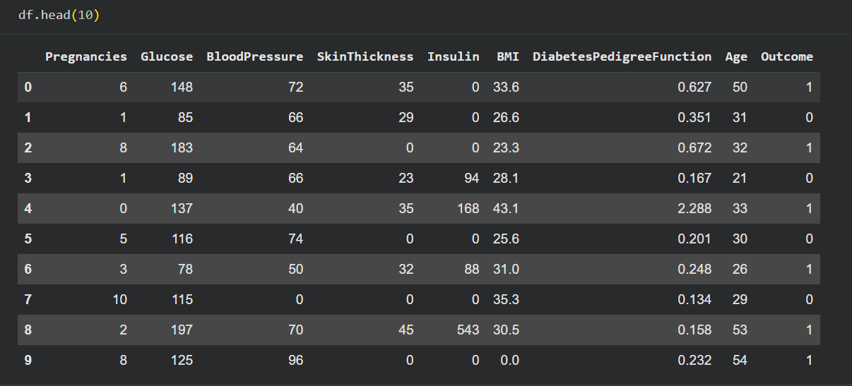
Checked dataset shape and structure

Slide 9
Data Cleaning & Preprocessing
Preprocessing Steps:
Handled invalid zero values
Scaled numerical features using StandardScaler
Split dataset into training and testing sets
Why Preprocessing is Important:
Improves model performance
Prevents bias
Ensures fair comparison between models

Slide 10
Machine Learning Models Used
We implemented and compared three supervised machine learning models:
Logistic Regression
  Simple and interpretable
  Baseline classification model
Random Forest Classifier
  Ensemble-based
  Handles non-linearity well
Support Vector Machine (SVM)
  Effective in high-dimensional spaces
  Good for complex decision boundaries

Slide 11
Model Training Approach
Training Strategy:
Train-test split
Cross-validation using Stratified K-Fold
Pipeline integration (Scaler + Model)
Why This Approach:
Prevents data leakage
Ensures robust and reliable evaluation
Improves reproducibility

Slide 12
Model Evaluation Metrics
Metrics Used:
Accuracy
Cross-validation score
Reason for Choosing Metrics:
Accuracy is intuitive for classification
Cross-validation ensures model stability

Slide 13
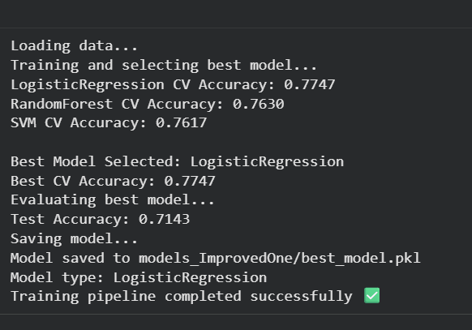
Model Performance Comparison
Best Performing Model:

Slide 14
Model Selection & Saving
Selected Model:
Random Forest Classifier
Why Selected:
Best performance
Handles feature interactions
Robust to noise
Model Saving:
Used joblib to save trained model
Enables reuse without retraining

Slide 15
API Development
Goal: Deploy the trained model as a REST API for real-world usage.
Framework Used:
FastAPI
API Capabilities:
Accept patient data
Predict diabetes outcome
Return result in JSON format

Slide 16
API Architecture
Components:
Input validation using Pydantic
Model loading at startup
Prediction endpoint
Advantages of FastAPI:
High performance
Automatic documentation (Swagger UI)
Production-ready

Slide 17
Example API Workflow
1. User sends patient data via HTTP request
API validates input
Data is scaled
Model makes prediction
API returns prediction result

Slide 18
Real-world Use Case
Who Can Use This System:
Hospitals
Clinics
Health monitoring applications
Benefits:
Early diabetes detection
Faster decision-making
Reduced healthcare risks

Slide 19
Challenges & Limitations
Data quality issues
Feature imbalance
Limited dataset size
Limitations:
Model depends on dataset quality
Does not replace medical diagnosis

Slide 20
Future Work
More data
Implement deep learning for image data
Cloud deployment
Frontend integration

Slide 21
Conclusion
Summary:
Built and compared three ML models
Selected best-performing model
Deployed a production-ready API
Demonstrated a real-world healthcare solution
Key Takeaway:
Machine learning can significantly support early disease prediction when applied correctly.

Slide 22
Thank You

