Slide 1


Three-dimensional simulation of neurotransmitter flow in a presynaptic bouton
Biologically inspired algorithms
III.2025

Slide 2
Biological parameters
Synapse diameter – about a micrometer, rather 0.6µm;
Single impulse (stimulation) – 0.4ms;

Slide 3
Theoretical assumptions of the model of presynaptic bouton
Kolbka presynaptyczna - obiekt (bryła) o stałym położeniu w przestrzeni 3D Obszar uwalniania cząsteczek NT na zewnątrz - ustalony podzbiór jej brzegu;
Gęstość neuroprzekaźnika w obszarze kolbki - niewiadoma;
Pęcherzyki dyfundują w całej przestrzeni kolbki, zaś ich synteza ma miejsce w pewnym podzbiorze tej przestrzeni (tzw. supply zone);
Wydajność supply - proporcjonalna do różnicy między jego chwilową gęstością a gęstością progową;
Nadejście potencjału czynnościowego (tzw. iglicowego) umożliwia uwalnianie cząsteczek NT na zewnątrz przez określony interwał czasu, proporcjonalnie do koncentracji NT w bezpośrednim otoczeniu obszaru uwalniania;

Slide 4

Assumptions (2): Mathematical model
Nonlinear partial differential equation
Explanations (ves = synaptic vesicle):
x = [x₁, x₂, x₃] albo [x,y,z] – point in Ω (in the bouton)
t – time coordinate of the simulated phenomenon [s]
ρ(x,t) : neurotransmitter (NT) density (ves/μm³);
ρ(x,0) = ρ₀ ;
a_{ij} : diffusion tensor (diagonal) (μm²/s)
f(x)=β(x) : synthesis rate distribution
Uniform distribution assumed: β(x) = β₀ [1/s]
ρ : synthesis threshold of NT [ves/μm³]
2023-11-13

Slide 5
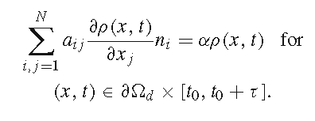
Assumptions (3): boundary condition
Boundary condition in finite element method (FEM)
, 0 – otherwise
Explanations:
∂Ω_{d} - Secretion zone of NT (active zone);
α – exocytosis rate [μm³/s];

Slide 6
Finite element method (2D)
Quality of triangular mesh (continued)
Ideal values for the equilateral triangle:
the longest edge length / the shortest height length
formula: EH = a / h = a / (a∙(3^{0,5})/2) ≈ 1,1547
the longest edge length / the radius of the inscribed sphere
formula: ER = a / r(ins) = a / ( a ∙ (3^{0,5})/6 ) ≈ 3,4641
the triangle perimeter / the square root of the surface
formula: PS = 3a / ( (3^{0,5}/4)a²) ^{0,5}) ≈ 4,5590

Slide 7
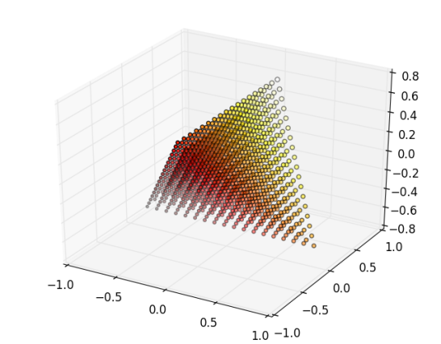
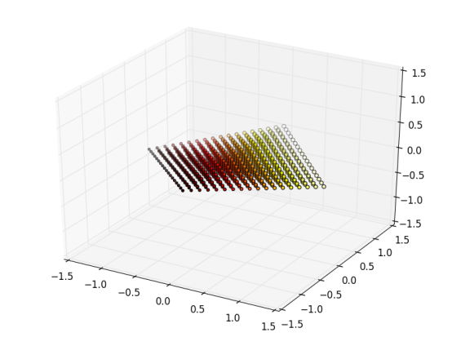
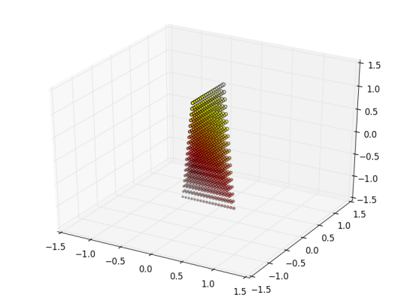
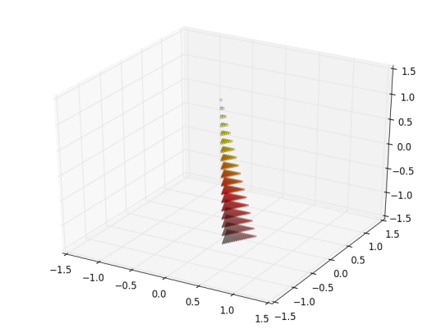
Finite element method (3D)
Three-dimensional mesh – cubes, tetrahedra, …
Tetrahedral mesh allows for dense packing of points
Disadvantage – three-dimensional space cannot be filled with regular tetrahedra (as it was for triangles in 2D)
Parameters of a tetrahedron
Heights, surface area, volume
Inscribed sphere, dihedral angles, face angles, solid angles
Quality measures – different kinds of tetrahedra

Slide 8
Finite element method (3D)
Quality measures of a tetrahedron:
a) (S^{1/2})/(V ^{1/3}) simple, zero-dimensional and independent of the tetrahedron size; (S2_TO_V3, SV)
b) longest edge of tetrahedron / radius of the inscribed sphere (E_TO_R, E/R, ER); also size-independent and zero-dimensional;
c) „aspect ratio” – longest edge / shortest tetrahedron height (E_TO_H, EH), used in TetGen(R) (Si 2008a, 2008b; Si 2013)
The ideal values for the regular tetrahedron should be:
S2_TO_V3 = (3^{1/4}) x(72^{1/6}) ≈ 1.316074 x 2.039649 ≈ 2.684329;
E_TO_R = 2*(6^{1/2}) ≈ 4.8989;
E_TO_H = (3^{1/2})/(2^{1/2}) ≈ 1.2247

Slide 9
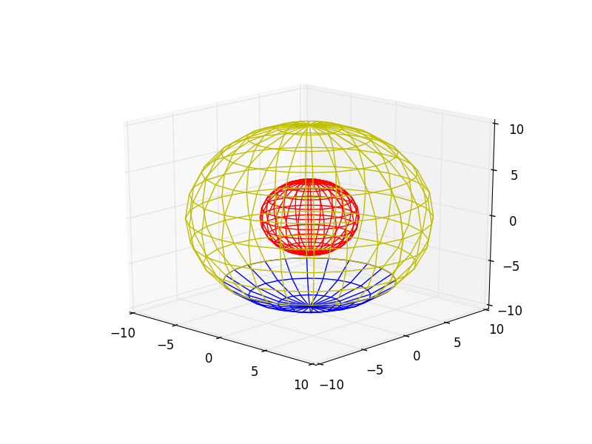
Simplified 3D model of a presynaptic bouton
Design of the surface mesh of the 3D model (Python)
„Globe” – bouton model (Ω) (yellow)
Radius – 1.6 units
24 „meridians” (i.e. with 15° interval)
11 „circles of latitude” (also with 15° interval)
Synthesis zone of NT (Ω₃) (red)
Radius – 0.64 units
Subdivision as for (1.)
Docking site (active zone, release zone) of NT (∂Ω_{d}) (blue)
It is a part of (1.)
Shape – spherical cap
„Latitude”: from 90°S to 45°S

Slide 10
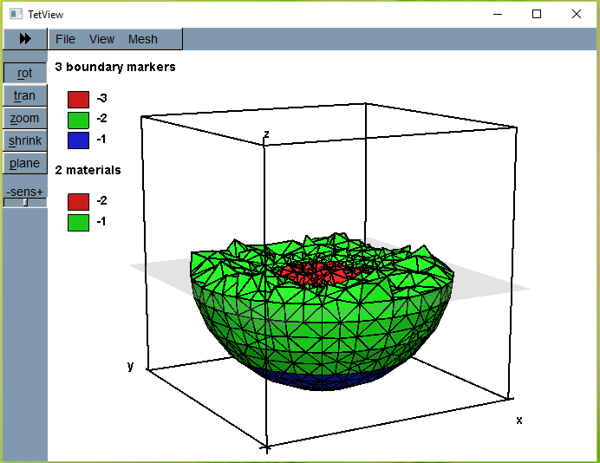
Simplified 3D model – after tetrahedralization
Mesh generated with TetGen® ( TetView® picture)
Synthesis
Docking
Other
Rescaled
bouton:
R = 0,64 μm
r = 0,256μm

Slide 11
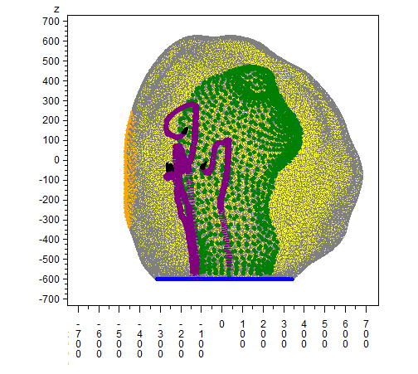
3d realistic model with mitochondrion and microtubules
y

Slide 12
Geometric parameters:
Parameter Value
Volume 1.1 ± 0.1 μm³
Surface 4.4 ± 0.3 μm²
Number of Vesicles 383.7 ± 37.9
Volume occupied by vesicles 0.015 ± 0.001 μm³
Number of Active Zones per synapse 0.71 ± 0.09
Average size of Active Zone 0.21 ± 0.04 μm²
Number of mitochondria per synapse 0.65 ± 0.08
Average size of mitochondria 0.18 ± 0.04 μm³
Wilhelm, B.G.: Stoichiometric Biology of the Synapse. Dissertation in partial ful-
llment of the requirements for the degree „Doctor of Natural Sciences” (Dr. rer.
nat) in the Neuroscience Program at the Georg August University Göttingen,
Faculty of Biology, Göttingen,, Germany (2013)

Slide 13
Various models of the presynaptic bouton – 3D
Two concentric spheres, the inner empty
Two concentric spheres, the inner as the domain of synthesis
Spherical models with variable number of synthesis zones
Realistically shaped bouton with mitochondrion and synaptic vesicles
Tetrahedral mesh of the bouton with mitochondrion [and microtubules]
Etc. …

Slide 14
Example 3D bouton model parameters
Total surface: S ≈ 6.78 μm²
Active zone: S_{AZ} ≈ 0.24 μm²
Mesh size: N = 77418
Total volume: V ≈ 0.9029 μm³
Volume of synthesis zone: V_{s} ≈ 0.0198 μm³
Initial neurotransmitter density
ρ(x,0) = ρ₀ = A e^{-br2} [ vesicles / μm³ ]
A = 300 μm⁻³
b = – 0.28μm⁻²
r = distance from the center of the bouton

Slide 15
Formulas for cellular automaton (I)
Cell i, volume V_{i} , supply rate β, supply threshold ρ
Neighboring cells {j:j∈NC_{i}}, time step Δ_{t}
Contributions of neighboring cells to NT diffusion
NT amount = m_{i} , new NT amount = m’_{i}
Change of m_{i} pertinent to diffusion and cell j = Δ₁m_{ij}
Δ₁m_{ij} = ((as_{ij} Δ_{t})/r_{ij} )(ρ_{j} - ρ_{i}); a – diffusion coefficient
Total change of m_{i} in cell i pertinent to diffusion
Δ₁m_{i} = sum(Δ₁m_{ij}) for j∈NC_{i}
Change of m_{i} in cell i pertinent to supply (synthesis)
Δ₂m_{i} = m_{i} + β (ρ - ρ_{i})⁺ Δ_{t}
www.agh.edu.pl

Slide 16
Formulas for cellular automaton (II)
Cell i, volume V_{i} , exocytosis rate α, impulse beginning for t = t₀+kT, impulse ending for t = t₀+kT+τ
impulse duration = τ : t ∈ < t₀+kT; t₀+kT+τ >
Change of m_{i} pertinent to exocytosis
Δ₃m_{i} = -α m_{i} Δ_{t} if Δ_{t} ⊂ < t₀+kT; t₀+kT+τ >
k = positive integer number; T – time period
Change of m_{i} in cell i pertinent to diffusion, supply and exocytosis and new m_{i} value
Δm_{i} = Δ₁m_{i} + Δ₂m_{i} + Δ₃m_{i} ; m_{i}’ = m_{i} + Δm_{i}
New density value: ρ_{i}’ = m_{i}’ / V_{i}

Slide 17
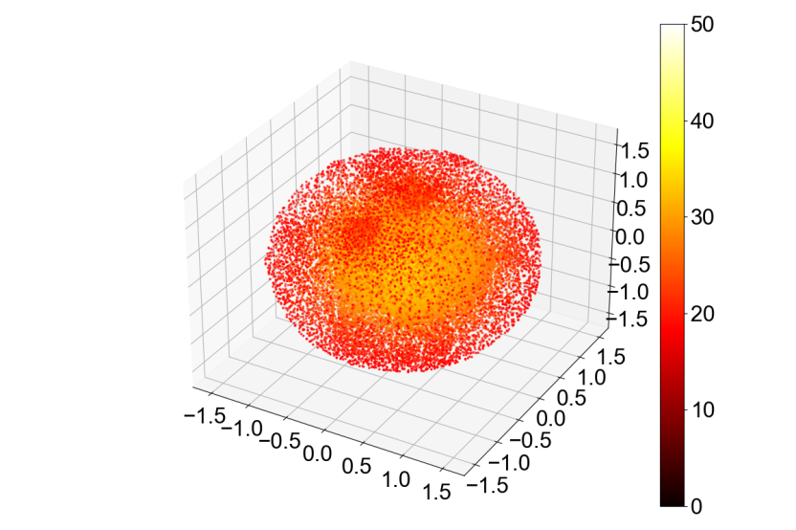



Spatial distribution of NT density (t=0.0000s; 0.0023s; 0.0025s; 0.0027s;)

Slide 18
Simulations
The simulations were performed with either 100Hz or 200Hz stimulation frequency.
For 200Hz two values of the correcting factor were introduced to account for mesh geometry. The experiment showed that a proper choice of the factor allows us to model the process with the accuracy similar to that of finite elements modeling.
The computer Ares was used for simulations.
The programming language was Python.
The simple experiments took about 2GB ram and 400 minutes simulation time.

Slide 19
Total amont of NT [vesicles] four example experiments (simulation time 0.1000s; red = finite elements)

Slide 20
Files
param90.1. node
param90.1. face
param90.1. ele
ele90.1b.txt

Slide 21
Node file

